Slide 1
AI
Artificiel intelligens

Slide 2
Neural Network
Learning algoritme

Slide 3
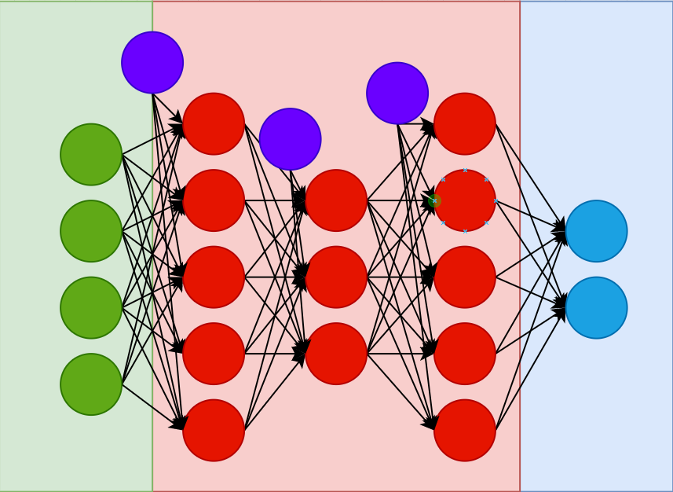
Neural network
Neuron
Activation function
Input Output Hidden layer
Bias

