Slide 1










$$p_{supply} p_{A} p_{B}$$
Motion
Reference
$$v_{ref}$$
Feed Forward
$$u_{ff}$$
$$X_{error}$$
Feed
Back
$$u_{fb}$$
$$u$$
Deadband comp
$$u_{tot}$$
DCV
$$Q$$
System
$$X_{ref}$$
$$X_{real}$$

Slide 2








$$p_{open}$$
$$u=1$$
$$0<u<1$$
$$P_{Fast}$$
$${Δp}_{open}$$
$$P_{Slow}$$
$$p_{cr}$$
Fully open
valve
$$Q$$

Slide 3





U
U
P
P
A
B
A
B
$$∆p=∆p_{0}$$
$$∆p=∆p_{m}$$
P
T
P
T
U
P
$$∆p_{0}$$
$$p_{supply}$$
$$p_{supply}$$

Slide 4




Flow characteristics for a pressure compensated directional control valve
$$P→B$$
$$P→A$$
$Q$ [$lpm$]
Control signal $u$

Slide 5


$A_{d}(u)$ characteristics for a directional control valve
$$P→B$$
$$P→A$$
$A_{d}$[$mm^{2}$]
Control signal $u$

Slide 6

HAWE
PVG
A
B
A
B
P
T
P
T
1
2
1
2
P
T
$$p_{supply}$$

Slide 7


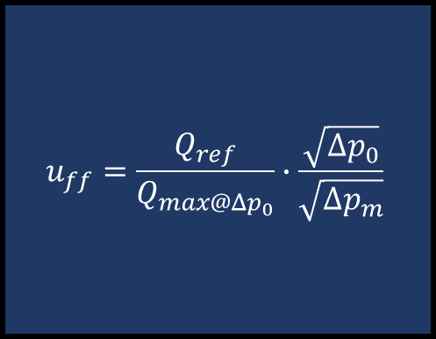
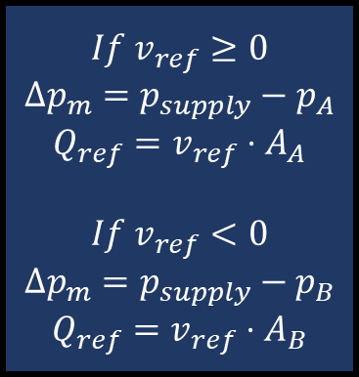





$$If v_{ref}≥0$$
$$Δp_{m}=p_{supply}−p_{A}$$
$$Q_{ref}=v_{ref}⋅A_{A}$$
$$If v_{ref}<0$$
$$Δp_{m}=p_{supply}−p_{B}$$
$$Q_{ref}=v_{ref}⋅A_{B}$$
$$u_{ff}=\frac{Q_{ref}}{Q_{max@Δp_{0}}}∙\frac{\sqrt{Δp_{0}}}{\sqrt{Δp_{m}}}$$
$$v_{ref}$$
$$Q_{ref}$$
$$p_{supply}$$
$$u_{ff}$$
$$p_{A}$$
$${Δp}_{m}$$
$$p_{B}$$

Slide 8
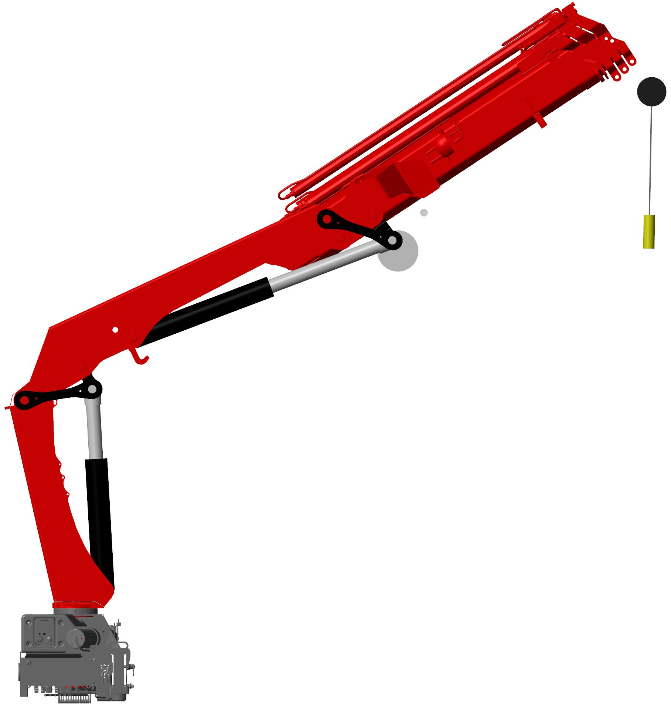
Point of rotation
Line of motion

Slide 9
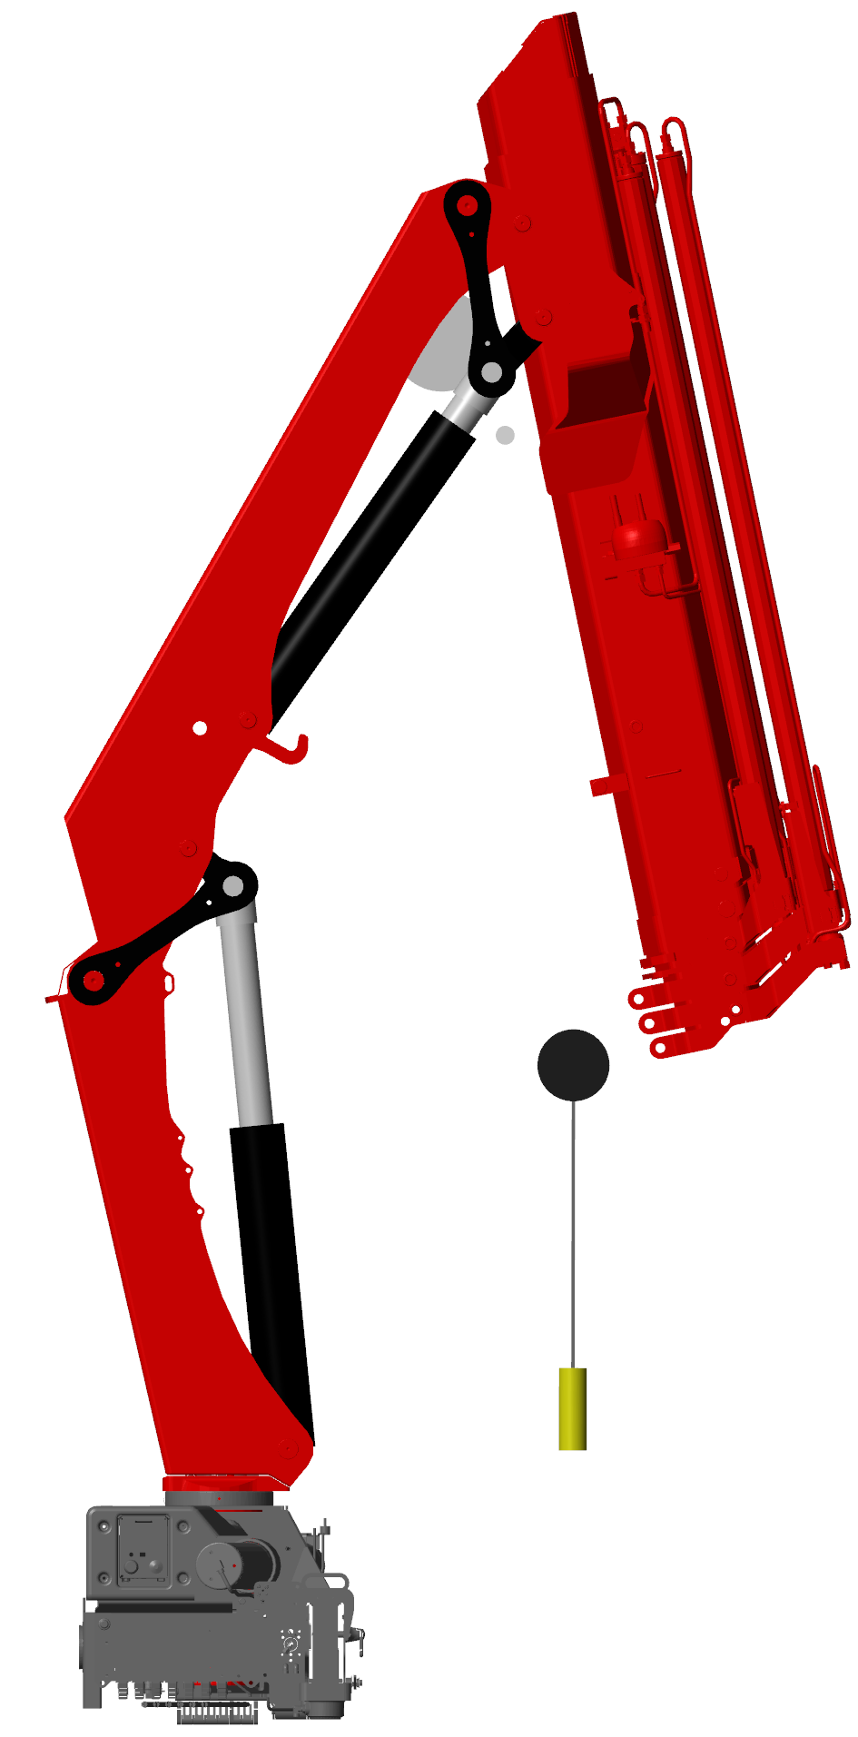
Point of rotation
Line of motion

Slide 10
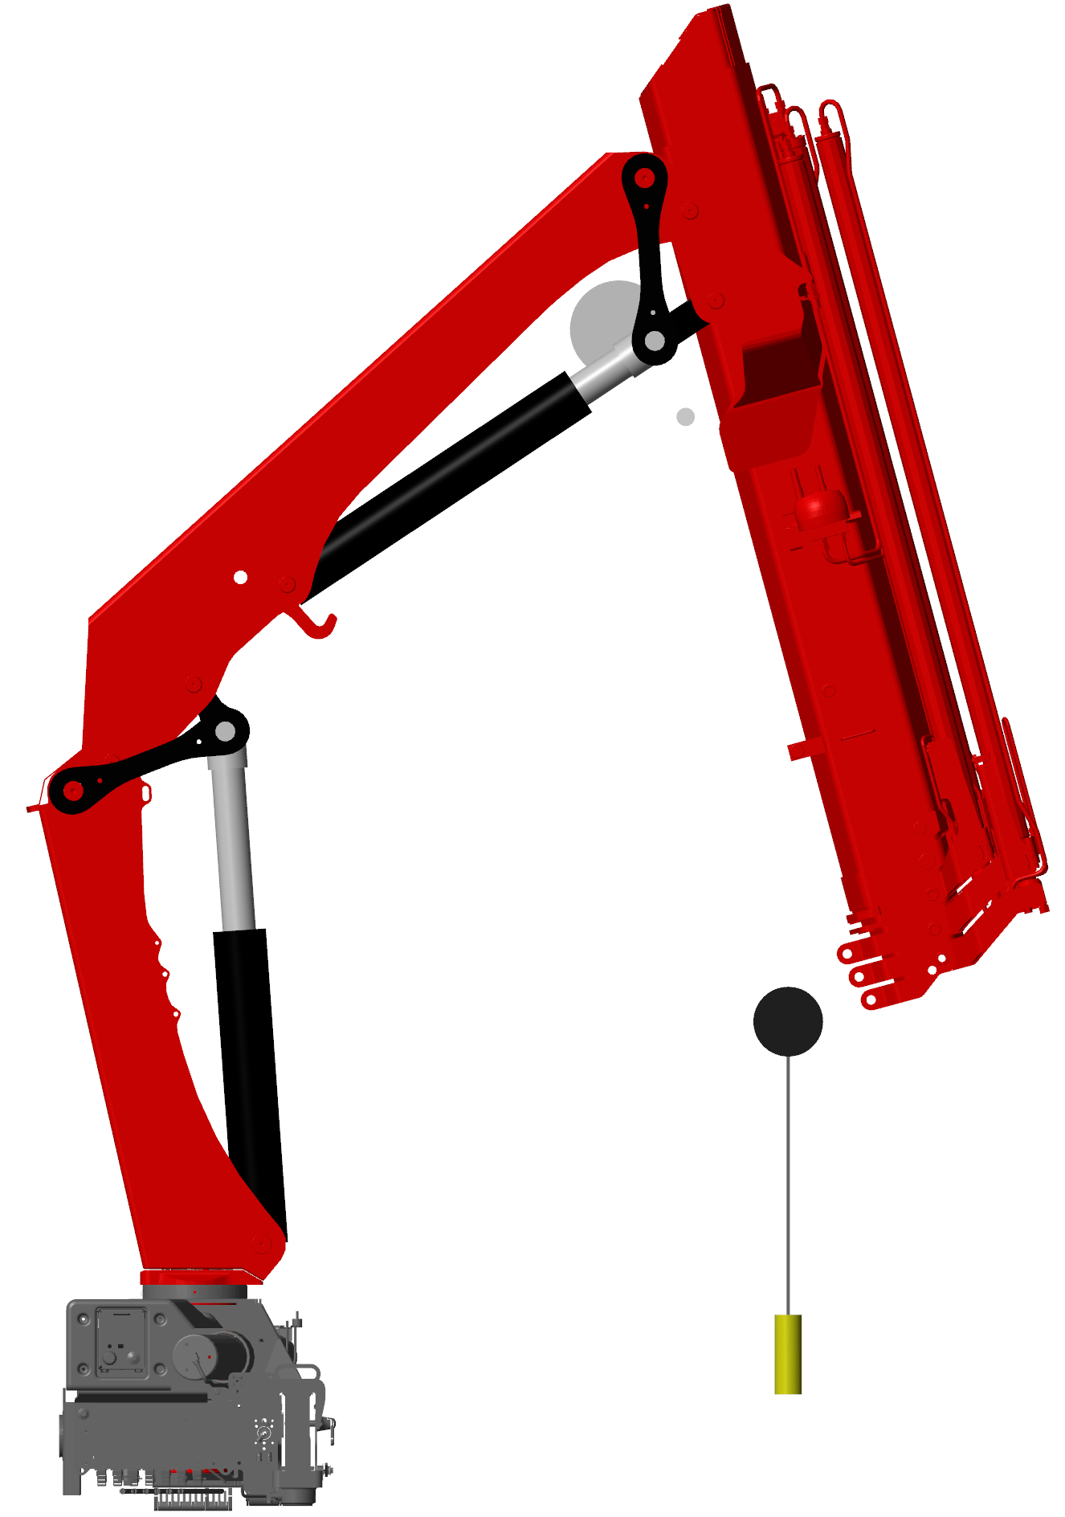
Point of rotation
Line of motion

Slide 11
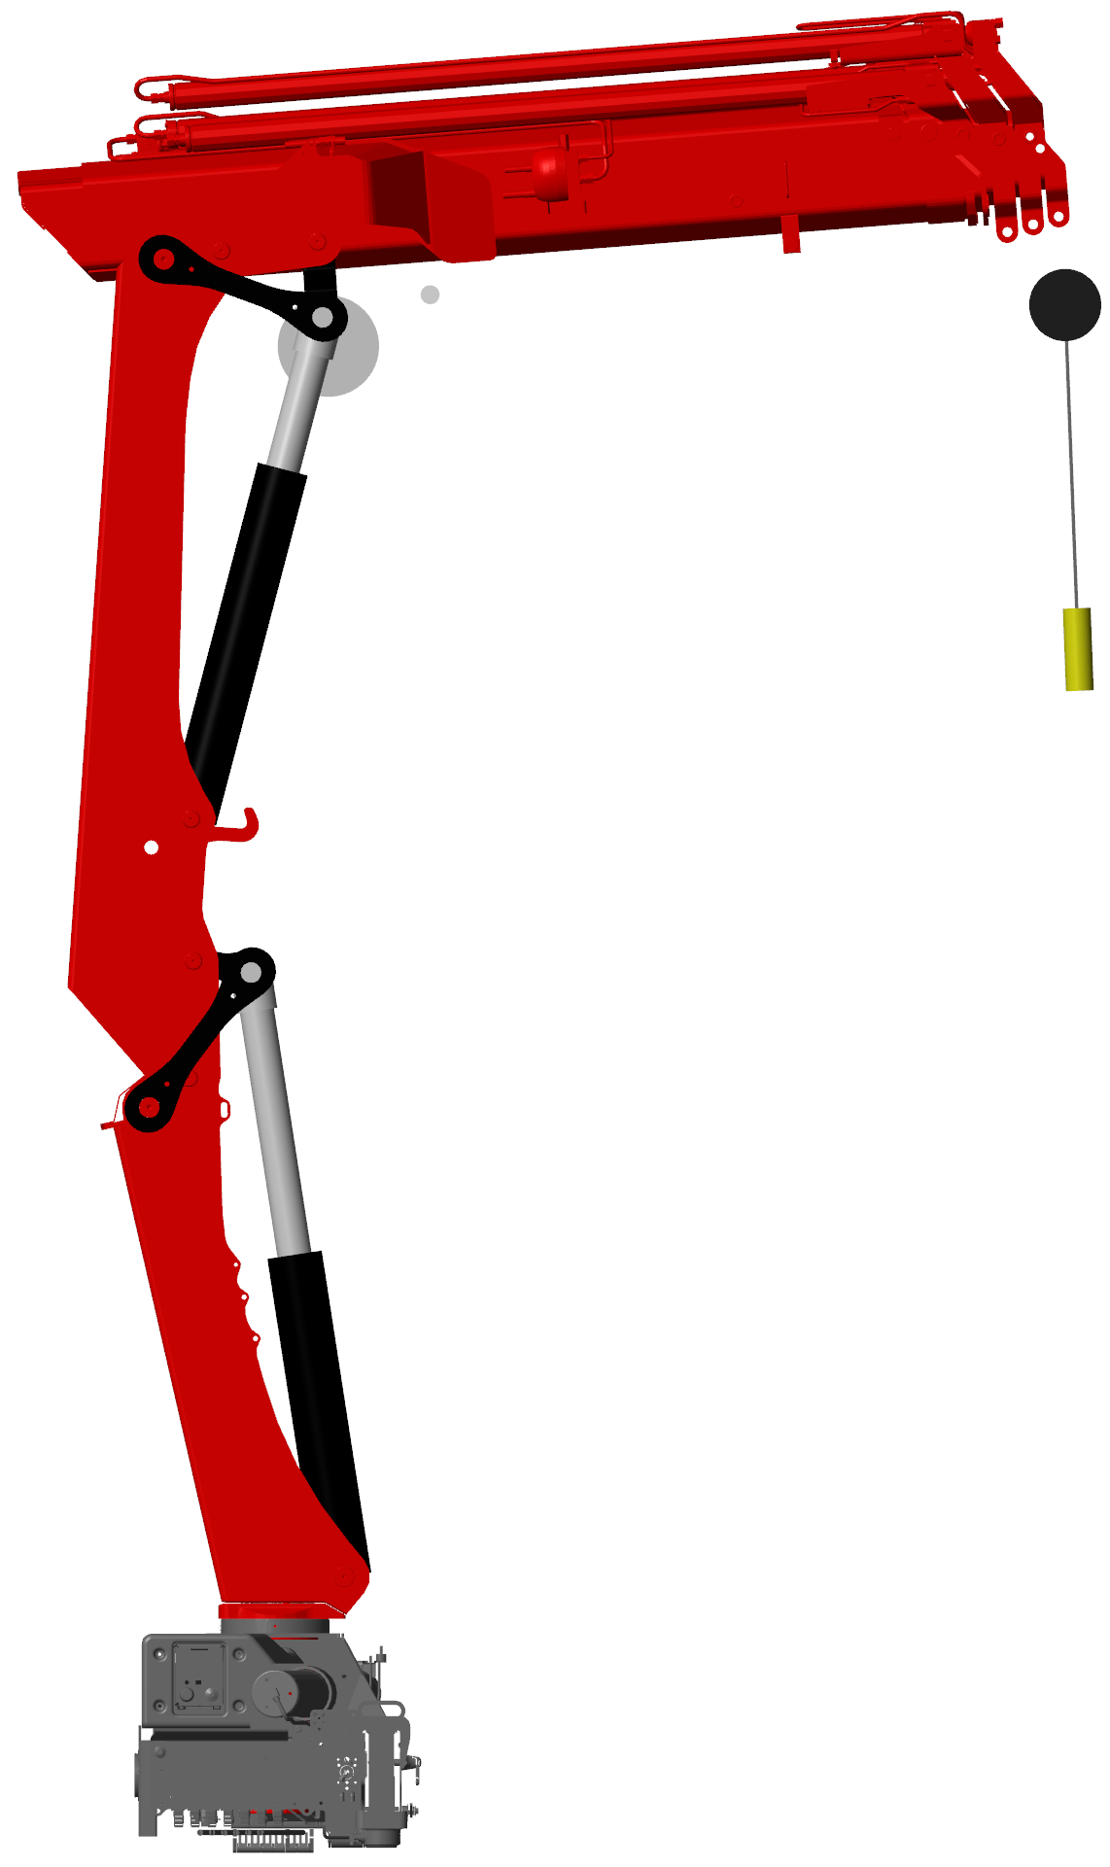
Point of rotation
Line of motion

Slide 12
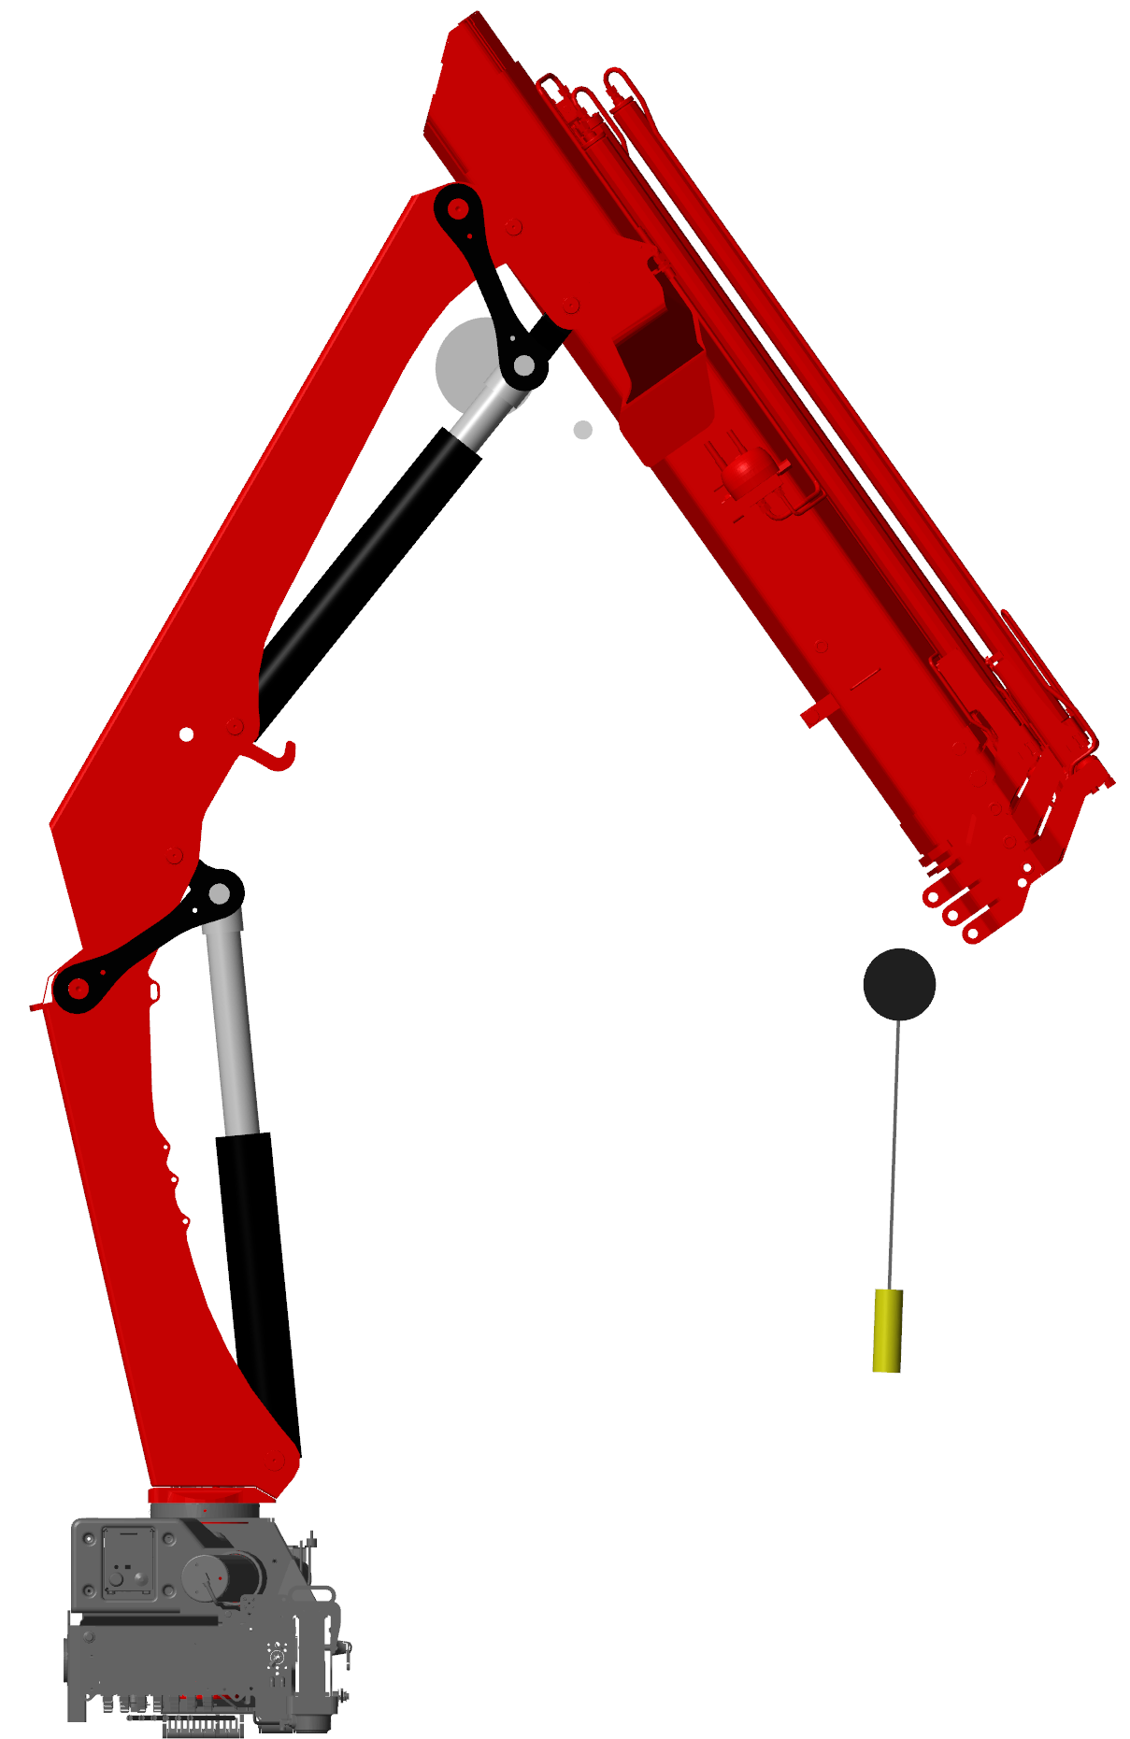
Point of rotation
Line of motion
Point of rotation
Line of motion

Slide 13
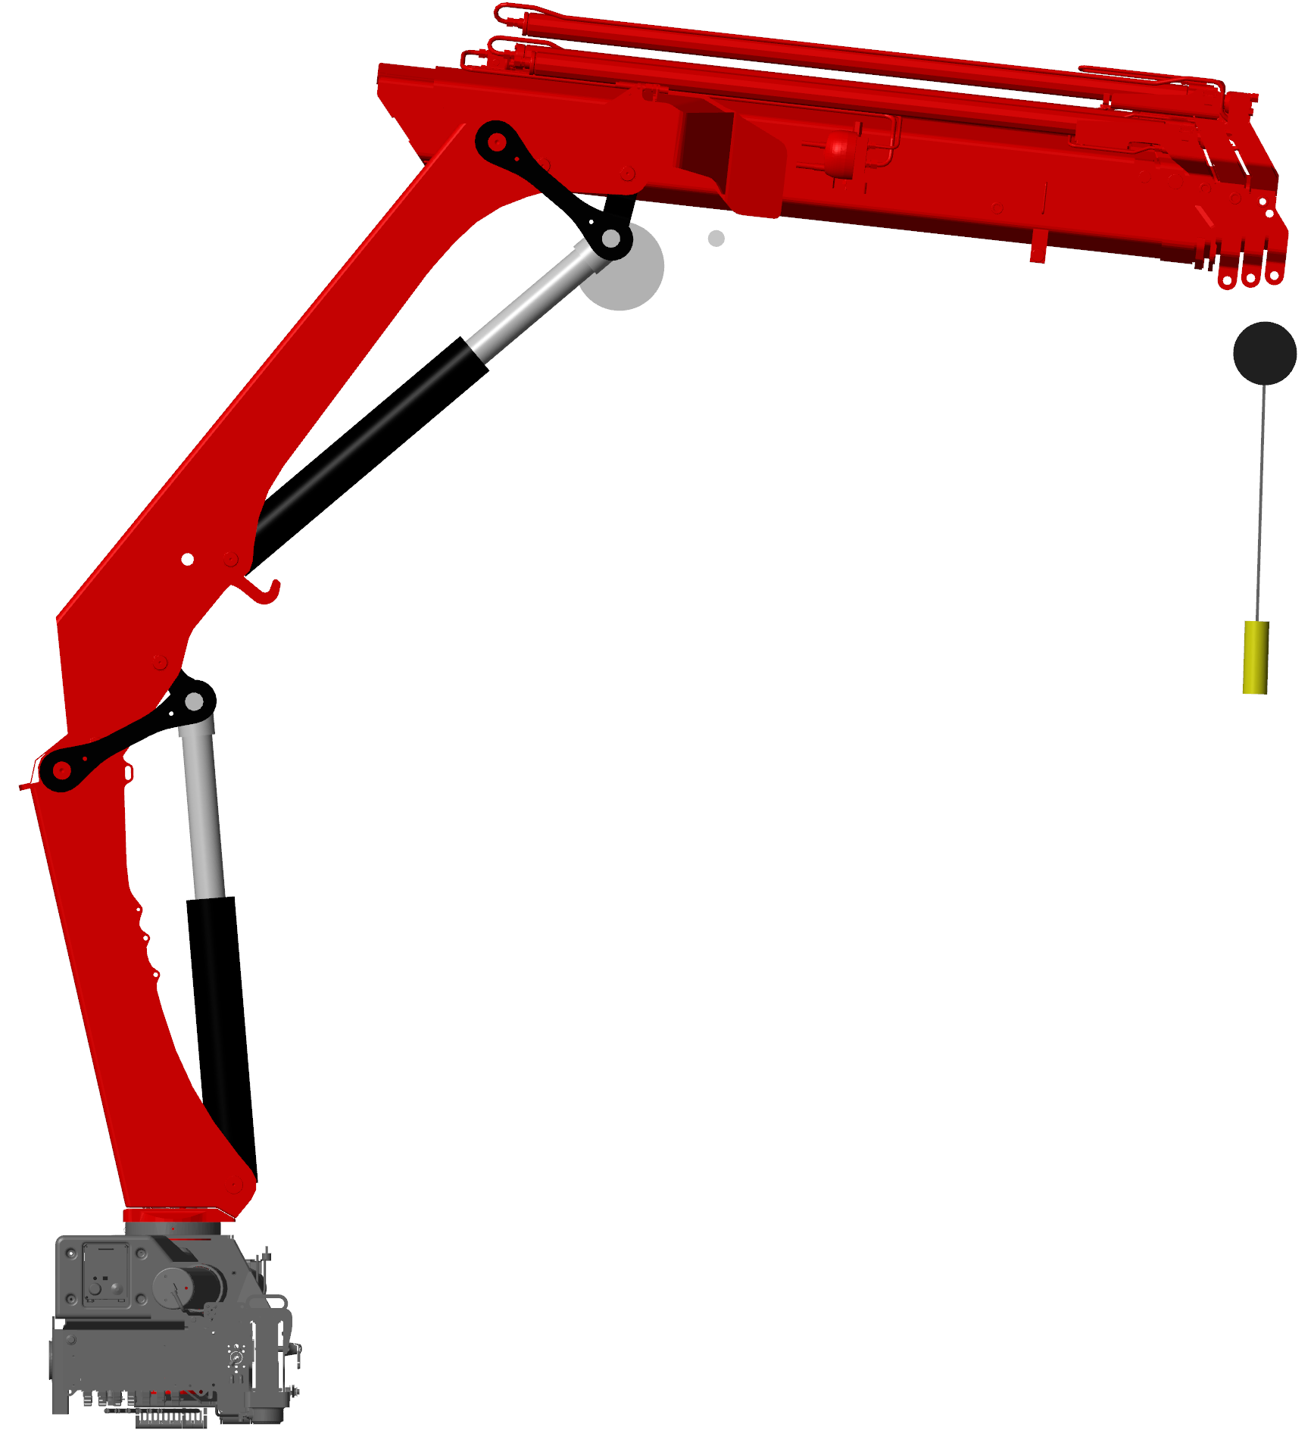
Point of rotation
Line of motion
Point of rotation
Line of motion

Slide 14
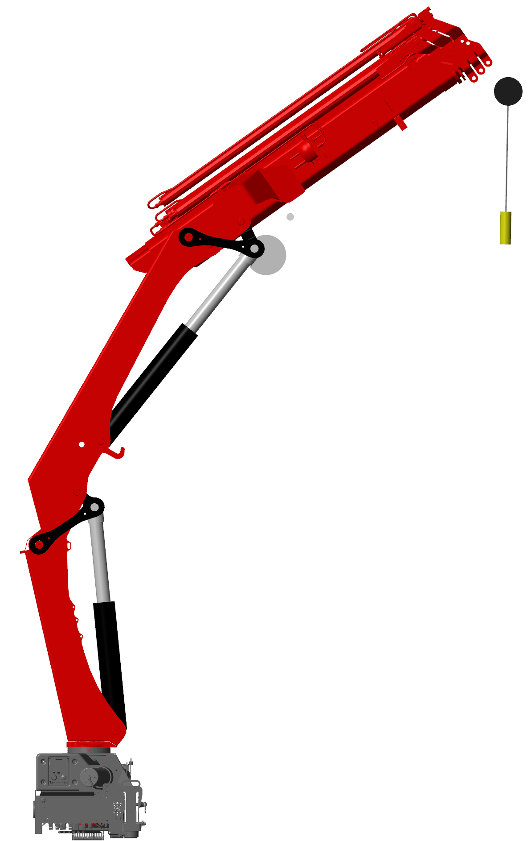
Point of rotation
Line of motion
Point of rotation
Line of motion

Slide 15
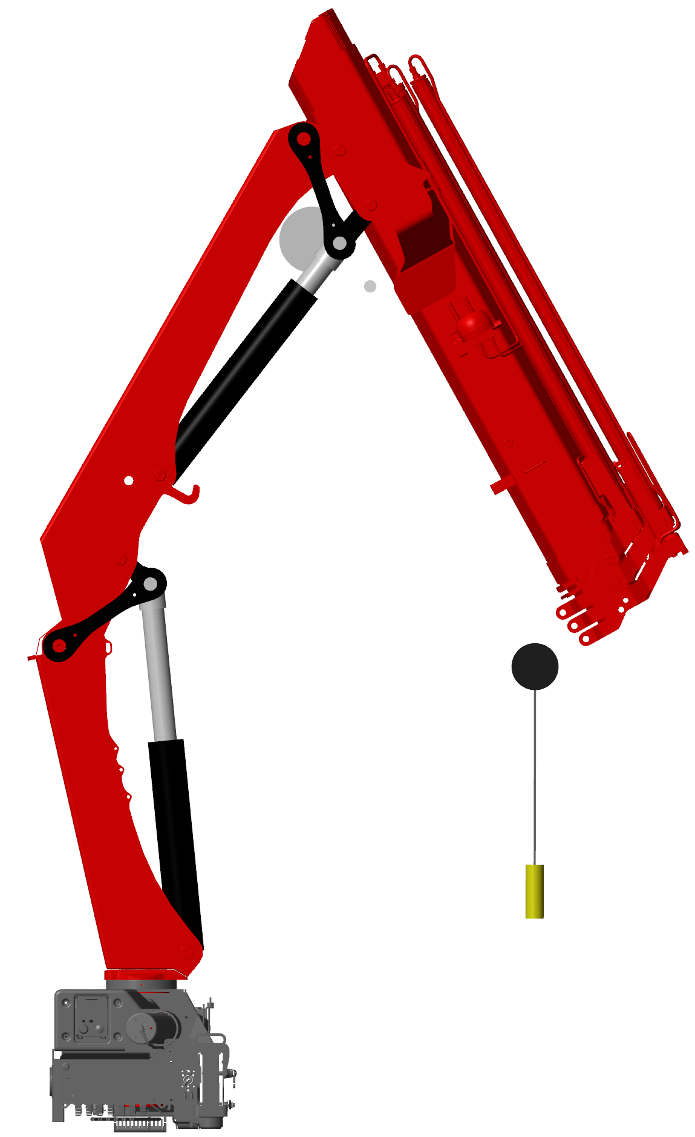
Point of rotation
Line of motion
Point of rotation
Line of motion

