Slide 1
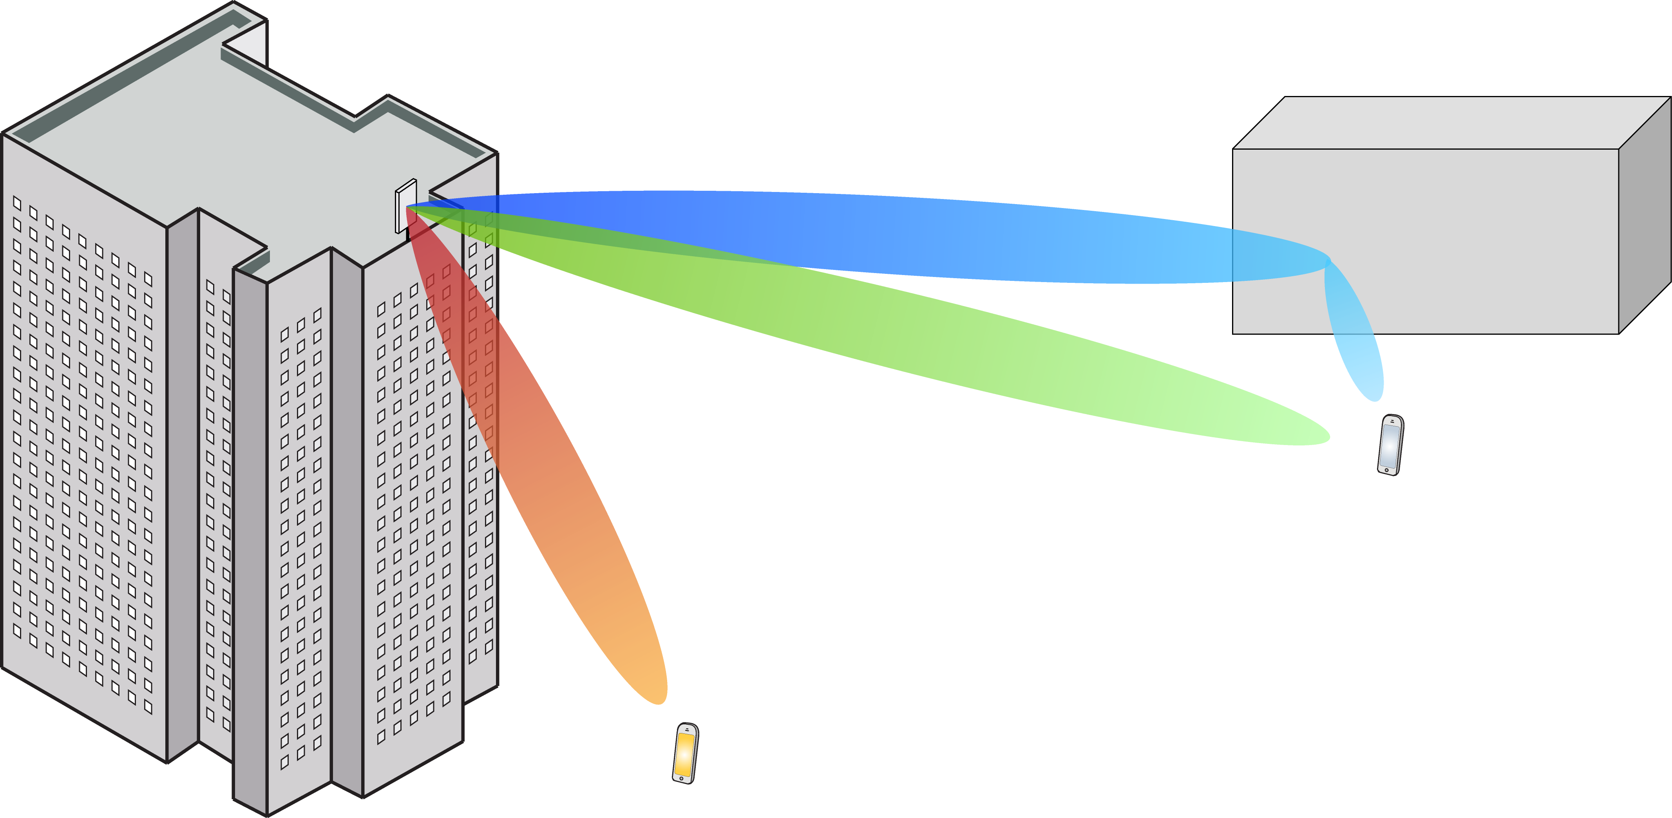
Multiple Antenna Communications
Background Lecture:
Linear Algebra and Complex Numbers
Emil Björnson

Slide 2
Outline
Complex numbers
Linear algebra
Vector analysis
Matrix analysis

Slide 3







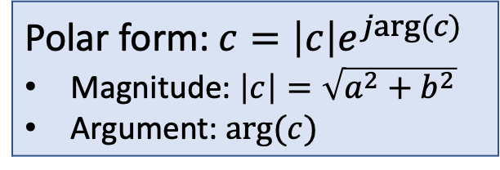


Real and complex numbers
$ℂ:$Complex numbers
$ℝ$: Real numbers
Imaginary numbers
Real number $a,b∈ℝ$
Imaginary unit: $j=\sqrt{−1}$
Complex number: $c=a+jb$
$$∈ℂ$$
Imaginary part
Real part
Imaginary part
$$b$$
$$c$$
Polar form: $c=\left|c\right|e^{jarg(c)}$
Magnitude: $\left|c\right|=\sqrt{a^{2}+b^{2}}$
Argument: $arg(c)$
$$\left|c\right|$$
$$arg(c)$$
Real part
$$a$$

Slide 4





Calculations with complex numbers
Two complex numbers: $a+jb$, $x+jy$
$$\left(a+jb\right)\left(x+jy\right)=ax+j^{2}by+jay+jbx$$
Complex conjugate of $c=a+jb$ is $c^{∗}=a−jb$
Note that:
$$cc^{∗}=\left(a+jb\right)\left(a−jb\right)=a^{2}+b^{2}+jab−jab=a^{2}+b^{2}$$
Change sign of argument: $c=\left|c\right|e^{jarg(c)}$, $c^{∗}=\left|c\right|e^{−jarg(c)}$
Imaginary
$$−1$$
$$c$$
Real
$$={\left|c\right|}^{2}$$
$$c^{∗}$$

Slide 5
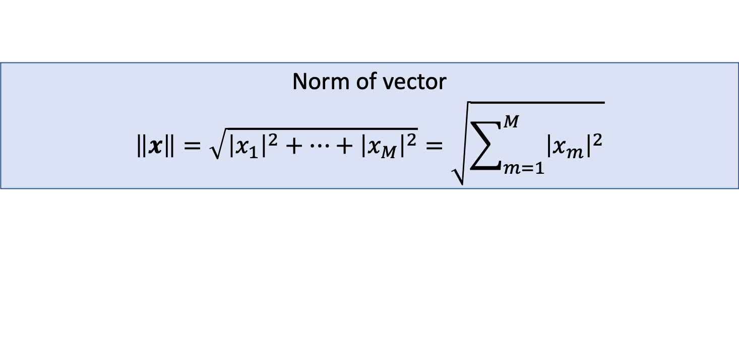





Complex vectors
Second entry
$M$-dimensional vector with complex entries:
$$x=\left[\begin{aligned}x_{1} \\ ⋮ \\ x_{M}\end{aligned}\right]$$
Decomposition:
$$x=\left\|x\right\|∙\frac{x}{\left\|x\right\|}$$
$$1$$
$$\left\|x\right\|$$
$$x$$
$$x/\left\|x\right\|$$
First entry
Direction
Length
Norm of vector
$$\left\|x\right\|=\sqrt{{\left|x_{1}\right|}^{2}+⋯+{\left|x_{M}\right|}^{2}}=\sqrt{\sum_{m=1}^{M}{{\left|x_{m}\right|}^{2}}}$$

Slide 6

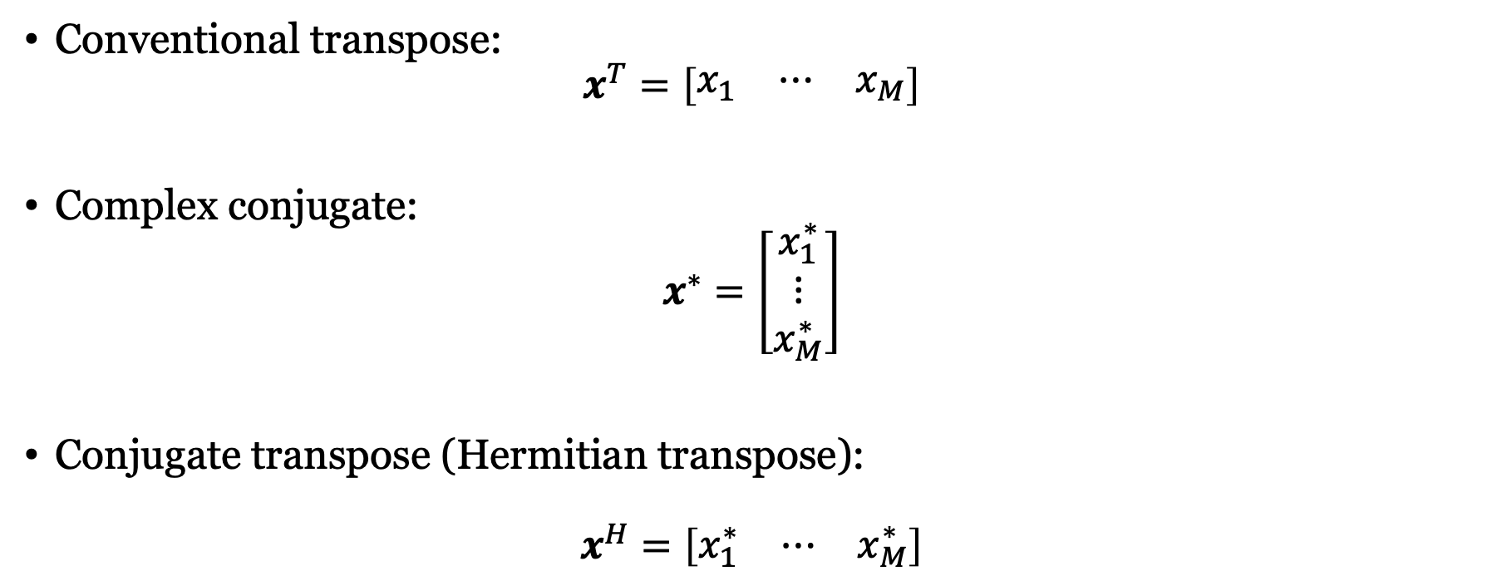

Transpose and conjugate of
$$x=\left[\begin{aligned}x_{1} \\ ⋮ \\ x_{M}\end{aligned}\right]$$
Conventional transpose:
$$x^{T}=\left[\begin{matrix}x_{1} & ⋯ & x_{M}\end{matrix}\right]$$
Complex conjugate:
$$x^{∗}=\left[\begin{aligned}x_{1}^{∗} \\ ⋮ \\ x_{M}^{∗}\end{aligned}\right]$$
Conjugate transpose (Hermitian transpose):
$$x^{H}=\left[\begin{matrix}x_{1}^{∗} & ⋯ & x_{M}^{∗}\end{matrix}\right]$$
$$x^{H}={\left(x^{∗}\right)}^{T}$$

Slide 7


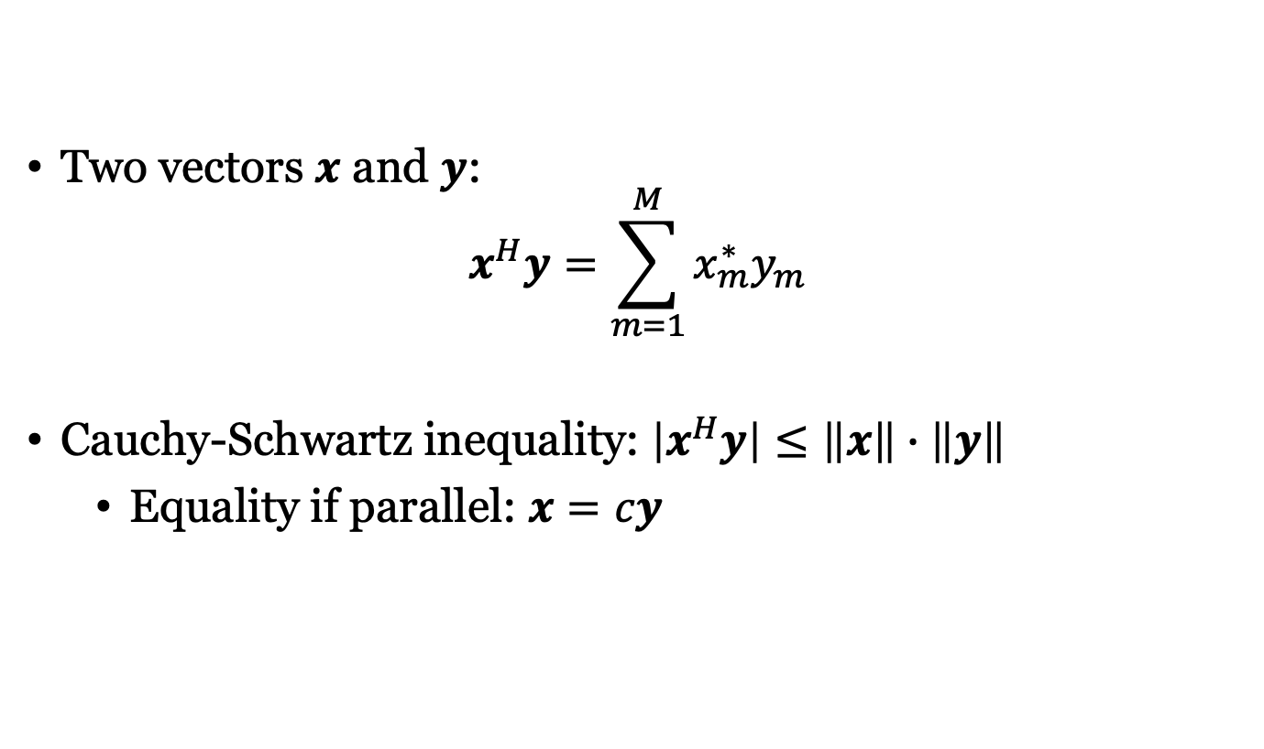



Inner product of vectors
Orthogonal
$$y_{3}$$
$$y_{2}$$
Two vectors $x$ and $y$:
$$x^{H}y=\sum_{m=1}^{M}{x_{m}^{∗}y_{m}}$$
Cauchy-Schwartz inequality: $\left|x^{H}y\right|≤\left\|x\right\|∙\left\|y\right\|$
Equality if parallel: $x=cy$
$$x$$
$$y_{1}$$
Parallel
$$x^{H}x=\sum_{m=1}^{M}{x_{m}^{∗}x_{m}}={\left\|x\right\|}^{2}$$

Slide 8
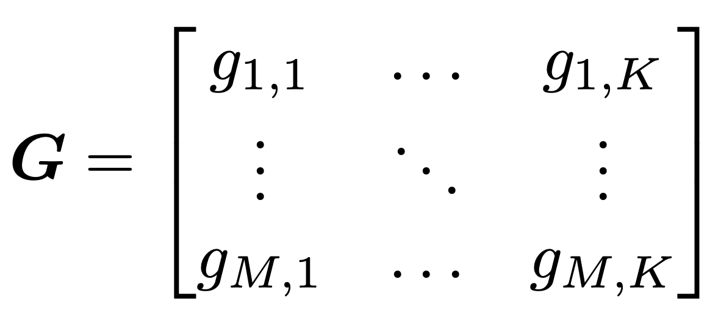
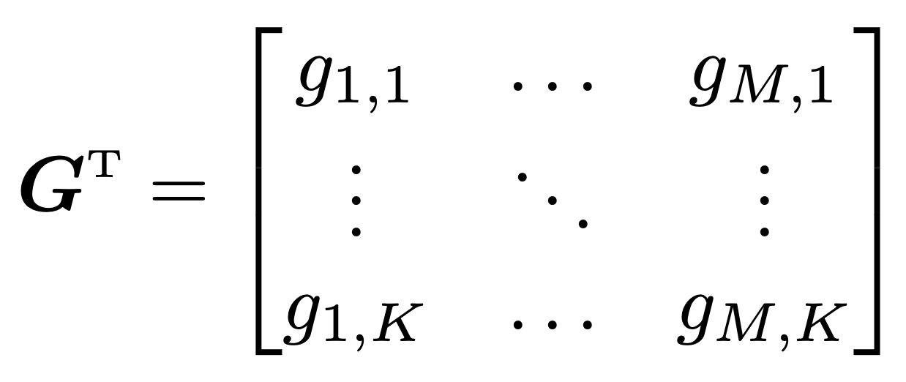
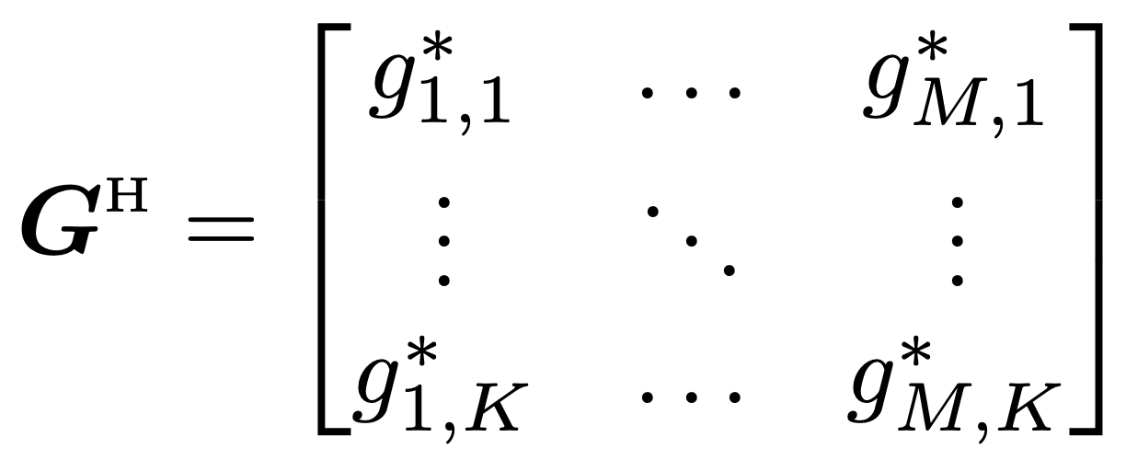

Matrices and basic operations
$M × K$ matrix:
Transpose:
Conjugate transpose:

Slide 9
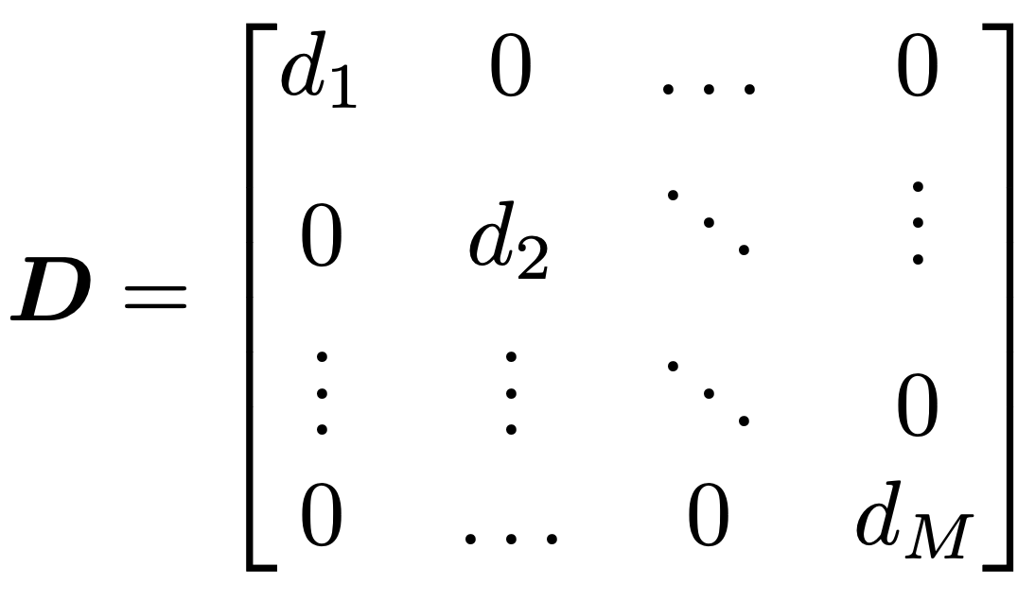
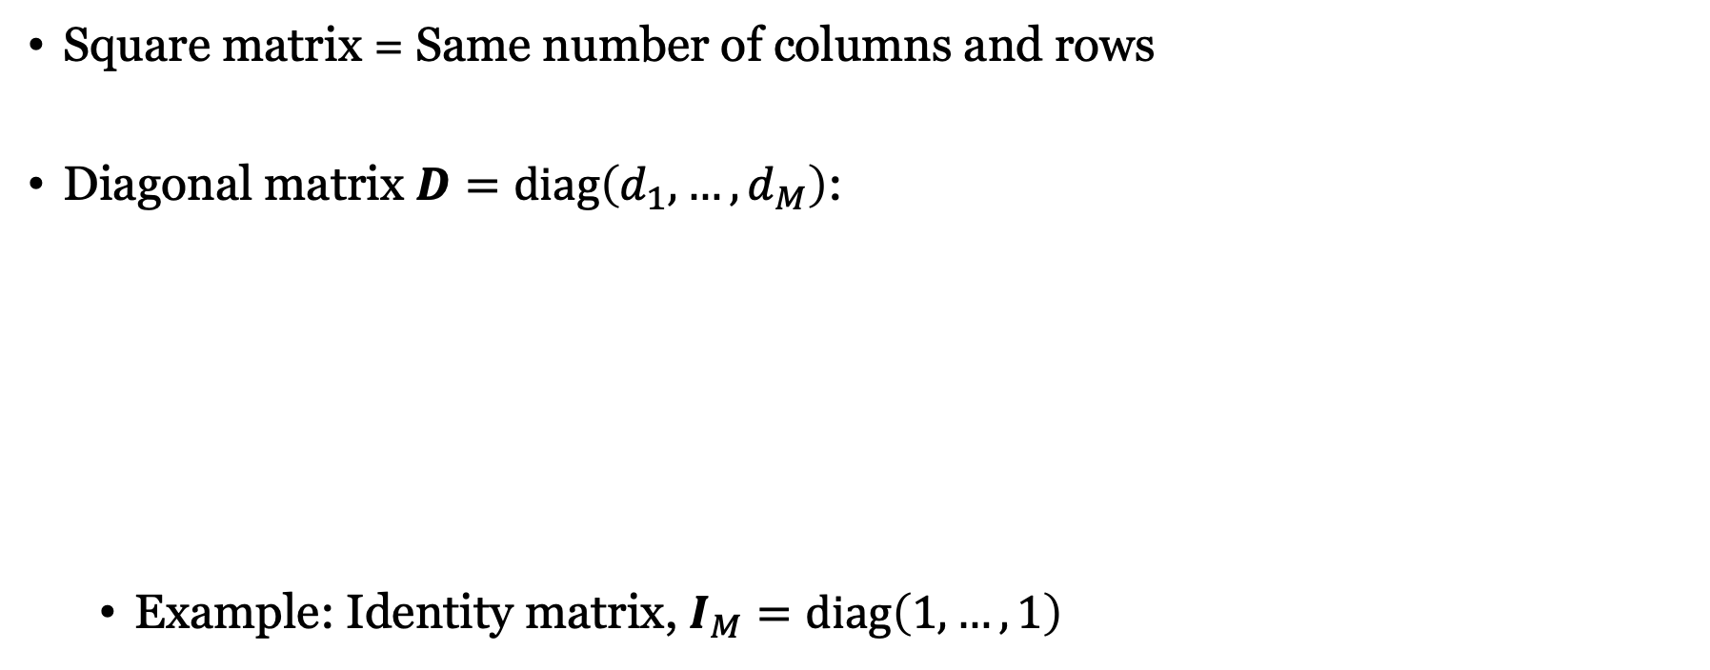
Square and diagonal matrices
Square matrix = Same number of columns and rows
Diagonal matrix $D=diag\left(d_{1},…,d_{M}\right)$:
Example: Identity matrix, $I_{M}=diag\left(1,…,1\right)$

Slide 10
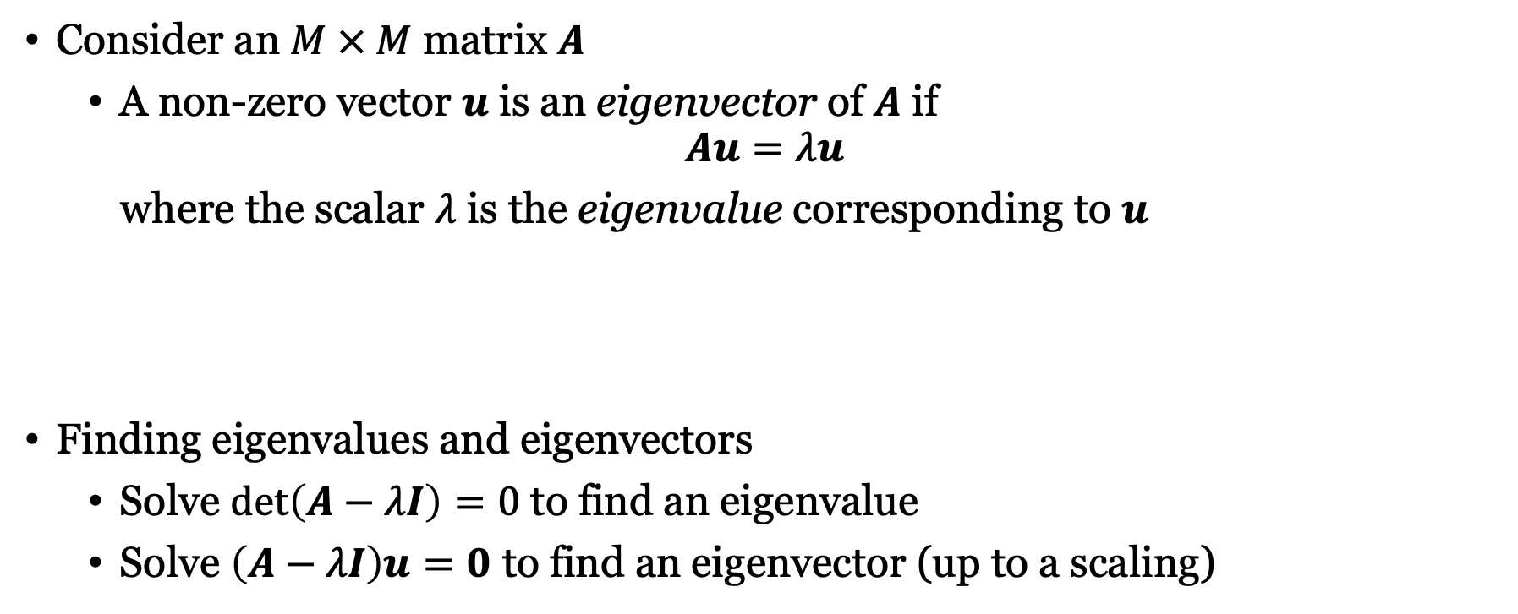
Eigenvalues and eigenvectors
Consider an $M × M$ matrix $A$
A non-zero vector $u$ is an eigenvector of $A$ if
$$Au=λu$$
where the scalar $λ$ is the eigenvalue corresponding to $u$
Finding eigenvalues and eigenvectors
Solve $det\left(A−λI\right)=0$ to find an eigenvalue
Solve $\left(A−λI\right)u=0$ to find an eigenvector (up to a scaling)
Rank: Number of linearly independent columns

Slide 11
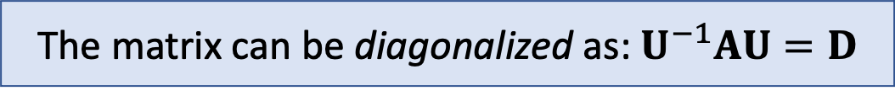

Eigenvalue decomposition
If $A$ has $M$ linearly independent eigenvectors, then
$$A=UDU^{−1}$$
$U$ contains (unit-norm) eigenvectors as columns
$D$ is the diagonal matrix with corresponding eigenvalues
The matrix can be diagonalized as: $U^{−1}AU=D$

Slide 12
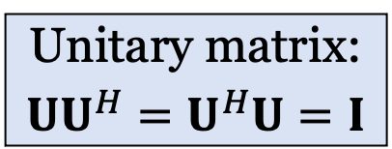
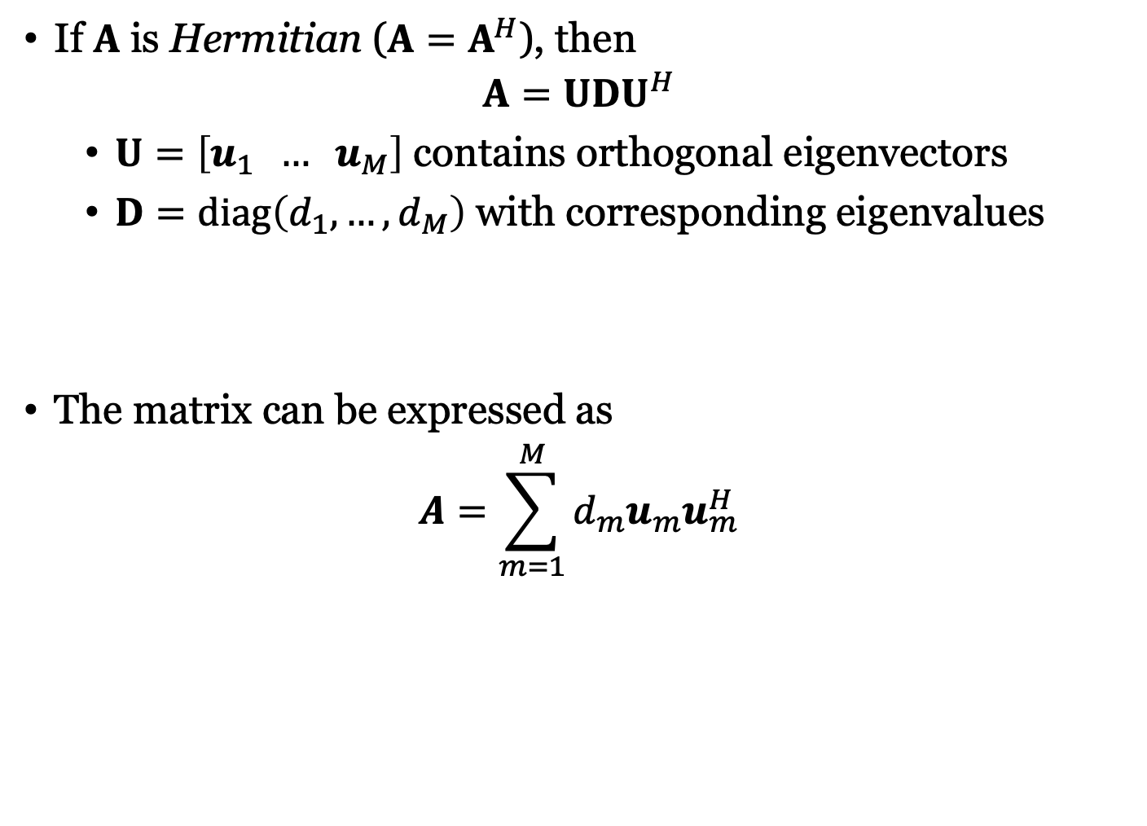

Eigenvalue decomposition for Hermitian matrices
If $A$ is Hermitian ($A=A^{H}$), then
$$A=UDU^{H}$$
$U=\left[u_{1} … u_{M}\right]$ contains orthogonal eigenvectors
$D=diag\left(d_{1},…,d_{M}\right)$ with corresponding eigenvalues
The matrix can be expressed as
$$A=\sum_{m=1}^{M}{d_{m}u_{m}u_{m}^{H}}$$
Unitary matrix:
$$UU^{H}=U^{H}U=I$$
Can be diagonalized as $U^{H}AU=D$

Slide 13
Summary
Definition of complex numbers
Describe communication signals
Complex vectors and matrices
Describe systems with multiple antennas
Absolute values, norms, eigenvalues
Describe signal strength, in different directions

Slide 14
Multiple Antenna Communications
Background Lecture:
Linear Algebra and Complex Numbers
Emil Björnson

