Slide 1
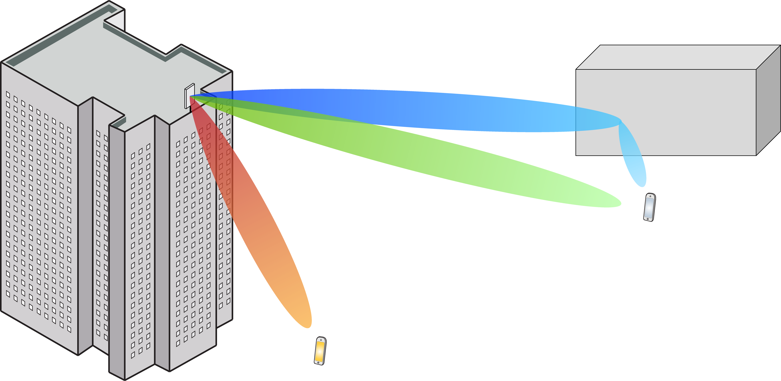
Multiple Antenna Communications
Background Lecture:
Random Variables
Emil Björnson

Slide 2
Outline
Random variables
Real and complex
Mean and variance
Gaussian distribution
Random vectors
Random processes

Slide 3





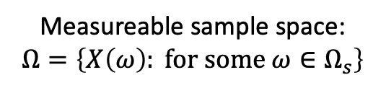
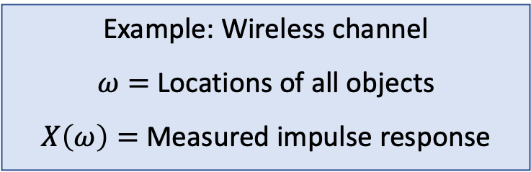

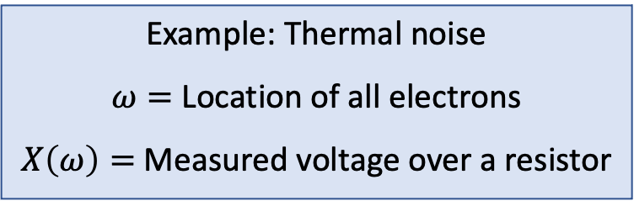
Random variable
Sample space:$Ω_{s}$
$$ω$$
Random variable
Total probability:
$$\operatorname{Pr}\left\{Ω\right\}=1$$
Probability of event $A$:
$$Pr⁡\{A\}∈ [0,1]$$
$$X\left(ω\right)$$
Event $A$
Event $B$
Measureable sample space:
$$Ω=\left\{X\left(ω\right): for some ω∈Ω_{s}\right\}$$
Example: Thermal noise
$ω=$ Location of all electrons
$X\left(ω\right)=$ Measured voltage over a resistor
Example: Wireless channel
$ω=$ Locations of all objects
$X\left(ω\right)=$ Measured impulse response

Slide 4




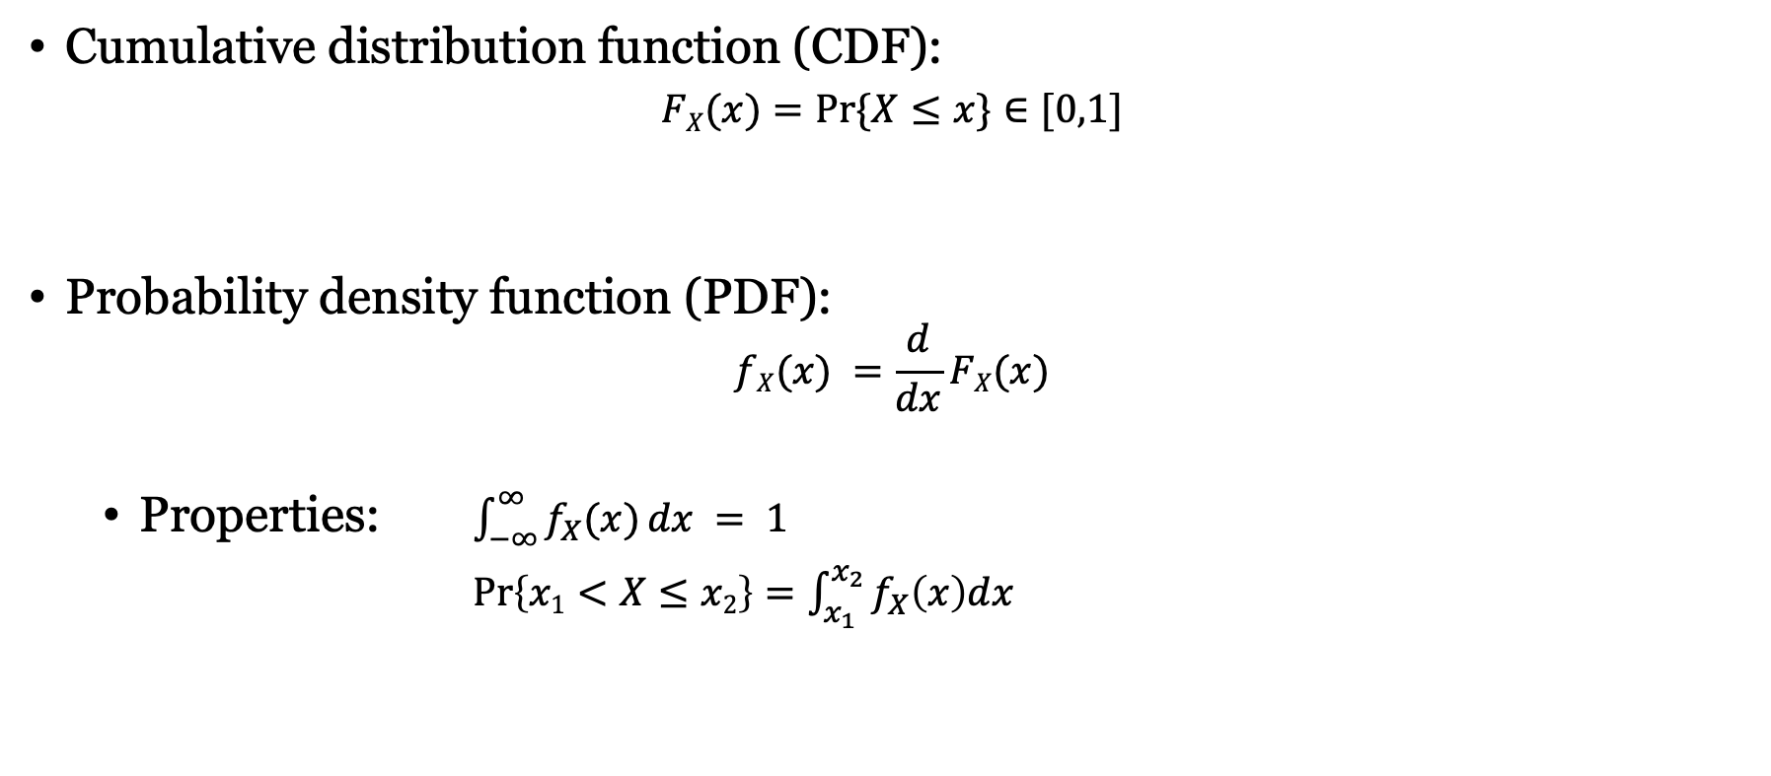

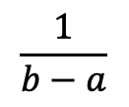




Probability density for real variables
$$FX(x)$$
$$1$$
Cumulative distribution function (CDF):
$$FX(x)=Pr⁡\{X≤x\}∈[0,1]$$
Probability density function (PDF):
$$fX(x) =\frac{d}{dx}FX(x)$$
Properties: $\int_{−∞}^{∞}{f_{X}(x)}dx = 1$
$\operatorname{Pr}\left\{x1<X≤x2\right\}=\int_{x_{1}}^{x_{2}}{f_{X}\left(x\right)dx}$
An event
$$a$$
$$b$$
$$x$$
Non-decreasing, non-zero
Uniform distribution
$$fX(x)$$
$$\frac{1}{b−a}$$
$$a$$
$$b$$
$$x$$
Non-zero, area 1

Slide 5
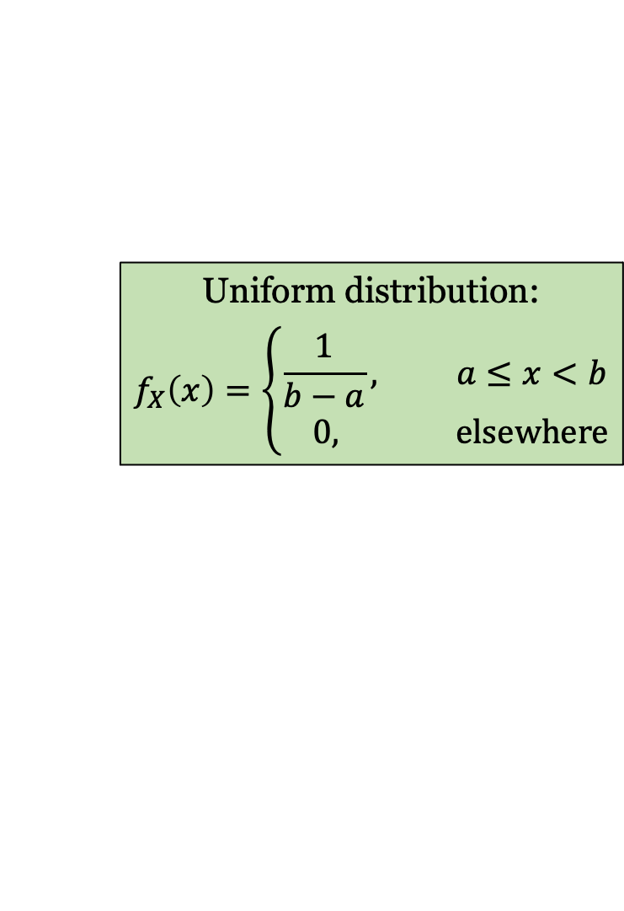
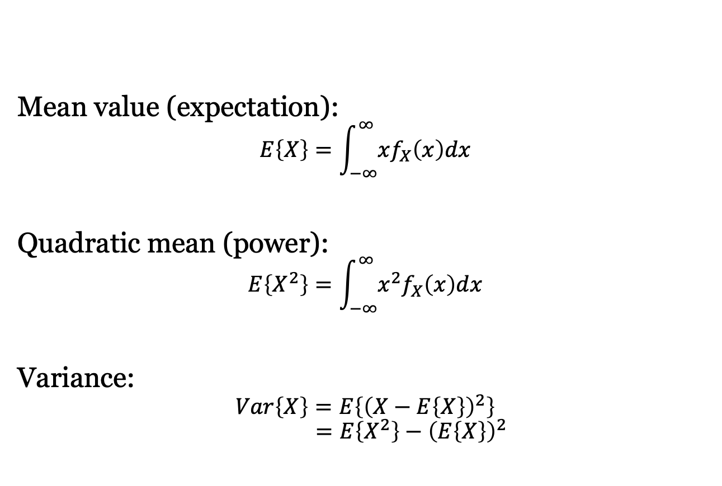
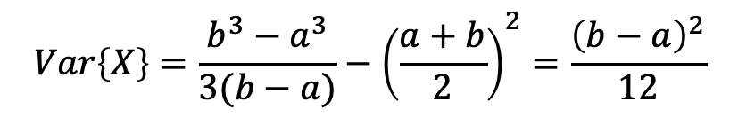
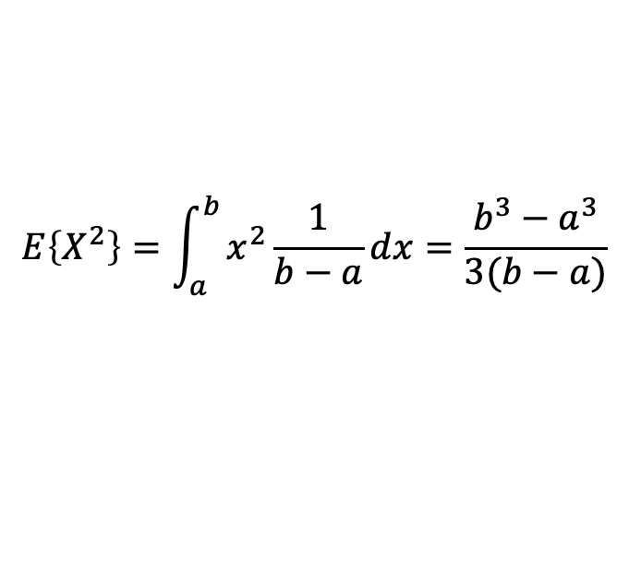
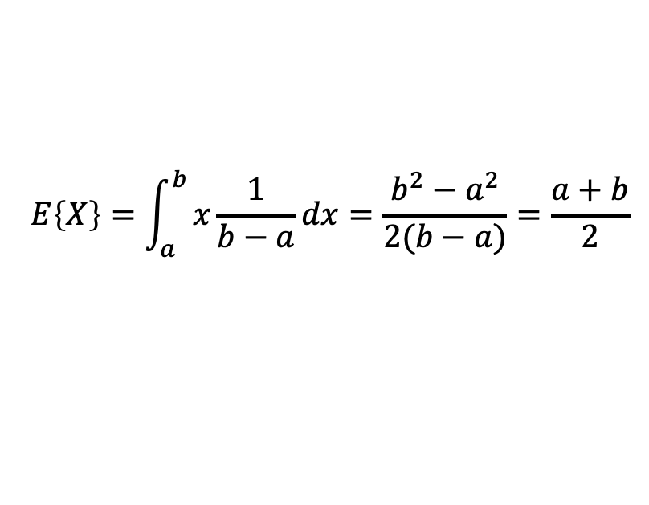
Mean and variance
Uniform distribution:
$$f_{X}\left(x\right)=\left\{\begin{aligned}\frac{1}{b−a}, a≤x<b \\ 0, elsewhere\end{aligned}\right.$$
Mean value (expectation):
$$E\left\{X\right\}=\int_{−∞}^{∞}{xf_{X}\left(x\right)dx}$$
Quadratic mean (power):
$$E\left\{X^{2}\right\}=\int_{−∞}^{∞}{x^{2}f_{X}\left(x\right)dx}$$
Variance:
$$Var\left\{X\right\}=E\left\{{\left(X−E\left\{X\right\}\right)}^{2}\right\}$$
$$=E\left\{X^{2}\right\}−{\left(E\left\{X\right\}\right)}^{2}$$
$$E\left\{X\right\}=\int_{a}^{b}{x\frac{1}{b−a}dx}=\frac{{b^{2}−a}^{2}}{2(b−a)}=\frac{a+b}{2}$$
$$E\left\{X^{2}\right\}=\int_{a}^{b}{x^{2}\frac{1}{b−a}dx}=\frac{{b^{3}−a}^{3}}{3(b−a)}$$
$$Var\left\{X\right\}=\frac{{b^{3}−a}^{3}}{3(b−a)}−{\left(\frac{a+b}{2}\right)}^{2}=\frac{{\left(b−a\right)}^{2}}{12}$$

Slide 6
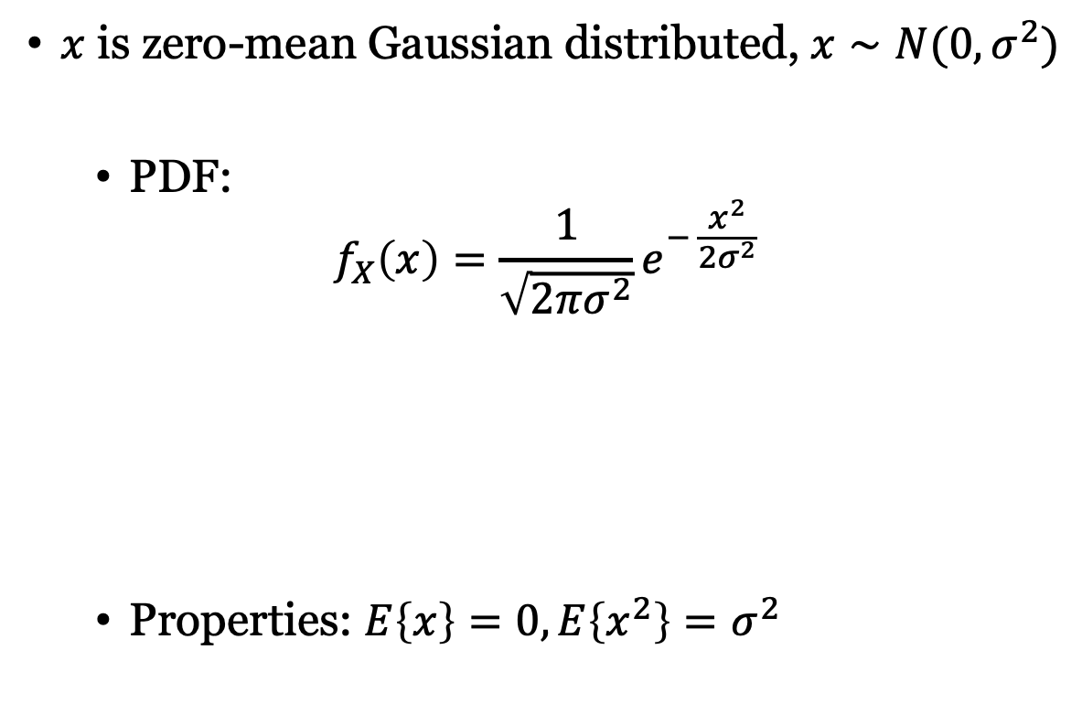
Gaussian distribution
$x$ is zero-mean Gaussian distributed, $x∼N(0,σ^{2})$
PDF:
$$f_{X}\left(x\right)=\frac{1}{\sqrt{2πσ^{2}}}e^{− \frac{x^{2}}{2σ^{2}}}$$
Properties: $E\left\{x\right\}=0,E\left\{x^{2}\right\}=σ^{2}$

Slide 7
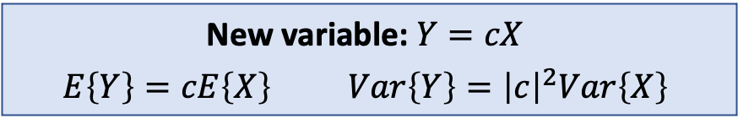
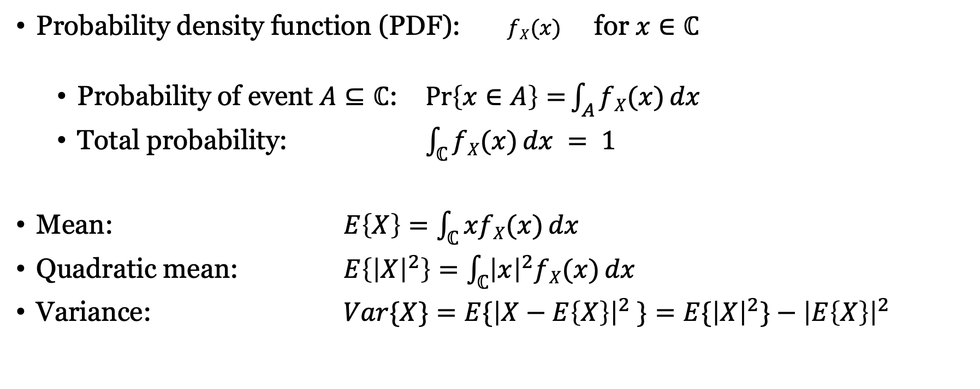
Probability density for complex variables
Probability density function (PDF): $fX(x)$ for $x∈ℂ$
Probability of event $A⊆ℂ$: $\operatorname{Pr}\left\{x∈A\right\}=\int_{A}{fX(x)}dx$
Total probability: $\int_{ℂ}{fX(x)}dx = 1$
Mean: $E\left\{X\right\}=\int_{ℂ}{xfX(x)}dx$
Quadratic mean: $E\left\{{\left|X\right|}^{2}\right\}=\int_{ℂ}{{\left|x\right|}^{2}fX(x)}dx$
Variance: $Var\{X\}=E\{{\left|X−E\left\{X\right\}\right|}^{2} \}=E\{{\left|X\right|}^{2}\}−{\left|E\left\{X\right\}\right|}^{2}$
New variable: $Y=cX$
$$E\left\{Y\right\}=cE\left\{X\right\} Var\left\{Y\right\}={\left|c\right|}^{2}Var\left\{X\right\}$$

Slide 8
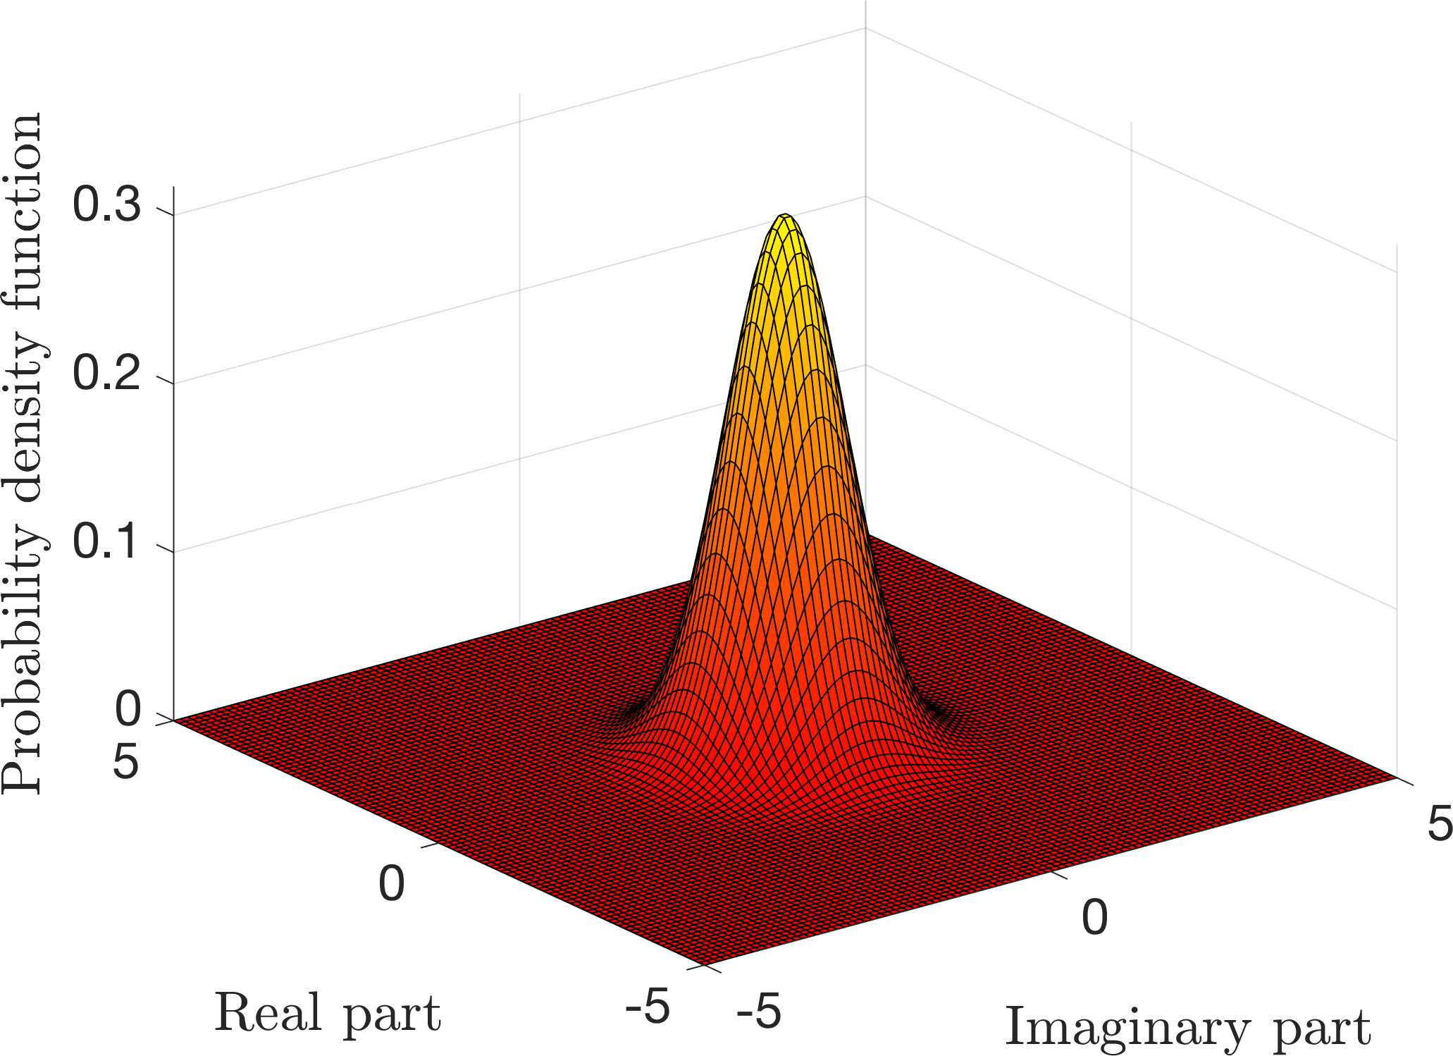
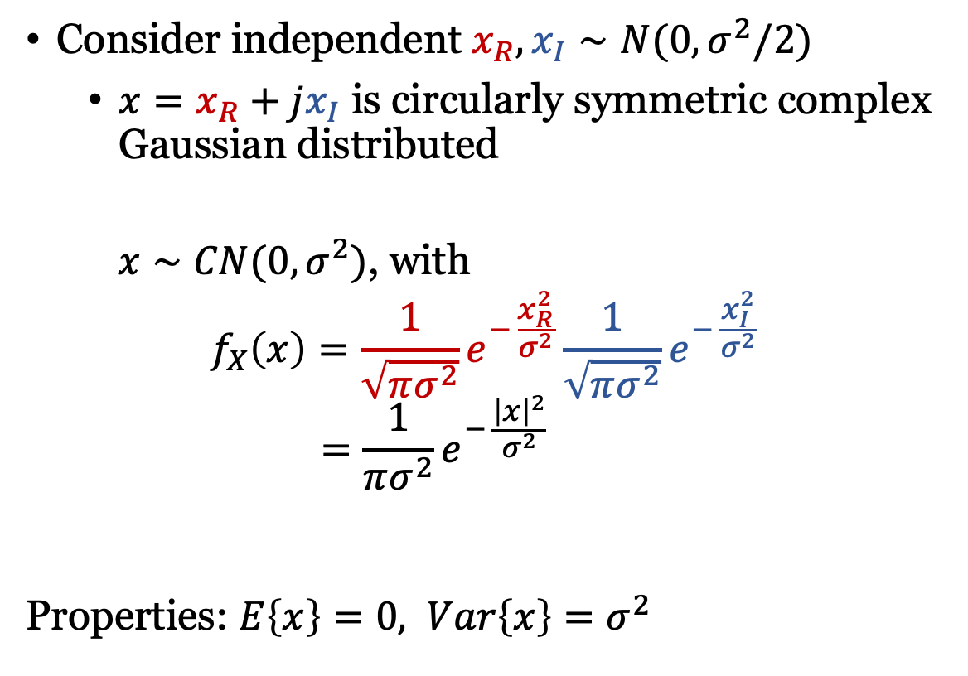
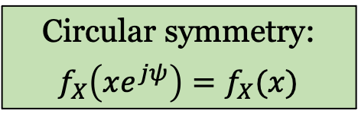
Complex Gaussian Distribution
Consider independent $x_{R},x_{I}∼N(0,σ^{2}/2)$
$x=x_{R}+jx_{I}$ is circularly symmetric complex Gaussian distributed
$x∼CN(0,σ^{2})$, with
$$f_{X}\left(x\right)=\frac{1}{\sqrt{πσ^{2}}}e^{− \frac{x_{R}^{2}}{σ^{2}}}\frac{1}{\sqrt{πσ^{2}}}e^{− \frac{x_{I}^{2}}{σ^{2}}}$$
$$=\frac{1}{πσ^{2}}e^{− \frac{{\left|x\right|}^{2}}{σ^{2}}}$$
Properties: $E\left\{x\right\}=0, Var\left\{x\right\}=σ^{2}$
Circular symmetry:
$$f_{X}\left(xe^{jψ}\right)=f_{X}(x)$$

Slide 9
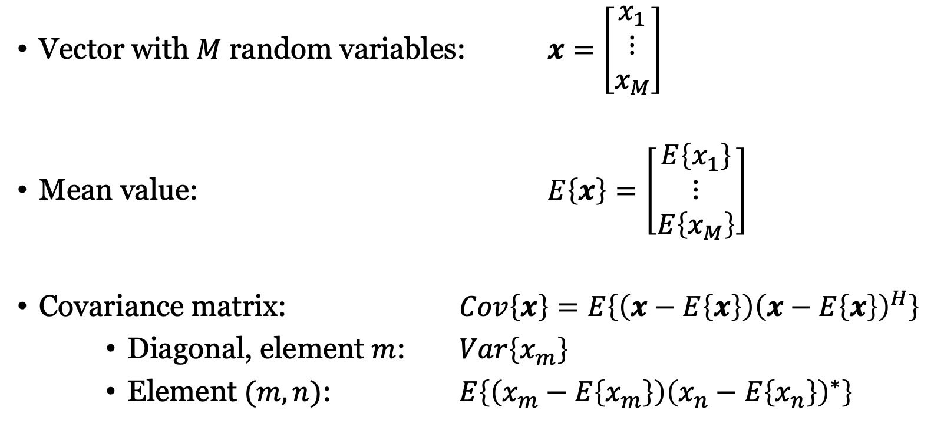
Multivariate distribution
Vector with $M$ random variables: $x=\left[\begin{matrix}x_{1} \\ ⋮ \\ x_{M}\end{matrix}\right]$
Mean value: $E\left\{x\right\}=\left[\begin{matrix}E\left\{x_{1}\right\} \\ ⋮ \\ E\left\{x_{M}\right\}\end{matrix}\right]$
Covariance matrix: $Cov\left\{x\right\}=E\left\{\left(x−E\left\{x\right\}\right){\left(x−E\left\{x\right\}\right)}^{H}\right\}$
Diagonal, element $m$: $Var\left\{x_{m}\right\}$
Element $(m,n)$: $E\left\{\left(x_{m}−E\left\{x_{m}\right\}\right){\left(x_{n}−E\left\{x_{n}\right\}\right)}^{∗}\right\}$

Slide 10

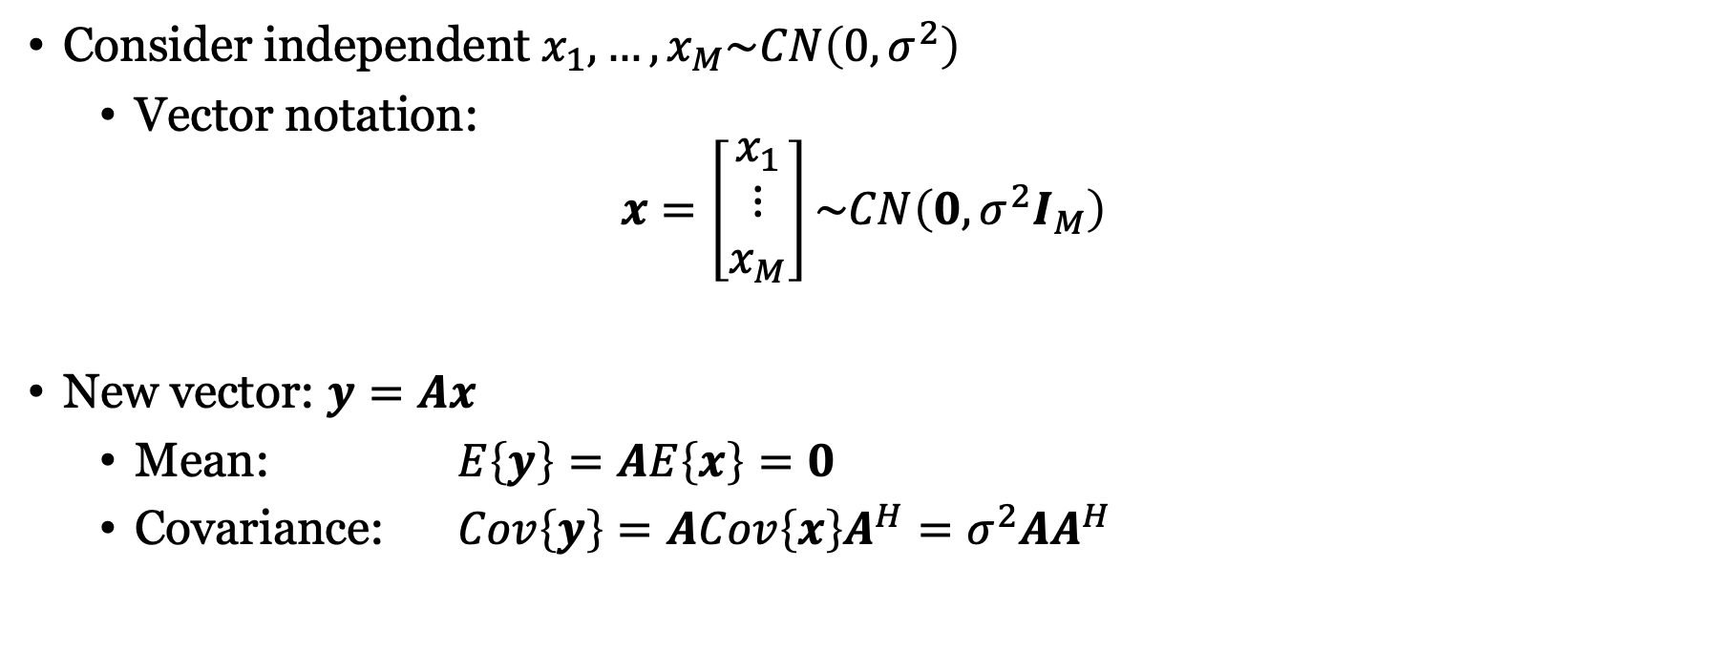
Complex Gaussian vectors
Consider independent $x_{1},…,x_{M}\sim CN\left(0,σ^{2}\right)$
Vector notation:
$$x=\left[\begin{matrix}x_{1} \\ ⋮ \\ x_{M}\end{matrix}\right]\sim CN\left(0,σ^{2}I_{M}\right)$$
New vector: $y=Ax$
Mean: $E\left\{y\right\}=AE\left\{x\right\}=0$
Covariance: $Cov\left\{y\right\}=ACov\left\{x\right\}A^{H}=σ^{2}AA^{H}$
Covariance matrix
Mean
$$y\sim CN\left(0,σ^{2}AA^{H}\right)$$

Slide 11



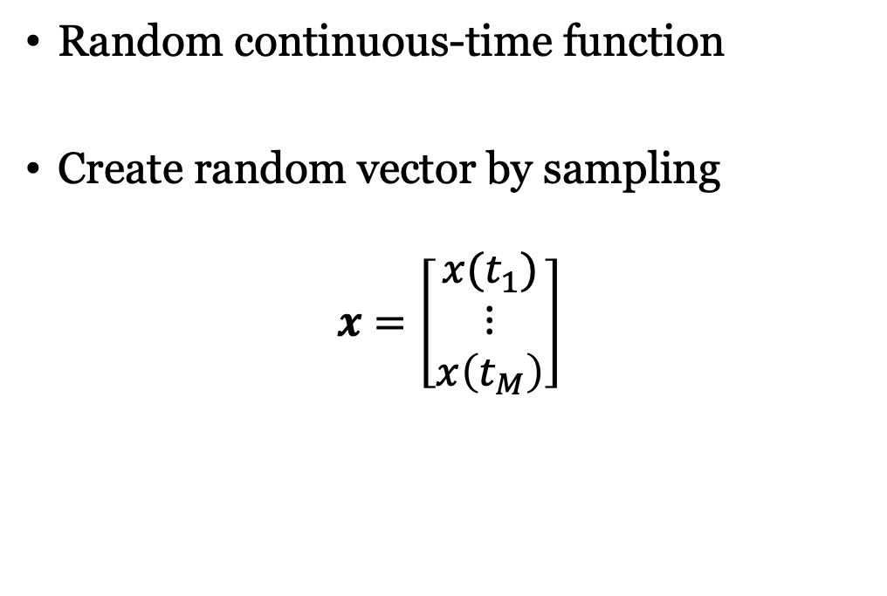

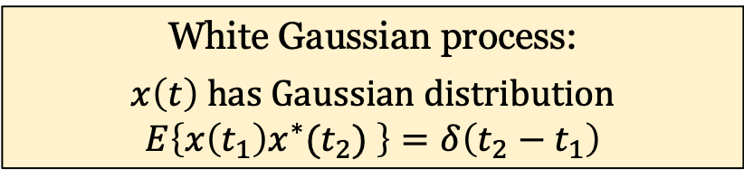

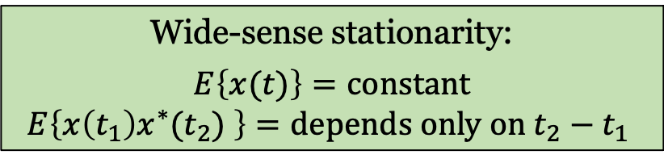


Random process
Sample space:$Ω_{s}$
Random continuous-time function
Create random vector by sampling
$$x=\left[\begin{matrix}x(t_{1}) \\ ⋮ \\ x\left(t_{M}\right)\end{matrix}\right]$$
$$ω_{2}$$
$$ω_{1}$$
$$X\left({t, ω}_{2}\right)$$
$$X\left({t, ω}_{1}\right)$$
$$t$$
$$t$$
Mean and covariance/correlation can be defined for arbitrary times
Wide-sense stationarity:
$$E\left\{x(t)\right\}=constant$$
$$E\left\{x\left(t_{1}\right)x^{∗}(t_{2}) \right\}=depends only on t_{2}−t_{1}$$
White Gaussian process:
$$x\left(t\right) has Gaussian distribution$$
$$E\left\{x\left(t_{1}\right)x^{∗}(t_{2}) \right\}=δ\left(t_{2}−t_{1}\right)$$

Slide 12
Summary
Scalars, vectors, and functions can be random
Useful to model
Signals with random data
Complicated communication channels
Thermal noise

Slide 13
Multiple Antenna Communications
Background Lecture:
Random Variables
Emil Björnson

