Slide 1
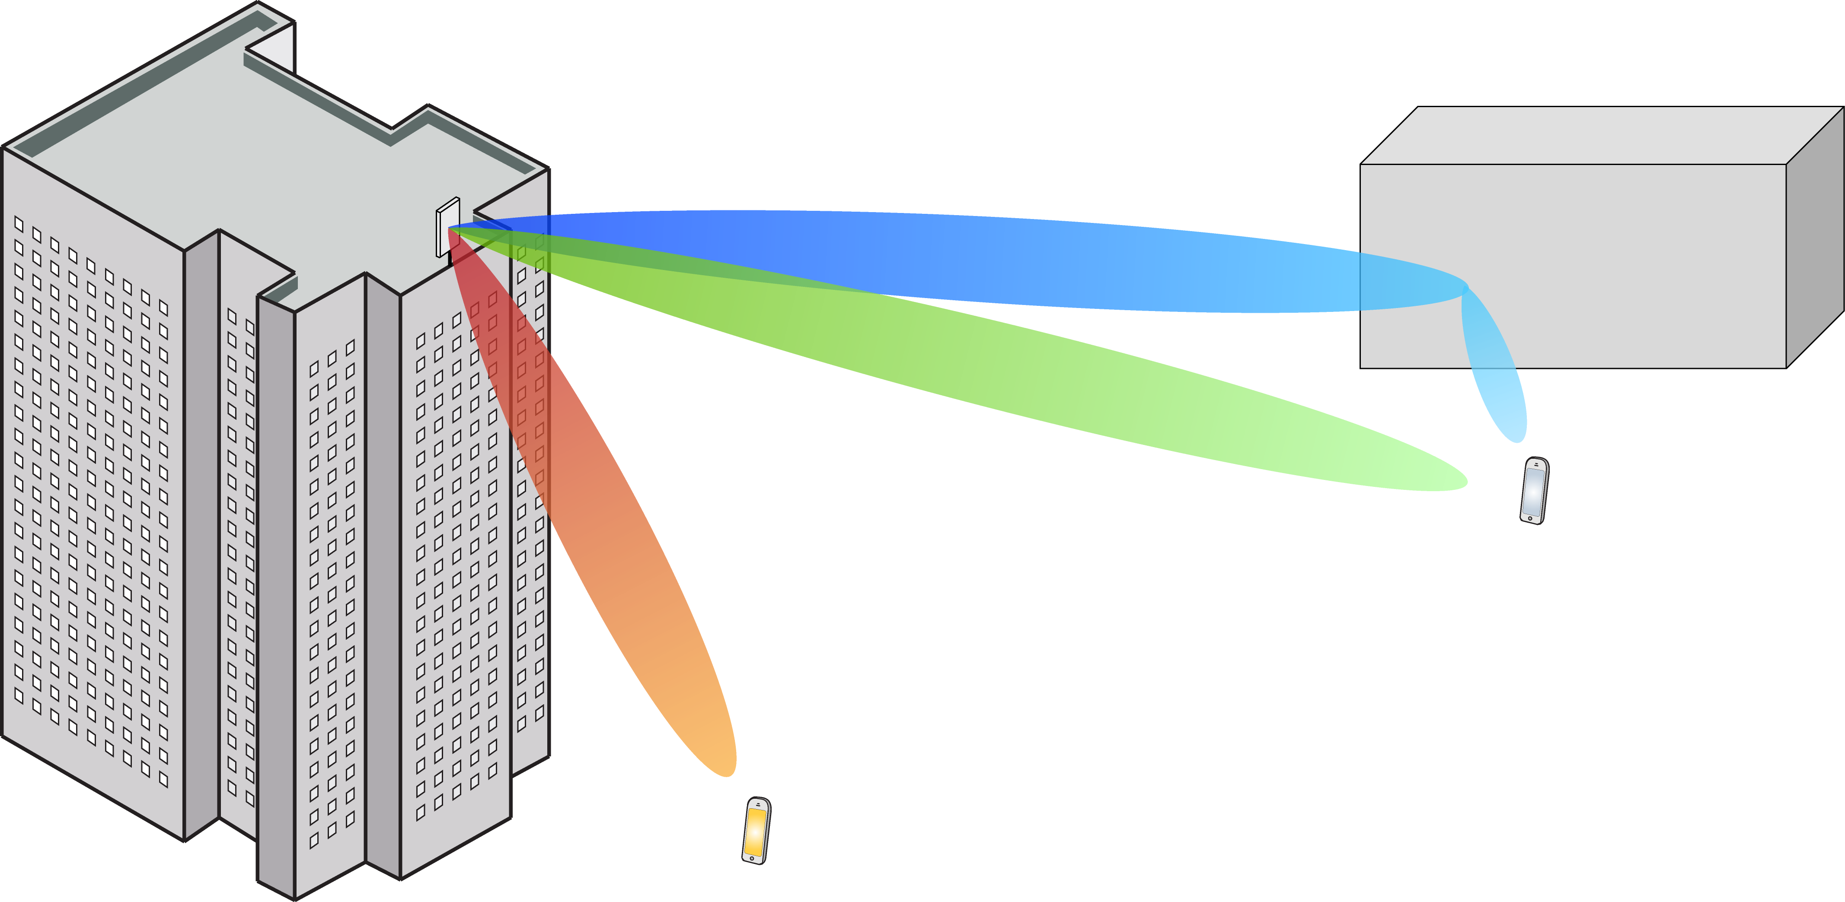
Multiple Antenna Communications
Background Lecture:
Information Theory and Capacity
Emil Björnson

Slide 2
Outline
Discrete memoryless channel
Performance metrics
Channel capacity
General formulation
Expression for discrete memoryless channel

Slide 3
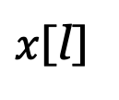
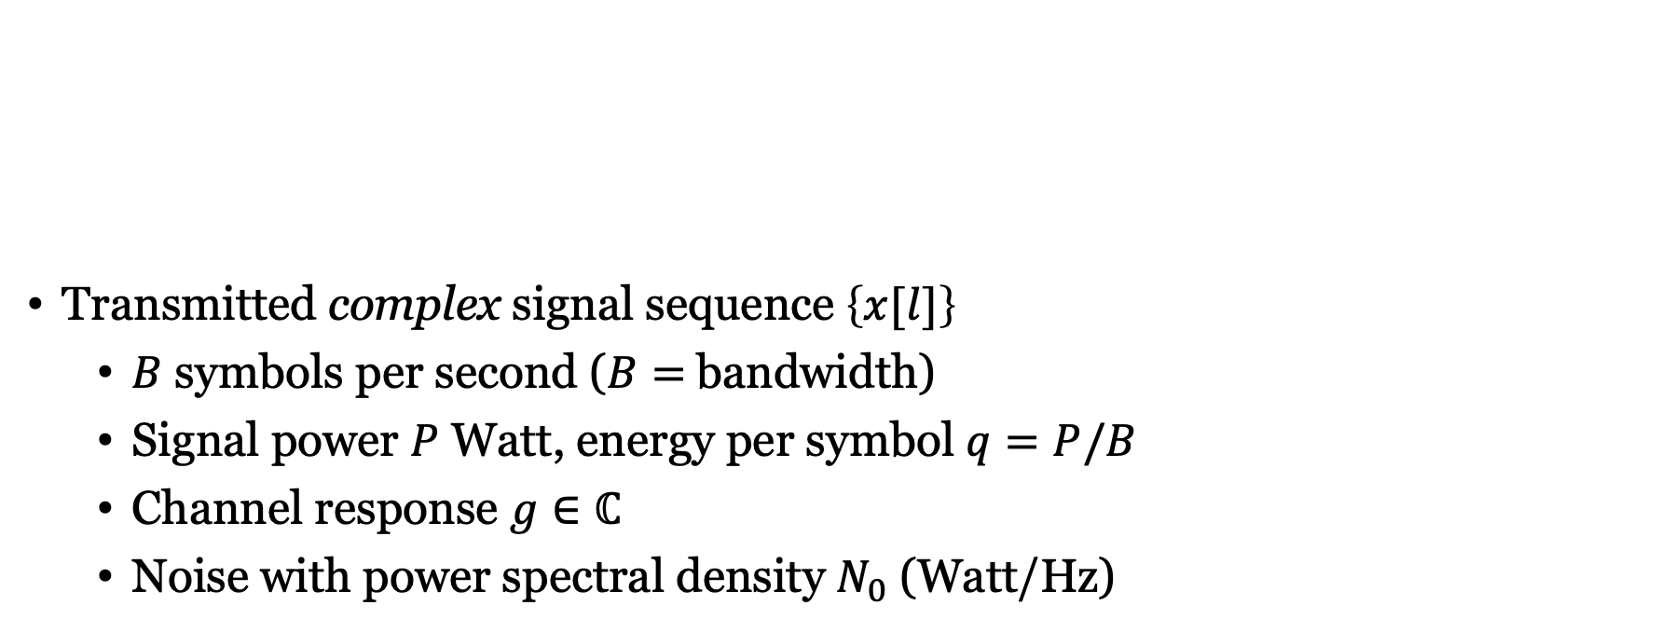



Discrete memoryless channel
$$n[l]∼CN(0,N_{0})$$
Transmitted complex signal sequence $\left\{x[l]\right\}$
$B$ symbols per second ($B=$bandwidth)
Signal power $P$ Watt, energy per symbol $q=P/B$
Channel response $g∈ℂ$
Noise with power spectral density $N_{0}$ (Watt/Hz)
$x$[l]
$$g$$
+
$$y[l]=g∙x[l]+n[l]$$

Slide 4
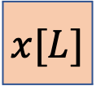
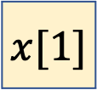

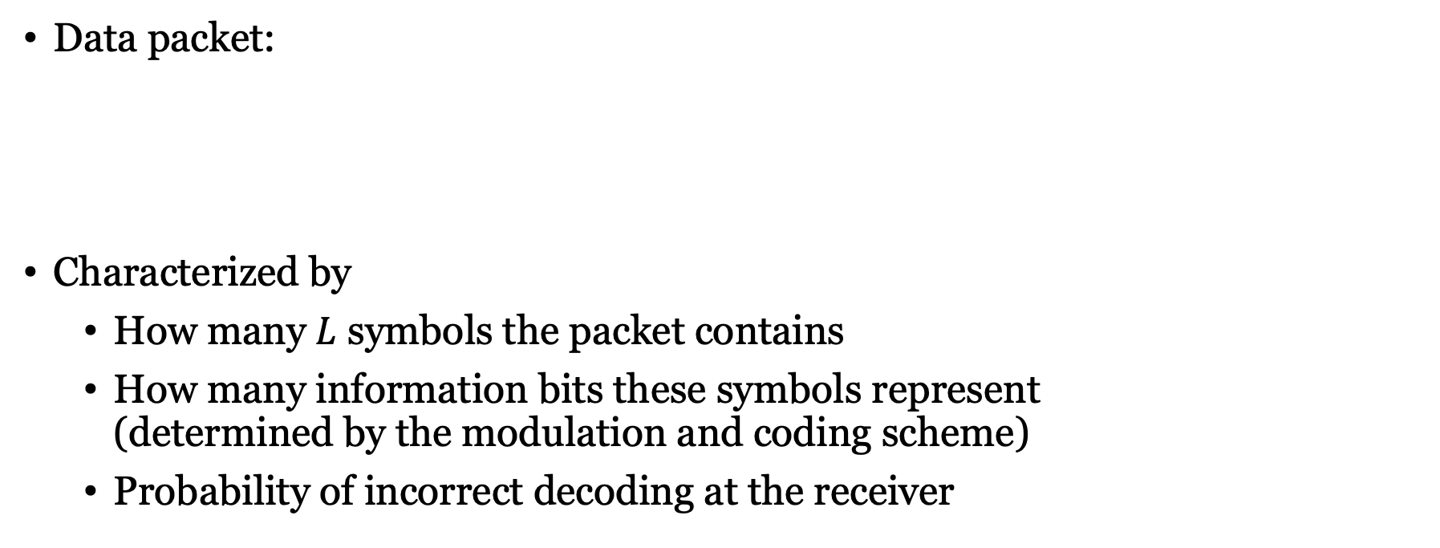
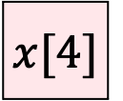
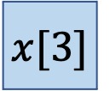
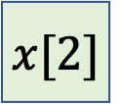
How to measure communication performance?
Data packet:
Characterized by
How many $L$ symbols the packet contains
How many information bits these symbols represent (determined by the modulation and coding scheme)
Probability of incorrect decoding at the receiver
$$x[1]$$
$$x[2]$$
$$x[3]$$
$$x[4]$$
$$…$$
$$x[L]$$

Slide 5

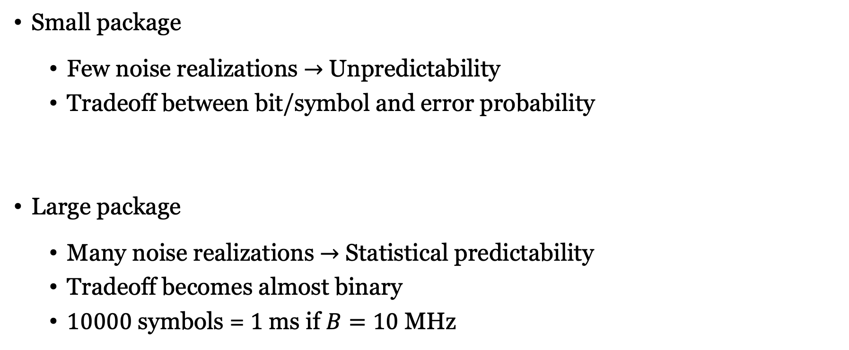
Small or large packages
$$x\left[1\right],…,x[8]$$
Few errors
Many errors
Small package
Few noise realizations $→$ Unpredictability
Tradeoff between bit/symbol and error probability
Large package
Many noise realizations $→$ Statistical predictability
Tradeoff becomes almost binary
$10000$ symbols = $1$ ms if $B=10$ MHz
Bit/symbol
$$x\left[1\right],…,x[10000]$$
Few
errors
Many
errors
Channel capacity
Bit/symbol

Slide 6


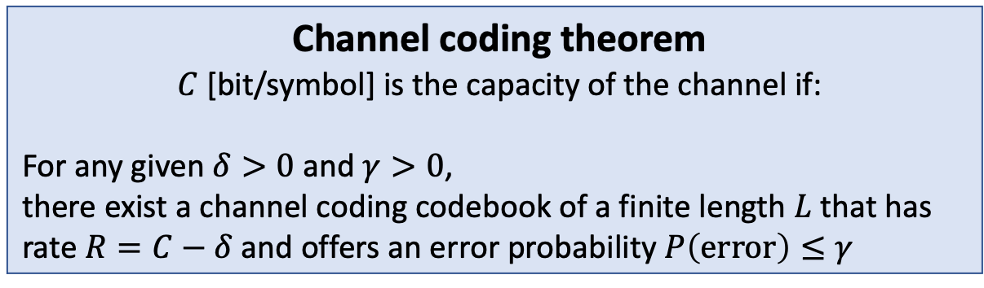


Channel capacity
Channel capacity
Random variables $X$ and $Y$
Channel described by conditional distribution
$$f_{Y|X}\left(y|x\right)$$
$$x$$
$$Channel$$
$$y$$
Channel coding theorem
$C$ [bit/symbol] is the capacity of the channel if:
For any given $δ>0$ and $γ>0$, there exist a channel coding codebook of a finite length $L$ that has rate $R=C−δ$and offers an error probability $P\left(error\right)≤γ$

Slide 7
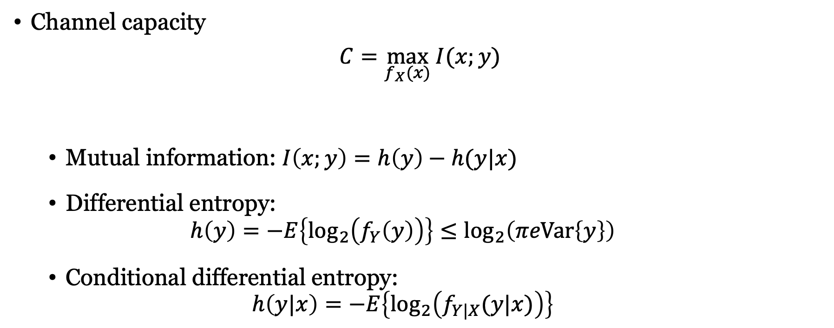
Capacity and mutual information
Channel capacity
$C=\max_{f_{X}(x)} I(x;y)$
Mutual information: $I\left(x;y\right)=h\left(y\right)−h(y|x)$
Differential entropy: $h\left(y\right)=−E\left\{\log_{2}\left(f_{Y}\left(y\right)\right)\right\}≤\log_{2}\left(πeVar\left\{y\right\}\right)$
Conditional differential entropy: $h\left(y|x\right)=−E\left\{\log_{2}\left(f_{Y|X}(y|x)\right)\right\}$
$$x$$
$$Channel$$
$$y$$
Equality if
Complex Gaussian

Slide 8
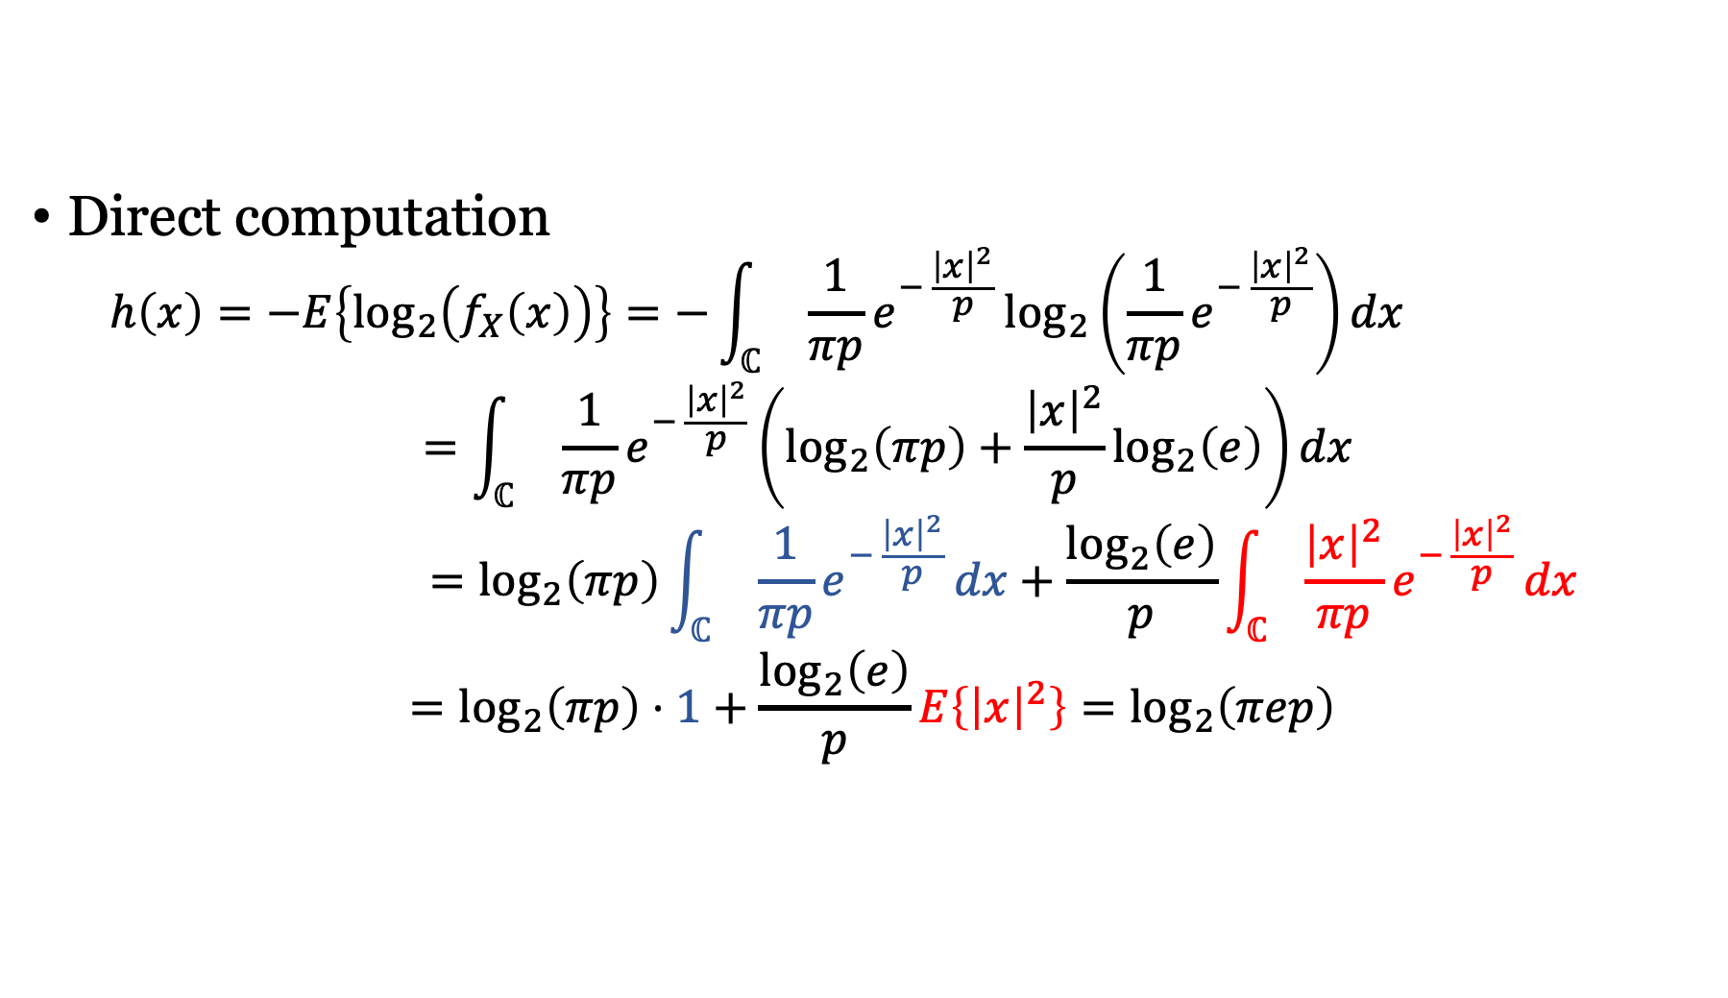
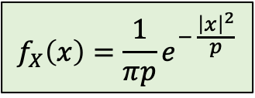
Differential entropy $h\left(x\right)$of $x∼CN(0,p)$
$$f_{X}\left(x\right)=\frac{1}{πp}e^{− \frac{{\left|x\right|}^{2}}{p}}$$
Direct computation
$$h\left(x\right)=−E\left\{\log_{2}\left(f_{X}\left(x\right)\right)\right\}=−\int_{ℂ}{ \frac{1}{πp}e^{− \frac{{\left|x\right|}^{2}}{p}}\log_{2}\left(\frac{1}{πp}e^{− \frac{{\left|x\right|}^{2}}{p}}\right)}dx$$
$$=\int_{ℂ}{ \frac{1}{πp}e^{− \frac{{\left|x\right|}^{2}}{p}}\left(\log_{2}\left(πp\right)+\frac{{\left|x\right|}^{2}}{p}\log_{2}\left(e\right)\right)}dx$$
$$=\log_{2}\left(πp\right)\int_{ℂ}{ \frac{1}{πp}e^{− \frac{{\left|x\right|}^{2}}{p}}}dx+\frac{\log_{2}\left(e\right)}{p}\int_{ℂ}{\frac{{\left|x\right|}^{2}}{πp}e^{− \frac{{\left|x\right|}^{2}}{p}}}dx$$
$$=\log_{2}\left(πp\right)⋅1+\frac{\log_{2}\left(e\right)}{p}E\left\{{\left|x\right|}^{2}\right\}=\log_{2}\left(πep\right)$$

Slide 9

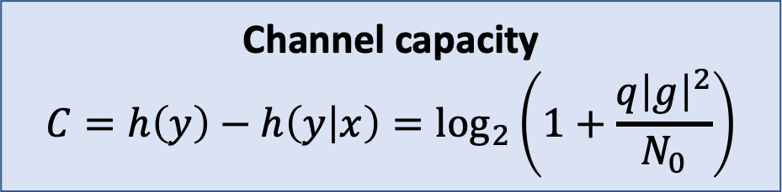
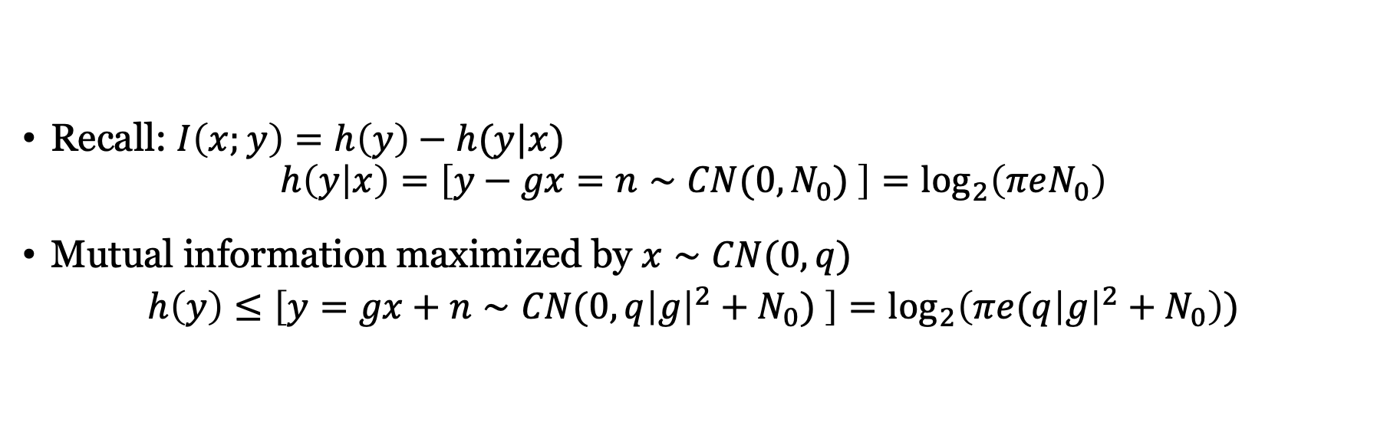



Capacity of complex discrete memoryless channel
$$n∼CN(0,N_{0})$$
Recall: $I\left(x;y\right)=h\left(y\right)−h(y|x)$
$$h\left(y | x\right)=\left[y−gx=n∼CN(0,N_{0}) \right]=\log_{2}\left(πeN_{0}\right)$$
Mutual information maximized by $x∼CN(0,q)$
$$h\left(y\right)≤\left[y=gx+n∼CN(0,q{\left|g\right|}^{2}+N_{0}) \right]=\log_{2}\left(πe(q{\left|g\right|}^{2}+N_{0}\right))$$
$$x$$
$$g$$
+
$$y=g∙x+n$$
Channel capacity
$$C=h\left(y\right)−h\left(y | x\right)=\log_{2}\left(1+\frac{q{\left|g\right|}^{2}}{N_{0}}\right)$$

Slide 10
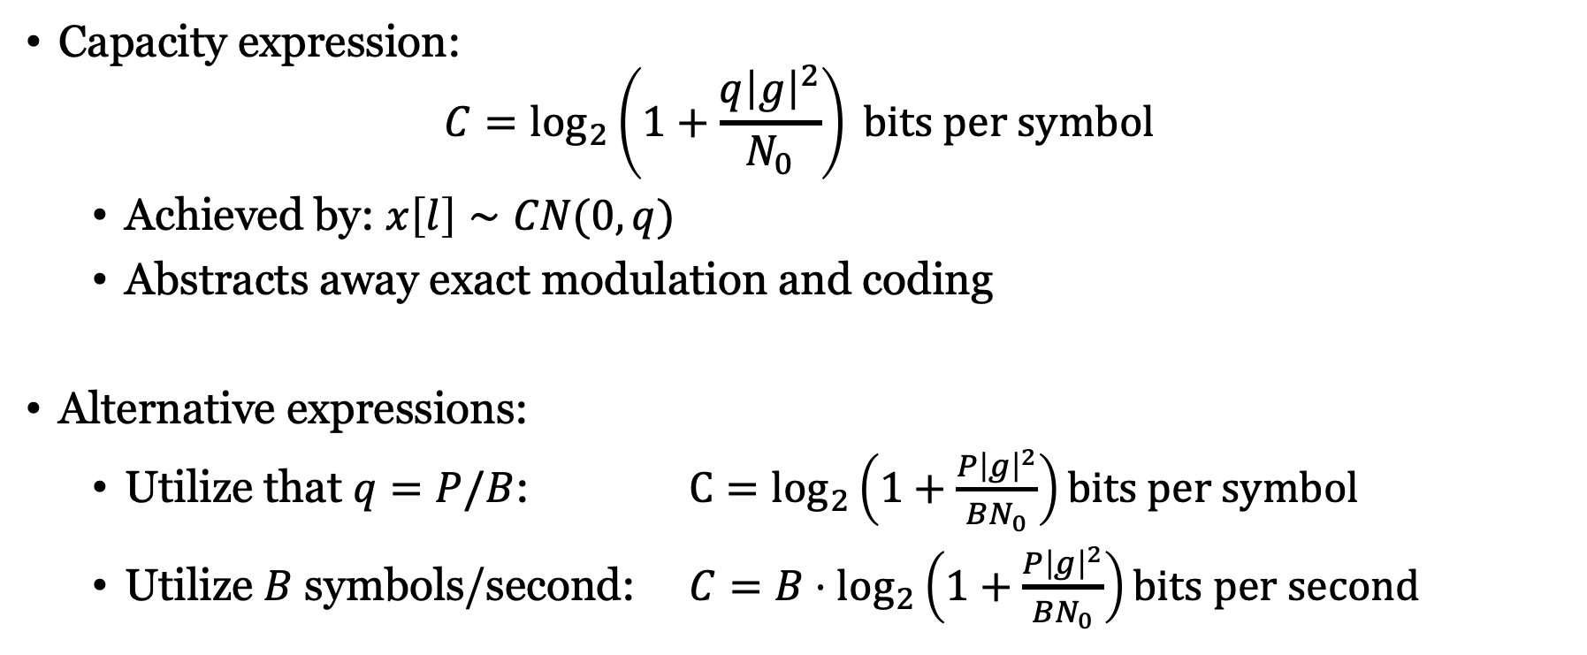
Different forms of same expression
Capacity expression:
$$C=\log_{2}\left(1+\frac{q{\left|g\right|}^{2}}{N_{0}}\right) bits per symbol$$
Achieved by: $x\left[l\right]∼CN(0,q)$
Abstracts away exact modulation and coding
Alternative expressions:
Utilize that $q=P/B$: ${C=log}_{2}\left(1+\frac{P{\left|g\right|}^{2}}{BN_{0}}\right)bits per symbol$
Utilize $B$ symbols/second: $C=B⋅\log_{2}\left(1+\frac{P{\left|g\right|}^{2}}{BN_{0}}\right)bits per second$

Slide 11
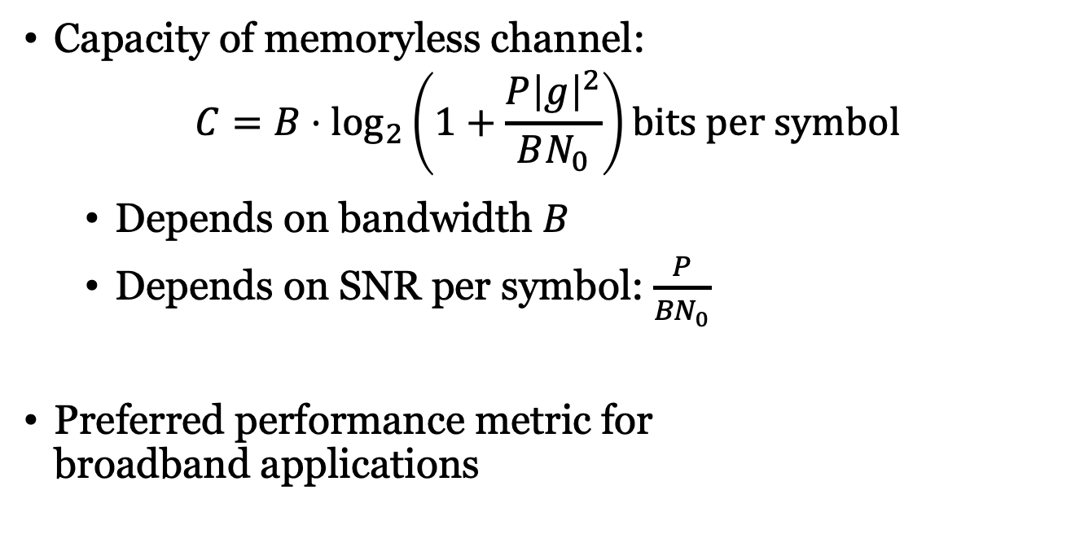
Summary
Capacity of memoryless channel:
$$C=B⋅\log_{2}\left(1+\frac{P{\left|g\right|}^{2}}{BN_{0}}\right)bits per symbol$$
Depends on bandwidth $B$
Depends on SNR per symbol: $\frac{P}{{BN}_{0}}$
Preferred performance metric for broadband applications

Slide 12
Multiple Antenna Communications
Background Lecture:
Information Theory and Capacity
Emil Björnson

