Slide 1
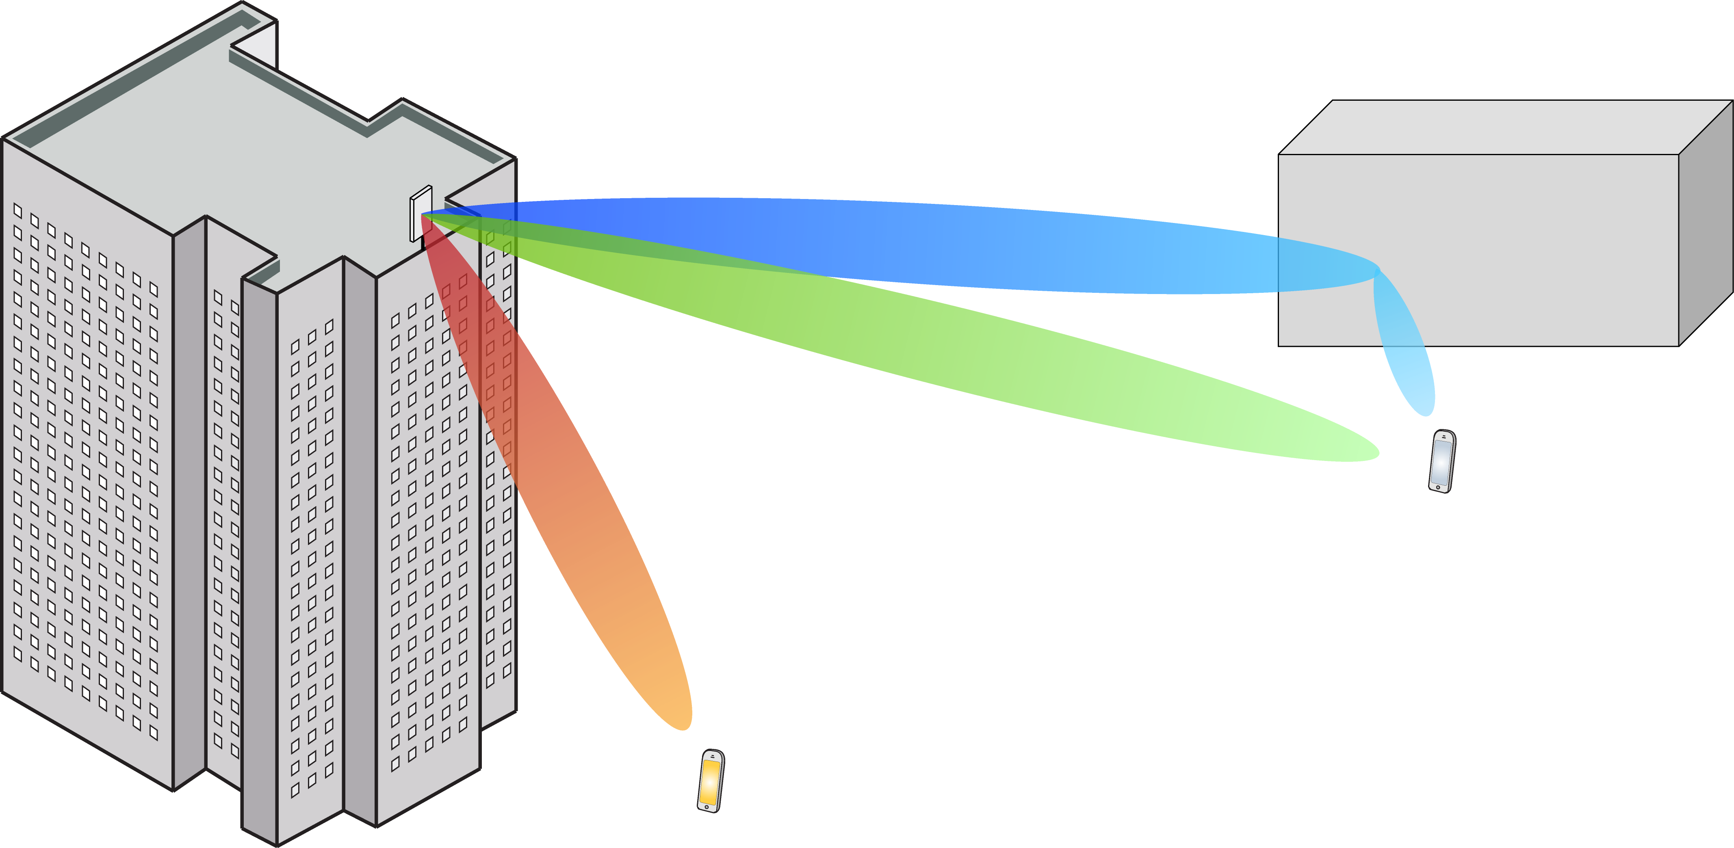
Multiple Antenna Communications
Background Lecture:
Estimation Theory
Emil Björnson

Slide 2
Outline
Principle of estimating an unknown variable
Minimum mean-squared error (MMSE) estimator
Estimate Gaussian variable in Gaussian noise

Slide 3
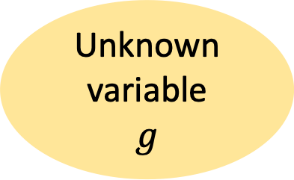
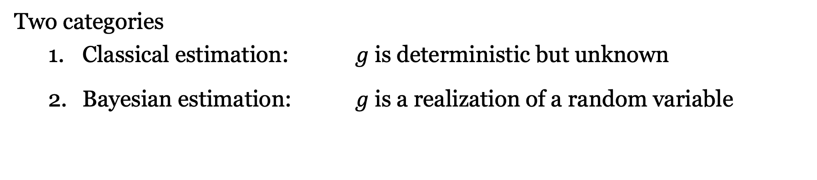
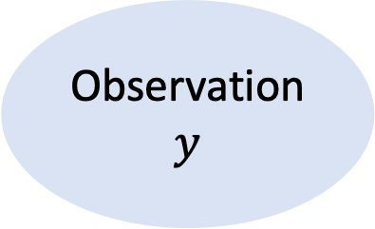
Estimating an Unknown Variable
Unknown variable
$$g$$
Observation
$$y$$
Connection
Two categories
Classical estimation: $g$ is deterministic but unknown
Bayesian estimation: $g$ is a realization of a random variable
Communication = transmission of long data packets
Easy to estimate deterministic variables
Challenging to estimate time-varying random variables

Slide 4
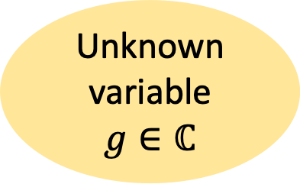
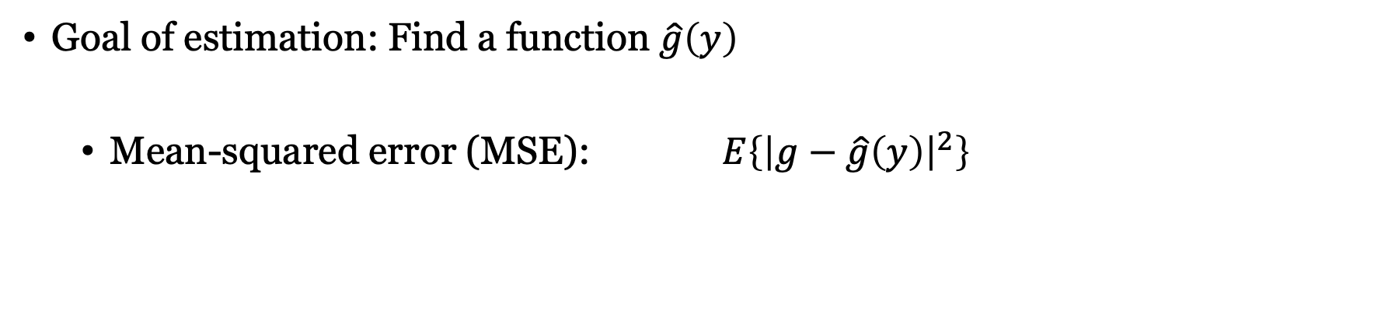
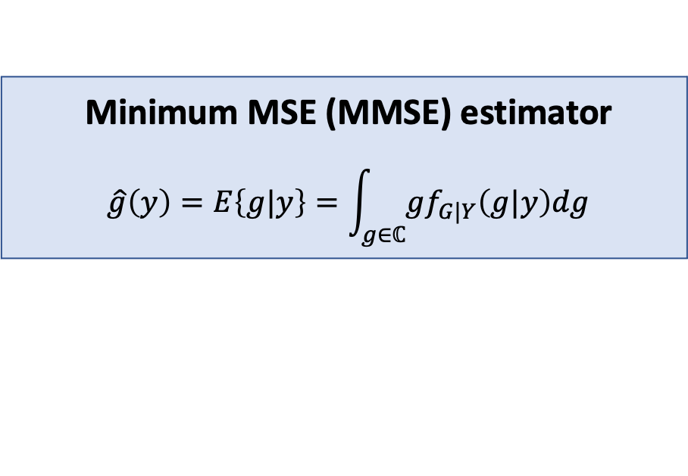

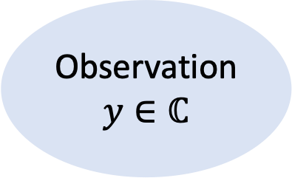
Principle of Bayesian estimation
Unknown variable
$$g∈ℂ$$
Observation
$$y∈ℂ$$
$$f_{G|Y}\left(g|y\right)$$
Goal of estimation: Find a function $\hat{g}\left(y\right)$
Mean-squared error (MSE): $E\left\{{\left|g−\hat{g}\left(y\right)\right|}^{2}\right\}$
Minimum MSE (MMSE) estimator
$$\hat{g}\left(y\right)=E\left\{g|y\right\}=\int_{g∈ℂ}{gf_{G|Y}\left(g|y\right)dg}$$

Slide 5
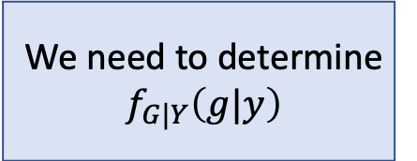
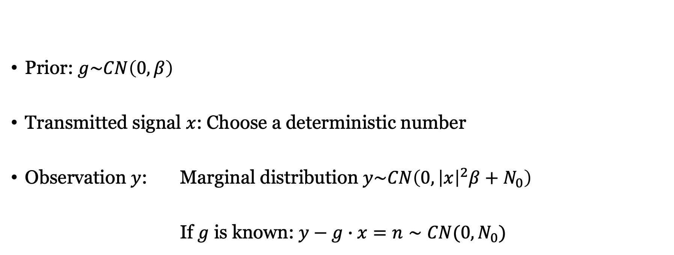




Example: Estimation of a channel
$$n∼CN(0,N_{0})$$
Prior: $g\sim CN\left(0,β\right)$
Transmitted signal $x$: Choose a deterministic number
Observation $y$: Marginal distribution $y\sim CN\left(0,{\left|x\right|}^{2}β+N_{0}\right)$
If $g$ is known: $y−g∙x=n∼CN(0,N_{0})$
$$x$$
$$g$$
+
$$y=g∙x+n$$
Called: pilot signal
We need to determine $f_{G|Y}\left(g|y\right)$

Slide 6
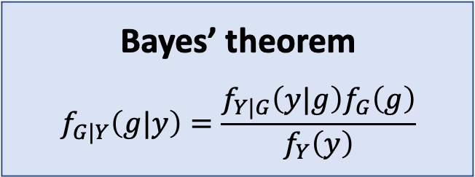
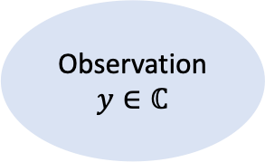
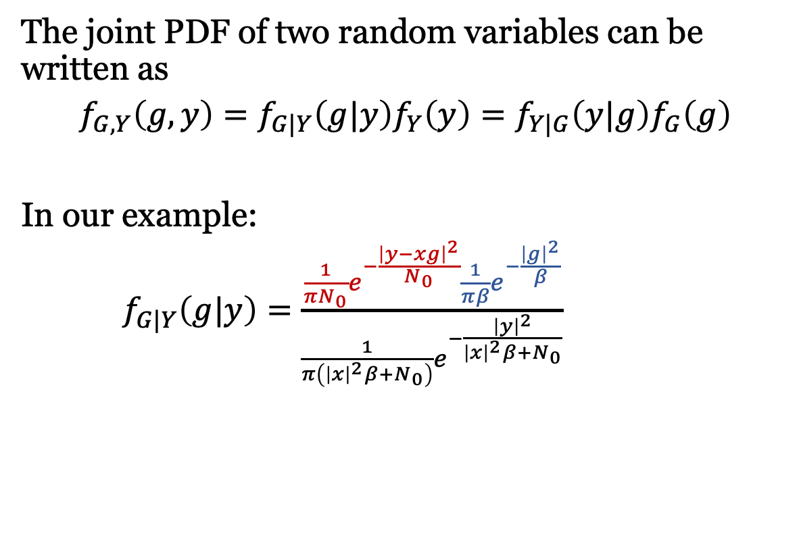
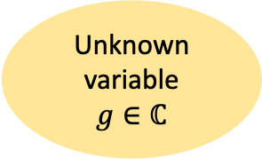
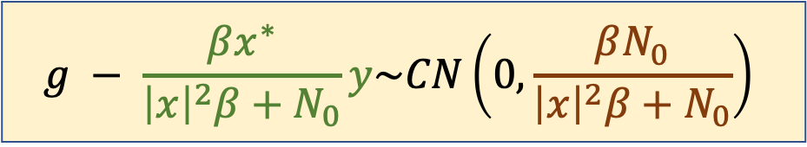
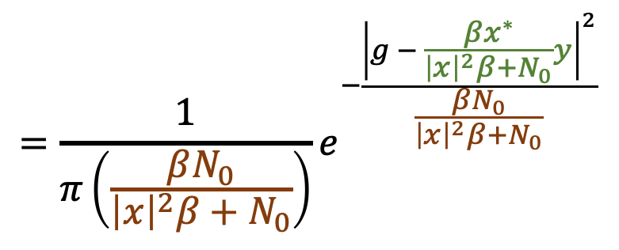
Finding the conditional PDF
Unknown variable
$$g∈ℂ$$
Observation
$$y∈ℂ$$
Connection
The joint PDF of two random variables can be written as
$$f_{G,Y}\left(g,y\right)=f_{G|Y}\left(g|y\right)f_{Y}\left(y\right)=f_{Y|G}\left(y|g\right)f_{G}\left(g\right)$$
In our example:
$f_{G|Y}\left(g|y\right)=\frac{\frac{1}{πN_{0}}e^{−\frac{{\left|y−xg\right|}^{2}}{N_{0}}}\frac{1}{πβ}e^{−\frac{{\left|g\right|}^{2}}{β}}}{\frac{1}{π\left({\left|x\right|}^{2}β+N_{0}\right)}e^{−\frac{{\left|y\right|}^{2}}{{\left|x\right|}^{2}β+N_{0}}}}$
Bayes’ theorem
$$f_{G|Y}\left(g|y\right)=\frac{f_{Y|G}\left(y|g\right)f_{G}\left(g\right)}{f_{Y}\left(y\right)}$$
$$=\frac{1}{π\left(\frac{βN_{0}}{{\left|x\right|}^{2}β+N_{0}}\right)}e^{−\frac{{\left|g − \frac{βx^{∗}}{{\left|x\right|}^{2}β+N_{0}}y\right|}^{2}}{\frac{βN_{0}}{{\left|x\right|}^{2}β+N_{0}}}}$$
$$g − \frac{βx^{∗}}{{\left|x\right|}^{2}β+N_{0}}y\sim CN\left(0,\frac{βN_{0}}{{\left|x\right|}^{2}β+N_{0}}\right)$$

Slide 7
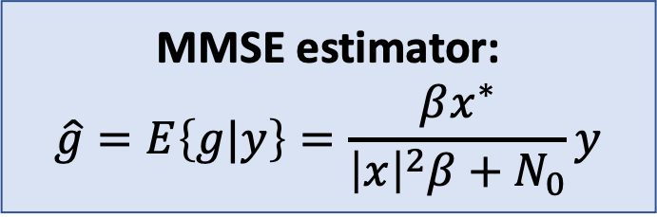


MMSE estimate of Gaussian variable in Gaussian noise
Consider $y=g∙x+n$ where
$x$ is a constant, $g∼CN\left(0,β\right), n∼CN\left(0,N_{0}\right)$
MMSE estimator:
$$\hat{g}=E\left\{g|y\right\}=\frac{βx^{∗}}{{\left|x\right|}^{2}β+N_{0}}y$$
Resulting MSE:
$$E\left\{{\left|\hat{g}−g\right|}^{2}\right\}=\frac{βN_{0}}{{\left|x\right|}^{2}β+N_{0}}$$
$$g − \frac{βx^{∗}}{{\left|x\right|}^{2}β+N_{0}}y\sim CN\left(0,\frac{βN_{0}}{{\left|x\right|}^{2}β+N_{0}}\right)$$

Slide 8
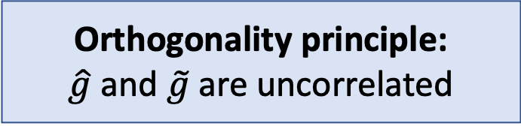
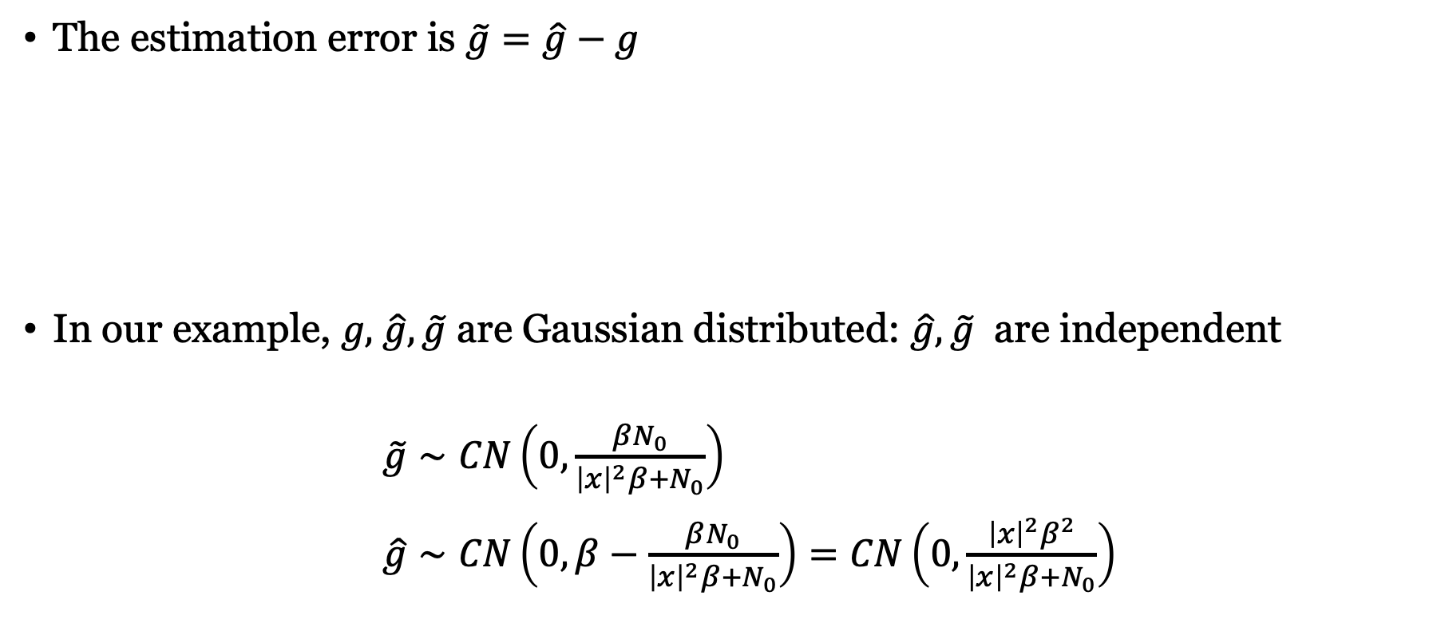
Estimation error and its random distribution
The estimation error is $\tilde{g}=\hat{g}−g$
In our example, $g\text{, }\hat{g},\tilde{g}$ are Gaussian distributed: $\hat{g},\tilde{g}$ are independent
$\tilde{g}∼CN\left(0,\frac{βN_{0}}{{\left|x\right|}^{2}β+N_{0}}\right)$
$\hat{g}∼CN\left(0,β−\frac{βN_{0}}{{\left|x\right|}^{2}β+N_{0}}\right)=CN\left(0,\frac{{\left|x\right|}^{2}β^{2}}{{\left|x\right|}^{2}β+N_{0}}\right)$
Orthogonality principle:
$$\hat{g} \text{and} \tilde{g} \text{are} \text{uncorrelated}$$
MSE

Slide 9
Summary
Estimate realizations of random variables
Based on observation and statistics
MMSE estimator minimizes MSE
Example of channel estimation
Transmit known signal
Scale the received signal correctly

Slide 10
Multiple Antenna Communications
Background Lecture:
Estimation Theory
Emil Björnson

