Slide 1
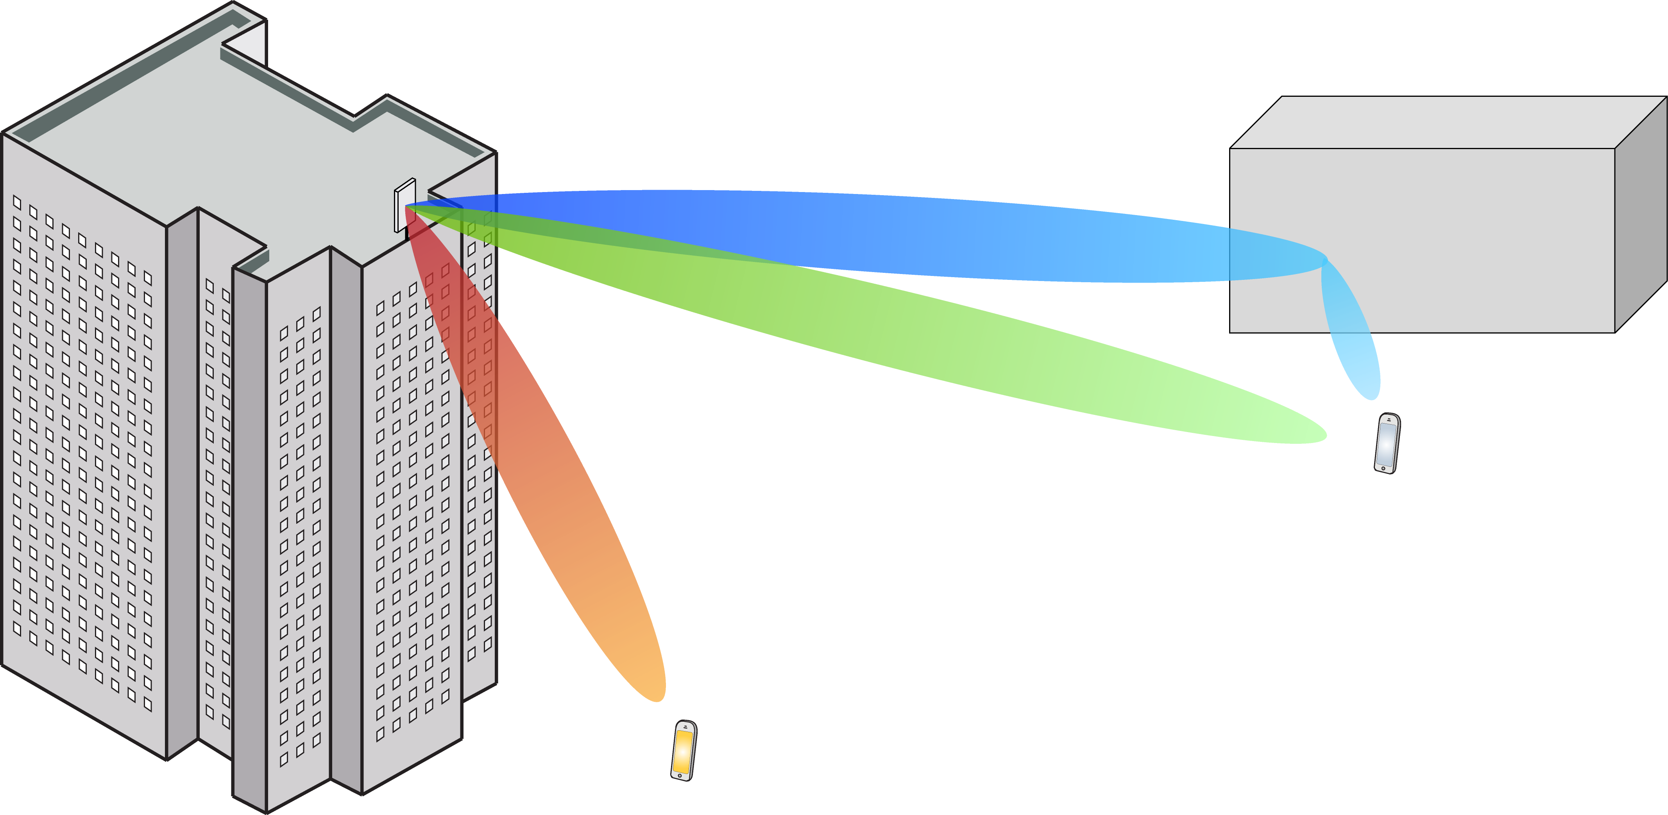
Multiple Antenna Communications
Background Lecture:
Channel Capacity Bounds
Emil Björnson

Slide 2
Outline
Hard to compute channel capacity
With non-Gaussian noise
With incomplete channel knowledge
Capacity lower bounds
Technical assumptions
Proof techniques

Slide 3
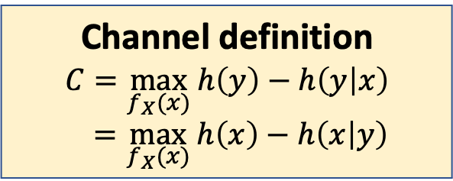
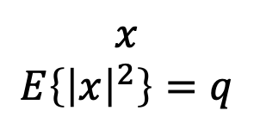
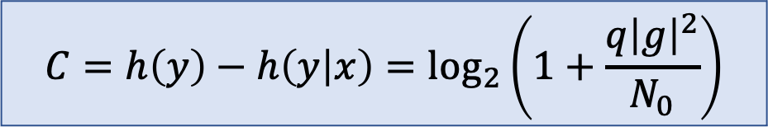
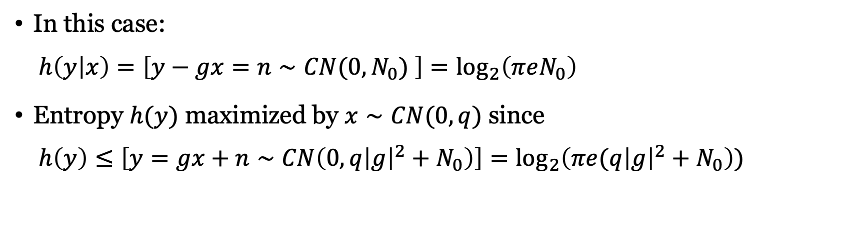



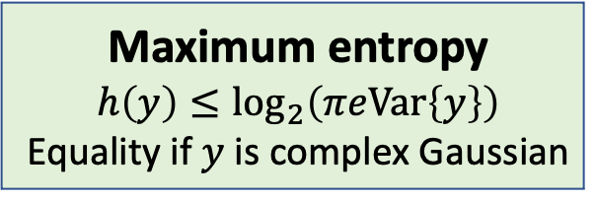
Recall: Capacity of complex discrete memoryless channel
$$n∼CN(0,N_{0})$$
Channel definition
$$C=\max_{f_{X}(x)} h\left(y\right)−h\left(y | x\right)$$
$$=\max_{f_{X}(x)} h\left(x\right)−h\left(x | y\right)$$
$$x$$
$$E\left\{{\left|x\right|}^{2}\right\}=q$$
$$g$$
+
$$y=g∙x+n$$
Maximum entropy
$$h\left(y\right)≤\log_{2}\left(πeVar\left\{y\right\}\right)$$
Equality if $y$ is complex Gaussian
In this case:
$h\left(y | x\right)=\left[y−gx=n∼CN(0,N_{0}) \right]=\log_{2}\left(πeN_{0}\right)$
Entropy $h(y)$ maximized by $x∼CN(0,q)$ since
$h\left(y\right)≤\left[y=gx+n∼CN\left(0,q{\left|g\right|}^{2}+N_{0}\right)\right]=\log_{2}\left(πe(q{\left|g\right|}^{2}+N_{0}\right))$
$$C=h\left(y\right)−h\left(y | x\right)=\log_{2}\left(1+\frac{q{\left|g\right|}^{2}}{N_{0}}\right)$$

Slide 4
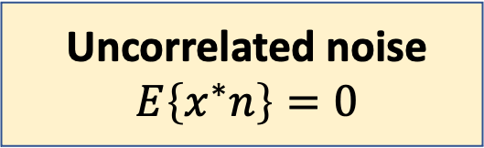
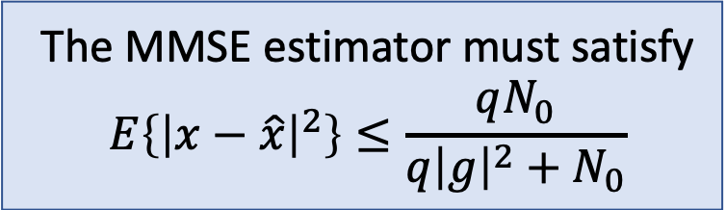
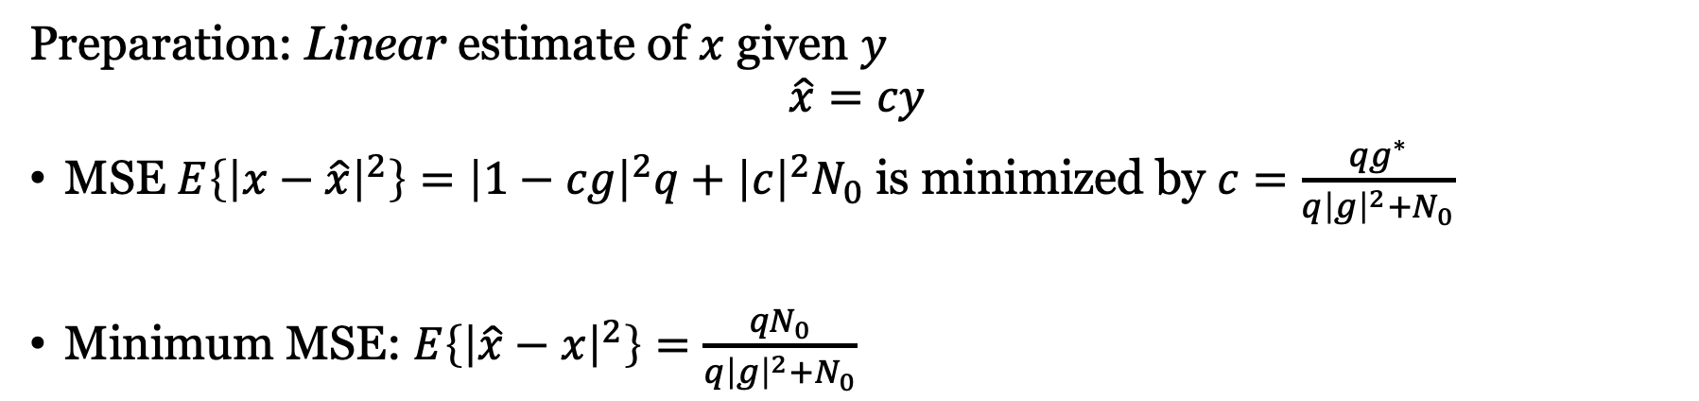

What if the noise is not Gaussian and only uncorrelated?
$$n:E\left\{n\right\}=0, Var\left\{n\right\}=N_{0}$$
Uncorrelated noise
$$E\left\{x^{∗}n\right\}=0$$
$$x$$
$$E\left\{{\left|x\right|}^{2}\right\}=q$$
$$g$$
+
$$y=g∙x+n$$
Preparation: Linear estimate of $x$ given $y$
$$\hat{x}=cy$$
MSE $E\left\{{\left|x−\hat{x}\right|}^{2}\right\}={\left|1−cg\right|}^{2}q+{\left|c\right|}^{2}N_{0}$ is minimized by $c=\frac{{qg}^{∗}}{{q\left|g\right|}^{2}+N_{0}}$
Minimum MSE: $E\left\{{\left|\hat{x}−x\right|}^{2}\right\}=\frac{{qN}_{0}}{q{\left|g\right|}^{2}+N_{0}}$
The MMSE estimator must satisfy
$$E\left\{{\left|x−\hat{x}\right|}^{2}\right\}≤\frac{qN_{0}}{{q\left|g\right|}^{2}+N_{0}}$$

Slide 5
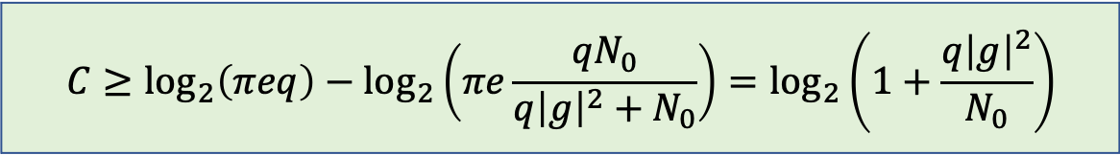
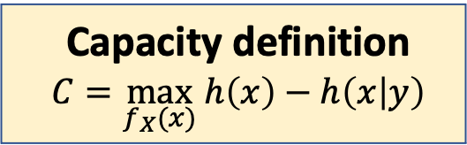
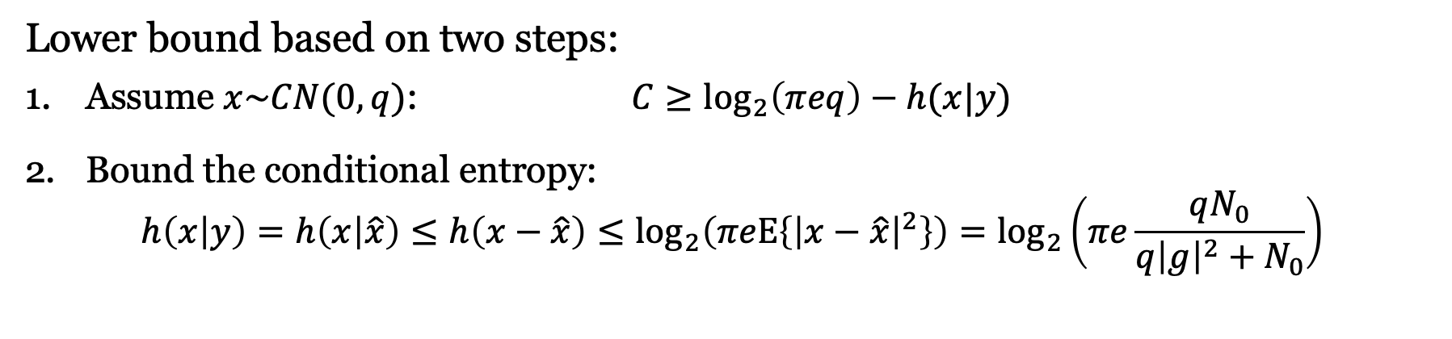

Bound on capacity with arbitrary uncorrelated noise
$$n:E\left\{n\right\}=0, Var\left\{n\right\}=N_{0}$$
Capacity definition
$$C=\max_{f_{X}(x)} h\left(x\right)−h\left(x | y\right)$$
$$x$$
$$E\left\{{\left|x\right|}^{2}\right\}=q$$
$$g$$
+
$$y=g∙x+n$$
Lower bound based on two steps:
Assume $x\sim CN(0,q)$: $C≥\log_{2}\left(πeq\right)−h(x|y)$
Bound the conditional entropy:
$$h\left(x | y\right)=h\left(x | \hat{x}\right)≤h\left(x−\hat{x}\right)≤\log_{2}\left(πeE\left\{{\left|x−\hat{x}\right|}^{2}\right\}\right)=\log_{2}\left(πe\frac{qN_{0}}{{q\left|g\right|}^{2}+N_{0}}\right)$$
$$C≥\log_{2}\left(πeq\right)−\log_{2}\left(πe\frac{qN_{0}}{{q\left|g\right|}^{2}+N_{0}}\right)=\log_{2}\left(1+\frac{q{\left|g\right|}^{2}}{N_{0}}\right)$$

Slide 6
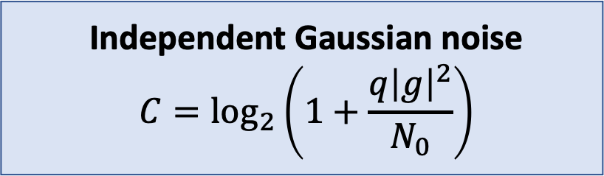
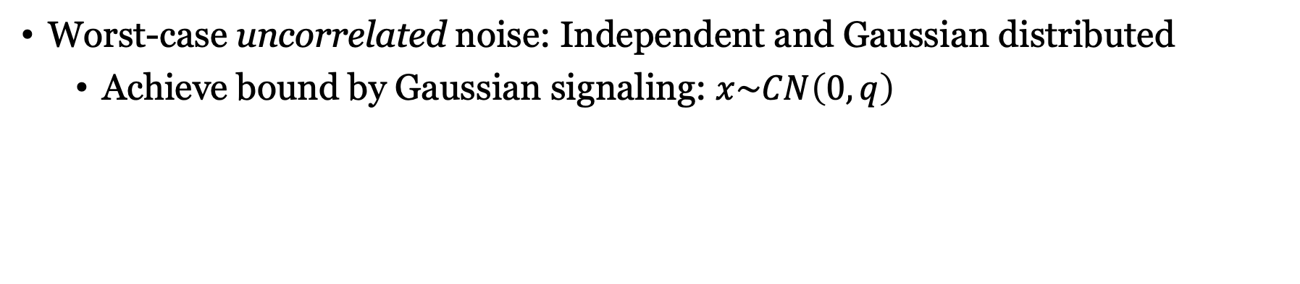
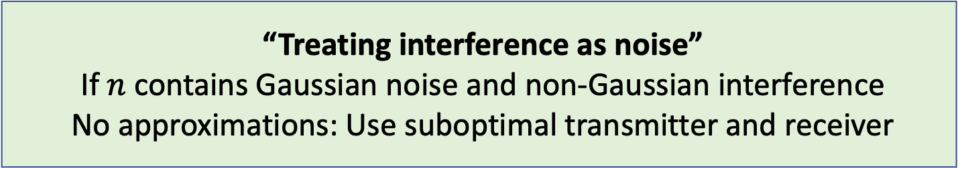
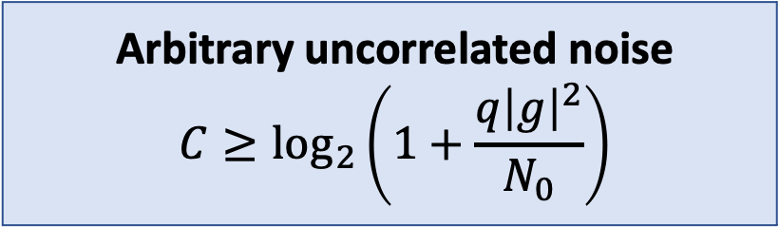
Gaussian versus arbitrary noise
Independent Gaussian noise
$$C=\log_{2}\left(1+\frac{q{\left|g\right|}^{2}}{N_{0}}\right)$$
Arbitrary uncorrelated noise
$$C≥\log_{2}\left(1+\frac{q{\left|g\right|}^{2}}{N_{0}}\right)$$
Worst-case uncorrelated noise: Independent and Gaussian distributed
Achieve bound by Gaussian signaling: $x\sim CN\left(0,q\right)$
“Treating interference as noise”
If $n$ contains Gaussian noise and non-Gaussian interference
No approximations: Use suboptimal transmitter and receiver

Slide 7
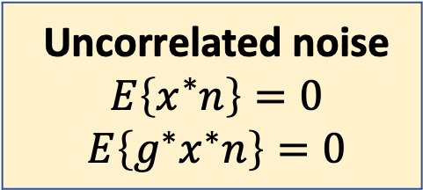
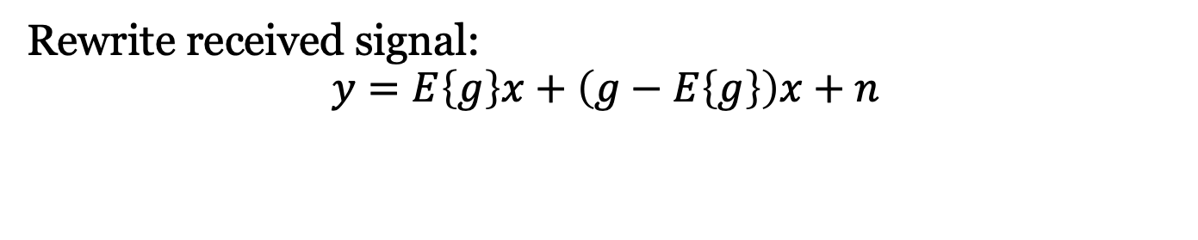
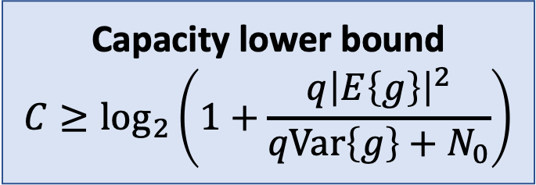
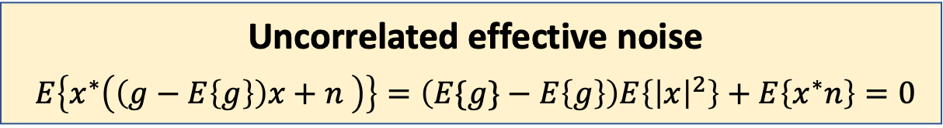
Fast-fading channel without channel knowledge
$$n:E\left\{n\right\}=0, Var\left\{n\right\}=N_{0}$$
Uncorrelated noise
$$E\left\{x^{∗}n\right\}=0$$
$$E\left\{{g^{∗}x}^{∗}n\right\}=0$$
$$x$$
$$E\left\{{\left|x\right|}^{2}\right\}=q$$
$$g$$
+
$$y=g∙x+n$$
New realization of $g$ for every transmission: Independent of $x$
Rewrite received signal:
$$y=E\left\{g\right\}x+\left(g−E\left\{g\right\}\right)x+n$$
Effective channel
Effective noise
Capacity lower bound
$$C≥\log_{2}\left(1+\frac{q{\left|E\left\{g\right\}\right|}^{2}}{qVar\left\{g\right\}+N_{0}}\right)$$
Uncorrelated effective noise
$$E\left\{x^{∗}\left(\left(g−E\left\{g\right\}\right)x+n \right)\right\}=\left(E\{g\}−E\left\{g\right\}\right)E\left\{{\left|x\right|}^{2}\right\}+E\left\{x^{∗}n\right\}=0$$

Slide 8

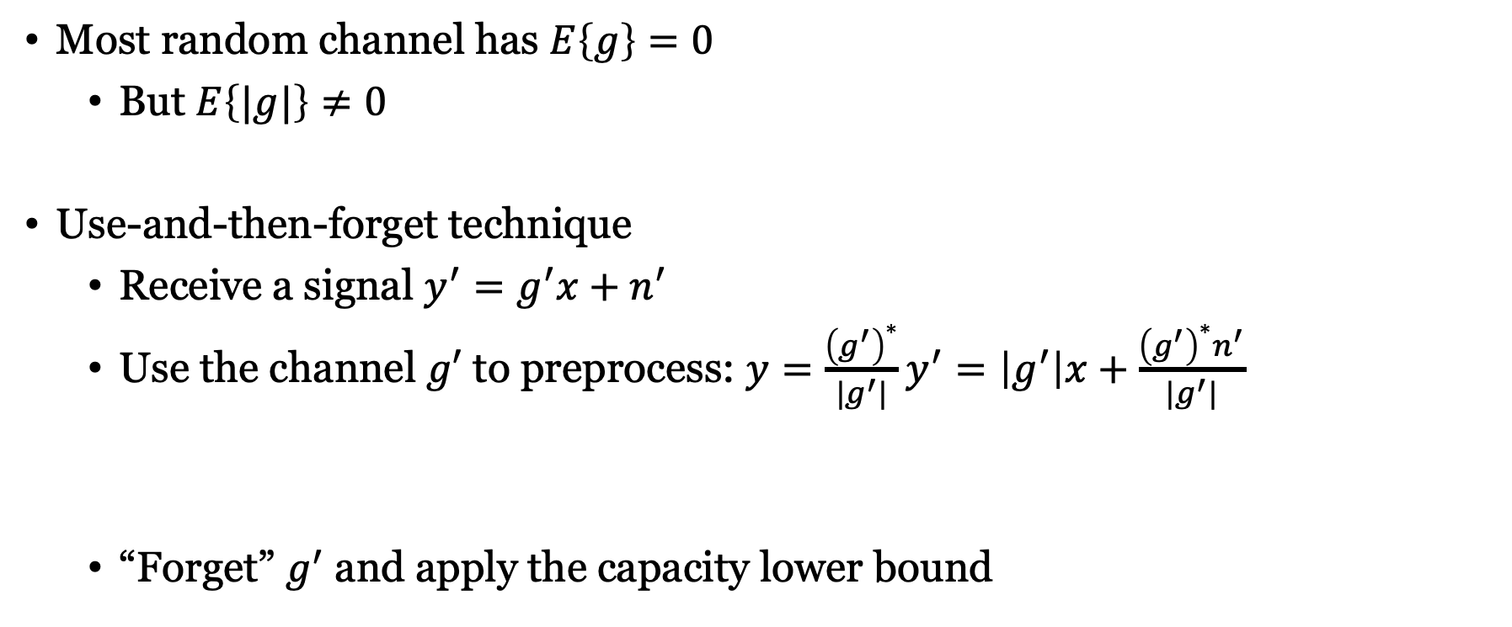


Will the channel have non-zero mean?
Most random channel has $E\left\{g\right\}=0$
But $E\left\{|g|\right\}≠0$
Use-and-then-forget technique
Receive a signal $y^{′}=g^{′}x+n^{′}$
Use the channel $g′$ to preprocess: $y=\frac{{\left(g^{′}\right)}^{∗}}{|g^{′}|}y^{′}=\left|g^{′}\right|x+\frac{{\left(g^{′}\right)}^{∗}n^{′}}{|g^{′}|}$
“Forget” $g^{′}$ and apply the capacity lower bound
Capacity lower bound
$$C≥\log_{2}\left(1+\frac{q{\left|E\left\{g\right\}\right|}^{2}}{qVar\left\{g\right\}+N_{0}}\right)$$
$$g$$
$$n$$

Slide 9



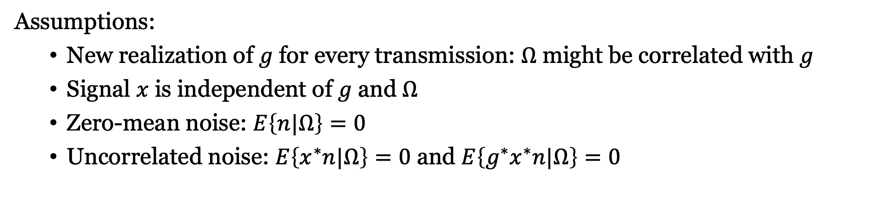

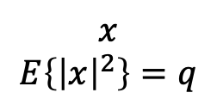

Fast-fading with partial channel knowledge
$$n$$
Channel side information $Ω$
$$x$$
$$E\left\{{\left|x\right|}^{2}\right\}=q$$
$$g$$
+
Receiver
$$\hat{x}$$
$$y=g∙x+n$$
Assumptions:
New realization of $g$ for every transmission: $Ω$ might be correlated with $g$
Signal $x$ is independent of $g$ and $Ω$
Zero-mean noise: $E\left\{n|Ω\right\}=0$
Uncorrelated noise: $E\left\{x^{∗}n|Ω\right\}=0$ and $E\left\{g^{∗}x^{∗}n|Ω\right\}=0$

Slide 10



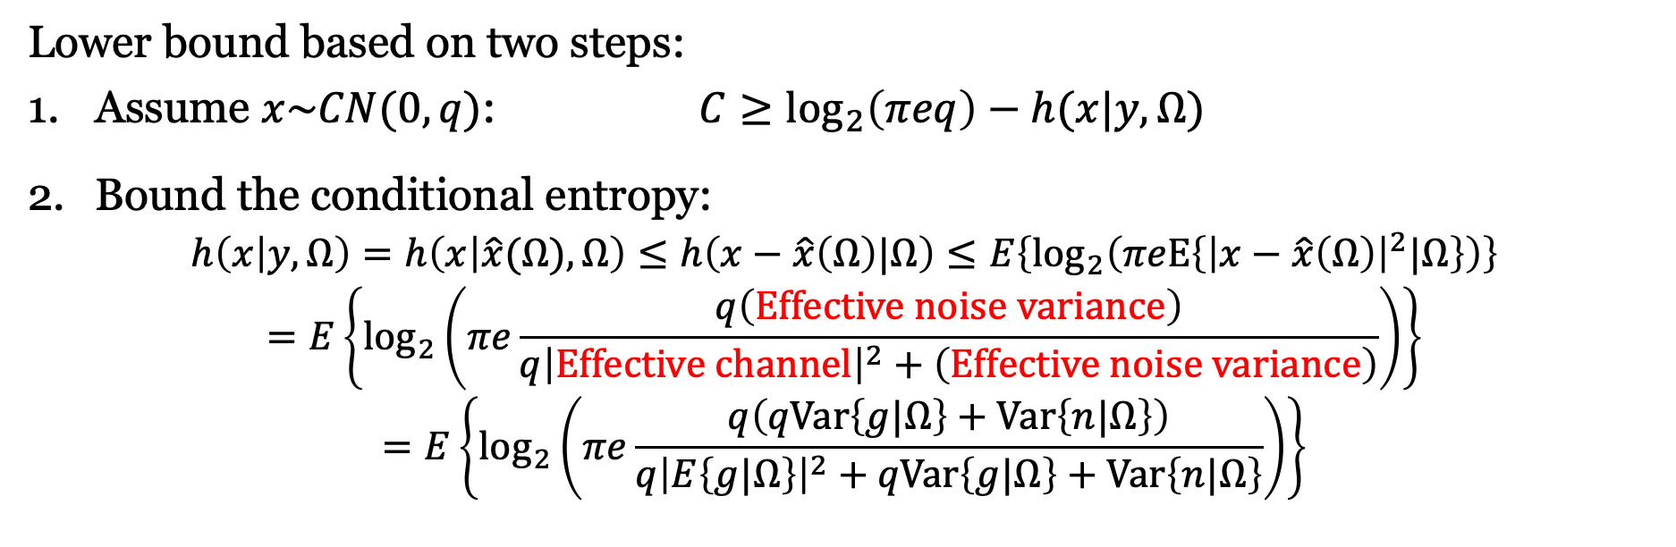

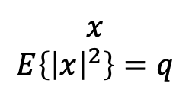

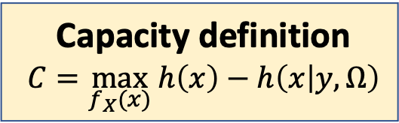
Computing a capacity lower bound with side information
$$n$$
Channel side information $Ω$
Capacity definition
$$C=\max_{f_{X}(x)} h\left(x\right)−h\left(x | y,Ω\right)$$
$$x$$
$$E\left\{{\left|x\right|}^{2}\right\}=q$$
$$g$$
+
Receiver
$$\hat{x}$$
$$y=g∙x+n$$
Lower bound based on two steps:
Assume $x\sim CN(0,q)$: $C≥\log_{2}\left(πeq\right)−h(x|y,Ω)$
Bound the conditional entropy:
$$h\left(x | y,Ω\right)=h\left(x | \hat{x}(Ω),Ω\right)≤h\left(x−\hat{x}\left(Ω\right)|Ω\right)≤E\left\{\log_{2}\left(πeE\left\{{\left|x−\hat{x}\left(Ω\right)\right|}^{2}|Ω\right\}\right)\right\}$$
$$=E\left\{\log_{2}\left(πe\frac{q\left(Effective noise variance\right)}{{q\left|Effective channel\right|}^{2}+\left(Effective noise variance\right)}\right)\right\}$$
$$=E\left\{\log_{2}\left(πe\frac{q\left(qVar\left\{g|Ω\right\}+Var\left\{n|Ω\right\}\right)}{{q\left|E\left\{g|Ω\right\}\right|}^{2}+qVar\left\{g|Ω\right\}+Var\left\{n|Ω\right\}}\right)\right\}$$

Slide 11



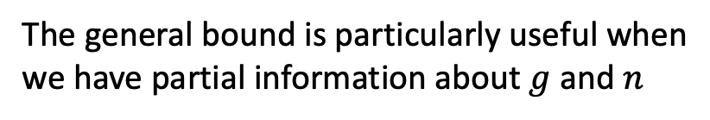

Finalizing the capacity bound with side information
$$C≥\log_{2}\left(πeq\right)−E\left\{\log_{2}\left(πe\frac{q\left(qVar\left\{g|Ω\right\}+Var\left\{n|Ω\right\}\right)}{q{\left|E\left\{g|Ω\right\}\right|}^{2}+qVar\left\{g|Ω\right\}+Var\left\{n|Ω\right\}}\right)\right\}$$
$$=E\left\{\log_{2}\left(1+\frac{q{\left|E\left\{g|Ω\right\}\right|}^{2}}{qVar\left\{g|Ω\right\}+Var\left\{n|Ω\right\}}\right)\right\}$$
Bound achieved by
$$x\sim CN(0,q)$$
Example:
Perfect knowledge, $Ω=g$
Uncorrelated noise, $Var\left\{n\right\}=N_{0}$
$$C≥E\left\{\log_{2}\left(1+\frac{{q\left|g\right|}^{2}}{N_{0}}\right)\right\}$$
Example:
No knowledge, $Ω=∅$
$$C≥\log_{2}\left(1+\frac{q{\left|E\left\{g\right\}\right|}^{2}}{qVar\left\{g\right\}+Var\left\{n\right\}}\right)$$
The general bound is particularly useful when
we have partial information about $g$ and $n$

Slide 12
Summary
Achievable rate / spectral efficiency
Lower bound on channel capacity
Handle uncorrelated noise and interference
Handle partial channel knowledge
Technical conditions must be satisfied
Not always the case for the capacity bound with side information

Slide 13
Multiple Antenna Communications
Background Lecture:
Channel Capacity Bounds
Emil Björnson

