Slide 1
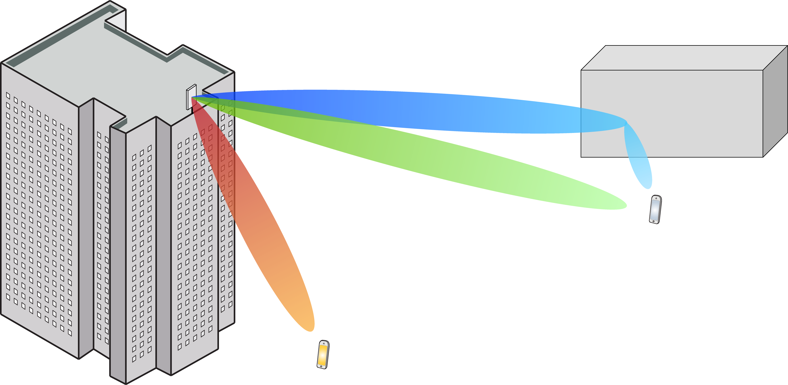
Multiple Antenna Communications
Lecture 10:
Massive MIMO in Cellular Networks
Emil Björnson

Slide 2
Outline
Cellular networks
Basic structure
Channel estimation
Pilot contamination
Spectral efficiency expressions with MR
Uplink
Downlink

Slide 3
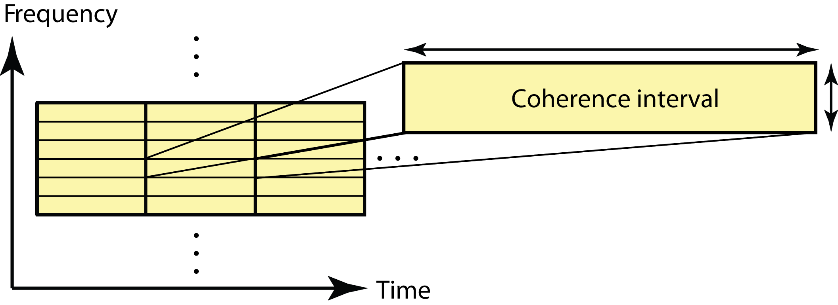
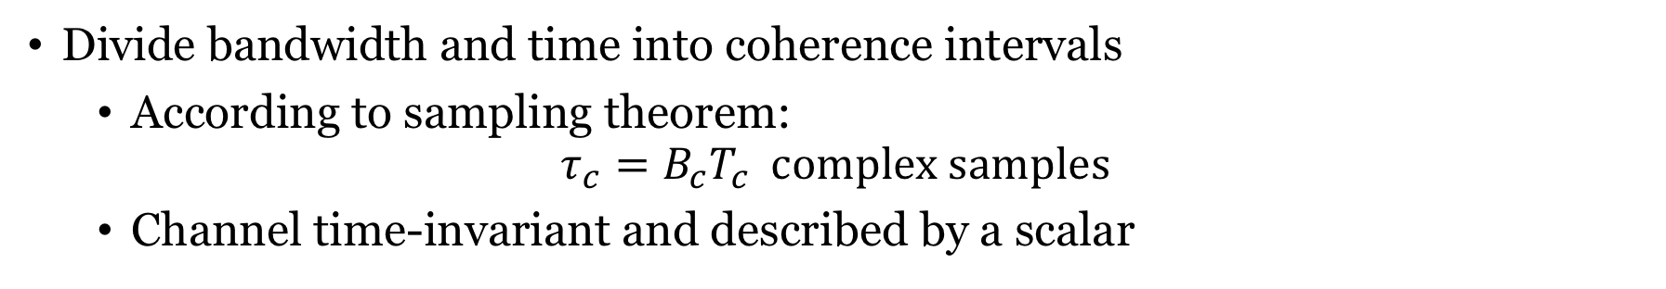


Recall: Coherence interval
$$T_{c}$$
$$B_{c}$$
Divide bandwidth and time into coherence intervals
According to sampling theorem:
$$τ_{c}=B_{c}T_{c} complex samples$$
Channel time-invariant and described by a scalar

Slide 4





Net spectral efficiency
Recall: Capacity bounds
When we use the channel for data
Pilot overhead: $τ_{p}$ samples per coherence interval
Net spectral efficiency:
Uplink:
$$\log_{2}\left(1+\frac{Mρ_{ul}η_{k}γ_{k}}{\sum_{i=1}^{K}{ρ_{ul}η_{i}β_{i}}+1}\right)$$
Downlink:
$$\log_{2}\left(1+\frac{Mρ_{dl}η_{k}γ_{k}}{β_{k}\sum_{i=1}^{K}{ρ_{dl}η_{i}}+1}\right)$$
Uplink:
$$\left(1−\frac{τ_{p}}{τ_{c}}\right)\log_{2}\left(1+\frac{Mρ_{ul}η_{k}γ_{k}}{\sum_{i=1}^{K}{ρ_{ul}η_{i}β_{i}}+1}\right)$$
Downlink:
$$\left(1−\frac{τ_{p}}{τ_{c}}\right)\log_{2}\left(1+\frac{Mρ_{dl}η_{k}γ_{k}}{β_{k}\sum_{i=1}^{K}{ρ_{dl}η_{i}}+1}\right)$$

Slide 5
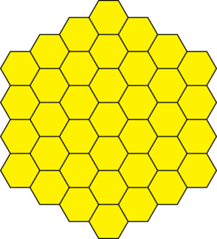
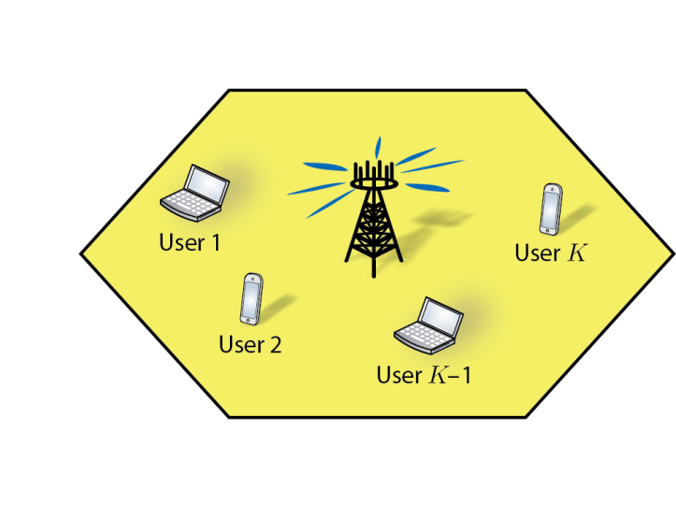
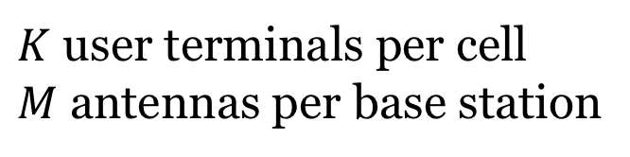
Cellular networks
Canonical hexagonal model:
$K$ user terminals per cell
$M$ antennas per base station

Slide 6
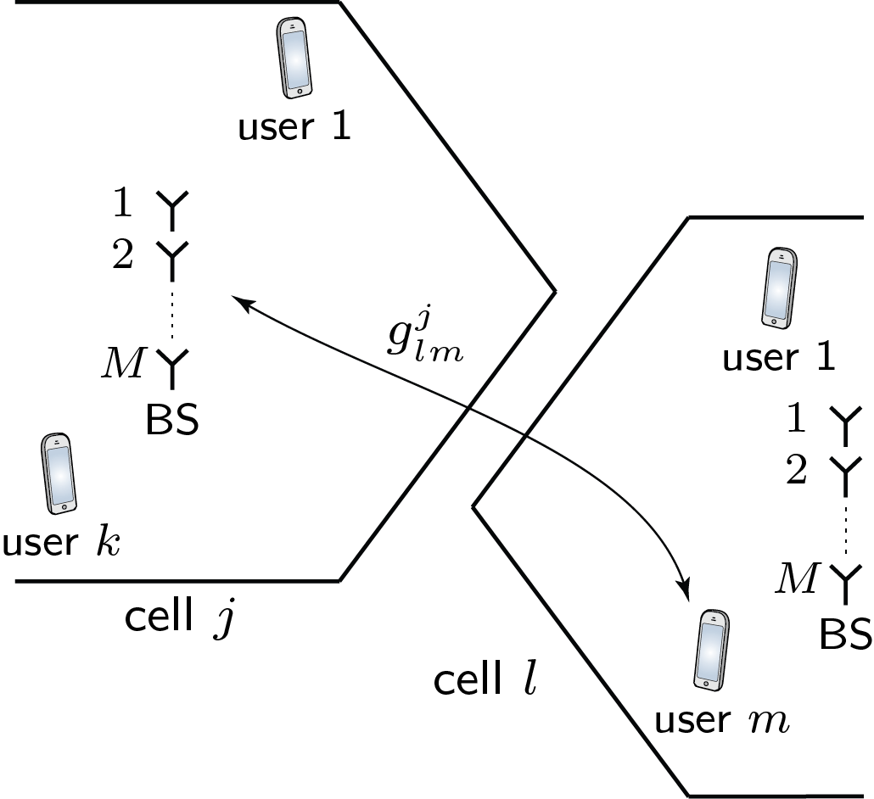
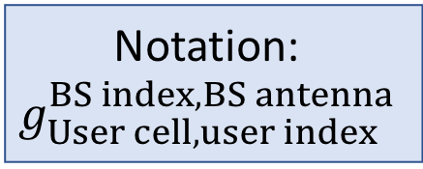

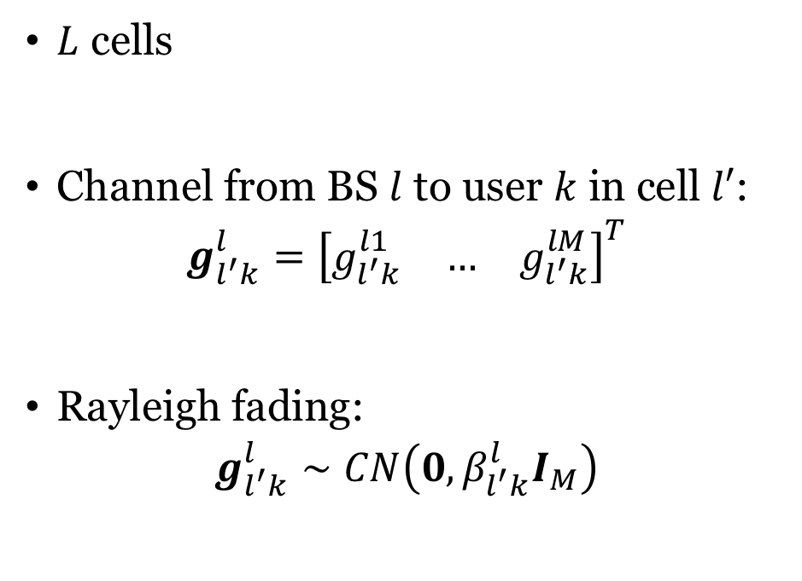



Multi-cell propagation model
Notation:
$$g_{User cell, user index}^{BS index,BS antenna}$$
$L$ cells
Channel from BS $l$ to user $k$ in cell $l′$:
$$g_{l^{′}k}^{l}={\left[\begin{matrix}g_{l^{′}k}^{l1} & … & g_{l^{′}k}^{lM}\end{matrix}\right]}^{T}$$
Rayleigh fading:
$$g_{l^{′}k}^{l}∼CN\left(0,β_{l^{′}k}^{l}I_{M}\right)$$
$$g_{l^{′}k}^{l}$$
cell $l$
cell $l′$
$k$

Slide 7
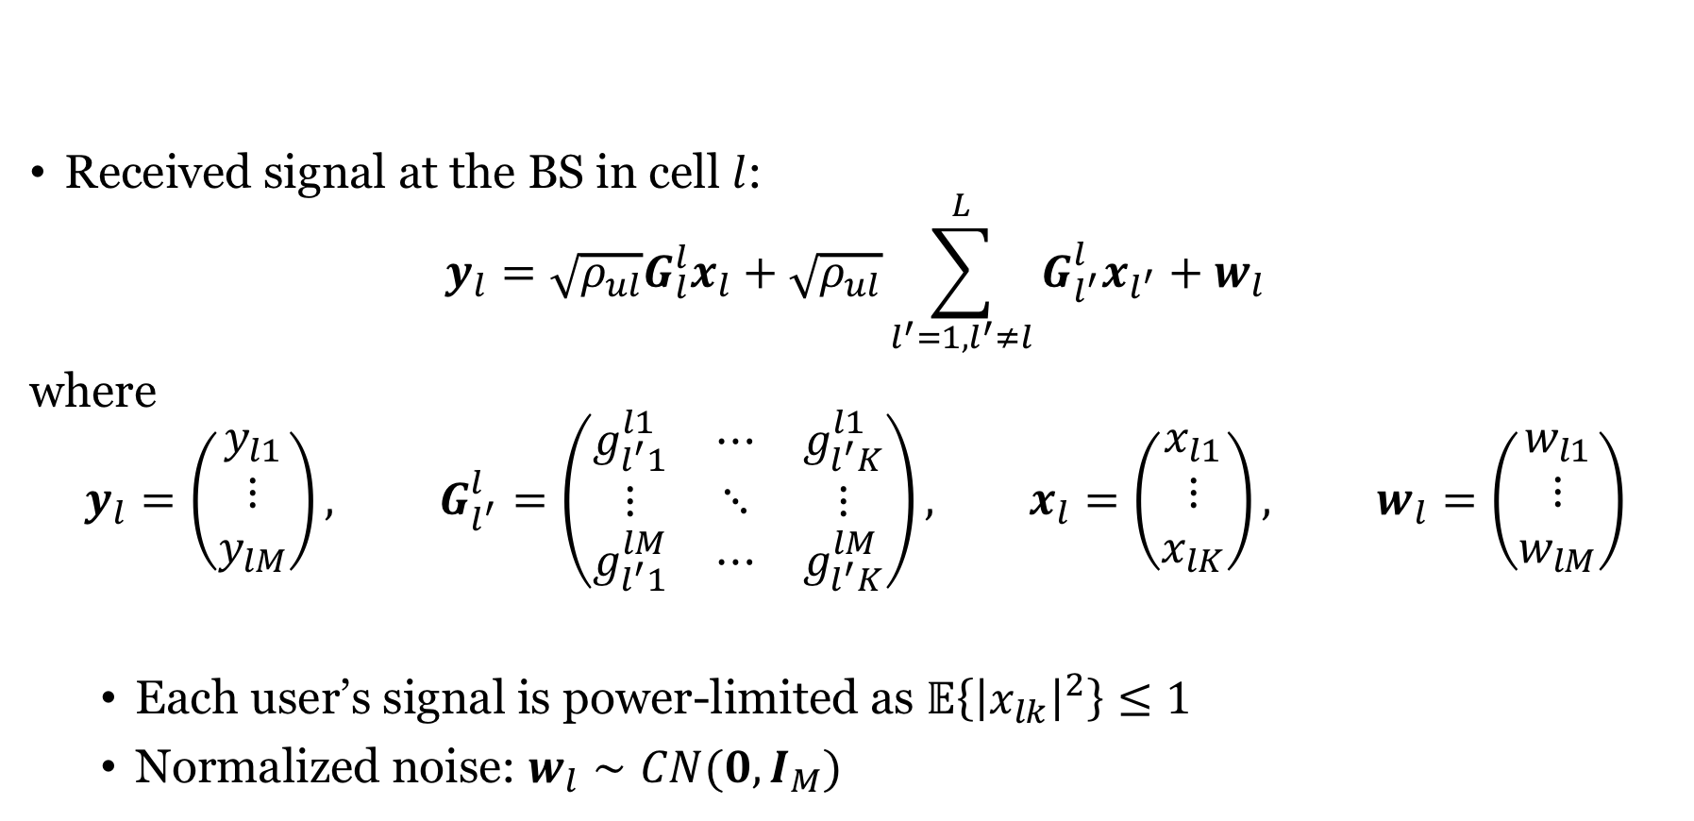
Uplink multi-cell MIMO model
Received signal at the BS in cell $l$:
$$y_{l}=\sqrt{ρ_{ul}}G_{l}^{l}x_{l}+\sqrt{ρ_{ul}}\sum_{l^{′}=1,l^{′}≠l}^{L}{G_{l^{′}}^{l}x_{l^{′}}}+w_{l}$$
where
$$y_{l}=\left(\begin{matrix}y_{l1} \\ ⋮ \\ y_{lM}\end{matrix}\right), G_{l^{′}}^{l}=\left(\begin{matrix}g_{l^{′}1}^{l1} & ⋯ & g_{l^{′}K}^{l1} \\ ⋮ & ⋱ & ⋮ \\ g_{l^{′}1}^{lM} & ⋯ & g_{l^{′}K}^{lM}\end{matrix}\right), x_{l}=\left(\begin{matrix}x_{l1} \\ ⋮ \\ x_{lK}\end{matrix}\right), w_{l}=\left(\begin{matrix}w_{l1} \\ ⋮ \\ w_{lM}\end{matrix}\right)$$
Each user’s signal is power-limited as $𝔼\left\{{\left|x_{lk}\right|}^{2}\right\}≤1$
Normalized noise: $w_{l}∼CN(0,I_{M})$

Slide 8
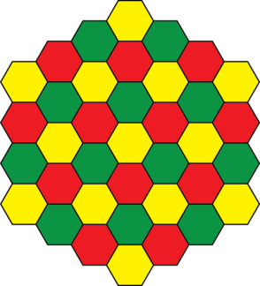
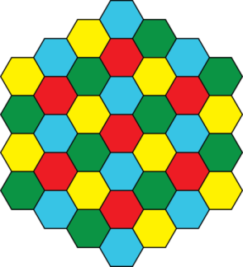




Examples of pilot reuse
Divide cells into $n_{reuse}$ clusters
Use ${K⋅n}_{reuse}$ pilots, same $K$ in each cell of a cluster
Pilot reuse
$$n_{reuse}=1$$
Pilot reuse
$$n_{reuse}=3$$
Pilot reuse
$$n_{reuse}=4$$

Slide 9
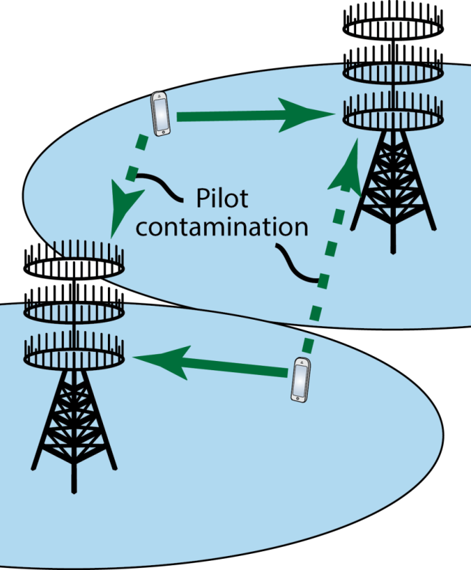
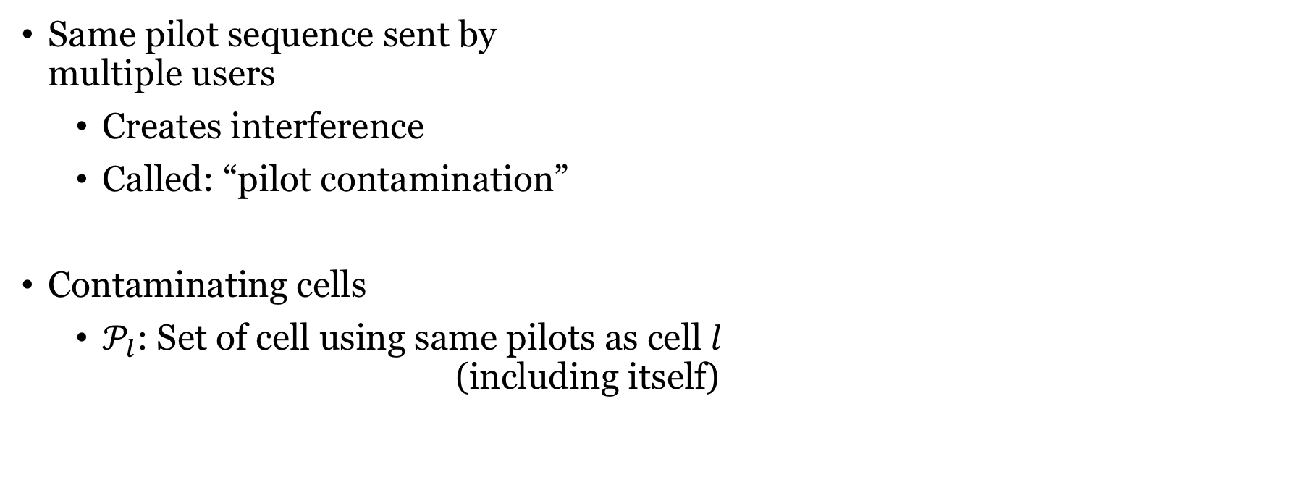
Impact of pilot reuse
Same pilot sequence sent by multiple users
Creates interference
Called: “pilot contamination”
Contaminating cells
$𝒫_{l}$: Set of cell using same pilots as cell $l$ (including itself)

Slide 10
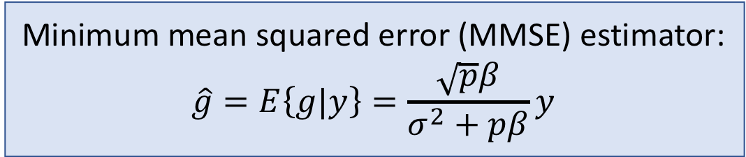
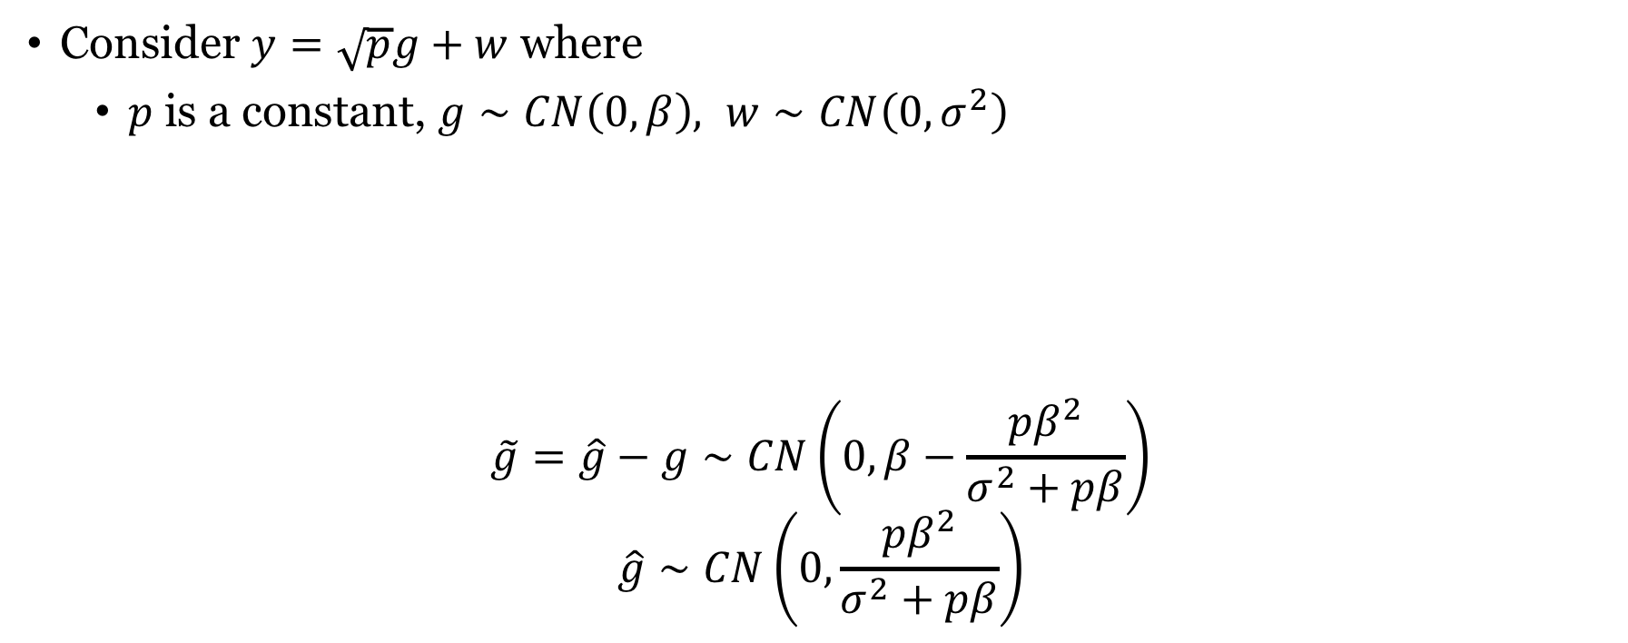
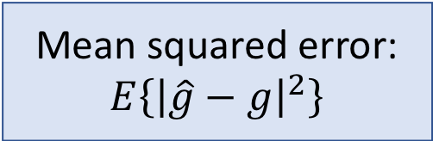
Estimating Gaussian variable in noise
Consider $y=\sqrt{p}g+w$ where
$p$is a constant, $g∼CN\left(0,β\right), w∼CN\left(0,σ^{2}\right)$
$$\tilde{g}=\hat{g}−g∼CN\left(0, β−\frac{pβ^{2}}{σ^{2}+pβ}\right)$$
$$\hat{g}∼CN\left(0,\frac{pβ^{2}}{σ^{2}+pβ}\right)$$
Minimum mean squared error (MMSE) estimator:
$$\hat{g}=E\left\{g|y\right\}=\frac{\sqrt{p}β}{σ^{2}+pβ}y$$
Mean squared error:
$$E\left\{{\left|\hat{g}−g\right|}^{2}\right\}$$
Estimation error:
Independent
random variables
Estimate:

Slide 11

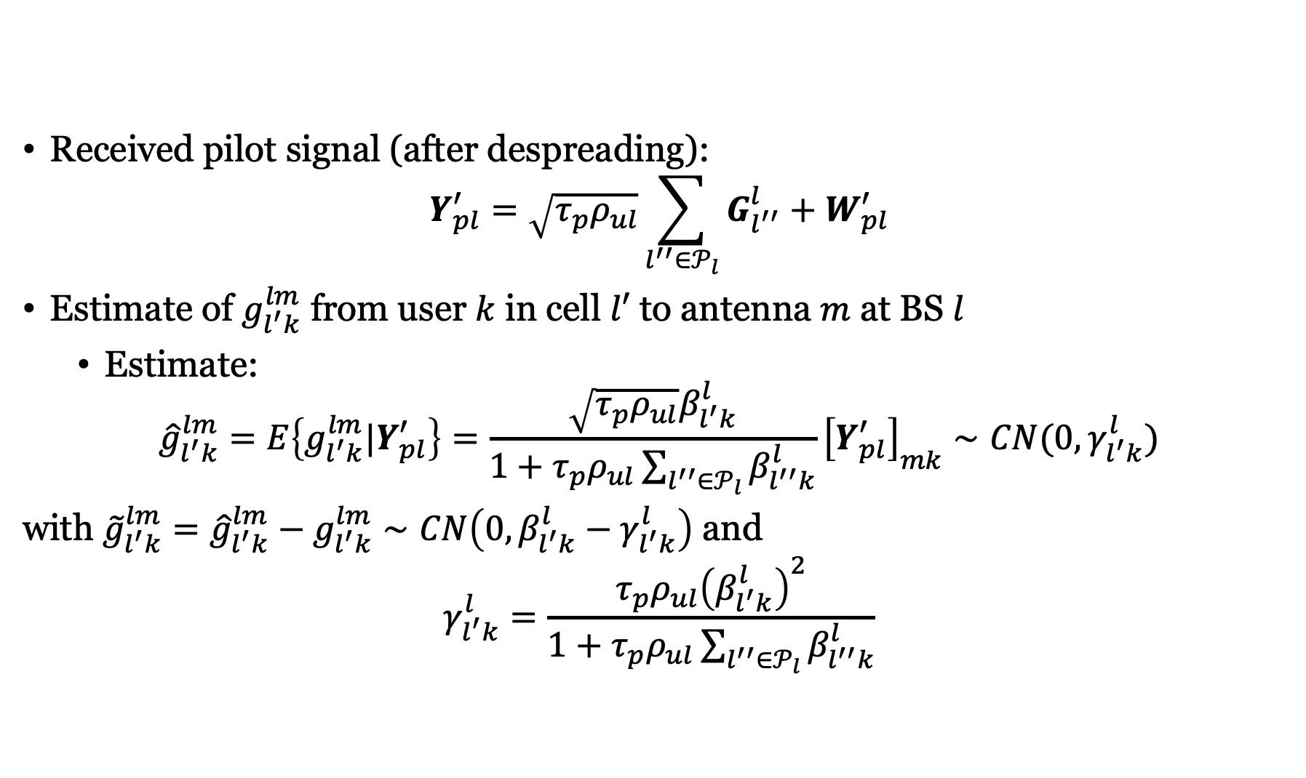
MMSE estimates of channels in cellular networks
Received pilot signal (after despreading):
$$Y_{pl}^{′}=\sqrt{τ_{p}ρ_{ul}}\sum_{l^{′′}∈𝒫_{l}}{G_{l^{′′}}^{l}}+W_{pl}^{′}$$
Estimate of $g_{l^{′}k}^{lm}$ from user $k$ in cell $l′$ to antenna $m$ at BS $l$
Estimate:
$${\hat{g}}_{l^{′}k}^{lm}=E\left\{g_{l^{′}k}^{lm}|Y_{pl}^{′}\right\}=\frac{\sqrt{τ_{p}ρ_{ul}}β_{l^{′}k}^{l}}{1+τ_{p}ρ_{ul}\sum_{l^{′′}∈𝒫_{l}}{β_{l^{′′}k}^{l}}}{\left[Y_{pl}^{′}\right]}_{mk}∼CN(0,γ_{l^{′}k}^{l})$$
with ${\tilde{g}}_{l^{′}k}^{lm}={\hat{g}}_{l^{′}k}^{lm}−g_{l^{′}k}^{lm}∼CN\left(0,β_{l^{′}k}^{l}−γ_{l^{′}k}^{l}\right)$ and
$$γ_{l^{′}k}^{l}=\frac{τ_{p}ρ_{ul}{\left(β_{l^{′}k}^{l}\right)}^{2}}{1+τ_{p}ρ_{ul}\sum_{l^{′′}∈𝒫_{l}}{β_{l^{′′}k}^{l}}}$$
Vector notation:
$${\hat{g}}_{l^{′}k}^{l}=\left[\begin{aligned}{\hat{g}}_{l^{′}k}^{l1} \\ ⋮ \\ {\hat{g}}_{l^{′}k}^{lM}\end{aligned}\right]$$

Slide 12
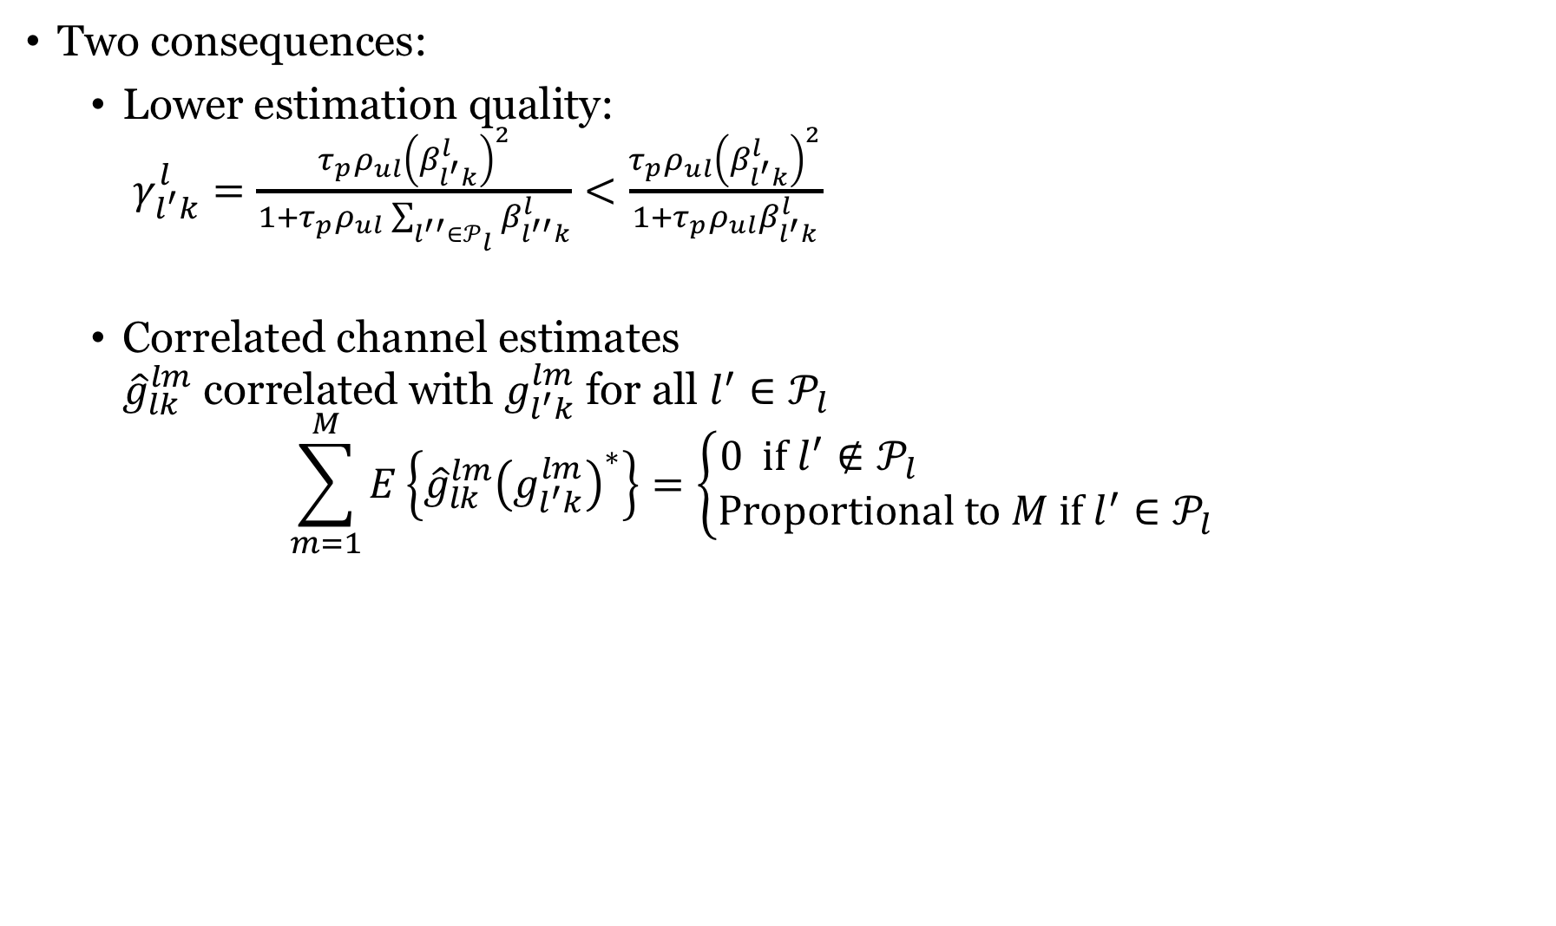
Pilot contamination
Two consequences:
Lower estimation quality: $γ_{l^{′}k}^{l}=\frac{τ_{p}ρ_{ul}{\left(β_{l^{′}k}^{l}\right)}^{2}}{1+τ_{p}ρ_{ul}\sum_{l^{′′}∈𝒫_{l}}{β_{l^{′′}k}^{l}}}<\frac{τ_{p}ρ_{ul}{\left(β_{l^{′}k}^{l}\right)}^{2}}{1+τ_{p}ρ_{ul}β_{l^{′}k}^{l}}$
Correlated channel estimates ${\hat{g}}_{lk}^{lm}$ correlated with $g_{l^{′}k}^{lm}$ for all $l^{′}∈𝒫_{l}$
$$\sum_{m=1}^{M}{E\left\{{\hat{g}}_{lk}^{lm}{\left(g_{l^{′}k}^{lm}\right)}^{∗}\right\}=\left\{\begin{aligned}0 if l^{′}{∉𝒫}_{l} \\ Proportional to M if l^{′}∈𝒫_{l}\end{aligned}\right.}$$
Without inter-cell interference

Slide 13

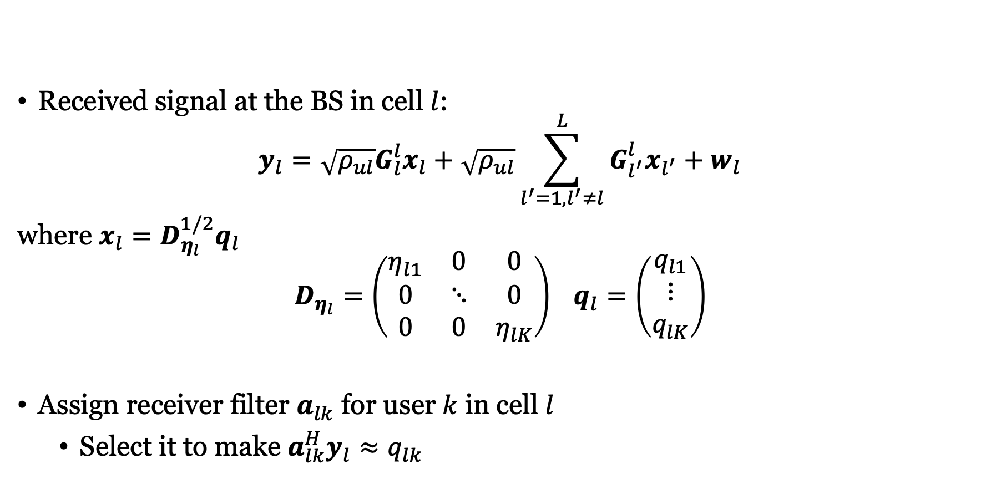
Linear receiver processing
Received signal at the BS in cell $l$:
$$y_{l}=\sqrt{ρ_{ul}}G_{l}^{l}x_{l}+\sqrt{ρ_{ul}}\sum_{l^{′}=1,l^{′}≠l}^{L}{G_{l^{′}}^{l}x_{l^{′}}}+w_{l}$$
where $x_{l}=D_{η_{l}}^{1/2}q_{l}$
$$D_{η_{l}}=\left(\begin{matrix}η_{l1} & 0 & 0 \\ 0 & ⋱ & 0 \\ 0 & 0 & η_{lK}\end{matrix}\right) q_{l}=\left(\begin{matrix}q_{l1} \\ ⋮ \\ q_{lK}\end{matrix}\right)$$
Assign receiver filter $a_{lk}$ for user $k$ in cell $l$
Select it to make $a_{lk}^{H}y_{l}≈q_{lk}$
Data signals
MR processing:
$$a_{lk}={\hat{g}}_{lk}^{l}$$

Slide 14
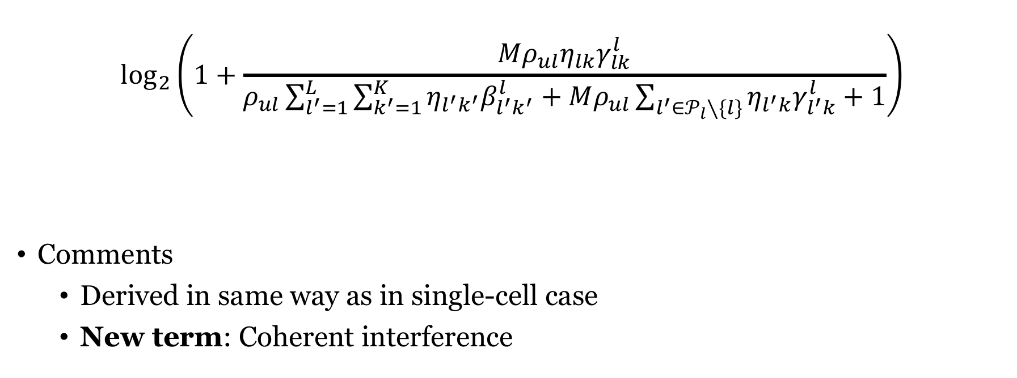
Uplink capacity lower bound with MR
Desired signal (coherent)
$$\log_{2}\left(1+\frac{Mρ_{ul}η_{lk}γ_{lk}^{l}}{ρ_{ul}\sum_{l^{′}=1}^{L}{\sum_{k^{′}=1}^{K}{η_{l^{′}k^{′}}β_{l^{′}k^{′}}^{l}}}+Mρ_{ul}\sum_{l^{′}∈𝒫_{l}∖\{l\}}{η_{l^{′}k}γ_{l^{′}k}^{l}}+1}\right)$$
Comments
Derived in same way as in single-cell case
New term: Coherent interference
Non-coherent interference from all users
Coherent interference from pilot-sharing users
Noise

Slide 15
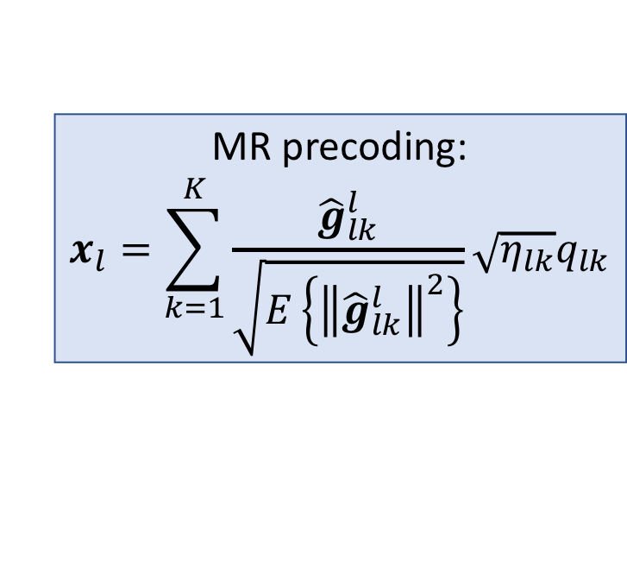
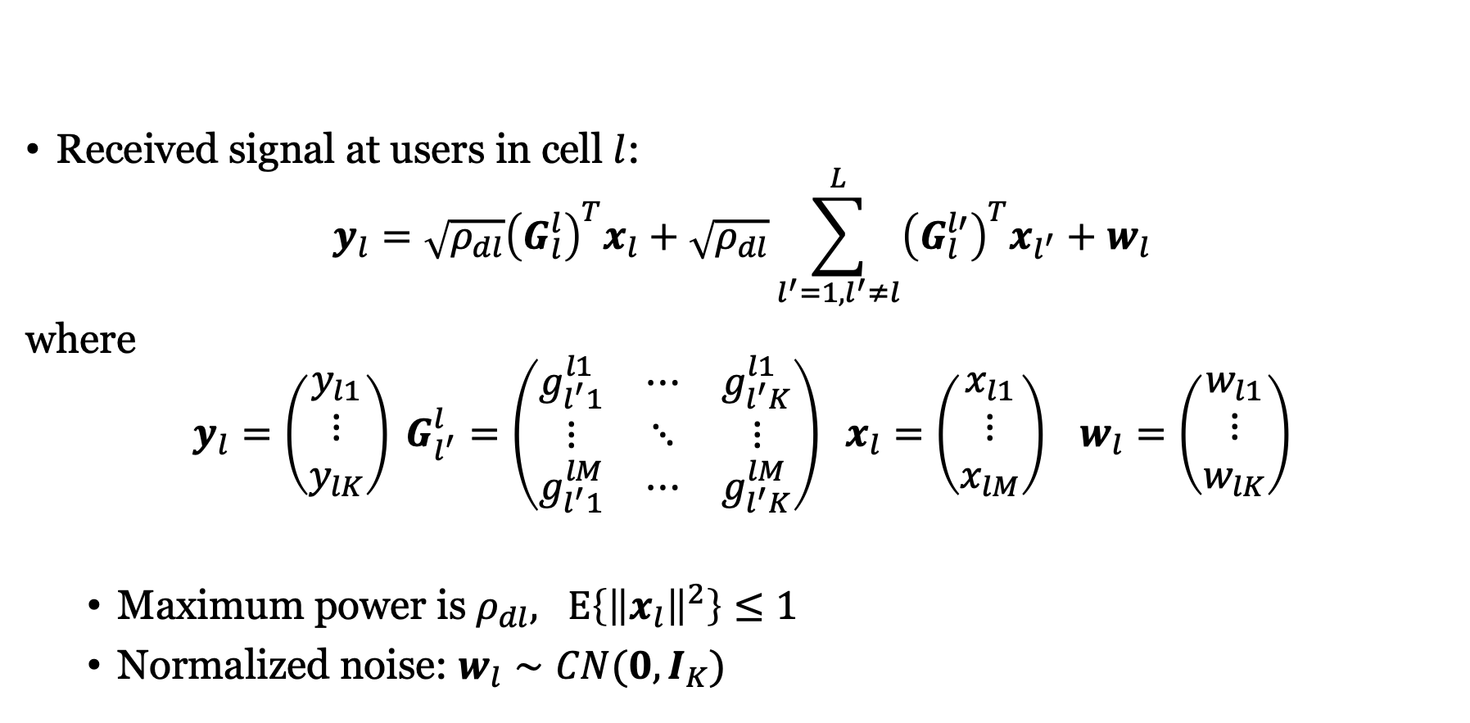
Downlink multi-cell MIMO model
Received signal at users in cell $l$:
$$y_{l}=\sqrt{ρ_{dl}}{\left(G_{l}^{l}\right)}^{T}x_{l}+\sqrt{ρ_{dl}}\sum_{l^{′}=1,l^{′}≠l}^{L}{{\left(G_{l}^{l′}\right)}^{T}x_{l^{′}}}+w_{l}$$
where
$$y_{l}=\left(\begin{matrix}y_{l1} \\ ⋮ \\ y_{lK}\end{matrix}\right) G_{l^{′}}^{l}=\left(\begin{matrix}g_{l^{′}1}^{l1} & ⋯ & g_{l^{′}K}^{l1} \\ ⋮ & ⋱ & ⋮ \\ g_{l^{′}1}^{lM} & ⋯ & g_{l^{′}K}^{lM}\end{matrix}\right) x_{l}=\left(\begin{matrix}x_{l1} \\ ⋮ \\ x_{lM}\end{matrix}\right) w_{l}=\left(\begin{matrix}w_{l1} \\ ⋮ \\ w_{lK}\end{matrix}\right)$$
Maximum power is $ρ_{dl}, E\left\{{\left\|x_{l}\right\|}^{2}\right\}≤1$
Normalized noise: $w_{l}∼CN(0,I_{K})$
MR precoding:
$$x_{l}=\sum_{k=1}^{K}{\frac{{\hat{g}}_{lk}^{l}}{\sqrt{E\left\{{\left\|{\hat{g}}_{lk}^{l}\right\|}^{2}\right\}}}\sqrt{η_{lk}}q_{lk}}$$

Slide 16
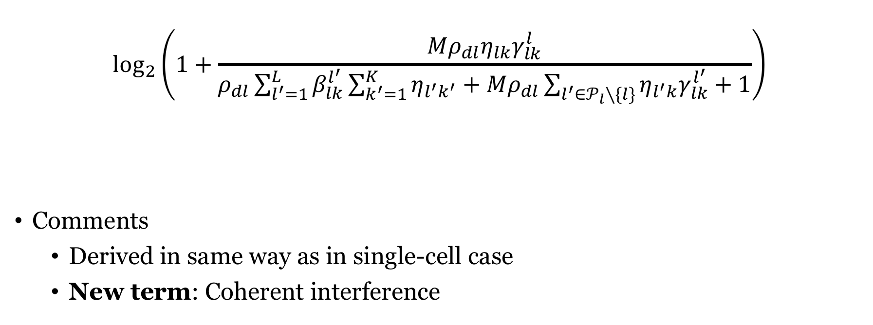
Downlink capacity lower bound with MR
Desired signal (coherent)
$$\log_{2}\left(1+\frac{Mρ_{dl}η_{lk}γ_{lk}^{l}}{ρ_{dl}\sum_{l^{′}=1}^{L}{β_{lk}^{l^{′}}\sum_{k^{′}=1}^{K}{η_{l^{′}k^{′}}}}+Mρ_{dl}\sum_{l^{′}∈𝒫_{l}∖\{l\}}{η_{l^{′}k}γ_{lk}^{l^{′}}}+1}\right)$$
Comments
Derived in same way as in single-cell case
New term: Coherent interference
Non-coherent interference from all users
Coherent interference from pilot-sharing users
Noise

Slide 17

Comparing uplink and downlink
Non-coherent interference
Uplink: $ρ_{ul}\sum_{l^{′}=1}^{L}{\sum_{k^{′}=1}^{K}{η_{l^{′}k^{′}}β_{l^{′}k^{′}}^{l}}}$
Downlink: $ρ_{dl}\sum_{l^{′}=1}^{L}{β_{lk}^{l^{′}}\sum_{k^{′}=1}^{K}{η_{l^{′}k^{′}}}}$
Differences:
$$ρ_{ul}↔ρ_{dl}$$
$$β_{l^{′}k^{′}}^{l}↔β_{lk}^{l^{′}}$$
Uplink: Interference comes from each user
Downlink: Interference comes from each base station

Slide 18
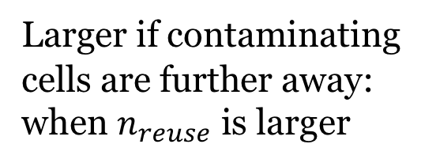



Uplink asymptotic limit
As $M→∞$: Capacity lower bound has a finite limit:
$$\log_{2}\left(1+\frac{Mρ_{ul}η_{lk}γ_{lk}^{l}}{ρ_{ul}\sum_{l^{′}=1}^{L}{\sum_{k^{′}=1}^{K}{η_{l^{′}k^{′}}β_{l^{′}k^{′}}^{l}}}+Mρ_{ul}\sum_{l^{′}∈𝒫_{l}∖\{l\}}{η_{l^{′}k}γ_{l^{′}k}^{l}}+1}\right)→\log_{2}\left(1+\frac{η_{lk}{\left(β_{lk}^{l}\right)}^{2}}{\sum_{l^{′}∈𝒫_{l}∖\{l\}}{η_{l^{′}k}{\left(β_{l^{′}k}^{l}\right)}^{2}}}\right)$$
Larger if contaminating
cells are further away:
when $n_{reuse}$ is larger
$$n_{reuse}=3$$
$$n_{reuse}=4$$

Slide 19
Summary
Massive MIMO in cellular networks
Similar capacity bounds as in a single cell, but more complicated notation
New phenomenon: Pilot contamination
Reduces estimation quality
Causes coherent interference

Slide 20
Multiple Antenna Communications
Lecture 10:
Massive MIMO in Cellular Networks
Emil Björnson

