Slide 1
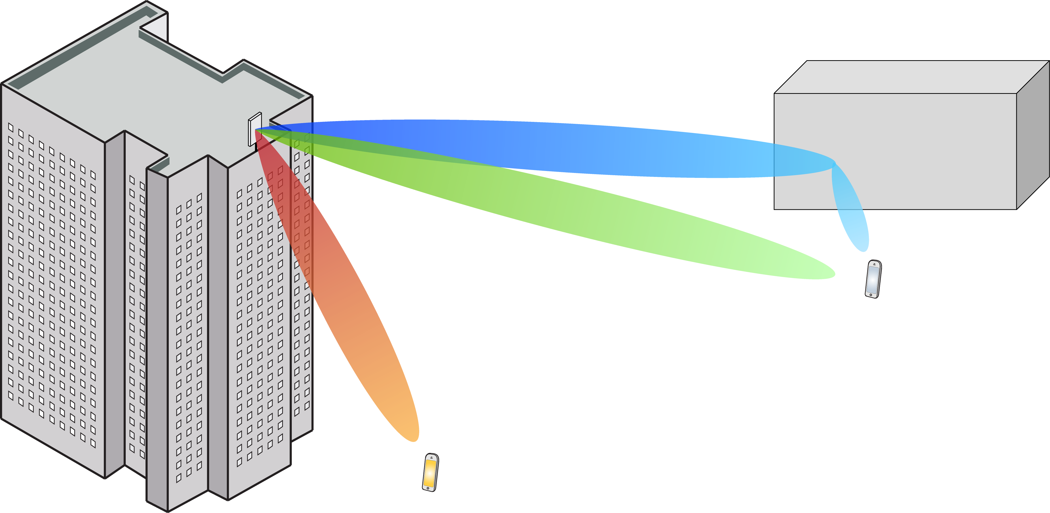
Multiple Antenna Communications
Lecture 12:
Power Control for Spectral and Energy Efficiency
Emil Björnson

Slide 2
Outline
Power control
Spectral efficiency (sum rate) maximization
Uplink, downlink
Simulation example
Energy efficiency maximization
Definition
Impact of beamforming and multipleixng

Slide 3
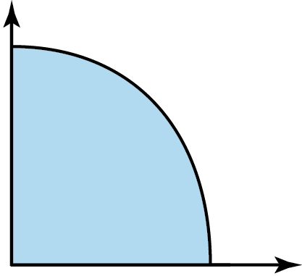



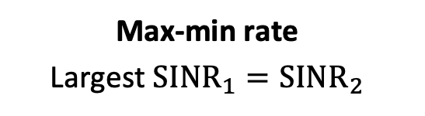
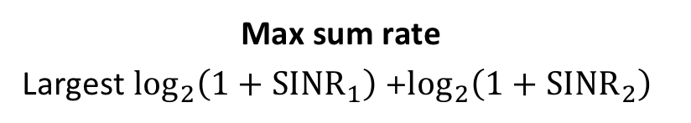
Power control
Effective SINRs depend on $η_{1},…,η_{K}$
Can be selected to achieve different operating points
Max sum rate
Largest $\log_{2}\left(1+SINR_{1}\right)$+$\log_{2}\left(1+SINR_{2}\right)$
$$\log_{2}\left(1+SINR_{2}\right)$$
Max-min rate
Largest ${SINR}_{1}={SINR}_{2}$
Rate region
$$\log_{2}\left(1+SINR_{1}\right)$$
Most spectrally efficient solution!

Slide 4
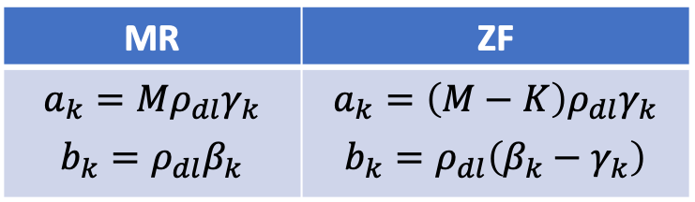
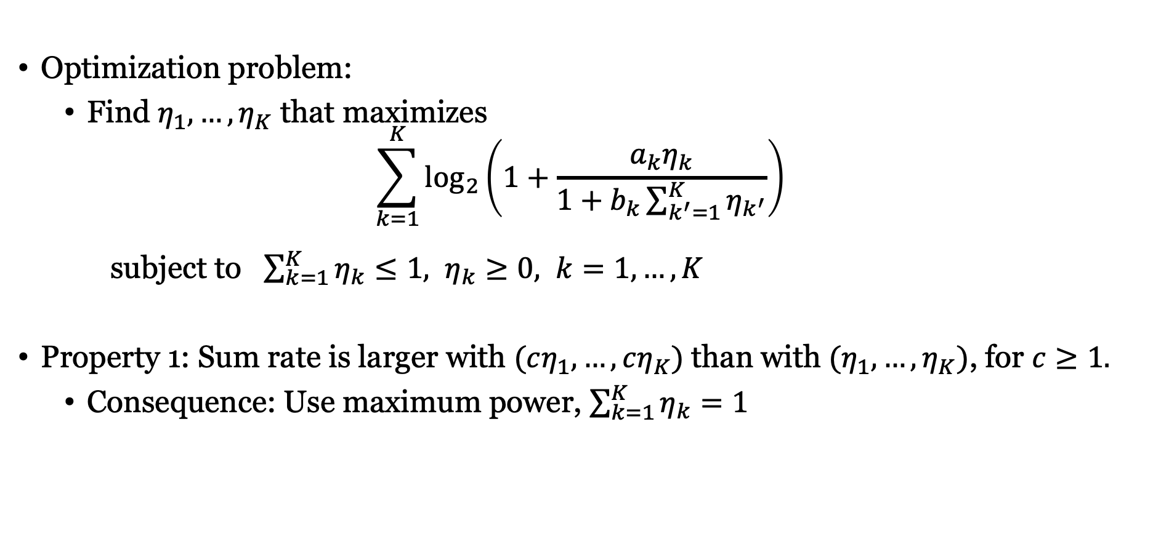
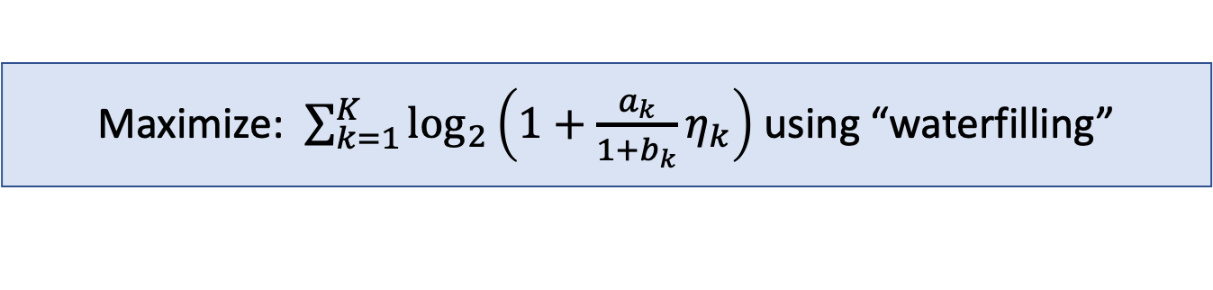
Downlink sum rate maximization
MR | ZF
$$a_{k}=Mρ_{dl}γ_{k}$$ $$b_{k}=ρ_{dl}β_{k}$$ | $$a_{k}=\left(M−K\right)ρ_{dl}γ_{k}$$ $$b_{k}=ρ_{dl}\left(β_{k}−γ_{k}\right)$$
Optimization problem:
Find $η_{1},…,η_{K}$ that maximizes
$$\sum_{k=1}^{K}{\log_{2}\left(1+\frac{a_{k}η_{k}}{1+b_{k}\sum_{k^{′}=1}^{K}{η_{k^{′}}}}\right)}$$
subject to $\sum_{k=1}^{K}{η_{k}}≤1, η_{k}≥0, k=1,…,K$
Property 1: Sum rate is larger with $(cη_{1},…,cη_{K})$than with $(η_{1},…,η_{K})$, for $c≥1.$
Consequence: Use maximum power, $\sum_{k=1}^{K}{η_{k}}=1$
Maximize: $\sum_{k=1}^{K}{\log_{2}\left(1+\frac{a_{k}}{1+b_{k}}η_{k}\right)}$ using “waterfilling”

Slide 5
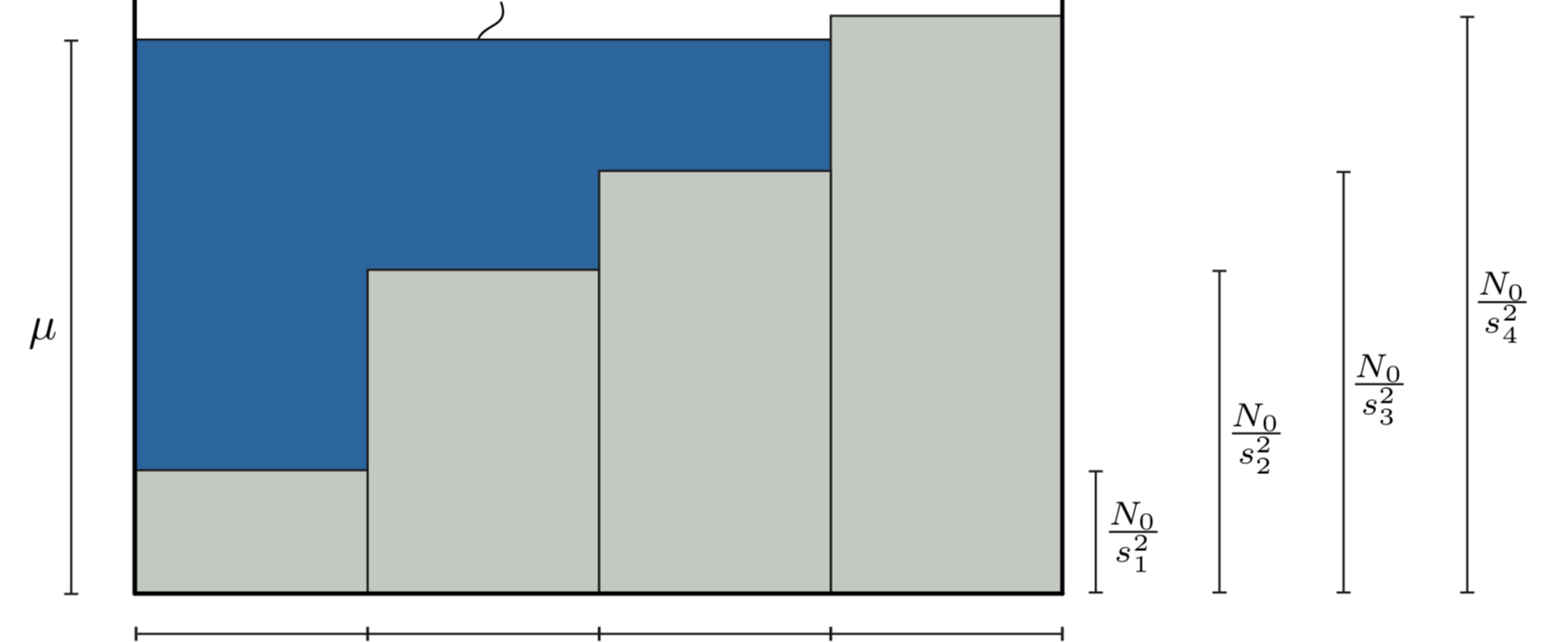

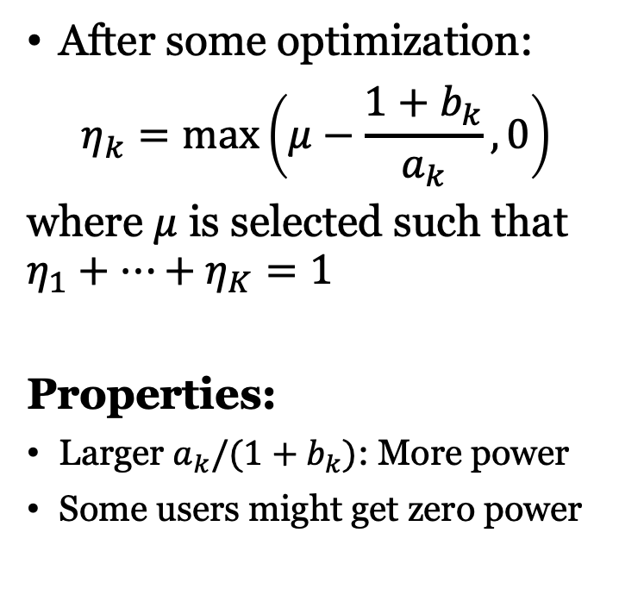



Sum rate maximizing waterfilling power allocation
After some optimization:
$$η_{k}=\max\left(μ−\frac{1+b_{k}}{a_{k}},0\right)$$
where $μ$ is selected such that $η_{1}+…+η_{K}=1$
Properties:
Larger $a_{k}/(1+b_{k})$: More power
Some users might get zero power
Total power = 1
$$\frac{1+b_{4}}{a_{4}}$$
$$\frac{1+b_{3}}{a_{3}}$$
$$\frac{1+b_{2}}{a_{2}}$$
$$\frac{1+b_{1}}{a_{1}}$$
User 1
User 2
User 3
User 4
Users ordered based on channel quality

Slide 6
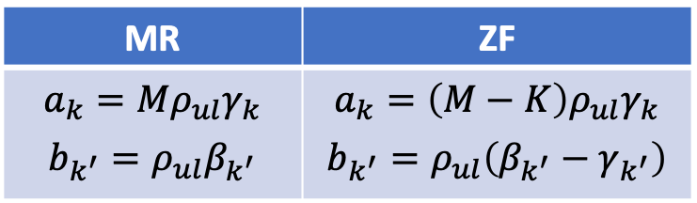
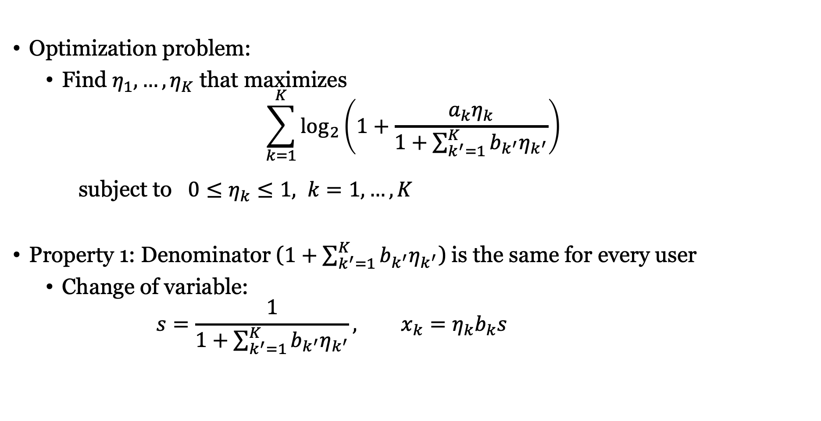
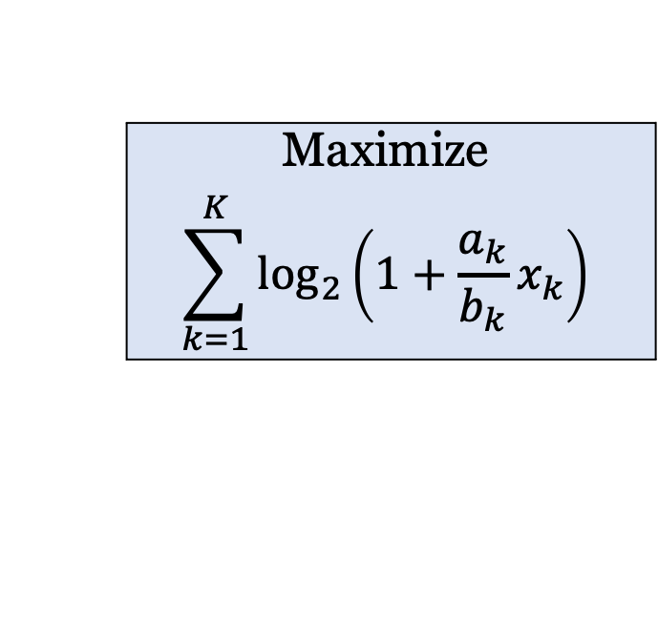
Uplink sum rate maximization
MR | ZF
$$a_{k}=Mρ_{ul}γ_{k}$$ $$b_{k^{′}}=ρ_{ul}β_{k^{′}}$$ | $$a_{k}=\left(M−K\right)ρ_{ul}γ_{k}$$ $$b_{k^{′}}=ρ_{ul}\left(β_{k^{′}}−γ_{k^{′}}\right)$$
Optimization problem:
Find $η_{1},…,η_{K}$ that maximizes
$$\sum_{k=1}^{K}{\log_{2}\left(1+\frac{a_{k}η_{k}}{1+\sum_{k^{′}=1}^{K}{b_{k^{′}}η_{k^{′}}}}\right)}$$
subject to $0≤η_{k}≤1, k=1,…,K$
Property 1: Denominator ($1+\sum_{k^{′}=1}^{K}{b_{k^{′}}η_{k^{′}}}$) is the same for every user
Change of variable:
$$s=\frac{1}{1+\sum_{k^{′}=1}^{K}{b_{k^{′}}η_{k^{′}}}}, x_{k}=η_{k}b_{k}s$$
Maximize
$$\sum_{k=1}^{K}{\log_{2}\left(1+\frac{a_{k}}{b_{k}}x_{k}\right)}$$

Slide 7
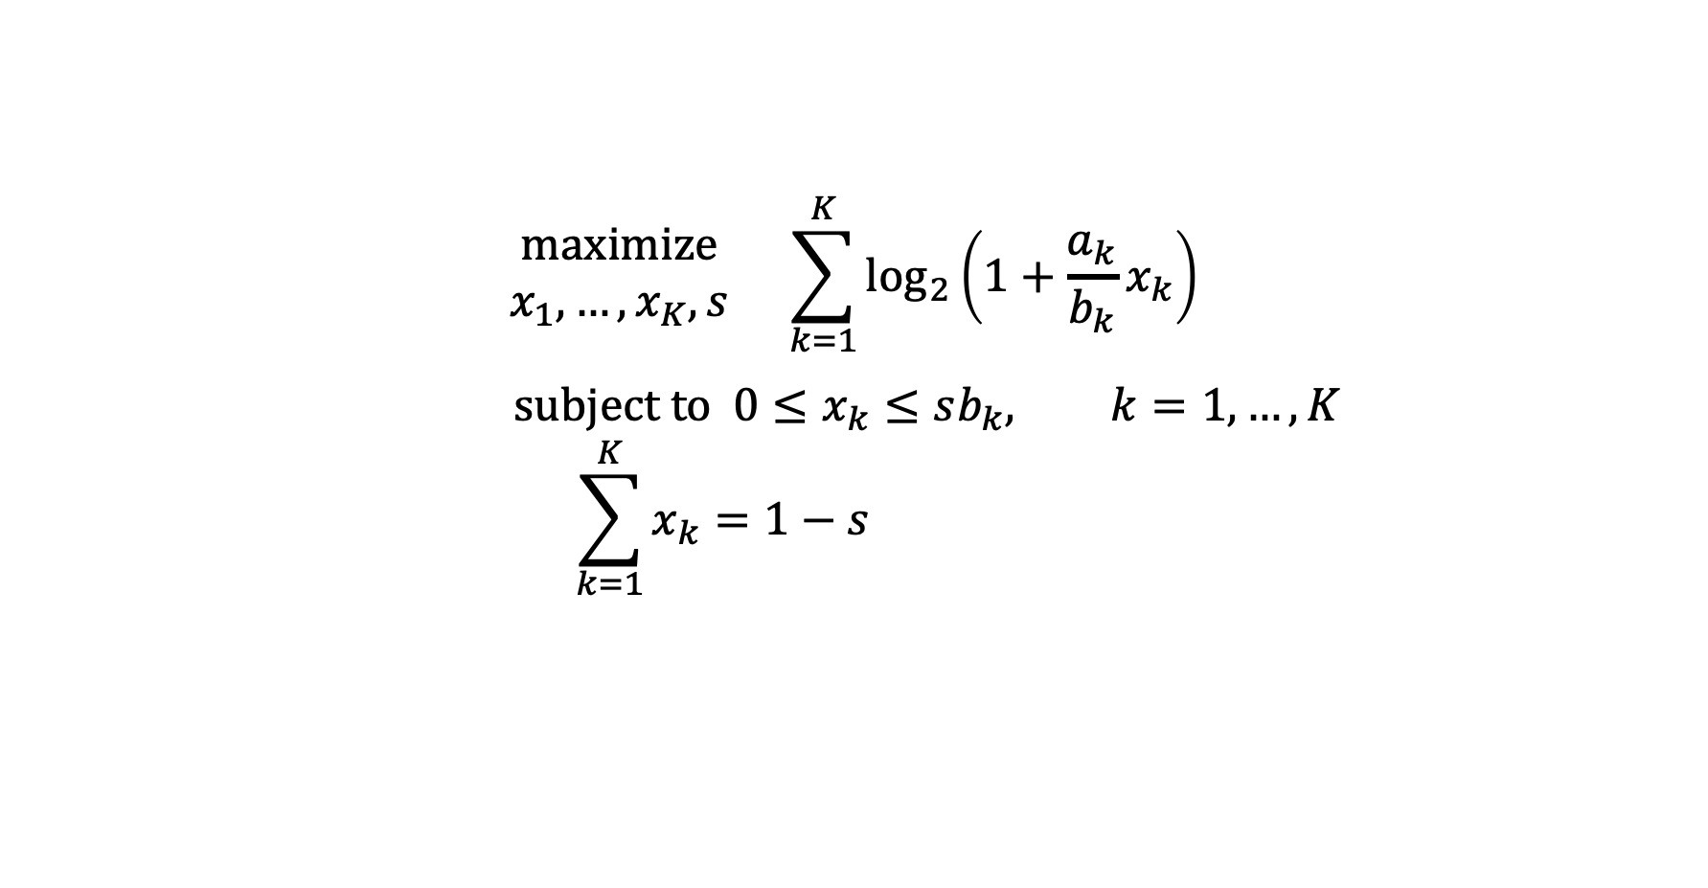
Revised problem formulation
$$\begin{matrix}maximize \\ x_{1},…,x_{K},s\end{matrix} \sum_{k=1}^{K}{\log_{2}\left(1+\frac{a_{k}}{b_{k}}x_{k}\right)}$$
$$subject to 0≤x_{k}≤sb_{k}, k=1,…,K \\ \sum_{k=1}^{K}{x_{k}=1−s}$$
Convex optimization problem
Maximize a concave function
Linear constraints
Solve with any convex optimization solver
(e.g., CVX)

Slide 8

Simulation example: Urban deployment
Single-cell setup
Circular cell with radius 500 m
Base station: $M=100$antennas
$K=10$ uniformly users
Important properties
Independent Rayleigh fading
No inter-cell interference
Carrier frequency: 2 GHz
Bandwidth 20 MHz
500 m
Same parameters as in last lecture

Slide 9
Uplink with power control
Sum rate maximization
Increase rates by sacrificing fairness
Focused on long-term fairness

Slide 10
Downlink with power control
Sum rate maximization
Similar to equal power allocation

Slide 11

Power Control for Maximum Energy Efficiency
Benefit-cost analysis:
Benefit-cost ratio:
$$Energy efficiency [bit/Joule]=\frac{Data rate [bit/s]}{Energy consumption [Joule/s]}$$
Cost:
Energy consumption
(Watt=Joule/s)
Benefit:
Data rate
(bit/s)
Communication system
Environmental concerns
Energy production is mainly non-renewable
Economical concerns
Energy price: Joule/€
Other costs can also be included

Slide 12
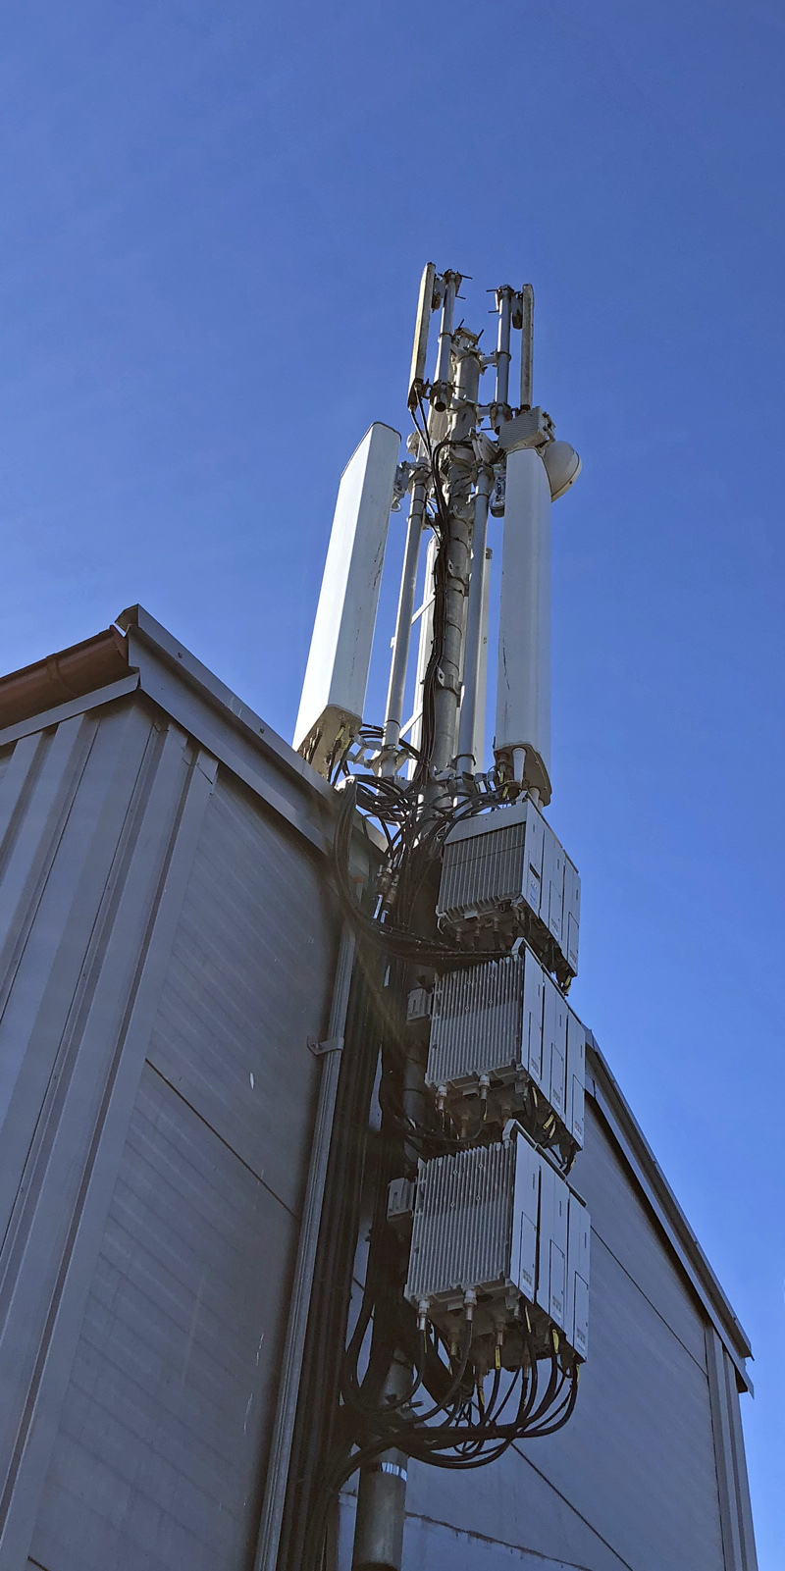
Example: Energy efficiency of 4G base station
Data throughput
Up to 28 Mbit/s
One site
Three base stations
Energy consumption
1.35 kW
Antenna panel
Power amplifiers
Energy efficiency
28 Mbit/s / 1.35 kW = 20 kbit/Joule
Components
Power amplifiers
Radio transceivers
Baseband processors
Reference:
Auer et al., “How much energy is needed to run a wireless network?,” IEEE Wireless Communication, 2011

Slide 13

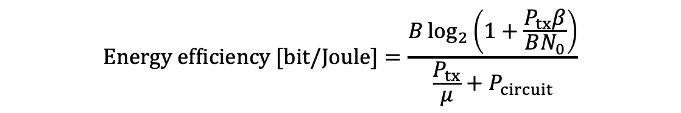
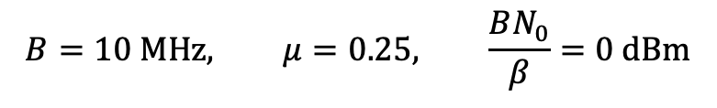
Energy Efficient Power Control
Transmit power
Bandwidth
Pathloss
$$Energy efficiency [bit/Joule]=\frac{B\log_{2}\left(1+\frac{P_{tx}β}{BN_{0}}\right)}{\frac{P_{tx}}{μ}+P_{circuit}}$$
Consider point-to-point system:
Noise power spectral density
Amplifier efficiency
Circuit power
Unimodal functions
Control transmit power to find optimum
Circuit power
Must be accurately modeled
$$B=10 MHz, μ=0.25, \frac{BN_{0}}{β}=0 dBm$$

Slide 14
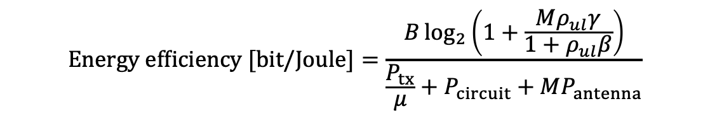

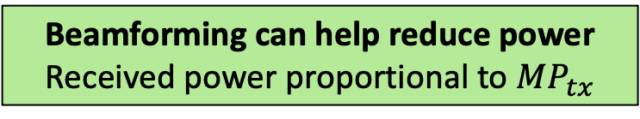
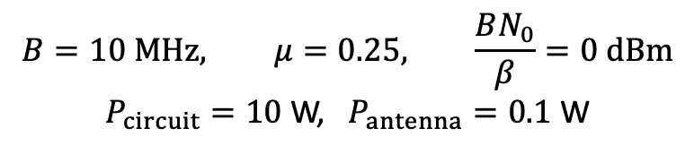
Energy Efficiency and Beamforming
SINR with MR
$$Energy efficiency [bit/Joule]=\frac{B\log_{2}\left(1+\frac{Mρ_{ul}γ}{1+ρ_{ul}β}\right)}{\frac{P_{tx}}{μ}+P_{circuit}+MP_{antenna}}$$
Consider SIMO system:
$$ρ_{ul}=\frac{P_{tx}}{BN_{0}}$$
Circuit power per antenna
Beamforming can help reduce power
Received power proportional to $MP_{tx}$
$$B=10 MHz, μ=0.25, \frac{BN_{0}}{β}=0 dBm$$
$P_{circuit}=10$ W, $P_{antenna}=0.1$ W

Slide 15

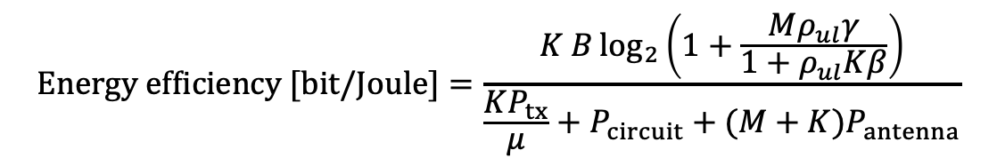
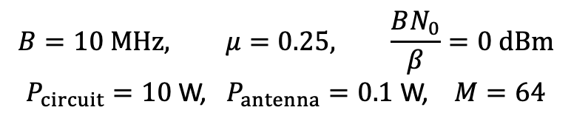

Energy Efficiency and Multiplexing
Uplink SINR with MR and $K$ users
$$Energy efficiency [bit/Joule]=\frac{K B\log_{2}\left(1+\frac{Mρ_{ul}γ}{1+ρ_{ul}Kβ}\right)}{\frac{KP_{tx}}{μ}+P_{circuit}+(M+K)P_{antenna}}$$
Consider Massive MIMO system:
Total transmit power
Circuit power per antenna/users
$$ρ_{ul}=\frac{P_{tx}}{BN_{0}}$$
Multiplexing increases efficiency
Share power cost between users
$$B=10 MHz, μ=0.25, \frac{BN_{0}}{β}=0 dBm$$
$P_{circuit}=10$ W, $P_{antenna}=0.1$ W, $M=64$

Slide 16
Summary
Power control used to increase efficiency
Spectral or energy efficiency
Sum rate power control
Downlink: Waterfilling
Uplink: Convex optimization
Energy efficiency
Rate divided by energy consumption
Accurate circuit power models needed
Beamforming and multiplexing useful

Slide 17
Multiple Antenna Communications
Lecture 12:
Power Control for Spectral and Energy Efficiency
Emil Björnson

