Slide 1
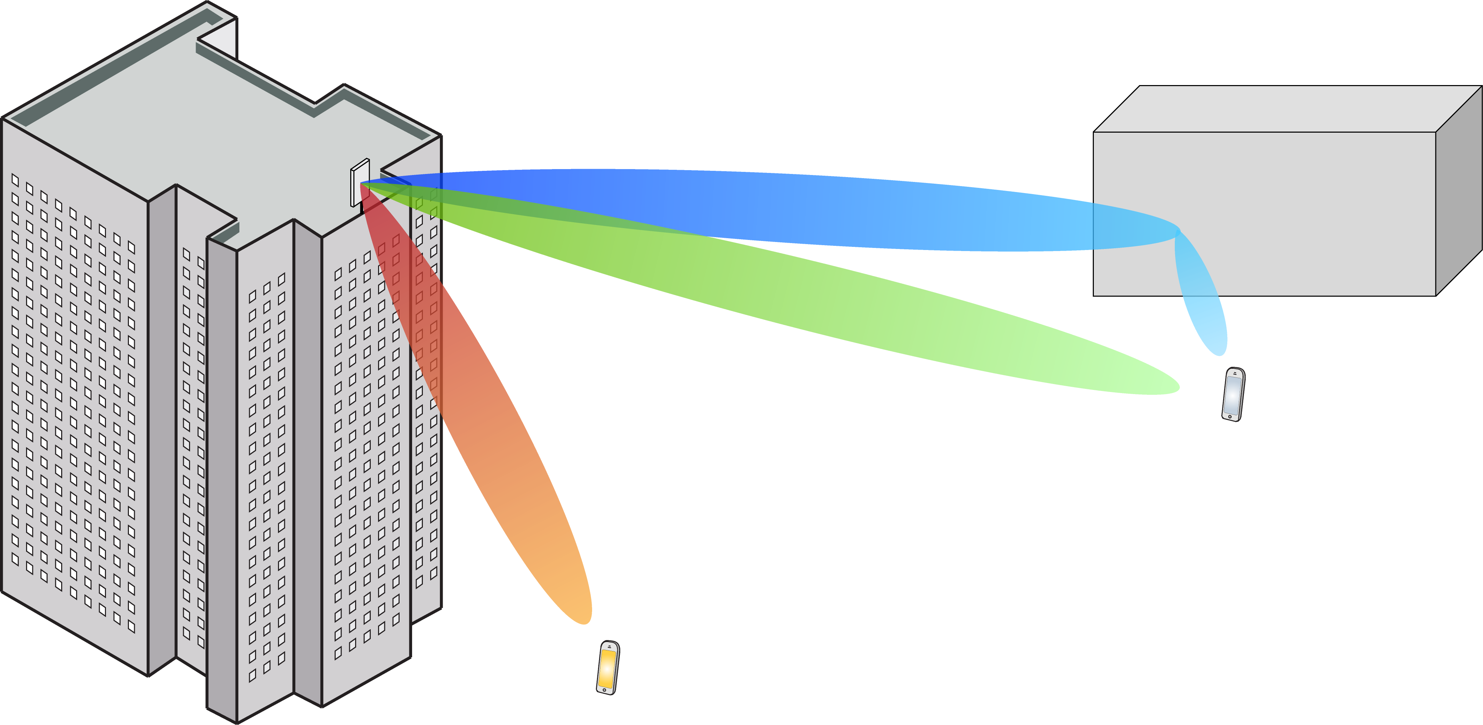
Multiple Antenna Communications
Lecture 4:
Capacity of Point-to-Point MIMO Channels
Emil Björnson

Slide 2
Outline
Point-to-point MIMO channels
Basic formulation
Some linear algebra results
Capacity of MIMO channels
Examples of capacity behavior
Transmitter diversity
MISO channels with slow fading

Slide 3
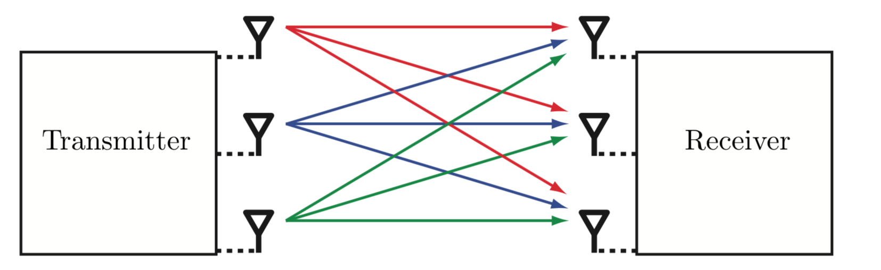

Point-to-point MIMO channel
$K$ transmit antennas
$M$ receive antennas
Deterministic channel
Generalization of SIMO and MISO channels
What is the capacity of such a channel?

Slide 4
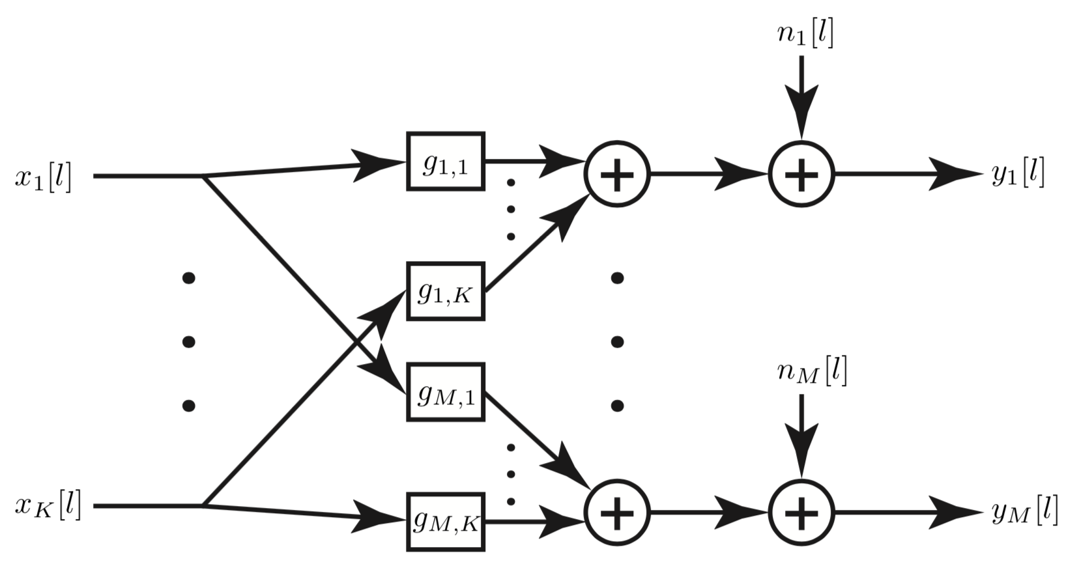
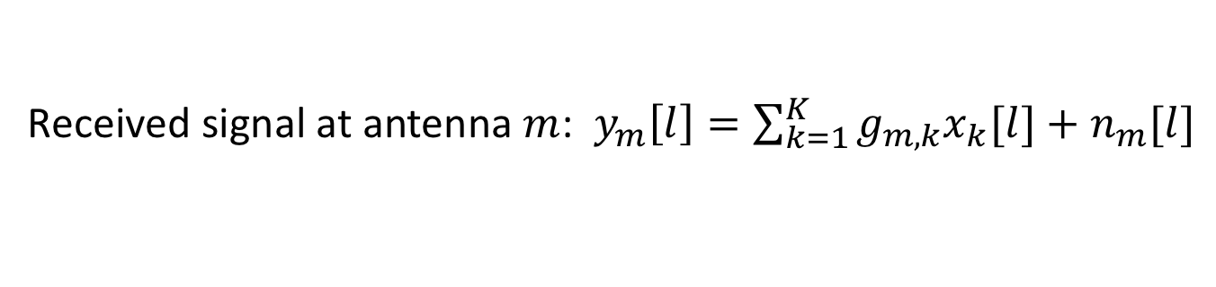
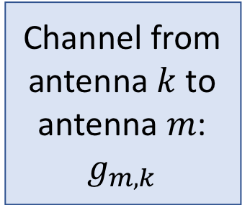
Notation
Channel from antenna $k$ to antenna $m$:
$$g_{m,k}$$
Noise:
Channel responses
Transmitted
signals
Received
signals
Noise:
Received signal at antenna $m$: $y_{m}\left[l\right]=\sum_{k=1}^{K}{g_{m,k}x_{k}[l]}+n_{m}[l]$

Slide 5
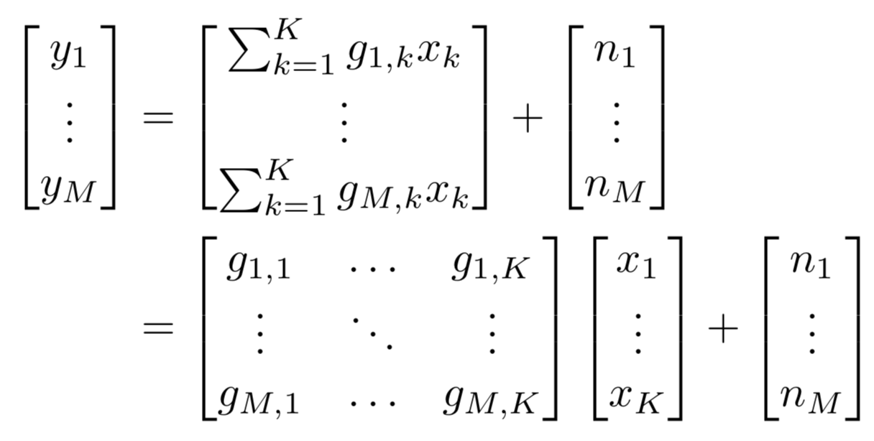
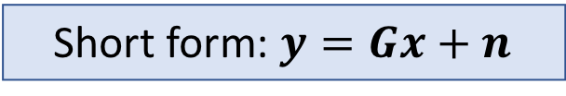

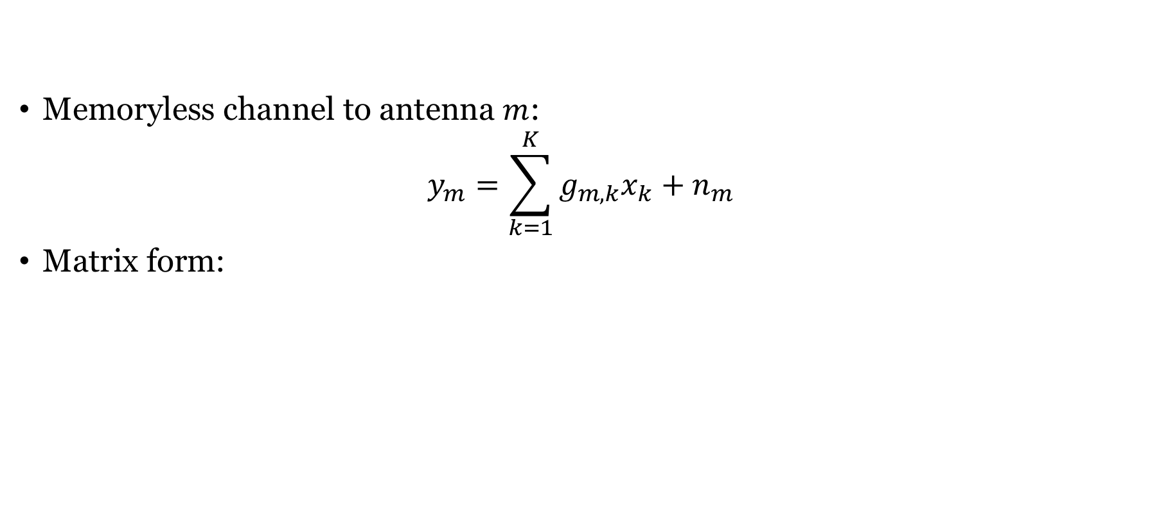



Vector-Matrix Description
Memoryless channel to antenna $m$:
$$y_{m}=\sum_{k=1}^{K}{g_{m,k}x_{k}}+n_{m}$$
Matrix form:
$$y$$
$$G$$
$$x$$
$$n$$
Short form: $y=Gx+n$

Slide 6
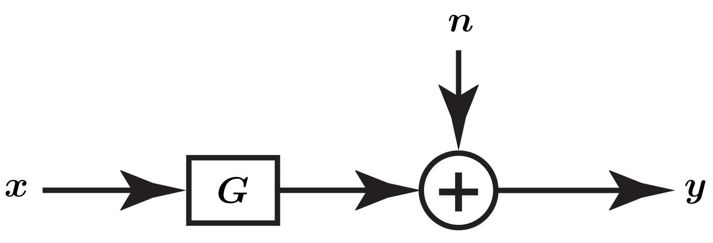
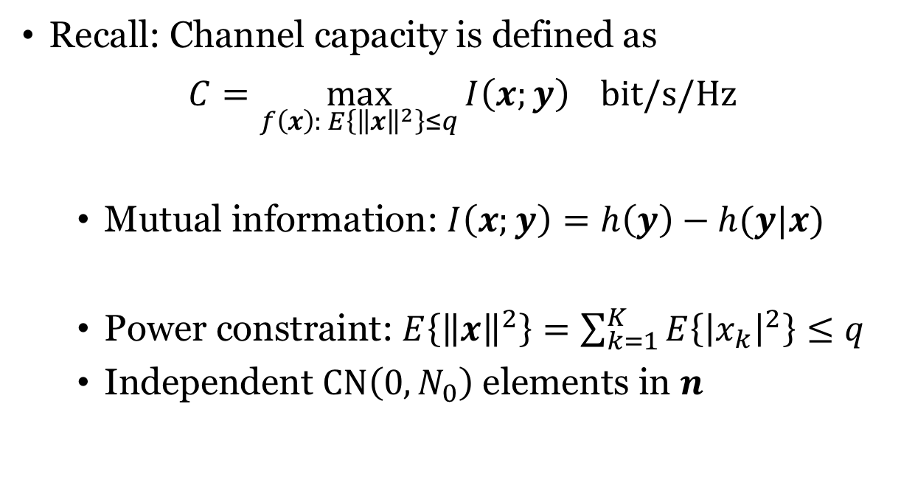
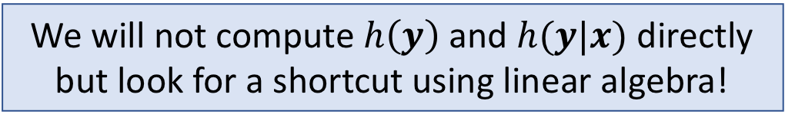
What is the channel capacity?
Recall: Channel capacity is defined as
$$C=\max_{f\left(x\right): E\left\{{\left\|x\right\|}^{2}\right\}≤q}{I\left(x;y\right)} bit/s/Hz$$
Mutual information: $I\left(x;y\right)=h\left(y\right)−h(y|x)$
Power constraint: $E\left\{{\left\|x\right\|}^{2}\right\}=\sum_{k=1}^{K}{E\left\{{\left|x_{k}\right|}^{2}\right\}}≤q$
Independent $CN\left(0,N_{0}\right)$ elements in $n$
We will not compute $h\left(y\right)$ and $h(y|x)$ directly but look for a shortcut using linear algebra!

Slide 7

Eigenvalues and eigenvectors
Consider an $M × M$ matrix $A$
A non-zero vector $u$ is an eigenvector of $A$ if
$$Au=λu$$
where the scalar $λ$ is the eigenvalue corresponding to $u$

Slide 8
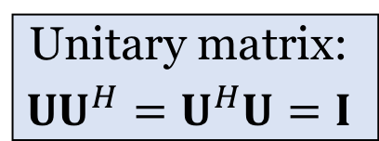
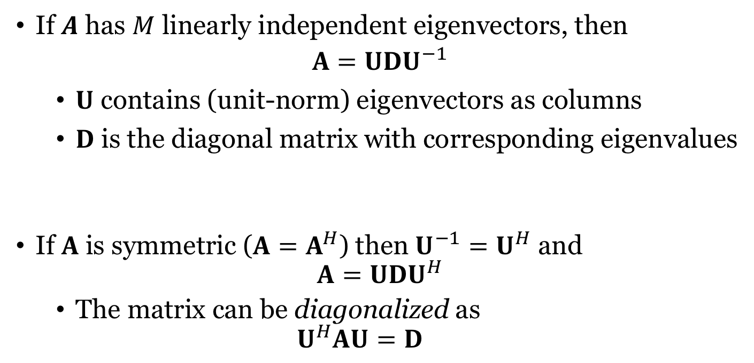
Eigenvalue decomposition
If $A$ has $M$ linearly independent eigenvectors, then
$$A=UDU^{−1}$$
$U$ contains (unit-norm) eigenvectors as columns
$D$ is the diagonal matrix with corresponding eigenvalues
If $A$ is symmetric ($A=A^{H}$) then $U^{−1}=U^{H}$ and
$$A=UDU^{H}$$
The matrix can be diagonalized as
$$U^{H}AU=D$$
Unitary matrix:
$$UU^{H}=U^{H}U=I$$

Slide 9
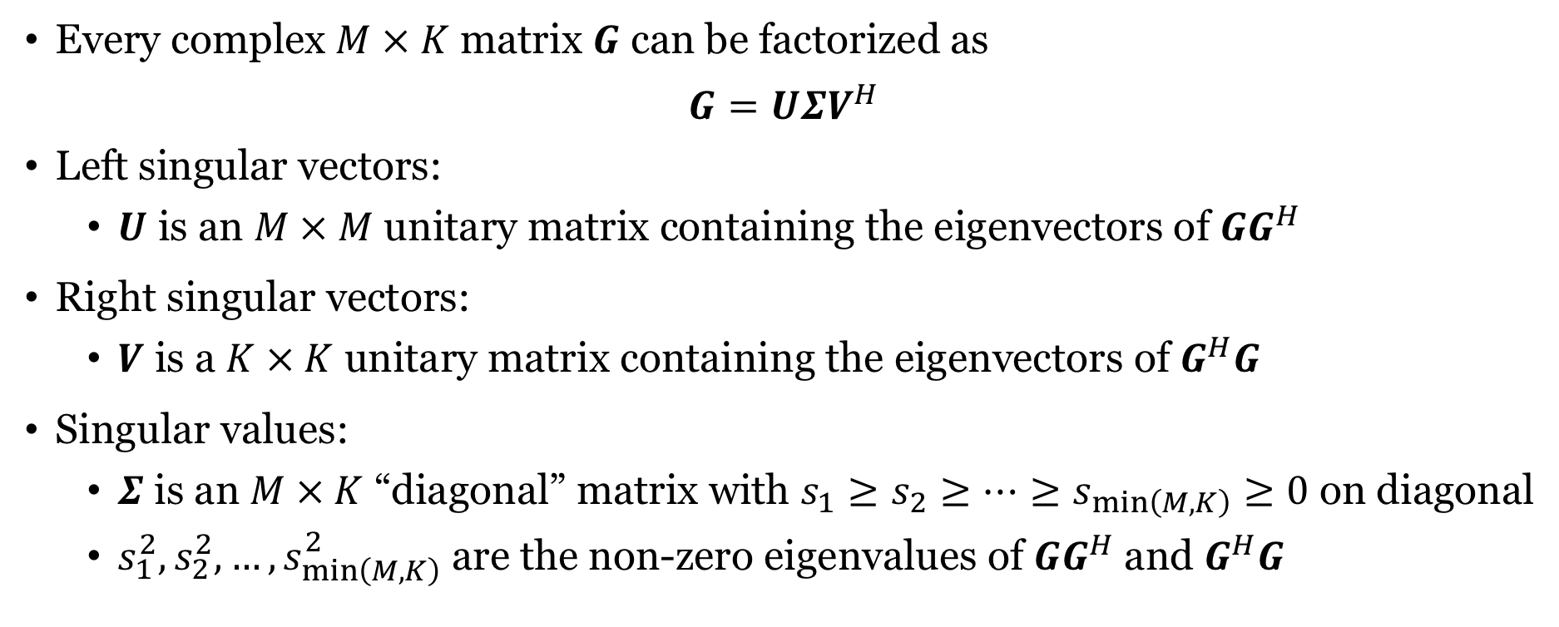
Singular value decomposition
Every complex $M × K$ matrix $G$ can be factorized as
$$G=UΣV^{H}$$
Left singular vectors:
$U$ is an $M × M$ unitary matrix containing the eigenvectors of $GG^{H}$
Right singular vectors:
$V$ is a $K × K$ unitary matrix containing the eigenvectors of $G^{H}G$
Singular values:
$Σ$ is an $M × K$ “diagonal” matrix with $s_{1}≥s_{2}≥…≥s_{\min\left(M,K\right)}≥0$ on diagonal
$s_{1}^{2},s_{2}^{2},…,s_{\min\left(M,K\right)}^{2}$ are the non-zero eigenvalues of $GG^{H}$ and $G^{H}G$

Slide 10
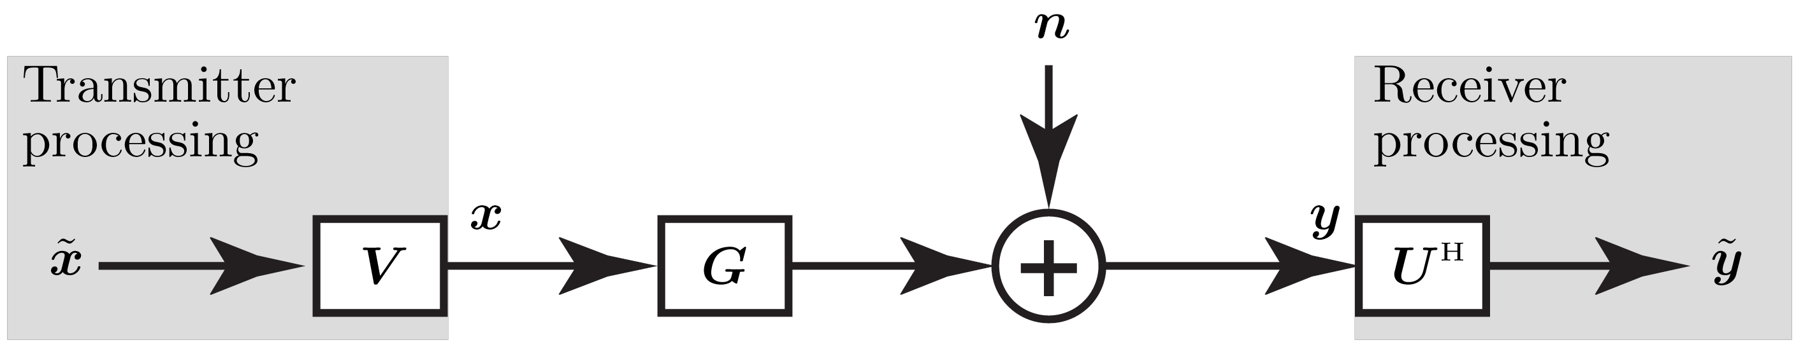


Diagonalizing the MIMO channel
Non-destructive processing:
Pre-processing: $x=V\tilde{x}$
Post-processing: $\tilde{y}=U^{H}y$
$$\tilde{y}=U^{H}\left(Gx+n\right)=U^{H}UΣV^{H}V\tilde{x}+U^{H}n$$
Singular value decomposition
$\tilde{n}$: Rotated noise: i.i.d. $CN(0,N_{0})$

Slide 11
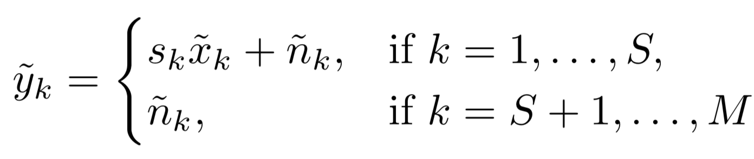

Diagonalizing the MIMO channel (2)
Processed received signal:
$$\tilde{y}=Σ\tilde{x}+\tilde{n}$$
Let $S$ denote the number of non-zero singular values (rank of $G$):
Useful subchannels
Useless subchannels

Slide 12
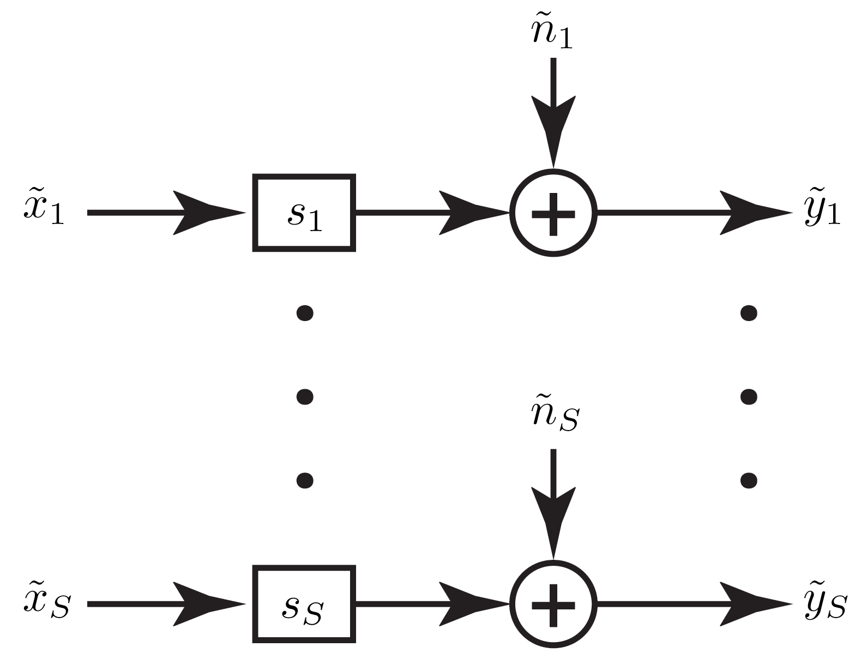
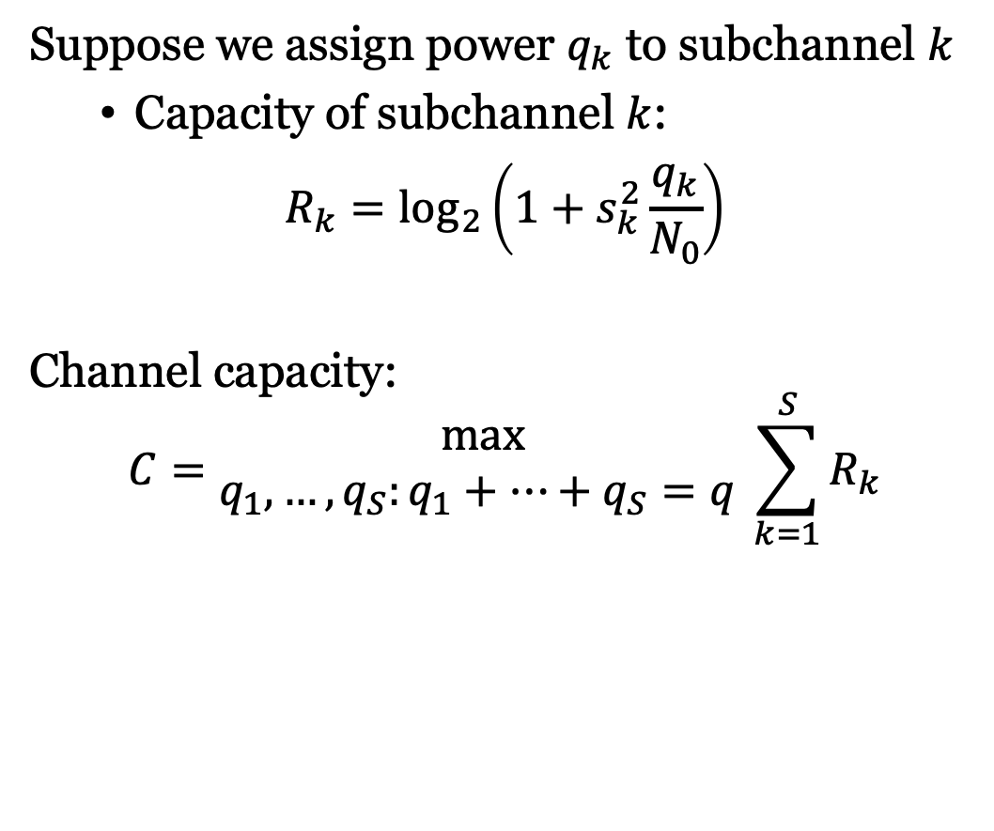
$S$ parallel channels
Suppose we assign power $q_{k}$ to subchannel $k$
Capacity of subchannel $k$:
$$R_{k}=\log_{2}\left(1+s_{k}^{2}\frac{q_{k}}{N_{0}}\right)$$
Channel capacity:
$$C=\begin{matrix}max \\ q_{1},…,q_{S}:q_{1}+…+q_{S}=q \end{matrix}\sum_{k=1}^{S}{R_{k}}$$

Slide 13
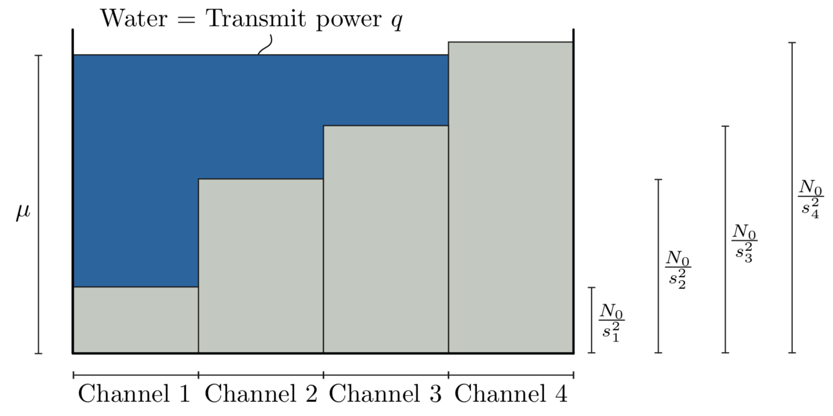
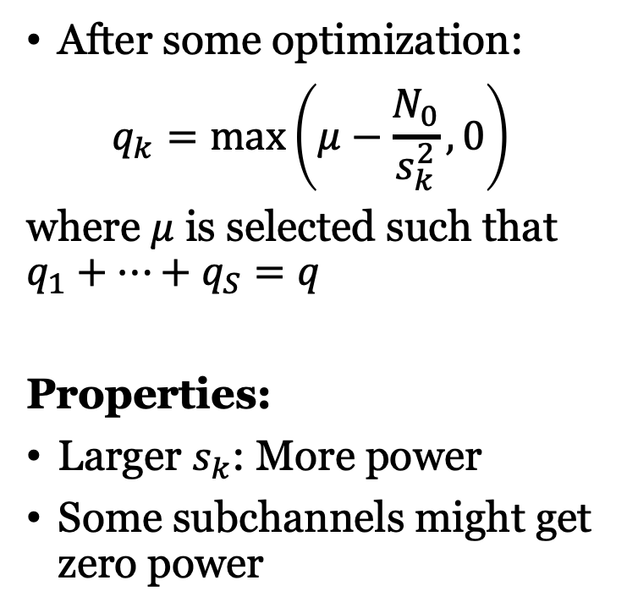
Optimal Power Allocation
After some optimization:
$$q_{k}=\max\left(μ−\frac{N_{0}}{s_{k}^{2}},0\right)$$
where $μ$ is selected such that $q_{1}+…+q_{S}=q$
Properties:
Larger $s_{k}$: More power
Some subchannels might get zero power
Called waterfilling

Slide 14
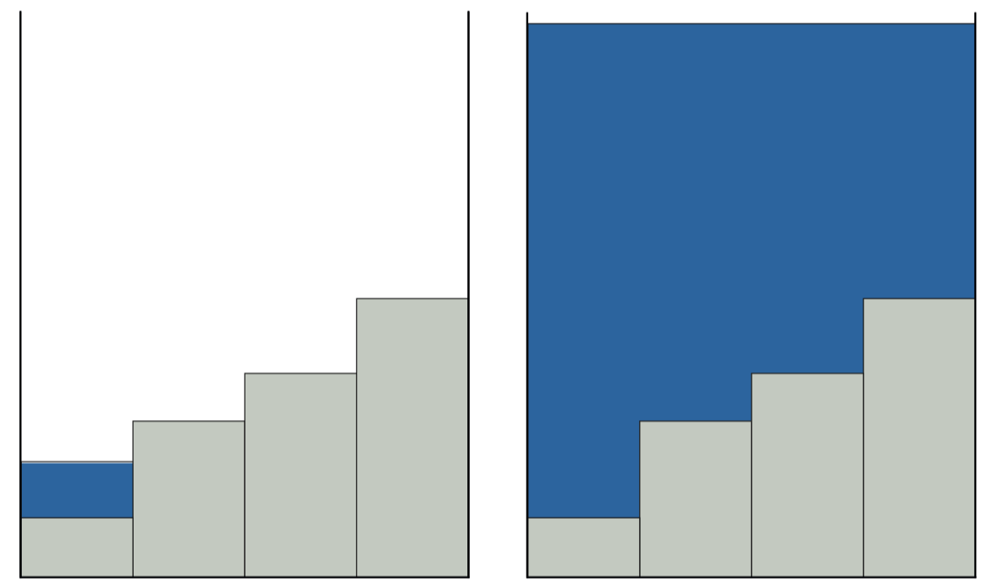
Low and high SNR
Low SNR:
Only power to one subchannel
High SNR:
Approximately the same power to all subchannels

Slide 15
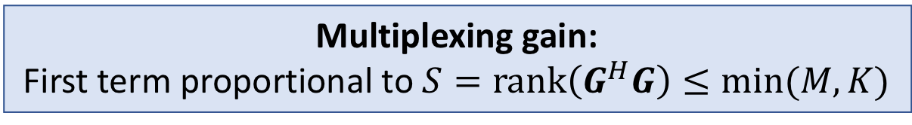
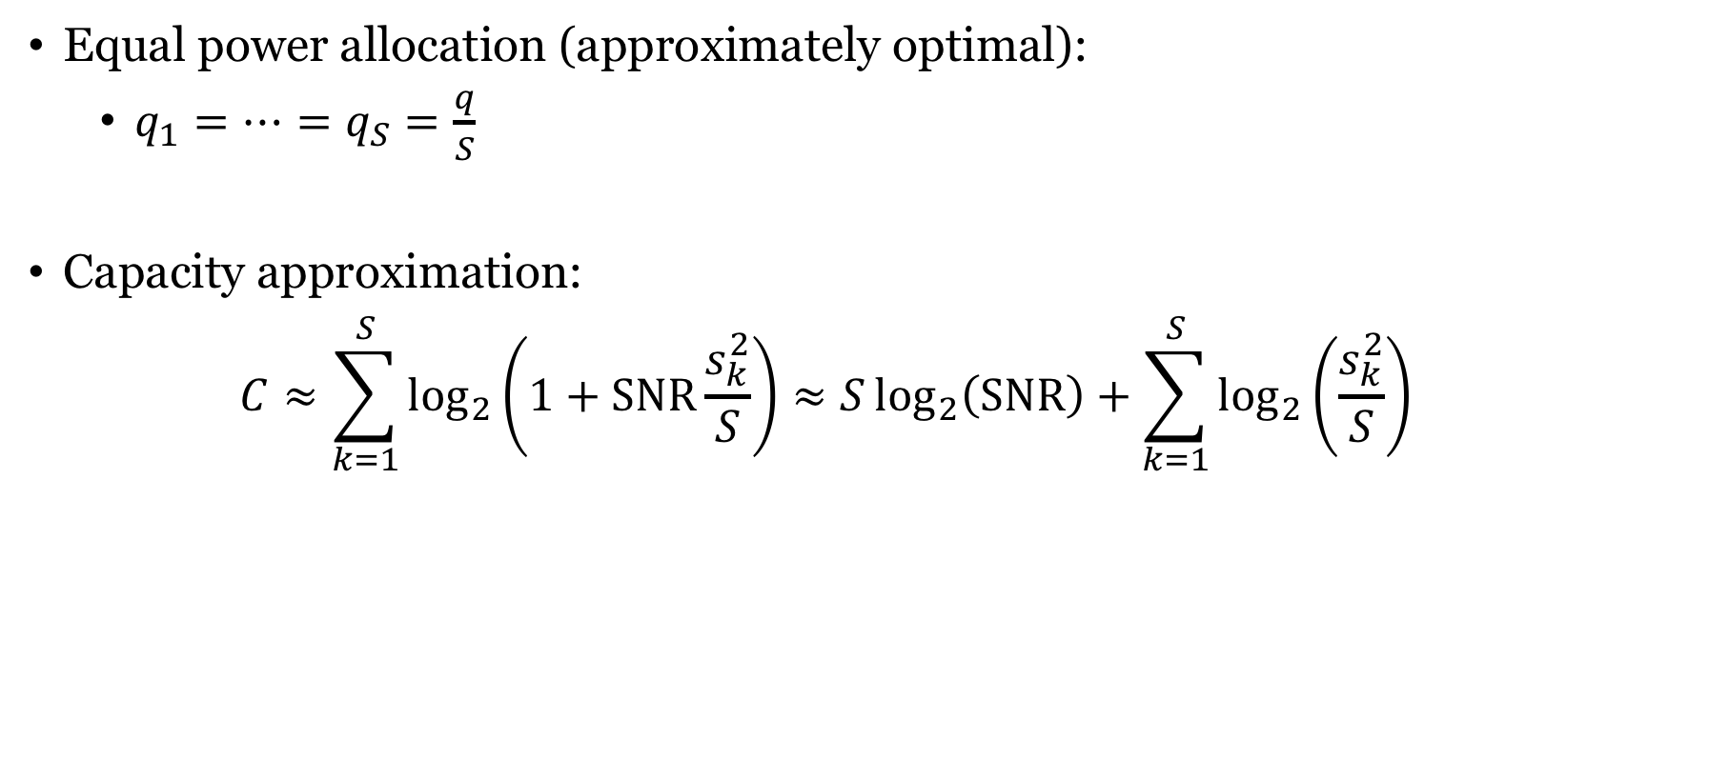

Capacity behavior at high SNR
Equal power allocation (approximately optimal):
$q_{1}=…=q_{S}=\frac{q}{S}$
Capacity approximation:
$$C≈\sum_{k=1}^{S}{\log_{2}\left(1+SNR\frac{s_{k}^{2}}{S}\right)}≈S\log_{2}\left(SNR\right)+\sum_{k=1}^{S}{\log_{2}\left(\frac{s_{k}^{2}}{S}\right)}$$
$$q/N_{0}$$
Multiplexing gain:
First term proportional to $S=rank\left(G^{H}G\right)≤min⁡(M,K)$

Slide 16
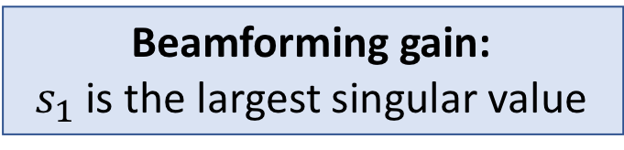
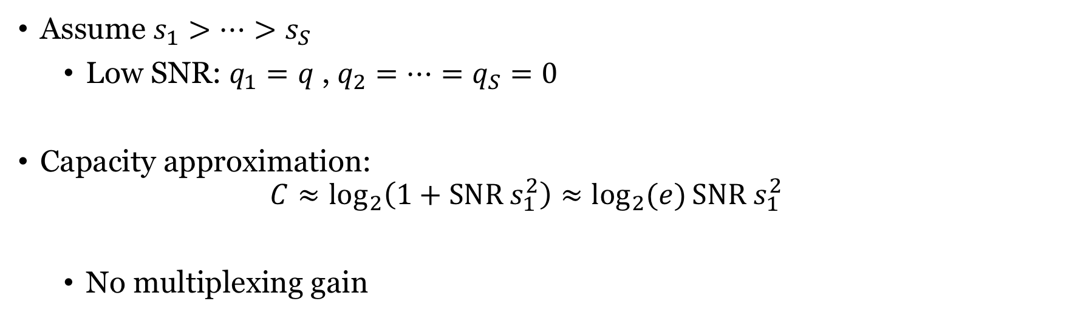
Capacity behavior at low SNR
Assume $s_{1}>…>s_{S}$
Low SNR: $q_{1}=q$ , $q_{2}=…=q_{S}=0$
Capacity approximation:
$$C≈\log_{2}\left(1+SNR s_{1}^{2}\right)≈\log_{2}{(e)}SNR s_{1}^{2}$$
No multiplexing gain
Beamforming gain:
$s_{1}$ is the largest singular value

Slide 17
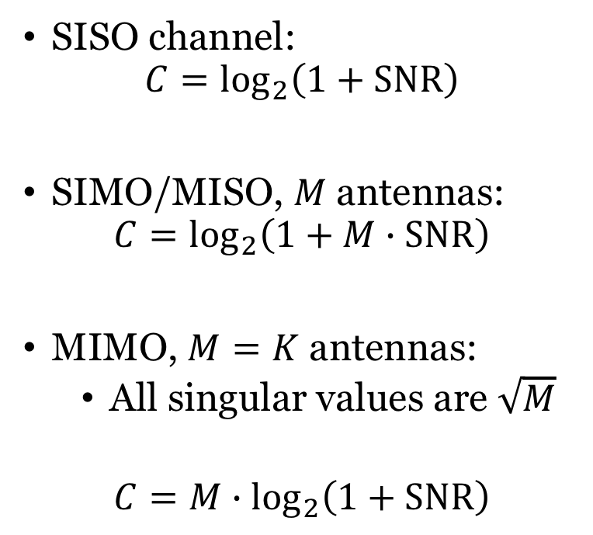
Capacity comparison with $\left|g_{m,k}\right|=1$
SISO channel:
$$C=\log_{2}\left(1+SNR\right)$$
SIMO/MISO, $M$ antennas:
$$C=\log_{2}\left(1+M∙SNR\right)$$
MIMO, $M=K$ antennas:
All singular values are $\sqrt{M}$
$$C=M∙\log_{2}\left(1+SNR\right)$$
Four times
steeper slope

Slide 18
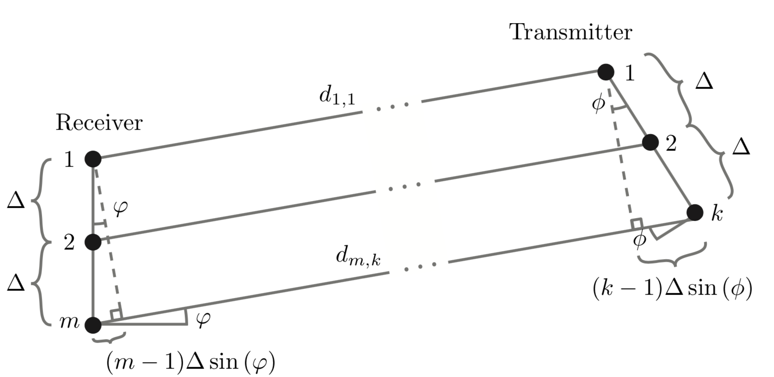
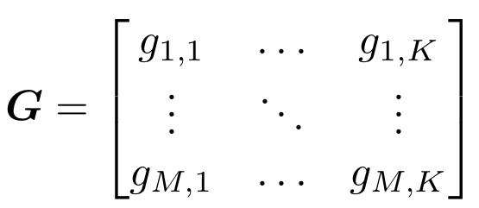
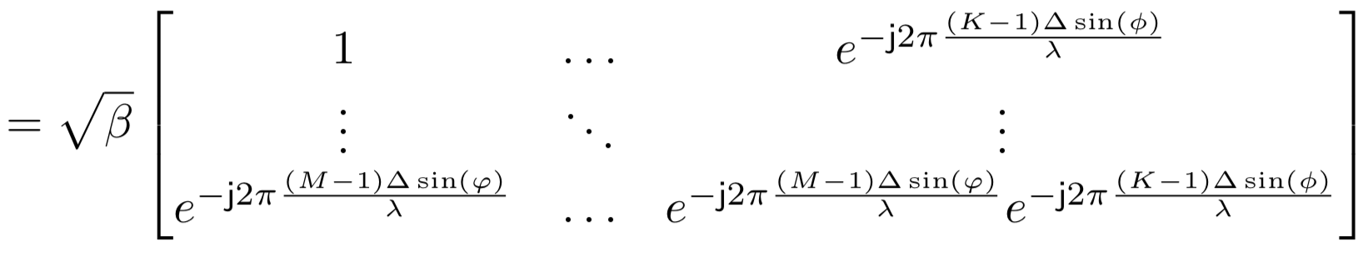
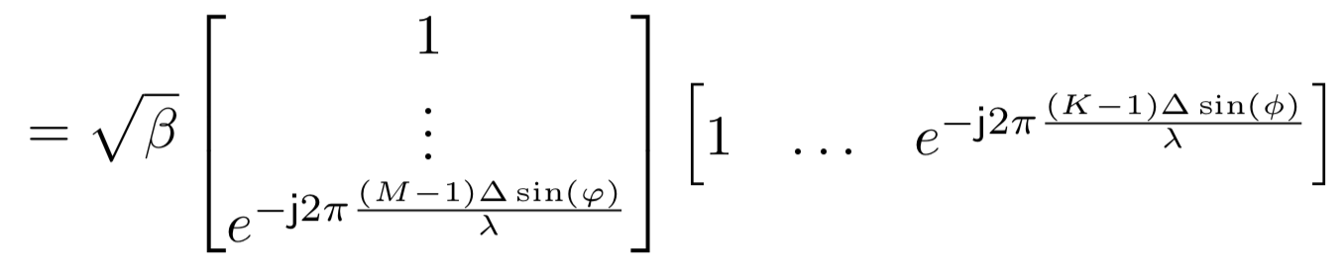
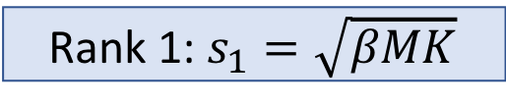
Example: Line-of-sight channel
Rank 1: $s_{1}=\sqrt{βMK}$

Slide 19
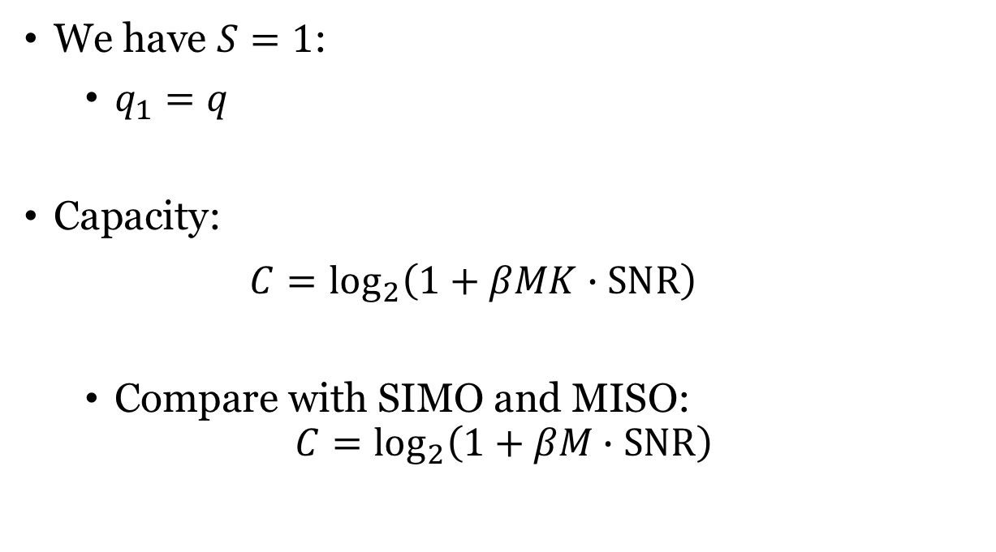
Line-of-sight channels: No multiplexing gain
We have $S=1$:
$q_{1}=q$
Capacity:
$$C=\log_{2}\left(1+βMK∙SNR\right)$$
Compare with SIMO and MISO:
$$C=\log_{2}\left(1+βM∙SNR\right)$$
Beamforming gain:
Larger in the MIMO case

Slide 20
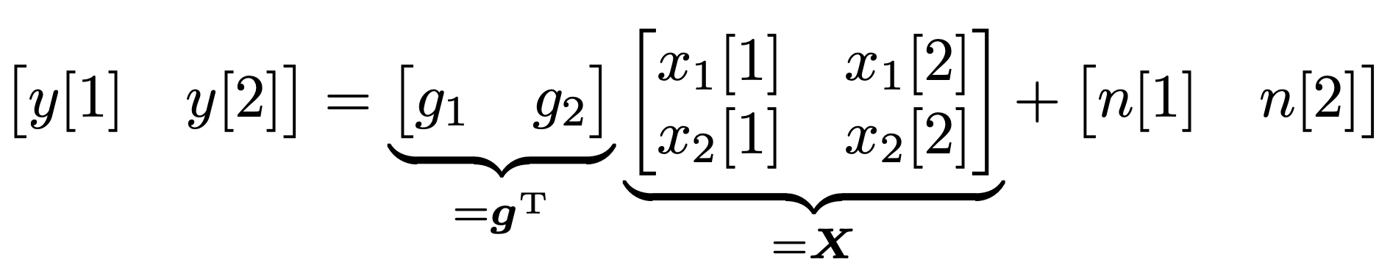
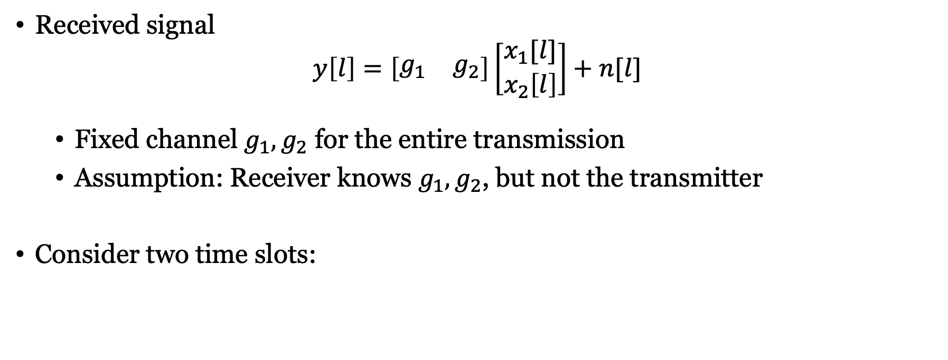
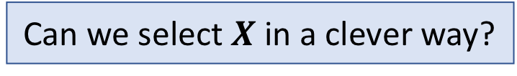
Slow fading and MISO channels ($M=2$)
Received signal
$$y\left[l\right]=\left[\begin{matrix}g_{1} & g_{2}\end{matrix}\right]\left[\begin{matrix}x_{1}[l] \\ x_{2}\left[l\right]\end{matrix}\right]+n[l]$$
Fixed channel $g_{1},g_{2}$ for the entire transmission
Assumption: Receiver knows $g_{1},g_{2}$, but not the transmitter
Consider two time slots:
Can we select $X$ in a clever way?

Slide 21
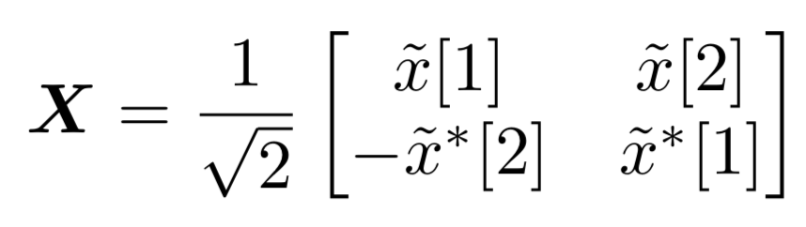
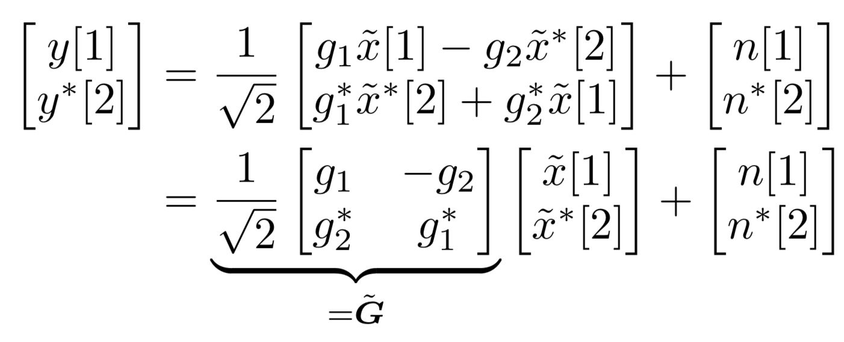
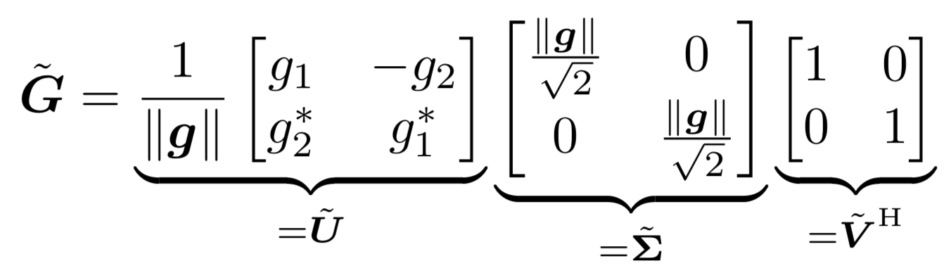

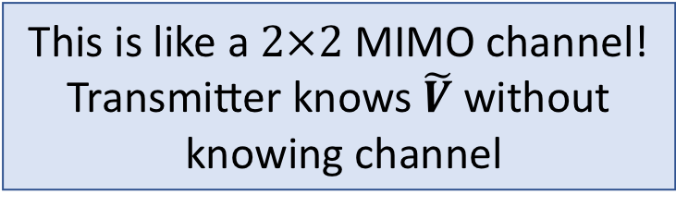
Space-time block coding
Data signals $\tilde{x}\left[1\right],\tilde{x}[2]$
Alamouti code:
Consider received signal:
This is like a $2×2$ MIMO channel!
Transmitter knows $\tilde{V}$ without knowing channel

Slide 22
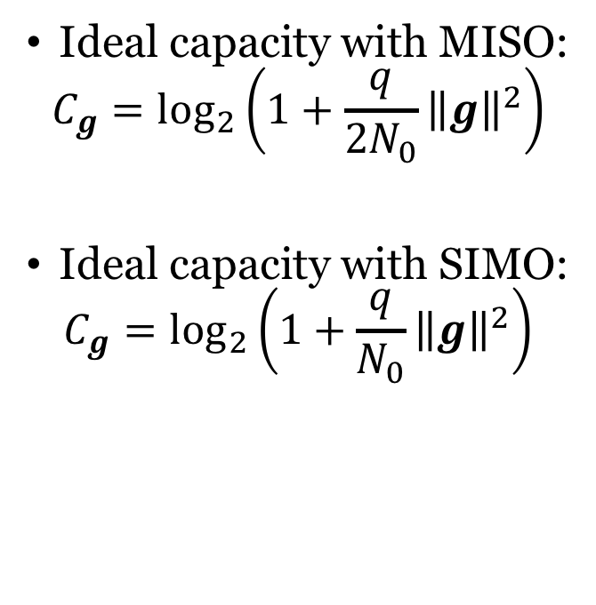
Transmit diversity versus receive diversity
Ideal capacity with MISO:
$$C_{g}=\log_{2}\left(1+\frac{q}{{2N}_{0}}{\left\|g\right\|}^{2}\right)$$
Ideal capacity with SIMO:
$$C_{g}=\log_{2}\left(1+\frac{q}{N_{0}}{\left\|g\right\|}^{2}\right)$$
Outage probability:
Same behavior but half the SNR
Diversity gain, but no beamforming gain

Slide 23
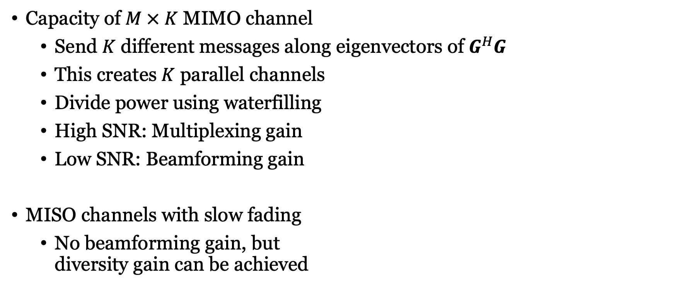
Summary
Capacity of $M × K$ MIMO channel
Send $K$ different messages along eigenvectors of $G^{H}G$
This creates $K$ parallel channels
Divide power using waterfilling
High SNR: Multiplexing gain
Low SNR: Beamforming gain
MISO channels with slow fading
No beamforming gain, but diversity gain can be achieved

Slide 24
Multiple Antenna Communications
Lecture 4:
Capacity of Point-to-Point MIMO Channels
Emil Björnson

