Slide 1
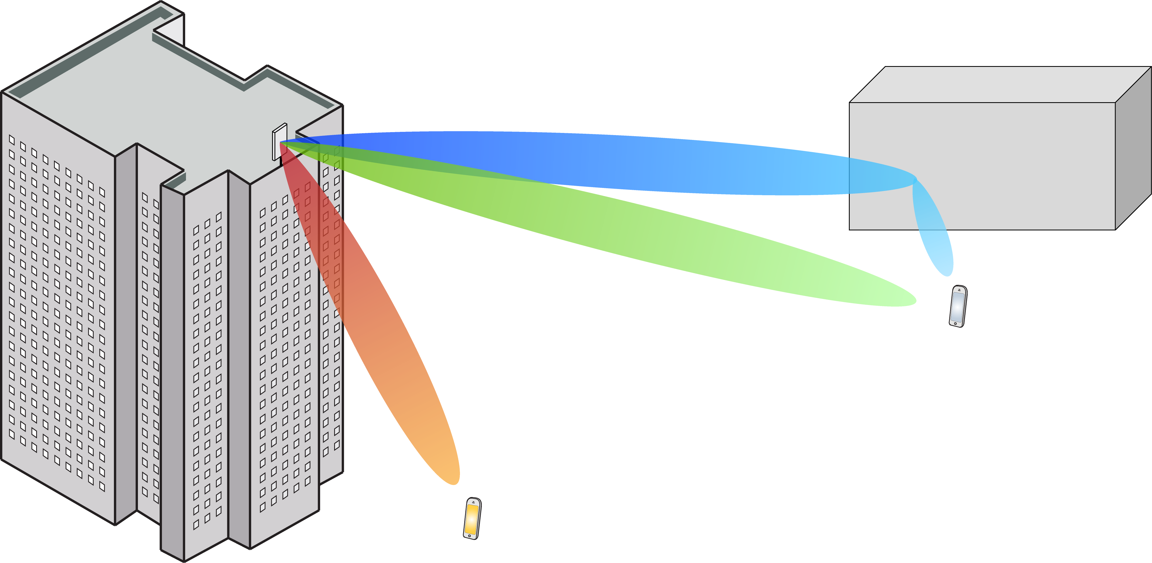
Multiple Antenna Communications
Lecture 5:
Introduction to Multiuser MIMO
Emil Björnson

Slide 2
Outline
Practical issues with point-to-point MIMO
Introduction to multi-user MIMO
Uplink and downlink
Orthogonal access vs. spatial multiplexing
Capacity region
Operating points

Slide 3
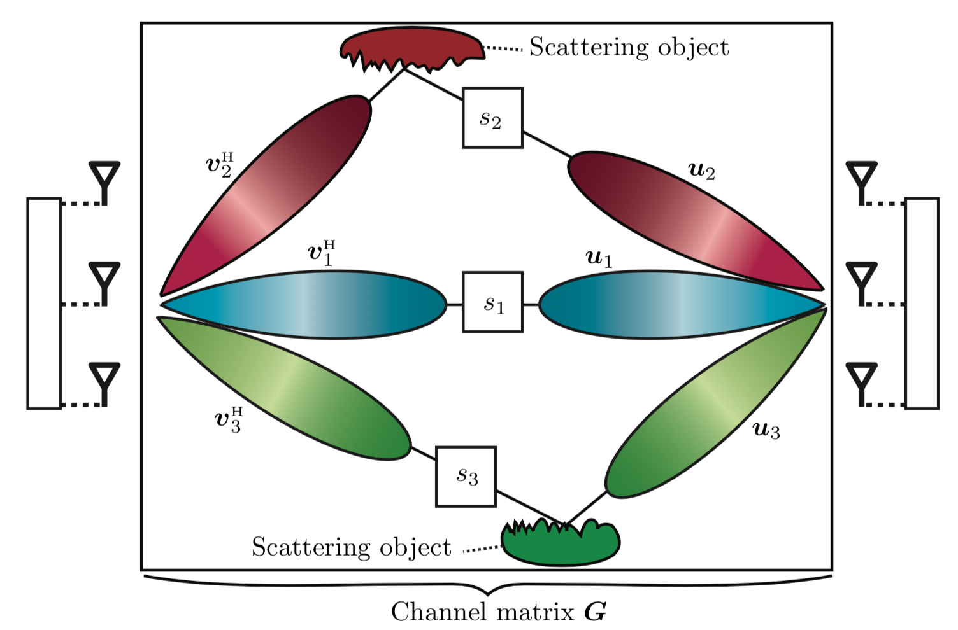
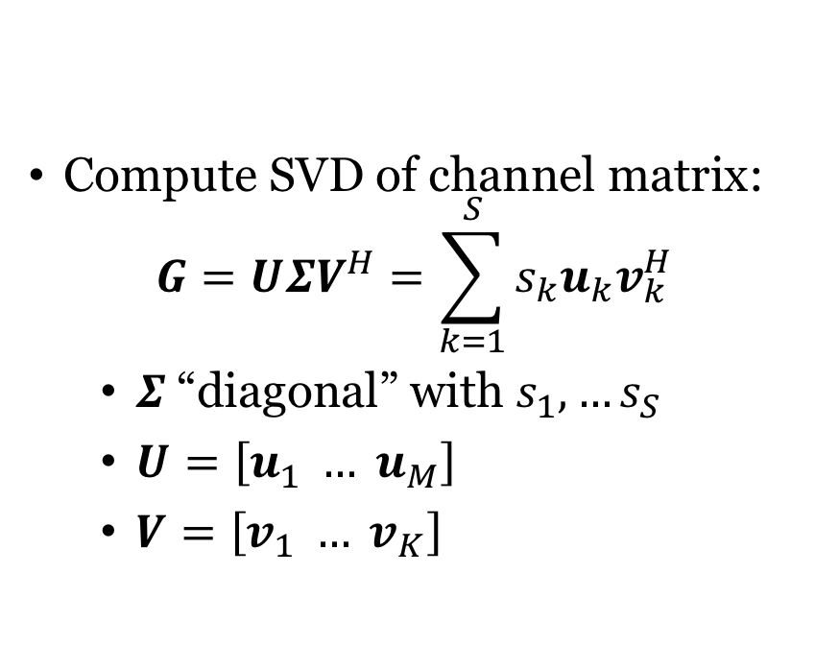
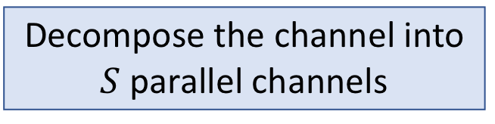
Recall: Point-to-Point MIMO Capacity
Compute SVD of channel matrix:
$$G=UΣV^{H}=\sum_{k=1}^{S}{s_{k}u_{k}v_{k}^{H}}$$
$Σ$ “diagonal” with $s_{1},…s_{S}$
$U=\left[u_{1} … u_{M}\right]$
$V=\left[v_{1} … v_{K}\right]$
Decompose the channel into $S$ parallel channels

Slide 4
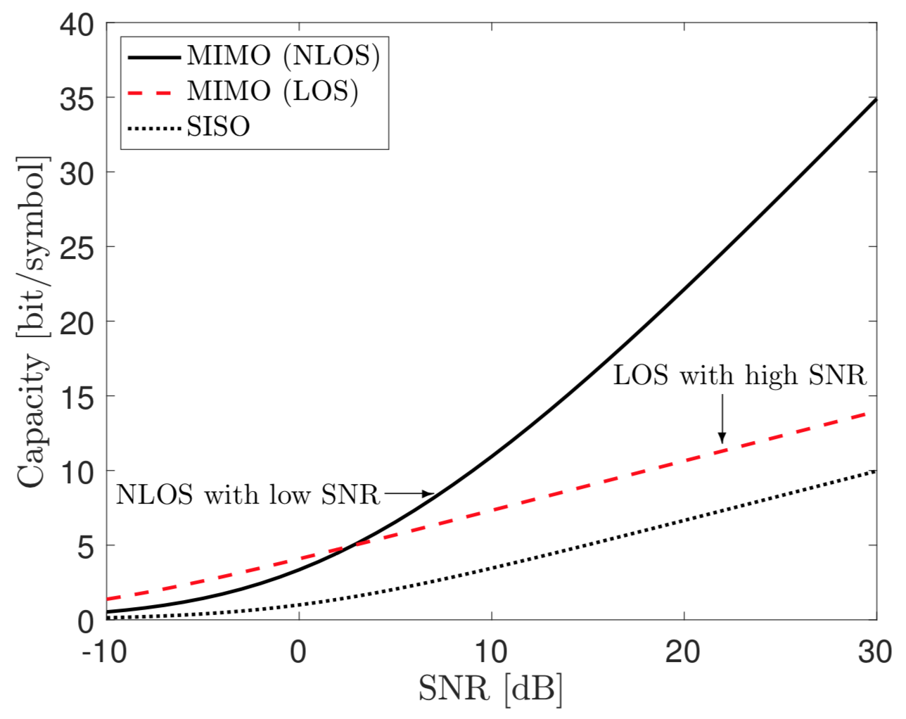

Problems with point-to-point MIMO
Multiplexing gain: $S=rank\left(G\right)$
Line-of-sight: $S≈1$
Non-line-of-sight: $S=\min\left(M,K\right)$
Mainly beamforming gain:
High SNR: Likely to be in line-of-sight (LOS)
Low SNR: Likely to be non-line-of-sight (NLOS)
Not scalable: User devices are small, cannot fit many antennas

Slide 5
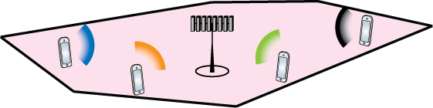
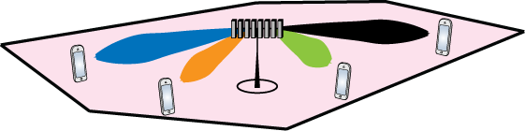
Multiuser MIMO Communication
Uplink
From users to base station
Multipoint-to-point MIMO
D0wnlink
From base station to users
Point-to-multipoint MIMO
Multiantenna base station

Slide 6
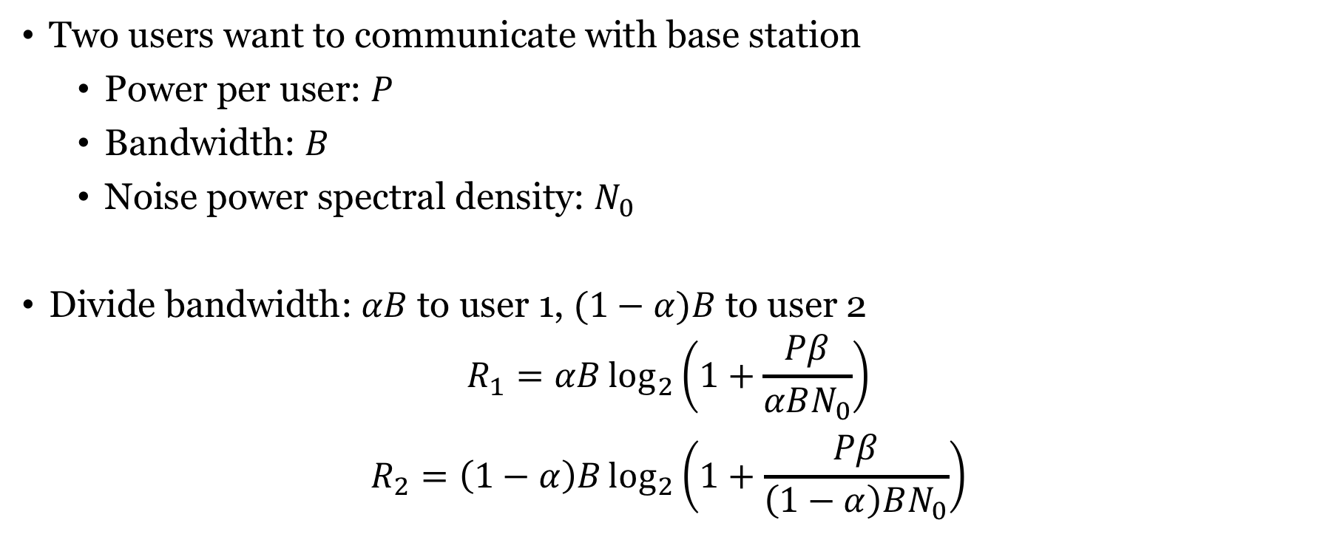


Orthogonal multiple access
$$\sqrt{β}$$
$$\sqrt{β}$$
Two users want to communicate with base station
Power per user: $P$
Bandwidth: $B$
Noise power spectral density: $N_{0}$
Divide bandwidth: $αB$ to user 1, $(1−α)B$ to user 2
$$R_{1}=αB\log_{2}\left(1+\frac{Pβ}{αBN_{0}}\right)$$
$$R_{2}=\left(1−α\right)B\log_{2}\left(1+\frac{Pβ}{\left(1−α\right)BN_{0}}\right)$$
User 1
User 2

Slide 7
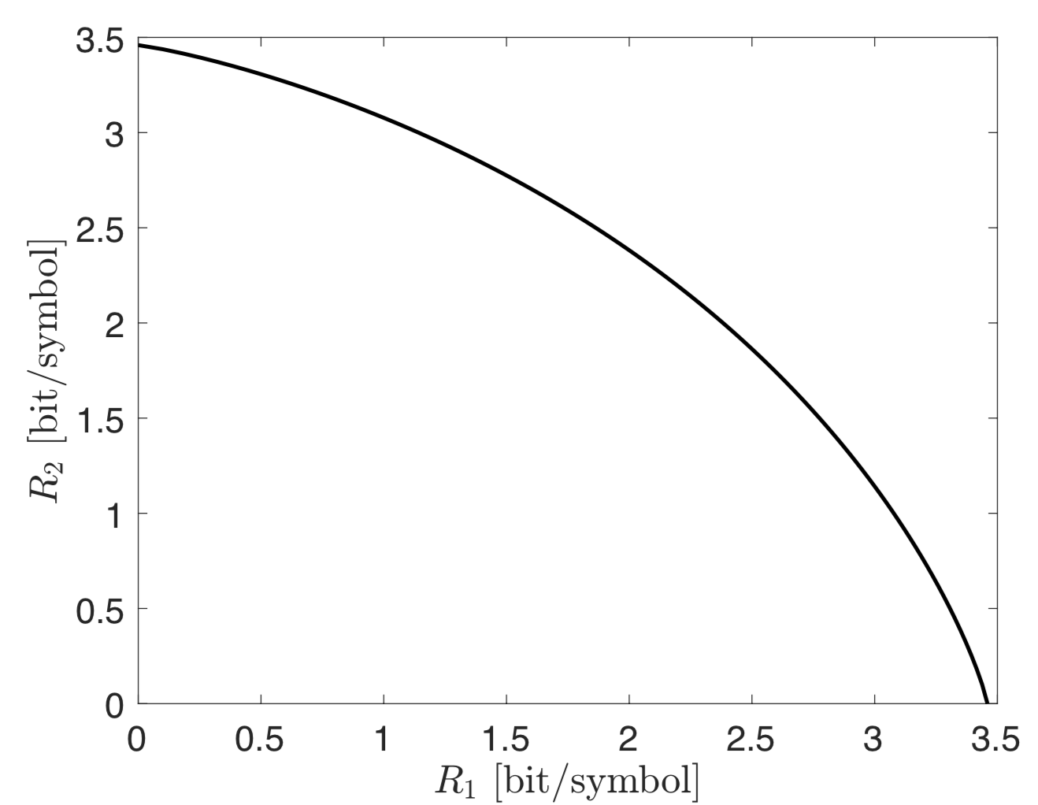
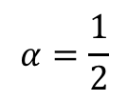




Orthogonal multiple access: Rate region
Rates depend on $α$:
$$R_{1}=αB\log_{2}\left(1+\frac{Pβ}{αBN_{0}}\right)$$
$$R_{2}=\left(1−α\right)B\log_{2}\left(1+\frac{Pβ}{\left(1−α\right)BN_{0}}\right)$$
$$α=0$$
$$α=\frac{1}{2}$$
What is the preferred operating point?
$$\frac{Pβ}{BN_{0}}=10 dB$$
$$α=1$$

Slide 8
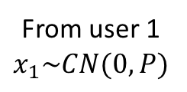
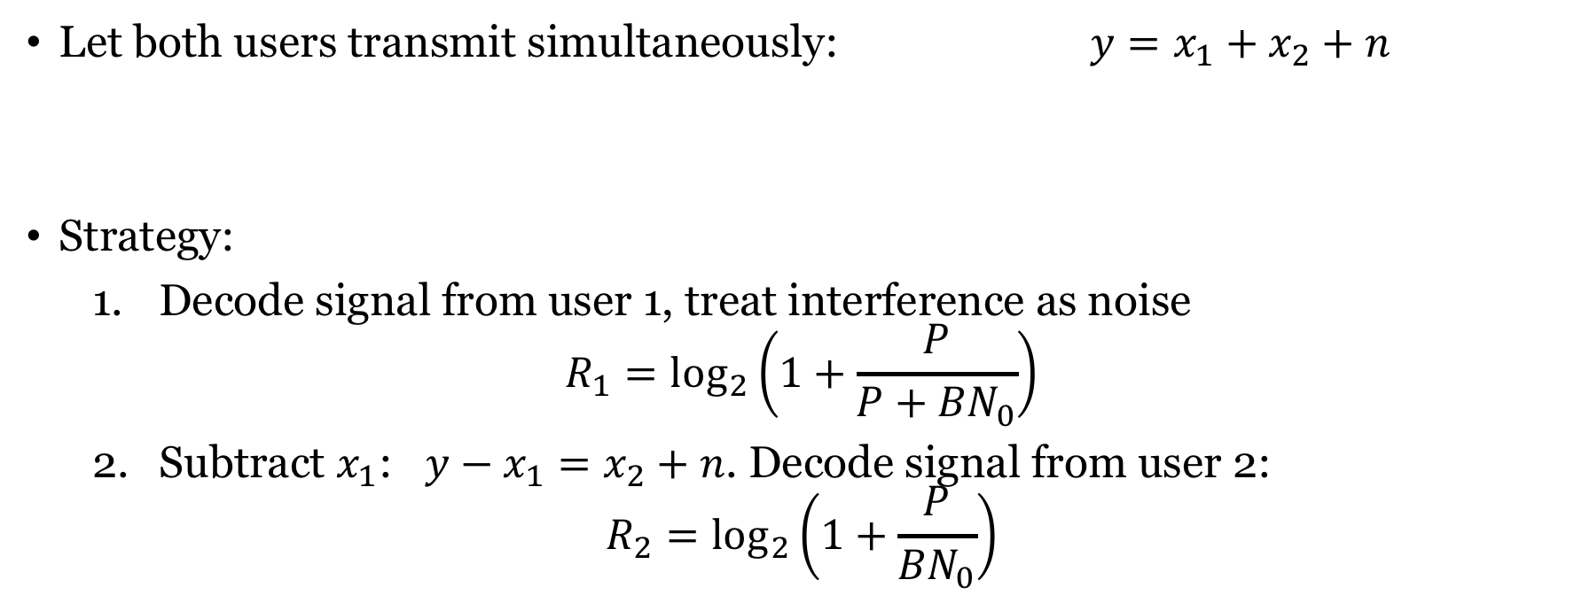
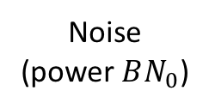
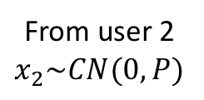
Non-orthogonal multiple access
From user 1
$$x_{1}\sim CN(0,P)$$
Noise
(power $BN_{0}$)
Let both users transmit simultaneously: $y=x_{1}+x_{2}+n$
Strategy:
Decode signal from user 1, treat interference as noise
$$R_{1}=\log_{2}\left(1+\frac{P}{P+{BN}_{0}}\right)$$
Subtract $x_{1}$: $y−x_{1}=x_{2}+n$. Decode signal from user 2:
$$R_{2}=\log_{2}\left(1+\frac{P}{{BN}_{0}}\right)$$
Received signal
From user 2
$$x_{2}\sim CN(0,P)$$
Called: Successive interference cancelation
We can change the user order

Slide 9
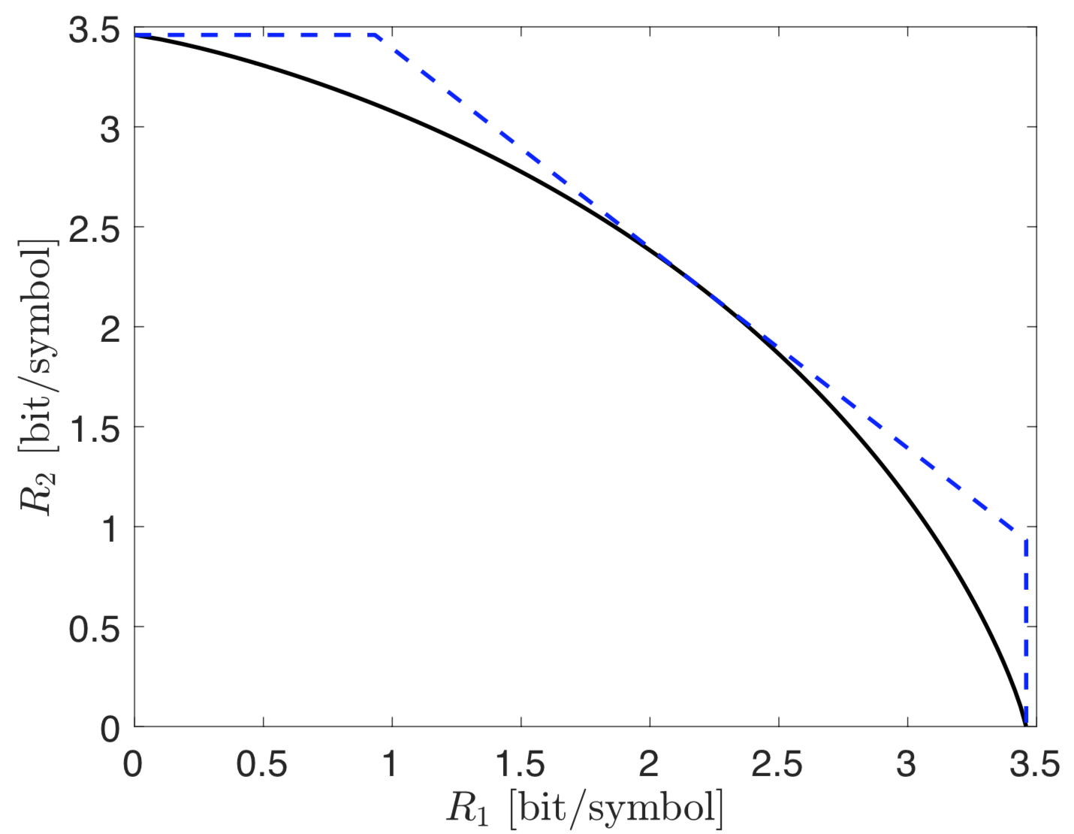
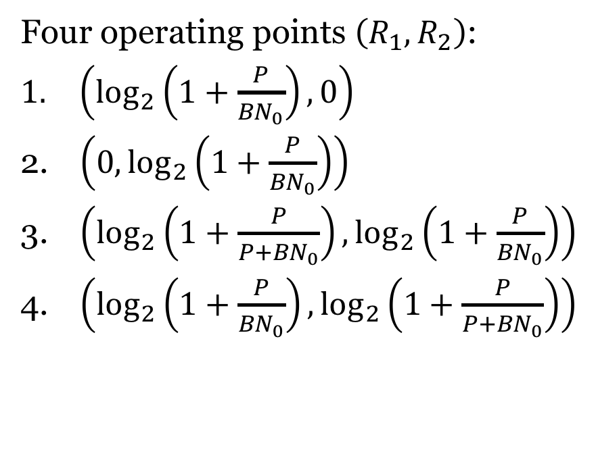
Non-orthogonal multiple access: Rate region
2
3
Four operating points $\left(R_{1},R_{2}\right)$:
$\left(\log_{2}\left(1+\frac{P}{{BN}_{0}}\right),0\right)$
$\left(0,\log_{2}\left(1+\frac{P}{{BN}_{0}}\right)\right)$
$\left(\log_{2}\left(1+\frac{P}{P+{BN}_{0}}\right),\log_{2}\left(1+\frac{P}{{BN}_{0}}\right)\right)$
$\left(\log_{2}\left(1+\frac{P}{{BN}_{0}}\right),\log_{2}\left(1+\frac{P}{P+{BN}_{0}}\right)\right)$
4
Time sharing:
We can achieve all points in between
1

Slide 10
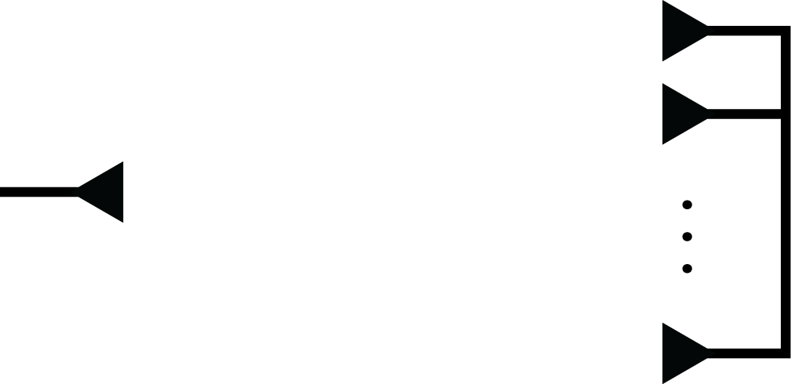


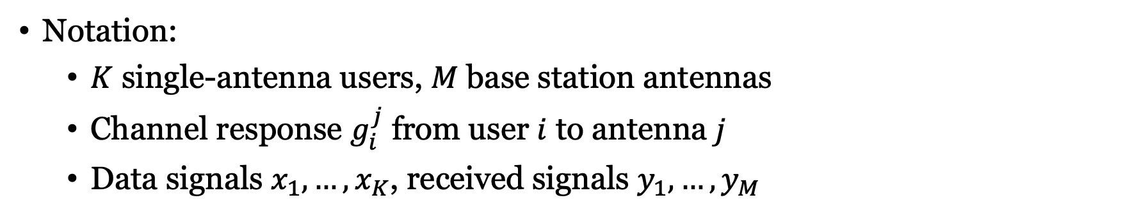




Uplink in Multiuser MIMO
$$x_{1}$$
$$y_{1}$$
$$y_{2}$$
Transmitters
$$x_{i}$$
Receiver
$$x_{K}$$
$$y_{M}$$
Notation:
$K$ single-antenna users, $M$ base station antennas
Channel response $g_{i}^{j}$ from user $i$ to antenna $j$
Data signals $x_{1},…,x_{K}$, received signals $y_{1},…,y_{M}$

Slide 11
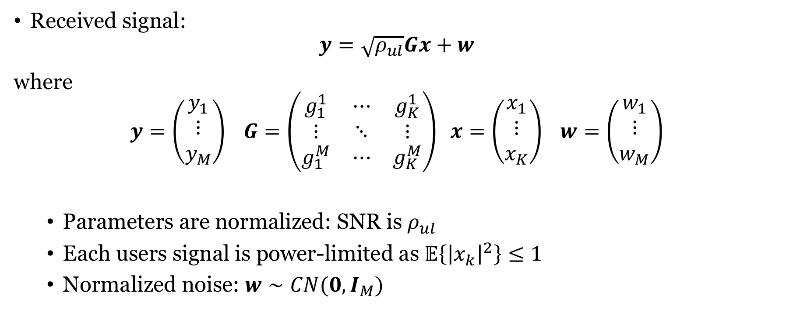
Uplink Multiuser MIMO: System model
Received signal:
$$y=\sqrt{ρ_{ul}}Gx+w$$
where
$$y=\left(\begin{matrix}y_{1} \\ ⋮ \\ y_{M}\end{matrix}\right) G=\left(\begin{matrix}g_{1}^{1} & ⋯ & g_{K}^{1} \\ ⋮ & ⋱ & ⋮ \\ g_{1}^{M} & ⋯ & g_{K}^{M}\end{matrix}\right) x=\left(\begin{matrix}x_{1} \\ ⋮ \\ x_{K}\end{matrix}\right) w=\left(\begin{matrix}w_{1} \\ ⋮ \\ w_{M}\end{matrix}\right)$$
Parameters are normalized: SNR is $ρ_{ul}$
Each users signal is power-limited as $𝔼\left\{{\left|x_{k}\right|}^{2}\right\}≤1$
Normalized noise: $w∼CN(0,I_{M})$

Slide 12
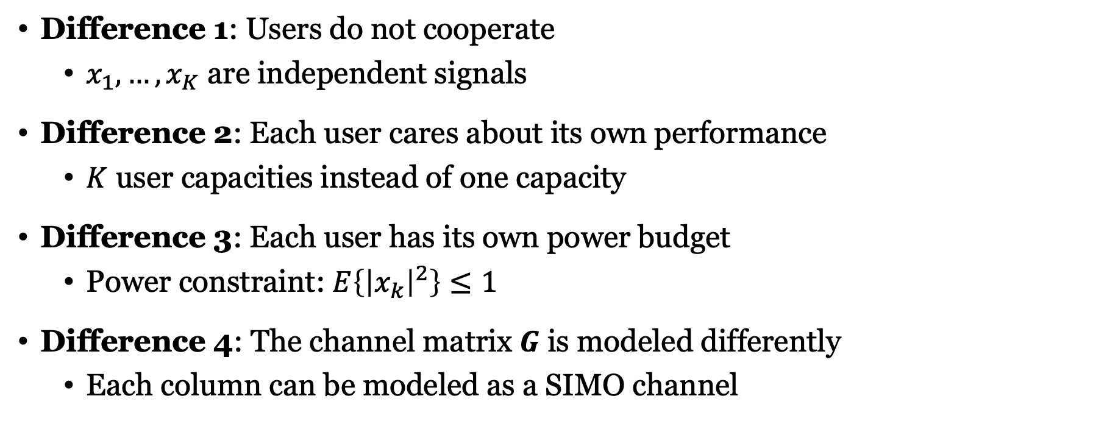
What is the difference from point-to-point MIMO?
Difference 1: Users do not cooperate
$x_{1},…,x_{K}$ are independent signals
Difference 2: Each user cares about its own performance
$K$ user capacities instead of one capacity
Difference 3: Each user has its own power budget
Power constraint: $E\left\{{\left|x_{k}\right|}^{2}\right\}≤1$
Difference 4: The channel matrix $G$ is modeled differently
Each column can be modeled as a SIMO channel

Slide 13






Motivating example
Multi-user MIMO
Orthogonal access
Non-orthogonal access
$$R_{2}$$
$$R_{2}$$
$$R_{2}$$
$$R_{1}$$
$$R_{1}$$
$$R_{1}$$
Capacity or rate region?
Capacity region is the largest possible rate region
Two benefits:
Beamforming gain for every user
Smaller interference loss

Slide 14
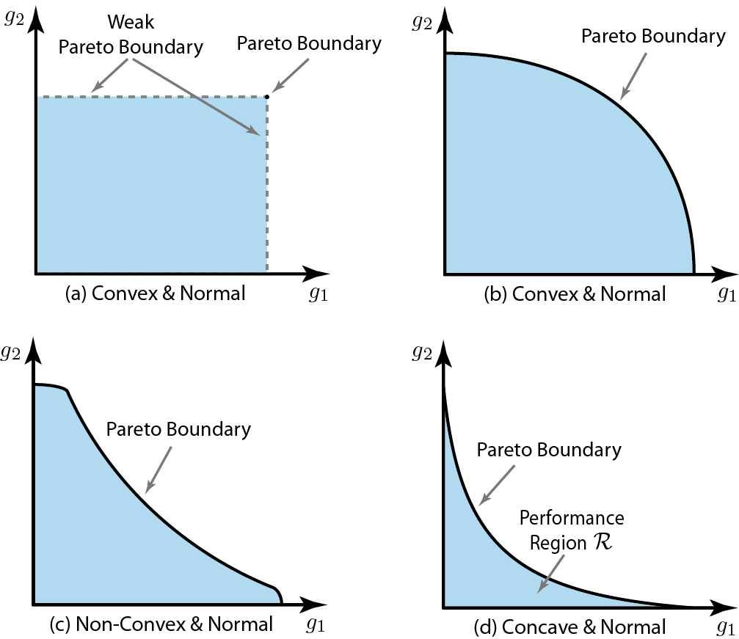
Shape of capacity region
One can pick two points and use them fractions of the time
Similar to time-sharing
Hence: Line between any two points are in the region
Conclusion: Region must be a convex set
Possible shape
Impossible
shape

Slide 15
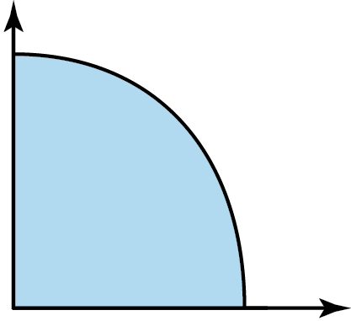
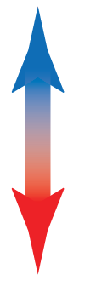




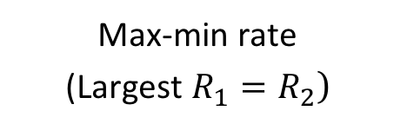
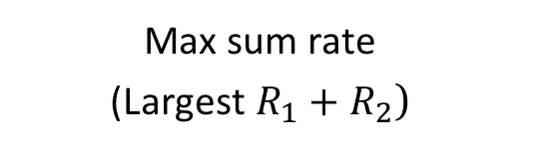

Points in the capacity region
Combinations $(R_{1},R_{2})$ of rates that can be simultaneously achieved
$$R_{2}$$
Max sum rate
(Largest $R_{1}+R_{2}$)
Many choices!
Only rule:
Always pick something on the outer boundary (Pareto boundary)!
Largest $R_{2}$
Max-min rate
(Largest $R_{1}=R_{2}$)
Capacity region
Largest $R_{1}$
Max sum rate
$$R_{1}$$
Fairness scale:
Max-min
fairness

Slide 16
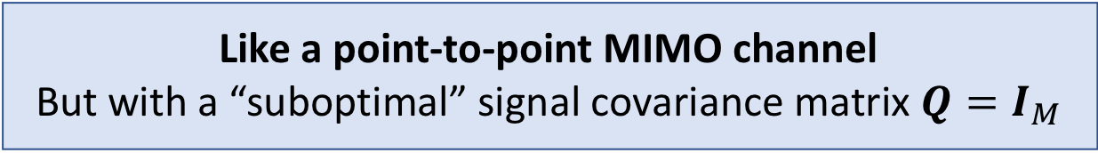
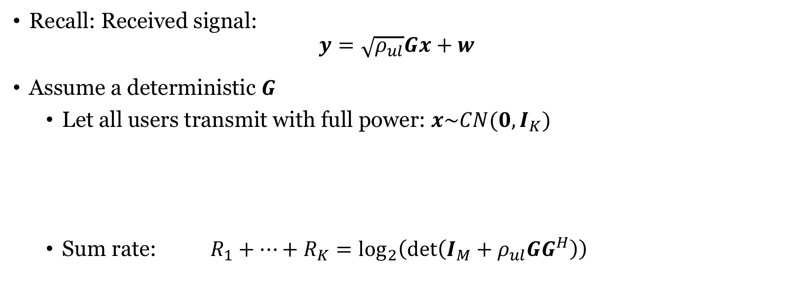
Sum Capacity of Uplink Multiuser MIMO
Recall: Received signal:
$$y=\sqrt{ρ_{ul}}Gx+w$$
Assume a deterministic $G$
Let all users transmit with full power: $x\sim CN(0,I_{K})$
Sum rate: $R_{1}+…+R_{K}=\log_{2}\left(\det\left(I_{M}+ρ_{ul}GG^{H}\right)\right)$
Like a point-to-point MIMO channel
But with a “suboptimal” signal covariance matrix $Q=I_{M}$
This is the sum capacity!
Achieved by successive interference cancellation
Decoding order determines who gets which share

Slide 17




Uplink Capacity Region with $K=2$
Region contains all ($R_{1},R_{2}$) satisfying:
$$R_{1}≤\log_{2}\left(1+ρ_{ul}{\left\|g_{1}\right\|}^{2}\right)$$
$$R_{2}≤\log_{2}\left(1+ρ_{ul}{\left\|g_{2}\right\|}^{2}\right)$$
$$R_{1}+R_{2}≤\log_{2}\left(\det\left(I_{M}+ρ_{ul}GG^{H}\right)\right)$$
$$R_{2}$$
2
3
Limited by sum capacity
$$G=\left[g_{1} g_{2}\right]$$
4
$$R_{1}$$
1

Slide 18
Summary
Point-to-point MIMO channels
Large multiplexing gains are hard to achieve in practice
Multi-user MIMO channels
Similar system model
Key differences: Independent users, different power, different performance
Capacity and rate regions
Orthogonal and non-orthogonal access

Slide 19
Multiple Antenna Communications
Lecture 5:
Introduction to Multiuser MIMO
Emil Björnson

