Slide 1
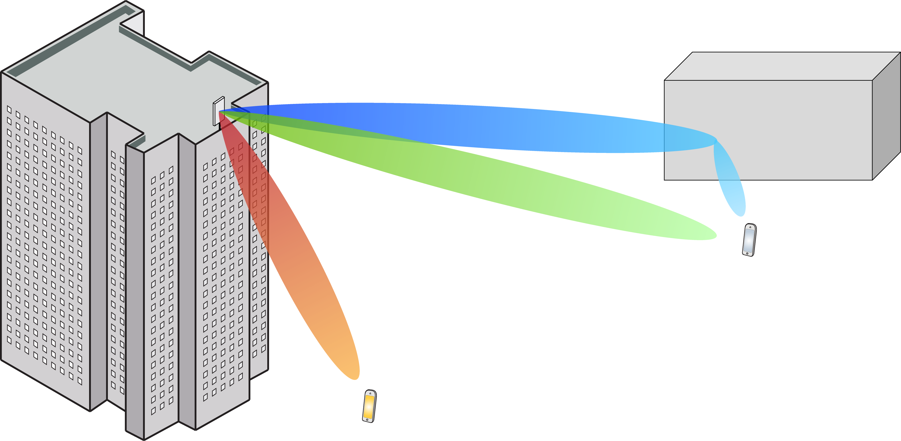
Multiple Antenna Communications
Lecture 6:
Uplink Multiuser MIMO and Channel Acquisition
Emil Björnson

Slide 2
Outline
Channel coherence intervals
Coherence time and coherence bandwidth
Massive MIMO
Motivation and basic properties
Duplexing modes
Uplink system model

Slide 3

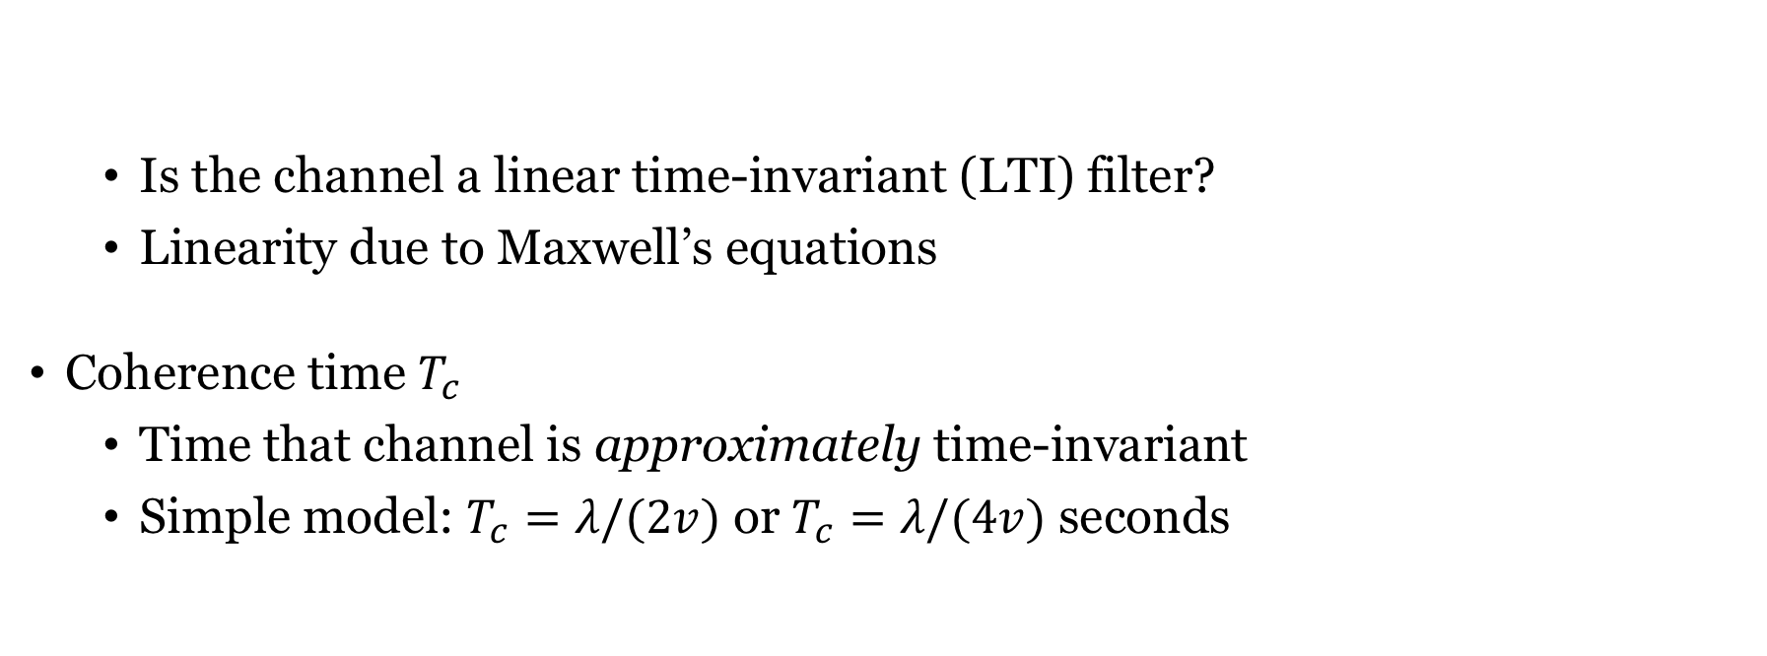


Linear time-invariant channels
Is the channel a linear time-invariant (LTI) filter?
Linearity due to Maxwell’s equations
Coherence time $T_{c}$
Time that channel is approximately time-invariant
Simple model: $T_{c}=λ/(2v)$ or $T_{c}=λ/(4v)$ seconds
$$x(t)$$
$$Channel$$
$y$(t)
Proportional to wavelength, inversely to speed 𝑣

Slide 4
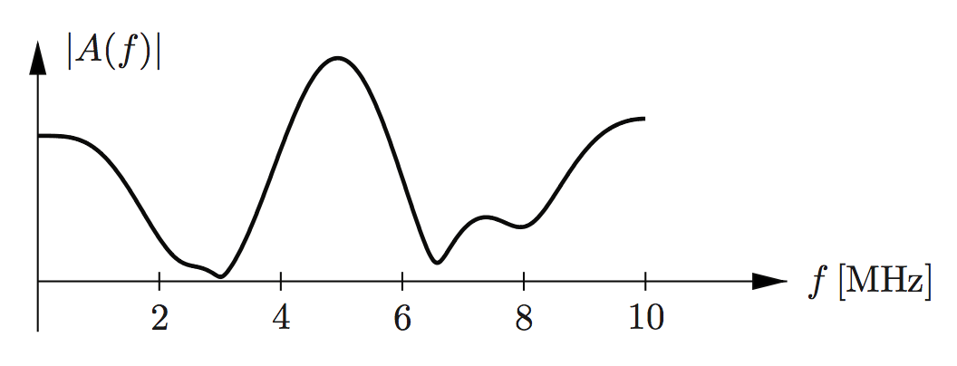


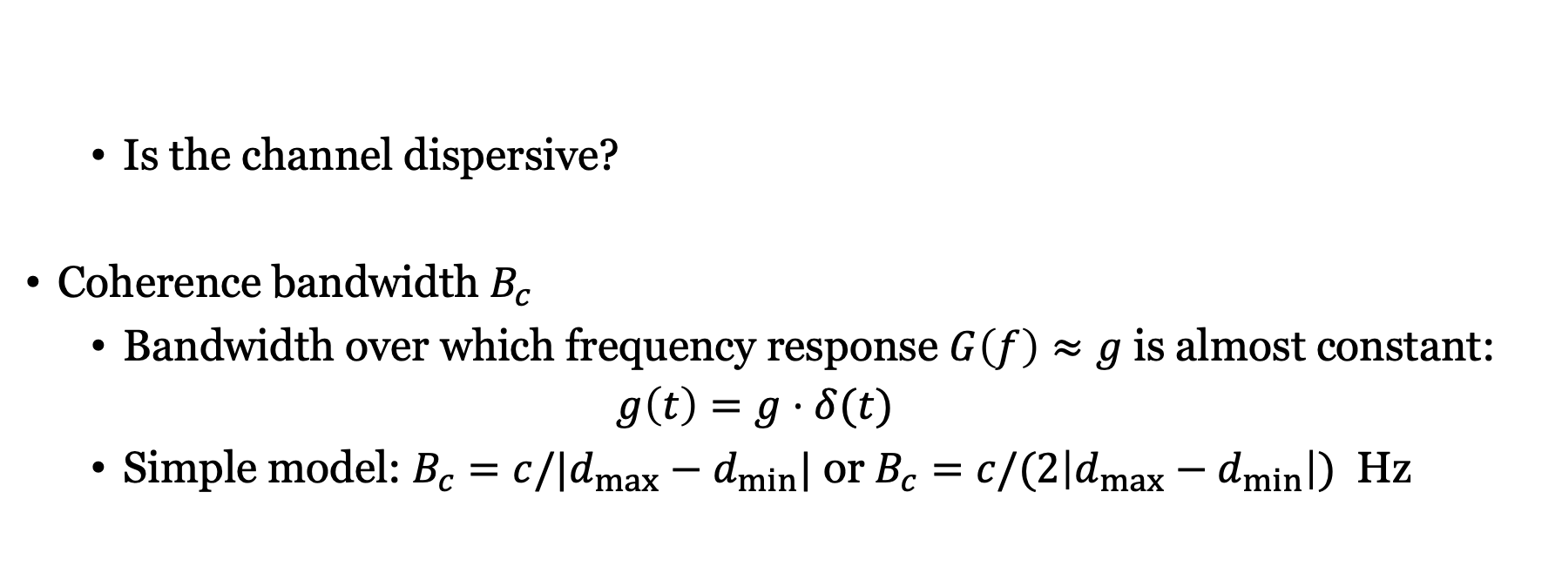
Channel dispersion
$$|G\left(f\right)|$$
Is the channel dispersive?
Coherence bandwidth $B_{c}$
Bandwidth over which frequency response $G\left(f\right)≈g$ is almost constant:
$$g\left(t\right)=g⋅δ(t)$$
Simple model: $B_{c}=c/|d_{max}−d_{min}|$ or $B_{c}=c/(2\left|d_{max}−d_{min}\right|)$ Hz
$$x(t)$$
$$Channel$$
$y$(t)
Inversely proportional to path length difference

Slide 5
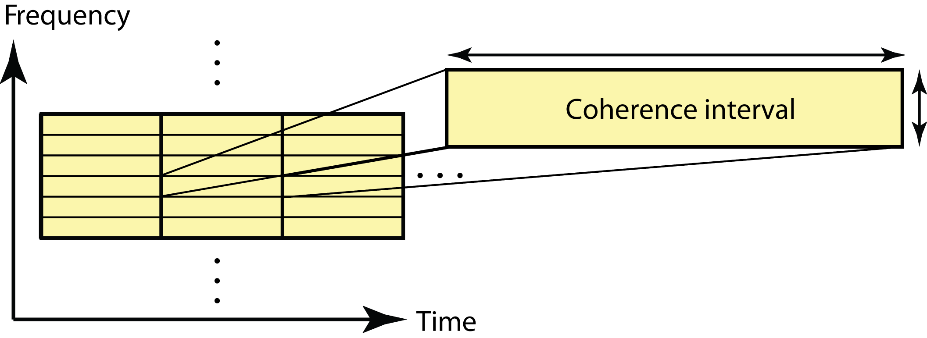
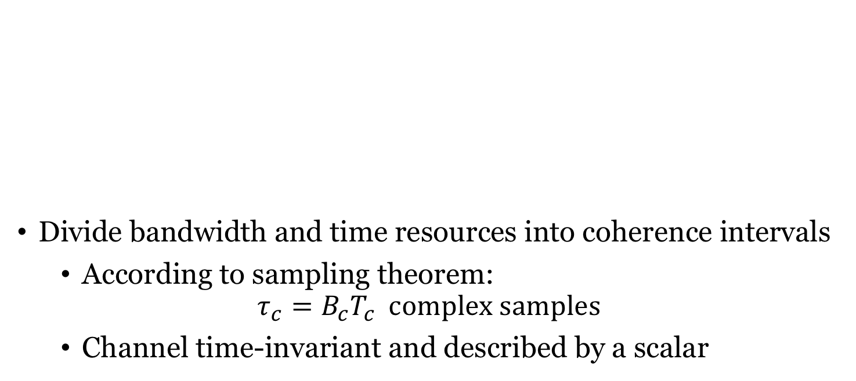


Coherence interval (block fading)
$$T_{c}$$
Divide bandwidth and time resources into coherence intervals
According to sampling theorem:
$$τ_{c}=B_{c}T_{c} complex samples$$
Channel time-invariant and described by a scalar
$$B_{c}$$
This is an example of fast fading

Slide 6
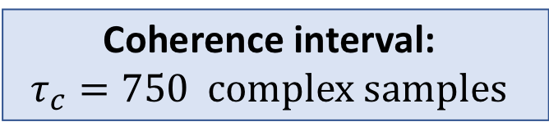
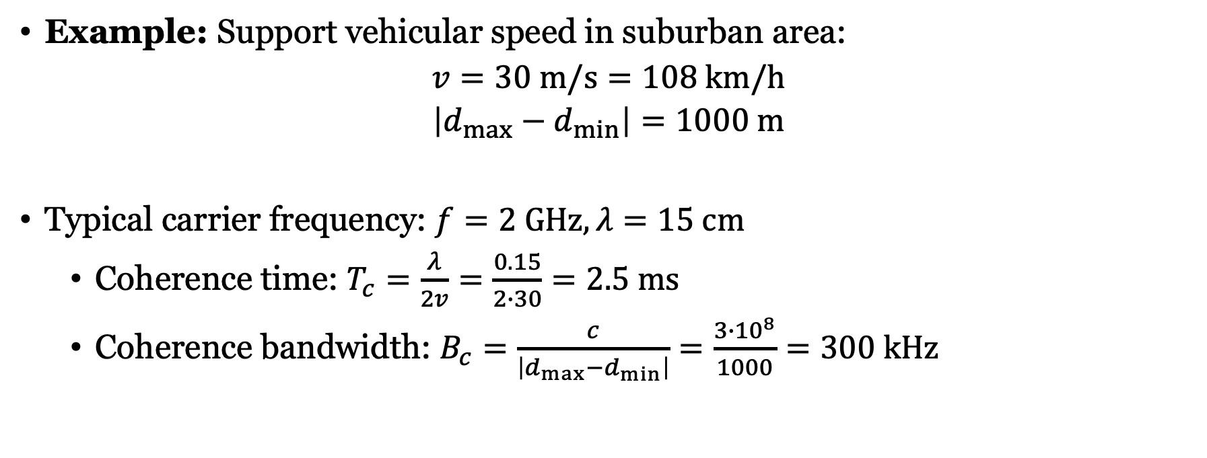
How large is a coherence interval?
Example: Support vehicular speed in suburban area:
$$v=30 m/s=108 km/h$$
$$\left|d_{max}−d_{min}\right|=1000 m$$
Typical carrier frequency: $f=2 GHz, λ=15 cm$
Coherence time: $T_{c}=\frac{λ}{2v}=\frac{0.15}{2∙30}=2.5 ms$
Coherence bandwidth: $B_{c}=\frac{c}{\left|d_{max}−d_{min}\right|}=\frac{3∙{10}^{8}}{1000}=300 kHz$
Coherence interval:
$$τ_{c}=750 complex samples$$

Slide 7
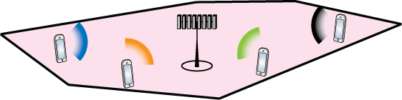
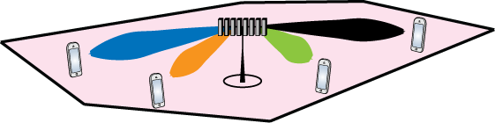

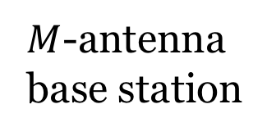
Recall: Multiuser MIMO Communication
Uplink
From $K$ users to base station
Multipoint-to-point MIMO
D0wnlink
From base station to $K$users
Point-to-multipoint MIMO
$M$-antenna base station

Slide 8
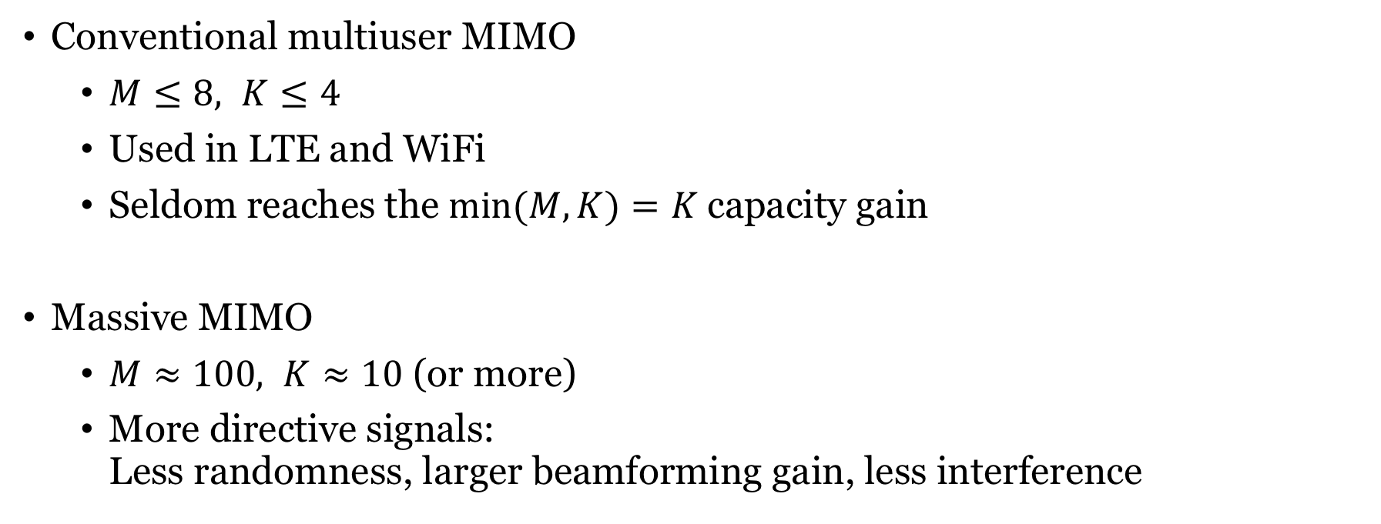
Multiuser MIMO vs. Massive MIMO
Conventional multiuser MIMO
$M≤8, K≤4$
Used in LTE and WiFi
Seldom reaches the $min⁡(M,K)=K$capacity gain
Massive MIMO
$M≈100, K≈10$ (or more)
More directive signals: Less randomness, larger beamforming gain, less interference

Slide 9

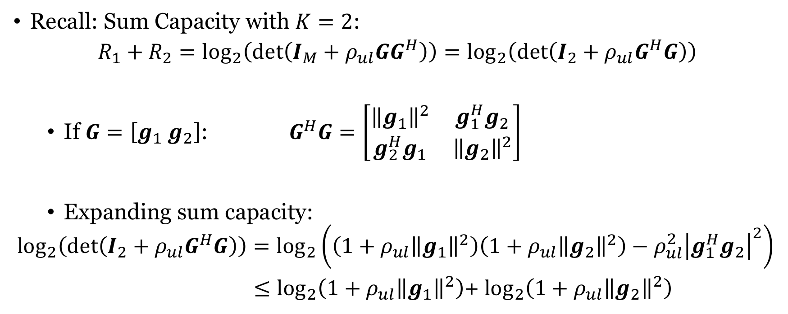
Motivation for Massive MIMO
Recall: Sum Capacity with $K=2$:
$$R_{1}+R_{2}=\log_{2}\left(\det\left(I_{M}+ρ_{ul}GG^{H}\right)\right)=\log_{2}\left(\det\left(I_{2}+ρ_{ul}G^{H}G\right)\right)$$
If $G=\left[g_{1} g_{2}\right]$: $G^{H}G=\left[\begin{matrix}{\left\|g_{1}\right\|}^{2} & g_{1}^{H}g_{2} \\ g_{2}^{H}g_{1} & {\left\|g_{2}\right\|}^{2}\end{matrix}\right]$
Expanding sum capacity:
$$\log_{2}\left(\det\left(I_{2}+ρ_{ul}G^{H}G\right)\right)=\log_{2}\left(\left(1+ρ_{ul}{\left\|g_{1}\right\|}^{2}\right)\left(1+ρ_{ul}{\left\|g_{2}\right\|}^{2}\right)−ρ_{ul}^{2}{\left|g_{1}^{H}g_{2}\right|}^{2}\right)$$
$≤\log_{2}\left(1+ρ_{ul}{\left\|g_{1}\right\|}^{2}\right)$+ $\log_{2}\left(1+ρ_{ul}{\left\|g_{2}\right\|}^{2}\right)$
Equality if and only if $g_{1}^{H}g_{2}=0$

Slide 10
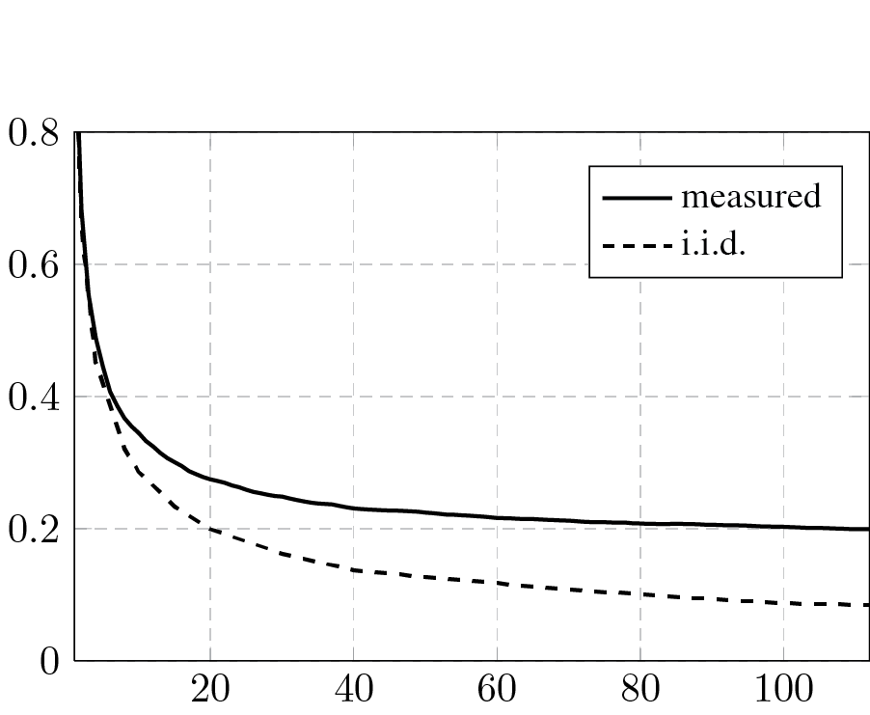
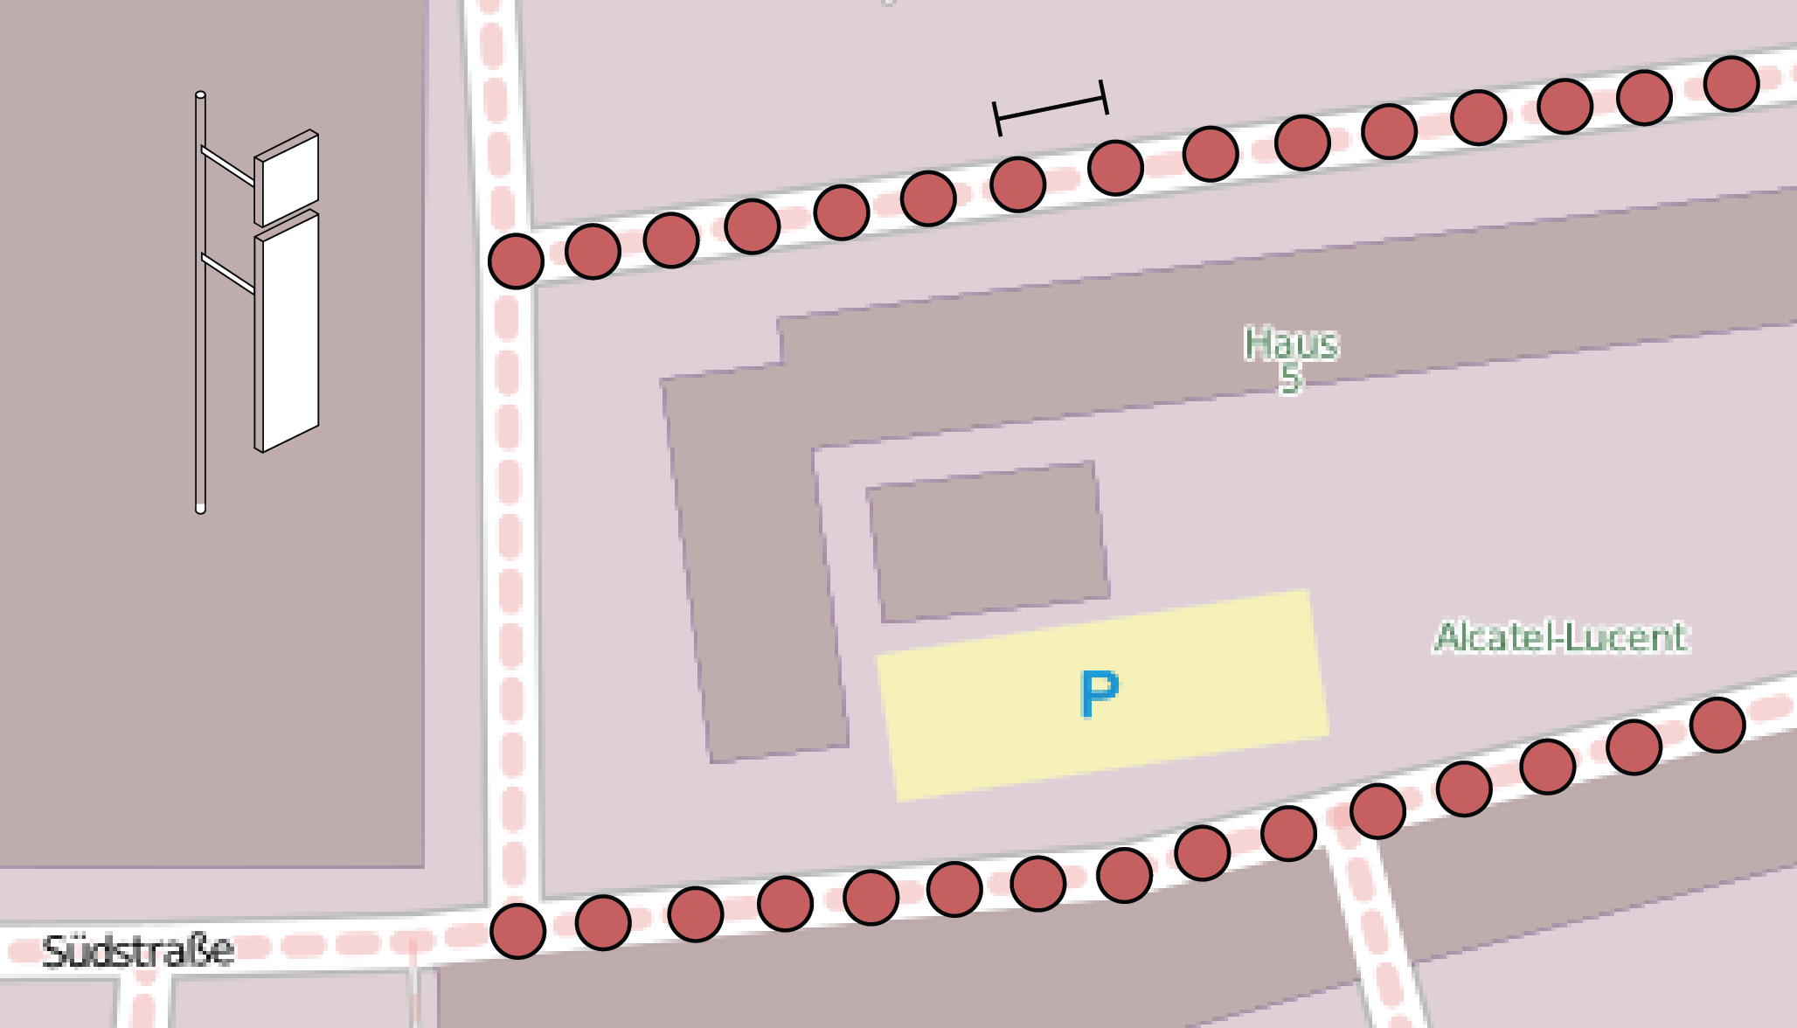


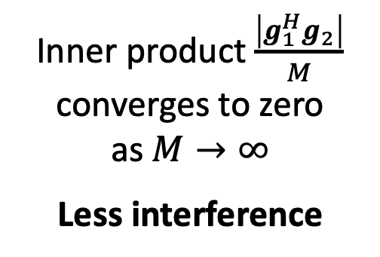

Motivation for Massive MIMO: Favorable propagation
Consider two $M$-antenna channels $g_{1},g_{2}$
Inner product $\frac{\left|g_{1}^{H}g_{2}\right|}{M}$ converges to zero as $M→∞$
Less interference
$$\frac{\left|g_{1}^{H}g_{2}\right|}{M}$$
Related to beamforming gain and beamwidth
Number of antennas ($M$)
Reference: J. Hoydis, C. Hoek, T. Wild, and S. ten Brink, “Channel Measurements for Large Antenna Arrays,” ISWCS 2012

Slide 11
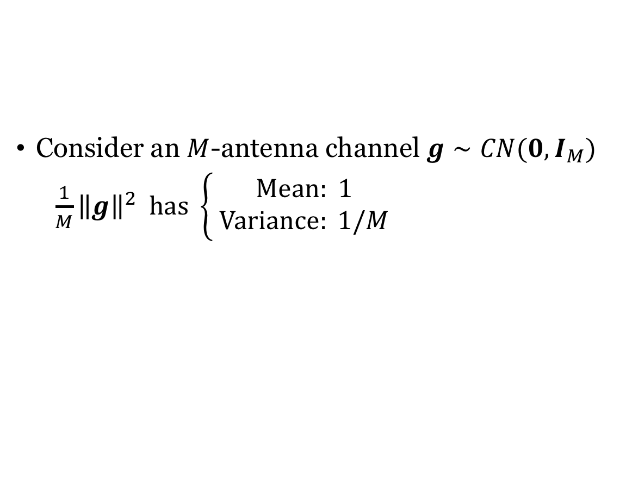
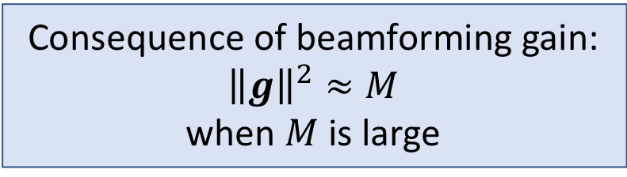
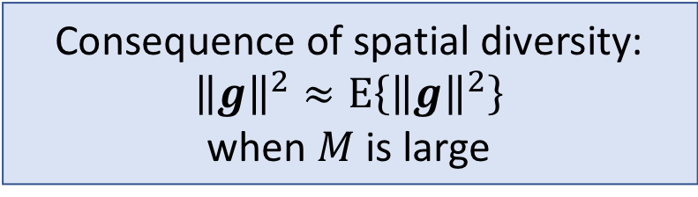

Motivation for Massive MIMO: Channel hardening
Consider an $M$-antenna channel $g∼CN(0,I_{M})$
$\frac{1}{M}{\left\|g\right\|}^{2} has \left\{\begin{aligned} Mean: 1 \\ Variance: 1/M\end{aligned}\right.$
$\frac{{\left\|g\right\|}^{2}}{M}$
Consequence of spatial diversity:
$${\left\|g\right\|}^{2}≈E\left\{{\left\|g\right\|}^{2}\right\}$$
when $M$ is large
Consequence of beamforming gain:
$${\left\|g\right\|}^{2}≈M$$
when $M$ is large

Slide 12
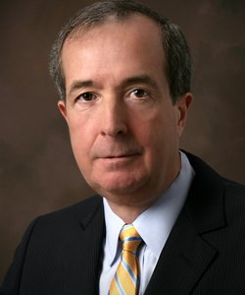
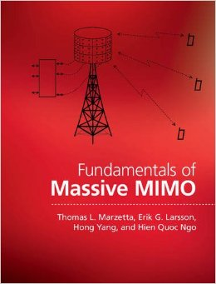
Background of Massive MIMO
Proposed by Thomas L. Marzetta
Awarded honorary doctor at Linköping University, 2015
First paper:
“Noncooperative Cellular Wireless with Unlimited Numbers of Base Station Antennas,” IEEE Trans. Wireless Communications, 2010.
Now a main component of 5G

Slide 13
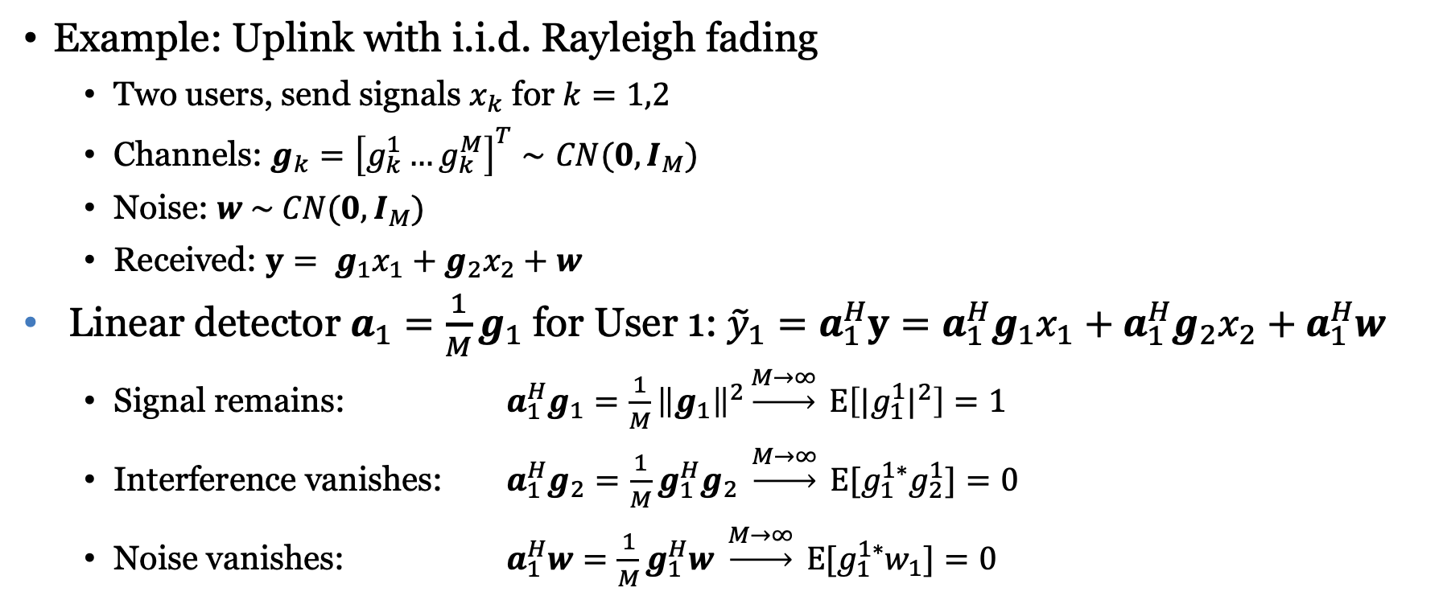


Marzetta’s asymptotic motivation
Example: Uplink with i.i.d. Rayleigh fading
Two users, send signals $x_{k}$ for $k=1,2$
Channels: $g_{k}={\left[g_{k}^{1}…g_{k}^{M}\right]}^{T}∼CN(0,I_{M})$
Noise: $w \sim CN(0,I_{M})$
Received: $y= g_{1}x_{1}+g_{2}x_{2}+w$
Linear detector $a_{1}=\frac{1}{M}g_{1}$ for User 1: ${\tilde{y}}_{1}=a_{1}^{H}y={a_{1}^{H}g}_{1}x_{1}+{a_{1}^{H}g}_{2}x_{2}+a_{1}^{H}w$
Signal remains: $a_{1}^{H}g_{1}=\frac{1}{M}{\left\|g_{1}\right\|}^{2}\underset{→}{M→∞} \text{E}\left[{|g_{1}^{1}|}^{2}\right]=1$
Interference vanishes: $a_{1}^{H}g_{2}=\frac{1}{M}g_{1}^{H}g_{2} \underset{→}{M→∞} \text{E}[g_{1}^{1∗}g_{2}^{1}]=0$
Noise vanishes: $a_{1}^{H}w=\frac{1}{M}g_{1}^{H}w \underset{→}{M→∞} \text{E}[g_{1}^{1∗}w_{1}]=0$
$$g_{2}x_{2}$$
$$g_{1}x_{1}$$
Asymptotically noise/interference-free communication: ${\tilde{y}}_{1}\underset{→}{M→∞}x_{1}$

Slide 14
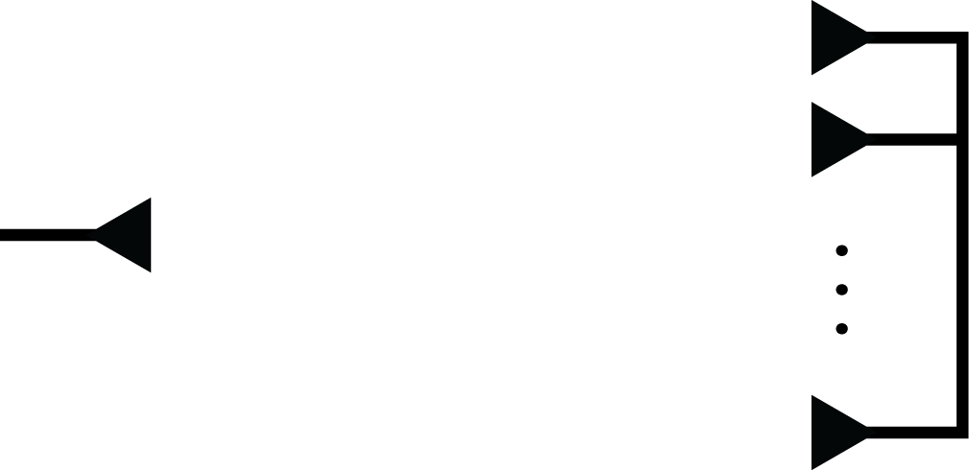








Estimating the channel responses
Channels: $K$ users with $M$-length channels
Estimate $MK$ coefficients in each coherence interval
Basic principle: Send known pilot signal
$$g_{1}$$
$$g_{1}$$
$$g_{2}$$
$$g_{2}$$
$$g_{M}$$
$$g_{M}$$
One pilot: Estimate all coefficients
$M$ pilots to estimate all coefficients

Slide 15
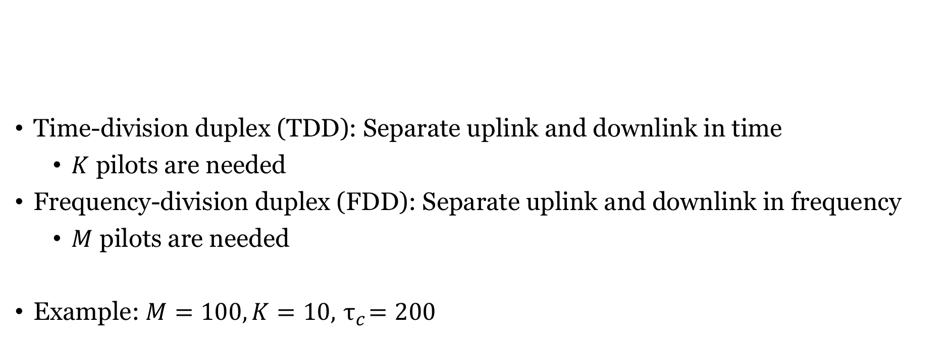
Duplexing
Time-division duplex (TDD): Separate uplink and downlink in time
$K$ pilots are needed
Frequency-division duplex (FDD): Separate uplink and downlink in frequency
$M$ pilots are needed
Example: $M=100, K=10, { τ}_{c}=200$
TDD operation is key!

Slide 16

Operating a TDD Massive MIMO System
Frames matched to coherence intervals
Fixed single-tap channel responses
Coherence time: $T_{c}$ s
Coherence bandwidth: $B_{c}$ Hz
Interval contains $τ_{c} =T_{c}B_{c}$ symbols
Uplink pilots:
Enable channel estimation

Slide 17
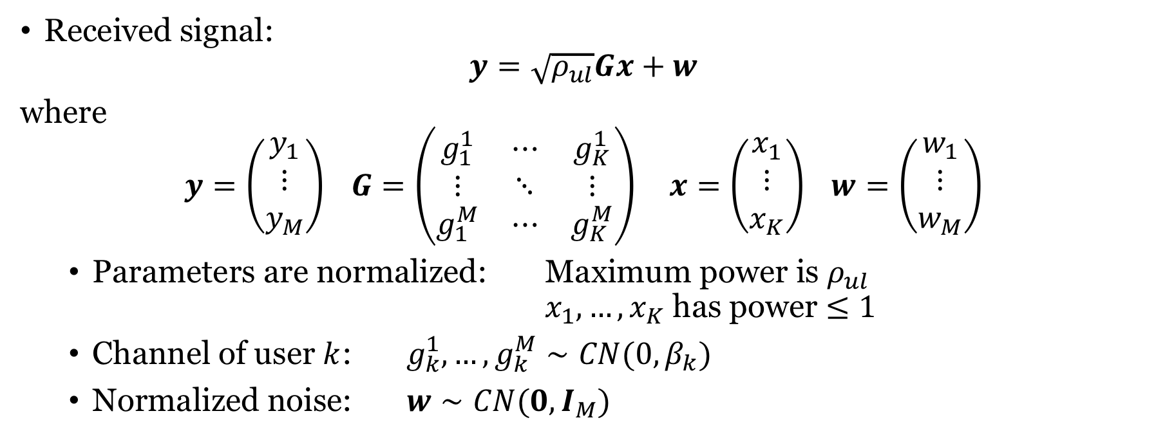
Uplink Massive MIMO system model
Received signal:
$$y=\sqrt{ρ_{ul}}Gx+w$$
where
$$y=\left(\begin{matrix}y_{1} \\ ⋮ \\ y_{M}\end{matrix}\right) G=\left(\begin{matrix}g_{1}^{1} & ⋯ & g_{K}^{1} \\ ⋮ & ⋱ & ⋮ \\ g_{1}^{M} & ⋯ & g_{K}^{M}\end{matrix}\right) x=\left(\begin{matrix}x_{1} \\ ⋮ \\ x_{K}\end{matrix}\right) w=\left(\begin{matrix}w_{1} \\ ⋮ \\ w_{M}\end{matrix}\right)$$
Parameters are normalized: Maximum power is $ρ_{ul}$ $x_{1},…,x_{K}$ has power $≤1$
Channel of user $k$: $g_{k}^{1},…,g_{k}^{M}∼CN(0,β_{k})$
Normalized noise: $w∼CN(0,I_{M})$
Large-scale fading coefficient

Slide 18

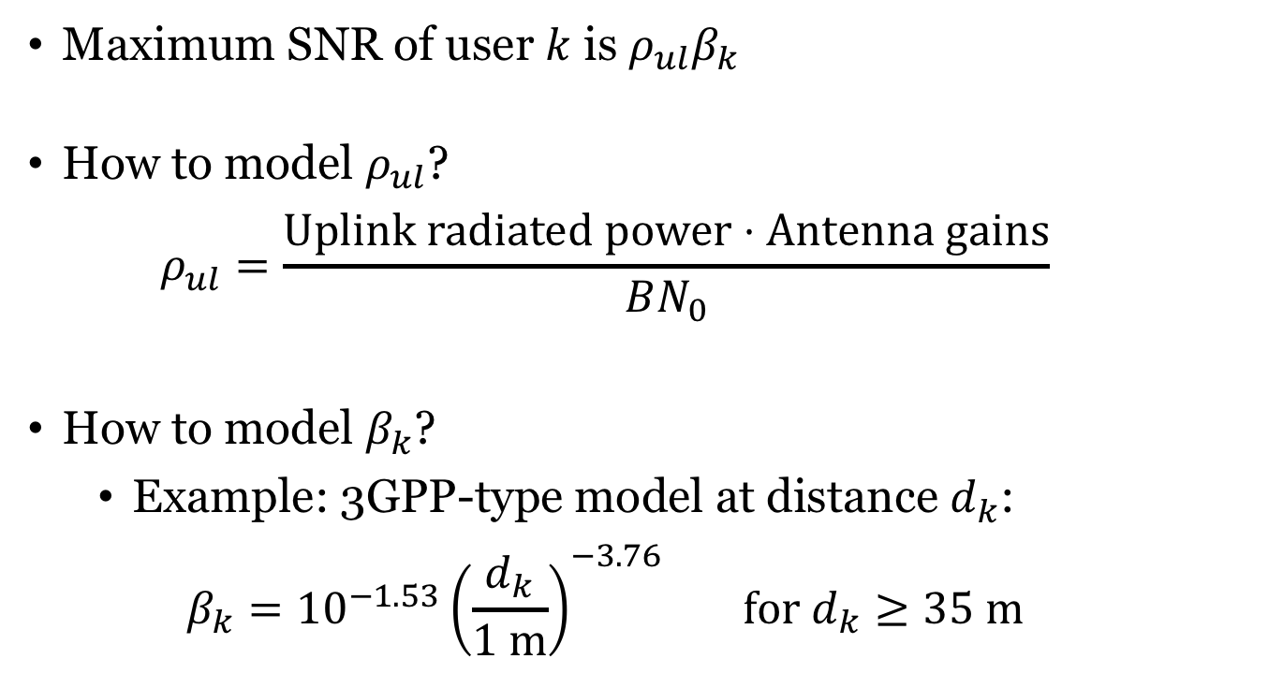
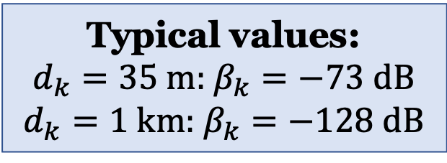
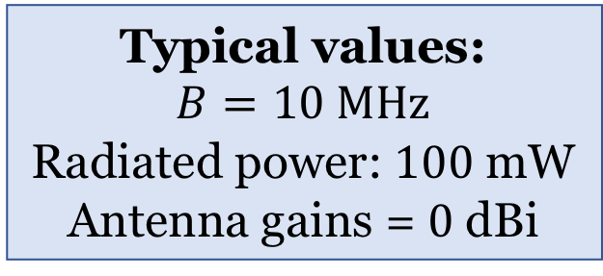
Modeling of power and large-scale fading coefficients
Maximum SNR of user $k$ is $ρ_{ul}β_{k}$
How to model $ρ_{ul}$?
$$ρ_{ul}=\frac{Uplink radiated power⋅Antenna gains}{BN_{0}}$$
How to model $β_{k}$?
Example: 3GPP-type model at distance $d_{k}$:
$$β_{k}={10}^{−1.53}{\left(\frac{d_{k}}{1 m}\right)}^{−3.76} for d_{k}≥35 m$$
Typical values:
$$B=10 MHz$$
Radiated power: $100$ mW
Antenna gains = $0$ dBi
$$N_{0}={10}^{−17}$$
Typical values:
$d_{k}=35 m$: $β_{k}=−73 dB$
$d_{k}=1 km$: $β_{k}=−128 dB$

Slide 19
Summary
Massive MIMO is multi-user MIMO with many antennas and users
No strict definition exists
TDD operation
Divide time-frequency resources into frames
Match frame size to coherence intervals
Send uplink pilots for channel estimation
Switch between uplink/downlink data in same coherence interval

Slide 20
Multiple Antenna Communications
Lecture 6:
Uplink Multiuser MIMO and Channel Acquisition
Emil Björnson

