Slide 1
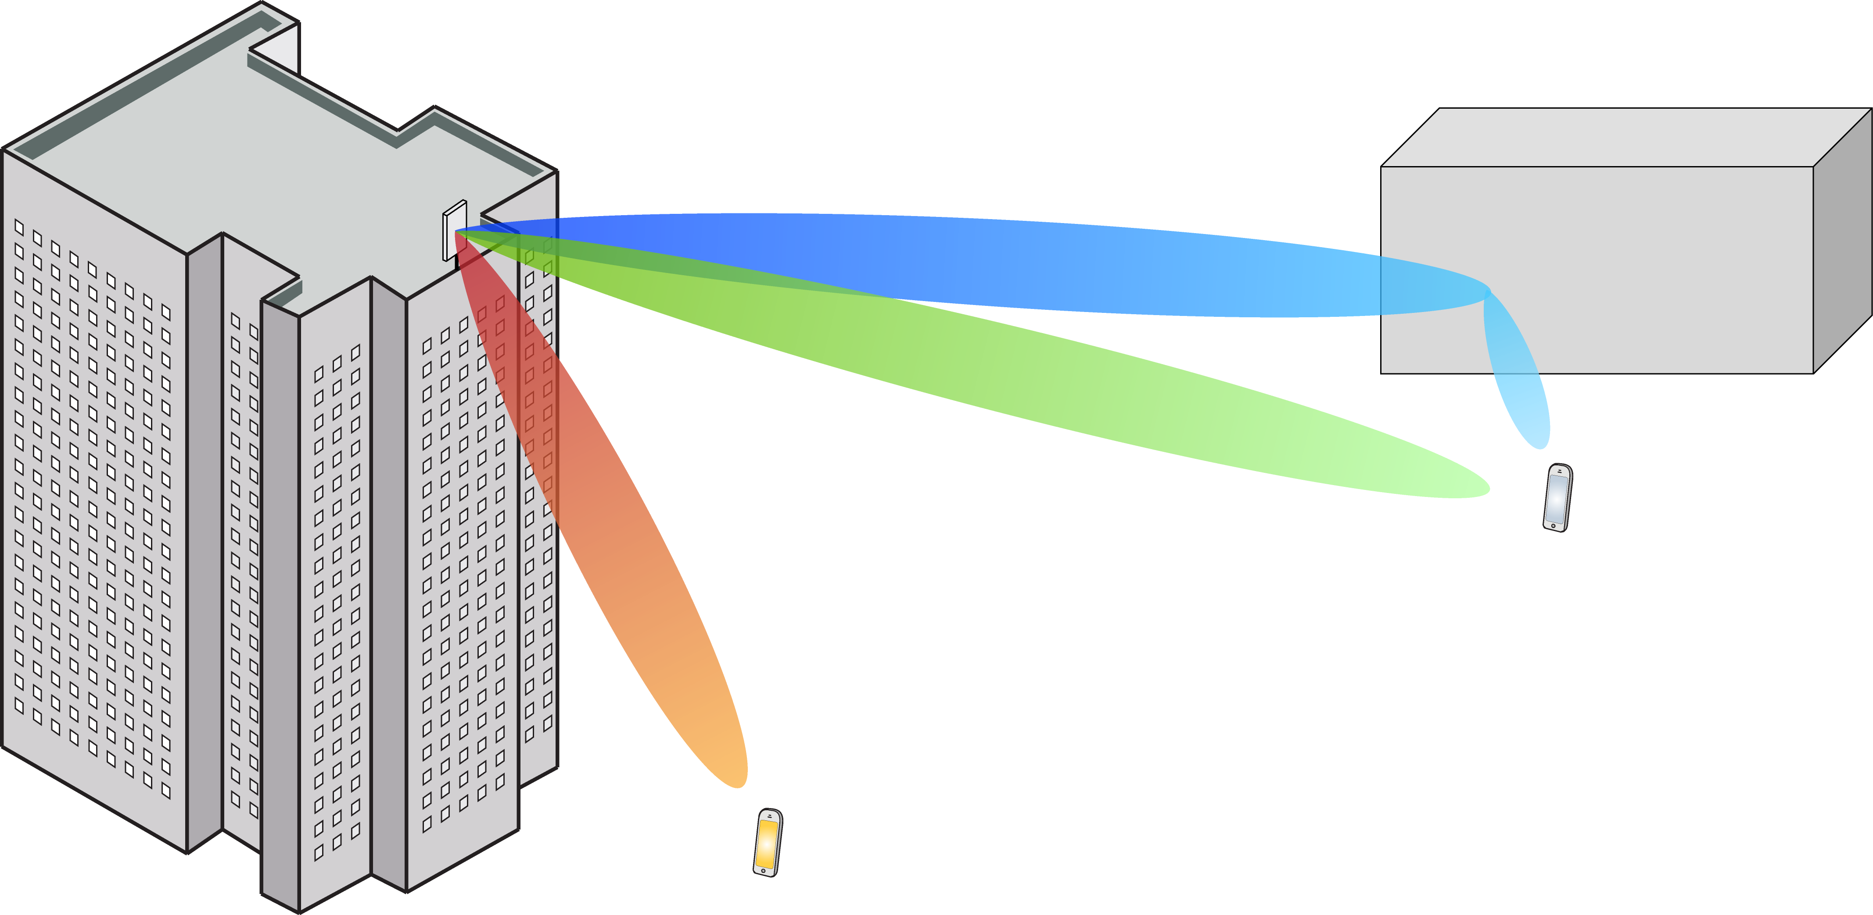
Multiple Antenna Communications
Lecture 7:
Multiuser MIMO With Optimal Linear Detection
Emil Björnson

Slide 2
Outline
Uplink Massive MIMO
Pilot transmission
Channel estimation
Capacity lower bound
Computation using channel estimates
Maximization of the bound

Slide 3
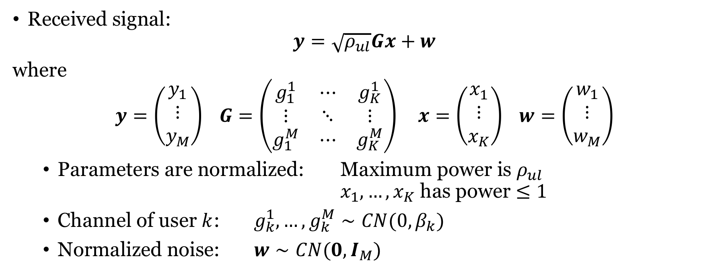
Recall: Uplink Massive MIMO system model
Received signal:
$$y=\sqrt{ρ_{ul}}Gx+w$$
where
$$y=\left(\begin{matrix}y_{1} \\ ⋮ \\ y_{M}\end{matrix}\right) G=\left(\begin{matrix}g_{1}^{1} & ⋯ & g_{K}^{1} \\ ⋮ & ⋱ & ⋮ \\ g_{1}^{M} & ⋯ & g_{K}^{M}\end{matrix}\right) x=\left(\begin{matrix}x_{1} \\ ⋮ \\ x_{K}\end{matrix}\right) w=\left(\begin{matrix}w_{1} \\ ⋮ \\ w_{M}\end{matrix}\right)$$
Parameters are normalized: Maximum power is $ρ_{ul}$ $x_{1},…,x_{K}$ has power $≤1$
Channel of user $k$: $g_{k}^{1},…,g_{k}^{M}∼CN(0,β_{k})$
Normalized noise: $w∼CN(0,I_{M})$
Large-scale fading coefficient

Slide 4


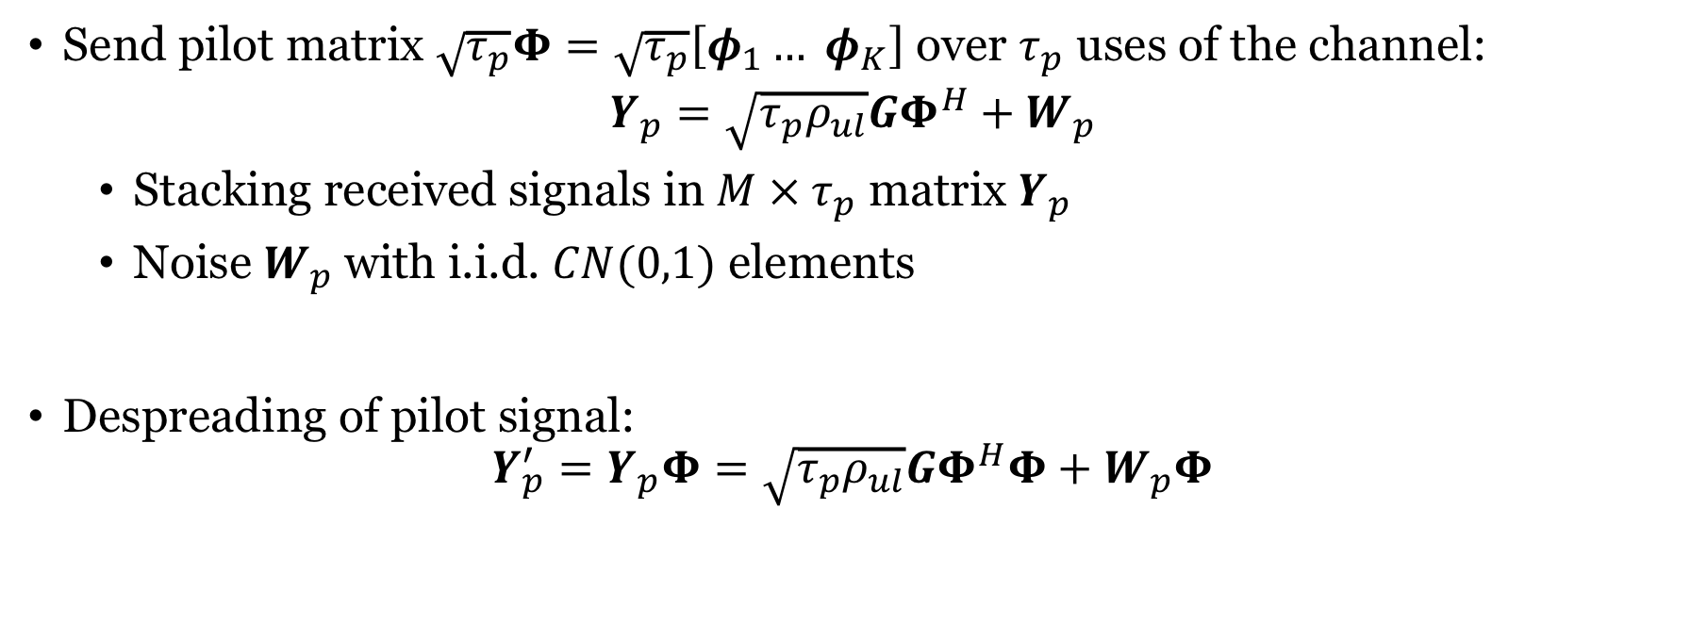

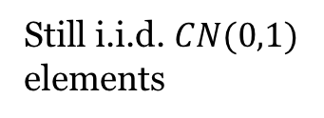
Sending pilot sequences
Send pilot matrix $\sqrt{τ_{p}}Φ=\sqrt{τ_{p}}\left[φ_{1}… φ_{K}\right]$ over $τ_{p}$ uses of the channel:
$$Y_{p}=\sqrt{τ_{p}ρ_{ul}}GΦ^{H}+W_{p}$$
Stacking received signals in $M × τ_{p}$ matrix $Y_{p}$
Noise $W_{p}$with i.i.d. $CN(0,1)$ elements
Despreading of pilot signal:
$$Y_{p}^{′}=Y_{p}Φ=\sqrt{τ_{p}ρ_{ul}}GΦ^{H}Φ+W_{p}Φ$$
$${\sqrt{τ_{p}}φ}_{2}$$
$${\sqrt{τ_{p}}φ}_{1}$$
$$=I_{K}$$
Still i.i.d. $CN(0,1)$
elements

Slide 5
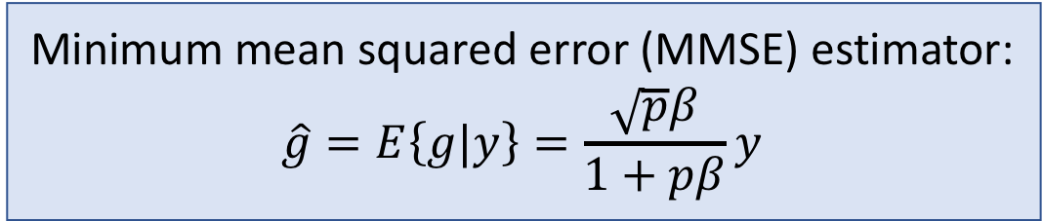
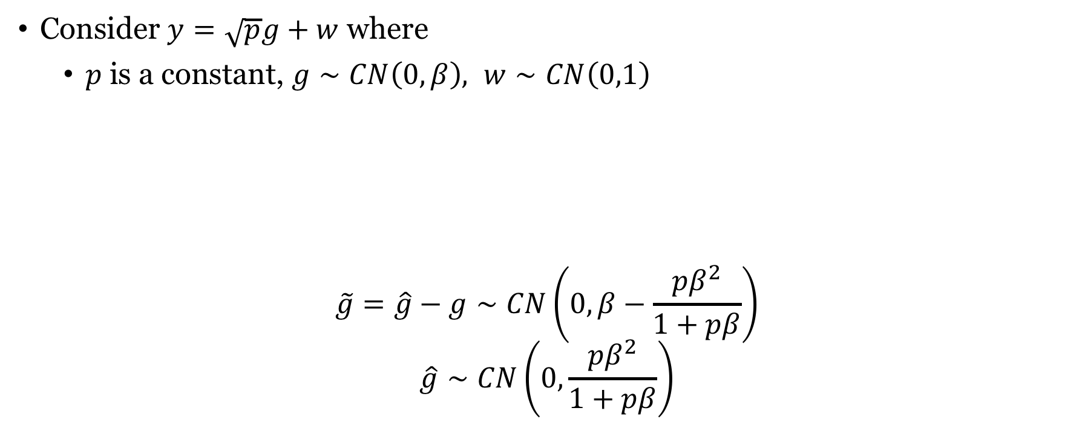
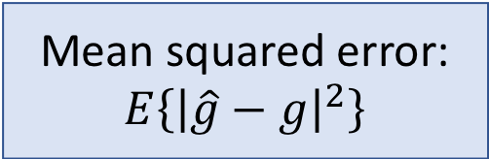
Estimating Gaussian variable in noise
Consider $y=\sqrt{p}g+w$ where
$p$is a constant, $g∼CN\left(0,β\right), w∼CN\left(0,1\right)$
$$\tilde{g}=\hat{g}−g∼CN\left(0, β−\frac{pβ^{2}}{1+pβ}\right)$$
$$\hat{g}∼CN\left(0,\frac{pβ^{2}}{1+pβ}\right)$$
Minimum mean squared error (MMSE) estimator:
$$\hat{g}=E\left\{g|y\right\}=\frac{\sqrt{p}β}{1+pβ}y$$
Mean squared error:
$$E\left\{{\left|\hat{g}−g\right|}^{2}\right\}$$
Estimation error:
Independent
random variables
Estimate:

Slide 6
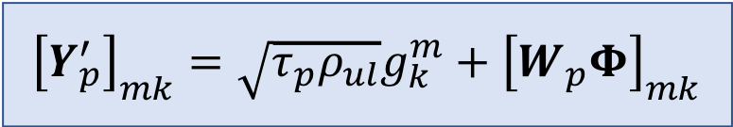
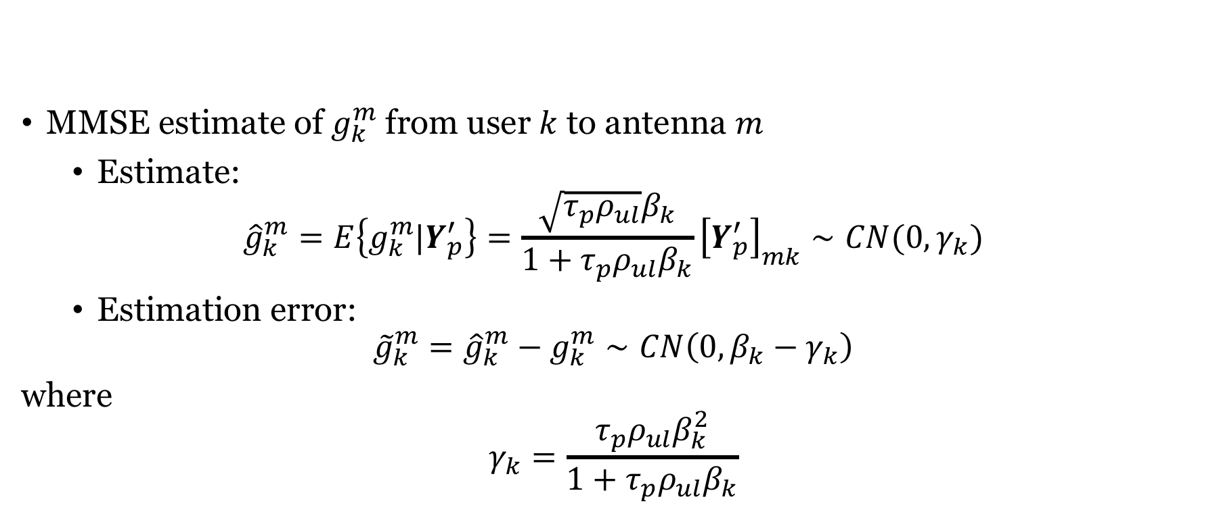
Estimates of the channels
$${\left[Y_{p}^{′}\right]}_{mk}=\sqrt{τ_{p}ρ_{ul}}g_{k}^{m}+{\left[W_{p}Φ\right]}_{mk}$$
MMSE estimate of $g_{k}^{m}$ from user $k$ to antenna $m$
Estimate:
$${\hat{g}}_{k}^{m}=E\left\{g_{k}^{m}|Y_{p}^{′}\right\}=\frac{\sqrt{τ_{p}ρ_{ul}}β_{k}}{1+τ_{p}ρ_{ul}β_{k}}{\left[Y_{p}^{′}\right]}_{mk}∼CN(0, γ_{k})$$
Estimation error:
$${\tilde{g}}_{k}^{m}={\hat{g}}_{k}^{m}−g_{k}^{m}∼CN\left(0,{β_{k}−γ}_{k}\right)$$
where
$$γ_{k}=\frac{τ_{p}ρ_{ul}β_{k}^{2}}{1+τ_{p}ρ_{ul}β_{k}}$$

Slide 7
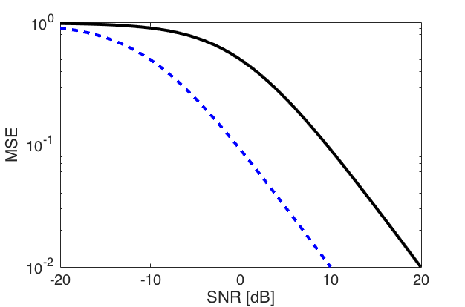




How good is the channel estimate?
Mean squared error (MSE):
$$E\left\{{\left|{\hat{g}}_{k}^{m}−g_{k}^{m}\right|}^{2}\right\}=E\left\{{\left|{\tilde{g}}_{k}^{m}\right|}^{2}\right\}=β_{k}−γ_{k}=β_{k}−\frac{τ_{p}ρ_{ul}β_{k}^{2}}{1+τ_{p}ρ_{ul}β_{k}}$$
Goes to zero as $ρ_{ul}→∞$ or $τ_{p}→∞$ (perfect estimate)
$$τ_{p}=10$$
$$τ_{p}=1$$
Simulation:
$$β_{k}=1$$
$$SNR=ρ_{ul}β_{k}=ρ_{ul}$$
10% error

Slide 8

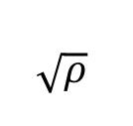

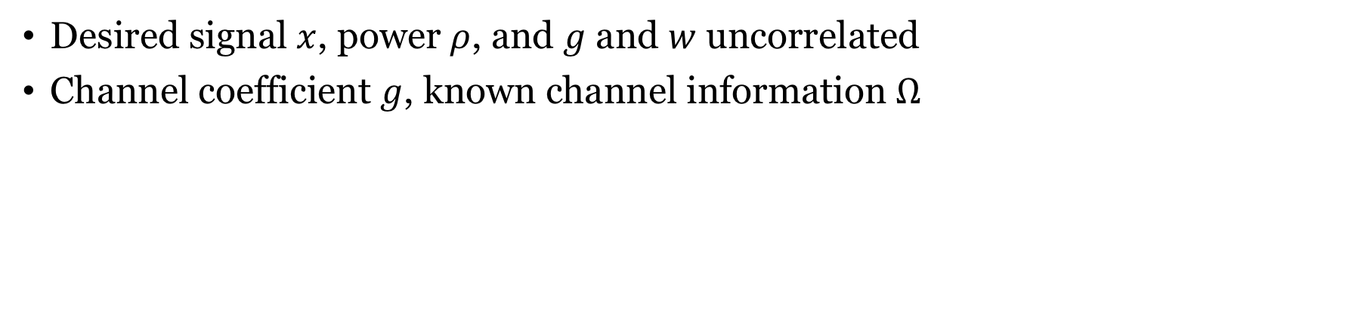

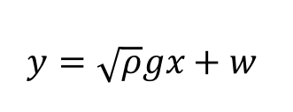
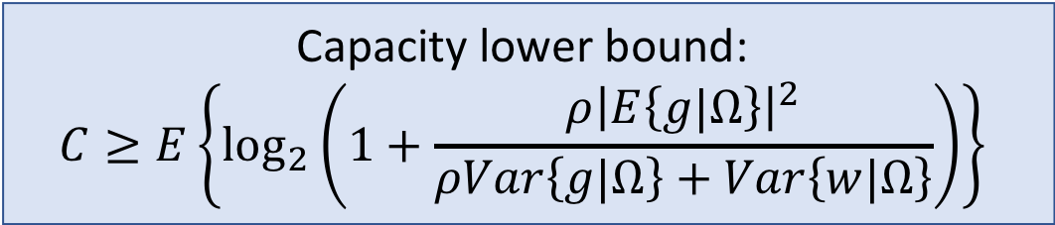


A capacity lower bound
Channel information $Ω$
$$w$$
$$x$$
$$\sqrt{ρ}$$
$$g$$
+
Receiver
$$\hat{x}$$
$$y=\sqrt{ρ}gx+w$$
Desired signal $x$, power $ρ$, and $g$ and $w$ uncorrelated
Channel coefficient $g$, known channel information $Ω$
Capacity lower bound:
$$C≥E\left\{\log_{2}\left(1+\frac{ρ{\left|E\left\{g|Ω\right\}\right|}^{2}}{ρVar\left\{g|Ω\right\}+Var\left\{w|Ω\right\}}\right)\right\}$$

Slide 9
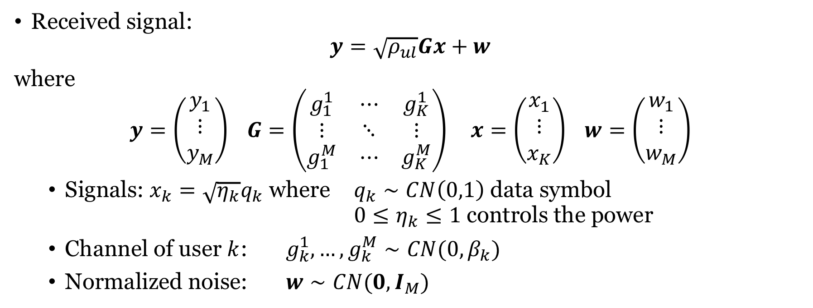
Uplink data transmission
Received signal:
$$y=\sqrt{ρ_{ul}}Gx+w$$
where
$$y=\left(\begin{matrix}y_{1} \\ ⋮ \\ y_{M}\end{matrix}\right) G=\left(\begin{matrix}g_{1}^{1} & ⋯ & g_{K}^{1} \\ ⋮ & ⋱ & ⋮ \\ g_{1}^{M} & ⋯ & g_{K}^{M}\end{matrix}\right) x=\left(\begin{matrix}x_{1} \\ ⋮ \\ x_{K}\end{matrix}\right) w=\left(\begin{matrix}w_{1} \\ ⋮ \\ w_{M}\end{matrix}\right)$$
Signals: $x_{k}=\sqrt{η_{k}}q_{k}$ where $q_{k}∼CN\left(0,1\right)$ data symbol $0≤η_{k}≤1$ controls the power
Channel of user $k$: $g_{k}^{1},…,g_{k}^{M}∼CN(0,β_{k})$
Normalized noise: $w∼CN(0,I_{M})$
Large-scale fading coefficient

Slide 10
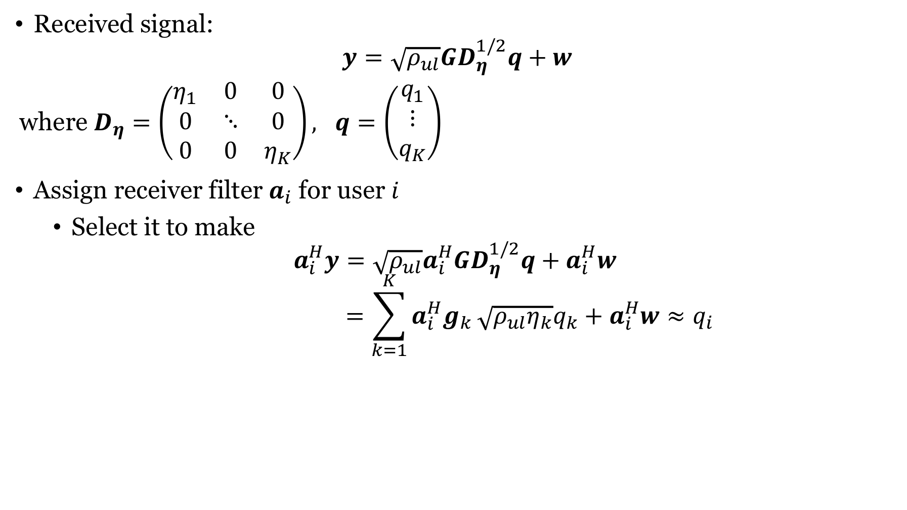
Linear receiver processing
Received signal:
$$y=\sqrt{ρ_{ul}}GD_{η}^{1/2}q+w$$
where $D_{η}=\left(\begin{matrix}η_{1} & 0 & 0 \\ 0 & ⋱ & 0 \\ 0 & 0 & η_{K}\end{matrix}\right), q=\left(\begin{matrix}q_{1} \\ ⋮ \\ q_{K}\end{matrix}\right)$
Assign receiver filter $a_{i}$ for user $i$
Select it to make
$$a_{i}^{H}y=\sqrt{ρ_{ul}}a_{i}^{H}GD_{η}^{1/2}q+a_{i}^{H}w$$
$$=\sum_{k=1}^{K}{a_{i}^{H}g_{k}}\sqrt{ρ_{ul}η_{k}}q_{k}+a_{i}^{H}w≈q_{i}$$
No successive interference cancelation
In some “good” sense

Slide 11
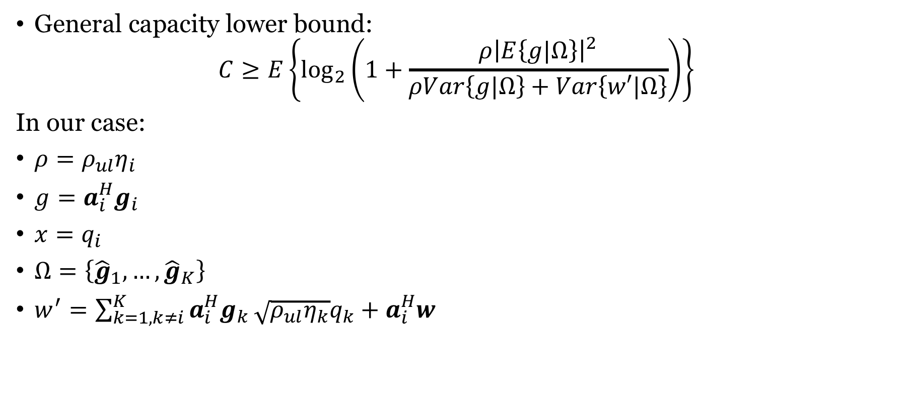
Capacity bound for User $i$ using Channel Estimates
General capacity lower bound:
$$C≥E\left\{\log_{2}\left(1+\frac{ρ{\left|E\left\{g|Ω\right\}\right|}^{2}}{ρVar\left\{g|Ω\right\}+Var\left\{w′|Ω\right\}}\right)\right\}$$
In our case:
$ρ=ρ_{ul}η_{i}$
$g=a_{i}^{H}g_{i}$
$x=q_{i}$
$Ω=\left\{{\hat{g}}_{1},…,{\hat{g}}_{K}\right\}$
$w^{′}=\sum_{k=1,k≠i}^{K}{a_{i}^{H}g_{k}}\sqrt{ρ_{ul}η_{k}}q_{k}+a_{i}^{H}w$
We need to compute each term!

Slide 12
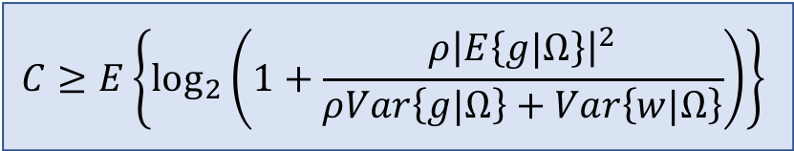
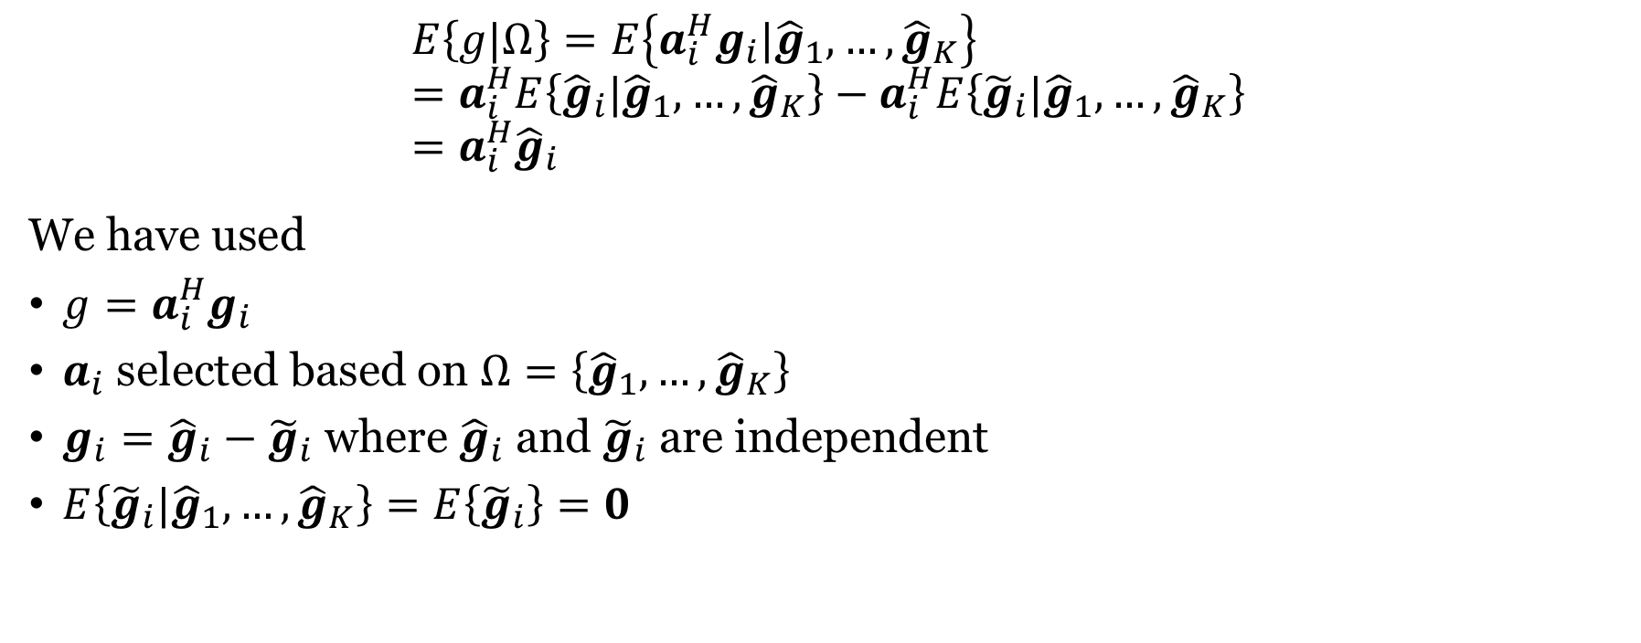
Computing the expectation in the numerator
$$E\left\{g|Ω\right\}=E\left\{a_{i}^{H}g_{i}|{\hat{g}}_{1},…,{\hat{g}}_{K}\right\} \\ =a_{i}^{H}E\left\{{\hat{g}}_{i}|{\hat{g}}_{1},…,{\hat{g}}_{K}\right\}−a_{i}^{H}E\left\{{\tilde{g}}_{i}|{\hat{g}}_{1},…,{\hat{g}}_{K}\right\} \\ =a_{i}^{H}{\hat{g}}_{i}$$
We have used
$g=a_{i}^{H}g_{i}$
$a_{i}$ selected based on $Ω=\left\{{\hat{g}}_{1},…,{\hat{g}}_{K}\right\}$
$g_{i}={\hat{g}}_{i}−{\tilde{g}}_{i}$ where ${\hat{g}}_{i}$ and ${\tilde{g}}_{i}$ are independent
$E\left\{{\tilde{g}}_{i}|{\hat{g}}_{1},…,{\hat{g}}_{K}\right\}=E\left\{{\tilde{g}}_{i}\right\}=0$
$$C≥E\left\{\log_{2}\left(1+\frac{ρ{\left|E\left\{g|Ω\right\}\right|}^{2}}{ρVar\left\{g|Ω\right\}+Var\left\{w|Ω\right\}}\right)\right\}$$

Slide 13
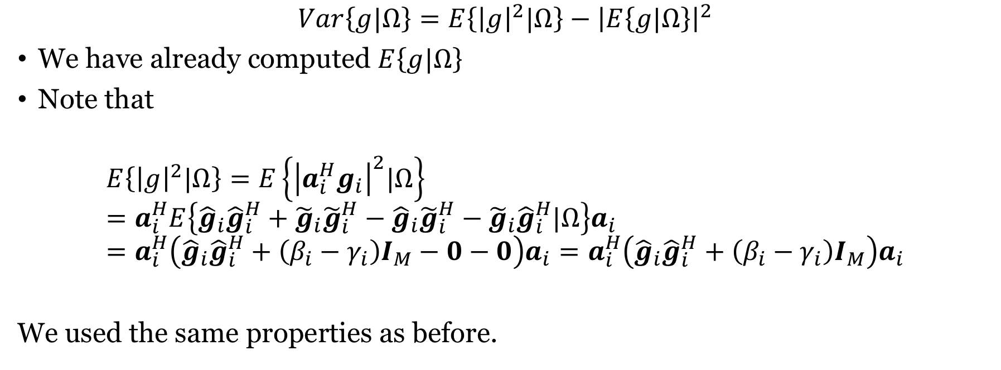
Computing the first term in the denominator
$$Var\left\{g|Ω\right\}=E\left\{{\left|g\right|}^{2}|Ω\right\}−{\left|E\left\{g|Ω\right\}\right|}^{2}$$
We have already computed $E\left\{g|Ω\right\}$
Note that
$$E\left\{{\left|g\right|}^{2}|Ω\right\}=E\left\{{\left|a_{i}^{H}g_{i}\right|}^{2}|Ω\right\} \\ =a_{i}^{H}E\left\{{\hat{g}}_{i}{\hat{g}}_{i}^{H}+{\tilde{g}}_{i}{\tilde{g}}_{i}^{H}−{\hat{g}}_{i}{\tilde{g}}_{i}^{H}−{\tilde{g}}_{i}{\hat{g}}_{i}^{H}|Ω\right\}a_{i} \\ =a_{i}^{H}\left({\hat{g}}_{i}{\hat{g}}_{i}^{H}+\left(β_{i}−γ_{i}\right)I_{M}−0−0\right)a_{i}=a_{i}^{H}\left({\hat{g}}_{i}{\hat{g}}_{i}^{H}+\left(β_{i}−γ_{i}\right)I_{M}\right)a_{i}$$
We used the same properties as before.
$$C≥E\left\{\log_{2}\left(1+\frac{ρ{\left|E\left\{g|Ω\right\}\right|}^{2}}{ρVar\left\{g|Ω\right\}+Var\left\{w|Ω\right\}}\right)\right\}$$

Slide 14
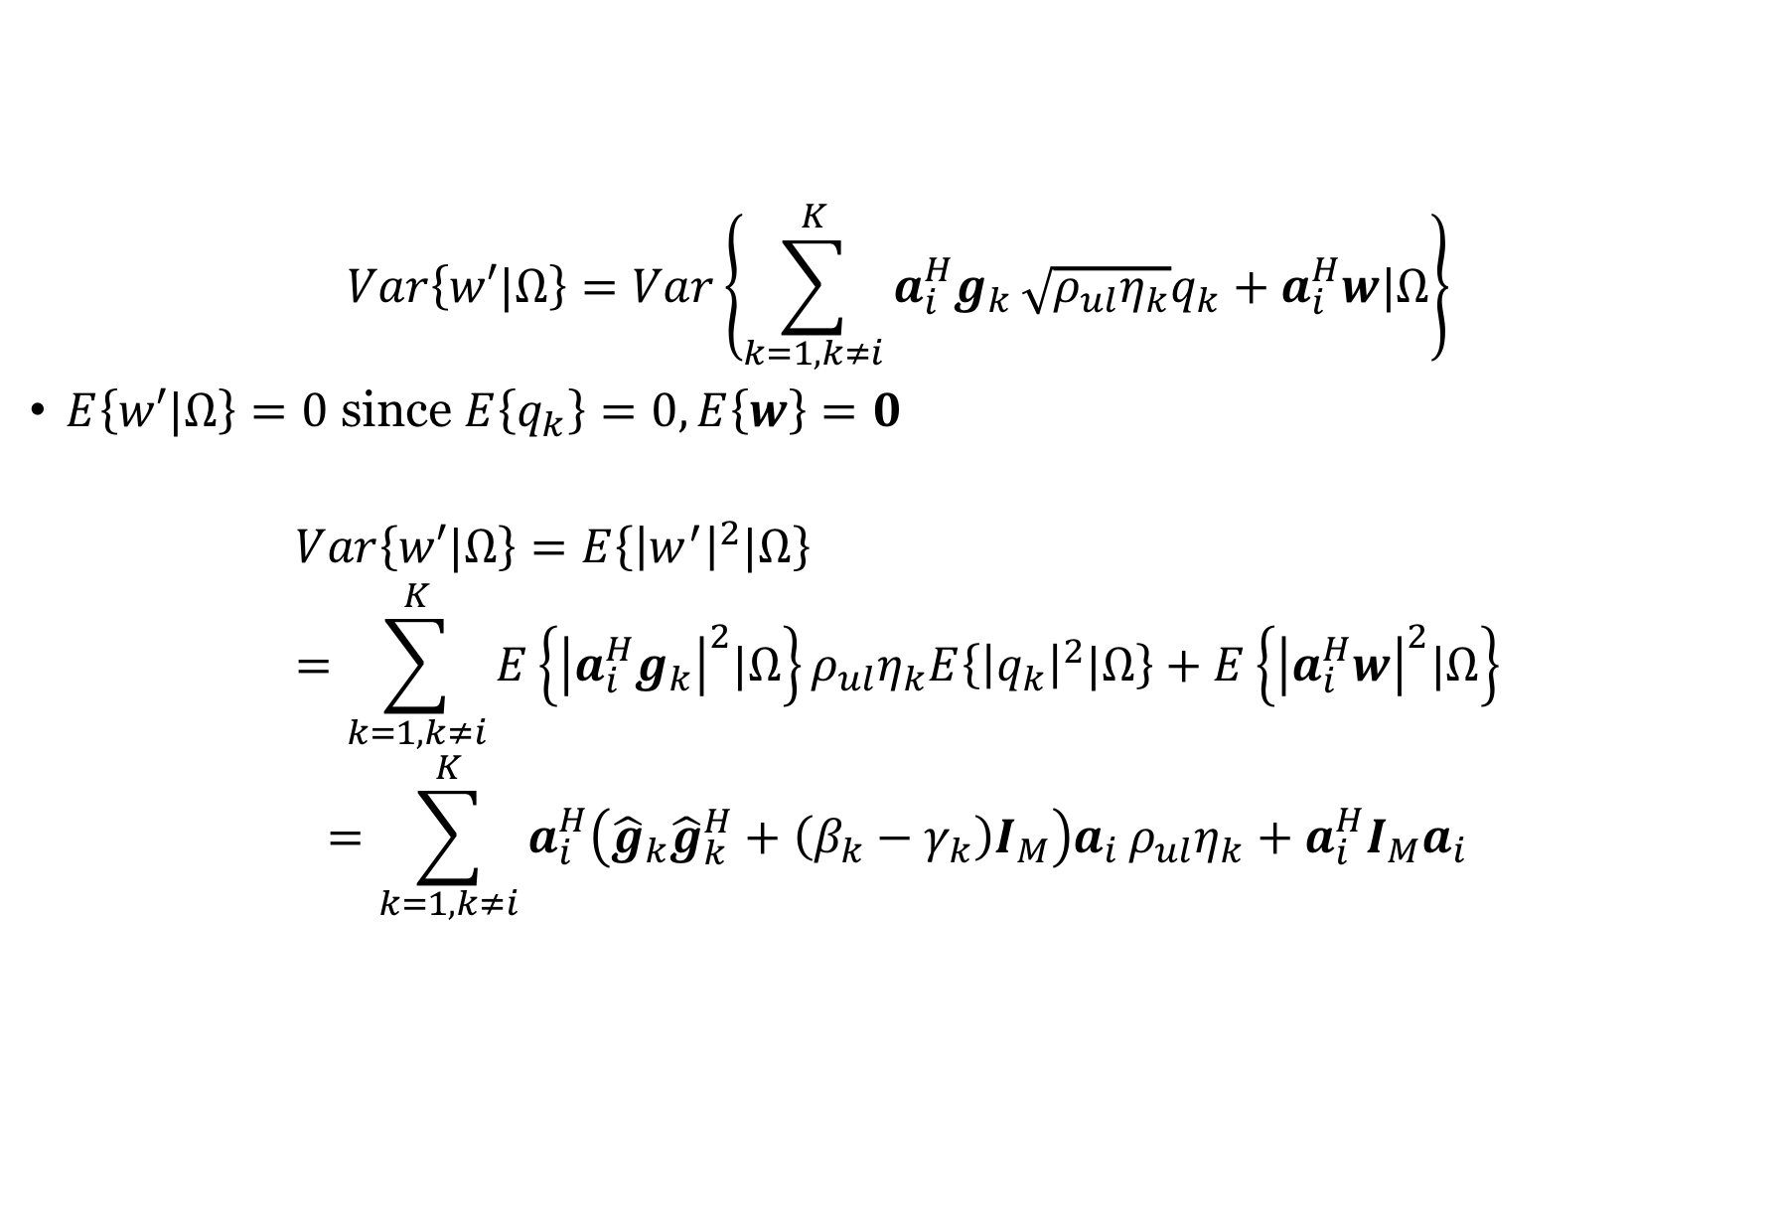
Computing the second term in the denominator
$$Var\left\{w′|Ω\right\}=Var\left\{\sum_{k=1,k≠i}^{K}{a_{i}^{H}g_{k}}\sqrt{ρ_{ul}η_{k}}q_{k}+a_{i}^{H}w|Ω\right\}$$
$E\left\{w′|Ω\right\}=0$ since $E\left\{q_{k}\right\}=0, E\left\{w\right\}=0$
$$Var\left\{w′|Ω\right\}=E\left\{{\left|w^{′}\right|}^{2}|Ω\right\} \\ =\sum_{k=1,k≠i}^{K}{E\left\{{\left|a_{i}^{H}g_{k}\right|}^{2}|Ω\right\}}ρ_{ul}η_{k}E\left\{{\left|q_{k}\right|}^{2}|Ω\right\}+E\left\{{\left|a_{i}^{H}w\right|}^{2}|Ω\right\}$$
$$=\sum_{k=1,k≠i}^{K}{a_{i}^{H}\left({\hat{g}}_{k}{\hat{g}}_{k}^{H}+\left(β_{k}−γ_{k}\right)I_{M}\right)a_{i}}ρ_{ul}η_{k}+a_{i}^{H}{I_{M}a}_{i}$$

Slide 15


Result: Capacity lower bound of User $i$
$$C≥E\left\{\log_{2}\left(1+\frac{ρ_{ul}η_{i}{\left|a_{i}^{H}{\hat{g}}_{i}\right|}^{2}}{a_{i}^{H}B_{i}a_{i}}\right)\right\}$$
where
$$B_{i}=\sum_{k=1,k≠i}^{K}{ρ_{ul}η_{k}{\hat{g}}_{k}{\hat{g}}_{k}^{H}}+\sum_{k=1 }^{K}{ρ_{ul}η_{k}\left(β_{k}−γ_{k}\right)I_{M}}+I_{M}$$
How to pick $a_{i}$?

Slide 16
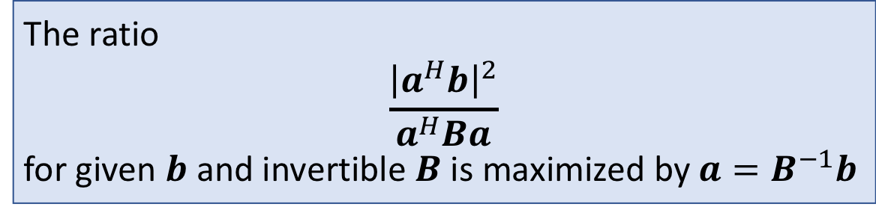

Generalized Rayleigh Quotient
Intuition:
The ratio $\frac{{\left|a^{H}b\right|}^{2}}{a^{H}a}$ is maximized by $a=b$
The extra term $B^{−1}$ is “whitening”
The ratio
$$\frac{{\left|a^{H}b\right|}^{2}}{a^{H}Ba}$$
for given $b$ and invertible $B$ is maximized by $a=B^{−1}b$
Extension of maximum ratio combining

Slide 17
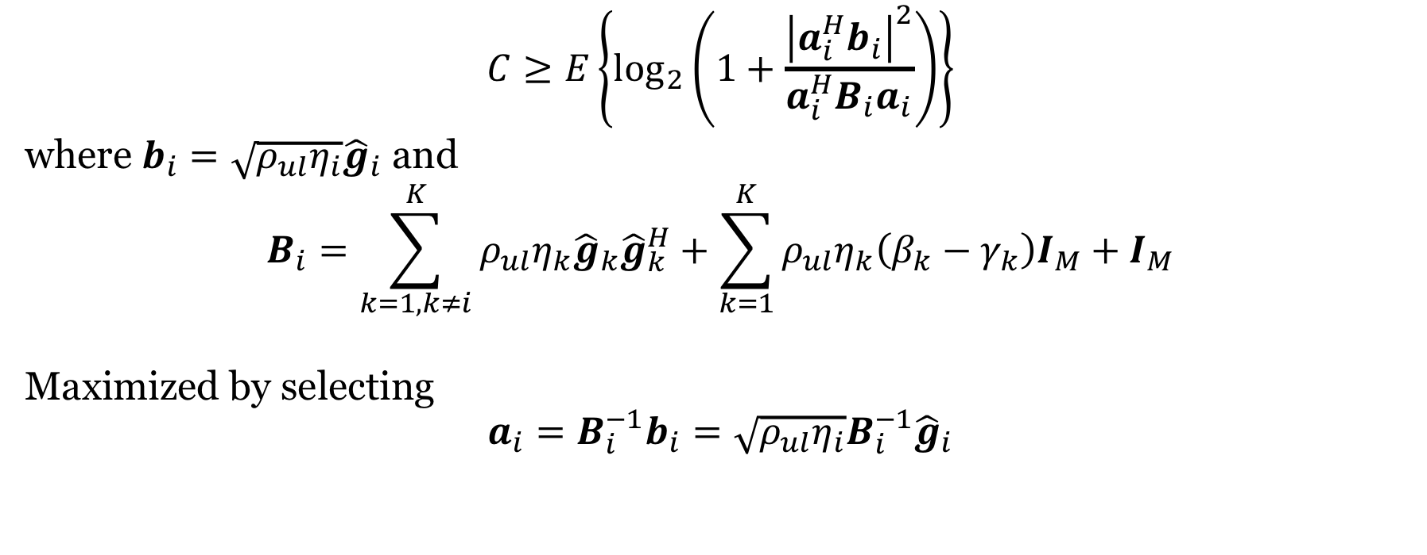
Maximizing the capacity lower bound
$$C≥E\left\{\log_{2}\left(1+\frac{{\left|a_{i}^{H}b_{i}\right|}^{2}}{a_{i}^{H}B_{i}a_{i}}\right)\right\}$$
where $b_{i}=\sqrt{ρ_{ul}η_{i}}{\hat{g}}_{i}$ and
$$B_{i}=\sum_{k=1,k≠i}^{K}{ρ_{ul}η_{k}{\hat{g}}_{k}{\hat{g}}_{k}^{H}}+\sum_{k=1}^{K}{ρ_{ul}η_{k}\left(β_{k}−γ_{k}\right)I_{M}}+I_{M}$$
Maximized by selecting
$$a_{i}=B_{i}^{−1}b_{i}=\sqrt{ρ_{ul}η_{i}}B_{i}^{−1}{\hat{g}}_{i}$$
Called MMSE combining

Slide 18
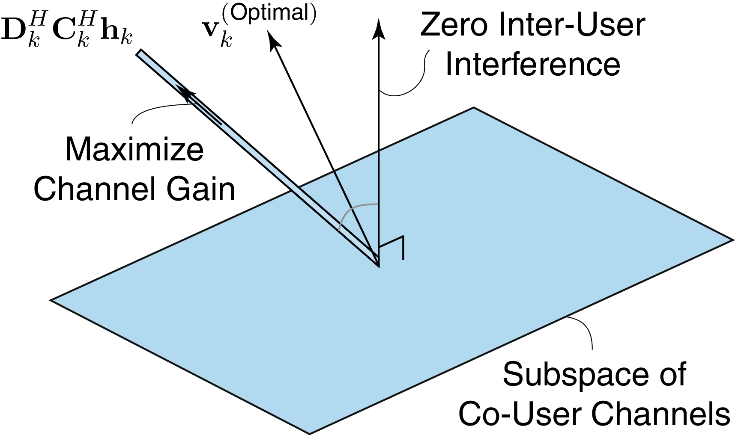
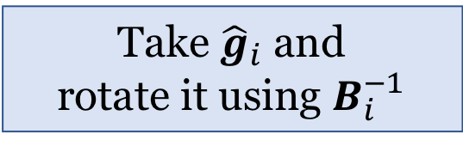



Interpretation of $a_{i}=\sqrt{ρ_{ul}η_{i}}B_{i}^{−1}{\hat{g}}_{i}$ (whitening)
$${\hat{g}}_{i}$$
$a_{i}$
Take ${\hat{g}}_{i}$ and rotate it using $B_{i}^{−1}$
$${\hat{g}}_{1},{\hat{g}}_{i−1},{\hat{g}}_{i+1},{\hat{g}}_{K}$$

Slide 19
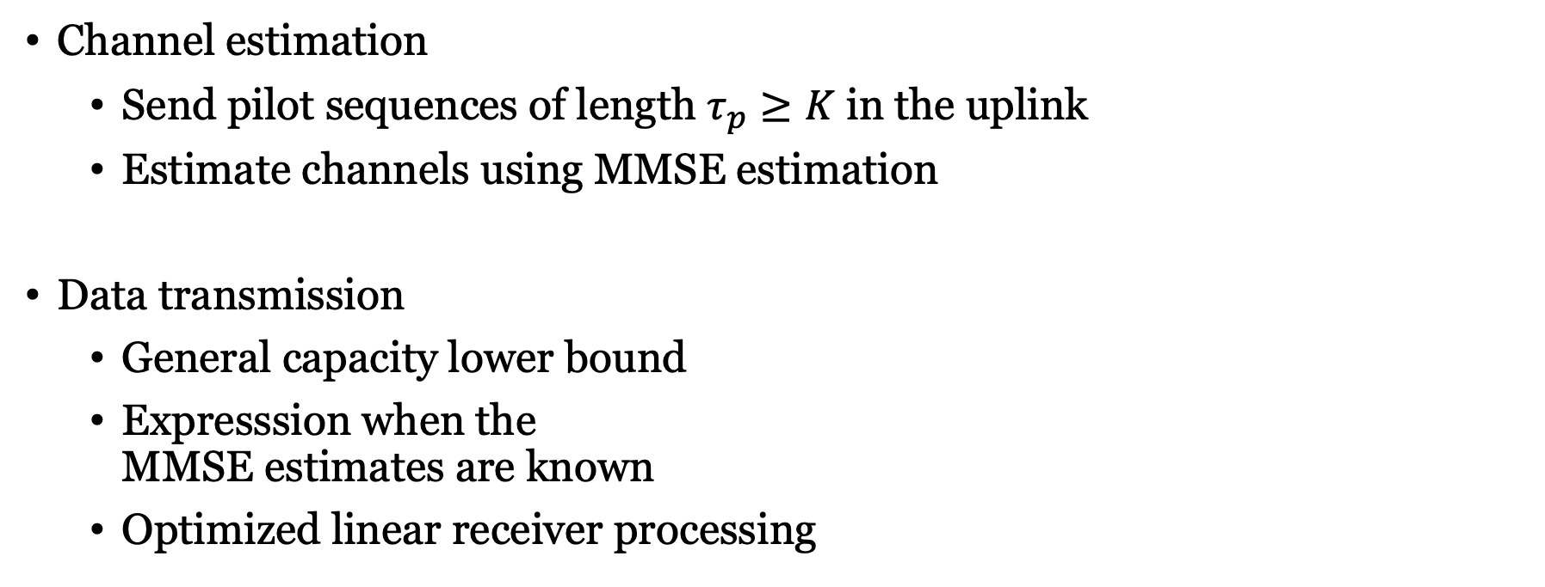
Summary
Channel estimation
Send pilot sequences of length $τ_{p}≥K$ in the uplink
Estimate channels using MMSE estimation
Data transmission
General capacity lower bound
Expresssion when the MMSE estimates are known
Optimized linear receiver processing

Slide 20
Multiple Antenna Communications
Lecture 7:
Multiuser MIMO With Optimal Linear Detection
Emil Björnson

