Slide 1
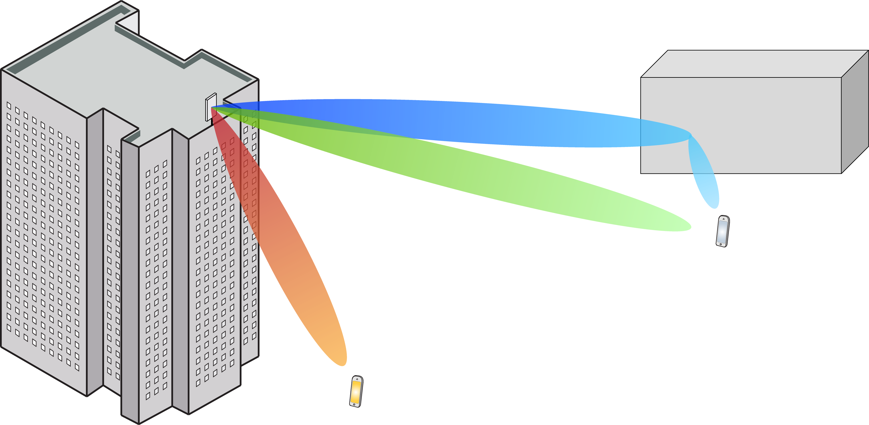
Multiple Antenna Communications
Lecture 8:
Favorable Propagation and MR Processing
Emil Björnson

Slide 2
Outline
Favorable propagation
Motivates using simple processing
Maximum ratio (MR) processing
Simple capacity lower bound
Use-and-then-forget technique
Expression with MR processing

Slide 3

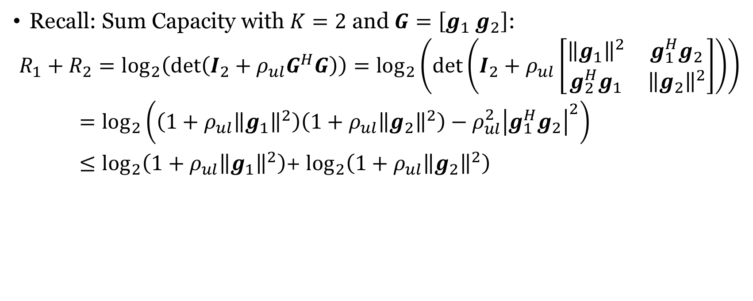






Recall: Sum Capacity with $K=2$
Recall: Sum Capacity with $K=2$ and $G=\left[g_{1} g_{2}\right]$:
$$R_{1}+R_{2}=\log_{2}\left(\det\left(I_{2}+ρ_{ul}G^{H}G\right)\right)=\log_{2}\left(\det\left(I_{2}+ρ_{ul}\left[\begin{matrix}{\left\|g_{1}\right\|}^{2} & g_{1}^{H}g_{2} \\ g_{2}^{H}g_{1} & {\left\|g_{2}\right\|}^{2}\end{matrix}\right]\right)\right)$$
$=\log_{2}\left(\left(1+ρ_{ul}{\left\|g_{1}\right\|}^{2}\right)\left(1+ρ_{ul}{\left\|g_{2}\right\|}^{2}\right)−ρ_{ul}^{2}{\left|g_{1}^{H}g_{2}\right|}^{2}\right)$
$≤\log_{2}\left(1+ρ_{ul}{\left\|g_{1}\right\|}^{2}\right)$+ $\log_{2}\left(1+ρ_{ul}{\left\|g_{2}\right\|}^{2}\right)$
Equality if and only if $g_{1}^{H}g_{2}=0$
$$R_{2}$$
$$R_{2}$$
$$g_{1}^{H}g_{2} ≠0$$
$$g_{1}^{H}g_{2}=0$$
$$R_{1}$$
$$R_{1}$$

Slide 4
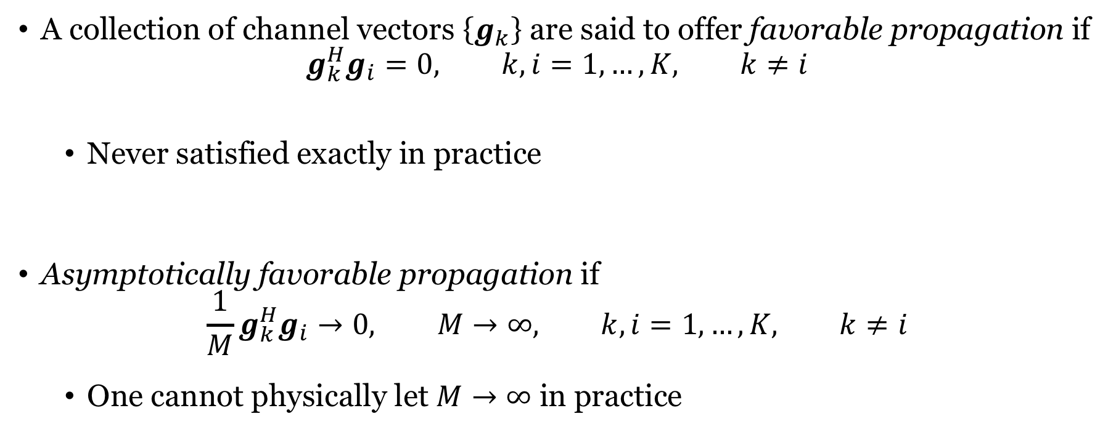
Favorable propagation
A collection of channel vectors $\left\{g_{k}\right\}$ are said to offer favorable propagation if
$$g_{k}^{H}g_{i}=0, k,i=1,…,K, k≠i$$
Never satisfied exactly in practice
Asymptotically favorable propagation if
$$\frac{1}{M}g_{k}^{H}g_{i}→0, M→∞, k,i=1,…,K, k≠i$$
One cannot physically let $M→∞$ in practice

Slide 5


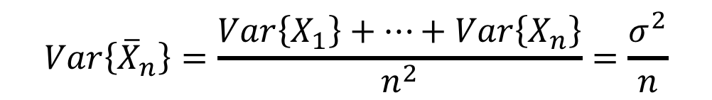
Law of large numbers
Consider a sequence $X_{1},X_{2},…$ of independent and identically distributed random variables
Assume $E\left\{X_{i}\right\}=μ$ for $i=1,2,…$
Assume $Var\left\{X_{i}\right\}=σ^{2}<∞$ for $i=1,2,…$
Law of large numbers
The sample average
$${\overline{X}}_{n}=\frac{X_{1}+…+X_{n}}{n}$$
converges to the expected value
$${\overline{X}}_{n}→μ as n→∞$$
$$Var\left\{{\overline{X}}_{n}\right\}=\frac{Var\left\{X_{1}\right\}+…+Var\left\{X_{n}\right\}}{n^{2}}=\frac{σ^{2}}{n}$$

Slide 6
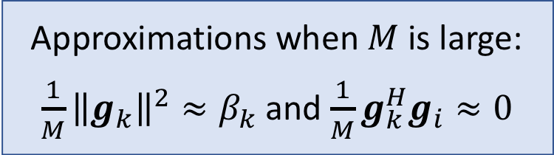
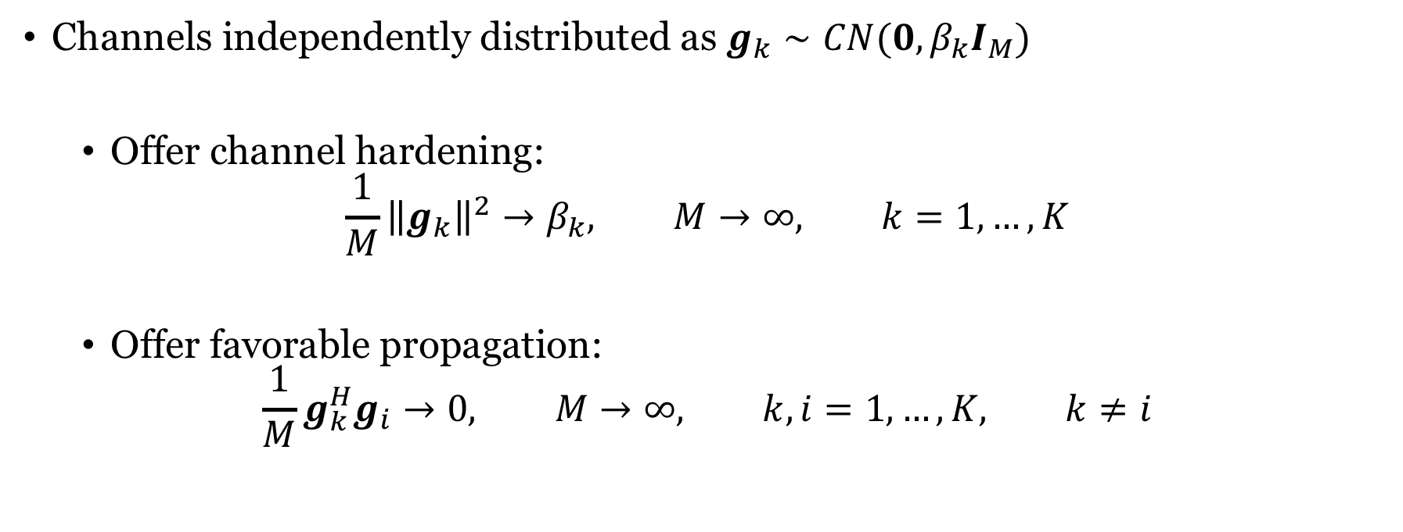
Properties of Rayleigh fading channels
Channels independently distributed as $g_{k}∼CN(0,β_{k}I_{M})$
Offer channel hardening:
$$\frac{1}{M}{\left\|g_{k}\right\|}^{2}→β_{k}, M→∞, k=1,…,K$$
Offer favorable propagation:
$$\frac{1}{M}g_{k}^{H}g_{i}→0, M→∞, k,i=1,…,K, k≠i$$
Approximations when $M$ is large:
$\frac{1}{M}{\left\|g_{k}\right\|}^{2}≈β_{k}$ and $\frac{1}{M}g_{k}^{H}g_{i}≈0$

Slide 7
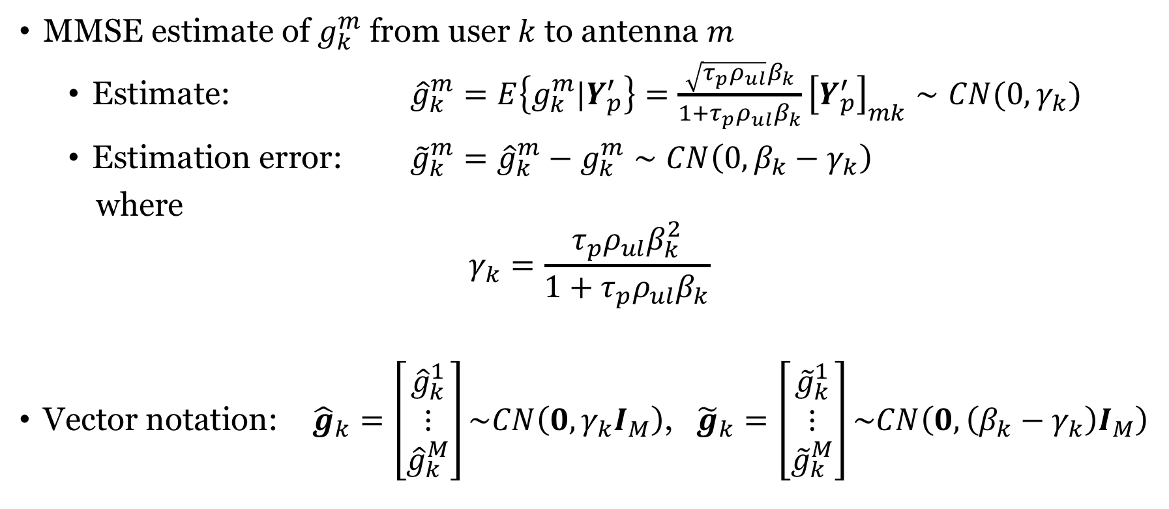
Recall: Estimates of channels
MMSE estimate of $g_{k}^{m}$ from user $k$ to antenna $m$
Estimate: ${\hat{g}}_{k}^{m}=E\left\{g_{k}^{m}|Y_{p}^{′}\right\}=\frac{\sqrt{τ_{p}ρ_{ul}}β_{k}}{1+τ_{p}ρ_{ul}β_{k}}{\left[Y_{p}^{′}\right]}_{mk}∼CN(0, γ_{k})$
Estimation error: ${\tilde{g}}_{k}^{m}={\hat{g}}_{k}^{m}−g_{k}^{m}∼CN\left(0,{β_{k}−γ}_{k}\right)$
where
$$γ_{k}=\frac{τ_{p}ρ_{ul}β_{k}^{2}}{1+τ_{p}ρ_{ul}β_{k}}$$
Vector notation: ${\hat{g}}_{k}=\left[\begin{matrix}{\hat{g}}_{k}^{1} \\ ⋮ \\ {\hat{g}}_{k}^{M}\end{matrix}\right]\sim CN\left(0,γ_{k}I_{M}\right)$, ${\tilde{g}}_{k}=\left[\begin{matrix}{\tilde{g}}_{k}^{1} \\ ⋮ \\ {\tilde{g}}_{k}^{M}\end{matrix}\right]\sim CN\left(0,\left({β_{k}−γ}_{k}\right)I_{M}\right)$

Slide 8
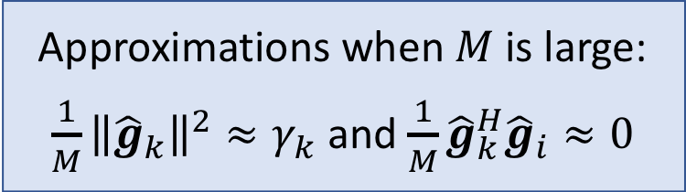
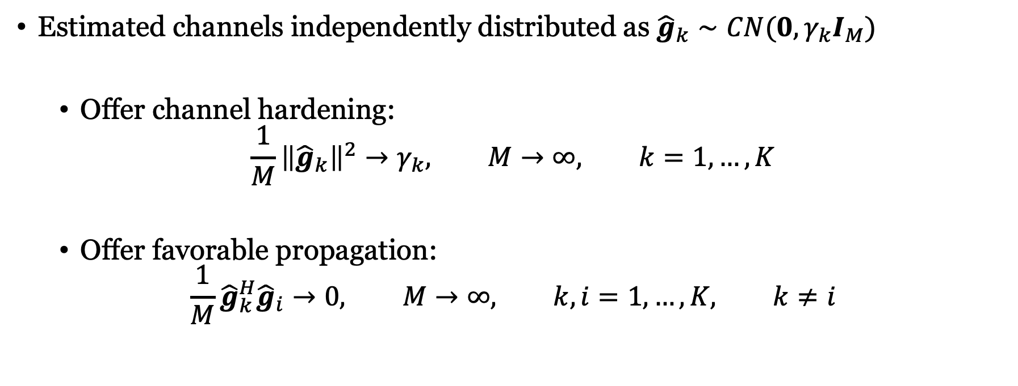
Properties of estimated Rayleigh fading channels
Estimated channels independently distributed as ${\hat{g}}_{k}∼CN(0,γ_{k}I_{M})$
Offer channel hardening:
$$\frac{1}{M}{\left\|{\hat{g}}_{k}\right\|}^{2}→γ_{k}, M→∞, k=1,…,K$$
Offer favorable propagation:
$$\frac{1}{M}{\hat{g}}_{k}^{H}{\hat{g}}_{i}→0, M→∞, k,i=1,…,K, k≠i$$
Approximations when $M$ is large:
$\frac{1}{M}{\left\|{\hat{g}}_{k}\right\|}^{2}≈γ_{k}$ and $\frac{1}{M}{\hat{g}}_{k}^{H}{\hat{g}}_{i}≈0$

Slide 9
Recall: Capacity lower bound
Channel information $Ω$
$$w$$
$$x$$
$$\sqrt{ρ}$$
$$g$$
+
Receiver
$$\hat{x}$$
$$y=\sqrt{ρ}gx+w$$
Desired signal $x$, power $ρ$, and $g$ and $w$ uncorrelated
Channel coefficient $g$, known channel information $Ω$
Capacity lower bound:
$$C≥E\left\{\log_{2}\left(1+\frac{ρ{\left|E\left\{g|Ω\right\}\right|}^{2}}{ρVar\left\{g|Ω\right\}+Var\left\{w|Ω\right\}}\right)\right\}$$

Slide 10
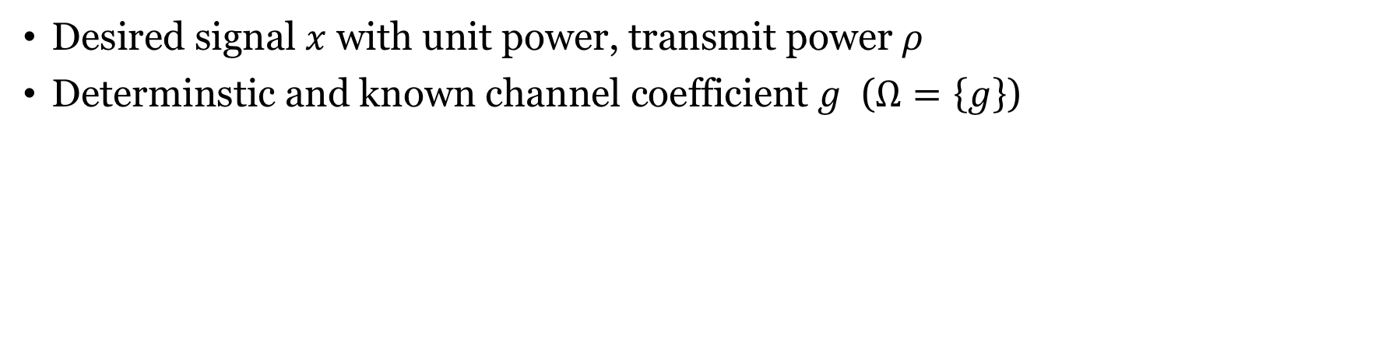
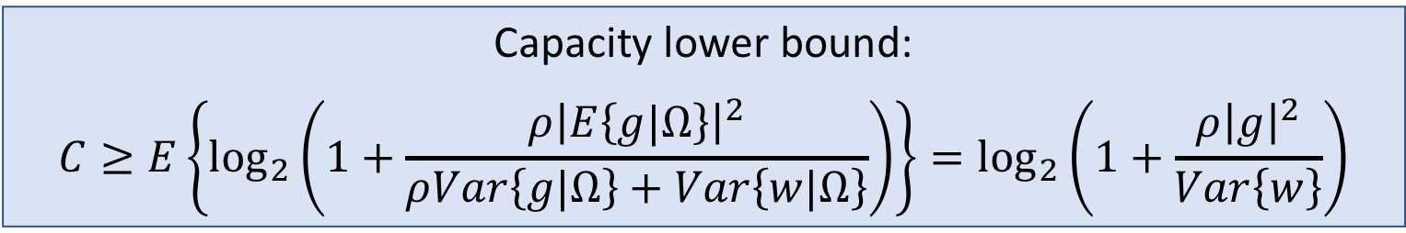

Capacity lower bound with deterministic channel
$$w$$
Channel information $Ω$
$$x$$
$$\sqrt{ρ}$$
$$g$$
+
Receiver
$$\hat{x}$$
$$y=\sqrt{ρ}gx+w$$
Desired signal $x$ with unit power, transmit power $ρ$
Determinstic and known channel coefficient $g$ ($Ω=\left\{g\right\}$)
Capacity lower bound:
$$C≥E\left\{\log_{2}\left(1+\frac{ρ{\left|E\left\{g|Ω\right\}\right|}^{2}}{ρVar\left\{g|Ω\right\}+Var\left\{w|Ω\right\}}\right)\right\}=\log_{2}\left(1+\frac{ρ{\left|g\right|}^{2}}{Var\left\{w\right\}}\right)$$

Slide 11

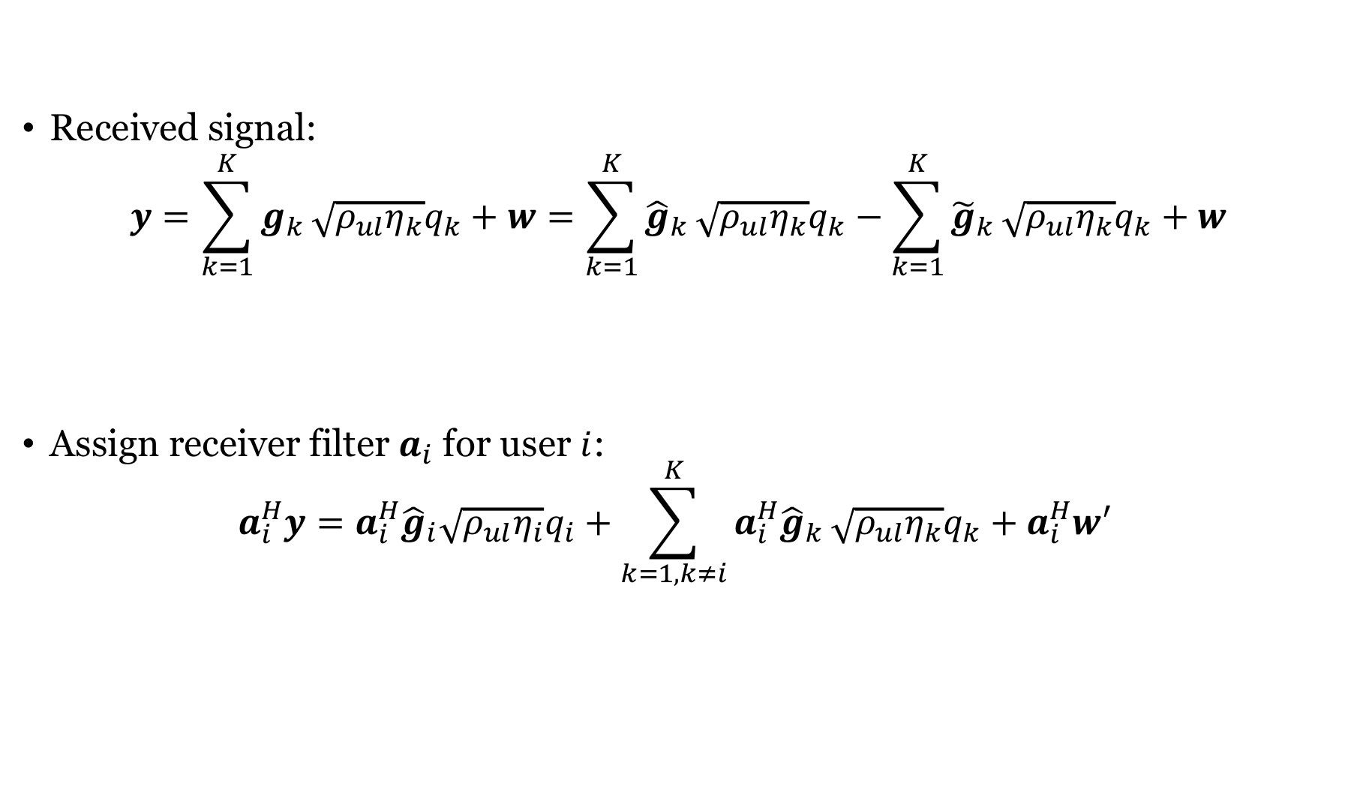
Revisiting the received uplink signal
Received signal:
$$y=\sum_{k=1}^{K}{g_{k}}\sqrt{ρ_{ul}η_{k}}q_{k}+w=\sum_{k=1}^{K}{{\hat{g}}_{k}}\sqrt{ρ_{ul}η_{k}}q_{k}−\sum_{k=1}^{K}{{\tilde{g}}_{k}}\sqrt{ρ_{ul}η_{k}}q_{k}+w$$
Assign receiver filter $a_{i}$ for user $i$:
$$a_{i}^{H}y=a_{i}^{H}{\hat{g}}_{i}\sqrt{ρ_{ul}η_{i}}q_{i}+\sum_{k=1,k≠i}^{K}{a_{i}^{H}{\hat{g}}_{k}}\sqrt{ρ_{ul}η_{k}}q_{k}+a_{i}^{H}w′$$
Useful part
$w^{′}$: Unusable part
Desired part
Interference

Slide 12
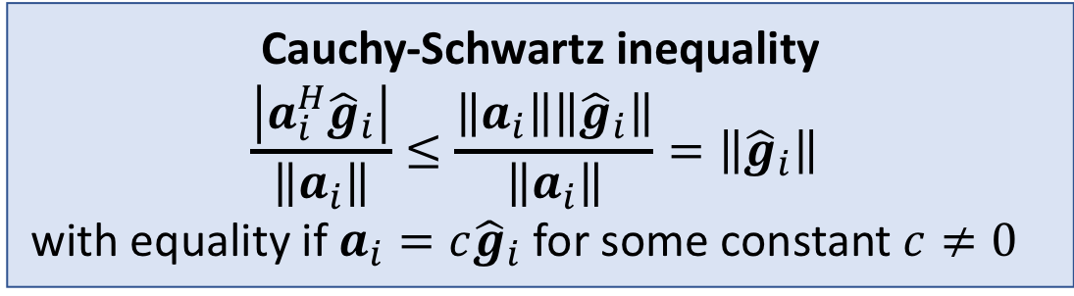

Focusing on the desired part
Consider ${\hat{g}}_{i}∼CN(0,{γ_{i}I}_{M})$
Which value of $a_{i}$ maximizes the ratio $\frac{\left|a_{i}^{H}{\hat{g}}_{i}\right|}{\left\|a_{i}\right\|}$?
We now call $a_{i}={c\hat{g}}_{i}$ maximum ratio (MR) processing
Same thing as MRC for $c=1/\left\|{\hat{g}}_{i}\right\|$
Cauchy-Schwartz inequality
$$\frac{\left|a_{i}^{H}{\hat{g}}_{i}\right|}{\left\|a_{i}\right\|}≤\frac{\left\|a_{i}\right\|\left\|{\hat{g}}_{i}\right\|}{\left\|a_{i}\right\|}=\left\|{\hat{g}}_{i}\right\|$$
with equality if $a_{i}=c{\hat{g}}_{i}$ for some constant $c≠0$

Slide 13

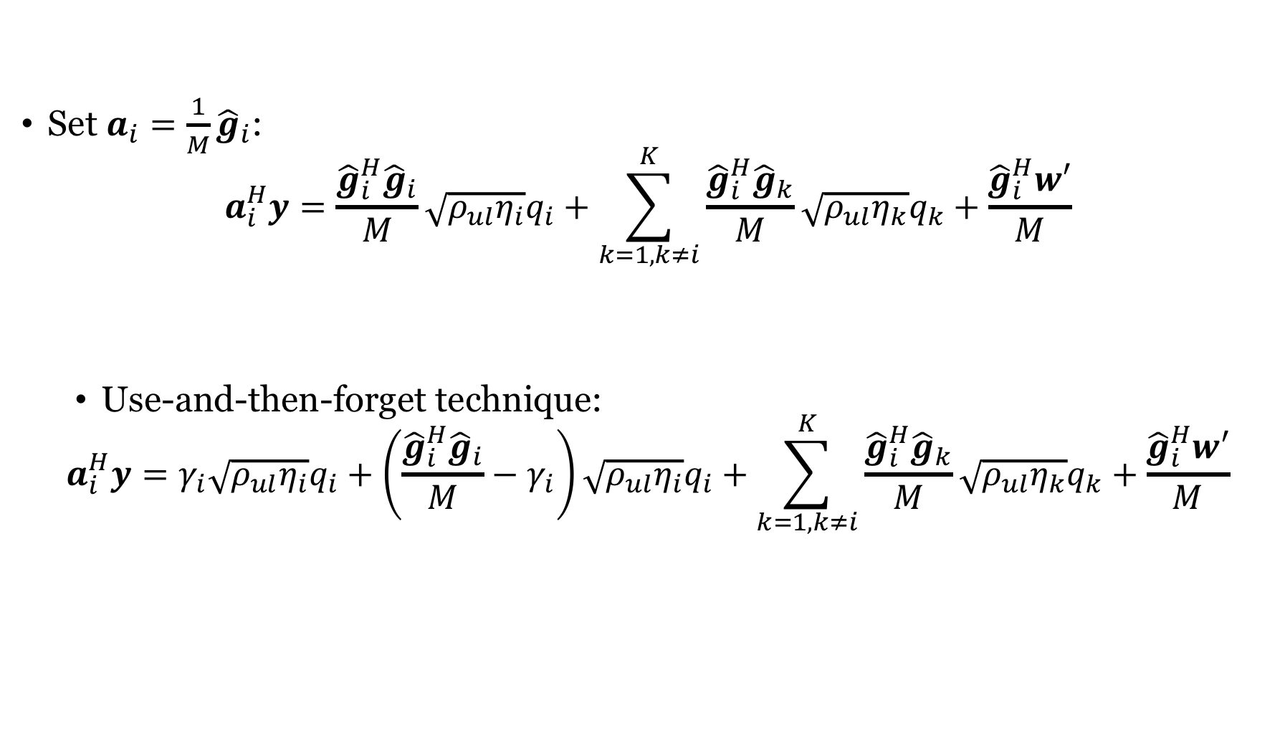



Received signal when using MR processing
Set $a_{i}=\frac{1}{M}{\hat{g}}_{i}$:
$$a_{i}^{H}y=\frac{{\hat{g}}_{i}^{H}{\hat{g}}_{i}}{M}\sqrt{ρ_{ul}η_{i}}q_{i}+\sum_{k=1,k≠i}^{K}{\frac{{\hat{g}}_{i}^{H}{\hat{g}}_{k}}{M}}\sqrt{ρ_{ul}η_{k}}q_{k}+\frac{{\hat{g}}_{i}^{H}w′}{M}$$
Use-and-then-forget technique:
$$a_{i}^{H}y=γ_{i}\sqrt{ρ_{ul}η_{i}}q_{i}+\left(\frac{{\hat{g}}_{i}^{H}{\hat{g}}_{i}}{M}−γ_{i}\right)\sqrt{ρ_{ul}η_{i}}q_{i}+\sum_{k=1,k≠i}^{K}{\frac{{\hat{g}}_{i}^{H}{\hat{g}}_{k}}{M}}\sqrt{ρ_{ul}η_{k}}q_{k}+\frac{{\hat{g}}_{i}^{H}w′}{M}$$
$$≈γ_{i}$$
$$≈0$$
$$≈0$$
Desired part with
deterministic channel!
$w$: Uncorrelated interference and noise

Slide 14
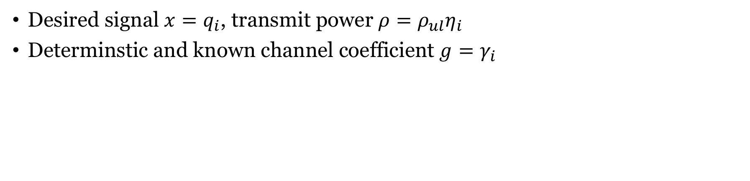
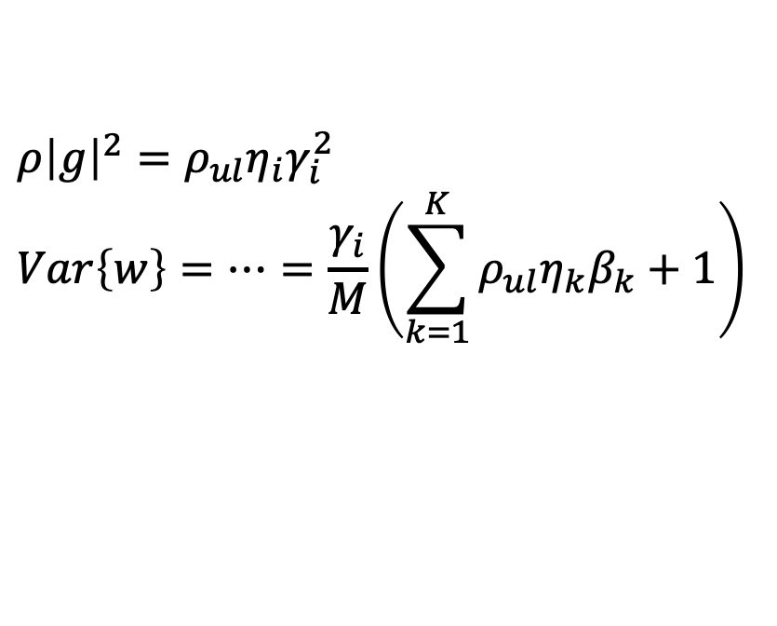

Using the capacity bound with deterministic channel
$$w$$
Channel information $Ω$
$$x$$
$$\sqrt{ρ}$$
$$g$$
+
Receiver
$$\hat{x}$$
$$y=\sqrt{ρ}gx+w$$
Desired signal $x=q_{i}$, transmit power $ρ=ρ_{ul}η_{i}$
Determinstic and known channel coefficient $g=γ_{i}$
Capacity lower bound:
$$C≥\log_{2}\left(1+\frac{ρ{\left|g\right|}^{2}}{Var\left\{w\right\}}\right)$$
$ρ{\left|g\right|}^{2}=ρ_{ul}η_{i}γ_{i}^{2}$
$$Var\left\{w\right\}=…=\frac{γ_{i}}{M}\left(\sum_{k=1}^{K}{ρ_{ul}η_{k}β_{k}}+1\right)$$

Slide 15
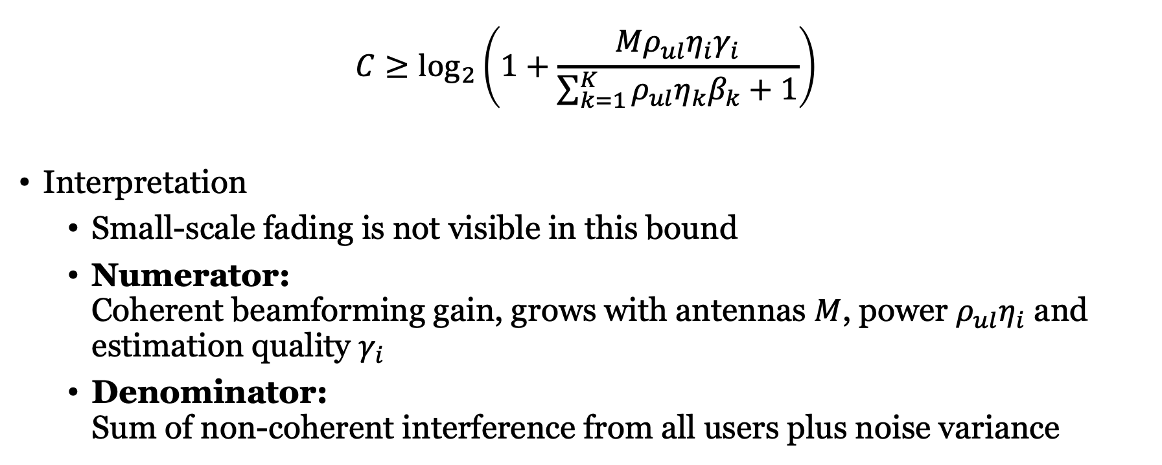
Capacity bound with MR and use-and-then-forget technique
$${C≥log}_{2}\left(1+\frac{Mρ_{ul}η_{i}γ_{i}}{\sum_{k=1}^{K}{ρ_{ul}η_{k}β_{k}}+1}\right)$$
Interpretation
Small-scale fading is not visible in this bound
Numerator: Coherent beamforming gain, grows with antennas $M$, power $ρ_{ul}η_{i}$ and estimation quality $γ_{i}$
Denominator: Sum of non-coherent interference from all users plus noise variance

Slide 16
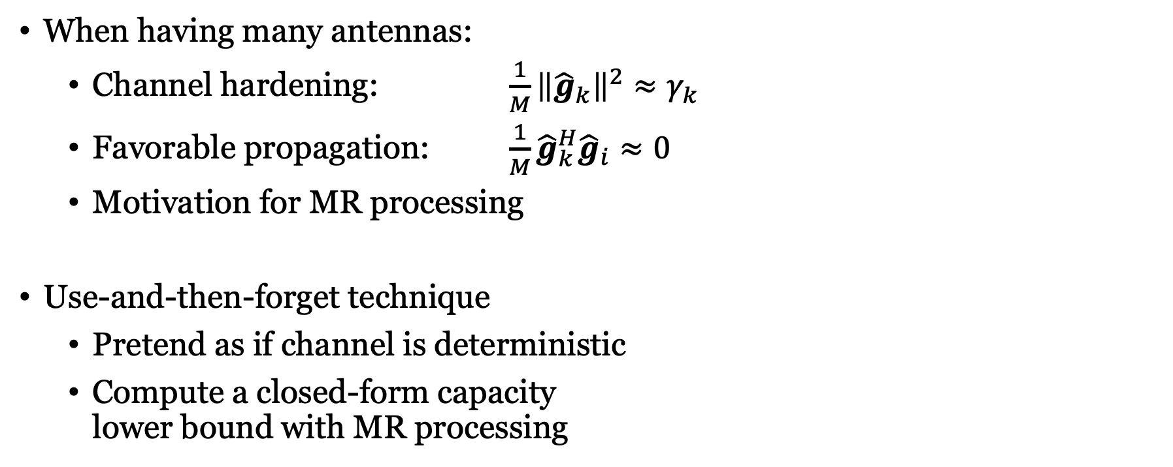
Summary
When having many antennas:
Channel hardening: $\frac{1}{M}{\left\|{\hat{g}}_{k}\right\|}^{2}≈γ_{k}$
Favorable propagation: $\frac{1}{M}{\hat{g}}_{k}^{H}{\hat{g}}_{i}≈0$
Motivation for MR processing
Use-and-then-forget technique
Pretend as if channel is deterministic
Compute a closed-form capacity lower bound with MR processing

Slide 17
Multiple Antenna Communications
Lecture 8:
Favorable Propagation and MR Processing
Emil Björnson

