Slide 1
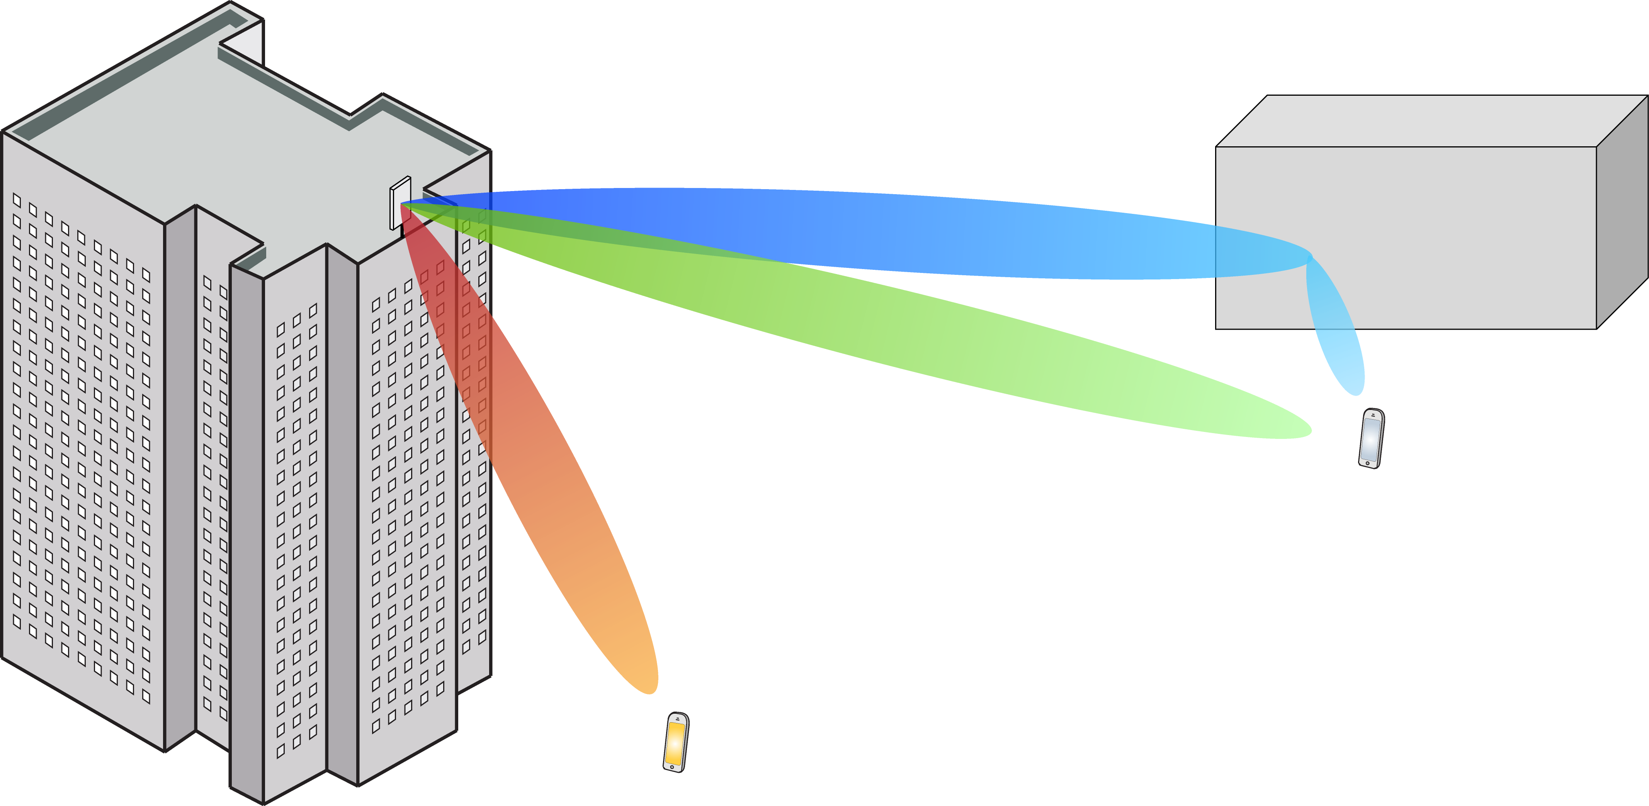
Multiple Antenna Communications
Lecture 9:
Downlink Multiuser MIMO With Linear Processing
Emil Björnson

Slide 2
Outline
Downlink communication
System model
Precoding
Capacity lower bound
Any precoding
MR precoding
Performance comparison: Uplink and downlink

Slide 3
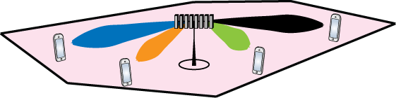
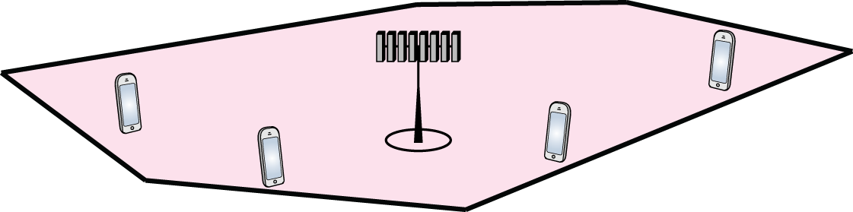


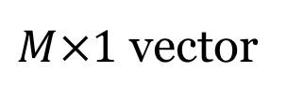

Downlink communication
$$g_{i}=\left(\begin{matrix}g_{i}^{1} \\ ⋮ \\ g_{i}^{M}\end{matrix}\right)$$
Notation:
Signal sent by base station
$$\sqrt{ρ_{dl}}x$$
User $i$
Transmit power
$M×1$ vector

Slide 4

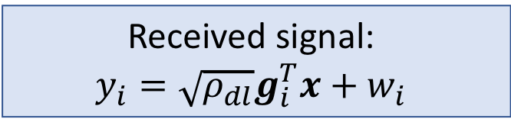

Received signal at User $i$
Transmitted signal: $\sqrt{ρ_{dl}}x$
Channel vector: $g_{i}$
Additive noise: $w_{i}\sim CN(0,1)$
User $i$
Received signal:
$$y_{i}=\sqrt{ρ_{dl}}g_{i}^{T}x+w_{i}$$

Slide 5
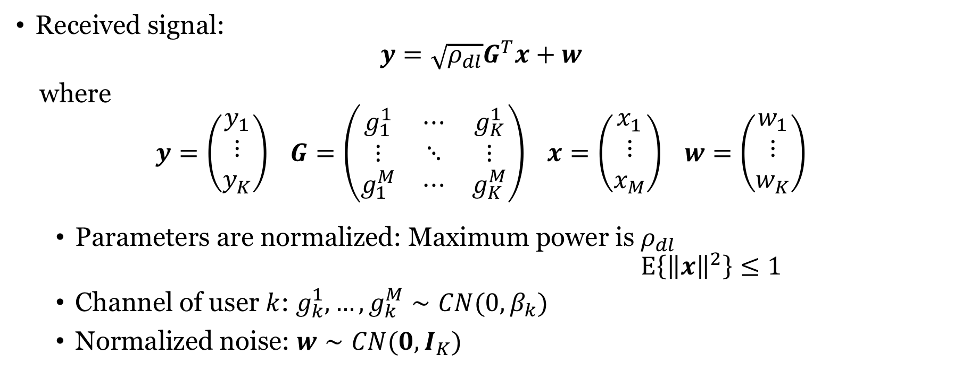
Downlink Massive MIMO system model
Received signal:
$$y=\sqrt{ρ_{dl}}G^{T}x+w$$
where
$$y=\left(\begin{matrix}y_{1} \\ ⋮ \\ y_{K}\end{matrix}\right) G=\left(\begin{matrix}g_{1}^{1} & ⋯ & g_{K}^{1} \\ ⋮ & ⋱ & ⋮ \\ g_{1}^{M} & ⋯ & g_{K}^{M}\end{matrix}\right) x=\left(\begin{matrix}x_{1} \\ ⋮ \\ x_{M}\end{matrix}\right) w=\left(\begin{matrix}w_{1} \\ ⋮ \\ w_{K}\end{matrix}\right)$$
Parameters are normalized: Maximum power is $ρ_{dl}$ $E\left\{{\left\|x\right\|}^{2}\right\}≤1$
Channel of user $k$: $g_{k}^{1},…,g_{k}^{M}∼CN(0,β_{k})$
Normalized noise: $w∼CN(0,I_{K})$
Large-scale fading coefficient

Slide 6
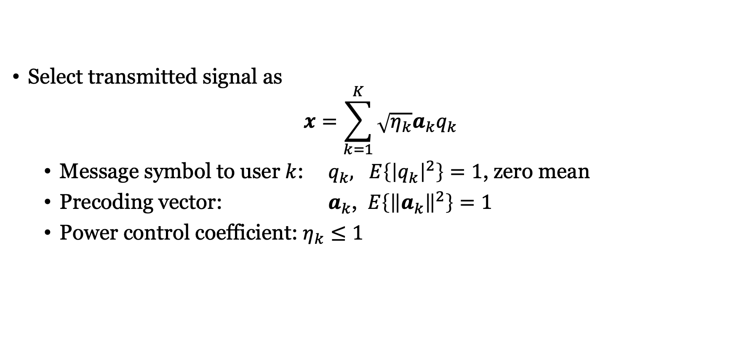

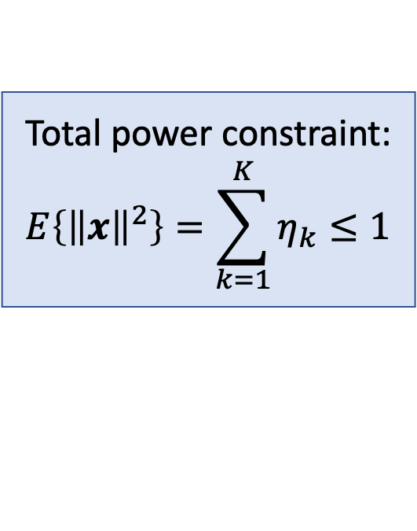
Linear precoding
If $b_{k}$ is a preferred precoder, pick
$$a_{k}=\frac{1}{\sqrt{E\left\{{\left\|b_{k}\right\|}^{2}\right\}}}b_{k}$$
Select transmitted signal as
$$x=\sum_{k=1}^{K}{\sqrt{η_{k}}a_{k}q_{k}}$$
Message symbol to user $k$: $q_{k}, E\left\{{\left|q_{k}\right|}^{2}\right\}=1$, zero mean
Precoding vector: $a_{k}$, $E\left\{{\left\|a_{k}\right\|}^{2}\right\}=1$
Power control coefficient: $η_{k}≤1$
Total power constraint:
$$E\left\{{\left\|x\right\|}^{2}\right\}=\sum_{k=1}^{K}{η_{k}}≤1$$

Slide 7
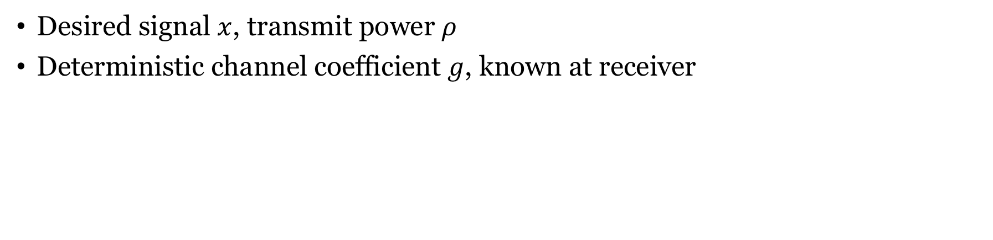


Capacity lower bound
$$w$$
$$x$$
$$\sqrt{ρ}$$
$$g$$
+
Receiver
$$\hat{x}$$
$$y=\sqrt{ρ}gx+w$$
Desired signal $x$, transmit power $ρ$
Deterministic channel coefficient $g$, known at receiver
Capacity lower bound:
$$C≥\log_{2}\left(1+\frac{ρ{\left|g\right|}^{2}}{Var\left\{w\right\}}\right)$$

Slide 8
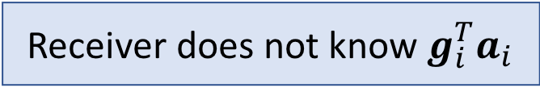
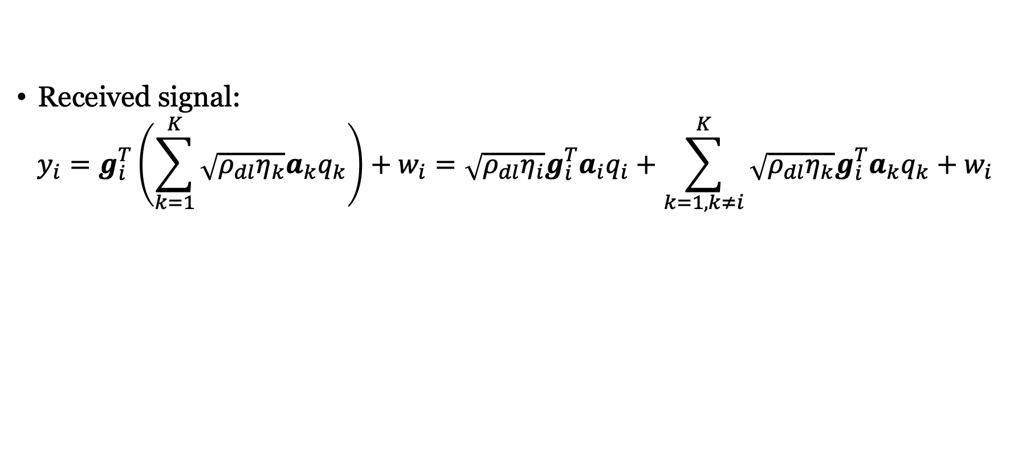
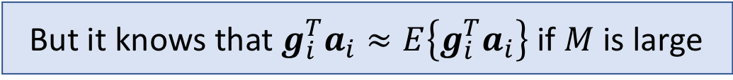
Rewriting the received downlink signal
Received signal:
$$y_{i}=g_{i}^{T}\left(\sum_{k=1}^{K}{\sqrt{{ρ_{dl}η}_{k}}a_{k}q_{k}}\right)+w_{i}=\sqrt{ρ_{dl}η_{i}}g_{i}^{T}a_{i}q_{i}+\sum_{k=1,k≠i}^{K}{\sqrt{ρ_{dl}η_{k}}g_{i}^{T}a_{k}q_{k}}+w_{i}$$
Desired signal
Interference plus noise
Receiver does not know $g_{i}^{T}a_{i}$
But it knows that $g_{i}^{T}a_{i}≈E\left\{g_{i}^{T}a_{i}\right\}$ if $M$ is large

Slide 9

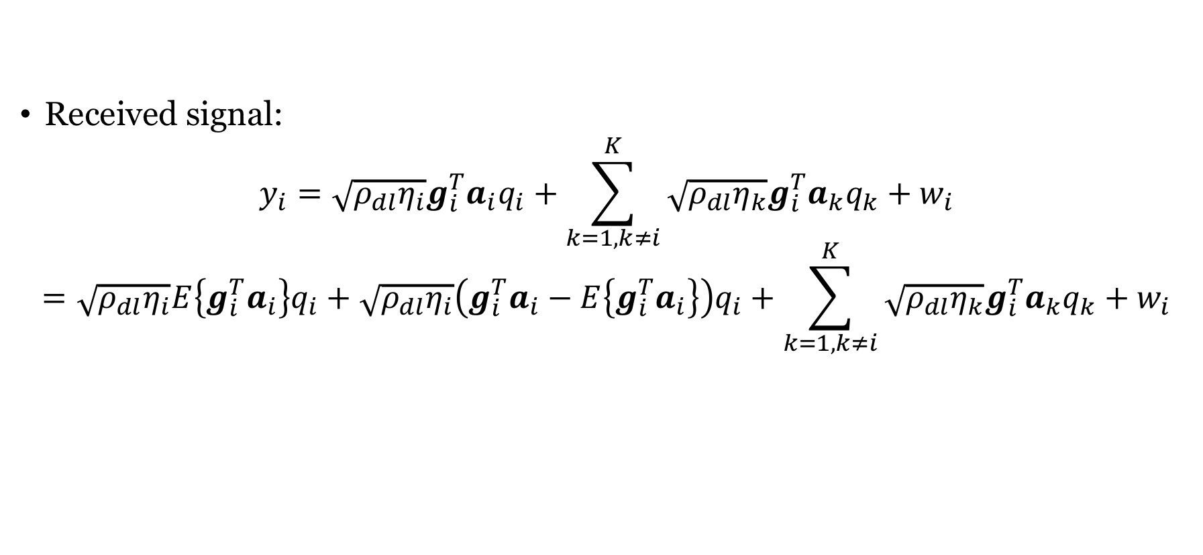




Add and subtract $E\left\{g_{i}^{T}a_{i}\right\}$
Received signal:
$$y_{i}=\sqrt{ρ_{dl}η_{i}}g_{i}^{T}a_{i}q_{i}+\sum_{k=1,k≠i}^{K}{\sqrt{ρ_{dl}η_{k}}g_{i}^{T}a_{k}q_{k}}+w_{i}$$
$$=\sqrt{ρ_{dl}η_{i}}E\left\{g_{i}^{T}a_{i}\right\}q_{i}+\sqrt{ρ_{dl}η_{i}}\left(g_{i}^{T}a_{i}−E\left\{g_{i}^{T}a_{i}\right\}\right)q_{i}+\sum_{k=1,k≠i}^{K}{\sqrt{ρ_{dl}η_{k}}g_{i}^{T}a_{k}q_{k}}+w_{i}$$
$$\sqrt{ρ}$$
$$g$$
$$q$$
$w$: Interference plus noise
Capacity lower bound:
$$C≥\log_{2}\left(1+\frac{ρ{\left|g\right|}^{2}}{Var\left\{w\right\}}\right)$$
Almost like an AWGN channel!

Slide 10
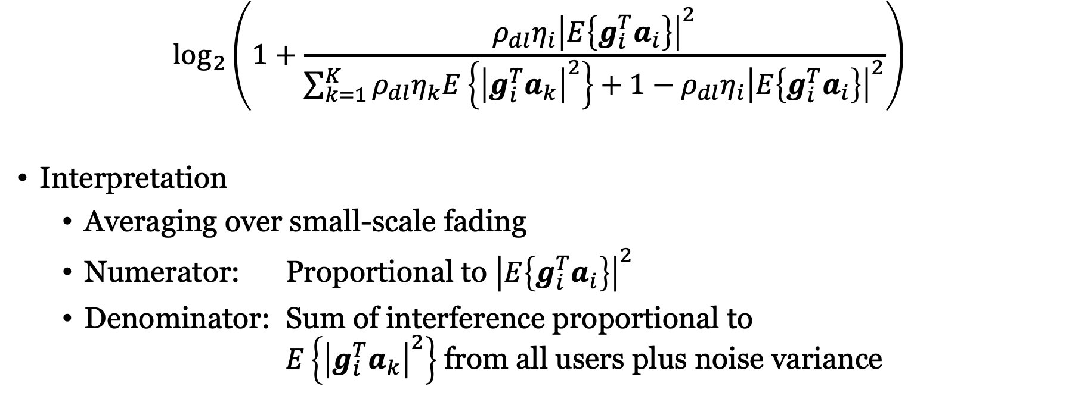
Capacity lower bound with any precoding
$$\log_{2}\left(1+\frac{ρ_{dl}η_{i}{\left|E\left\{g_{i}^{T}a_{i}\right\}\right|}^{2}}{\sum_{k=1}^{K}{ρ_{dl}η_{k}E\left\{{\left|g_{i}^{T}a_{k}\right|}^{2}\right\}}+1−ρ_{dl}η_{i}{\left|E\left\{g_{i}^{T}a_{i}\right\}\right|}^{2}}\right)$$
Interpretation
Averaging over small-scale fading
Numerator: Proportional to ${\left|E\left\{g_{i}^{T}a_{i}\right\}\right|}^{2}$
Denominator: Sum of interference proportional to $E\left\{{\left|g_{i}^{T}a_{k}\right|}^{2}\right\}$ from all users plus noise variance

Slide 11
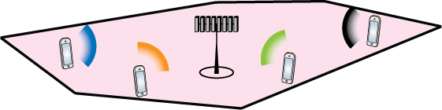
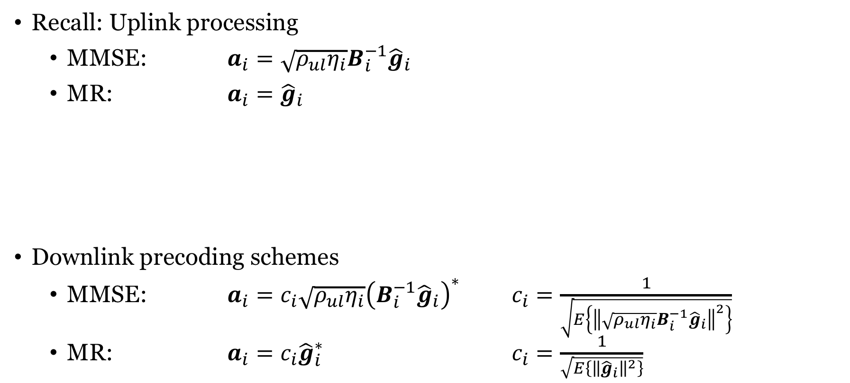
How to select precoding?
Recall: Uplink processing
MMSE: $a_{i}=\sqrt{ρ_{ul}η_{i}}B_{i}^{−1}{\hat{g}}_{i}$
MR: $a_{i}={\hat{g}}_{i}$
Downlink precoding schemes
MMSE: $a_{i}=c_{i}\sqrt{ρ_{ul}η_{i}}{\left(B_{i}^{−1}{\hat{g}}_{i}\right)}^{∗}$ $c_{i}=\frac{1}{\sqrt{E\left\{{\left\|\sqrt{ρ_{ul}η_{i}}B_{i}^{−1}{\hat{g}}_{i}\right\|}^{2}\right\}}}$
MR: $a_{i}={c_{i}\hat{g}}_{i}^{∗}$ $c_{i}=\frac{1}{\sqrt{E\left\{{\left\|{\hat{g}}_{i}\right\|}^{2}\right\}}}$
Precoding principle
Transmit in the direction where you heard the users “most clearly”

Slide 12
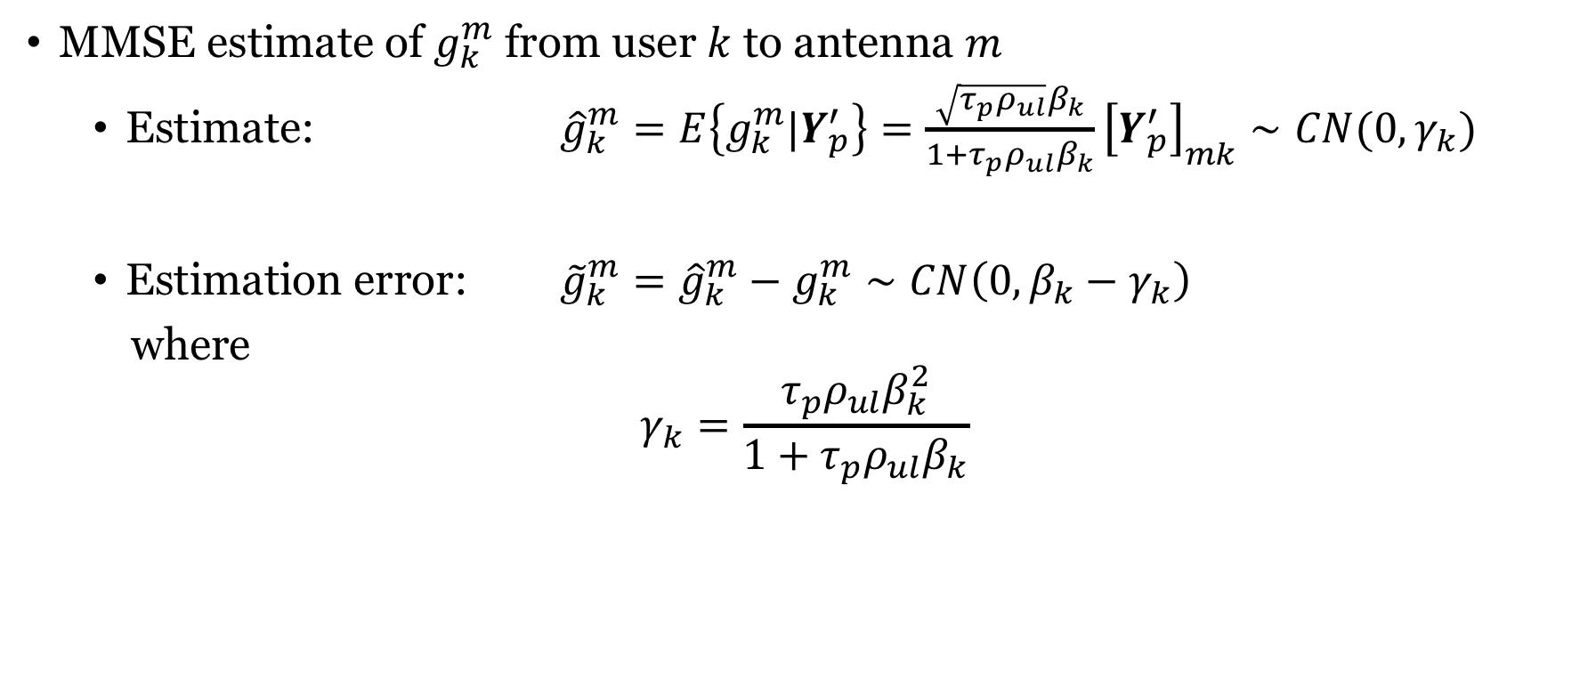
Recall: Estimates of channels
MMSE estimate of $g_{k}^{m}$ from user $k$ to antenna $m$
Estimate: ${\hat{g}}_{k}^{m}=E\left\{g_{k}^{m}|Y_{p}^{′}\right\}=\frac{\sqrt{τ_{p}ρ_{ul}}β_{k}}{1+τ_{p}ρ_{ul}β_{k}}{\left[Y_{p}^{′}\right]}_{mk}∼CN(0, γ_{k})$
Estimation error: ${\tilde{g}}_{k}^{m}={\hat{g}}_{k}^{m}−g_{k}^{m}∼CN\left(0,{β_{k}−γ}_{k}\right)$
where
$$γ_{k}=\frac{τ_{p}ρ_{ul}β_{k}^{2}}{1+τ_{p}ρ_{ul}β_{k}}$$

Slide 13
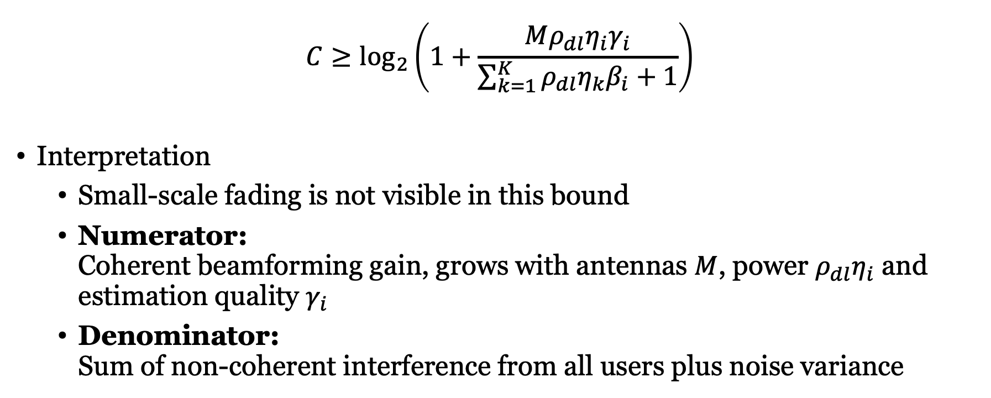
Downlink capacity lower bound with MR
$${C≥log}_{2}\left(1+\frac{Mρ_{dl}η_{i}γ_{i}}{\sum_{k=1}^{K}{ρ_{dl}η_{k}β_{i}}+1}\right)$$
Interpretation
Small-scale fading is not visible in this bound
Numerator: Coherent beamforming gain, grows with antennas $M$, power $ρ_{dl}η_{i}$ and estimation quality $γ_{i}$
Denominator: Sum of non-coherent interference from all users plus noise variance

Slide 14
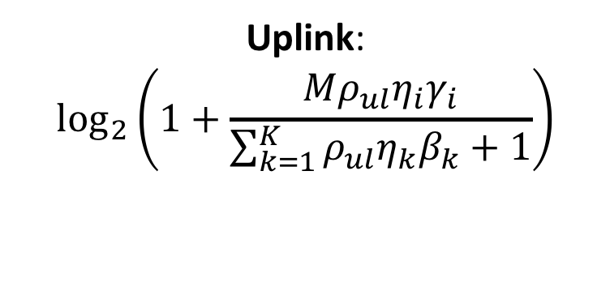
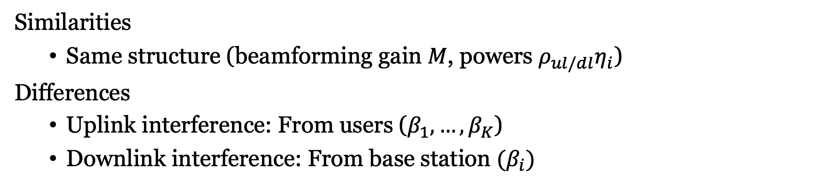
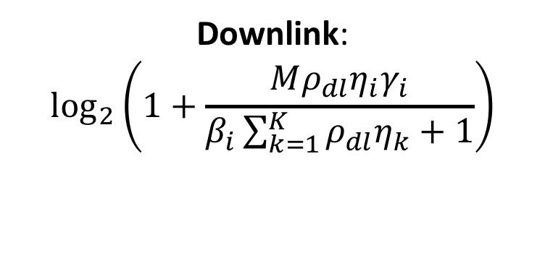
Comparing uplink and downlink (with MR)
Uplink:
$$\log_{2}\left(1+\frac{Mρ_{ul}η_{i}γ_{i}}{\sum_{k=1}^{K}{ρ_{ul}η_{k}β_{k}}+1}\right)$$
Downlink:
$$\log_{2}\left(1+\frac{Mρ_{dl}η_{i}γ_{i}}{β_{i}\sum_{k=1}^{K}{ρ_{dl}η_{k}}+1}\right)$$
Similarities
Same structure (beamforming gain $M$, powers $ρ_{ul/dl}η_{i}$)
Differences
Uplink interference: From users ($β_{1},…,β_{K}$)
Downlink interference: From base station $(β_{i})$

Slide 15
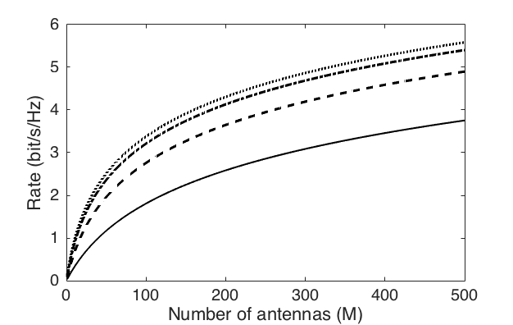
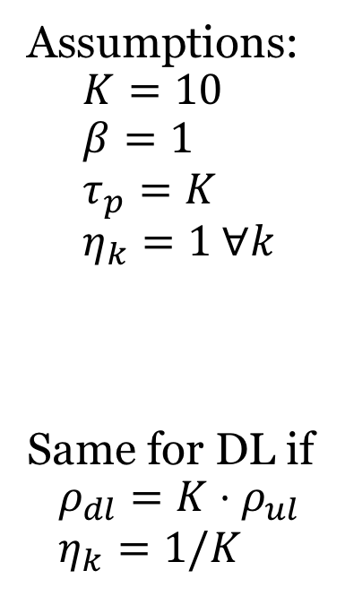
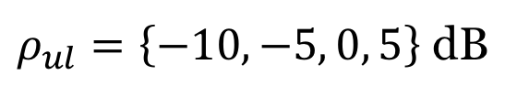
Example: Uplink rate, varying SNR
Assumptions:
$$K=10 \\ β=1 \\ τ_{p}=K \\ η_{k}=1 ∀k$$
Same for DL if
$$ρ_{dl}={K⋅ρ}_{ul} \\ η_{k}=1/K$$
$ρ_{ul}=\left\{−10,−5, 0, 5\right\}$ dB
Always better with more antennas

Slide 16
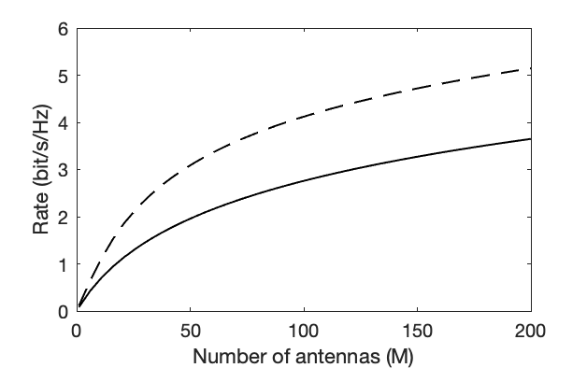
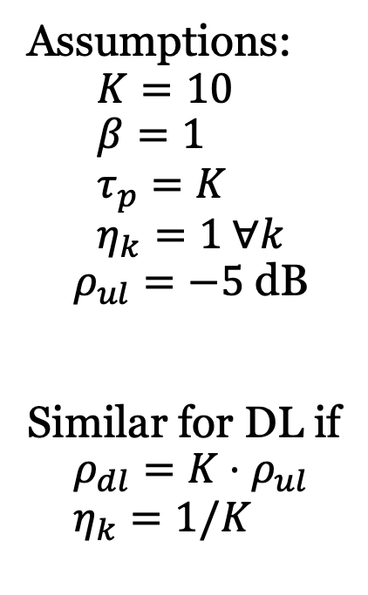
Example: Uplink rate, different schemes
Assumptions:
$$K=10 \\ β=1 \\ τ_{p}=K \\ η_{k}=1 ∀k$$
$ρ_{ul}=−5$ dB
Similar for DL if
$$ρ_{dl}={K⋅ρ}_{ul} \\ η_{k}=1/K$$
MMSE
MR
Same trend, but 40-60% higher rate with MMSE

Slide 17
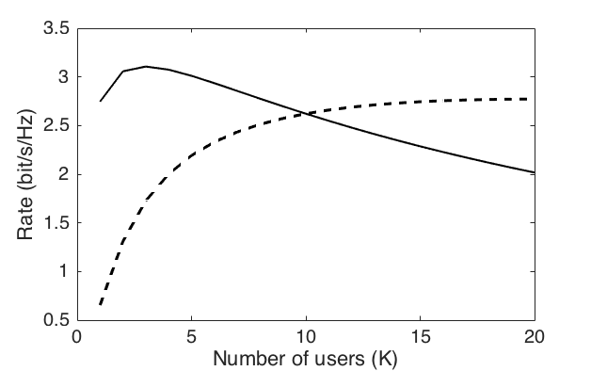
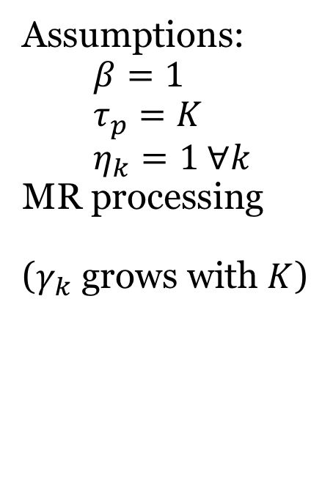


Example: Rate when scaling number of users
Assumptions: $$β=1 \\ τ_{p}=K \\ η_{k}=1 ∀k$$ MR processing
($γ_{k}$ grows with $K$)
$$M=100$$
$$M=10K$$
Same behavior, but higher rates with MMSE

Slide 18
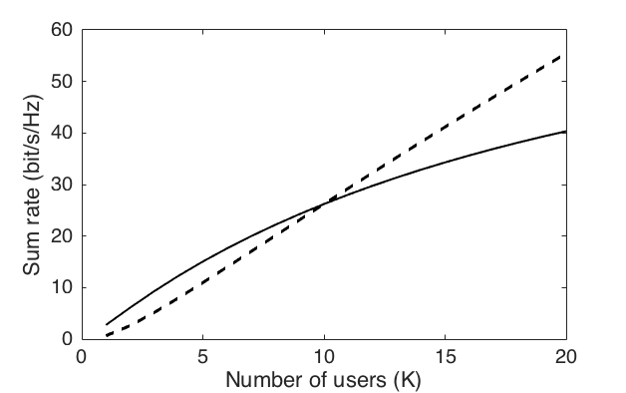



Example: Sum rate, scaling number of users
Assumptions: $$β=1 \\ τ_{p}=K \\ η_{k}=1 ∀k$$
MR processing
$$M=10K$$
$$M=100$$
Same behavior, but higher rates with MMSE

Slide 19
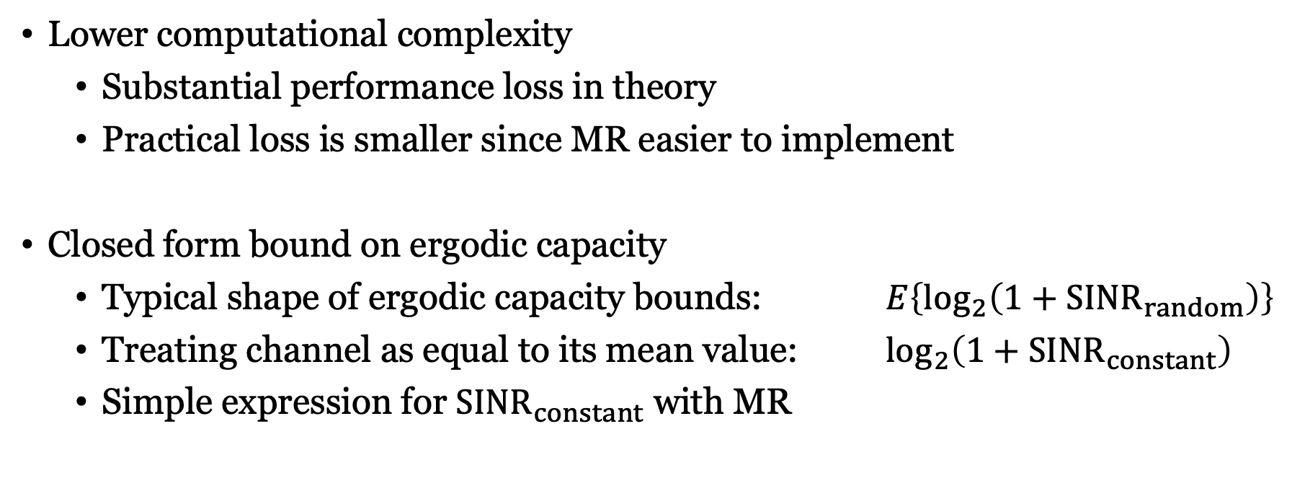
What are the benefits of MR processing?
Lower computational complexity
Substantial performance loss in theory
Practical loss is smaller since MR easier to implement
Closed form bound on ergodic capacity
Typical shape of ergodic capacity bounds: $E\left\{\log_{2}\left(1+{SINR}_{random}\right)\right\}$
Treating channel as equal to its mean value: $\log_{2}\left(1+{SINR}_{constant}\right)$
Simple expression for ${SINR}_{constant}$ with MR

Slide 20
Summary
Downlink communication
Rate expression for arbitrary precoding
Closed-form expression with MR precoding
Insights
Uplink and downlink rates behave similarly
MMSE is substantially better than MR
Should increase the number of antennas when the number of users increase

Slide 21
Multiple Antenna Communications
Lecture 9:
Downlink Multiuser MIMO With Linear Processing
Emil Björnson

