Slide 1
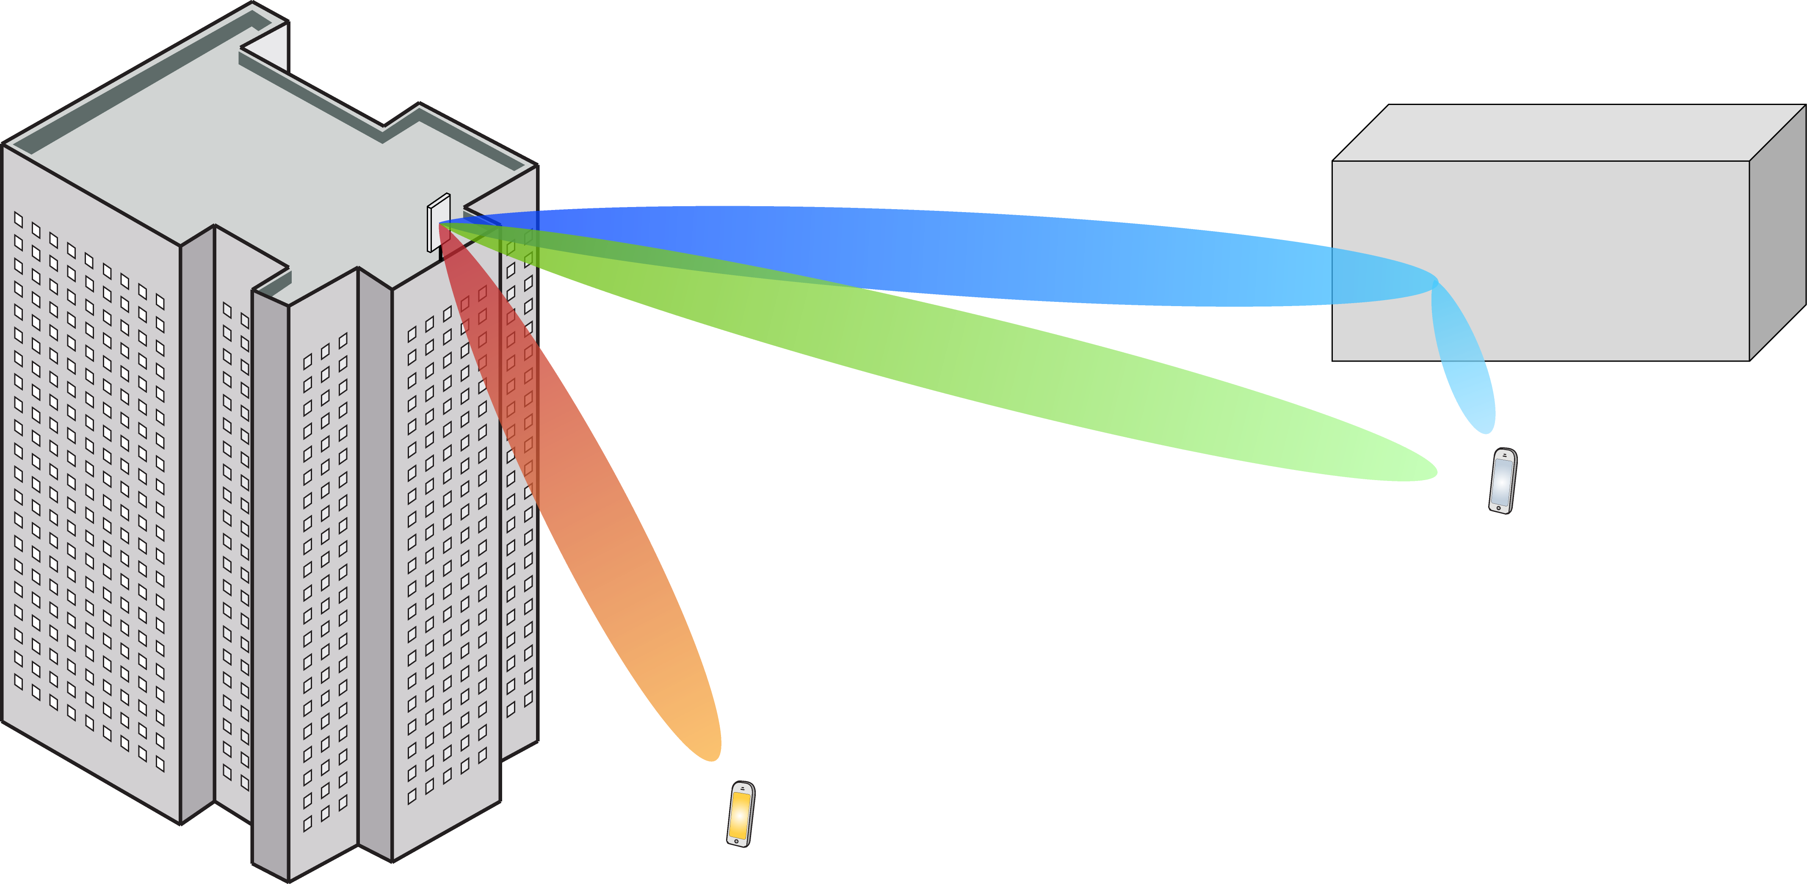
Multiple Antenna Communications
Lecture 9b:
Zero-Forcing Processing in Uplink and Downlink
Emil Björnson

Slide 2
Outline
Revisit MMSE processing
  Asymptotic behaviors
Zero-forcing processing
  Key properties
  Closed-form expression
Performance comparison:
Different processing schemes

Slide 3
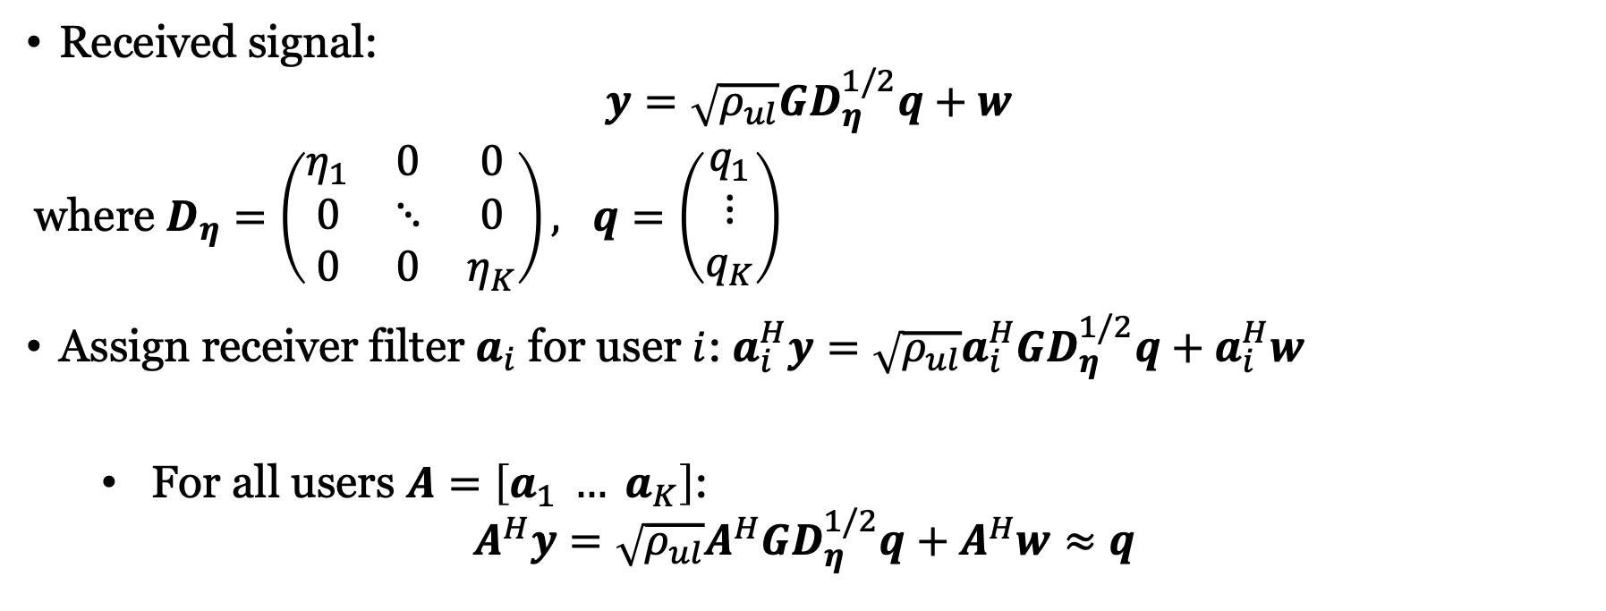
Recall: Uplink Massive MIMO with linear processing
Received signal:
$$y=\sqrt{ρ_{ul}}GD_{η}^{1/2}q+w$$
where $D_{η}=\left(\begin{matrix}η_{1} & 0 & 0 \\ 0 & ⋱ & 0 \\ 0 & 0 & η_{K}\end{matrix}\right), q=\left(\begin{matrix}q_{1} \\ ⋮ \\ q_{K}\end{matrix}\right)$
Assign receiver filter $a_{i}$ for user $i$: $a_{i}^{H}y=\sqrt{ρ_{ul}}a_{i}^{H}GD_{η}^{1/2}q+a_{i}^{H}w$
  For all users $A=\left[a_{1} … a_{K}\right]$:
$$A^{H}y=\sqrt{ρ_{ul}}A^{H}GD_{η}^{1/2}q+A^{H}w≈q$$
In some “good” sense

Slide 4
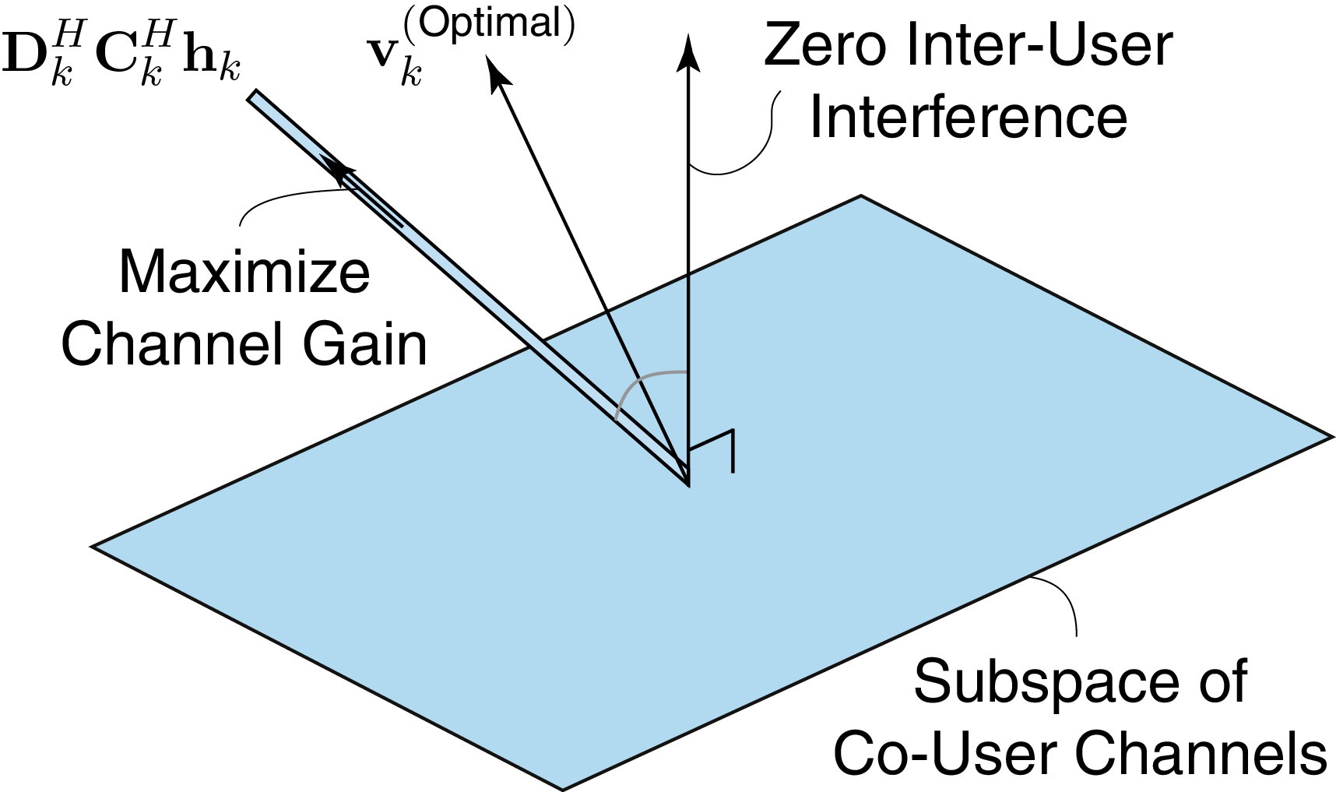
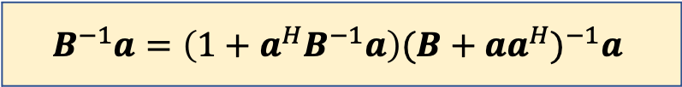

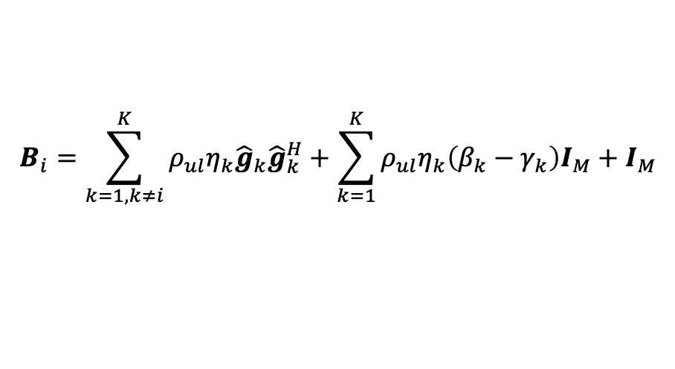
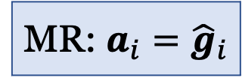
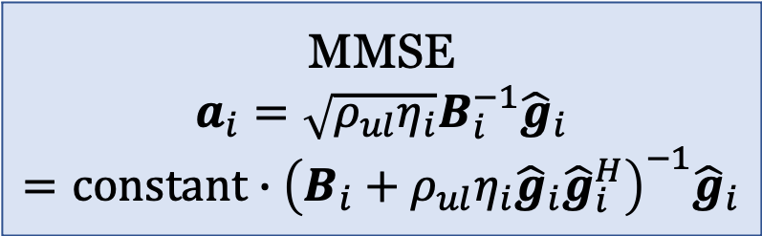

MMSE receiver processing
MMSE
$$a_{i}=\sqrt{ρ_{ul}η_{i}}B_{i}^{−1}{\hat{g}}_{i} \\ =constant∙{\left(B_{i}+ρ_{ul}η_{i}{\hat{g}}_{i}{\hat{g}}_{i}^{H}\right)}^{−1}{\hat{g}}_{i}$$
MMSE
$${\hat{g}}_{i}$$
“Zero forcing”
$$B^{−1}a=\left(1+a^{H}B^{−1}a\right){(B+aa^{H})}^{−1}a$$
MR: $a_{i}={\hat{g}}_{i}$
$$B_{i}=\sum_{k=1,k≠i}^{K}{ρ_{ul}η_{k}{\hat{g}}_{k}{\hat{g}}_{k}^{H}}+\sum_{k=1}^{K}{ρ_{ul}η_{k}\left(β_{k}−γ_{k}\right)I_{M}}+I_{M}$$
What happens to MMSE asymptotically?
$${\hat{g}}_{1},{\hat{g}}_{i−1},{\hat{g}}_{i+1},{\hat{g}}_{K}$$

Slide 5
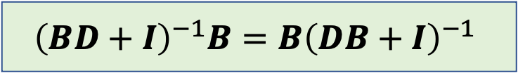
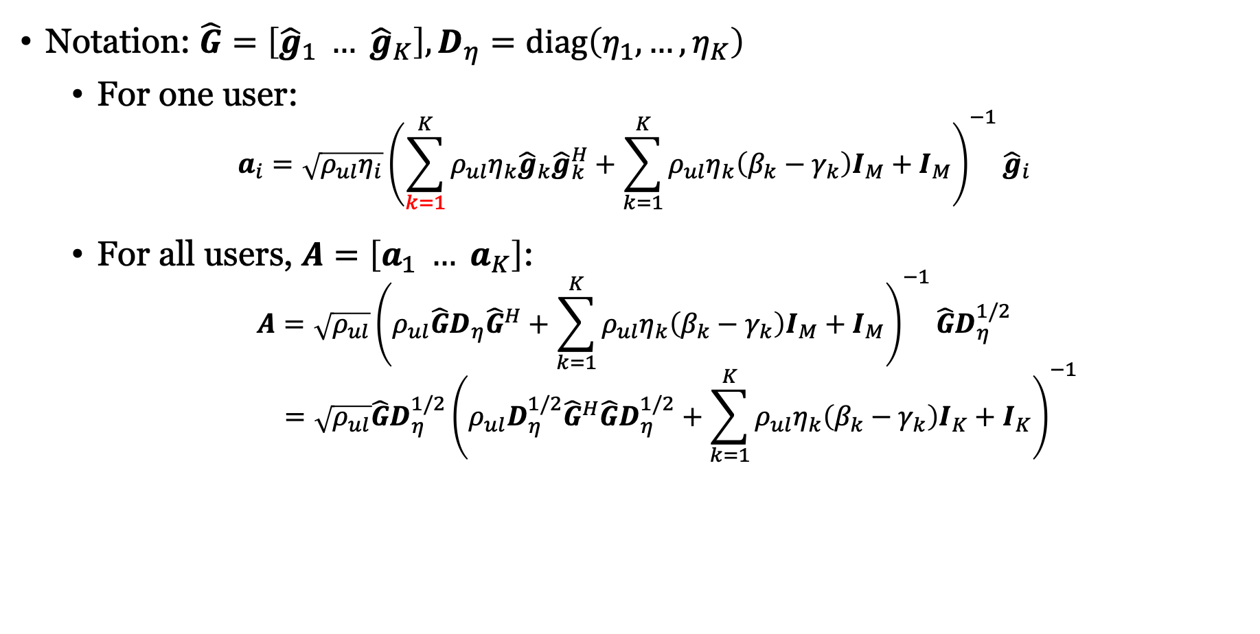
Reformulating MMSE processing
Notation: $\hat{G}=\left[{\hat{g}}_{1} … {\hat{g}}_{K}\right], D_{η}=diag\left(η_{1},…,η_{K}\right)$
  For one user:
$$a_{i}=\sqrt{ρ_{ul}η_{i}}{\left(\sum_{k=1}^{K}{ρ_{ul}η_{k}{\hat{g}}_{k}{\hat{g}}_{k}^{H}}+\sum_{k=1}^{K}{ρ_{ul}η_{k}\left(β_{k}−γ_{k}\right)I_{M}}+I_{M}\right)}^{−1}{\hat{g}}_{i}$$
  For all users, $A=\left[a_{1} … a_{K}\right]$:
$$A=\sqrt{ρ_{ul}}{\left(ρ_{ul}\hat{G}D_{η}{\hat{G}}^{H}+\sum_{k=1}^{K}{ρ_{ul}η_{k}\left(β_{k}−γ_{k}\right)I_{M}}+I_{M}\right)}^{−1}\hat{G}D_{η}^{1/2}$$
$$=\sqrt{ρ_{ul}}\hat{G}D_{η}^{1/2}{\left(ρ_{ul}D_{η}^{1/2}{\hat{G}}^{H}\hat{G}D_{η}^{1/2}+\sum_{k=1}^{K}{ρ_{ul}η_{k}\left(β_{k}−γ_{k}\right)I_{K}}+I_{K}\right)}^{−1}$$
$${\left(BD+I\right)}^{−1}B=B{\left(DB+I\right)}^{−1}$$

Slide 6
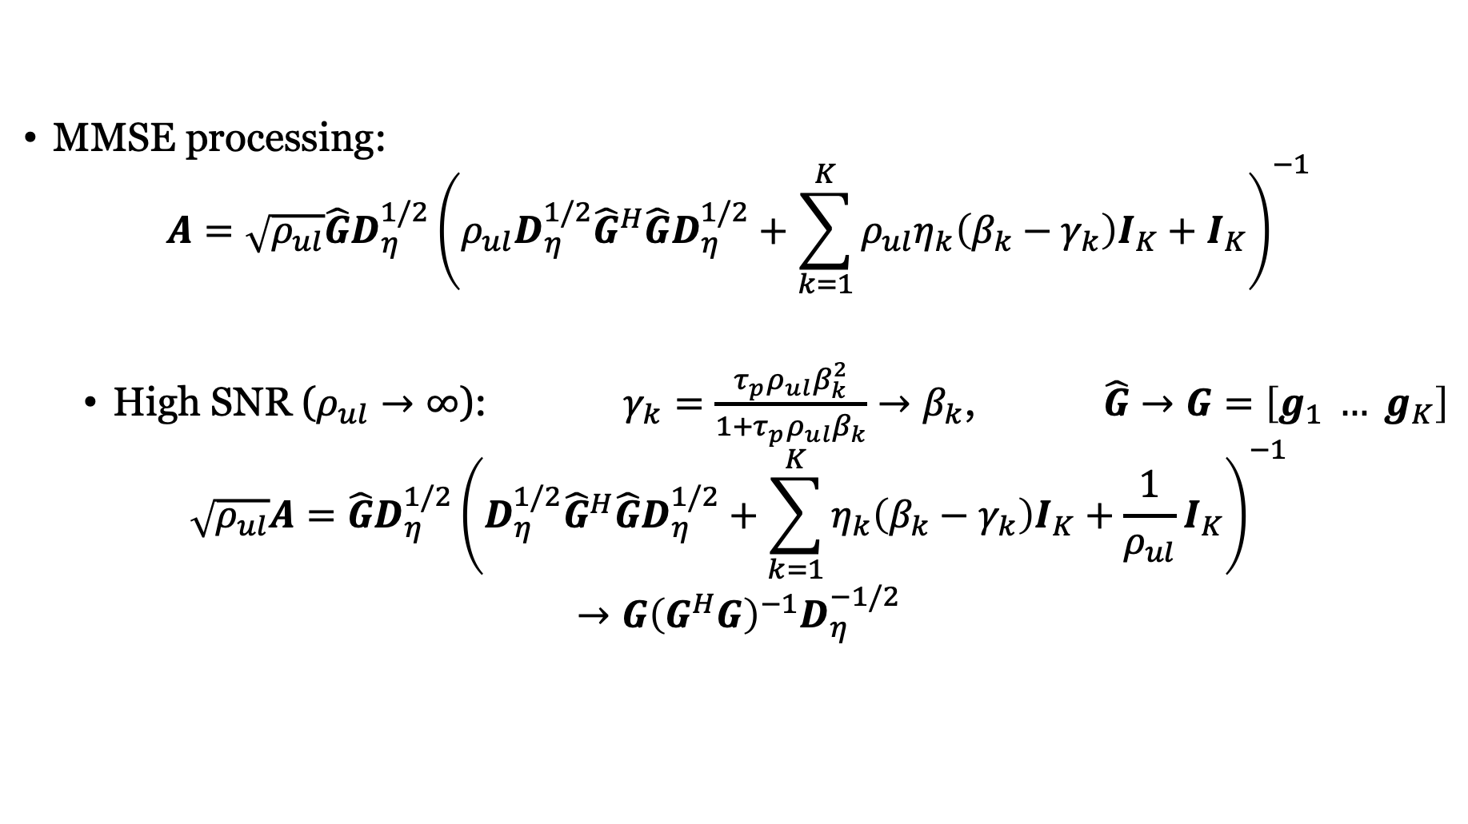
Asymptotic: High SNR ($M≥K$)
MMSE processing:
$$A=\sqrt{ρ_{ul}}\hat{G}D_{η}^{1/2}{\left(ρ_{ul}D_{η}^{1/2}{\hat{G}}^{H}\hat{G}D_{η}^{1/2}+\sum_{k=1}^{K}{ρ_{ul}η_{k}\left(β_{k}−γ_{k}\right)I_{K}}+I_{K}\right)}^{−1}$$
  High SNR ($ρ_{ul}→∞$): $γ_{k}=\frac{τ_{p}ρ_{ul}β_{k}^{2}}{1+τ_{p}ρ_{ul}β_{k}}→β_{k}$, $\hat{G}→G=\left[g_{1} … g_{K}\right]$
$$\sqrt{ρ_{ul}}A=\hat{G}D_{η}^{1/2}{\left(D_{η}^{1/2}{\hat{G}}^{H}\hat{G}D_{η}^{1/2}+\sum_{k=1}^{K}{η_{k}\left(β_{k}−γ_{k}\right)I_{K}}+\frac{1}{ρ_{ul}}I_{K}\right)}^{−1}$$
$$→G{\left(G^{H}G\right)}^{−1}D_{η}^{−1/2}$$
$A^{H}y={D_{η}^{−1/2}\left(G^{H}G\right)}^{−1}G^{H}GD_{η}^{1/2}q+A^{H}w/\sqrt{ρ_{ul}}=$ $q+A^{H}w/\sqrt{ρ_{ul}}$
Zero-forcing (ZF):
Cancel all interference

Slide 7
Geometry of MR and ZF
Desired signal
MR processing
ZF processing
Interference
Noise
Use all signal power
Get part of the interference
Remove all interference
Get part of the signal

Slide 8

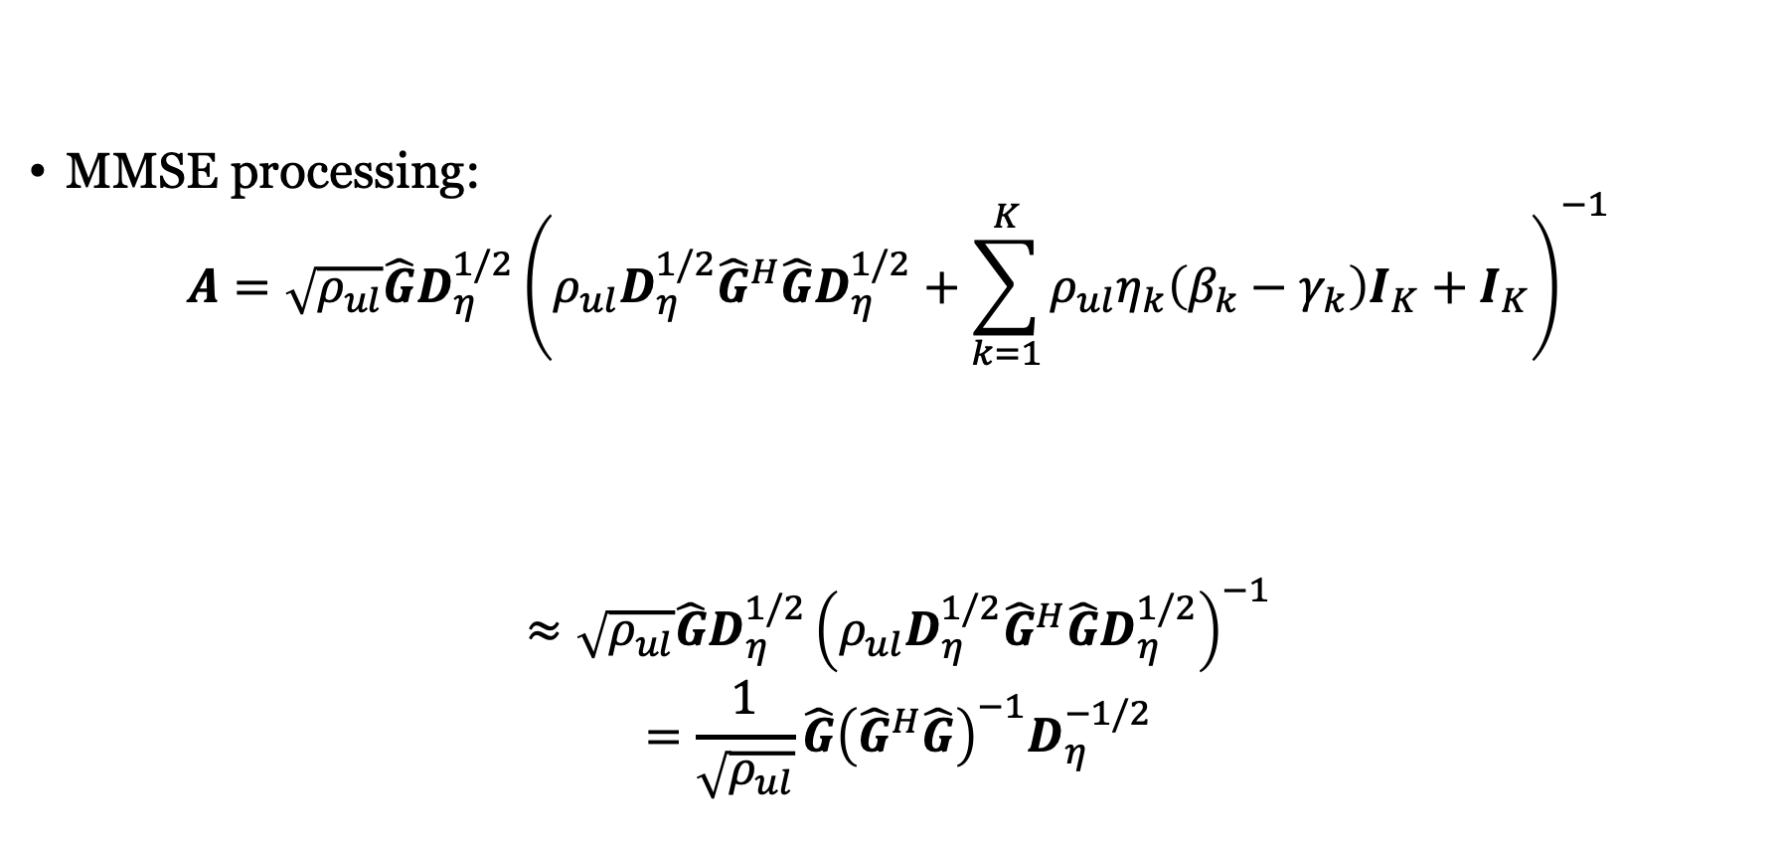

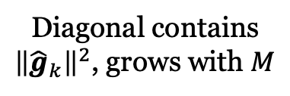
Asymptotic: Many Antennas
MMSE processing:
$$A=\sqrt{ρ_{ul}}\hat{G}D_{η}^{1/2}{\left(ρ_{ul}D_{η}^{1/2}{\hat{G}}^{H}\hat{G}D_{η}^{1/2}+\sum_{k=1}^{K}{ρ_{ul}η_{k}\left(β_{k}−γ_{k}\right)I_{K}}+I_{K}\right)}^{−1}$$
$$≈\sqrt{ρ_{ul}}\hat{G}D_{η}^{1/2}{\left(ρ_{ul}D_{η}^{1/2}{\hat{G}}^{H}\hat{G}D_{η}^{1/2}\right)}^{−1}$$
$$=\frac{1}{\sqrt{ρ_{ul}}}\hat{G}{\left({\hat{G}}^{H}\hat{G}\right)}^{−1}D_{η}^{−1/2}$$
  Diagonal contains
  ${\left\|{\hat{g}}_{k}\right\|}^{2}$, grows with $M$
  Independent of $M$
Large $M$
Zero-forcing with imperfect channel estimates

Slide 9
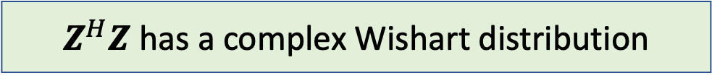

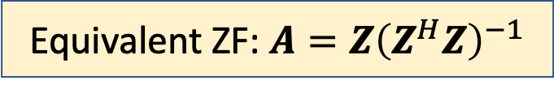
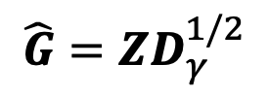
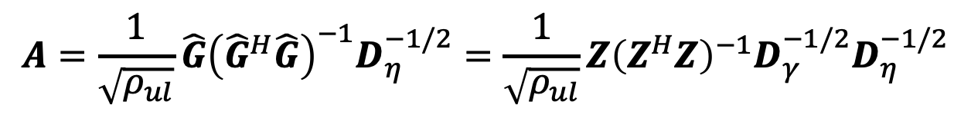
Complex Wishart Matrices
$Z$ is an $M × K$ matrix with i.i.d. $CN\left(0,1\right)$ random variables ($M≥K)$
Properties:
  $E\left\{Z^{H}Z\right\}=MI_{K}$
  $E\left\{{\left(Z^{H}Z\right)}^{−1}\right\}=\frac{1}{M−K}I_{K}$
$Z^{H}Z$ has a complex Wishart distribution
$$A=\frac{1}{\sqrt{ρ_{ul}}}\hat{G}{\left({\hat{G}}^{H}\hat{G}\right)}^{−1}D_{η}^{−1/2}=\frac{1}{\sqrt{ρ_{ul}}}Z{\left(Z^{H}Z\right)}^{−1}D_{γ}^{−1/2}D_{η}^{−1/2}$$
ZF:
Equivalent ZF: $A=Z{\left(Z^{H}Z\right)}^{−1}$
$$\hat{G}=ZD_{γ}^{1/2}$$

Slide 10

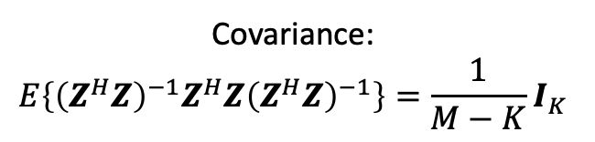
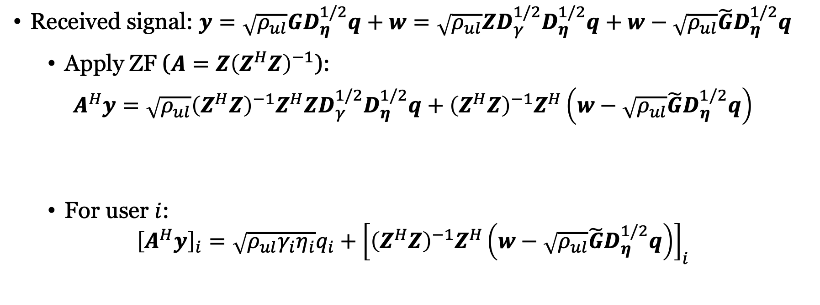
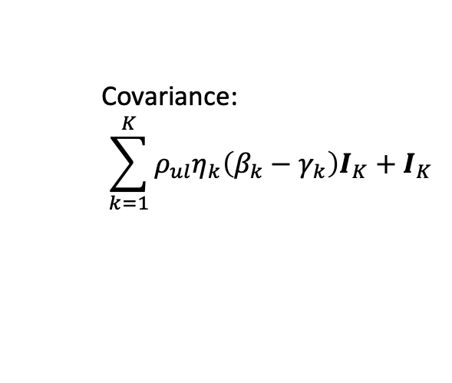
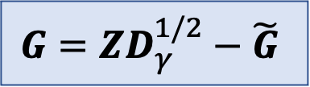

Received signal when using ZF processing
$$G=ZD_{γ}^{1/2}−\tilde{G}$$
Received signal: $y=\sqrt{ρ_{ul}}GD_{η}^{1/2}q+w=\sqrt{ρ_{ul}}ZD_{γ}^{1/2}D_{η}^{1/2}q+w−\sqrt{ρ_{ul}}\tilde{G}D_{η}^{1/2}q$
  Apply ZF ($A=Z{\left(Z^{H}Z\right)}^{−1}$):
$$A^{H}y=\sqrt{ρ_{ul}}{\left(Z^{H}Z\right)}^{−1}Z^{H}ZD_{γ}^{1/2}D_{η}^{1/2}q+{\left(Z^{H}Z\right)}^{−1}Z^{H}\left(w−\sqrt{ρ_{ul}}\tilde{G}D_{η}^{1/2}q\right)$$
  For user $i$:
$${\left[A^{H}y\right]}_{i}=\sqrt{ρ_{ul}γ_{i}η_{i}}q_{i}+{\left[{\left(Z^{H}Z\right)}^{−1}Z^{H}\left(w−\sqrt{ρ_{ul}}\tilde{G}D_{η}^{1/2}q\right)\right]}_{i}$$
$$=I_{K}$$
$w$: Uncorrelated interference and noise
Deterministic
channel
Covariance:
$$\sum_{k=1}^{K}{ρ_{ul}η_{k}\left(β_{k}−γ_{k}\right)I_{K}}+I_{K}$$
Covariance:
$$E\left\{{\left(Z^{H}Z\right)}^{−1}Z^{H}Z{\left(Z^{H}Z\right)}^{−1}\right\}=\frac{1}{M−K}I_{K}$$

Slide 11
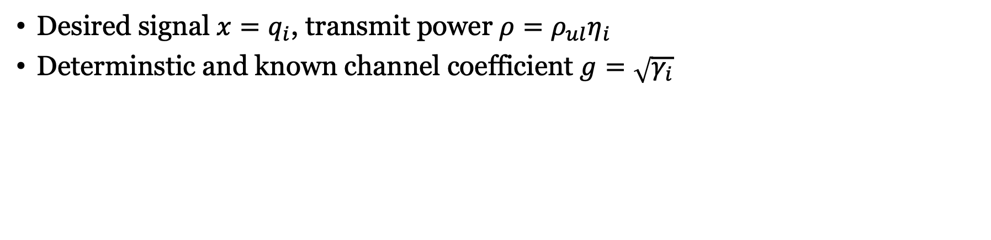



Using the capacity bound with deterministic channel
$$w$$
Channel information $Ω$
$$x$$
$$\sqrt{ρ}$$
$$g$$
+
Receiver
$$\hat{x}$$
$$y=\sqrt{ρ}gx+w$$
Desired signal $x=q_{i}$, transmit power $ρ=ρ_{ul}η_{i}$
Determinstic and known channel coefficient $g=\sqrt{γ_{i}}$
Capacity lower bound:
$$C≥\log_{2}\left(1+\frac{ρ{\left|g\right|}^{2}}{Var\left\{w\right\}}\right)$$
$$ρ{\left|g\right|}^{2}=ρ_{ul}η_{i}γ_{i}$$
$$Var\left\{w\right\}=\frac{1}{M−K}\left(\sum_{k=1}^{K}{ρ_{ul}η_{k}\left(β_{k}−γ_{k}\right)}+1\right)$$

Slide 12
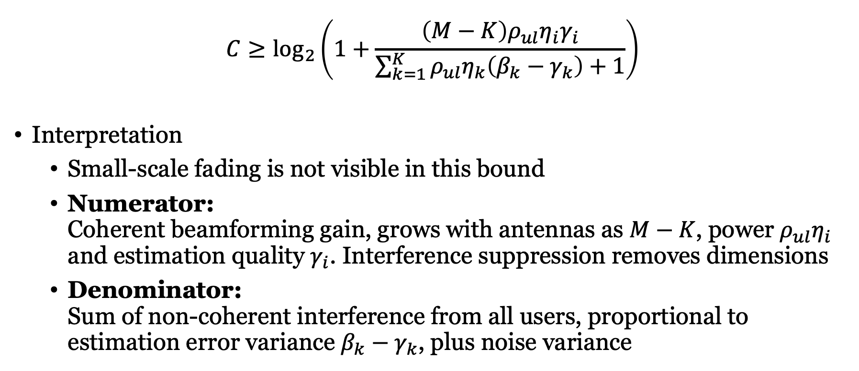
Capacity bound with ZF and use-and-then-forget technique
$${C≥log}_{2}\left(1+\frac{\left(M−K\right)ρ_{ul}η_{i}γ_{i}}{\sum_{k=1}^{K}{ρ_{ul}η_{k}\left(β_{k}−γ_{k}\right)}+1}\right)$$
Interpretation
  Small-scale fading is not visible in this bound
  Numerator:
  Coherent beamforming gain, grows with antennas as $M−K$, power $ρ_{ul}η_{i}$ and estimation quality $γ_{i}$. Interference suppression removes dimensions
  Denominator:
  Sum of non-coherent interference from all users, proportional to estimation error variance $β_{k}−γ_{k}$, plus noise variance

Slide 13
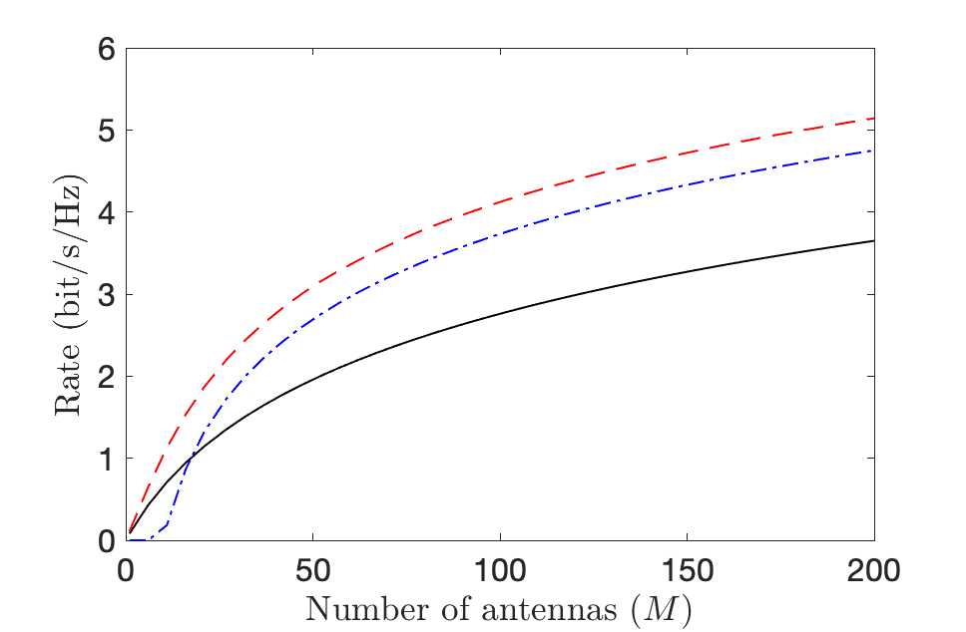
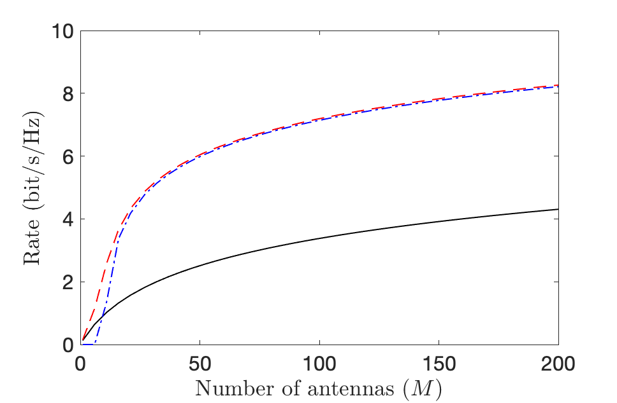
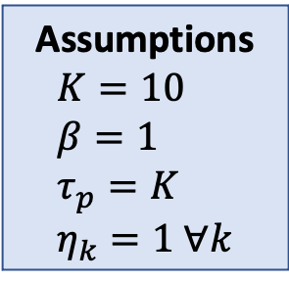



MR versus ZF processing
Assumptions
$$K=10 \\ β=1 \\ τ_{p}=K \\ η_{k}=1 ∀k$$
MR: $\log_{2}\left(1+\frac{Mρ_{ul}η_{i}γ_{i}}{\sum_{k=1}^{K}{ρ_{ul}η_{k}β_{k}}+1}\right)$
ZF: $\log_{2}\left(1+\frac{\left(M−K\right)ρ_{ul}η_{i}γ_{i}}{\sum_{k=1}^{K}{ρ_{ul}η_{k}\left(β_{k}−γ_{k}\right)}+1}\right)$
MMSE
ZF
MR
$ρ_{ul}=−5$ dB
$ρ_{ul}=5$ dB

Slide 14
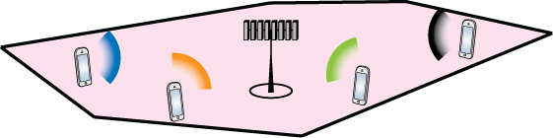
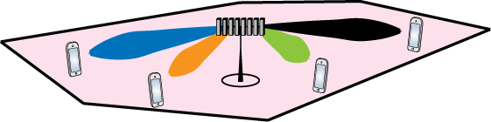

Zero-forcing precoding
Uplink ZF expression
$A=Z{\left(Z^{H}Z\right)}^{−1}$
Downlink ZF expression
  $A=\sqrt{M−K}{\left(Z{\left(Z^{H}Z\right)}^{−1}\right)}^{∗}$
  since $E\left\{{{\left(Z^{H}Z\right)}^{−1}Z^{H}Z\left(Z^{H}Z\right)}^{−1}\right\}=E\left\{{\left(Z^{H}Z\right)}^{−1}\right\}=\frac{1}{M−K}I_{K}$
Precoding principle
Transmit in the direction where you heard the users “most clearly”

Slide 15
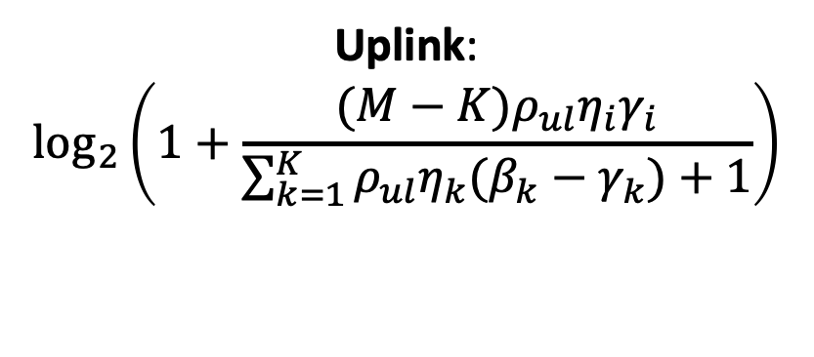
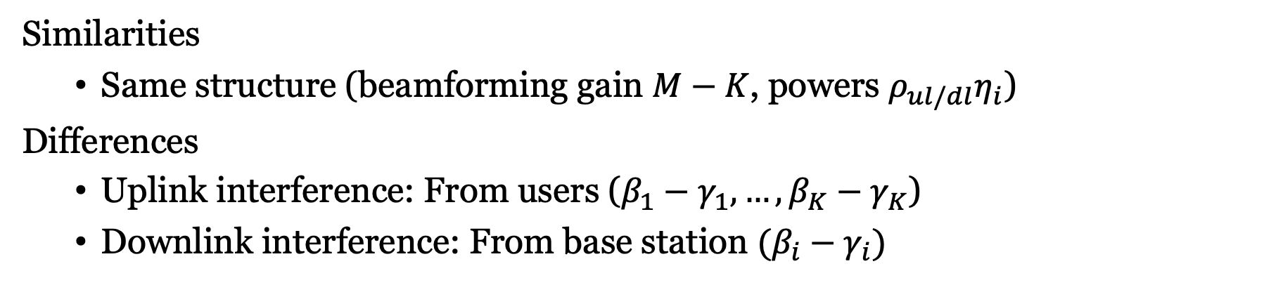
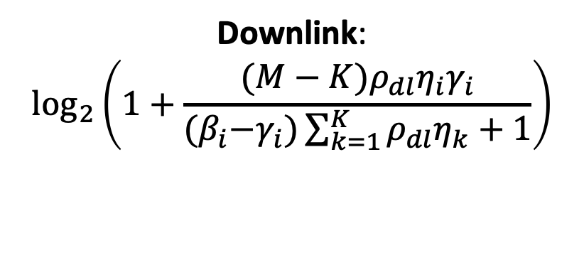
Comparing uplink and downlink (with ZF)
Uplink:
$$\log_{2}\left(1+\frac{(M−K)ρ_{ul}η_{i}γ_{i}}{\sum_{k=1}^{K}{ρ_{ul}η_{k}(β_{k}−γ_{k})}+1}\right)$$
Downlink:
$$\log_{2}\left(1+\frac{(M−K)ρ_{dl}η_{i}γ_{i}}{{(β}_{i}−γ_{i})\sum_{k=1}^{K}{ρ_{dl}η_{k}}+1}\right)$$
Similarities
  Same structure (beamforming gain $M−K$, powers $ρ_{ul/dl}η_{i}$)
Differences
  Uplink interference: From users ($β_{1}−γ_{1},…,β_{K}−γ_{K}$)
  Downlink interference: From base station $(β_{i}−γ_{i})$

Slide 16
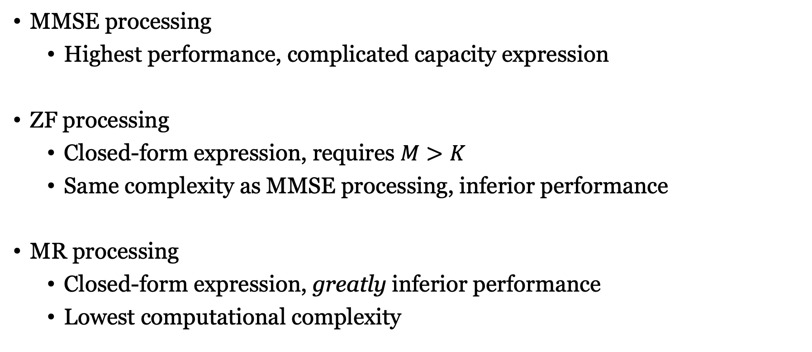
What processing method to utilize?
MMSE processing
  Highest performance, complicated capacity expression
ZF processing
  Closed-form expression, requires $M>K$
  Same complexity as MMSE processing, inferior performance
MR processing
  Closed-form expression, greatly inferior performance
  Lowest computational complexity

Slide 17
Summary
Zero-forcing processing
  Focus on interference cancellation
  Equivalent to MMSE at high SNR
  or many antennas
Closed-form expression
  Remaining interference depends
  on estimation errors
  Sacrifice antenna dimensions

Slide 18
Multiple Antenna Communications
Lecture 9b:
Zero-Forcing Processing in Uplink and Downlink
Emil Björnson

