Slide 1
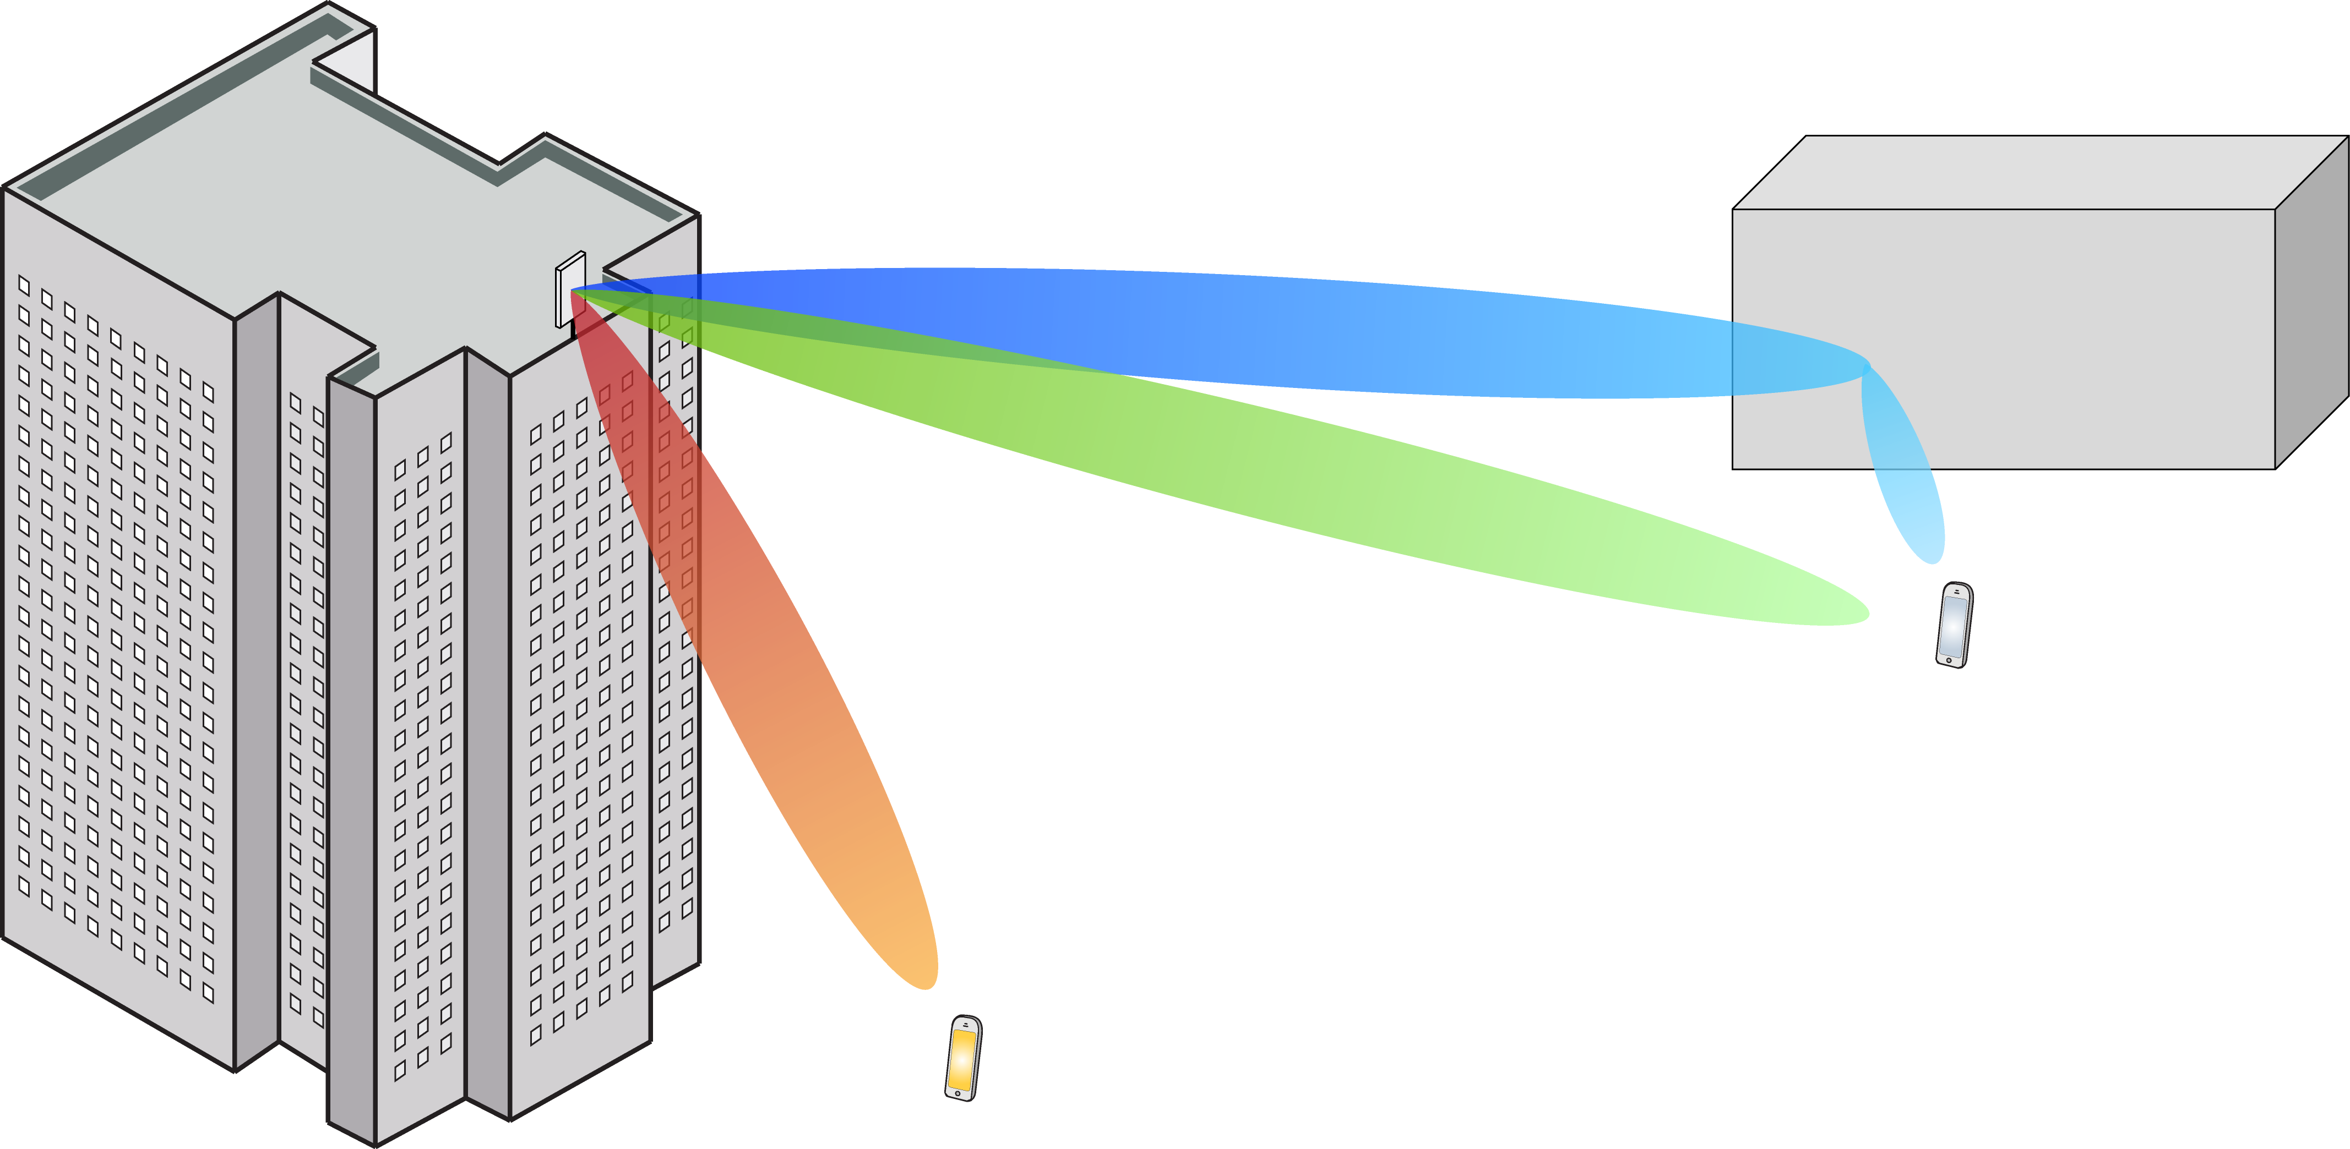
Multiple Antenna Communications
Background Lecture:
Monte Carlo Methods
Emil Björnson

Slide 2
Outline
Main principle of the Monte Carlo method
Estimate mean value of a random variable
Estimate error probability
Estimate entire statistical distribution

Slide 3




Statistical inference
$$x_{1}$$
Random variable
Estimate statistical properties
$$x_{2}$$
$$⋮$$
$$x_{L}$$
Realizations
Monte Carlo method
Generate many independent random realizations
Use them to estimate deterministic properties

Slide 4
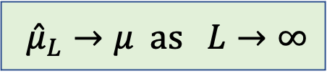
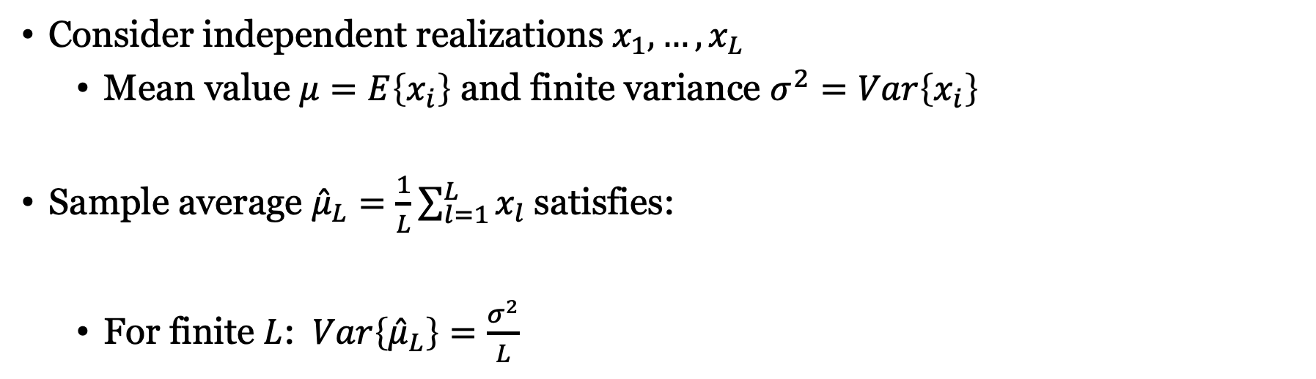
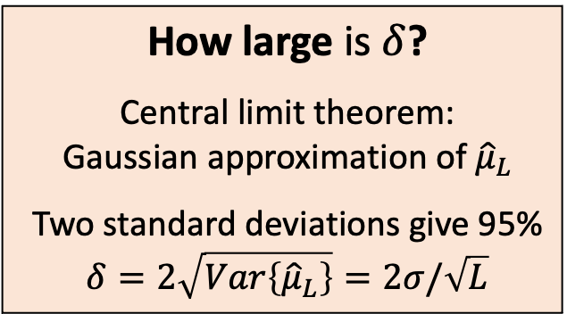
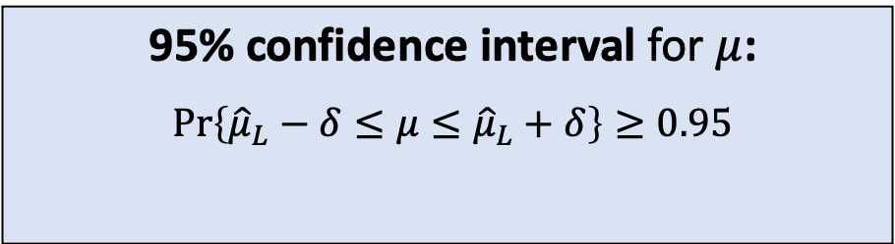
Properties of sample average
Consider independent realizations $x_{1},…,x_{L}$
Mean value $μ=E\left\{x_{i}\right\}$ and finite variance $σ^{2}=Var\left\{x_{i}\right\}$
Sample average ${\hat{μ}}_{L}=\frac{1}{L}\sum_{l=1}^{L}{x_{l}}$satisfies:
For finite $L$: $Var\left\{{\hat{μ}}_{L}\right\}=\frac{σ^{2}}{L}$
$${\hat{μ}}_{L}→μ as L→∞$$
How large is $δ$?
Central limit theorem:
Gaussian approximation of ${\hat{μ}}_{L}$
Two standard deviations give 95%
$$δ=2\sqrt{Var\left\{{\hat{μ}}_{L}\right\}}=2σ/\sqrt{L}$$
95% confidence interval for $μ$:
$$\operatorname{Pr}\left\{{\hat{μ}}_{L}−δ≤μ≤{\hat{μ}}_{L}+δ\right\}≥0.95$$
Error tolerance

Slide 5
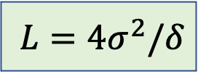
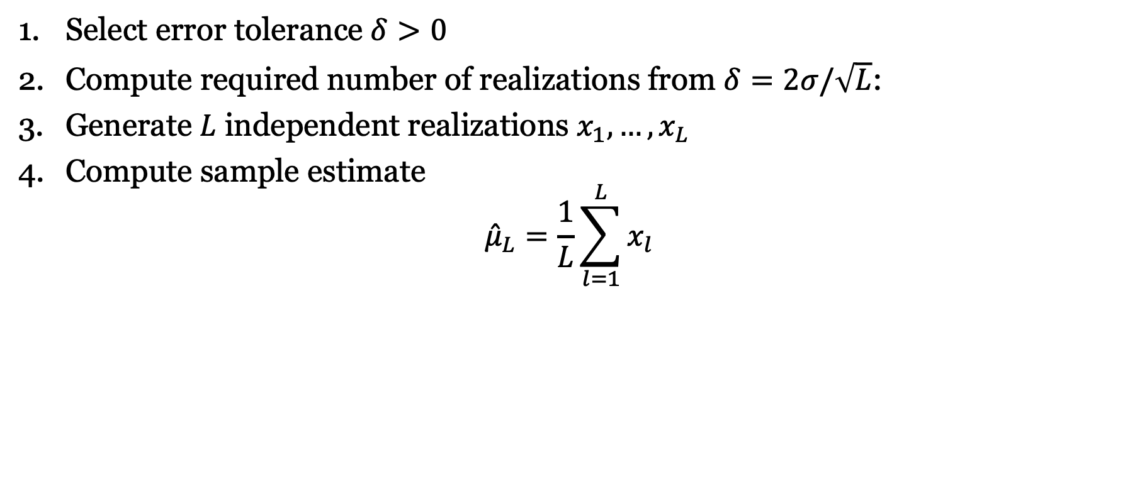
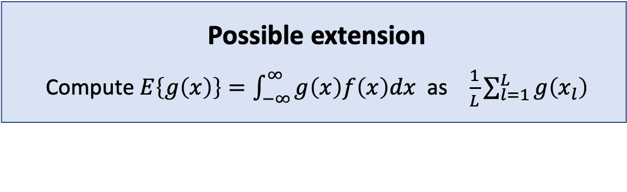
Estimate mean value: Monte Carlo method
Select error tolerance $δ>0$
Compute required number of realizations from $δ=2σ/\sqrt{L}$:
Generate $L$ independent realizations $x_{1},…,x_{L}$
Compute sample estimate
$${\hat{μ}}_{L}=\frac{1}{L}\sum_{l=1}^{L}{x_{l}}$$
$$L=4σ^{2}/δ$$
Possible extension
Compute $E\left\{g\left(x\right)\right\}=\int_{−∞}^{∞}{g\left(x\right)f\left(x\right)dx}$ as $\frac{1}{L}\sum_{l=1}^{L}{g\left(x_{l}\right)}$

Slide 6
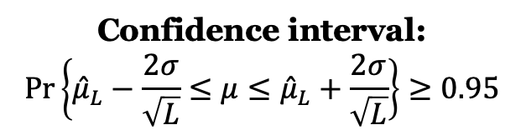
Example: Exponential distribution, Exp(1)
Confidence interval:
$$\operatorname{Pr}\left\{{\hat{μ}}_{L}−\frac{2σ}{\sqrt{L}}≤μ≤{\hat{μ}}_{L}+\frac{2σ}{\sqrt{L}}\right\}≥0.95$$

Slide 7
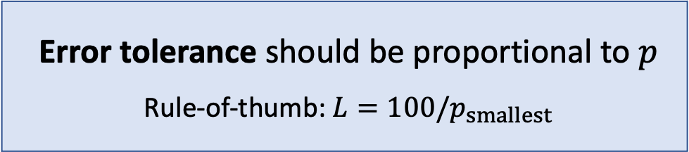
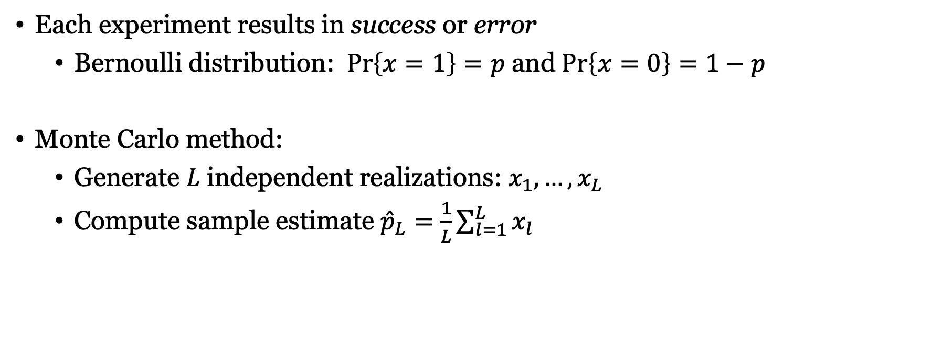
Estimate error probability of experiment
Each experiment results in success or error
Bernoulli distribution: $\operatorname{Pr}\left\{x=1\right\}=p$ and $\operatorname{Pr}\left\{x=0\right\}=1−p$
Monte Carlo method:
Generate $L$ independent realizations: $x_{1},…,x_{L}$
Compute sample estimate ${\hat{p}}_{L}=\frac{1}{L}\sum_{l=1}^{L}{x_{l}}$
Error tolerance should be proportional to $p$
Rule-of-thumb: $L=100/p_{smallest}$

Slide 8
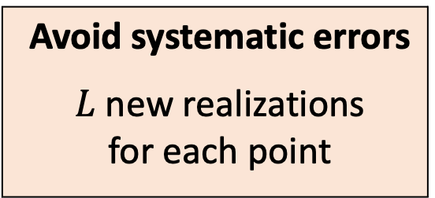

Example: $p=1−e^{−1/SNR}$
Avoid systematic errors
$L$ new realizations for each point
Accurate until $p=100/L$

Slide 9
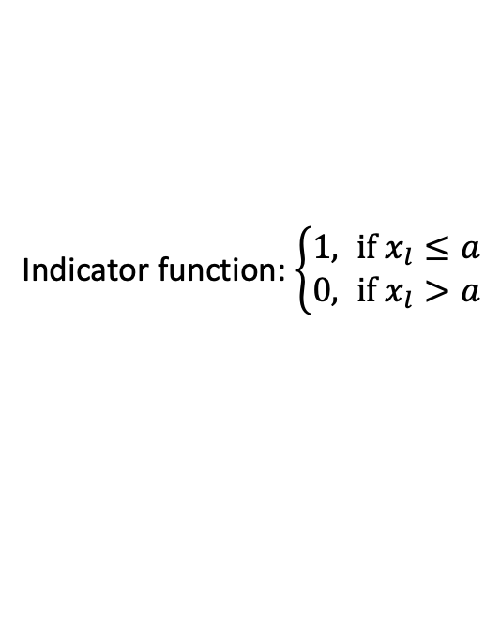
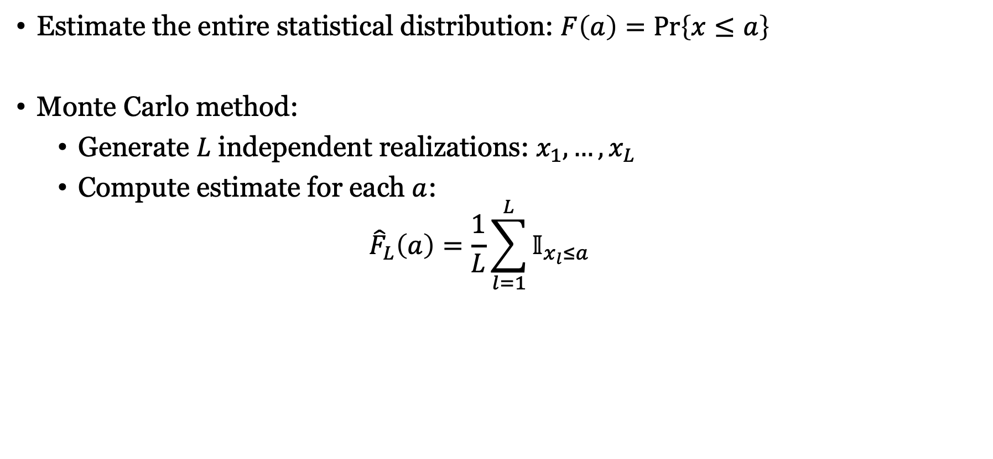
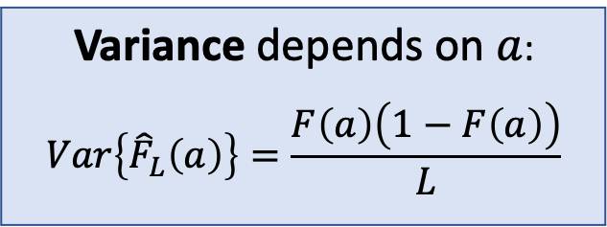
Empirical cumulative distribution function
Estimate the entire statistical distribution: $F\left(a\right)=\operatorname{Pr}\left\{x≤a\right\}$
Monte Carlo method:
Generate $L$ independent realizations: $x_{1},…,x_{L}$
Compute estimate for each $a$:
$${\hat{F}}_{L}\left(a\right)=\frac{1}{L}\sum_{l=1}^{L}{𝕀_{x_{l}≤a}}$$
Indicator function: $\left\{\begin{aligned}1, if x_{l}≤a \\ 0, if x_{l}>a\end{aligned}\right.$
Variance depends on $a$:
$$Var\left\{{\hat{F}}_{L}\left(a\right)\right\}=\frac{F\left(a\right)\left(1−F\left(a\right)\right)}{L}$$

Slide 10
Example: $F\left(x\right)=1−e^{−x^{2}}$

Slide 11
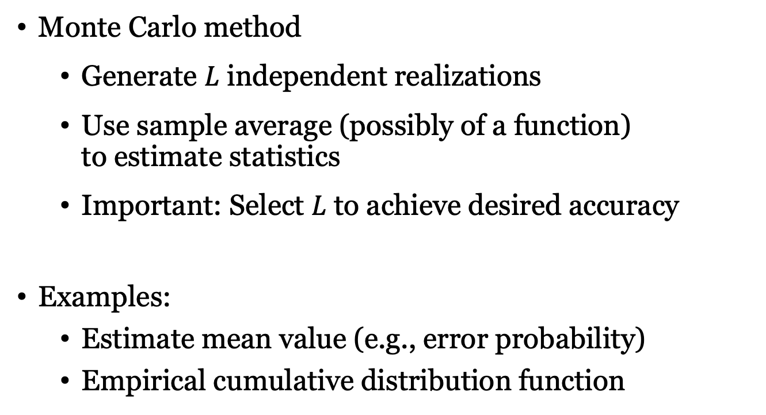
Summary
Monte Carlo method
Generate $L$ independent realizations
Use sample average (possibly of a function) to estimate statistics
Important: Select $L$ to achieve desired accuracy
Examples:
Estimate mean value (e.g., error probability)
Empirical cumulative distribution function

Slide 12
Multiple Antenna Communications
Background Lecture:
Monte Carlo Methods
Emil Björnson

