Slide 1
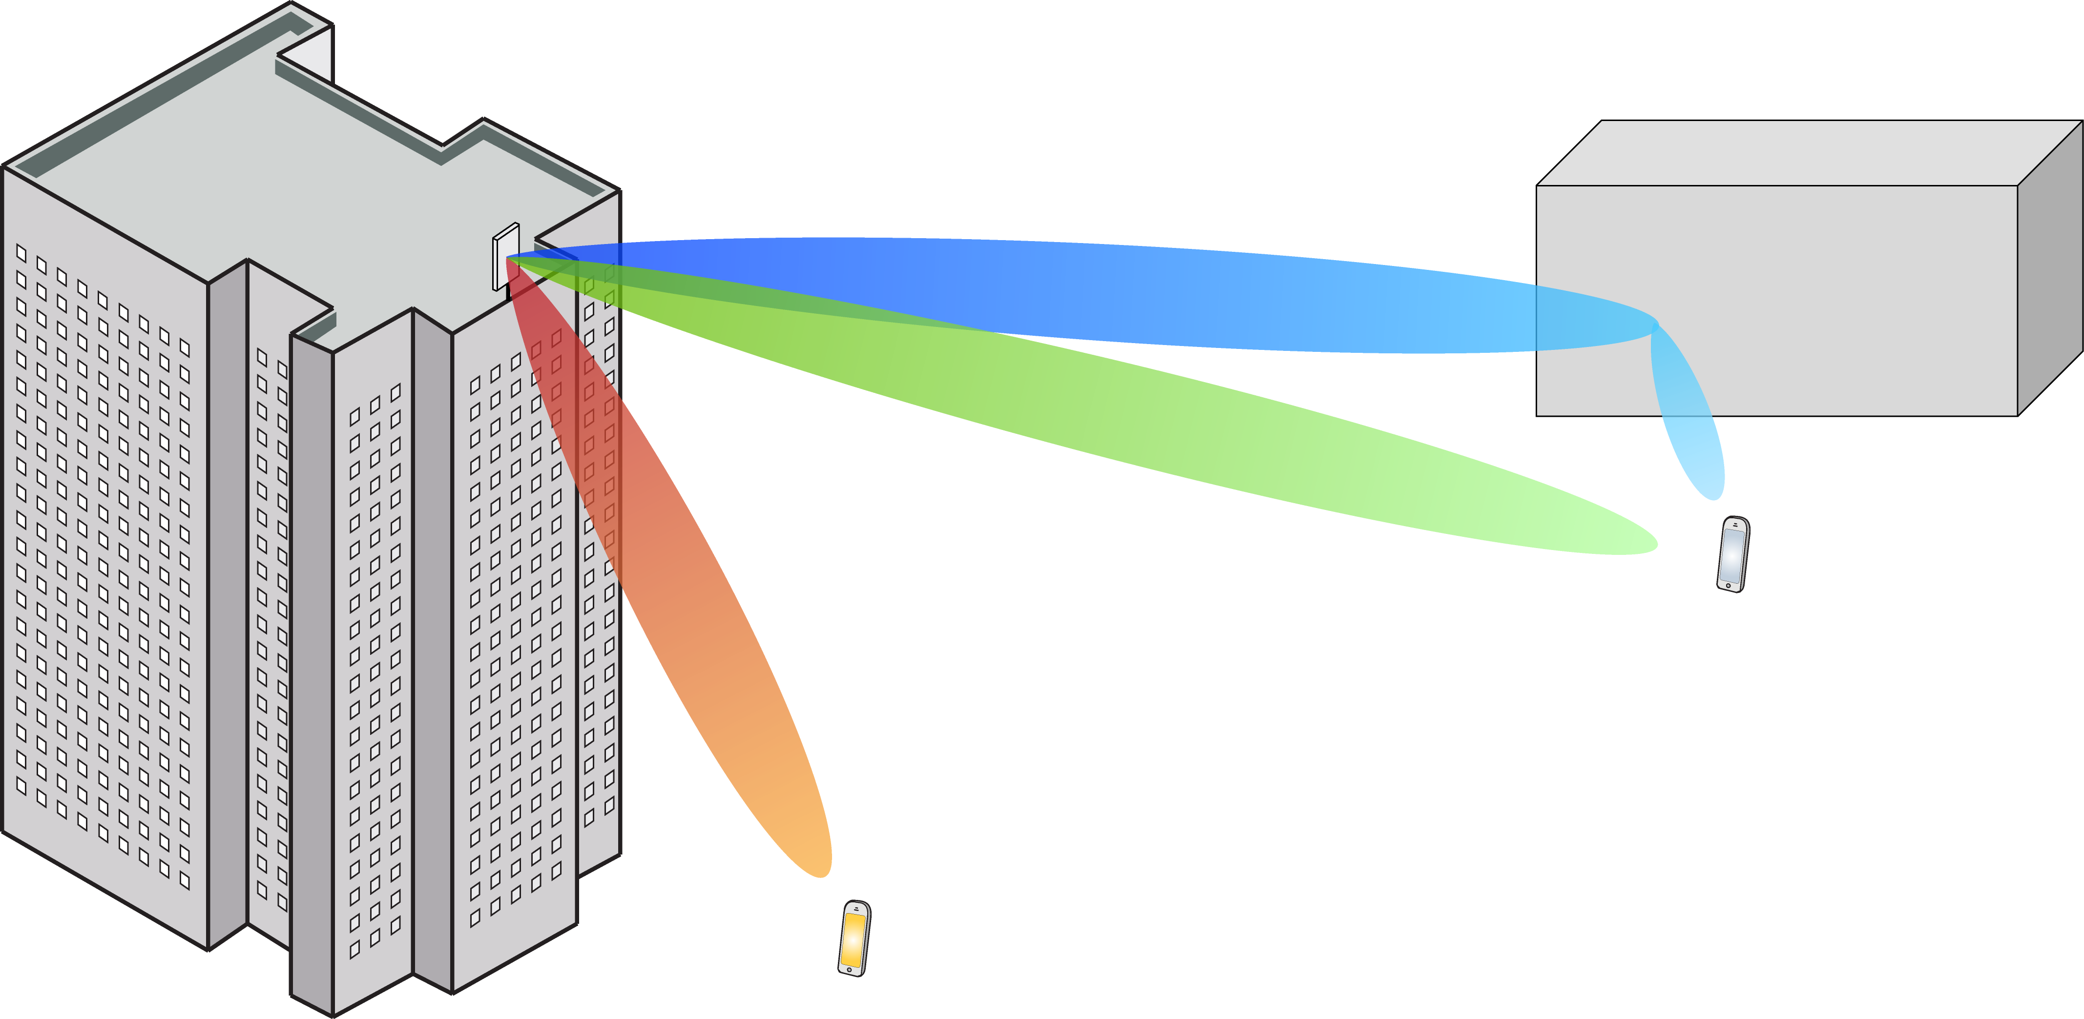
Multiple Antenna Communications
Background Lecture:
Discrete Fourier Transform
Emil Björnson

Slide 2
Outline
Sampled signals are vectors
Discrete Fourier transform
Analysis of discrete-time filtering

Slide 3
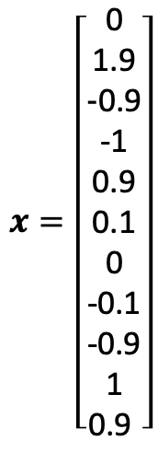
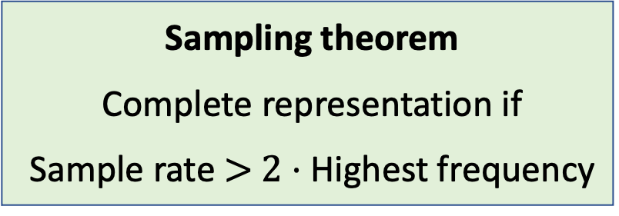
Sampling of Continuous Signal
Take discrete samples of continuous-time signal
Here: Sample rate 1 kHz
Store result in a vector
$$x=\left[\begin{aligned}\text{0} \\ \text{1.9} \\ \text{-}\text{0.9} \\ \text{-1} \\ \text{0.9} \\ \text{0.1} \\ \text{0} \\ \text{-0.1} \\ \text{-0.9} \\ \text{1} \\ \text{0}\text{.9 }\end{aligned}\right]$$
Sampling theorem
Complete representation if
Sample rate $>$ $2⋅$Highest frequency

Slide 4
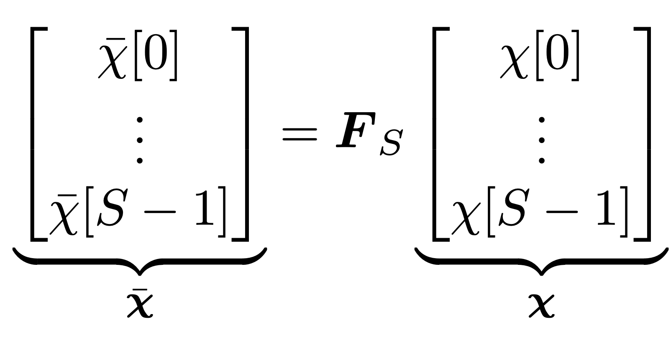
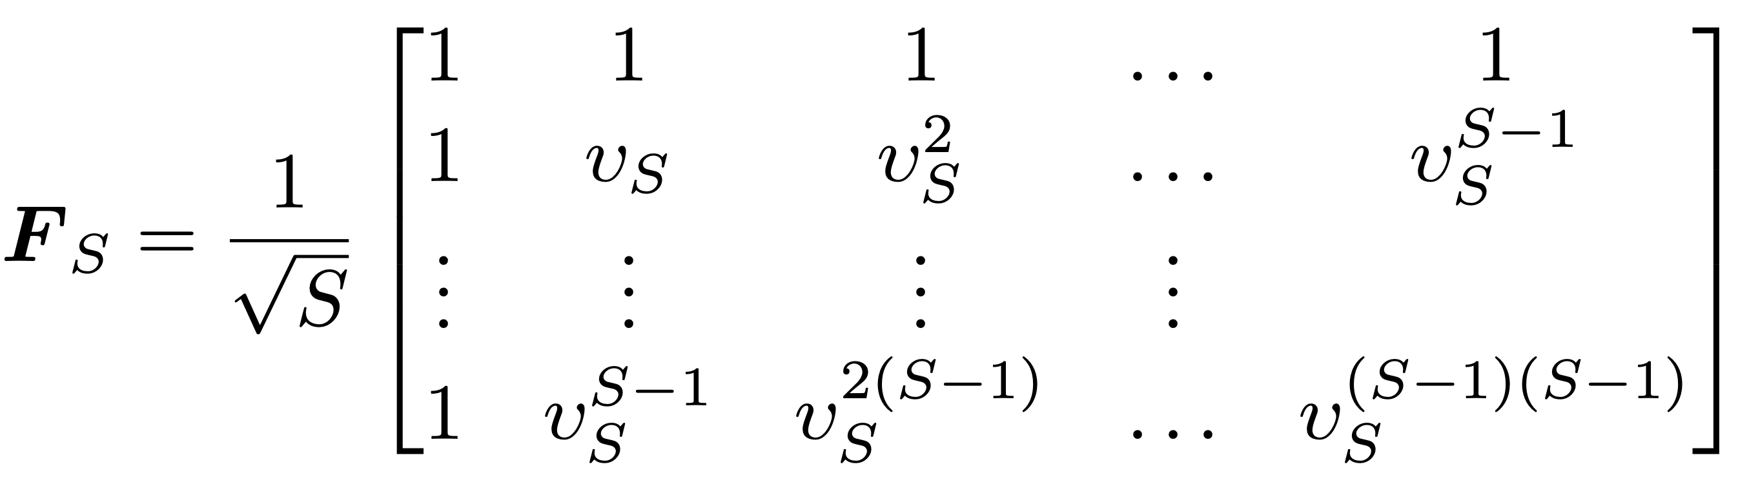
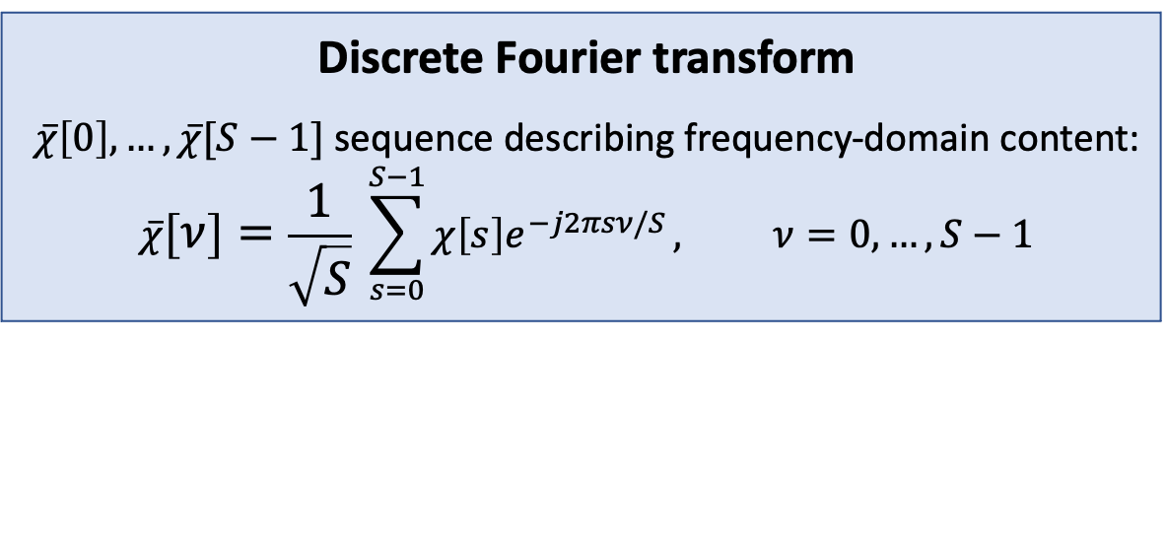


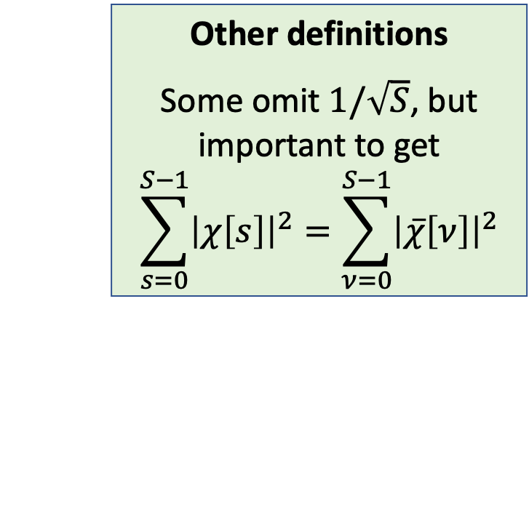
Discrete Fourier Transform (DFT)
$S$-length discrete-time sequence: $χ\left[0\right],…,χ[S−1]$
Matrix representation:
Other definitions
Some omit $1/\sqrt{S}$, but important to get
$$\sum_{s=0}^{S−1}{{\left|χ\left[s\right]\right|}^{2}}=\sum_{ν=0}^{S−1}{{\left|\overline{χ}\left[ν\right]\right|}^{2}}$$
Discrete Fourier transform
$\overline{χ}\left[0\right],…,\overline{χ}[S−1]$sequence describing frequency-domain content:
$$\overline{χ}\left[ν\right]=\frac{1}{\sqrt{S}} \sum_{s=0}^{S−1}{χ\left[s\right]e^{−j2πsν/S}}, ν=0,…,S−1$$
DFT matrix:
$$υ_{S}=e^{−j2π/S}=\cos\left(2π/S\right)−j\sin\left(2π/S\right)$$

Slide 5
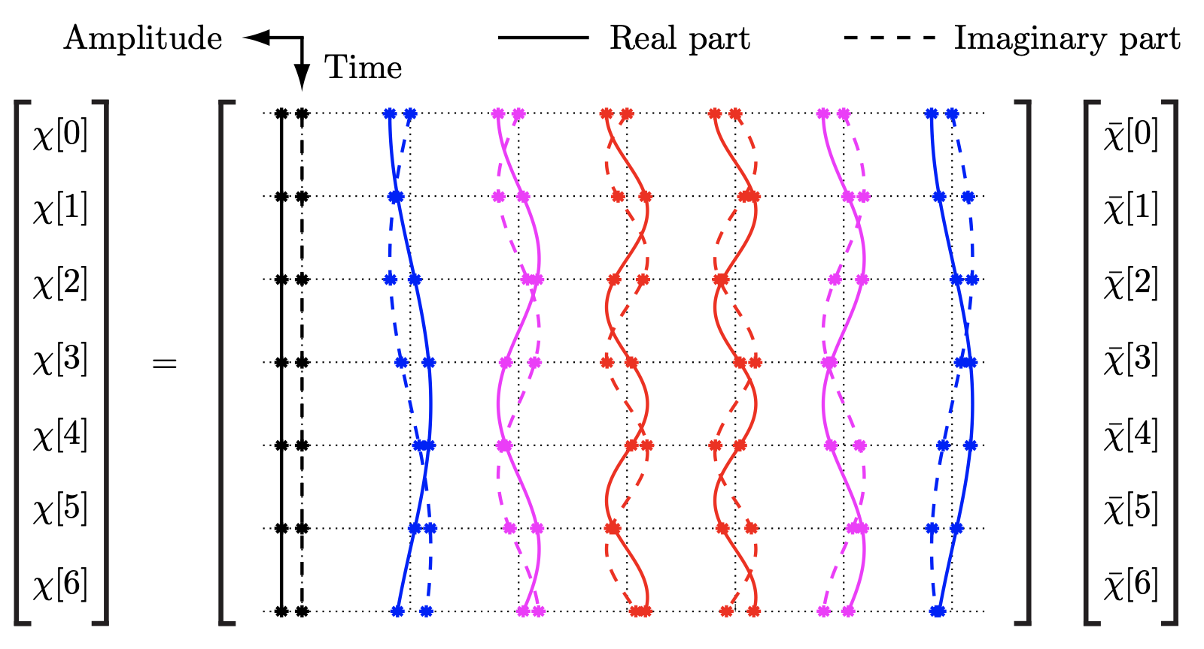


Inverse Discrete Fourier Transform
Unitary matrix
Matrix notation: $χ=F_{S}^{−1} \overline{χ}=F_{S}^{H} \overline{χ}$
Columns of $F_{S}^{H}$
Basis vectors in $ℂ^{S}$
Represent frequencies

Slide 6
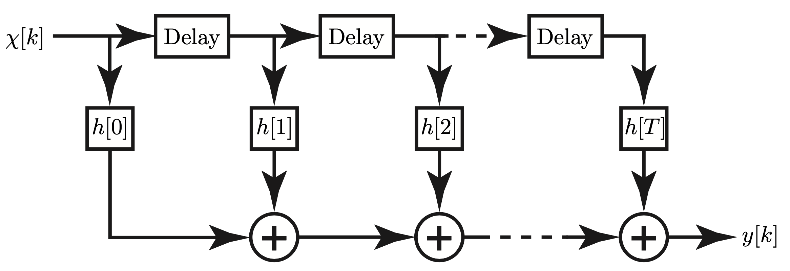
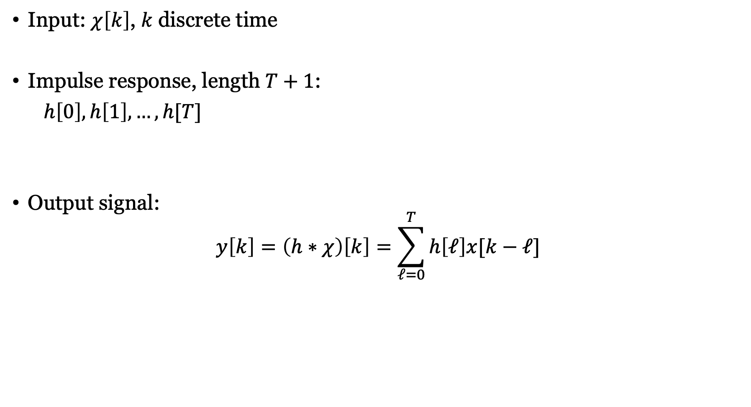

Finite impulse response (FIR) filter
Memory of length $T$
Input: $χ\left[k\right]$, $k$ discrete time
Impulse response, length $T+1$:
$h\left[0\right],h\left[1\right],…,h[T]$
Output signal:
$$y\left[k\right]=\left(h∗χ\right)\left[k\right]=\sum_{ℓ=0}^{T}{h\left[ℓ\right]x[k−ℓ]}$$
How do we start using this filter?

Slide 7

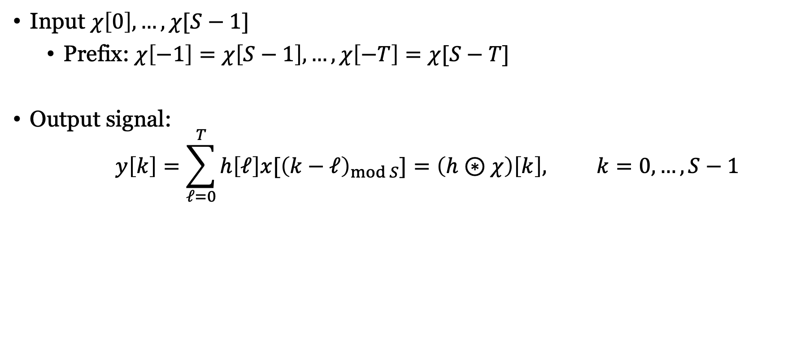
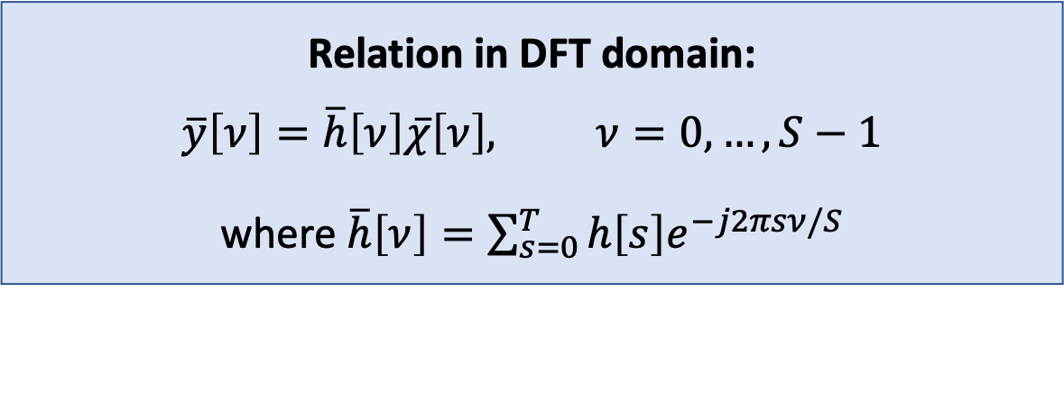
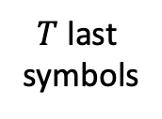
Initiate with cyclic prefix
$S$ input symbols
Cyclic prefix
$T$ last symbols
Input $χ\left[0\right],…,χ[S−1]$
Prefix: $χ\left[−1\right]=χ\left[S−1\right],…,χ\left[−T\right]=χ[S−T]$
Output signal:
$$y\left[k\right]=\sum_{ℓ=0}^{T}{h\left[ℓ\right]x[{\left(k−ℓ\right)}_{mod S}]}=\left(h⊛χ\right)\left[k\right], k=0,…,S−1$$
Cyclic convolution
Relation in DFT domain:
$$\overline{y}\left[ν\right]=\overline{h}\left[ν\right]\overline{χ}\left[ν\right], ν=0,…,S−1$$
where $\overline{h}\left[ν\right]=\sum_{s=0}^{T}{h\left[s\right]e^{−j2πsν/S}}$

Slide 8
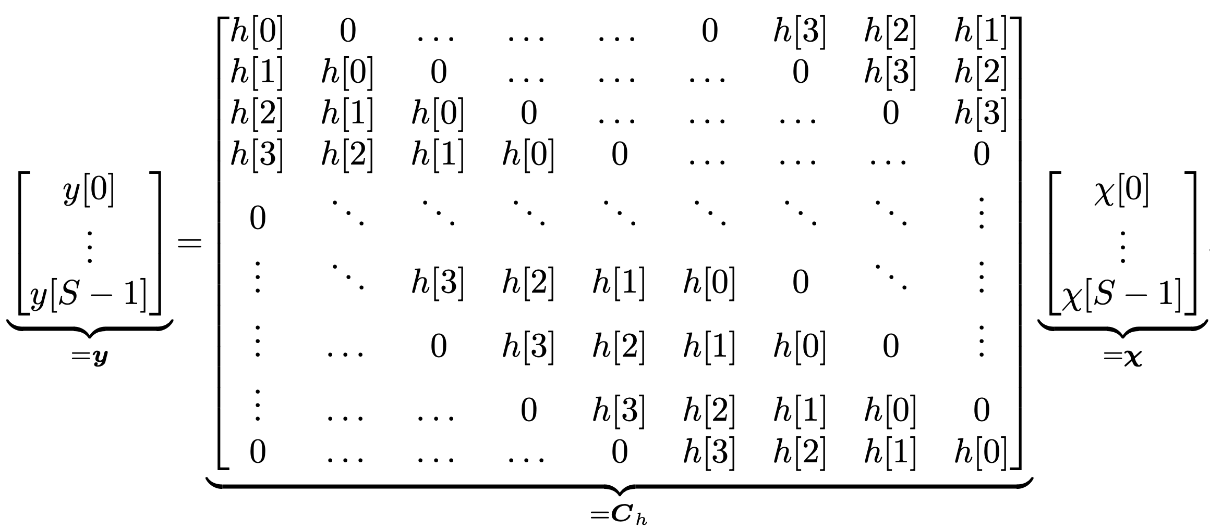
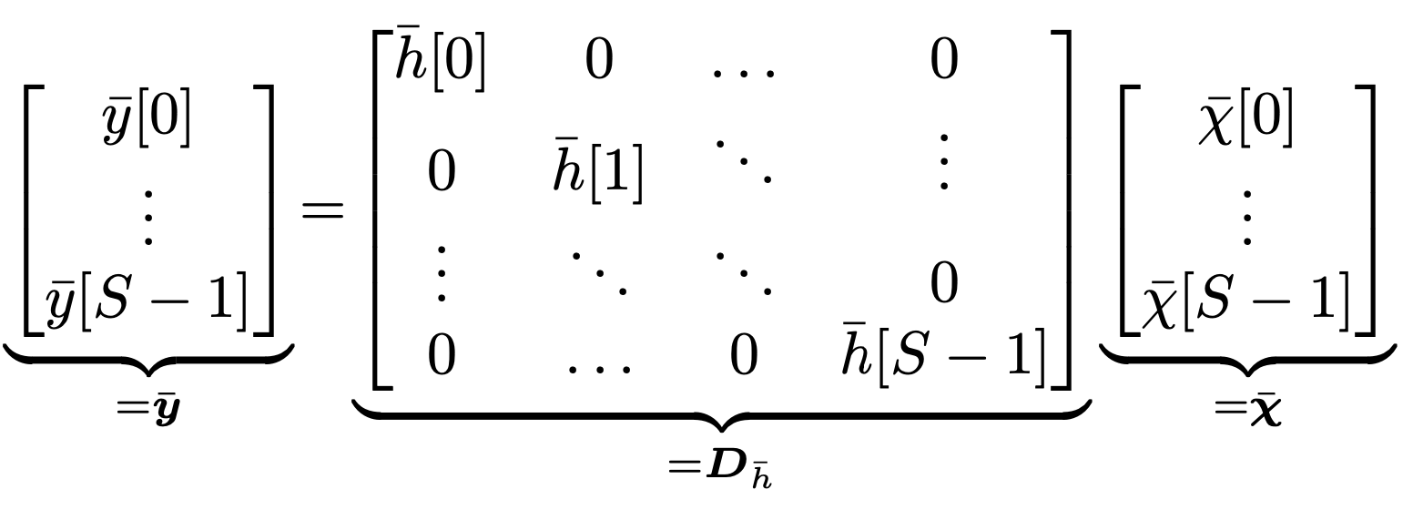
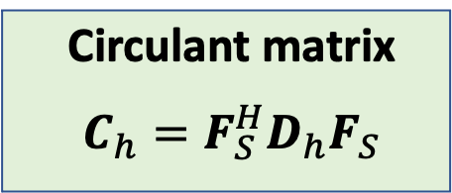
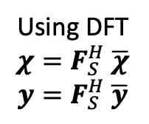
Matrix representation of FIR filtering
Using DFT
$$χ=F_{S}^{H} \overline{χ}$$
$$y=F_{S}^{H} \overline{y}$$
Circulant matrix
$$C_{h}=F_{S}^{H}D_{h}F_{S}$$

Slide 9
Summary
Discrete Fourier transform
Natural basis for vectors with samples
Linear combination of sampled complex exponentials
One application:
Study output of FIR filter
No inter-symbol interference in frequency domain

Slide 10
Multiple Antenna Communications
Background Lecture:
Monte-Carlo Methods
Emil Björnson

