Slide 1
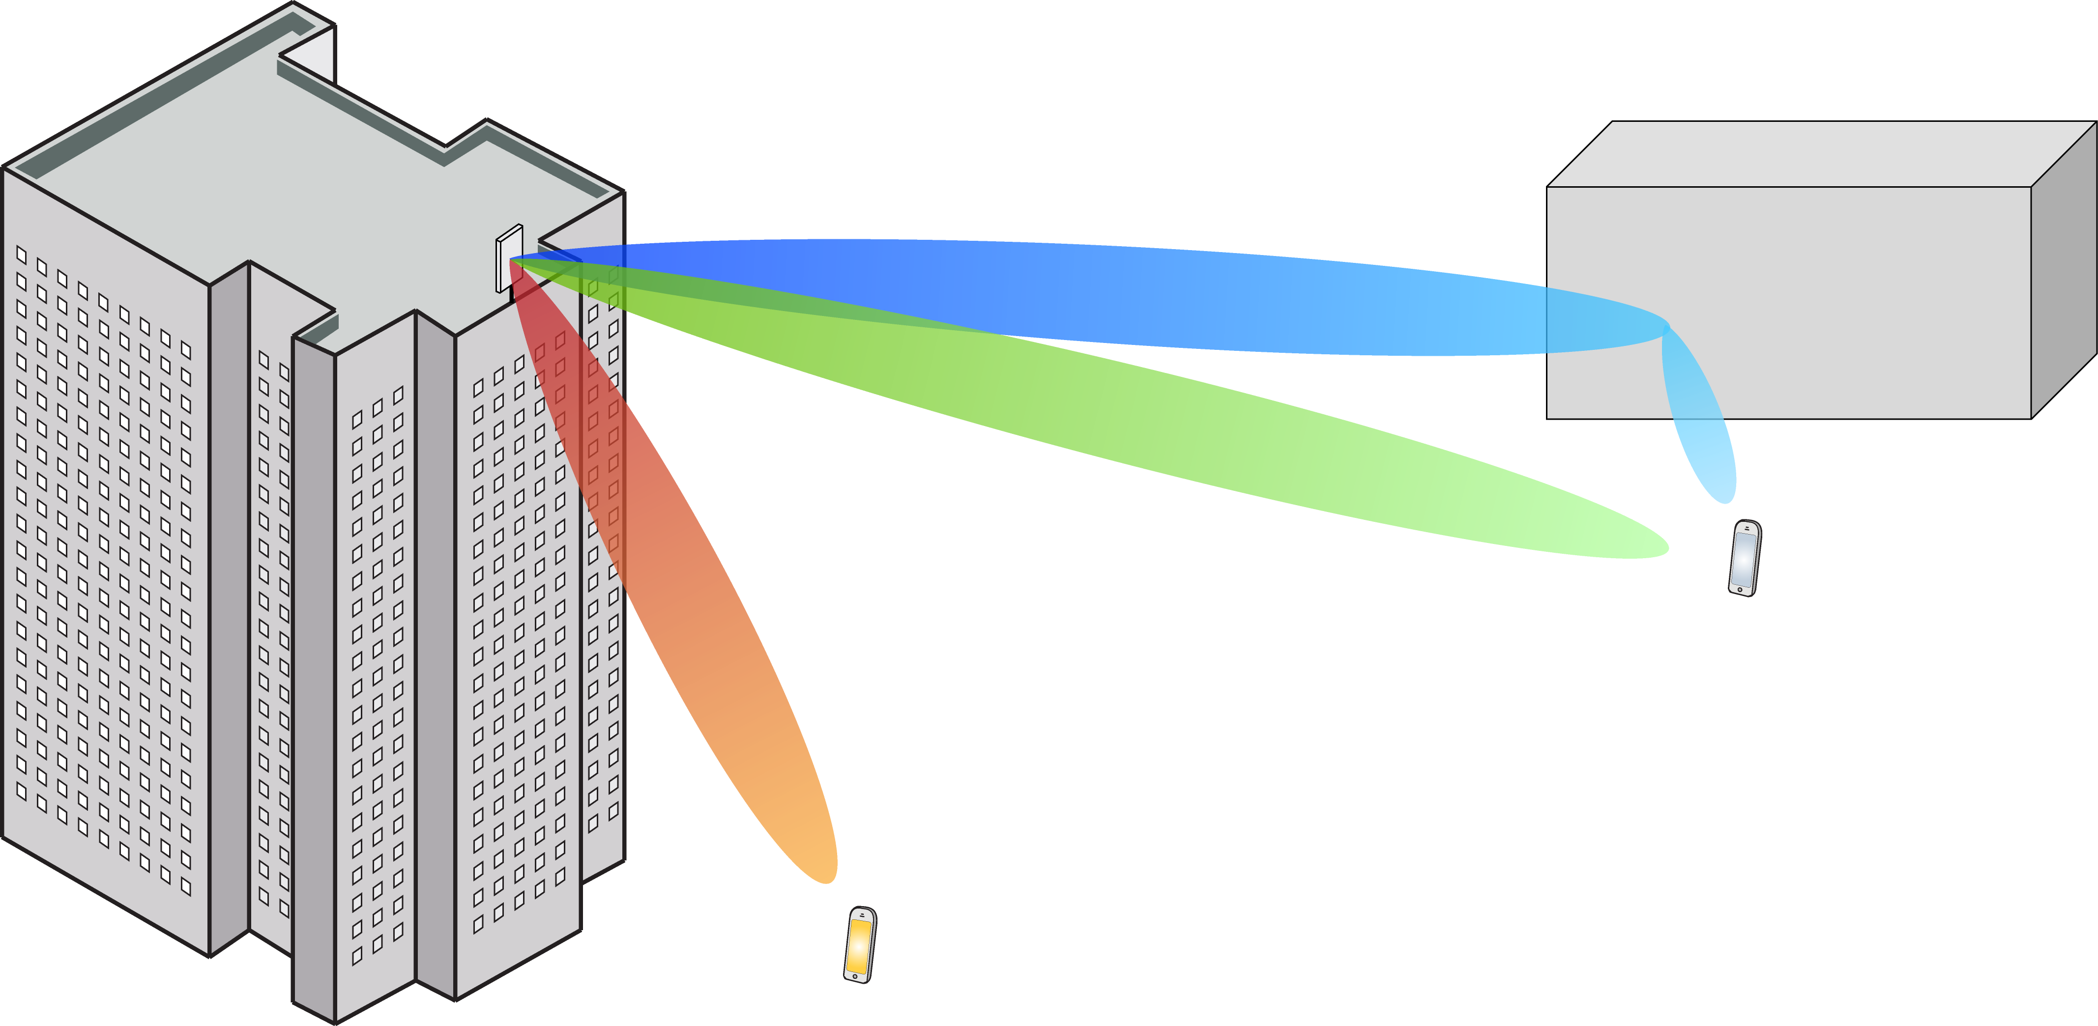
Multiple Antenna Communications
Lecture 13:
3D Array Responses and Multicarrier Channels
Emil Björnson

Slide 2
Outline
Analysis of antenna arrays in three dimensions
Array response vectors with multiple users
Impact of antenna directivity
Channel modeling
Scattering clusters
Multicarrier systems

Slide 3
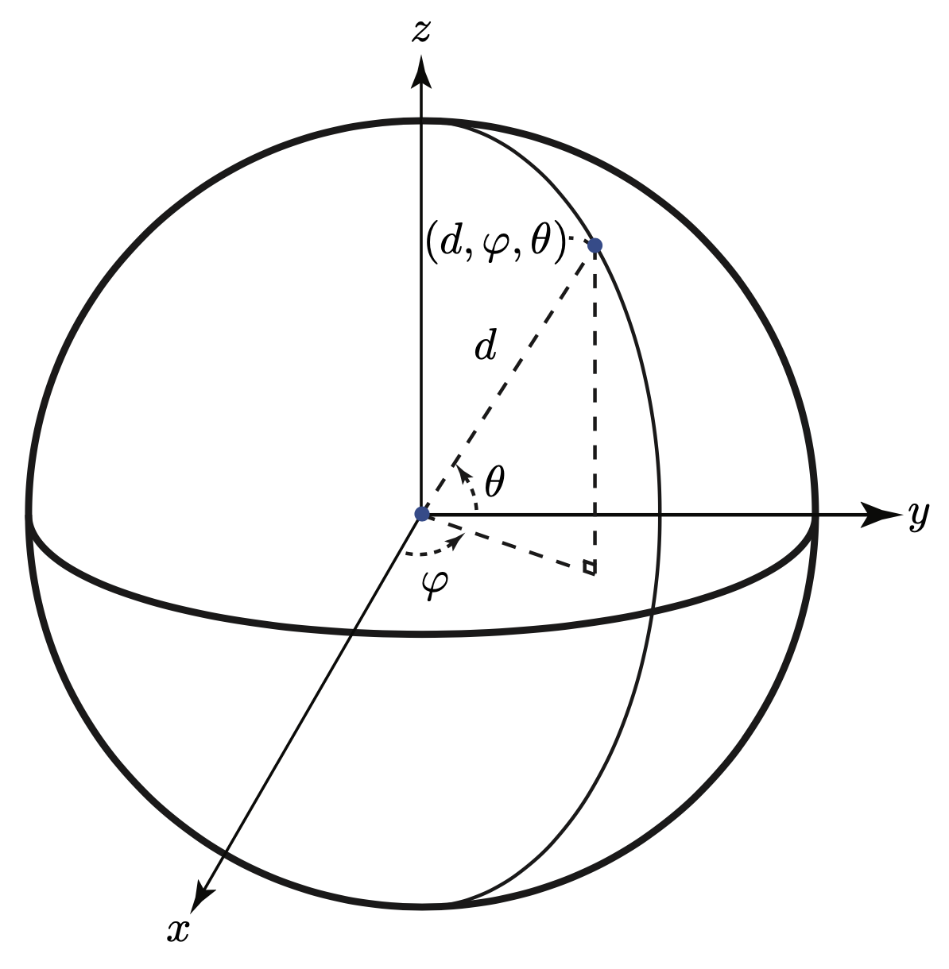
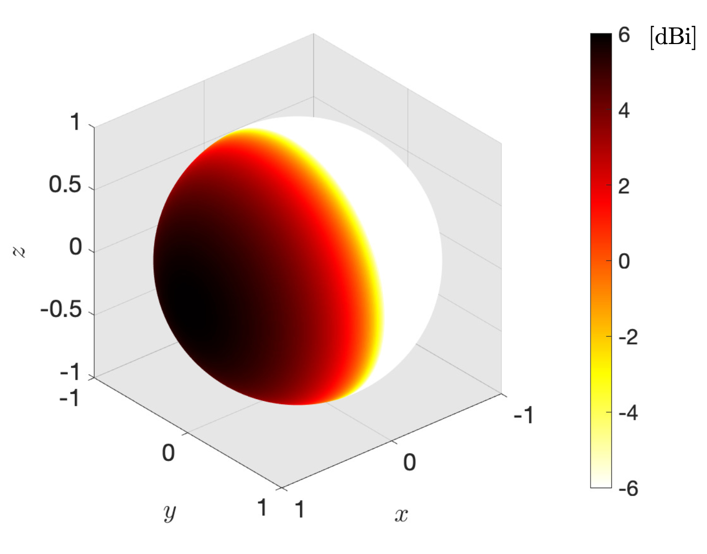
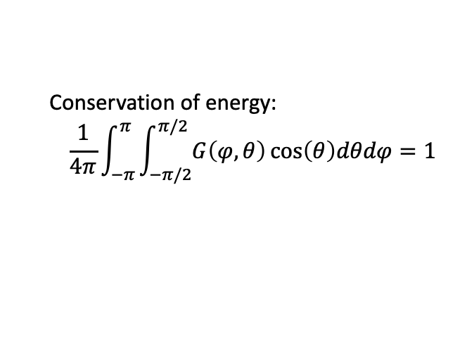
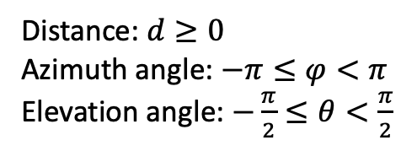
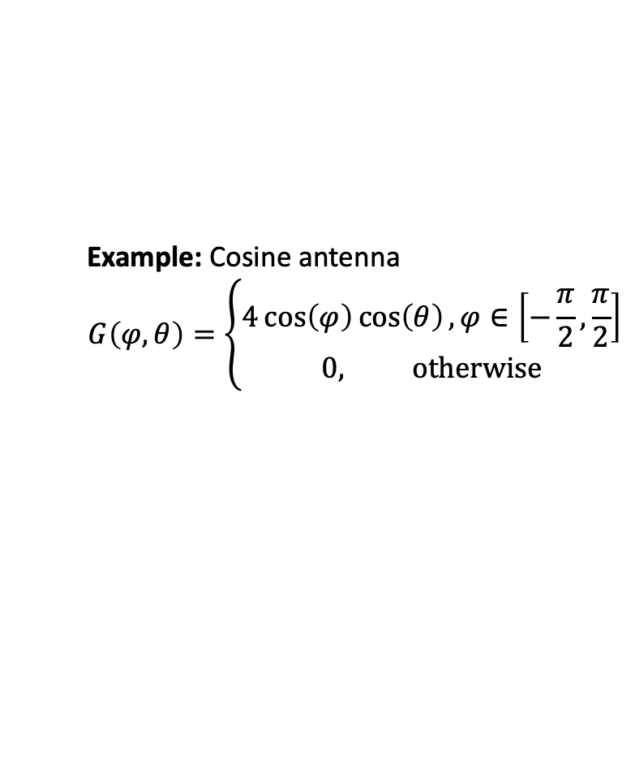


Spherical coordinate system
$$\left[\begin{aligned}x \\ y \\ z\end{aligned}\right]=d\left[\begin{aligned}cos\left(φ\right)cos\left(θ\right) \\ sin\left(φ\right)cos\left(θ\right) \\ \sin\left(θ\right)\end{aligned}\right]$$
Cartesian coordinates: $(x,y,z)$
Spherical coordinates: $\left(d,φ,θ\right)$
Example: Cosine antenna
$$G\left(φ,θ\right)=\left\{\begin{aligned}4\cos\left(φ\right)\cos\left(θ\right), φ∈\left[−\frac{π}{2},\frac{π}{2}\right] \\ 0, otherwise\end{aligned}\right.$$
Distance: $d≥0$
Azimuth angle: $−π≤φ<π$
Elevation angle: $−\frac{π}{2}≤θ<\frac{π}{2}$
Conservation of energy:
$$\frac{1}{4π}\int_{−π}^{π}{\int_{−π/2}^{π/2}{G\left(φ,θ\right)}}\cos\left(θ\right)dθdφ=1$$

Slide 4



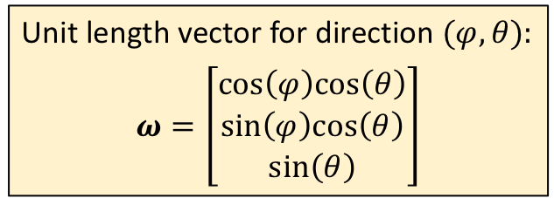

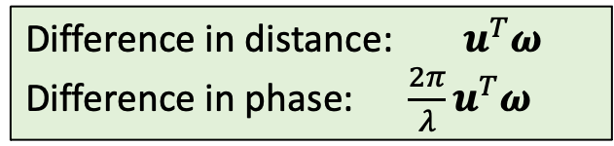


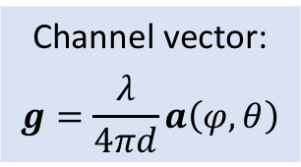


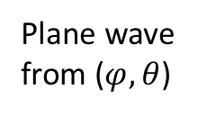
Array response in three dimensions
Transmitter
Unit length vector for direction $(φ,θ)$:
$$ω=\left[\begin{aligned}cos\left(φ\right)cos\left(θ\right) \\ sin\left(φ\right)cos\left(θ\right) \\ \sin\left(θ\right)\end{aligned}\right]$$
Plane wave
Receiver
$$u$$
Antennas at locations in $ℝ^{3}$
Array response:
$$a\left(φ,θ\right)=\left[\begin{matrix}\begin{matrix}e^{j\frac{2π}{λ}u_{1}^{T}ω} \\ e^{j\frac{2π}{λ}u_{2}^{T}ω}\end{matrix} \\ \begin{matrix}⋮ \\ e^{j\frac{2π}{λ}u_{M}^{T}ω}\end{matrix}\end{matrix}\right]$$
$ω$, unit length
$$u^{T}ω$$
$$u_{1}$$
Plane wave
from ($φ,θ$)
Difference in distance: $u^{T}ω$
Difference in phase: $\frac{2π}{λ}u^{T}ω$
$$u_{2}$$
Channel vector:
$$g=\frac{λ}{4πd}a\left(φ,θ\right)$$
$$u_{M}$$

Slide 5



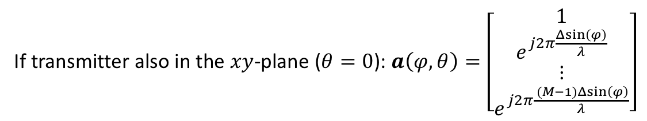

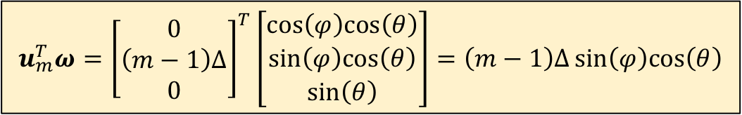

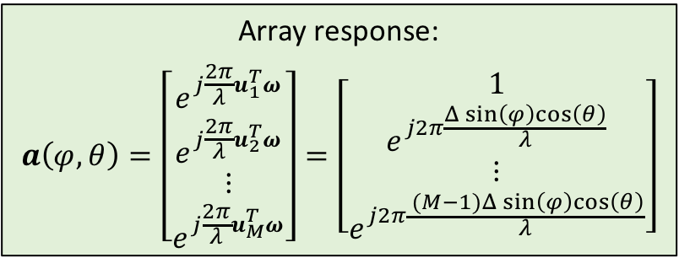

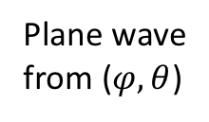
Uniform linear array (ULA) in three dimensions
$$y$$
$$u_{m}^{T}ω={\left[\begin{aligned}0 \\ \left(m−1\right)Δ \\ 0\end{aligned}\right]}^{T}\left[\begin{aligned}cos\left(φ\right)cos\left(θ\right) \\ sin\left(φ\right)cos\left(θ\right) \\ \sin\left(θ\right)\end{aligned}\right]=\left(m−1\right)Δsin\left(φ\right)cos\left(θ\right)$$
$$u_{3}=\left[\begin{aligned}0 \\ 2Δ \\ 0\end{aligned}\right]$$
Array response:
$$a\left(φ,θ\right)=\left[\begin{matrix}\begin{matrix}e^{j\frac{2π}{λ}u_{1}^{T}ω} \\ e^{j\frac{2π}{λ}u_{2}^{T}ω}\end{matrix} \\ \begin{matrix}⋮ \\ e^{j\frac{2π}{λ}u_{M}^{T}ω}\end{matrix}\end{matrix}\right]=\left[\begin{matrix}\begin{matrix}1 \\ e^{j2π\frac{Δsin\left(φ\right)cos\left(θ\right)}{λ}}\end{matrix} \\ \begin{matrix}⋮ \\ e^{j2π\frac{ (M−1)Δsin\left(φ\right)cos\left(θ\right)}{λ}}\end{matrix}\end{matrix}\right]$$
$$Δ$$
$$u_{2}=\left[\begin{aligned}0 \\ Δ \\ 0\end{aligned}\right]$$
Plane wave
from ($φ,θ$)
$$Δ$$
$$u_{1}=\left[\begin{aligned}0 \\ 0 \\ 0\end{aligned}\right]$$
If transmitter also in the $xy$-plane ($θ=0$): $a\left(φ,θ\right)=\left[\begin{matrix}\begin{matrix}1 \\ e^{j2π\frac{Δsin\left(φ\right)}{λ}}\end{matrix} \\ \begin{matrix}⋮ \\ e^{j2π\frac{ (M−1)Δsin\left(φ\right)}{λ}}\end{matrix}\end{matrix}\right]$

Slide 6

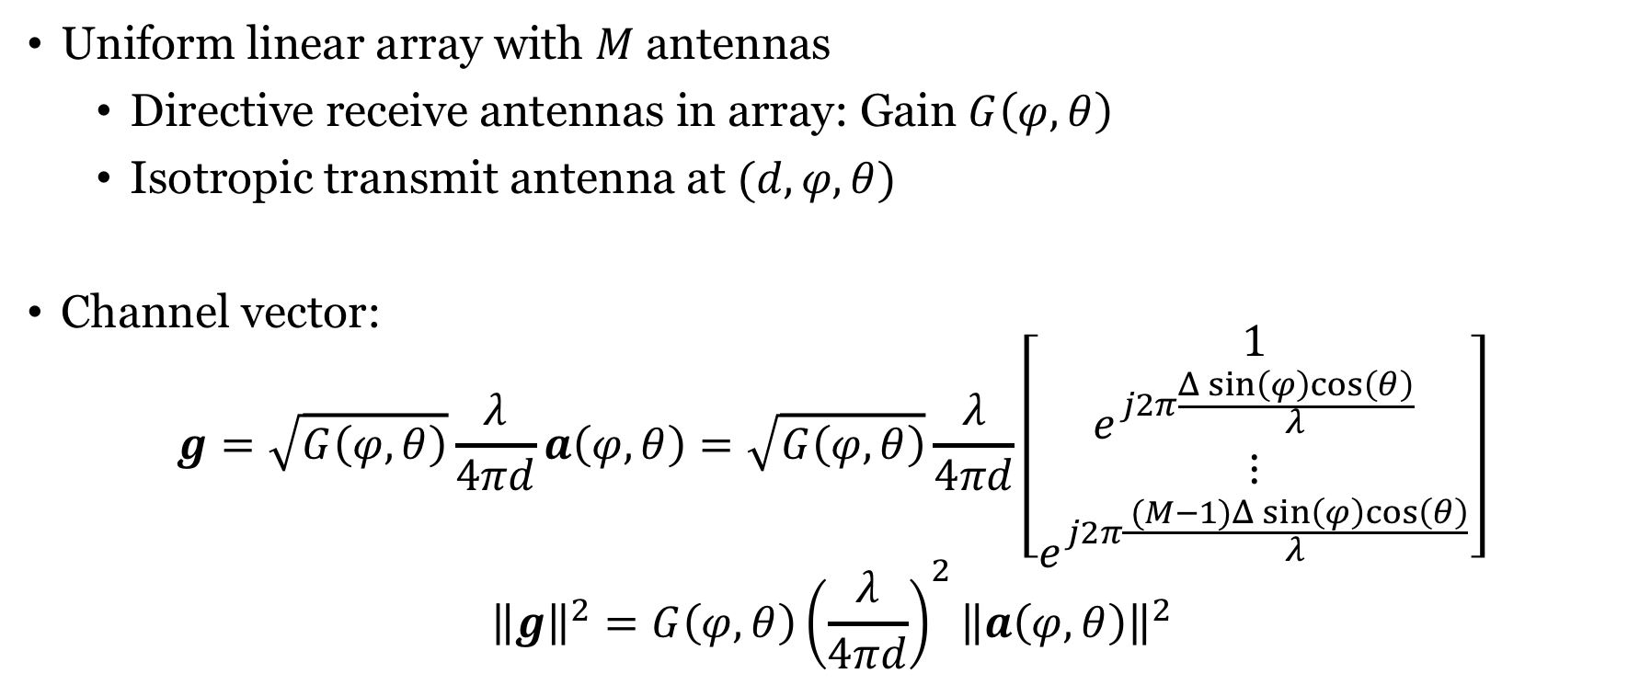
Array response with directive antennas
Uniform linear array with $M$ antennas
Directive receive antennas in array: Gain $G\left(φ,θ\right)$
Isotropic transmit antenna at $(d,φ,θ)$
Channel vector:
$$g=\sqrt{G\left(φ,θ\right)}\frac{λ}{4πd}a\left(φ,θ\right)=\sqrt{G\left(φ,θ\right)}\frac{λ}{4πd}\left[\begin{matrix}\begin{matrix}1 \\ e^{j2π\frac{Δsin\left(φ\right)cos\left(θ\right)}{λ}}\end{matrix} \\ \begin{matrix}⋮ \\ e^{j2π\frac{ (M−1)Δsin\left(φ\right)cos\left(θ\right)}{λ}}\end{matrix}\end{matrix}\right]$$
$${\left\|g\right\|}^{2}=G\left(φ,θ\right){\left(\frac{λ}{4πd}\right)}^{2}{\left\|a\left(φ,θ\right)\right\|}^{2}$$
Amplification/attenuation
$$=M$$

Slide 7
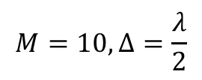
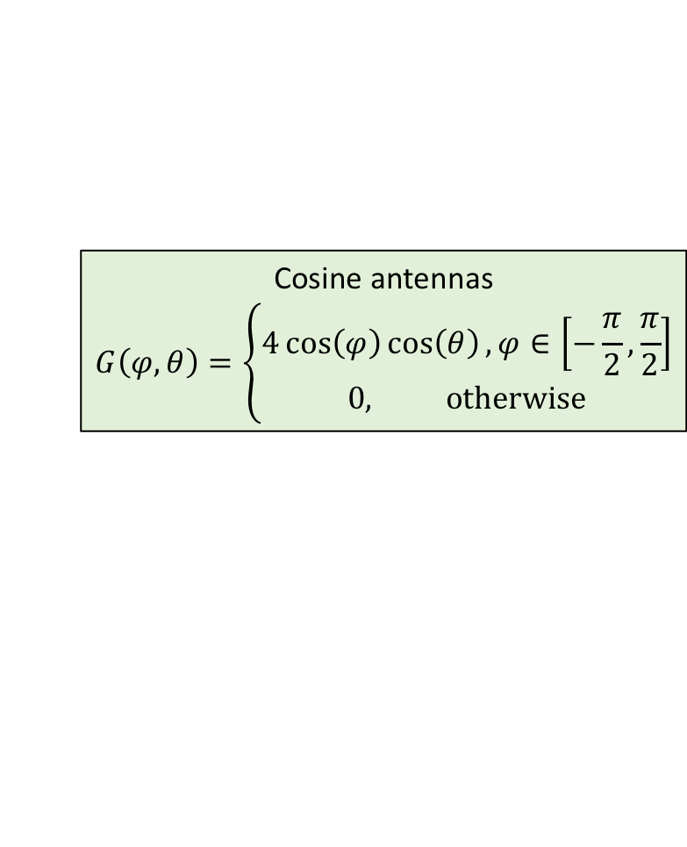
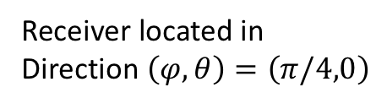
Electrical versus mechanical beamforming
$$M=10, Δ=\frac{λ}{2}$$
Receiver
Receiver located in
Direction $\left(φ,θ\right)=\left(π/4,0\right)$
Rotated transmitter
Transmitter
Cosine antennas
$$G\left(φ,θ\right)=\left\{\begin{aligned}4\cos\left(φ\right)\cos\left(θ\right), φ∈\left[−\frac{π}{2},\frac{π}{2}\right] \\ 0, otherwise\end{aligned}\right.$$

Slide 8
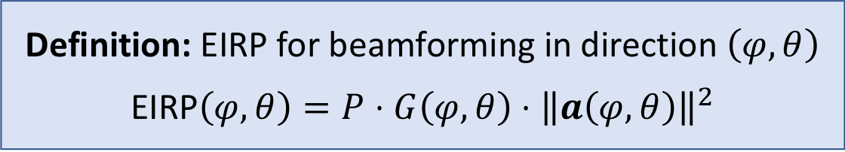
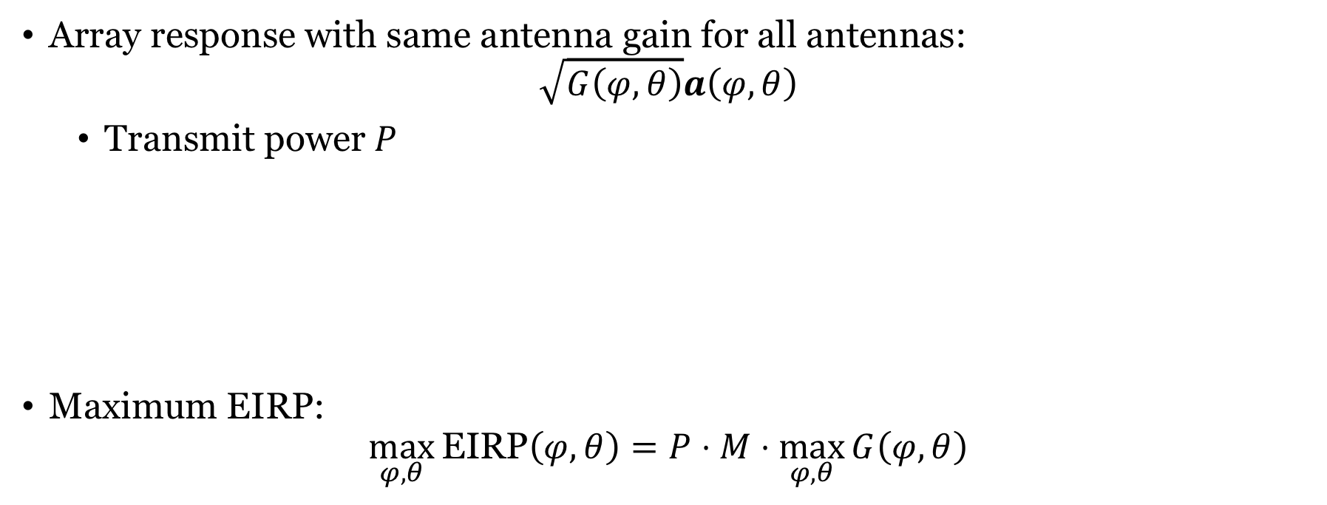
Effective isotropic radiated power (EIRP)
Array response with same antenna gain for all antennas:
$$\sqrt{G\left(φ,θ\right)}a\left(φ,θ\right)$$
Transmit power $P$
Maximum EIRP:
$$\max_{φ,θ}{\text{EIRP}\left(φ,θ\right)}=P⋅M⋅\max_{φ,θ}{G\left(φ,θ\right)}$$
Definition: EIRP for beamforming in direction $\left(φ,θ\right)$
EIRP$\left(φ,θ\right)=P⋅G\left(φ,θ\right)⋅{\left\|a\left(φ,θ\right)\right\|}^{2}$
Spectrum licenses: Limits on transmit power and maximum EIRP

Slide 9
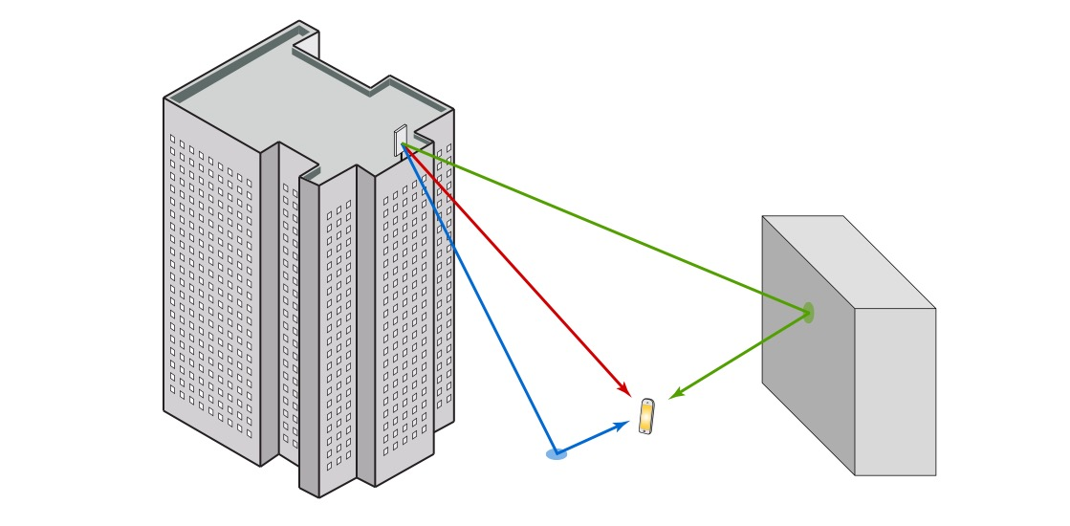


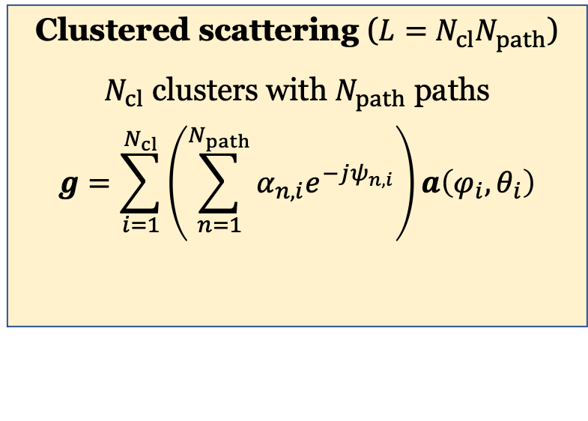
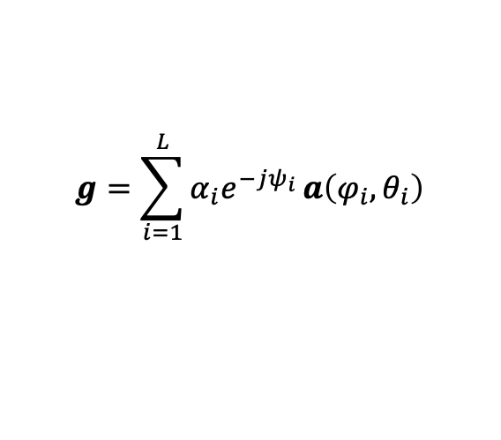



Sparse multipath propagation
Carrier frequency
Propagation delay
$$2πf_{c}τ_{i}$$
$$g=\sum_{i=1}^{L}{α_{i}e^{−jψ_{i}}}a\left(φ_{i},θ_{i}\right)$$
$$\left(φ_{2},θ_{2}\right)$$
Amplitude loss
$$\left(φ_{1},θ_{1}\right)$$
Clustered scattering ($L=$ $N_{cl}N_{path}$)
$N_{cl}$ clusters with $N_{path}$ paths
$$g=\sum_{i=1}^{N_{cl}}{\left(\sum_{n=1}^{N_{path}}{α_{n,i}e^{−jψ_{n,i}}}\right)}a\left(φ_{i},θ_{i}\right)$$
$$\left(φ_{3},θ_{3}\right)$$
$∼CN\left(0,β_{i}\right)$ if $N_{path}$ is large
i.i.d. fading if clusters everywhere

Slide 10
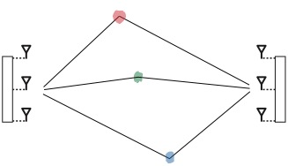

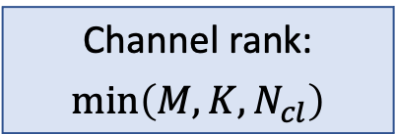




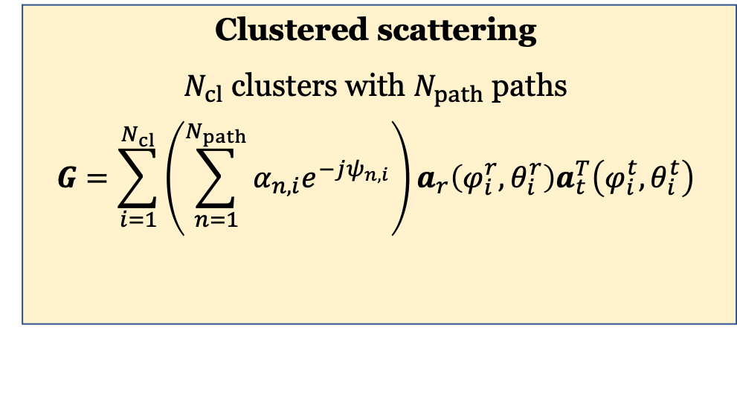

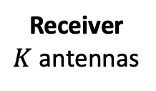



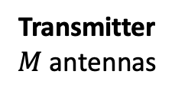
Clustered MIMO channel
Cluster 1
Transmitter $M$ antennas
Receiver $K$ antennas
Array responses
Transmitter: $a_{t}\left(φ,θ\right)$
Receiver : $a_{r}\left(φ,θ\right)$
$$\left(φ_{1}^{r},θ_{1}^{r}\right)$$
$$\left(φ_{1}^{t},θ_{1}^{t}\right)$$
Cluster 2
$$\left(φ_{2}^{t},θ_{2}^{t}\right)$$
$$\left(φ_{2}^{r},θ_{2}^{r}\right)$$
Clustered scattering
$N_{cl}$ clusters with $N_{path}$ paths
$$G=\sum_{i=1}^{N_{cl}}{\left(\sum_{n=1}^{N_{path}}{α_{n,i}e^{−jψ_{n,i}}}\right)}a_{r}\left(φ_{i}^{r},θ_{i}^{r}\right)a_{t}^{T}\left(φ_{i}^{t},θ_{i}^{t}\right)$$
$$\left(φ_{N_{cl}}^{t},θ_{N_{cl}}^{t}\right)$$
$$\left(φ_{N_{cl}}^{r},θ_{N_{cl}}^{r}\right)$$
Cluster $N_{cl}$
Channel rank:
$$\min\left(M,K,N_{cl}\right)$$
$∼CN\left(0,β_{i}\right)$ if $N_{path}$ is large

Slide 11
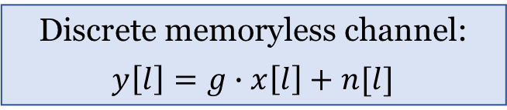

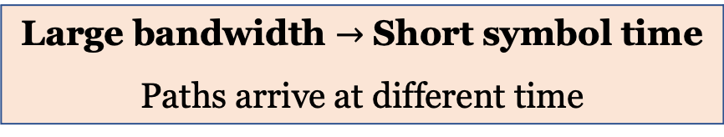
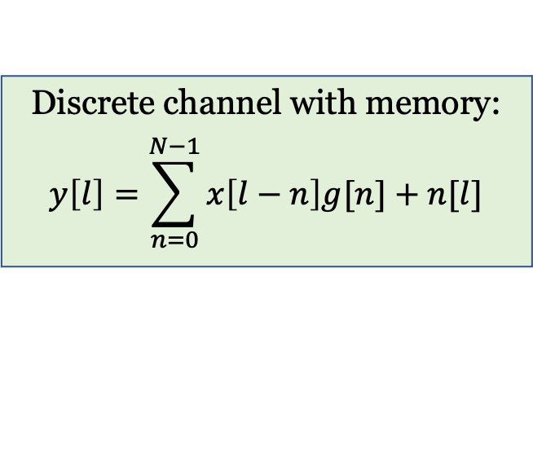
Channels with memory
Discrete memoryless channel:
$$y\left[l\right]=g∙x\left[l\right]+n[l]$$
Discrete channel with memory:
$$y\left[l\right]=\sum_{n=0}^{N−1}{x\left[l−n\right]g[n]}+n[l]$$
Channel with $N$ taps: $g\left[0\right],…,g[N−1]$
Large bandwidth $→$ Short symbol time
Paths arrive at different time

Slide 12
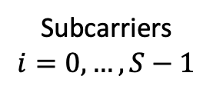

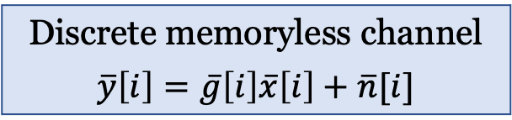
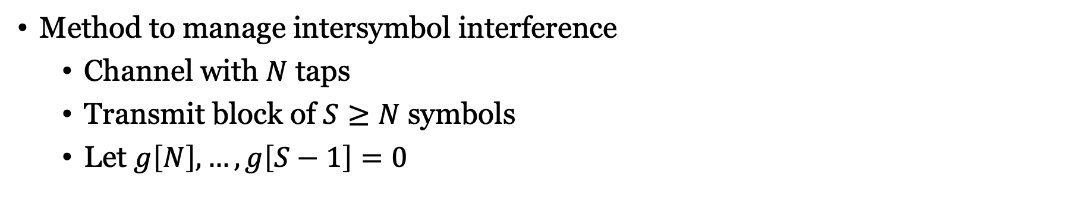
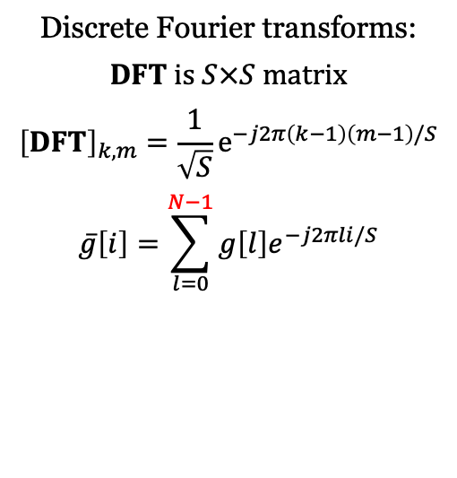
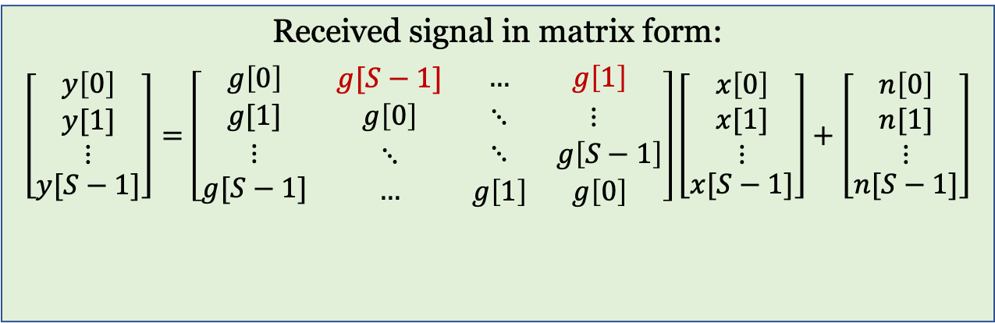
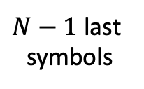

Orthogonal frequency-division multiplexing (OFDM)
$N−1$ last symbols
Method to manage intersymbol interference
Channel with $N$ taps
Transmit block of $S≥N$ symbols
Let $g\left[N\right],…,g\left[S−1\right]=0$
$S$ symbols
Cyclic prefix
Discrete Fourier transforms:
$DFT$ is $S×S$ matrix
$${\left[DFT\right]}_{k,m}=\frac{1}{\sqrt{S}}e^{−j2π\left(k−1\right)\left(m−1\right)/S}$$
$$\overline{g}\left[i\right]=\sum_{l=0}^{N−1}{g\left[l\right]e^{−j2πli/S}}$$
Received signal in matrix form:
$$\left[\begin{matrix}y\left[0\right] \\ \begin{matrix}y[1] \\ ⋮\end{matrix} \\ y[S−1]\end{matrix}\right]=\left[\begin{matrix}g\left[0\right] & g[S−1] & \begin{matrix}… & g\left[1\right] \end{matrix} \\ g[1] & g\left[0\right] & \begin{matrix}⋱ & ⋮ \end{matrix} \\ \begin{matrix}⋮ \\ g[S−1]\end{matrix} & \begin{matrix}⋱ \\ …\end{matrix} & \begin{matrix}⋱ & g\left[S−1\right] \\ g\left[1\right] & g\left[0\right] \end{matrix}\end{matrix}\right]\left[\begin{matrix}x\left[0\right] \\ \begin{matrix}x[1] \\ ⋮\end{matrix} \\ x[S−1]\end{matrix}\right]+\left[\begin{matrix}n\left[0\right] \\ \begin{matrix}n[1] \\ ⋮\end{matrix} \\ n[S−1]\end{matrix}\right]$$
$${DFT}^{H}⋅diag\left(\overline{g}\left[0\right],…,\overline{g}\left[S−1\right]\right)⋅DFT$$
Discrete memoryless channel
$$\overline{y}\left[i\right]=\overline{g}\left[i\right]\overline{x}\left[i\right]+\overline{n}[i]$$
Subcarriers
$$i=0,…,S−1$$
Point-to-point MIMO processing

Slide 13
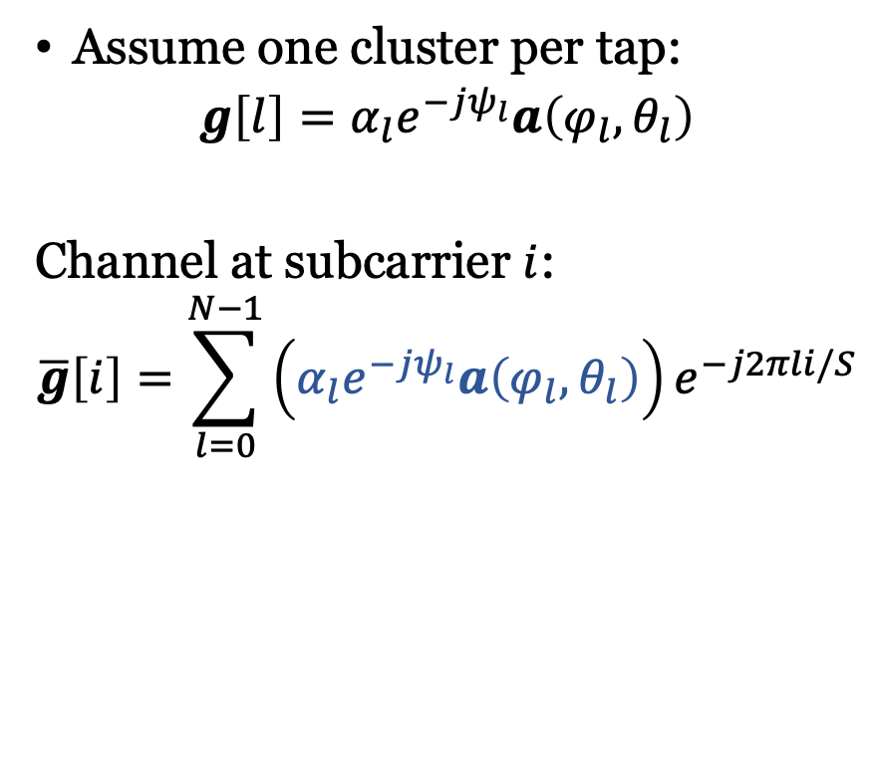
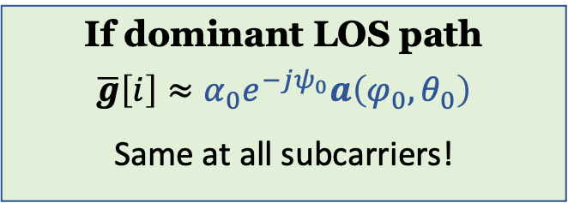
Multiple antenna OFDM
Assume one cluster per tap:
$$g\left[l\right]=α_{l}e^{−jψ_{l}}a\left(φ_{l},θ_{l}\right)$$
Channel at subcarrier $i$:
$$\overline{g}\left[i\right]=\sum_{l=0}^{N−1}{\left(α_{l}e^{−jψ_{l}}a\left(φ_{l},θ_{l}\right)\right)e^{−j2πli/S}}$$
Different weighted sums at each subcarrier
If dominant LOS path
$$\overline{g}\left[i\right]≈α_{0}e^{−jψ_{0}}a\left(φ_{0},θ_{0}\right)$$
Same at all subcarriers!
Use different precoding at each subcarrier

Slide 14
Summary
Array response
Depends on azimuth and elevation angle
Important to model
Sparse multipath propagation
Impact of directive antennas
Multicarrier OFDM systems
Resolve intersymbol interference
Different channels on the subcarriers

Slide 15
Multiple Antenna Communications
Lecture 13:
3D Array Responses and Multicarrier Channels
Emil Björnson

