Slide 1
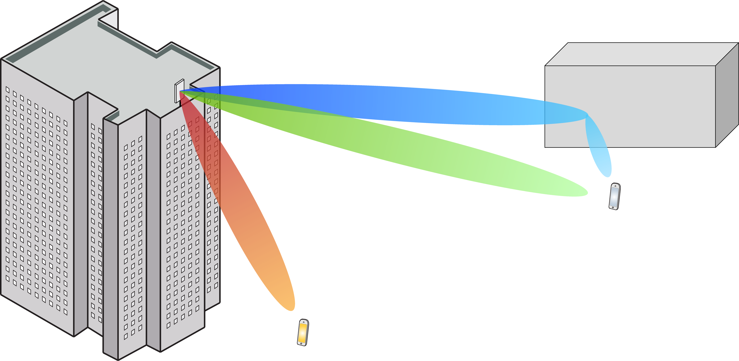
Multiple Antenna Communications
Background Lecture:
Complex Baseband Model
Emil Björnson

Slide 2
Outline
Signals and systems
Fourier transform
Complex baseband representation
Signals and communication channels
Pulse amplitude modulation
Received signal
Narrowband channel

Slide 3








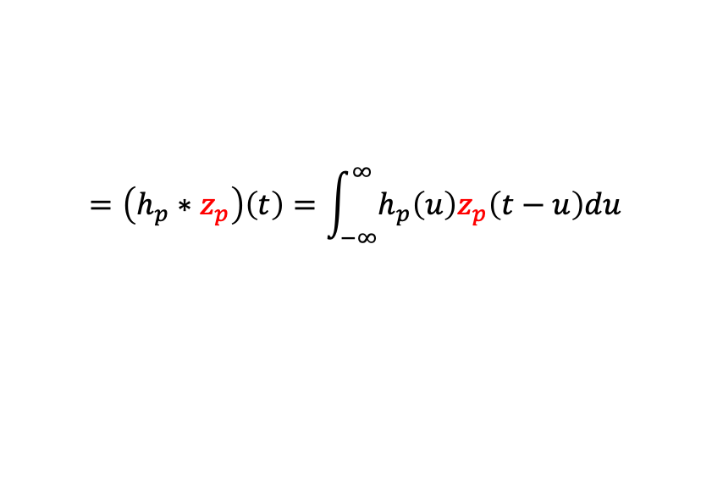


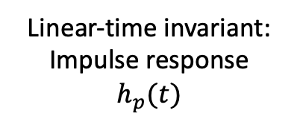

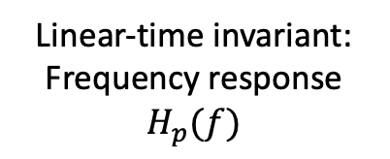
Linear time-invariant system
Impulse (Dirac function)
$δ(t)$: $\int_{−∞}^{∞}{x\left(t\right)}δ\left(t\right) dt=x(0)$
System in time-domain:
System in frequency domain:
Linear-time invariant:
Impulse response
$$h_{p}(t)$$
$$=\left(h_{p}∗z_{p}\right)\left(t\right)=\int_{−∞}^{∞}{h_{p}\left(u\right)z_{p}\left(t−u\right)du}$$
$$z_{p}(t)$$
$$υ_{p}(t)$$
Passband signal:
$$X_{p}\left(f\right)$$
$$Υ_{p}(f)$$
Linear-time invariant:
Frequency response
$$H_{p}(f)$$
$$Z_{p}(f)$$
$Υ_{p}\left(f\right)=H_{p}(f)$ $Z_{p}(f)$
$$0$$
$$f_{c}$$
$$f$$
$$B$$

Slide 4

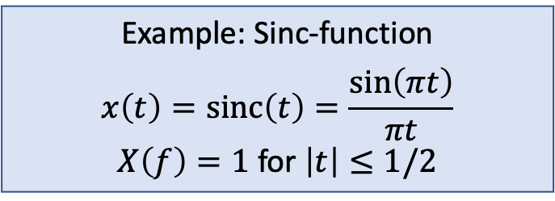

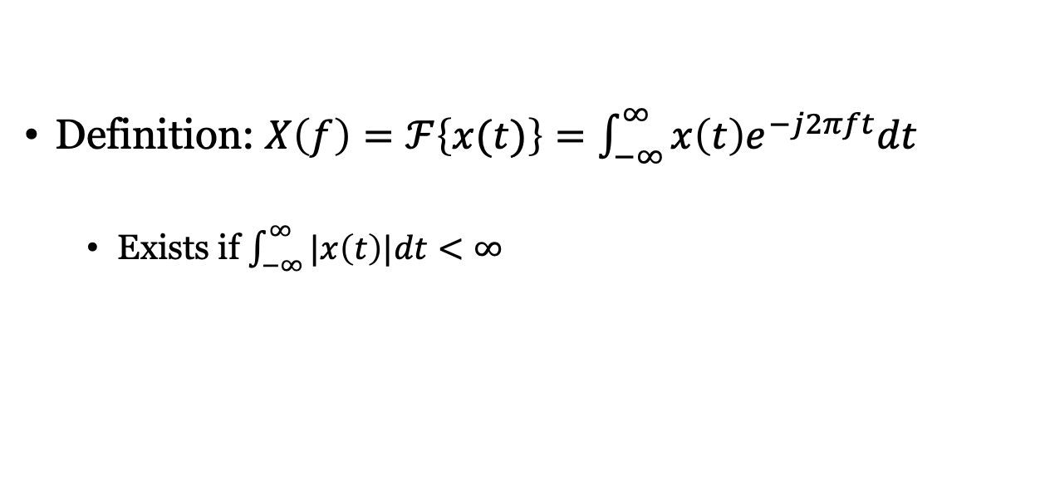

Fourier transform
$$x\left(t\right)$$
$$X\left(f\right)$$
Fourier transform
Time
Frequency
Definition: $X\left(f\right)=ℱ\left\{x(t)\right\}=\int_{−∞}^{∞}{x\left(t\right)e^{−j2πft}dt}$
Exists if $\int_{−∞}^{∞}{|x\left(t\right)|dt}<∞$
Example: Cosine
$$x\left(t\right)=\cos\left(2πf_{c}t\right)$$
$$X\left(f\right)=\frac{1}{2}δ\left(f−f_{c}\right)+\frac{1}{2}δ(f+f_{c})$$
Example: Sinc-function
$$x\left(t\right)=sinc\left(t\right)=\frac{\sin\left(πt\right)}{πt}$$
$X\left(f\right)=1$ for $\left|t\right|≤1/2$

Slide 5
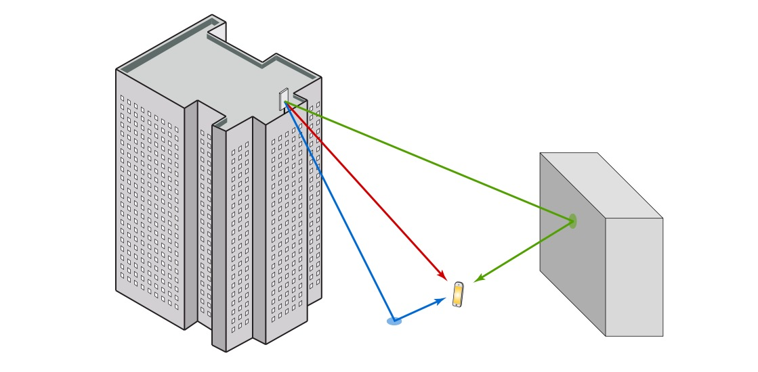

Wireless channels are systems/filters
$$z_{p}(t)$$
$$υ_{p}\left(t\right)=α_{1}z_{p}\left(t−τ_{1}\right)+α_{2}z_{p}\left(t−τ_{2}\right)+α_{3}z_{p}\left(t−τ_{3}\right)$$
Impulse response: $h_{p}\left(t\right)=α_{1}δ\left(t−τ_{1}\right)+α_{2}δ\left(t−τ_{2}\right)+α_{3}δ\left(t−τ_{3}\right)$

Slide 6


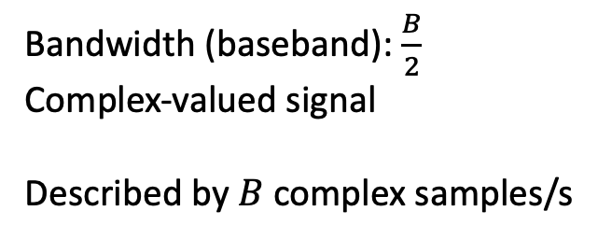

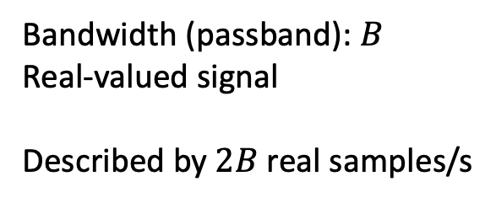




Sampling theorem: Passband and baseband signals
Bandwidth:
Distance from smallest to largest frequency
Bandwidth (passband): $B$
Real-valued signal
Described by $2B$ real samples/s
$$B$$
$${−f}_{c}$$
$$f_{c}$$
$$f$$
$$\frac{B}{2}$$
Bandwidth (baseband): $\frac{B}{2}$
Complex-valued signal
Described by $B$ complex samples/s
$$0$$
$$f$$
These samples are used to convey information

Slide 7


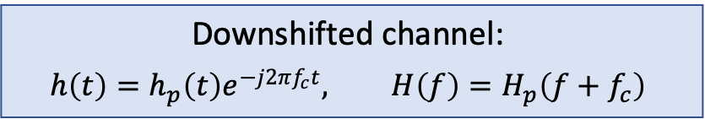


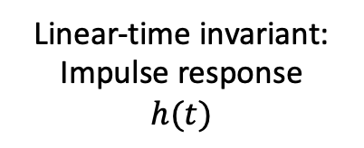

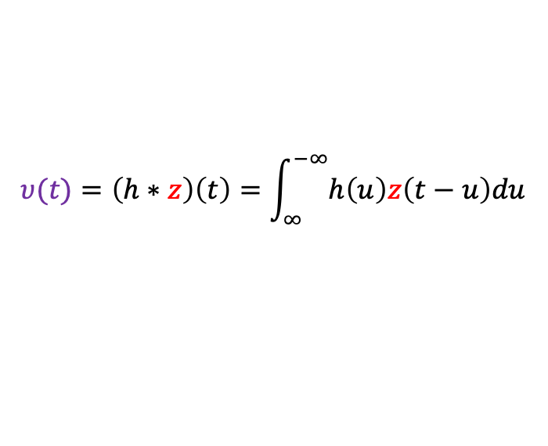






Communication theory is not developed for a passband
Real passband
Complex baseband
Downshifting
$$Z_{p}\left(f\right)$$
$$Z\left(f\right)$$
$$Υ_{p}(f)$$
$$Υ(f)$$
$$0$$
$$f_{c}$$
$$f$$
$$0$$
$$f_{c}$$
$$f$$
$$B$$
$$B/2$$
Connection: $Z_{p}\left(f\right)=\frac{Z\left(f−f_{c}\right)+Z^{∗}\left(−f−f_{c}\right)}{\sqrt{2}}$, $Υ_{p}\left(f\right)=\frac{Υ\left(f−f_{c}\right)+Υ^{∗}\left(−f−f_{c}\right)}{\sqrt{2}}$
Equivalent complex-baseband system:
Linear-time invariant:
Impulse response
$$h(t)$$
$$υ(t)=\left(h∗z\right)\left(t\right)=\int_{∞}^{−∞}{h\left(u\right)z\left(t−u\right)du}$$
$$z(t)$$
Downshifted channel:
$$h\left(t\right)=h_{p}\left(t\right)e^{−j2πf_{c}t}, H\left(f\right)=H_{p}\left(f+f_{c}\right)$$

Slide 8
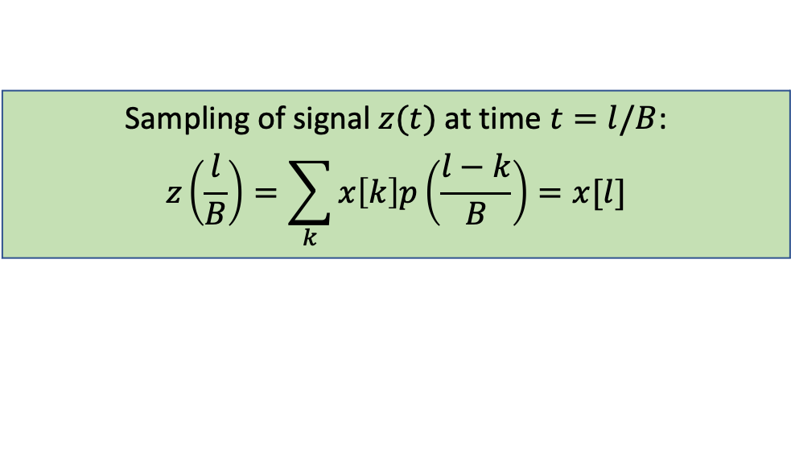
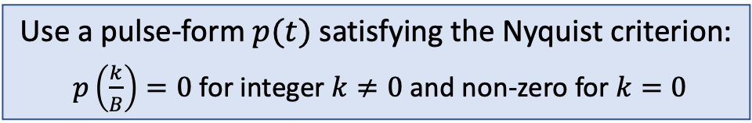




How to transmit data?
$$x\left[1\right]=2$$
Transmit discrete sequence $x\left[k\right], k=integer$
Pulse amplitude modulation:
$$z\left(t\right)=\sum_{k}{x\left[k\right]p\left(t−\frac{k}{B}\right)}$$
Example: $p\left(t\right)=\sqrt{B}sinc\left(Bt\right)$
$$x\left[0\right]=1$$
$$x\left[2\right]=−1$$
Use a pulse-form $p(t)$ satisfying the Nyquist criterion:
$p\left(\frac{k}{B}\right)=0$ for integer $k≠0$ and non-zero for $k=0$
Sampling of signal $z(t)$ at time $t=l/B$:
$$z\left(\frac{l}{B}\right)=\sum_{k}{x\left[k\right]p\left(\frac{l−k}{B}\right)}=x[l]$$

Slide 9
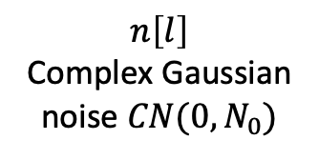
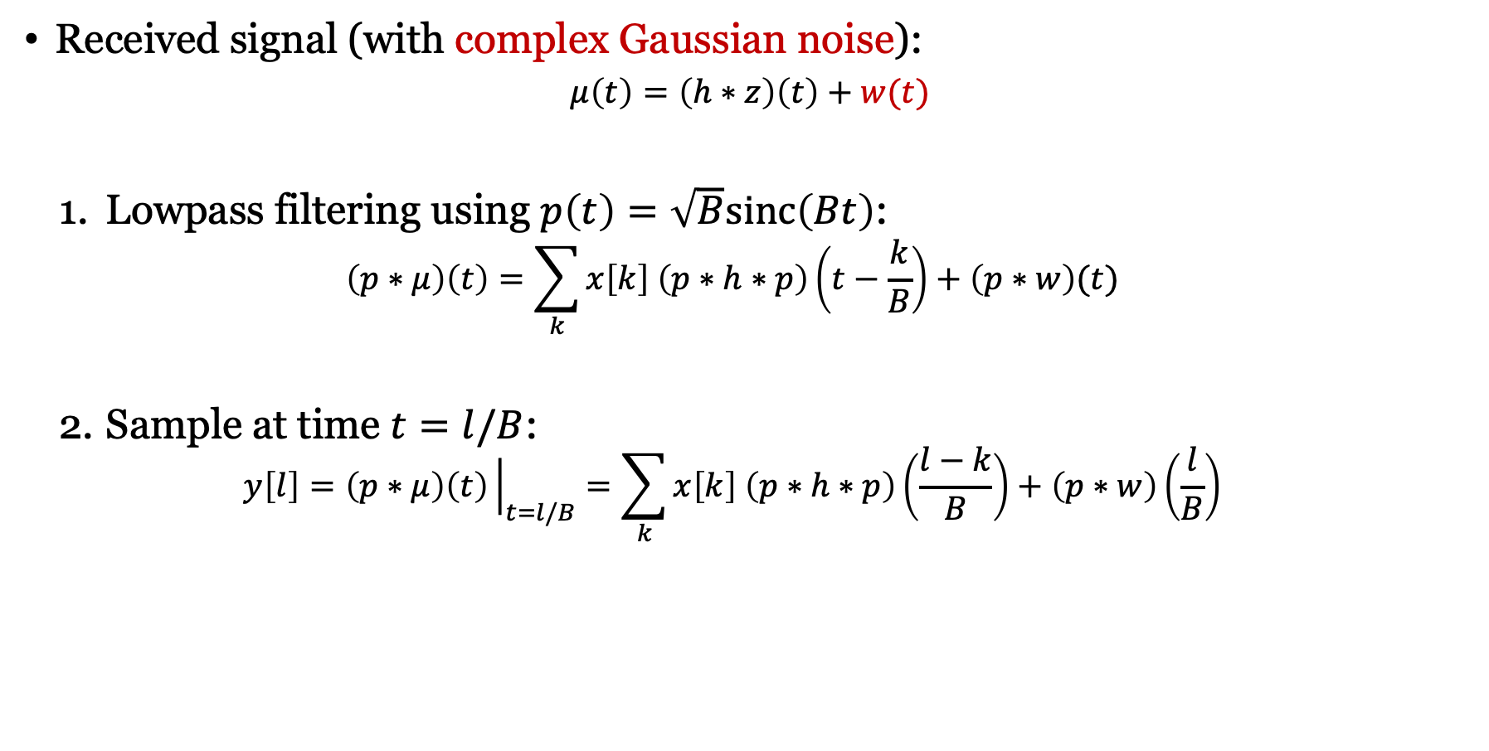
Reception with channel and noise
Received signal (with complex Gaussian noise):
$$μ\left(t\right)=\left(h∗z\right)\left(t\right)+w(t)$$
Lowpass filtering using $p\left(t\right)=\sqrt{B}sinc\left(Bt\right)$: $\left(p∗μ\right)\left(t\right)=\sum_{k}{x\left[k\right] \left(p∗h∗p\right)\left(t−\frac{k}{B}\right)}+\left(p∗w\right)(t)$
Sample at time $t=l/B$:
$$y\left[l\right]=\left(p∗\text{μ}\right)\left(t\right){\left.​\right|}_{t=l/B}=\sum_{k}{x\left[k\right] \left(p∗h∗p\right)\left(\frac{l−k}{B}\right)}+\left(p∗w\right)\left(\frac{l}{B}\right)$$
Effective pulse function
$$n\left[l\right]$$
Complex Gaussian noise $CN(0,N_{0})$
Channel with memory?

Slide 10
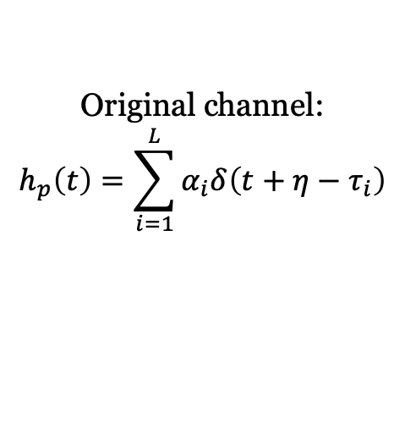
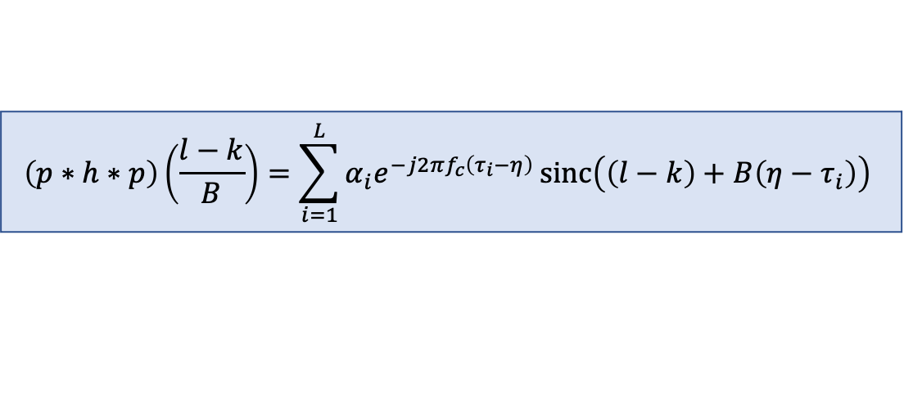
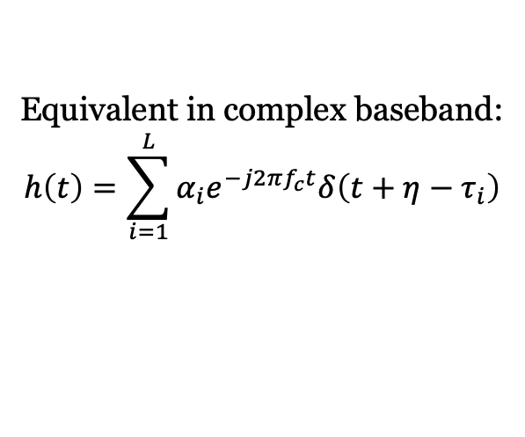
Revisiting channel model
Propagation delay
Original channel:
$$h_{p}\left(t\right)=\sum_{i=1}^{L}{α_{i}δ\left(t+η−τ_{i}\right)}$$
Amplitude loss
Synchronization
Equivalent in complex baseband:
$$h\left(t\right)=\sum_{i=1}^{L}{α_{i}e^{−j2πf_{c}t}δ\left(t+η−τ_{i}\right)}$$
$$\left(p∗h∗p\right)\left(\frac{l−k}{B}\right)=\sum_{i=1}^{L}{α_{i}e^{−j2πf_{c}\left(τ_{i}−η\right)}}sinc\left(\left(l−k\right)+B\left(η−τ_{i}\right)\right)$$

Slide 11

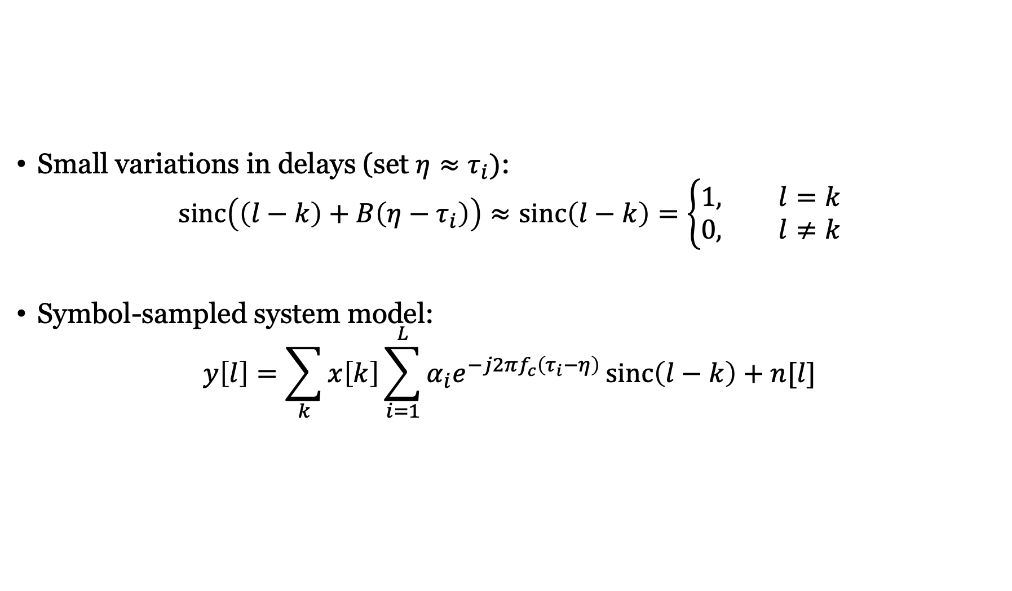
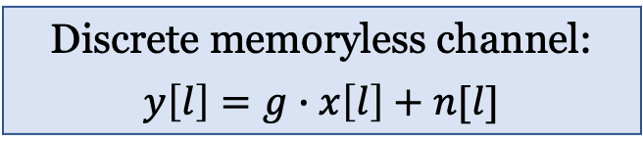
Narrowband assumption
Small variations in delays (set $η≈τ_{i})$:
$$sinc\left(\left(l−k\right)+B\left(η−τ_{i}\right)\right)≈sinc\left(l−k\right)=\left\{\begin{aligned}1, l=k \\ 0, l≠k\end{aligned}\right.$$
Symbol-sampled system model:
$$y\left[l\right]=\sum_{k}{x\left[k\right]\sum_{i=1}^{L}{α_{i}e^{−j2πf_{c}\left(τ_{i}−η\right)}}sinc\left(l−k\right)}+n[l]$$
$$g$$
Discrete memoryless channel:
$$y\left[l\right]=g∙x\left[l\right]+n[l]$$

Slide 12
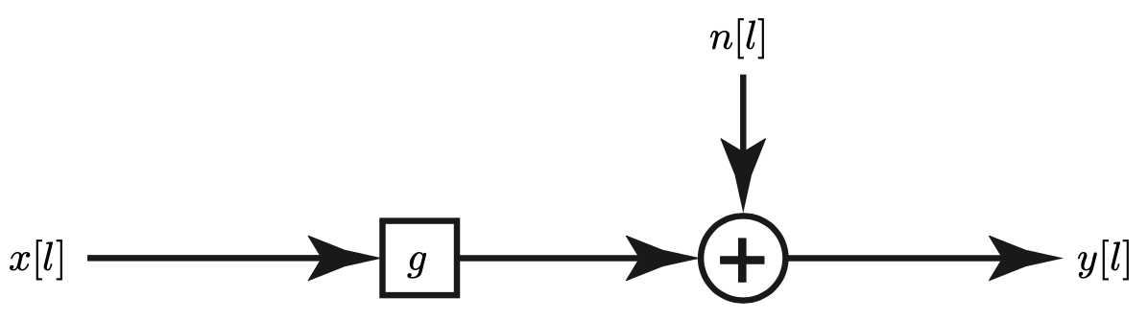
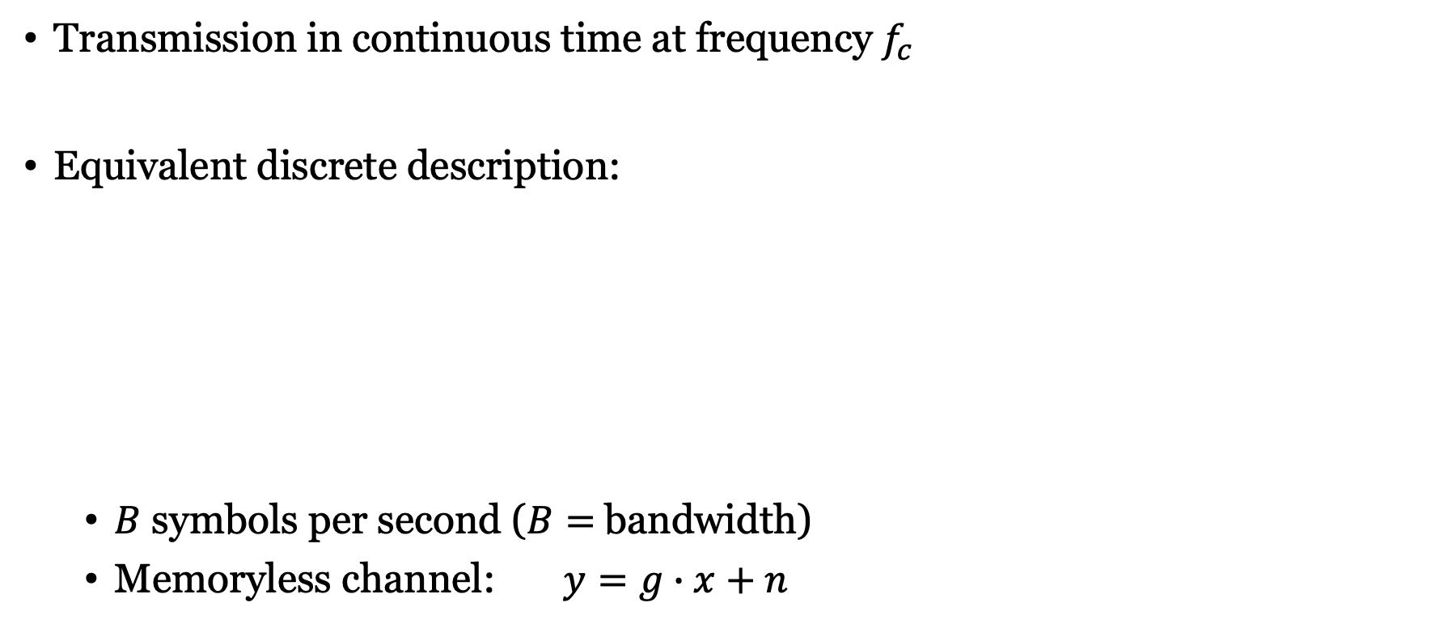

Summary
Transmission in continuous time at frequency $f_{c}$
Equivalent discrete description:
$B$ symbols per second ($B=$bandwidth)
Memoryless channel: $y=g∙x+n$
$$\sim CN(0,N_{0})$$

Slide 13
Multiple Antenna Communications
Background Lecture:
Complex Baseband Model
Emil Björnson

