Slide 1

Hardware Impairments in Large-scale MISO Systems
Energy Efficiency, Estimation, and Capacity Limits
Emil Björnson‡*, Jakob Hoydis†, Marios Kountouris‡, and Mérouane Debbah‡
‡Alcatel-Lucent Chair on Flexible Radio and Department of Telecommunications, Supélec, France
†Bell Laboratories, Alcatel-Lucent, Stuttgart, Germany
*Signal Processing Lab, KTH Royal Institute of Technology, Sweden

Slide 2
Introduction

Slide 3

Challenge of Network Traffic Growth
Data Dominant Era
66% annual traffic growth
Exponential increase!
Is this Growth Sustainable?
User demand will increase
Increased traffic supply only if network revenue is sustained!
Continuous Network Evolution
What will be the next step?
Source: Cisco Visual Networking Index

Slide 4
What Will Be Next Steps?
More Frequency Spectrum
Scarcity in conventional bands: Use mmWave, cognitive radio
Joint optimization of current networks (Wifi, 2G/3G/4G)
Improved Spectral Efficiency
More antennas/km² (space division multiple access)
What Limits the Spectral Efficiency?
Propagation losses and transmit power
Channel capacity
Channel estimation accuracy (inter-user interference)
Signal processing complexity
Our Focus:

Slide 5

New Paradigm: Large Antenna Arrays
Remarkable New Network Architecture
Deploy large arrays at macro base stations
Everything Seems to Become Better [1]
Large array gain (improves channel conditions)
Higher capacity (more antennas → more users)
Orthogonal channels (little inter-user interference)
Linear processing optimal (low complexity)
Properties Proved by Asymptotic Analysis
Are conventional models applicable?
[1] F. Rusek, D. Persson, B. Lau, E. Larsson, T. Marzetta, O. Edfors, F. Tufvesson, “Scaling up MIMO: Opportunities and challenges with very large arrays,” IEEE Signal Process. Mag., 2013.

Slide 6
Transceiver Hardware Impairments
Physical Hardware is Non-Ideal
Oscillator phase noise
Amplifier non-linearity
IQ imbalance in mixers, etc.
Impact of Hardware Impairments
Mismatch between the intended and emitted signal
Distortion of received signal
Limits capacity in high-SNR regime [2]
[2]: E. Björnson, P. Zetterberg, M. Bengtsson, B. Ottersten, “Capacity Limits and Multiplexing Gains of MIMO Channels with Transceiver Impairments,” IEEE Communications Letters, 2013
What happens in many-antennas regime?
Will everything still get better?

Slide 7
Channel Model with Hardware Impairments

Slide 8
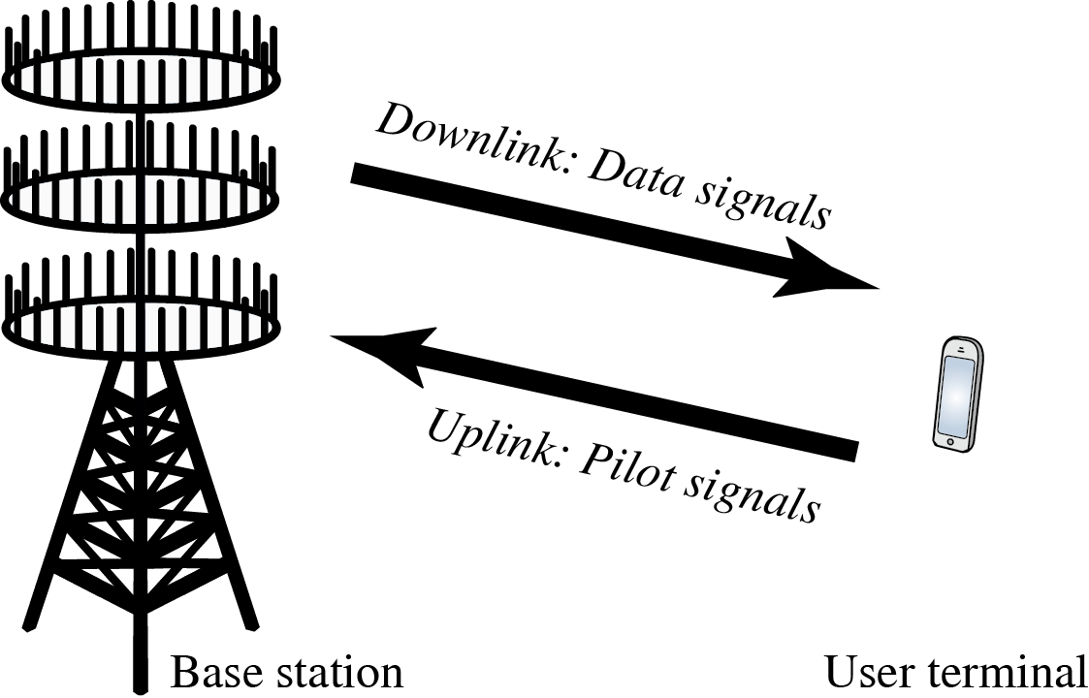
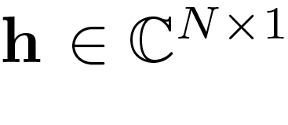
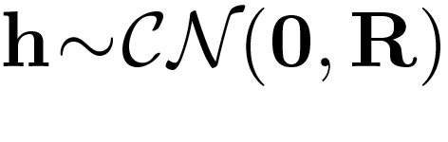
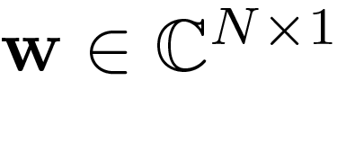
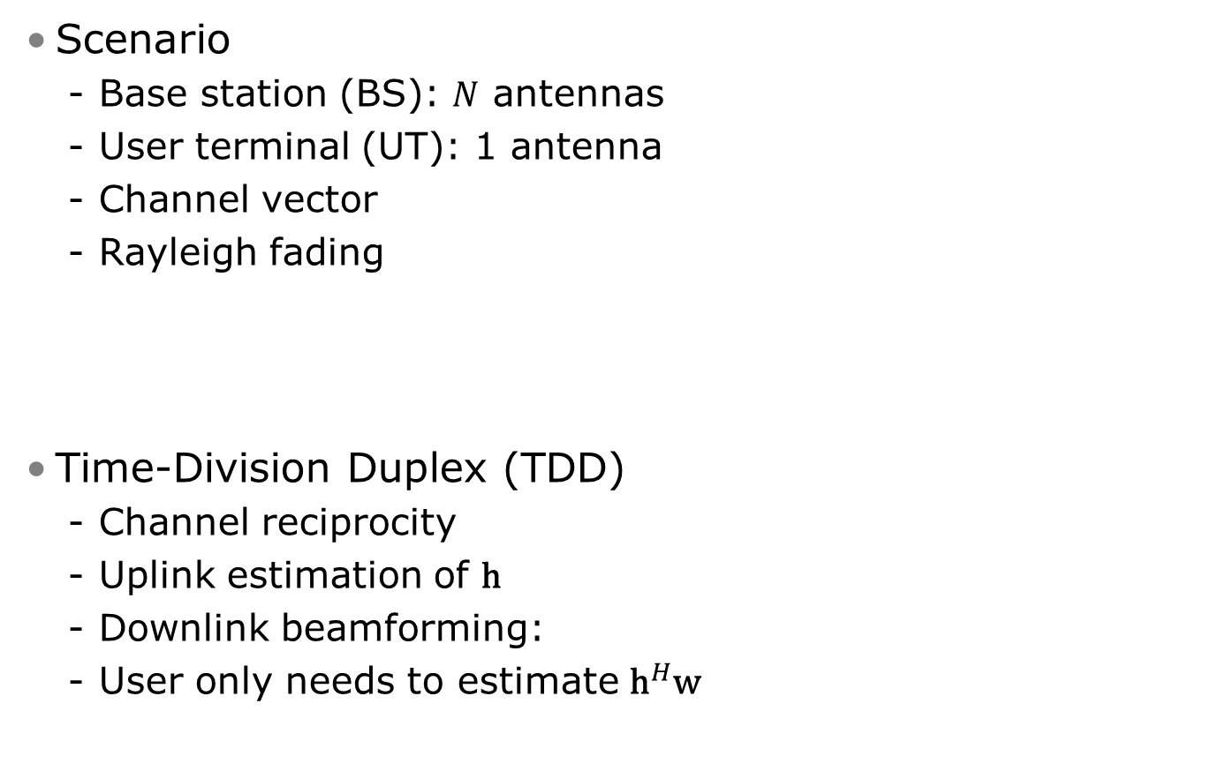
Our Focus: Point-to-Point Channel
Scenario
Base station (BS): $N$ antennas
User terminal (UT): 1 antenna
Channel vector
Rayleigh fading
Time-Division Duplex (TDD)
Channel reciprocity
Uplink estimation of $\text{h}$
Downlink beamforming:
User only needs to estimate ${\text{h}}^{H}\text{w}$

Slide 9
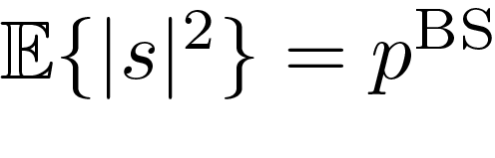
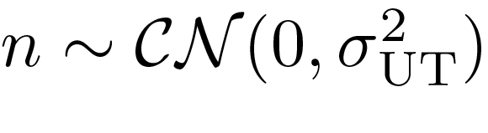
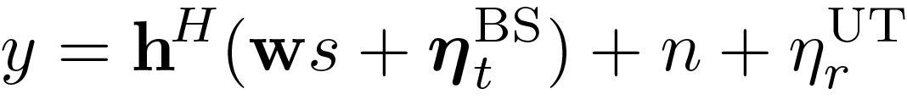
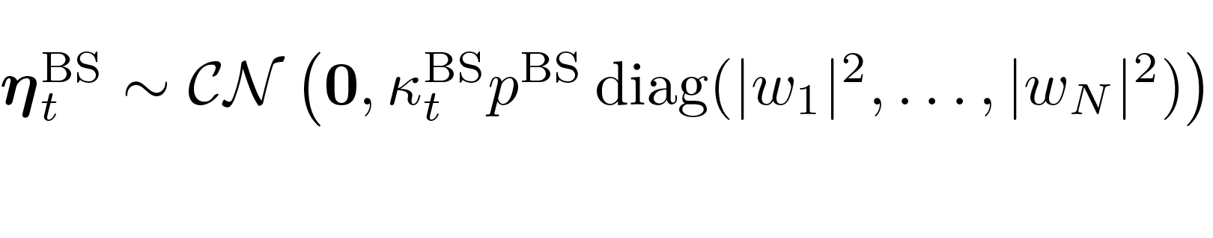
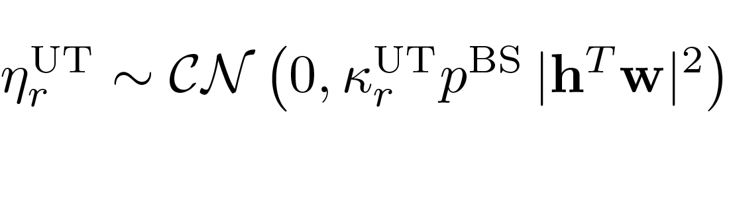
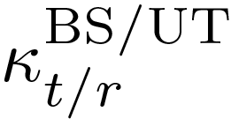
Generalized Channel Model
Uplink:
Analogous
generalization
Received Downlink Signal
[3]: T. Schenk, RF Imperfections in High-Rate Wireless Systems: Impact and Digital Compensation. Springer, 2008
Data Signal:
Noise:
Transmitter Distortion
Receiver Distortion
Distortion Noise per Antenna
Proportional to transmitted/received signal power
4 Prop. Constants: BS or UT, transmit or receive

Slide 10
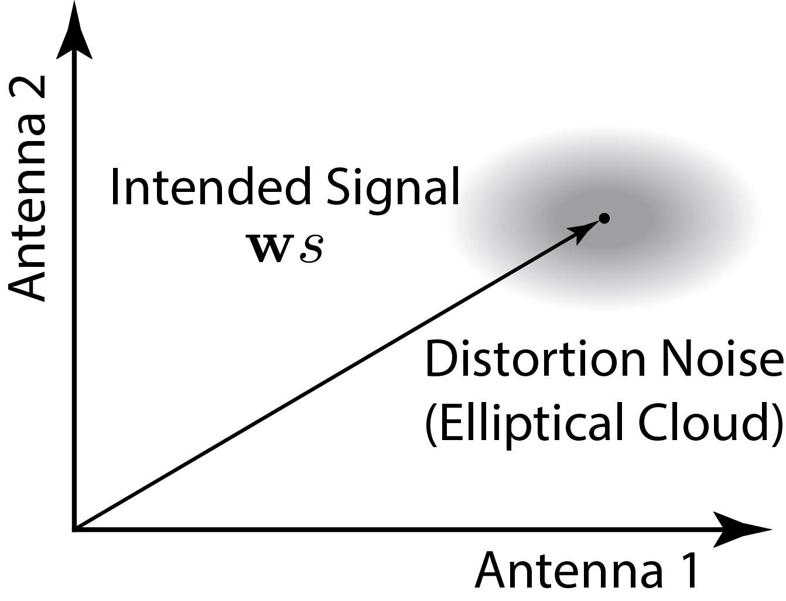
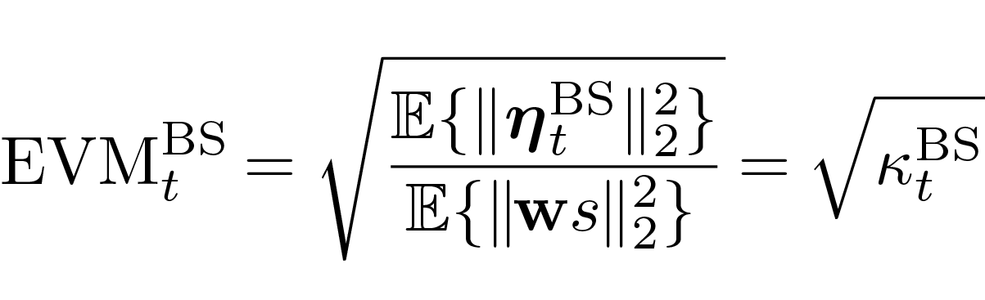
Interpretation of Distortion Model
Gaussian Distortion Noise
Independent between antennas
Depends on beamforming
Still uncorrelated directivity → Little in the signal dimension
Error Vector Magnitude (EVM)
Quality of transceivers:
LTE requirements: 0≤EVM≤0.17 (smaller → higher rates)
Distortion will not vanish at high SNR!

Slide 11
Main Contribution

Slide 12
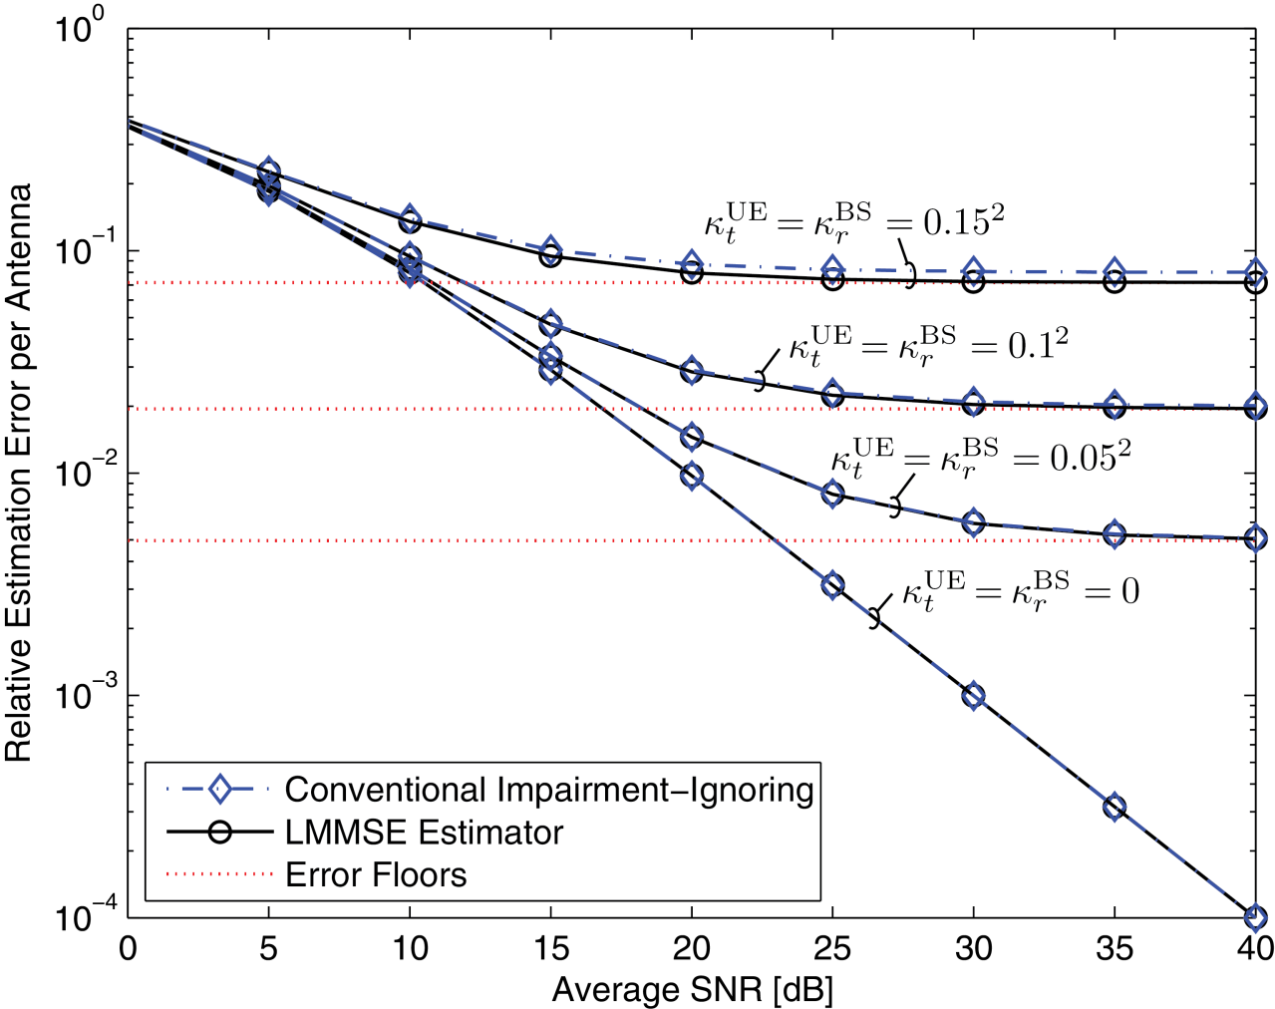
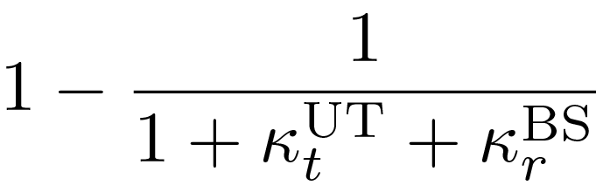

Contribution 1: Channel Estimation
New Linear MMSE Estimator
Distortion noise is correlated with channel
Normalized MSE is independent of $N$
New Insights
Low SNR: Small difference
High SNR: Error floor
Error floor for i.i.d. channels:
Characterized by impairments!
Very different MSE but no need to change estimator

Slide 13
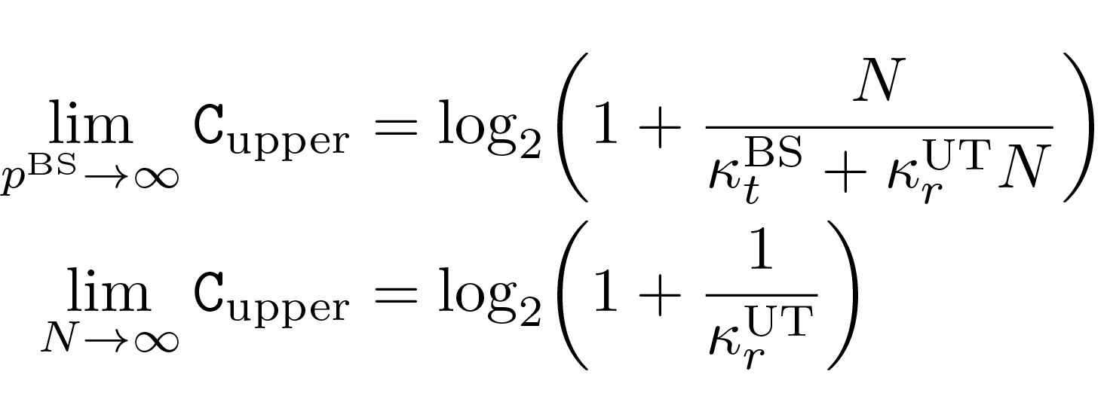
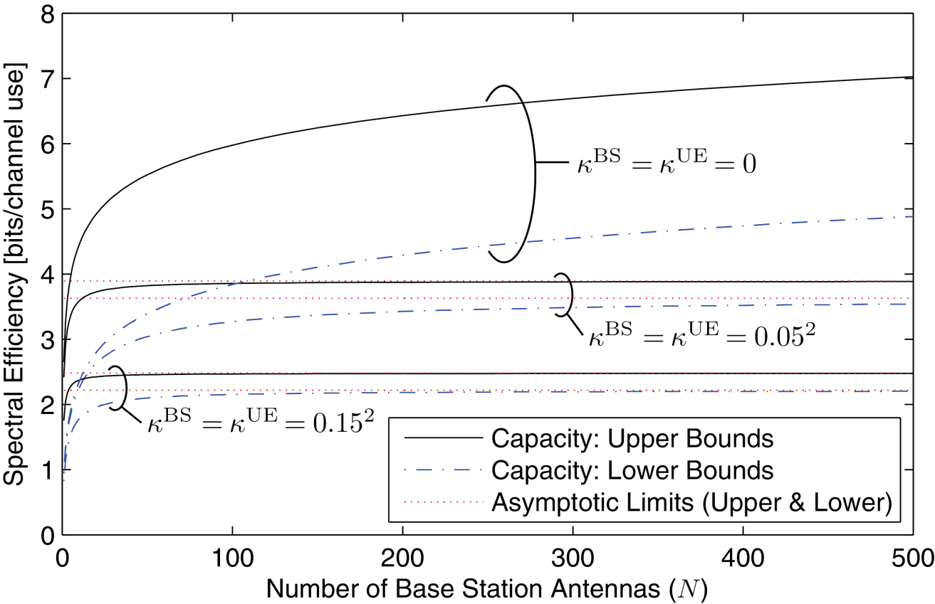
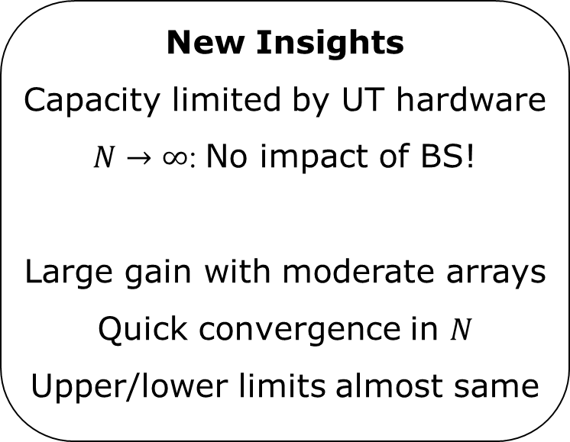
Contribution 2: Capacity Limits
Explicit Capacity Bounds
Upper: Channel is known
Lower: LMMSE estimator
Asymptotic limits:
New Insights
Capacity limited by UT hardware
$N→∞$: No impact of BS!
Large gain with moderate arrays
Quick convergence in $N$
Upper/lower limits almost same

Slide 14
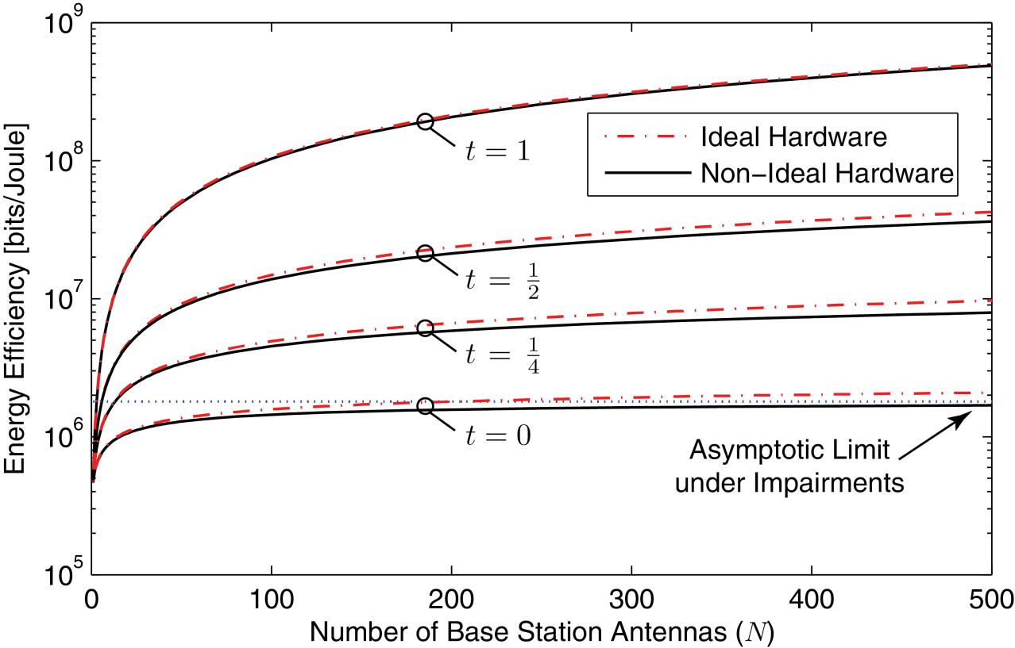
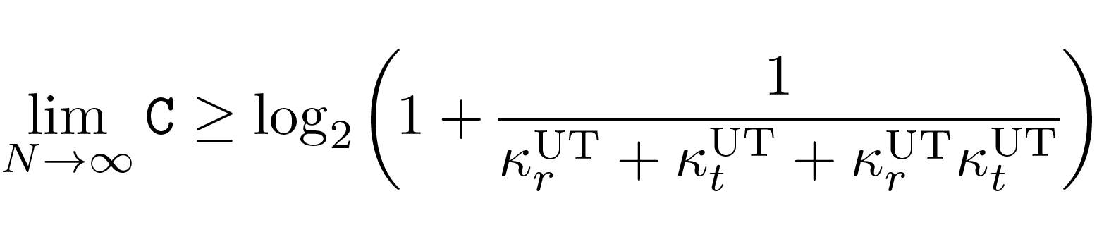
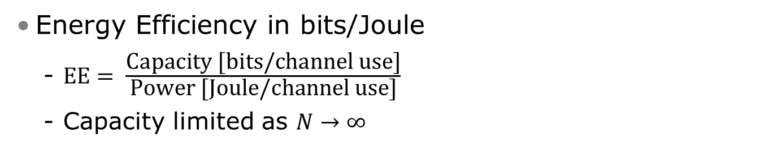

Contribution 3: Energy Efficiency
Theorem
Reduce power as $\frac{1}{N^{t}}, t<\frac{1}{2}$
Non-zero capacity as $N→∞$
Energy Efficiency in bits/Joule
$\text{EE}= \frac{\text{Capacity}\text{ [}\text{bits}\text{/}\text{channel} \text{use}\text{]}}{\text{P}\text{ower}\text{ [}\text{Joule}\text{/}\text{channel} \text{use}\text{]}}$
Capacity limited as $N→∞$
New Insights
Power reduction from array gain
Same as with ideal hardware!
Capacity lower bounded by
EE grows without bound!

Slide 15
Conclusions & Outlook

Slide 16
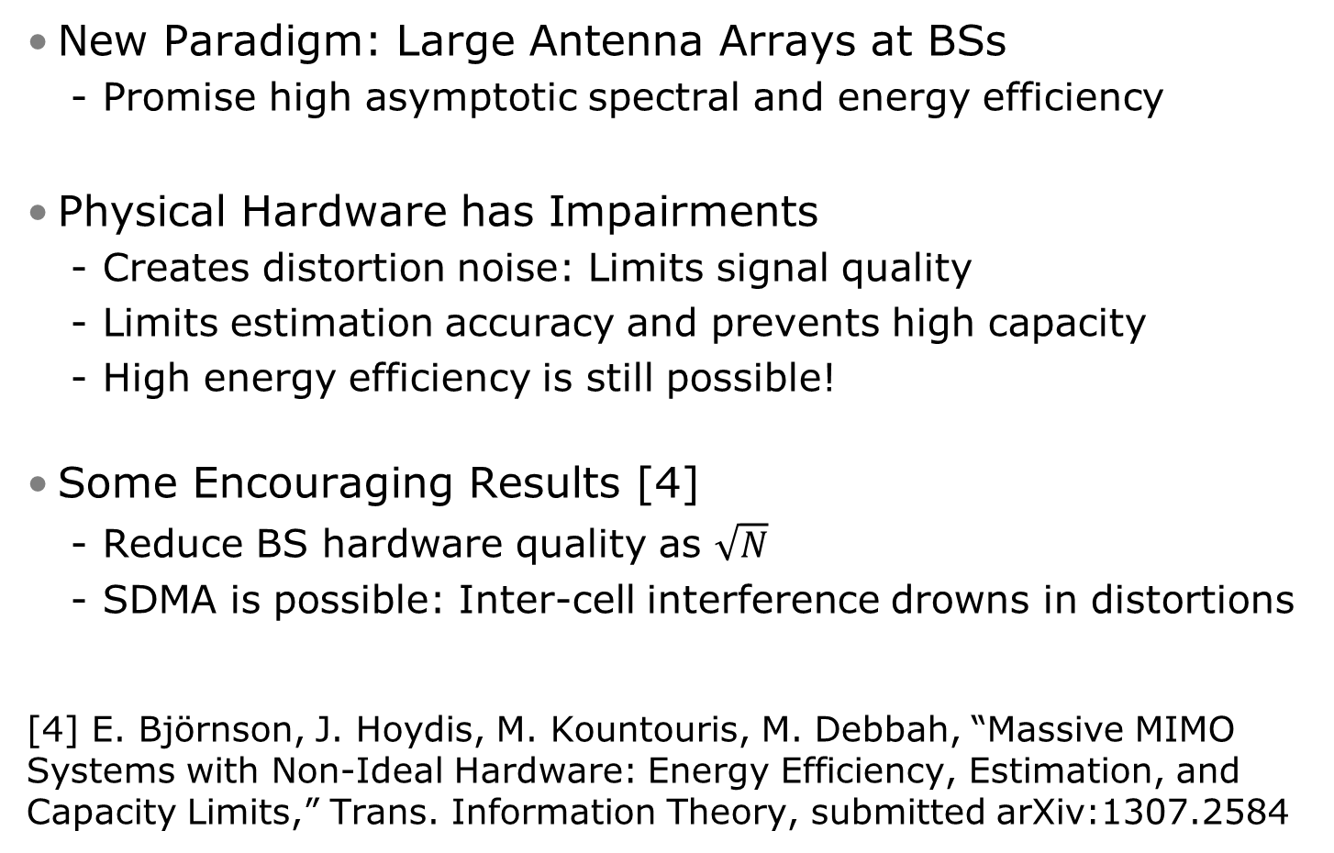
Conclusions
New Paradigm: Large Antenna Arrays at BSs
Promise high asymptotic spectral and energy efficiency
Physical Hardware has Impairments
Creates distortion noise: Limits signal quality
Limits estimation accuracy and prevents high capacity
High energy efficiency is still possible!
Some Encouraging Results [4]
Reduce BS hardware quality as $\sqrt{N}$
SDMA is possible: Inter-cell interference drowns in distortions
[4] E. Björnson, J. Hoydis, M. Kountouris, M. Debbah, “Massive MIMO Systems with Non-Ideal Hardware: Energy Efficiency, Estimation, and Capacity Limits,” Trans. Information Theory, submitted arXiv:1307.2584

Slide 17
Thank You for Listening!
Questions?
All Papers Available:
http://flexible-radio.com/emil-bjornson

