Slide 1
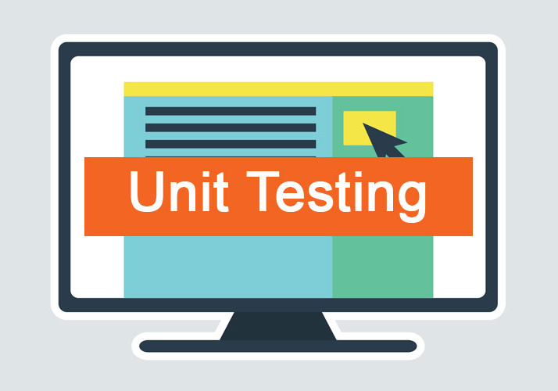
Unit Testing Methods
Unit Testing Concepts. Testing Frameworks. NUnit. Writing Your First Test with NUnit
SoftUni Team
Technical Trainers
Software University
https://softuni.bg

Slide 2
Table of Contents
͏Unit Testing and Testing Frameworks
͏NUnit Basics: Automated Testing with C# and NUnit
The AAA Pattern: Arrange, Act, Assert
͏Assertions in NUnit: Assert.That(…)
͏Code Coverage
͏Best Practices
2

Slide 3

What is Unit Testing?
Automated Testing of Software Components (Units)

Slide 4
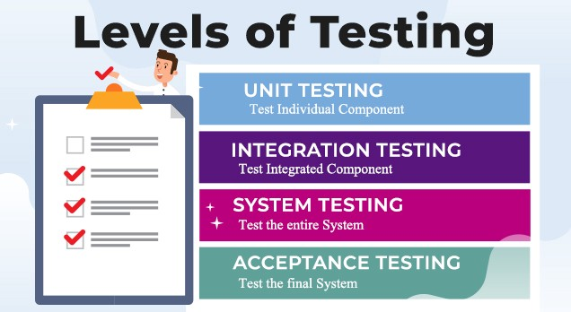
Test Levels
Unit tests
Test a single component
NUnit, JUnit, PyUnit, Mocha
Integration tests
Test an interaction between components, e. g. API tests
System tests / end-to-end tests
Test the entire system
Selenium, Appium, Cypress, Playwright

Slide 5
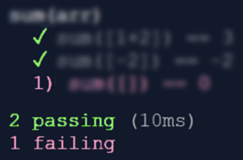
Unit Testing
Unit test == a piece of code that tests specific functionality in certain software component (unit)
int Sum(int[] arr)
{
int sum = 0;
foreach (int num in arr)
sum += num;
return sum;
}
void Test_SumTwoNumbers()
{
if (Sum(new[] {1, 2}) != 3)
throw new Exception(
"1+2=3!");
}

Slide 6
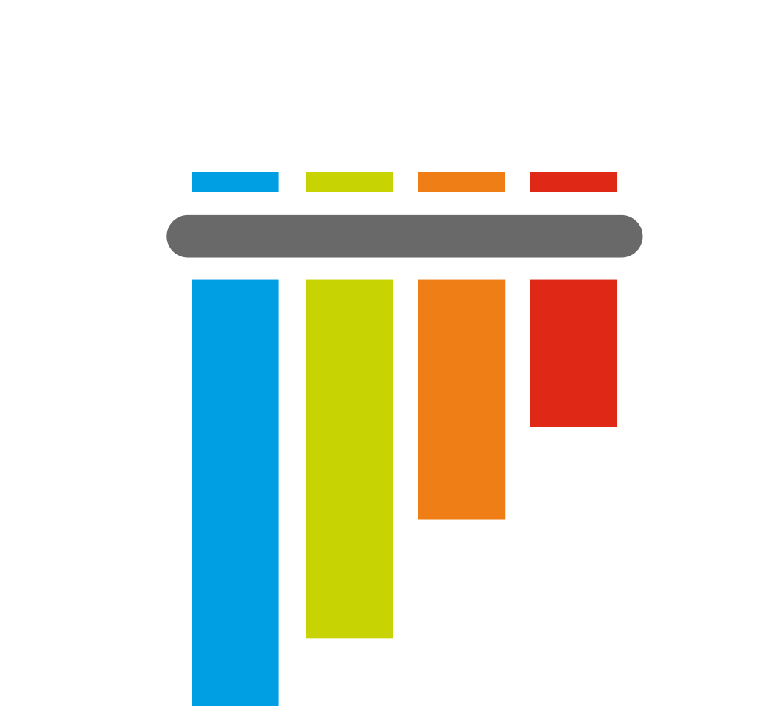




Testing Frameworks
Concepts

Slide 7




Testing Frameworks
Testing frameworks provide foundation for test automation
Structure the tests into hierarchical or other form
Create and run test cases, then make reports
Check the results and exit conditions
Perform initialization at startup and cleanup at shut down
Examples of testing frameworks:
NUnit, xUnit, MSTest (C#), Junit, TestNG (Java), Mocha, Jest (JS), PyTest (Python)

Slide 8
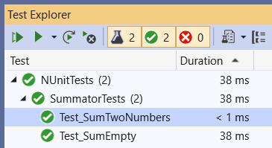
Testing Framework – Example
Testing frameworks simplify automated testing and reporting
Example: NUnit testing framework for C#
using NUnit.Framework;
public class SummatorTests
{
[Test]
public void Test_SumTwoNumbers()
{
var sum = Sum(new[] { 1, 2 });
Assert.AreEqual(3, sum);
}
}

Slide 9

NUnit: First Steps
Setup and First Test

Slide 10

Setup and First Test
NUnit == popular C# testing framework
Supports test suites, test cases, before & after code, startup & cleanup code, timeouts, expected errors, …
Free, open-source
Powerful and mature
Wide community
Built-in support in Visual Studio
Official site: nunit.org

Slide 11
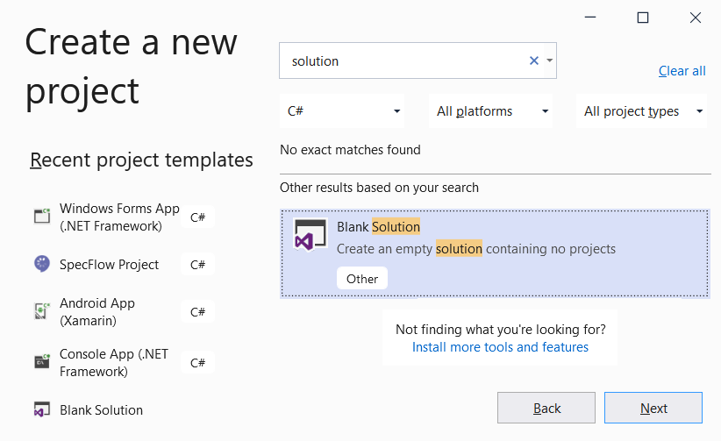
Creating a Blank Solution
Create a blank solution in Visual Studio
It will hold the project for testing
And the unit test project (tests)

Slide 12
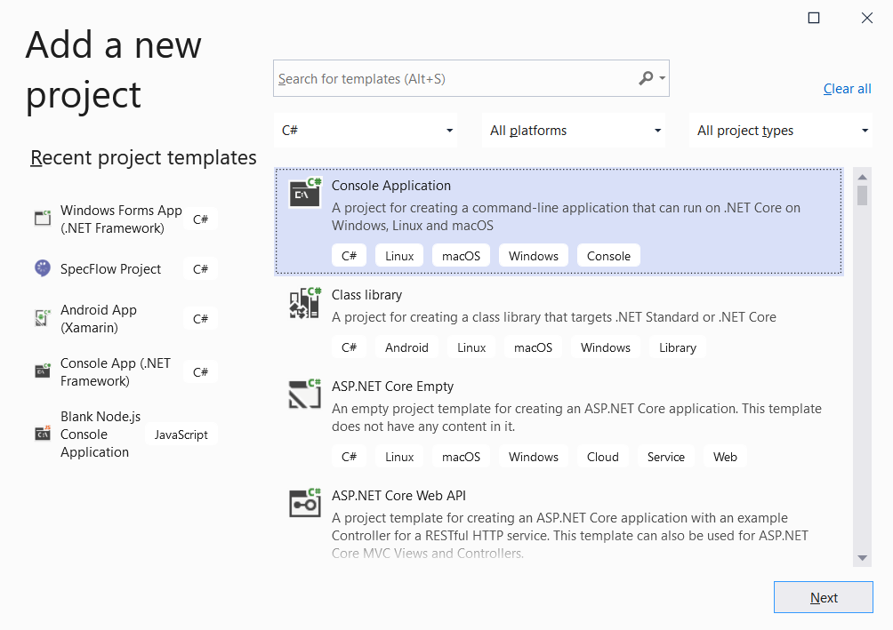
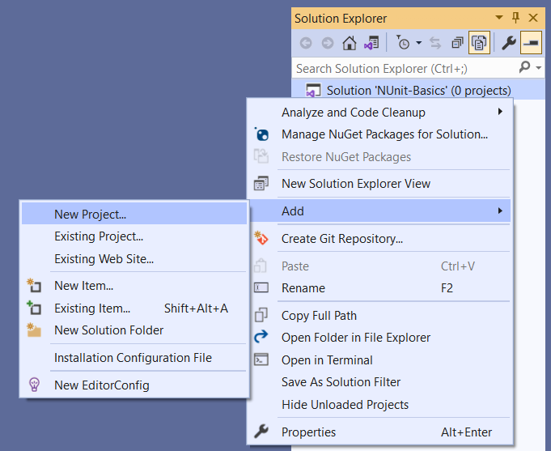
Creating a Project for Testing
Add a New Project in your Solution, to hold the code for testing

Slide 13
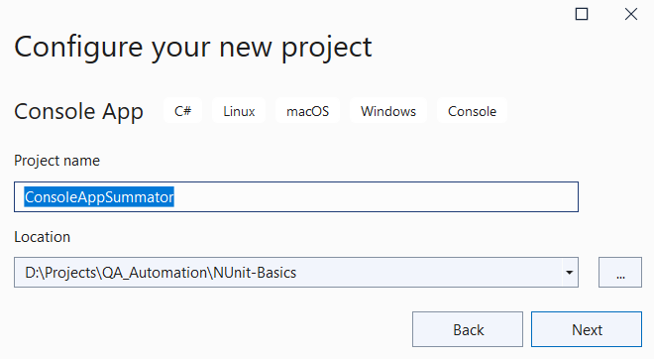
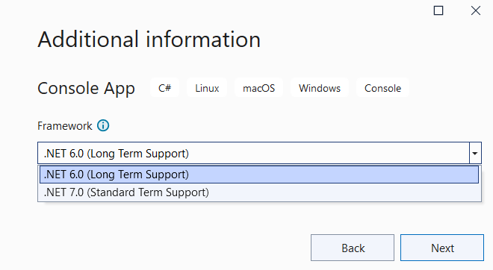
Creating a Project for Testing (2)
Choose a meaningful name for your project
Choose a place to store it
Use .NET 6.0
(Long Term Support)

Slide 14
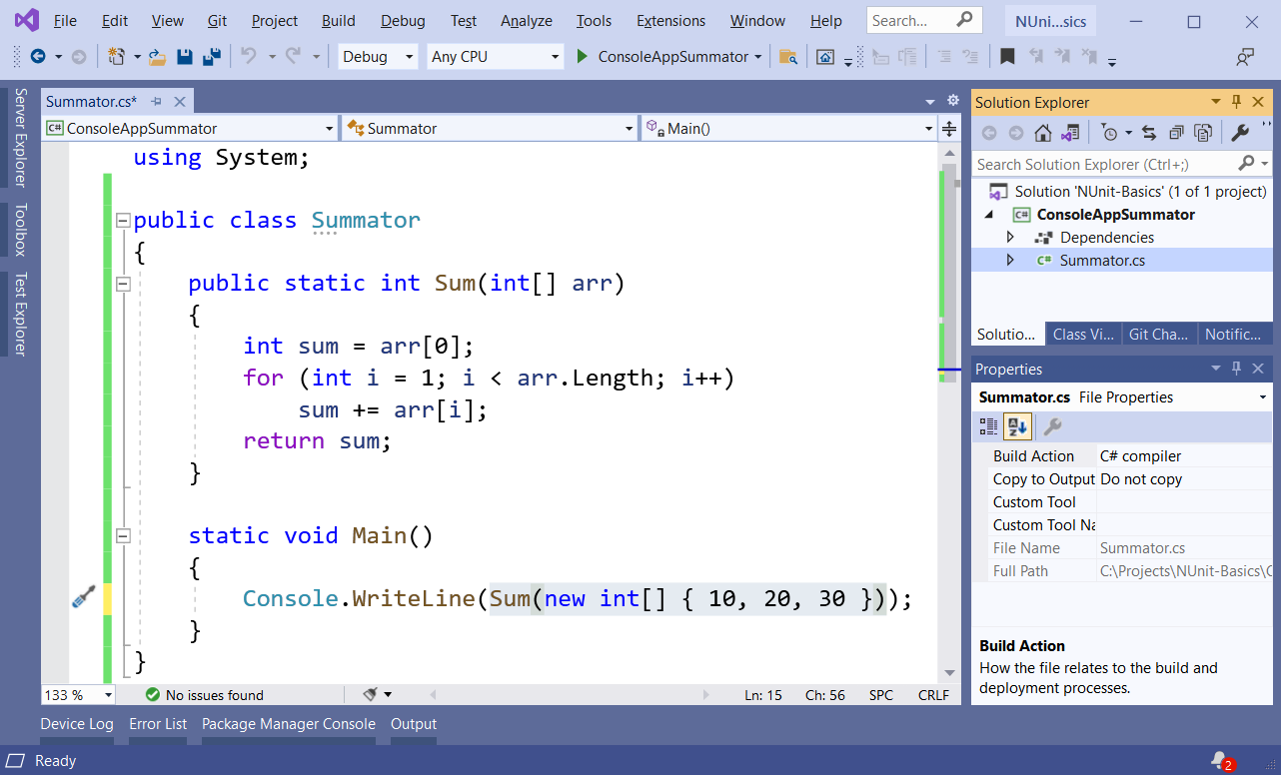
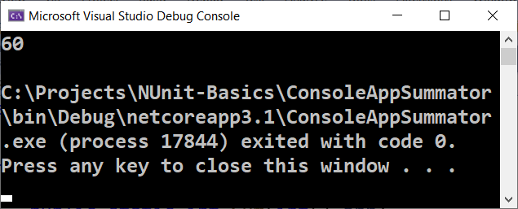
Creating a Project for Testing (3)

Slide 15
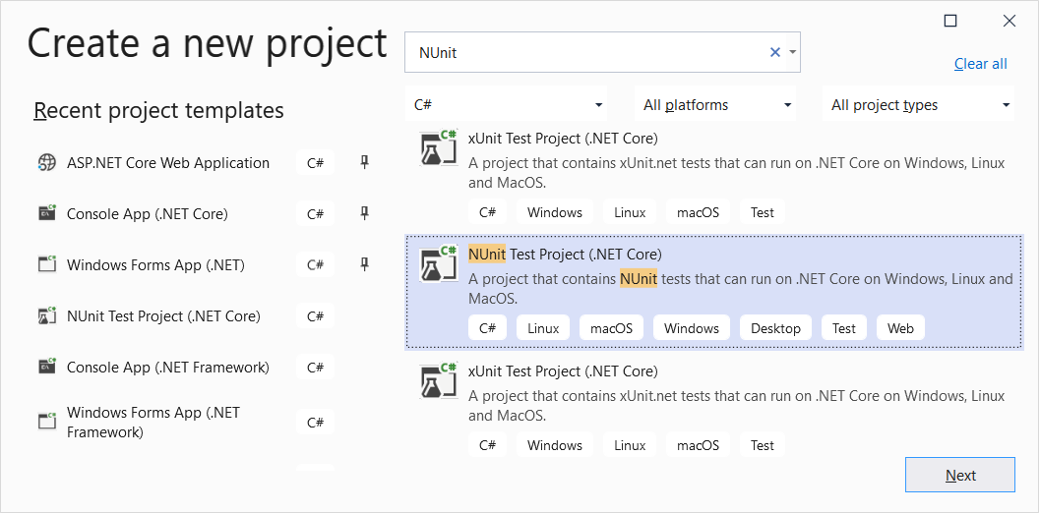
Creating a NUnit Project

Slide 16
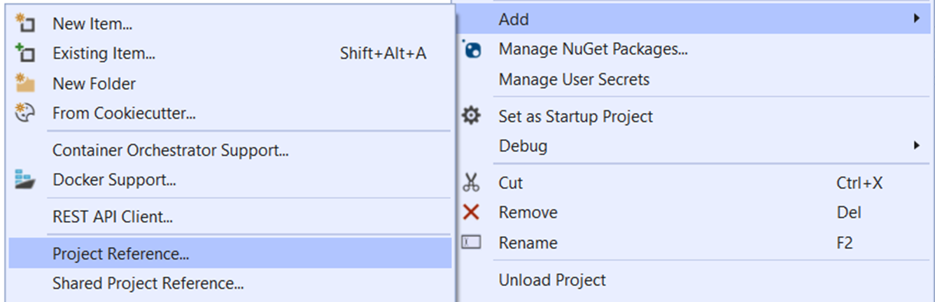
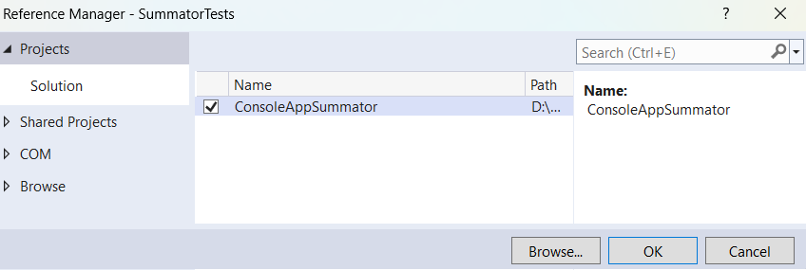
Adding Project Reference
Add Project Reference to target the project for testing:

Slide 17
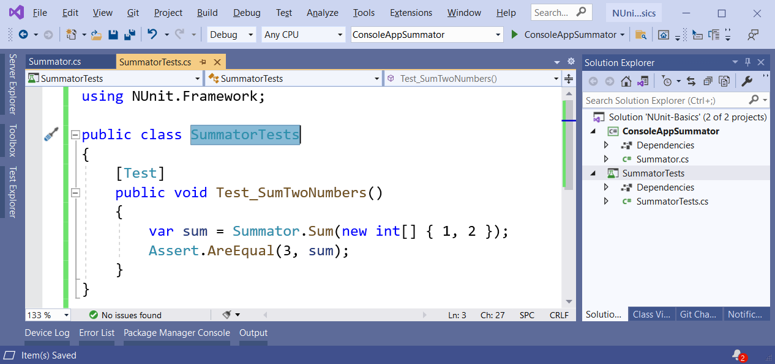
Writing your First Test
Writing a NUnit test method:

Slide 18
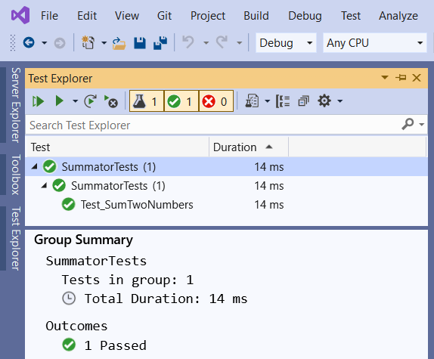
Test Explorer
The [Test Explorer] tool in Visual Studio
Open with [Ctrl + E] + T
Visualizes the hierarchy of tests
Executes tests
Reports results

Slide 19
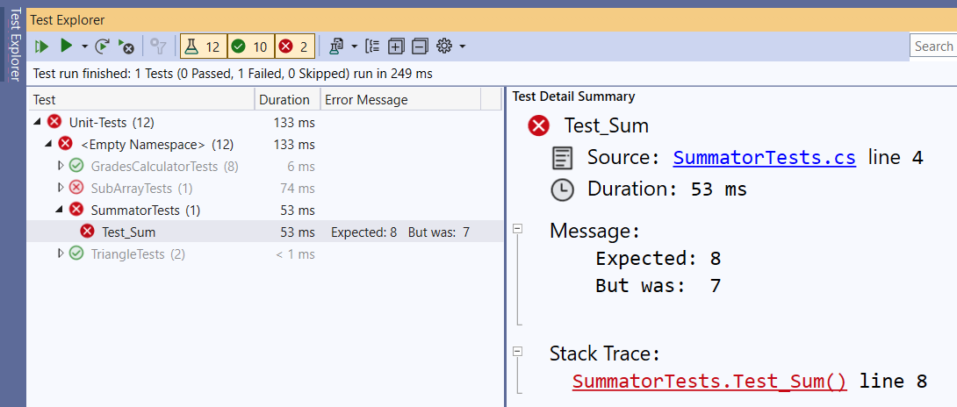
Failing Tests Produce Errors

Slide 20
NUnit: Basics
Test Classes and Test Methods

Slide 21
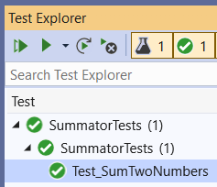
Test Classes and Test Methods
Test classes hold test methods:
Import NUnit
using NUnit.Framework;
public class SummatorTests
{
[Test]
public void Test_SumTwoNumbers() {
var sum = Sum(new int[] { 1, 2 });
Assert.AreEqual(3, sum);
}
}
Test class
Test method
Assertion

Slide 22
Initialization and Cleanup Methods
private Summator summator;
[SetUp] // or [OneTimeSetUp]
public void TestInitialize()
{
this.summator = new Summator();
}
[TearDown] // or [OneTimeTearDown]
public void TestCleanup()
{
// …
}
Executes before each test
Executes after each test

Slide 23
The "AAA" Pattern
AAA
Arrange → Act → Assert

Slide 24
The "AAA" Testing Pattern
Automated tests usually follow the "AAA" pattern
Arrange: prepare the input data
Act: invoke the action for testing
Assert: check the output received
[Test]
public void Test_SumNumbers()
{
// Arrange
int[] nums = new[] {3, 5};
// Act
int sum = Sum(nums);
// Assert
Assert.AreEqual(8, sum);
}

Slide 25
Assertions
Checking the Results and Output Conditions

Slide 26
Two Models of Assertions
Constraint Model (Assert.That)
The logic necessary to carry out each assertion is expressed as a constraint passed as the second parameter
Classic Model (Assert.AreEqual)
Assert.AreEqual, Assert.True, Assert.False, …
Uses a separate method to express each individual assertion:
Assert.That(expected, Is.EqualTo(actual));
Assert.AreEqual(expected, actual);

Slide 27
Assertions
Assert that condition is true
Comparison (equal, greater than, less than or equal, …)
Assertions for expected exception
Assert.That(bool condition);
Assert.That(actual, Is.EqualTo(expected));
Assert.AreEqual(expected, actual);
Assert.That(() => { code },
Throws.InstanceOf<ArgumentOutOfRangeException>());

Slide 28
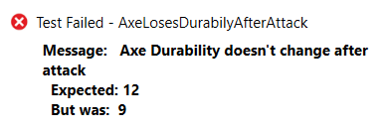
Assertion Messages
Assertions can show messages to helps with diagnostics
Assert.That(axe.DurabilityPoints, Is.EqualTo(12),
"Axe Durability doesn't change after attack");
Failure messages in the tests help finding the problem

Slide 29

Unit Testing Best Practices
Naming, Repeatable, No Dependencies

Slide 30


Naming the Test Methods
Test names should answer the question "what's inside?"
Should use business domain terminology
Should be descriptive and readable
IncrementNumber() {}
Test1() {}
TestTransfer() {}
Test_DepositAddsMoneyToBalance() {}
Test_DepositNegativeShouldNotAddMoney() {}
Test_TransferSubtractsFromSourceAddsToDestAccount() {}

Slide 31
Automation Tests: Good Practices
Test cases must be repeatable
Tests should behave the same if you run them many times
The expected results must be consistent and easily verified
Test cases should have no dependencies
The order of test execution should never be important
Input data and entrance conditions should be set in the test
Test cases may depend on the test initialization only: [SetUp]
Tests should cleanup properly any resources used

Slide 32
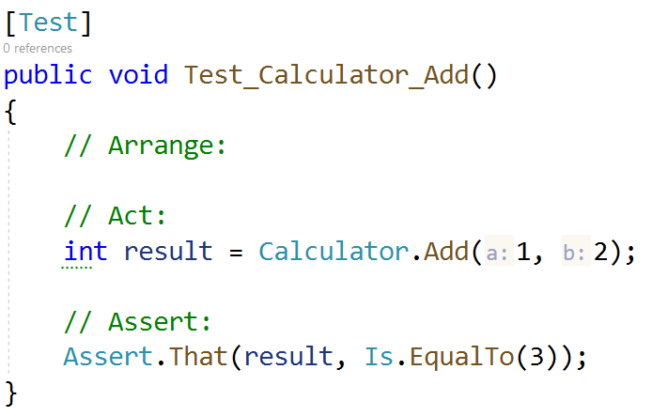
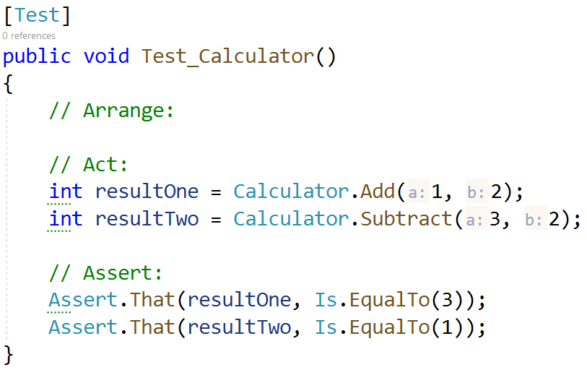

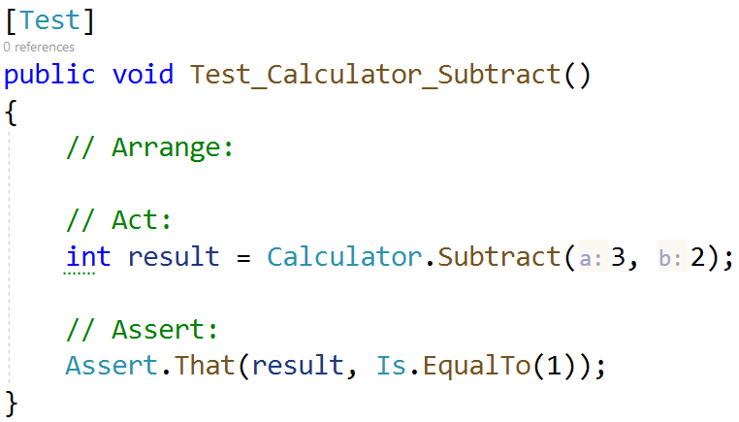
Automation Tests: Good Practices (2)
Single scenario per test case, not multiple

Slide 33

Summary
Unit testing - automated testing of single component (unit)
NUnit – automated testing framework for C#
[Test], Assert, [SetUp], [TearDown]
The AAA pattern: Arrange, Act, Assert
Assertion – checking results / exit conditions
Best practices – naming and conventions
Notes:
33

Slide 34









Questions?

Slide 35













SoftUni Diamond Partners

Slide 36
Trainings @ Software University (SoftUni)
Software University – High-Quality Education, Profession and Job for Software Developers
softuni.bg, about.softuni.bg
Software University Foundation
softuni.foundation
Software University @ Facebook
facebook.com/SoftwareUniversity
Software University Forums
forum.softuni.bg
36
Notes:
36

Slide 37

License
This course (slides, examples, demos, exercises, homework, documents, videos and other assets) is copyrighted content
Unauthorized copy, reproduction or use is illegal
© SoftUni – https://about.softuni.bg
© Software University – https://softuni.bg
Notes:
37

