Slide 1

AI Agent protocols for 6G systems draft-stephan-ai-agent-6g-00
July 2025

Slide 2
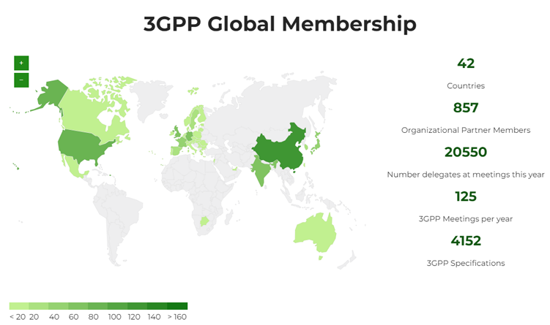
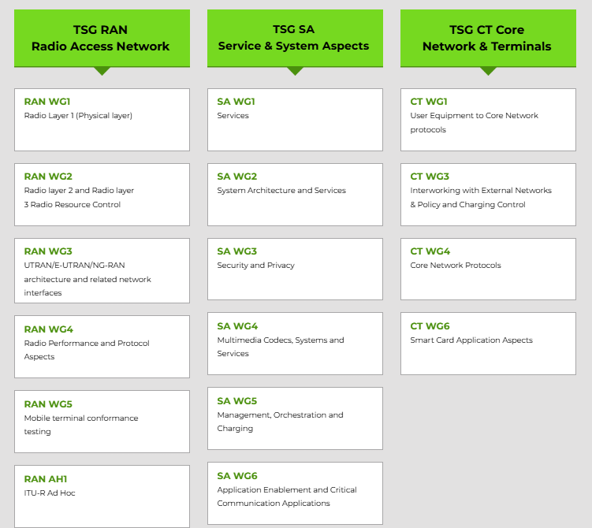
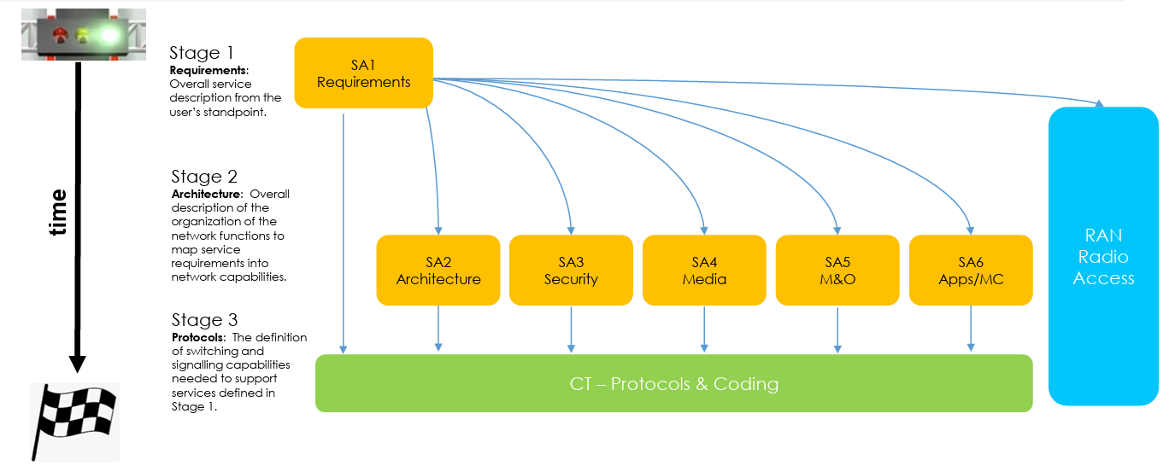
3GPP
3GPP specifications cover cellular telecommunications technologies, including radio access, core network and service capabilities, which provide a complete system description for mobile telecommunications.
3GPP produces Technical Specifications, to be transposed by seven Standardization Bodies (ARIB, ATIS, CCSA, ETSI, TDSI, TTA, TTC) into their appropriate deliverables (e.g., standards).
https://www.3gpp.org/about-us/introducing-3gpp

Slide 3
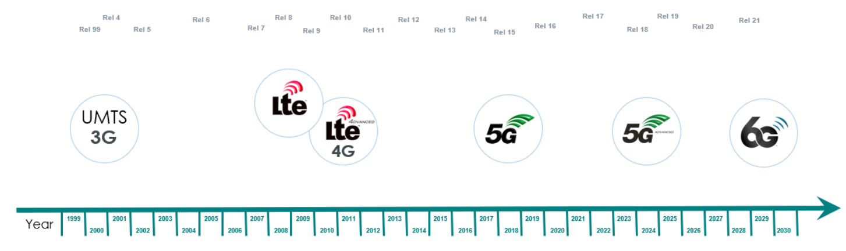
3GPP Releases and Generations
https://www.3gpp.org/about-us/introducing-3gpp

Slide 4
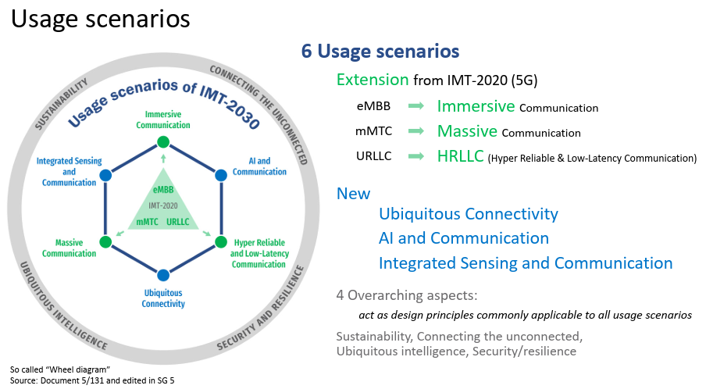
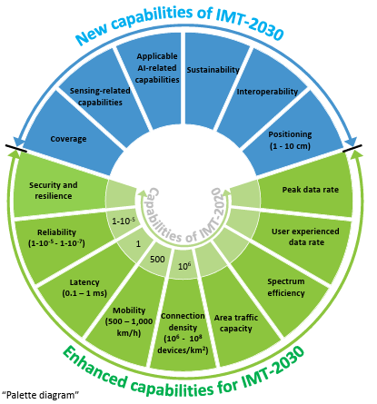
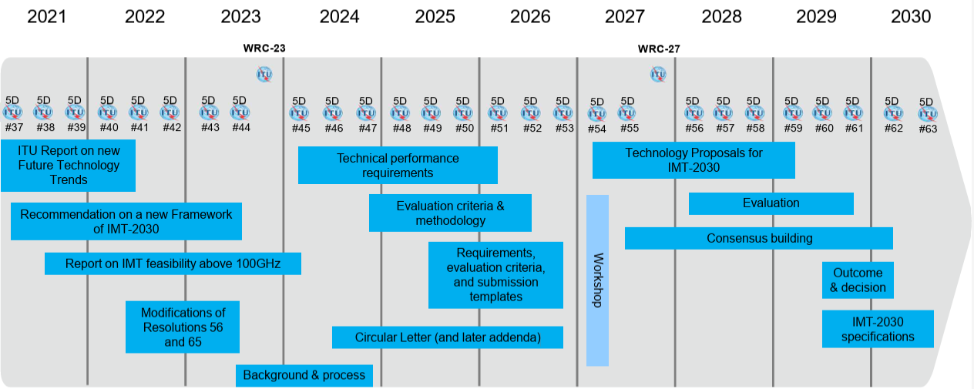
6G Roadmap: ITU-R IMT 2030
ITU-R has commenced the process of developing ITU-R Recommendations for the terrestrial components of the IMT-2030 radio interface(s), i.e., 6G.
6G is expected to provide enhanced capabilities compared to those described for IMT-2020 (aka 5G), as well as new capabilities to support the expanded usage scenarios of IMT-2030.
3GPP will submit a proposal for a 6G system (Radio+Core)

Slide 5
3GPP 6G workplan
2024
2025
2026
2027
2028
2029
*
Feasibility Study Phase (Rel-20)
Normative Phase (Rel-21)
Service requirements
Service requirements
Architecture
Architecture
Security
Security
Media
Media
O&M
O&M
Application Enablers
Application Enablers
Protocols
Protocols
*Exact timeline for Rel-21 TBD

Slide 6
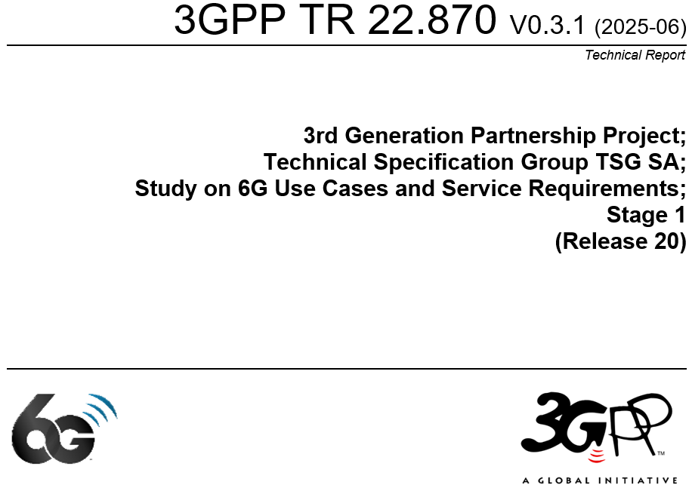
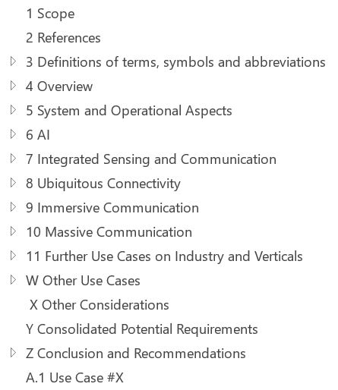
Study on 6G Use Cases and Service Requirements
6G Use Cases and Service Requirements captured in 3GPP TR 22.870 (https://www.3gpp.org/dynareport/22870.htm)
Initiated 2024/12 for completion expected by 2026/03
Objectives:
Identify high level principles and use cases
based on, but not limited to, IMT-2030 usage scenarios
Define potential requirements for 6G system to support new/enhanced services
Status: at an early stage and study being still a work in progress
Anyway, useful insights on the potential foundation pillars of the new 6G system.
AI and AI agents are clearly hot topics

Slide 7
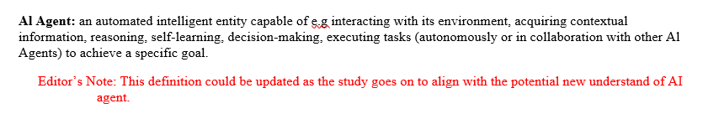
"AI Agent" as defined in the TR 22.870

Slide 8
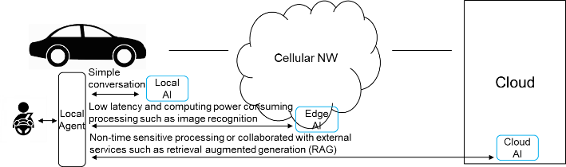
Example 1 (for illustration): end-to-end AI for connected cars
In-vehicle local agent collaborating with Edge AI and cloud agents to provide services to the end-users

Slide 9
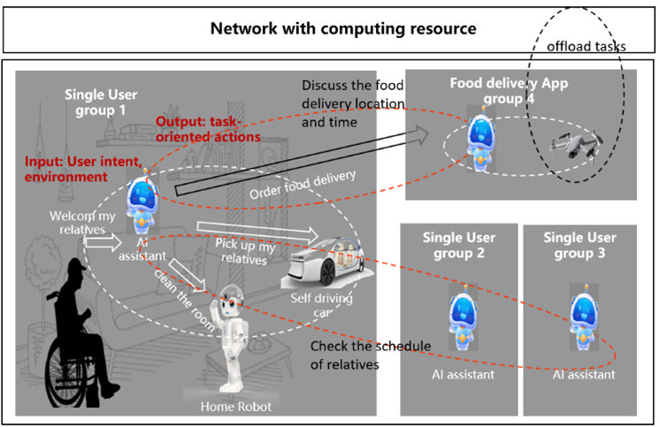
Example 2 (for illustration): AI-agents group communication
AI agents from distinct groups collaborating inside temporary communication domain to complete with each other for a specific task during a specific time.

Slide 10
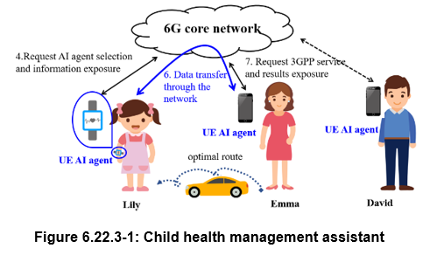
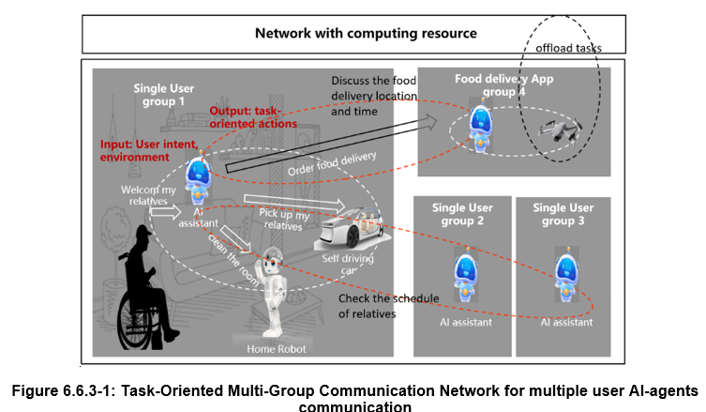
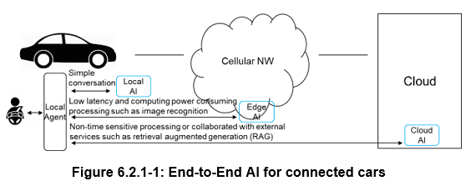

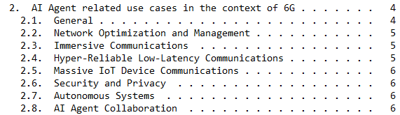
Objectives of the draft
From use cases described in the TR 22.870
Highlight AI Agent communication scenarios

Slide 11
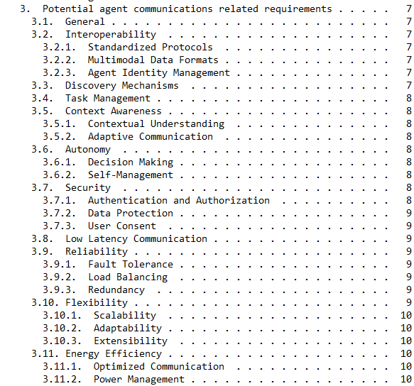

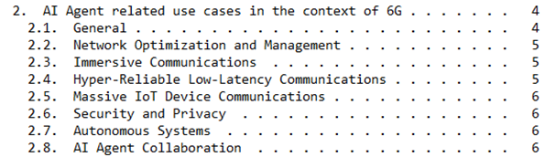
Objectives of the draft
Potential key requirements derived from the illustrative use cases

Slide 12



Potential Key Requirements 1/3
Interoperability
Standardized Protocols: Ensuring seamless interaction across platforms.
Multimodal Data Formats: Supporting text, files, audio, and video.
Agent Identity Management: Secure identification and verification.
Discovery Mechanisms
Dynamic identification and location of AI agents and tools.
Combining multiple discovery mechanisms for efficiency.
Task Management
Task decomposition, assignment, scheduling, and coordination.
Importance of seamless collaboration among agents.
Prospect

Slide 13



Potential Key Requirements 2/3
Context Awareness
Contextual Understanding: Awareness of operational context.
Adaptive Communication: Adapting communication based on context.
Autonomy
Decision Making: Autonomous and collaborative decisions.
Self-Management: Self-configuration, optimization, and healing.
Security
Authentication and Authorization: Identity verification and access control.
Data Protection: Encryption for privacy and confidentiality.
User Consent: Mechanisms for secure data exchange.
Prospect

Slide 14




Potential Key Requirements 3/3
Low Latency Communication
Importance of minimal delay in data transmission.
Critical for real-time applications.
Reliability
Fault Tolerance: Detecting, mitigating, and recovering from anomalies.
Load Balancing: Distributing tasks to prevent bottlenecks.
Redundancy: Ensuring high reliability and service continuity.
Flexibility
Scalability: Accommodating increasing network sizes and data volumes.
Adaptability: Adjusting to various contexts and transmission methods.
Extensibility: Evolving with new technologies.
Energy Efficiency
Optimized Communication: Reducing energy consumption.
Power Management: Extending operational life of devices.
Prospect

Slide 15
Conclusions
Ongoing study demonstrates the potential of AI agent communication in the scope of 6G.
Early stage: 3GPP is still discussing the AI agent related use cases. Functional and protocol related aspects will be studied in the upcoming months
If a multi-AI agent-based system is formally adopted by 3GPP in the scope of 6G, standard solutions will be required to support secure and reliable communication between agents and between agents and external tools.
Standard solutions for intra-network but also for interaction with 3rd-party platforms.
Authors consider that IETF could be the right place for such standard effort.
Close coordination between IETF and 3GPP is expected

Slide 16
Next: Study on Architecture for 6G System
Study on use cases and service requirements in SA1 WG will be concluded in March 2026.
In parallel, the study on Architecture and functional aspects for 6G system has just been launched in SA2 WG (SP-250890), to be completed by end of 2026/beginning of 2027:
This study aims to define a system architecture for 6G mobile networks for improvement of existing services and support of new services, to meet the 6G system requirements as defined by 3GPP SA1 and TSG RAN.
The study includes the following high level work tasks, and the conclusion will consolidate the 6G architecture among all work tasks:
WT#1: Define the overall 6G architecture as collection of capabilities and high level functionalities considering the
WT#2: Study migration and interworking
WT#3: Study how to support and enable use of AI in 6G (e.g. AI agent, framework).
WT#4: Study the integration of Sensing and Communication over 3GPP access, considering the sensing modes to be supported and other sources of sensing data.
WT#5: Study data framework for all aspects related to efficient and scalable data handling
WT#6: Study aspects on support of computing for UE, core network and application server in 6G
WT#7: Study how to support 6G RAT for NTN, based on RAN decision, and support service continuity aspects.
WT#8: Study whether and how to support cellular IoT enablers in 6G, based on RAN decision for 6G IoT.
The conclusions of this study will form the basis for the normative work and/or for any further study.
To conclude on WT#3, 3GPP will need to know if standardized solutions are or will be available
Study on protocol aspects will be launched in upcoming months, using first outputs of the study.

Slide 17
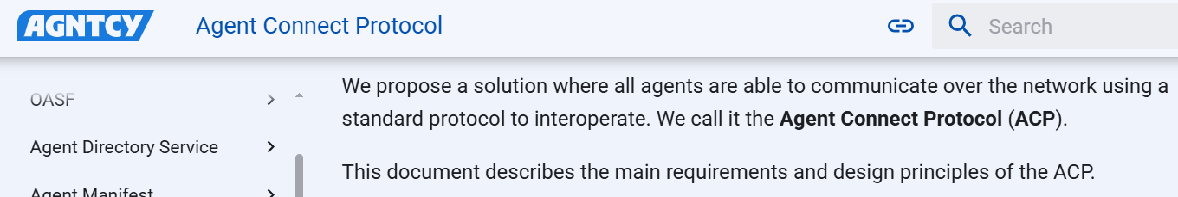
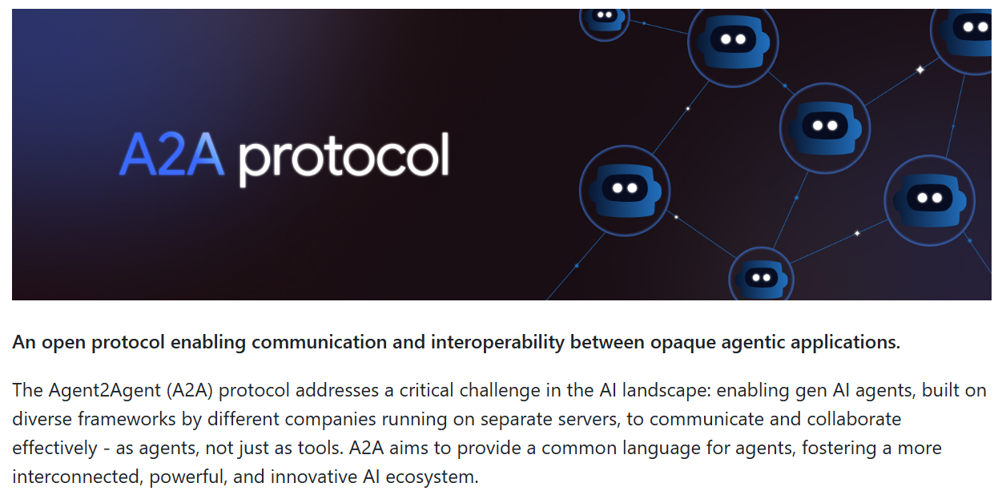
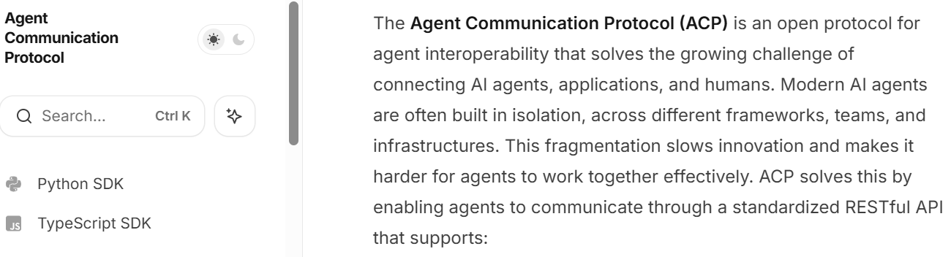
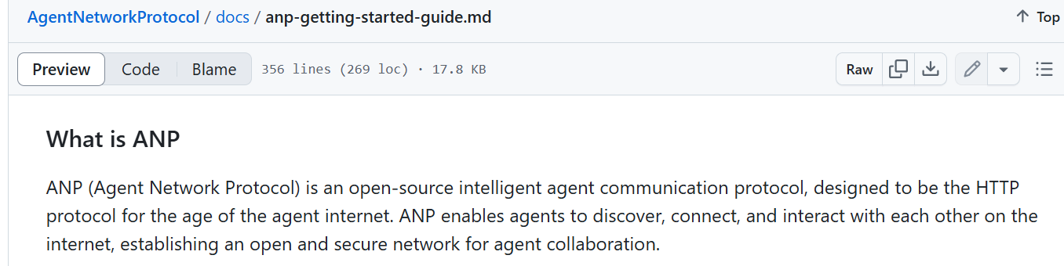
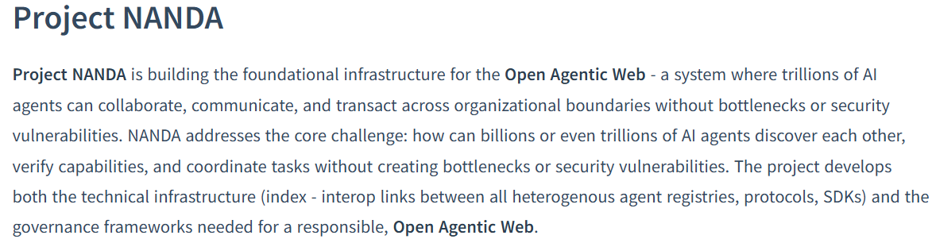
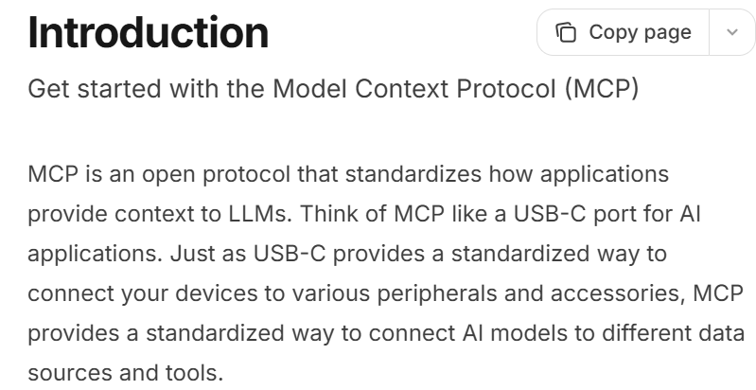
Clear need for a standard for Agent communications…
* MCP currently considered as de facto solution for agent-tool communication

Slide 18

But at the end…
If you really want a STANDARD solution
to ensure full interoperability between agents!

Slide 19
Next steps
Help to build consensus on:
Existing need for a standard for agent communication
IETF is the right place to work on it
Include 3GPP specific requirements (if any) in the scope of the discussion on a possible charter
Provide updates on the progress of the work in 3GPP
Promote close cooperation between IETF and 3GPP

Slide 20
Useful References
ITU-R, "Recommendation ITU-R M.2160-0: Framework and overall objectives of the future development of IMT for 2030 and beyond",
https://www.itu.int/dms_pubrec/itu-r/rec/m/R-REC-M.2160-0-202311-I!!PDF-E.pdf .
3GPP TR 22.870: Study on 6G Use Cases and Service Requirements; Stage 1 (Release 20)"
https://www.3gpp.org/ftp/Specs/archive/22_series/22.870
3GPP SA2 Study Item on Architecture for 6G System
https://www.3gpp.org/ftp/tsg_sa/TSG_SA/TSGS_108_Prague_2025-06/Docs/SP-250806.zip
3GPP Work Plan: Review at Plenary #108 (June 2025)
https://www.3gpp.org/ftp/tsg_sa/TSG_SA/TSGS_108_Prague_2025-06/Docs/SP-250890.zip

