Slide 1

AI Agent protocols for 6G systems draft-stephan-ai-agent-6g-00
July 2025

Slide 2

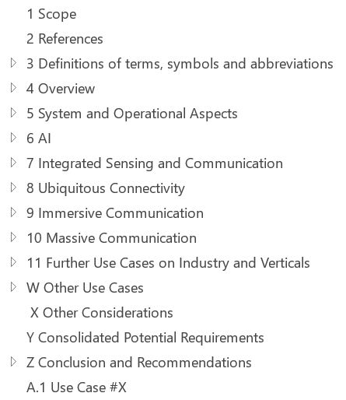
Study on 6G Use Cases and Service Requirements
6G Use Cases and Service Requirements captured in 3GPP TR 22.870 (https://www.3gpp.org/dynareport/22870.htm)
Initiated 2024/12 for completion expected by 2026/03
Objectives:
Identify high level principles and use cases
based on, but not limited to, IMT-2030 usage scenarios
Define potential requirements for 6G system to support new/enhanced services
Status: at an early stage and study being still a work in progress
Anyway, useful insights on the potential foundation pillars of the new 6G system.
AI and AI agents are clearly hot topics

Slide 3
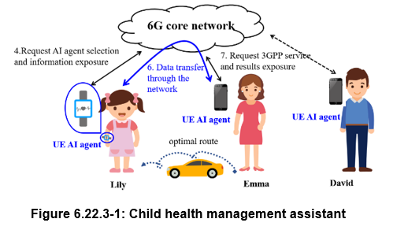
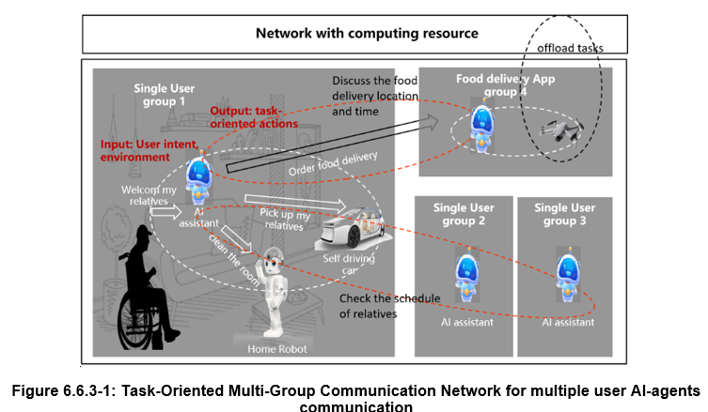
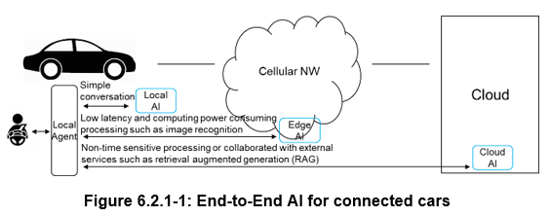

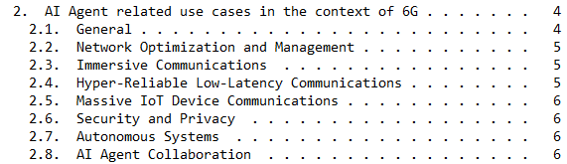
Objectives of the draft
From use cases described in the TR 22.870
Highlight AI Agent communication scenarios

Slide 4
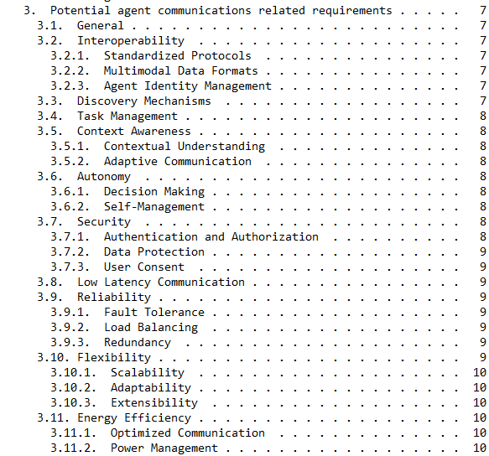

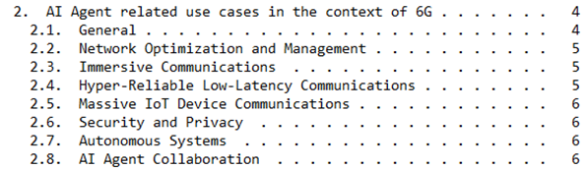
Objectives of the draft
Potential key requirements derived from the illustrative use cases

Slide 5
Conclusions
Ongoing study demonstrates the potential of AI agent communication in the scope of 6G.
Early stage: 3GPP is still discussing the AI agent related use cases. Functional and protocol related aspects will be studied in the upcoming months
If a multi-AI agent-based system is formally adopted by 3GPP in the scope of 6G, standard solutions will be required to support secure and reliable communication between agents and between agents and external tools.
Standard solutions for intra-network but also for interaction with 3rd-party platforms.
Authors consider that IETF could be the right place for such standard effort.
Close coordination between IETF and 3GPP is expected

Slide 6
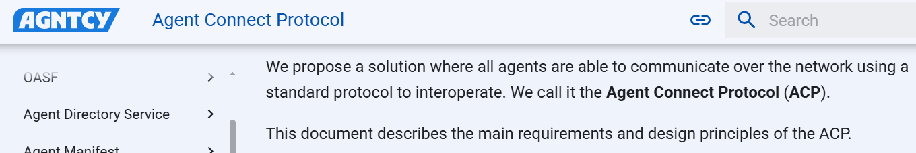
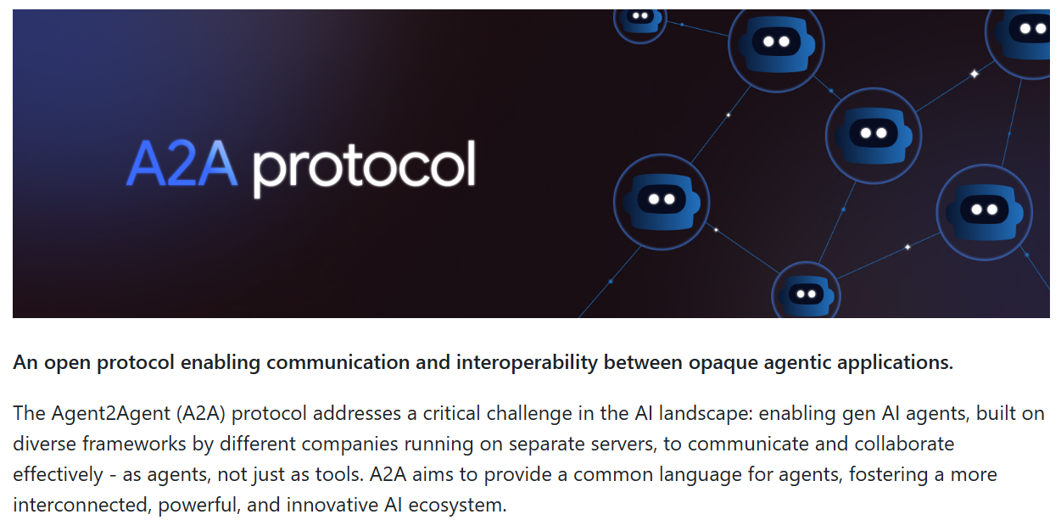
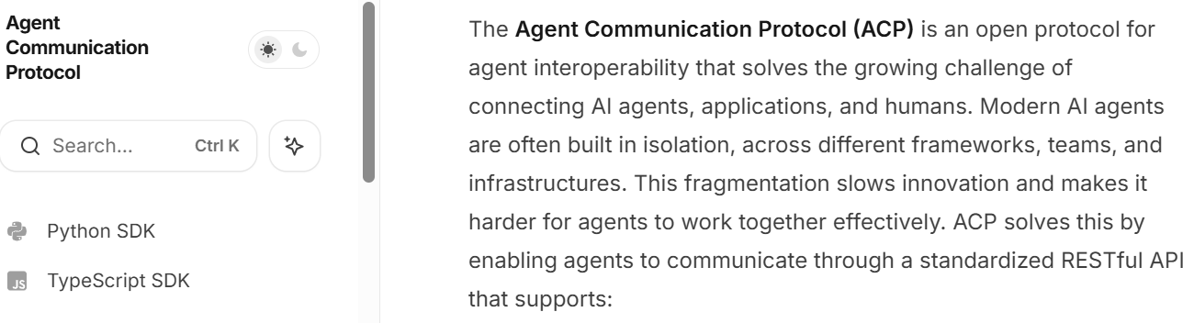
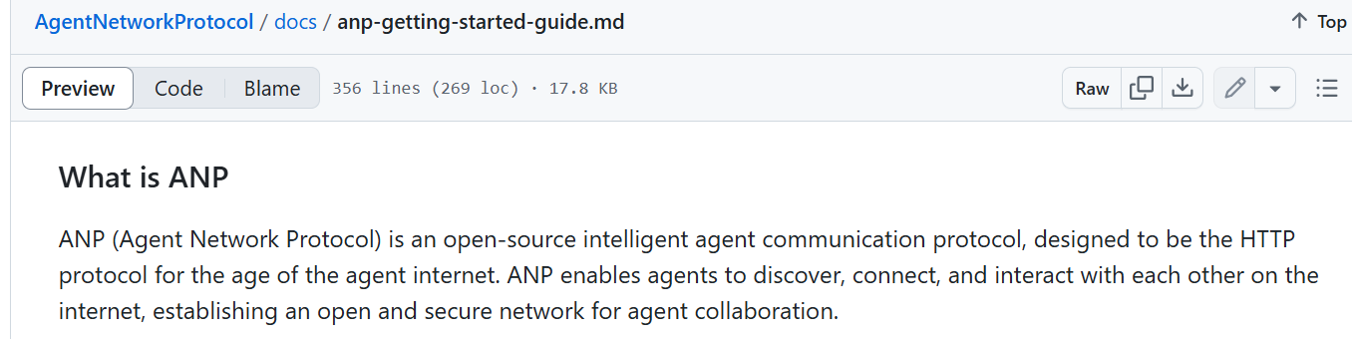
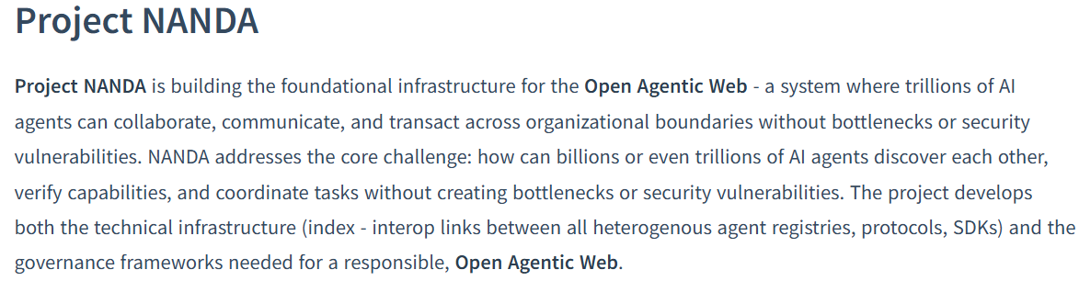
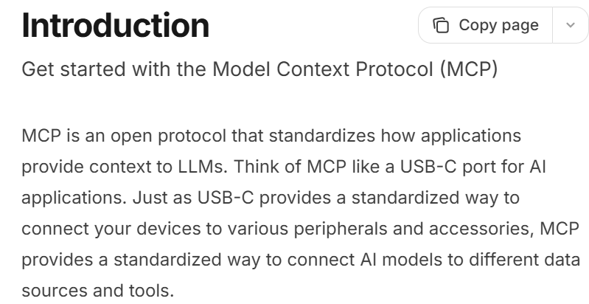
Clear need for a standard for Agent communications…
* MCP currently considered as de facto solution for agent-tool communication

Slide 7

But at the end…
If you really want a STANDARD solution
to ensure full interoperability between agents!

Slide 8
Next steps
Help to build consensus on:
Existing need for a standard for agent communication
IETF is the right place to work on it
Include 3GPP specific requirements (if any) in the scope of the discussion on a possible charter
Provide updates on the progress of the work in 3GPP
Promote close cooperation between IETF and 3GPP

Slide 9
Useful References
ITU-R, "Recommendation ITU-R M.2160-0: Framework and overall objectives of the future development of IMT for 2030 and beyond",
https://www.itu.int/dms_pubrec/itu-r/rec/m/R-REC-M.2160-0-202311-I!!PDF-E.pdf .
3GPP TR 22.870: Study on 6G Use Cases and Service Requirements; Stage 1 (Release 20)"
https://www.3gpp.org/ftp/Specs/archive/22_series/22.870
3GPP SA2 Study Item on Architecture for 6G System
https://www.3gpp.org/ftp/tsg_sa/TSG_SA/TSGS_108_Prague_2025-06/Docs/SP-250806.zip
3GPP Work Plan: Review at Plenary #108 (June 2025)
https://www.3gpp.org/ftp/tsg_sa/TSG_SA/TSGS_108_Prague_2025-06/Docs/SP-250890.zip

