Slide 1

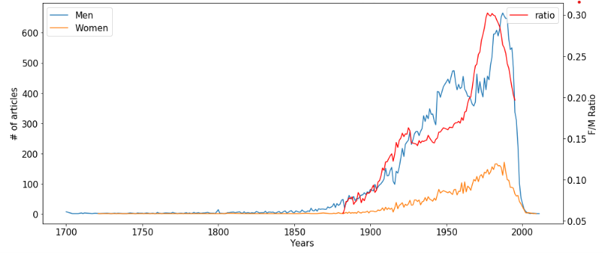
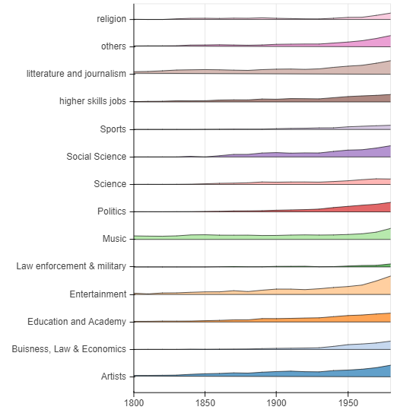
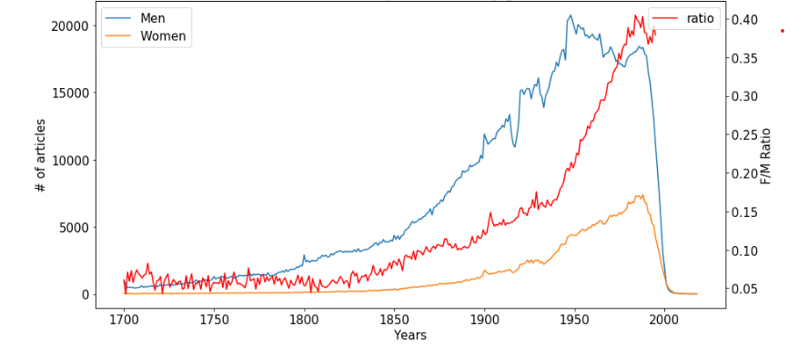
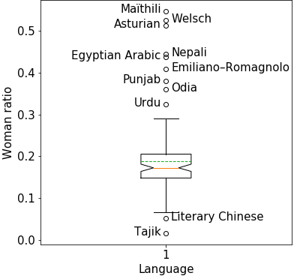
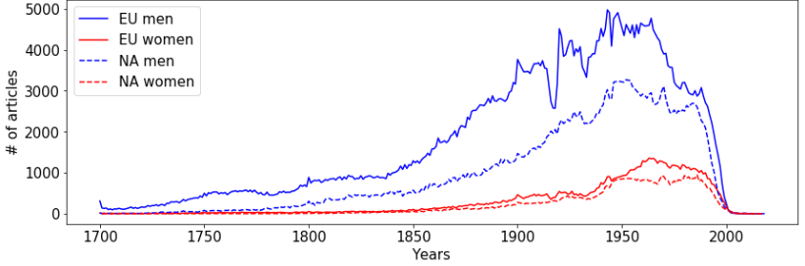
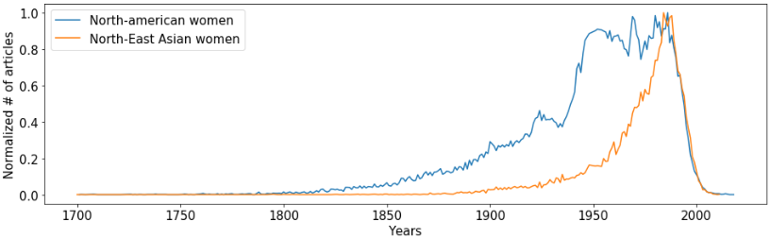
A Comprehensive Analysis of Women’s Representation Using Wikipedia Data.
Introduction
The issue of gender equality is of prime importance in society today. One of the questions it raises is about the representation of women, more specifically, how are their achievements showcased in the media? We chose to approach this question from the angle of women’s recognition for their achievements using Wikipedia articles. We postulated that the repartition of articles is a good way of approximating the trends throughout time. As a way to answer this question, we will focus mainly on gender representation in different cultures and fields of works as well as their evolution for the past 3 centuries.
Data Gathering and Cleaning
The final observation that we wanted to make was concerning the countries were historicaly women have been repressed and not allowed basic rights. This is the Arabic countries in the middle east, we also included Maghreb countries here since we saw they had similar curves. The shape of the curve here is very interesting, especially the ratio, it follows the classic curve at first but in the 1970’s there is a sharp drop with a ratio that ends at 0.20, as seen in Fig.4. We have attributed this to the repression of women with the upsurge of religion in politics after that time in Arabic countries.
Representation in Fields of Work
To answer this question, we gathered relevant info on people that have their own Wikipedia page. For the initial step, we went with the WHGI dataset which can be used to get a global view of the gender disparities on Wikipedia; this was very useful for us to guide our latter efforts. We also quickly came to the realization that the data was lacking some of the depth we needed to have a nicer analysis and thus we chose to parse the entire Wikidata JSON file ourselves, in search of what we needed. Each of the article is viewed as an item and has several properties. These describe its characteristics and can take several values. Our parsing was done on the cluster as it is a long operation and needs to have access to the uncompressed JSON file (which is quite heavy at 680GB). We parsed one item at a time to see if it had the value ‘human’ under the property ‘instance of’ and if that was the case, we saved in another file all the values of the properties we were interested in. Once this process was done, we were able to load the remaining data in a Spark dataframe to use it in Python.
For the cleaning of the data, we got rid of all the article with a null or non binary gender, then we cleaned the dates of birth since when they are not indicated, Wikidata tends to attribute them seemingly arbitrarily. We worked using the following properties: date of birth, citizenships, page language, fields of work, gender, for the people born after 1700 to have relevant and sufficient data.
After regrouping the people on Wikidata by domain of occupation, we were able to get a picture of the evolution of gender equality in different domains. In Fig. 5 we observe that for most domains, the ratio of women increases over the years which seems to reflect well the situation worldwide were most occupations tend towards more and more equality. We can see however that most occupations still do not have equal ratio of men and women: only literature and journalism and social science reach a ratio that is close to 0.5 and entertainment is the only occupation where the ratio is noticeably higher than 0.5. Most categories are still below a 0.5 ratio but the trends looks to be going the right way for all of them. Even in categories that were exclusively masculine until recently like religion or military and law enforcement, the ratio is going up steadily. Thus, on this side, the analysis follows what one would expect.
Figure 4: Ratio of genders in Wikipedia articles from Muslim countries.
Description for Fig3
Equality Among Languages
Figure 1: Global Evolution and Ratio Since 1700.
Summary of the evolution and ratio of the article number per gender. The trend shows increasing ratio ending at 0.40.
We then wanted to investigate whether the representation of women were the same in different languages. We postulated that in languages spoken by less egalitarian countries, we would see less articles featuring women, since there would be less pressure to give credit to famous women than with man.
On Fig.4 we can see that the ratio of women seems to be fairly homogeneous across Wikipedia languages. The outliers that we can observe here are only for rare languages and dialects that have fewer articles, and thus they might be the result of random variability. Furthermore, they are very heterogenous geographically and culturally and did not seem to correspond to the place of women in their culture which leads us to conclude that the languages of the articles in Wikipedia can not be used accurately to represent the gender disparities.
Figure 5: Evolution of ratio of women through time across different domains of occupations.
The distance between each category line corresponds to a ratio of 1
Differences Across Citizenships
The first effect we were interested in was whether the citizenship had any influence on the evolution of gender through time and their final repartition. For this we used previous work on the subject, using the Konieczky and Klein cultural clusters we grouped the data with similar cultures. This allowed us to have more data points even with cultures that had sparser Wikipedia entries.
To test whether this hypothesis was true, we compared the evolution for western Europe and north America that have had similar cultures and developments for the last centuries. In Fig.2 we can see that indeed the evolution for those regions has a similar shape, which, in turn validates our previous choice of clustering.
Figure 4: Boxplot of distribution of ratio of women for different Wikipedia article languages.
The median is shown in red with a notched 95% confidence interval and the mean is represented by the green dotted line.
Conclusion
Through these analysis, we can conclude that Wikidata can indeed be used to highlight gender inequalities across time, culture or space. We have shown that those inequalities are reflected in the representation of women on Wikipedia and that the difference that we expected between different culture does indeed appear. We also showed that though equality has different levels in different places and does not seem to have been reached yet, the trends point toward an ever increasing equality, in all domains of occupations or countries. There are however some limitations to our approach:
Wikipedia only features famous people which is not necessarily reprensentative of the whole society.
There is a limited temporal resolution
The data becomes sparse if when we take only small subsets like countries.
To conclude, we can say that even with these limitations, the equality between men and women is shown to still be an issue in most of the world, but the trends that we observe leave us hopeful that we will reach it in a not so distant future.
Figure 2: Comparative Evolution Between North America and Western Europe.
The same shapes can be observed in Europe and North America. Similar cultures have similar evolution
The next task intended to show that non-similar cultures would have different evolutions through time and different outcomes today. For this we chose to compare to the data for north-east Asia and Muslim countries to the previous western example.
The example of Asian countries, in Fig.3, we can see that even though, at first, the amount of women is largely inferior compared to western countries. After the 1950’s there is a sudden sharp increase unseen in any other culture and, for the most recent period, the F/M ratio has reached 0.84. Making those countries the most equal in our analysis at least.
Although it is not what we expected, an interrresting take we can have on this result is that the the cultures and thus the languages where there is less equalities do represent women equally for their accomplishements.
Figure 3: Number of articles on women in Asia compared to north-America
Sharp and delayed increase in the number of women after the 1950’s
References:
Piotr Konieczny. Maximilian Klein. 2018. Gender gap through time and space.
Wikidata Human Gender Indicators (WHGI) 2018. url: http://whgi.wmflabs.org/
Emile Bourban, Florian Delberghe 2019

