Slide 1
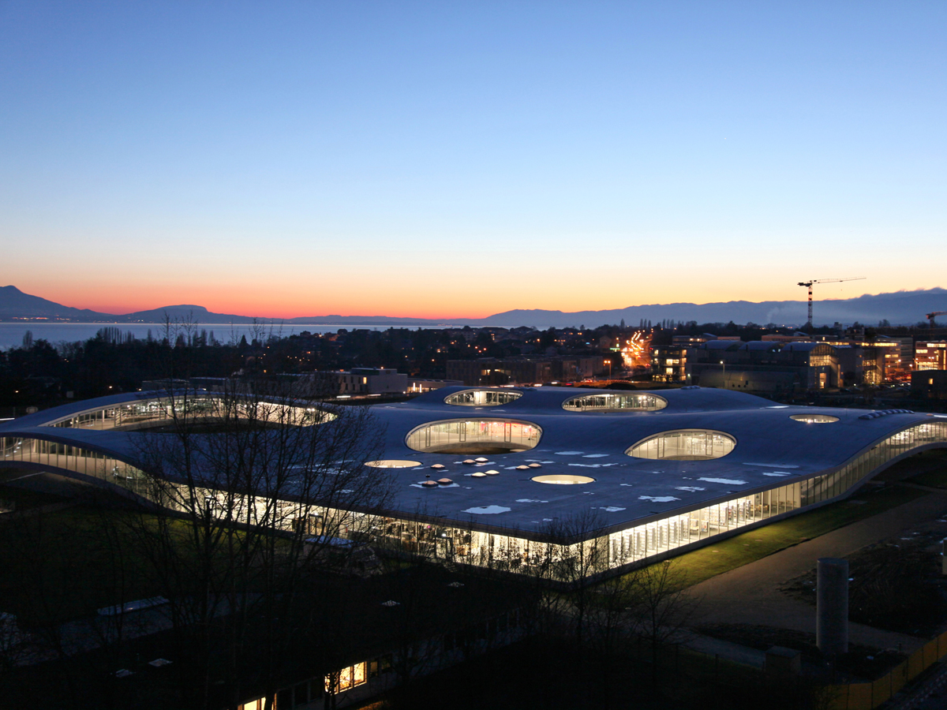

Ecole Polytechnique
Fédérale de Lausanne
EPFL
Présentation EPFL-Public | 21.12.2016

Slide 2
Boiling on Tube Bundles
ME-446 Two-phase flow
and heat transfert
Sébastien BALAS
Emile DECOSTERD
Mickaël FREY
Vincent MAYORAZ
Niels PICHLER
Gautier ROUAZE
Présentation EPFL-Public | 21.12.2016

Slide 3
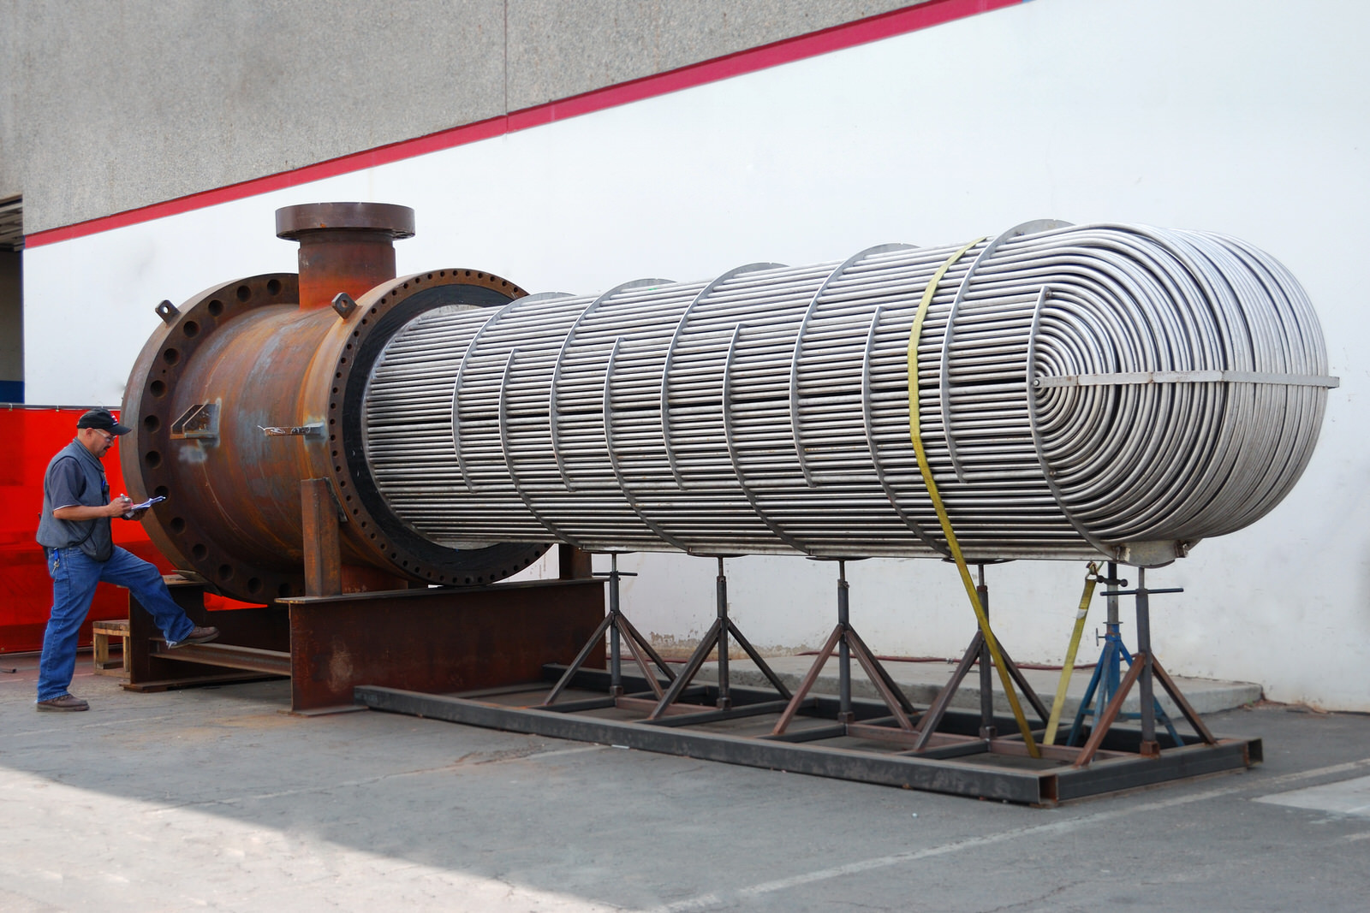
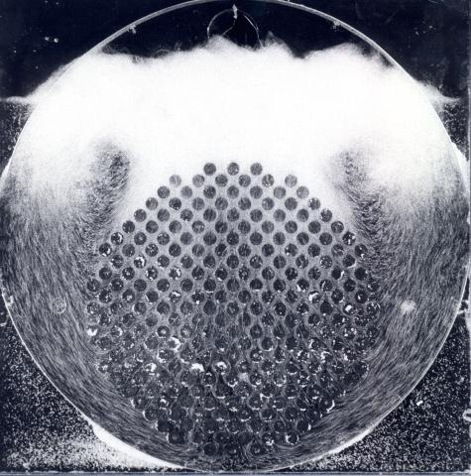
Tube Bundle
Heat exchangers are used in many industrial application
Chemical plants
Power plants
Cooling system
However, this is useless and except for keeping Jackson busy
Introduction

Slide 4
Layout
Goal
Algorithm
GUI
Live demo
Trend curves
Case study
Potential improvements
Layout

Slide 5
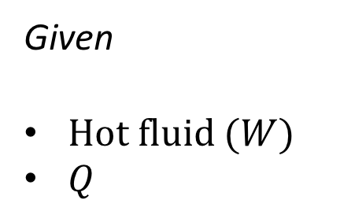
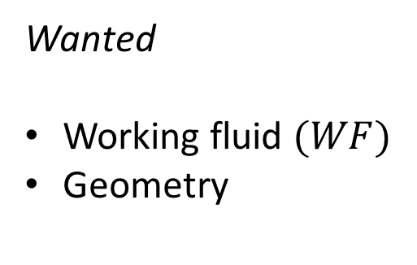
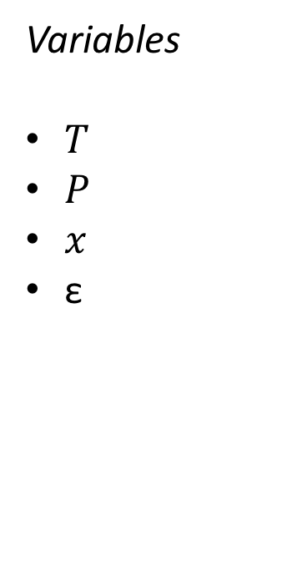
Goal
For a desired heat, what is the best setup for a tube bundles heat exchanger?
Given
Hot fluid $(W$)
$Q$
Wanted
Working fluid $(WF)$
Geometry
Variables
$T$
$P$
$x$
ε
Algorithm

Slide 6
Nucleate Pool Boiling
We restrict ourselves to nucleate pool boiling, most common and most documented

Slide 7


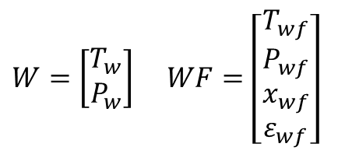


Discretized domain
$$WF^{out}$$
No exchange in this direction
$W=\left[\begin{aligned}T_{w} \\ P_{w}\end{aligned}\right]$ $WF=\left[\begin{aligned}T_{wf} \\ P_{wf} \\ x_{wf} \\ ε_{wf}\end{aligned}\right]$
$$W^{in}$$
$$W^{out}$$
$$WF^{in}$$
Algorithm

Slide 8
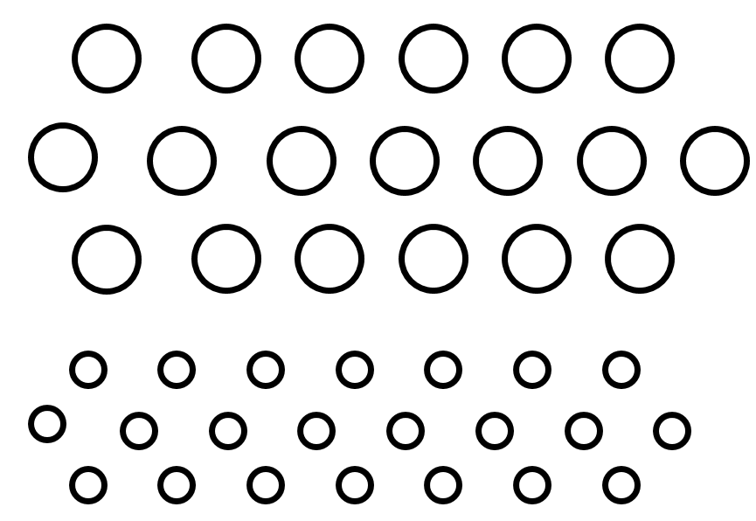

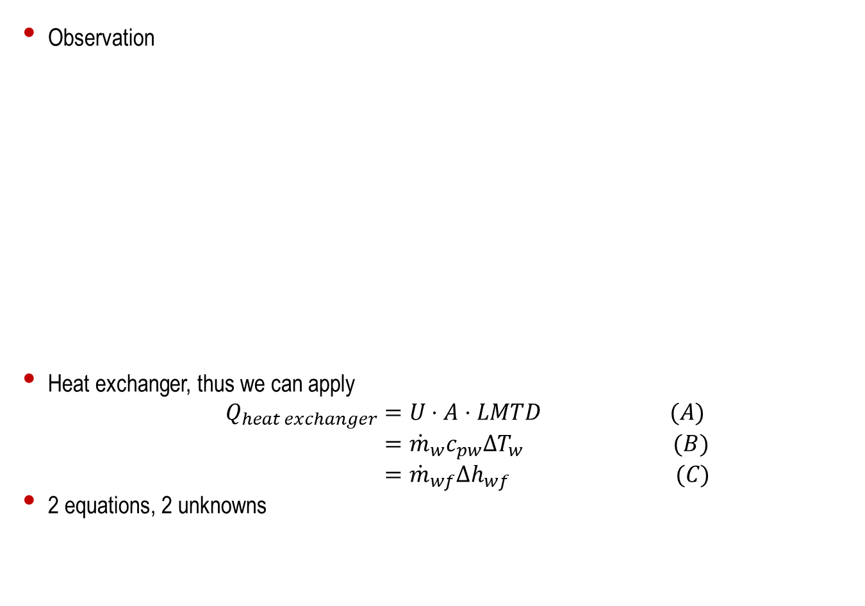


Heat exchange
Observation
Heat exchanger, thus we can apply
$Q_{heat exchanger}$ $=U⋅A⋅LMTD (A)$
$={\dot{m}}_{w}c_{pw}ΔT_{w} (B)$
$={\dot{m}}_{wf}Δh_{wf} (C)$
2 equations, 2 unknowns
$$ΔQ_{wf}={\dot{m}}_{wf}Δh_{w}$$
Evaporation, $x$ rises
$$ΔQ_{w}={\dot{m}}_{w}c_{pw}ΔT_{w}$$
Single flow heat transfert, $T$ decreases
Introduction
Notes:
We cannot solve directly, depends on tables and shit

Slide 9
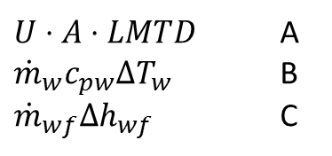

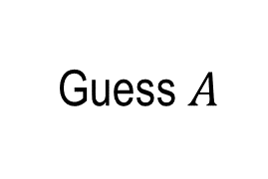
Solving principle
$U⋅A⋅LMTD$ A
${\dot{m}}_{w}c_{pw}ΔT_{w}$ B
${\dot{m}}_{wf}Δh_{wf}$ C
$$A=B$$
𝐴=𝐵
$$B=C$$
𝐵=𝐶
Update terms in $A$ using $C$ and $B$
Update terms in 𝐴 using 𝐶 and 𝐵
Guess $A$

Slide 10

SolveCell
Needs: $T_{w}^{in}, P_{wf}^{in}, T_{wf}^{in}T_{wf}^{out}$
Needs: 𝑇_𝑤^𝑖𝑛, 𝑃_𝑤𝑓^𝑖𝑛, 𝑇_𝑤𝑓^𝑖𝑛 𝑇_𝑤𝑓^𝑜𝑢𝑡
2: cell_vaporQuality
Needs: $T_{w}^{in}, T_{w}^{out}, T_{wf}^{in}, x_{wf}^{in}$
Needs: 𝑇_𝑤^𝑖𝑛, 𝑇_𝑤^𝑜𝑢𝑡, 𝑇_𝑤𝑓^𝑖𝑛, 𝑥_𝑤𝑓^𝑖𝑛
Computes $x_{wf}^{out}$
Computes 𝑥_𝑤𝑓^𝑜𝑢𝑡
3: cell_voidFraction
Needs: $x_{wf}^{out}, T_{wf}^{out}, ε_{wf}^{in}$
Needs: 𝑥_𝑤𝑓^𝑜𝑢𝑡, 𝑇_𝑤𝑓^𝑜𝑢𝑡, 𝜀_𝑤𝑓^𝑖𝑛
4: cell_pressureDrop
Needs: $T_{w}^{out}, ε_{wf}^{out}, x_{wf}^{out}, T_{wf}^{out}, P_{wf}^{in}, P_{w}^{in}, ε_{wf}^{in}$
Needs: 𝑇_𝑤^𝑜𝑢𝑡, 𝜀_𝑤𝑓^𝑜𝑢𝑡, 𝑥_𝑤𝑓^𝑜𝑢𝑡, 𝑇_𝑤𝑓^𝑜𝑢𝑡, 𝑃_𝑤𝑓^𝑖𝑛, 𝑃_𝑤^𝑖𝑛, 𝜀_𝑤𝑓^𝑖𝑛
5: $T_{wf}^{out}$update
5: 𝑇_𝑤𝑓^𝑜𝑢𝑡update
Update of $T_{wf}^{out}$ using new state ($P_{wf}^{out}$ and $x_{wf}^{out}$)
Update of 𝑇_𝑤𝑓^𝑜𝑢𝑡 using new state (𝑃_𝑤𝑓^𝑜𝑢𝑡 and 𝑥_𝑤𝑓^𝑜𝑢𝑡)
Computes $T_{w}^{out}$ using Newton algorithm and EnergyBalance.py
Computes 𝑇_𝑤^𝑜𝑢𝑡 using Newton algorithm and EnergyBalance.py
1: $T_{w}^{out}$computation
1: 𝑇_𝑤^𝑜𝑢𝑡computation
Computes $ε_{wf}^{out}$
Computes 𝜀_𝑤𝑓^𝑜𝑢𝑡
Computes $P_{wf}^{out}, P_{w}^{out}$
Computes 𝑃_𝑤𝑓^𝑜𝑢𝑡, 𝑃_𝑤^𝑜𝑢𝑡
Iterate until $\left|P_{wf_{NEW}}^{out}−P_{wf}^{out}\right|<tol$
Algorithm

Slide 11
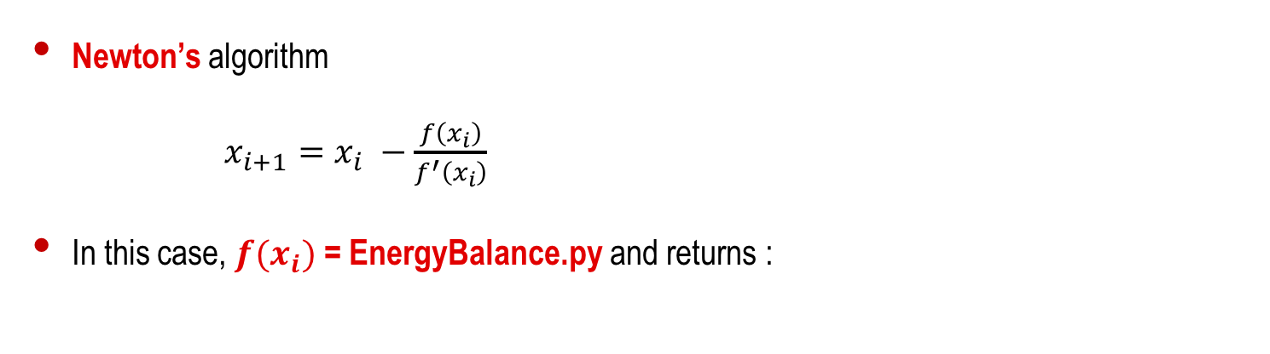
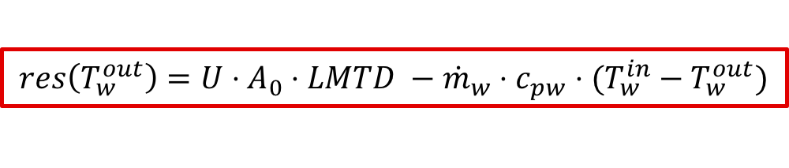

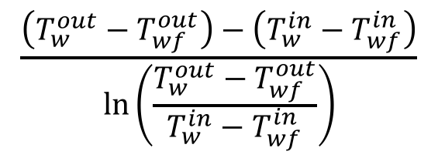
$T_{w}^{out}$ computation
Newton’s algorithm
$x_{i+1}=x_{i} −\frac{f\left(x_{i}\right)}{f^{′}\left(x_{i}\right)}$
In this case, $f(x_{i})$ = EnergyBalance.py and returns :
External tube surface
$$res\left(T_{w}^{out}\right)=U⋅A_{0}⋅LMTD −{\dot{m}}_{w}⋅c_{pw}⋅(T_{w}^{in}−T_{w}^{out})$$
Depends among others on $T_{w}^{out}$
$$\frac{\left(T_{w}^{out}−T_{wf}^{out}\right)−\left(T_{w}^{in}−T_{wf}^{in}\right)}{\ln\left(\frac{T_{w}^{out}−T_{wf}^{out}}{T_{w}^{in}−T_{wf}^{in}}\right)}$$
Algorithm

Slide 12





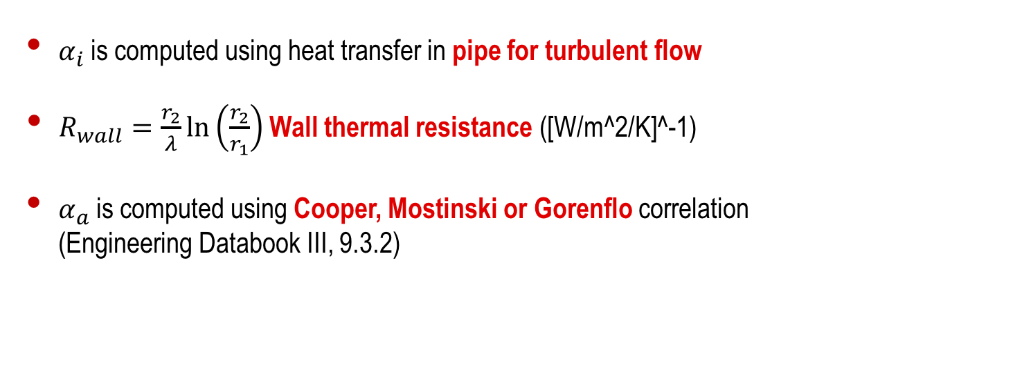

$T_{w}^{out}$ computation
$$U={\left[\frac{r_{2}}{r_{1}⋅α_{i}}+\frac{r_{2}}{λ}\ln\left(\frac{r_{2}}{r_{1}}\right)+\frac{1}{α_{a}}\right]}^{−1}$$
$α_{i}$ is computed using heat transfer in pipe for turbulent flow
$R_{wall}=\frac{r_{2}}{λ}\ln\left(\frac{r_{2}}{r_{1}}\right)$ Wall thermal resistance ([W/m^2/K]^-1)
$α_{a}$ is computed using Cooper, Mostinski or Gorenflo correlation
(Engineering Databook III, 9.3.2)
Algorithm

Slide 13
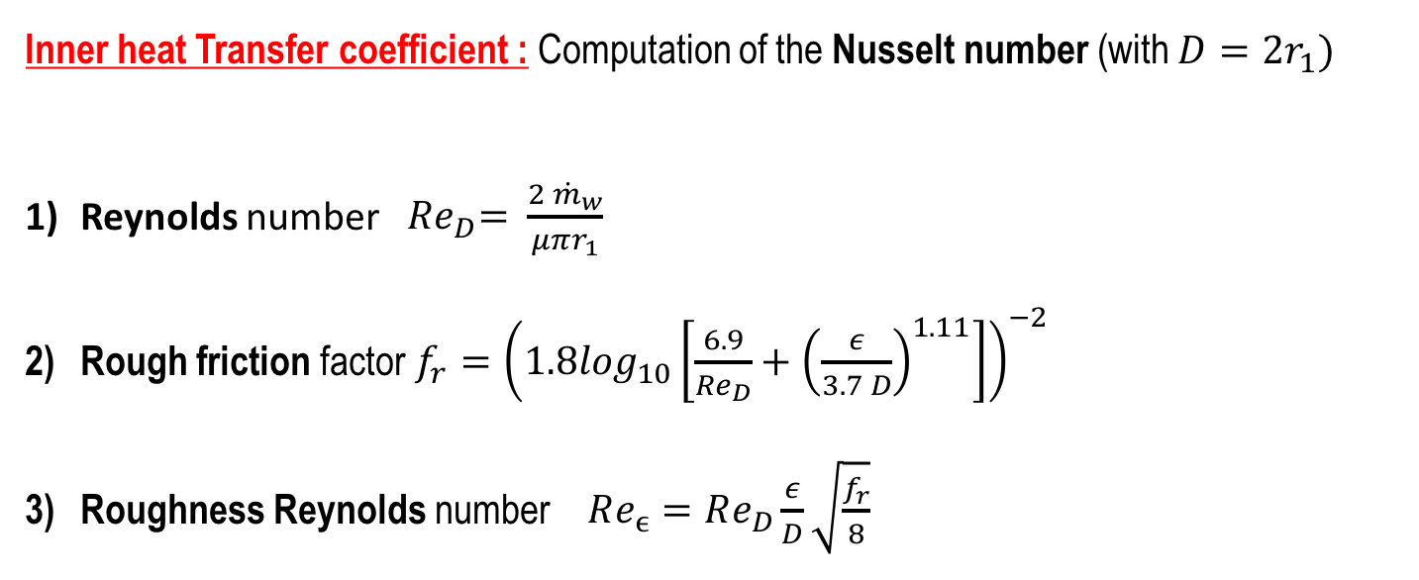
$T_{w}^{out}$ computation
Inner heat Transfer coefficient : Computation of the Nusselt number (with $D=2r_{1})$
Reynolds number ${ Re}_{D}= \frac{2 {\dot{m}}_{w}}{μπr_{1}}$
Rough friction factor $f_{r}={\left(1.8\log_{10}\left[\frac{6.9}{{Re}_{D}}+{\left(\frac{ε}{3.7 D}\right)}^{1.11}\right]\right)}^{−2}$
Roughness Reynolds number $Re_{ϵ}=Re_{D}\frac{ε}{D}\sqrt{\frac{f_{r}}{8}}$

Slide 14
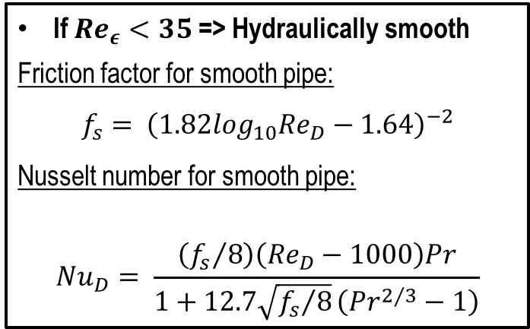
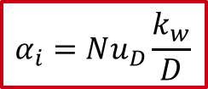
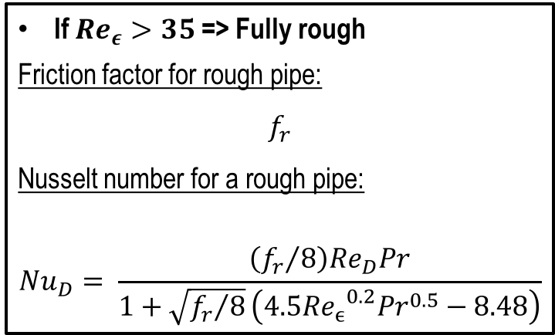
$T_{w}^{out}$ computation
Inner heat Transfer coefficient : Computation of the Nusselt number
If $Re_{ε}<35$ => Hydraulically smooth
Friction factor for smooth pipe:
$$f_{s}= {\left(1.82\log_{10}Re_{D}−1.64\right)}^{−2}$$
Nusselt number for smooth pipe:
$$Nu_{D}= \frac{\left({f_{s}}/8\right)\left(Re_{D}−1000\right)Pr}{1+12.7\sqrt{{f_{s}}/8}\left({Pr}^{2/3}−1\right)}$$
If $Re_{ε}>35$ => Fully rough
Friction factor for rough pipe:
$$f_{r}$$
Nusselt number for a rough pipe:
$$Nu_{D}= \frac{\left({f_{r}}/8\right)Re_{D}Pr}{1+\sqrt{{f_{r}}/8}\left({4.5{Re_{ϵ}}^{0.2}Pr}^{0.5}−8.48\right)}$$
$$α_{i}=Nu_{D}\frac{k_{w}}{D}$$

Slide 15


$T_{w}^{out}$ computation
Inner heat Transfer coefficient :
$$α_{i}=Nu_{D}\frac{k_{w}}{D}$$
Limitations:
$$2300<Re_{D}<5 × {10}^{6}$$
$$0.5 < Pr⁡< 10$$
$0.002<\frac{ε}{D }<0.05$

Slide 16
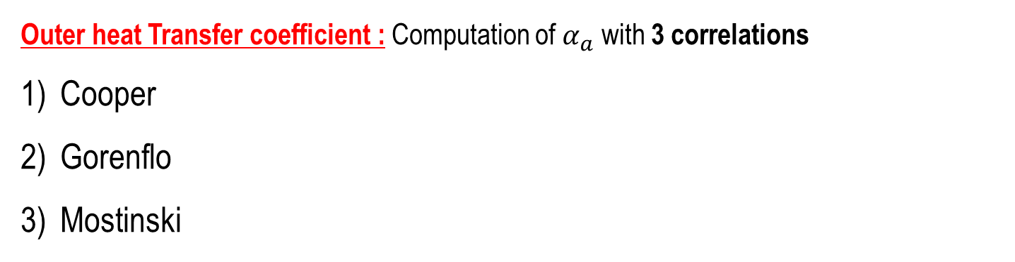
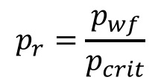
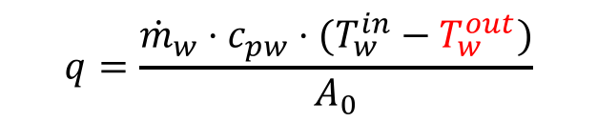
$T_{w}^{out}$ computation
Outer heat Transfer coefficient : Computation of $α_{a}$ with 3 correlations
Cooper
Gorenflo
Mostinski
For all correlation :
$$p_{r}=\frac{p_{wf}}{p_{crit}}$$
$$q=\frac{{\dot{m}}_{w}⋅c_{pw}⋅(T_{w}^{in}−T_{w}^{out})}{A_{0}}$$

Slide 17
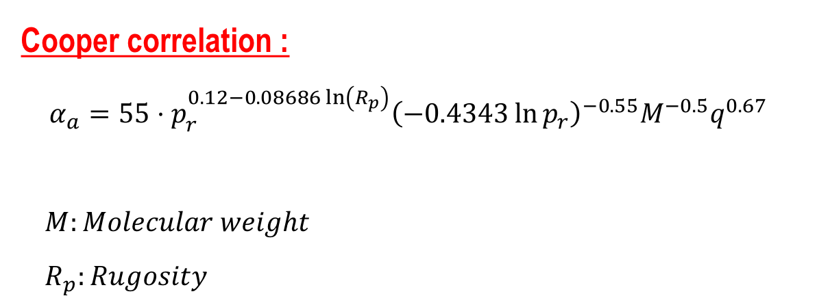
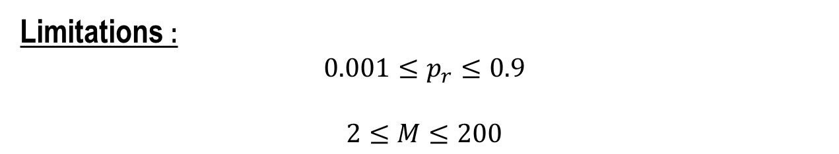
$T_{w}^{out}$ computation
Cooper correlation :
$$α_{a}=55⋅p_{r}^{0.12−0.08686\ln\left(R_{p}\right)}{\left(−0.4343\ln{p_{r}}\right)}^{−0.55}M^{−0.5}q^{0.67}$$
$M:Molecular weight$
$R_{p}:Rugosity$
Limitations :
$$0.001≤p_{r}≤0.9$$
$$2≤M≤200$$

Slide 18
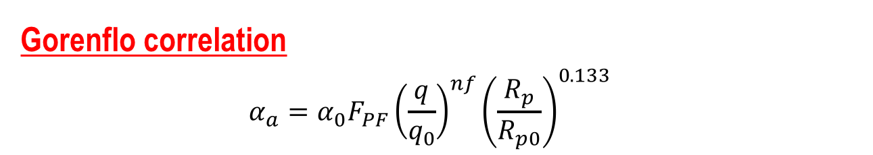
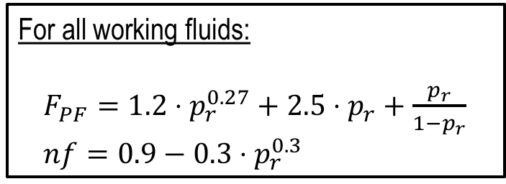
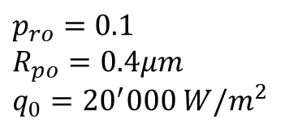
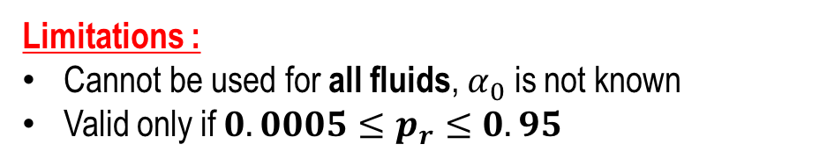
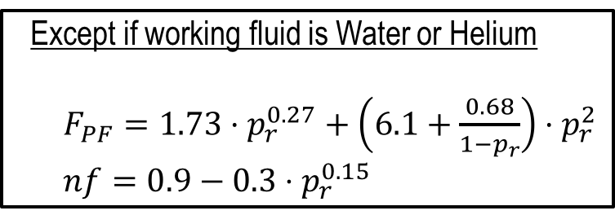
$T_{w}^{out}$ computation
Gorenflo correlation
$$α_{a}=α_{0}F_{PF}{\left(\frac{q}{q_{0}}\right)}^{nf}{\left(\frac{R_{p}}{R_{p0}}\right)}^{0.133}$$
$p_{ro}=0.1$
$R_{po}=0.4μm$
$q_{0}={20}^{′}000 W/m^{2}$
For all working fluids:
$F_{PF}=1.2⋅p_{r}^{0.27}+2.5⋅p_{r}+\frac{p_{r}}{1−p_{r}}$
$nf=0.9−0.3⋅p_{r}^{0.3}$
Except if working fluid is Water or Helium
$F_{PF}=1.73⋅p_{r}^{0.27}+\left(6.1+\frac{0.68}{1−p_{r}}\right)⋅p_{r}^{2}$
$nf=0.9−0.3⋅p_{r}^{0.15}$
Limitations :
Cannot be used for all fluids, $α_{0}$ is not known
Valid only if $0.0005≤p_{r}≤0.95$

Slide 19
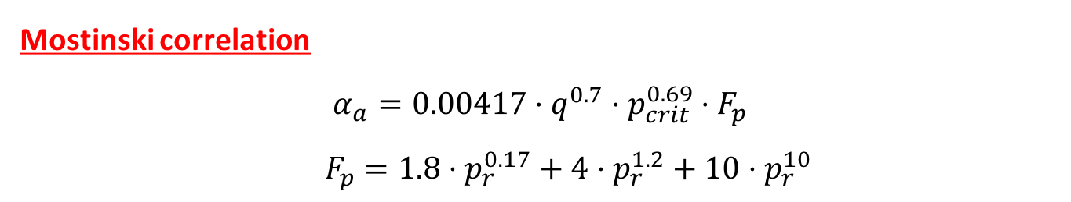
$T_{w}^{out}$ computation
Mostinski correlation
$$α_{a}=0.00417⋅q^{0.7}⋅p_{crit}^{0.69}⋅F_{p}$$
$F_{p}=1.8⋅p_{r}^{0.17}+4⋅p_{r}^{1.2}+10⋅p_{r}^{10}$
No limitations are specified

Slide 20
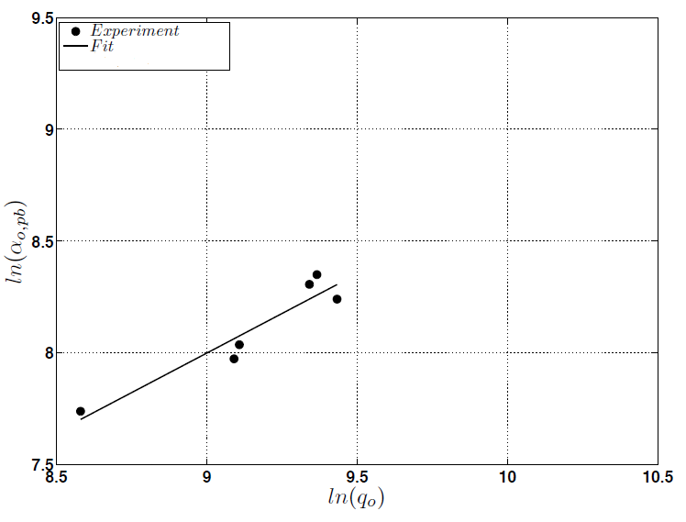
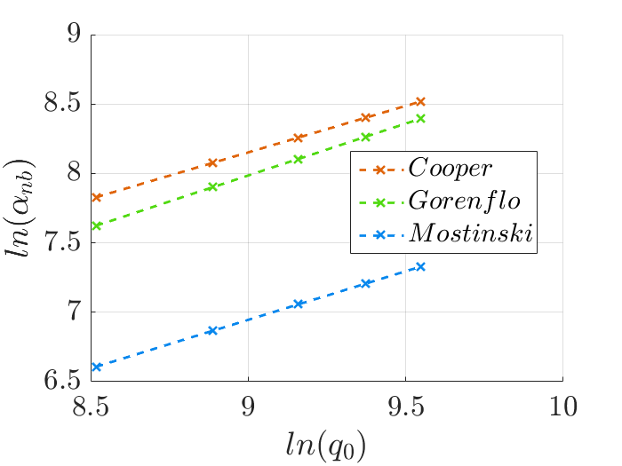
$T_{w}^{out}$ computation
Heat transfer results for similar conditions
Heat transfer implemented in our code
Heat transfer measured by Agostini

Slide 21
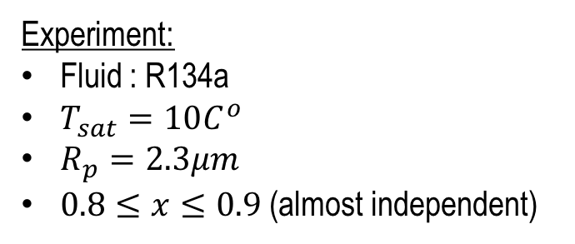
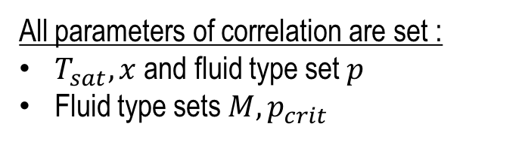
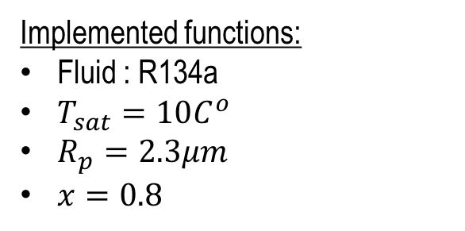
Backup: $α_{nb}$validation case
Implemented functions:
Fluid : R134a
$T_{sat}=10C^{o}$
$R_{p}=2.3μm$
$x=0.8$
Experiment:
Fluid : R134a
$T_{sat}=10C^{o}$
$R_{p}=2.3μm$
$0.8≤x≤0.9$ (almost independent)
All parameters of correlation are set :
$T_{sat}, x$ and fluid type set $p$
Fluid type sets $M, p_{crit}$

Slide 22

SolveCell
Needs: $T_{w}^{in}, P_{wf}^{in}, T_{wf}^{in}T_{wf}^{out}$
Needs: 𝑇_𝑤^𝑖𝑛, 𝑃_𝑤𝑓^𝑖𝑛, 𝑇_𝑤𝑓^𝑖𝑛 𝑇_𝑤𝑓^𝑜𝑢𝑡
2: cell_vaporQuality
Needs: $T_{w}^{in}, T_{w}^{out}, T_{wf}^{in}, x_{wf}^{in}$
Needs: 𝑇_𝑤^𝑖𝑛, 𝑇_𝑤^𝑜𝑢𝑡, 𝑇_𝑤𝑓^𝑖𝑛, 𝑥_𝑤𝑓^𝑖𝑛
Computes $x_{wf}^{out}$
Computes 𝑥_𝑤𝑓^𝑜𝑢𝑡
3: cell_voidFraction
Needs: $x_{wf}^{out}, T_{wf}^{out}, ε_{wf}^{in}$
Needs: 𝑥_𝑤𝑓^𝑜𝑢𝑡, 𝑇_𝑤𝑓^𝑜𝑢𝑡, 𝜀_𝑤𝑓^𝑖𝑛
4: cell_pressureDrop
Needs: $T_{w}^{out}, ε_{wf}^{out}, x_{wf}^{out}, T_{wf}^{out}, P_{wf}^{in}, P_{w}^{in}, ε_{wf}^{in}$
Needs: 𝑇_𝑤^𝑜𝑢𝑡, 𝜀_𝑤𝑓^𝑜𝑢𝑡, 𝑥_𝑤𝑓^𝑜𝑢𝑡, 𝑇_𝑤𝑓^𝑜𝑢𝑡, 𝑃_𝑤𝑓^𝑖𝑛, 𝑃_𝑤^𝑖𝑛, 𝜀_𝑤𝑓^𝑖𝑛
5: $T_{wf}^{out}$update
5: 𝑇_𝑤𝑓^𝑜𝑢𝑡update
Update of $T_{wf}^{out}$ using new state ($P_{wf}^{out}$ and $x_{wf}^{out}$)
Update of 𝑇_𝑤𝑓^𝑜𝑢𝑡 using new state (𝑃_𝑤𝑓^𝑜𝑢𝑡 and 𝑥_𝑤𝑓^𝑜𝑢𝑡)
Computes $T_{w}^{out}$ using Newton algorithm and EnergyBalance.py
Computes 𝑇_𝑤^𝑜𝑢𝑡 using Newton algorithm and EnergyBalance.py
1: $T_{w}^{out}$computation
1: 𝑇_𝑤^𝑜𝑢𝑡computation
Computes $ε_{wf}^{out}$
Computes 𝜀_𝑤𝑓^𝑜𝑢𝑡
Computes $P_{wf}^{out}, P_{w}^{out}$
Computes 𝑃_𝑤𝑓^𝑜𝑢𝑡, 𝑃_𝑤^𝑜𝑢𝑡
Iterate until $\left|P_{wf_{NEW}}^{out}−P_{wf}^{out}\right|<tol$
Algorithm

Slide 23
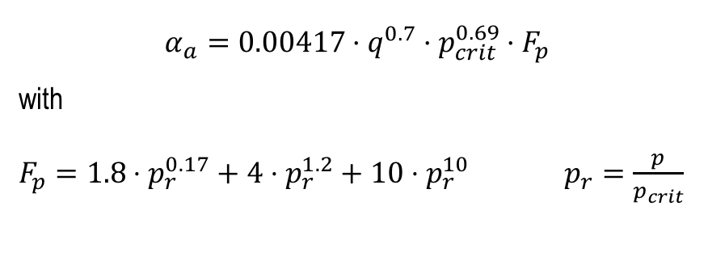
cell_vaporQuality
$Q_{cell}={\dot{m}}_{w}⋅c_{pw}⋅\left(T_{w}^{in}−T_{w}^{out}\right)={\dot{m}}_{wf}⋅Δh$
and
$$x=\frac{h−h_{l}}{h_{g}−h_{l}}⇒Δx=\frac{Δh}{h_{g}−h_{l}}$$
thus
$$x_{wf}^{out}=x_{wf}^{in}+\frac{{\dot{m}}_{w}⋅c_{pw}⋅\left(T_{w}^{in}−T_{w}^{out}\right)}{{\dot{m}}_{wf}⋅(h_{g}−h_{l})}$$
if $x_{wf}^{out}>1$ we set $x_{wf}^{out}=1$ and define
$$Q_{res}={\dot{m}}_{wf}⋅(h_{wf}^{out}−h_{g})$$
and update $T_{w}^{out}$
$$T_{w}^{out}=T_{w}^{out}+\frac{Q_{res}}{{\dot{m}}_{w}c_{pw}}$$
Algorithm
Notes:
If x>1 we assume no heat exchange for pure vapor
Q_res is the excess energy exchanged in Energybalance, we “put it back” in the water

Slide 24
SolveCell
Needs: $T_{w}^{in}, P_{wf}^{in}, T_{wf}^{in}T_{wf}^{out}$
Needs: 𝑇_𝑤^𝑖𝑛, 𝑃_𝑤𝑓^𝑖𝑛, 𝑇_𝑤𝑓^𝑖𝑛 𝑇_𝑤𝑓^𝑜𝑢𝑡
2: cell_vaporQuality
Needs: $T_{w}^{in}, T_{w}^{out}, T_{wf}^{in}, x_{wf}^{in}$
Needs: 𝑇_𝑤^𝑖𝑛, 𝑇_𝑤^𝑜𝑢𝑡, 𝑇_𝑤𝑓^𝑖𝑛, 𝑥_𝑤𝑓^𝑖𝑛
Computes $x_{wf}^{out}$
Computes 𝑥_𝑤𝑓^𝑜𝑢𝑡
3: cell_voidFraction
Needs: $x_{wf}^{out}, T_{wf}^{out}, ε_{wf}^{in}$
Needs: 𝑥_𝑤𝑓^𝑜𝑢𝑡, 𝑇_𝑤𝑓^𝑜𝑢𝑡, 𝜀_𝑤𝑓^𝑖𝑛
4: cell_pressureDrop
Needs: $T_{w}^{out}, ε_{wf}^{out}, x_{wf}^{out}, T_{wf}^{out}, P_{wf}^{in}, P_{w}^{in}, ε_{wf}^{in}$
Needs: 𝑇_𝑤^𝑜𝑢𝑡, 𝜀_𝑤𝑓^𝑜𝑢𝑡, 𝑥_𝑤𝑓^𝑜𝑢𝑡, 𝑇_𝑤𝑓^𝑜𝑢𝑡, 𝑃_𝑤𝑓^𝑖𝑛, 𝑃_𝑤^𝑖𝑛, 𝜀_𝑤𝑓^𝑖𝑛
5: $T_{wf}^{out}$update
5: 𝑇_𝑤𝑓^𝑜𝑢𝑡update
Update of $T_{wf}^{out}$ using new state ($P_{wf}^{out}$ and $x_{wf}^{out}$)
Update of 𝑇_𝑤𝑓^𝑜𝑢𝑡 using new state (𝑃_𝑤𝑓^𝑜𝑢𝑡 and 𝑥_𝑤𝑓^𝑜𝑢𝑡)
Computes $T_{w}^{out}$ using Newton algorithm and EnergyBalance.py
Computes 𝑇_𝑤^𝑜𝑢𝑡 using Newton algorithm and EnergyBalance.py
1: $T_{w}^{out}$computation
1: 𝑇_𝑤^𝑜𝑢𝑡computation
Computes $ε_{wf}^{out}$
Computes 𝜀_𝑤𝑓^𝑜𝑢𝑡
Computes $P_{wf}^{out}, P_{w}^{out}$
Computes 𝑃_𝑤𝑓^𝑜𝑢𝑡, 𝑃_𝑤^𝑜𝑢𝑡
Iterate until $\left|P_{wf_{NEW}}^{out}−P_{wf}^{out}\right|<tol$
Algorithm

Slide 25


cell_voidFraction
We implemented the Feenstra et al. correlation, which is an iterative process
$\begin{matrix}\begin{aligned}u_{g}=\frac{x_{wf}^{out}⋅{\dot{m}}_{wf}}{ε⋅ρ_{g}} \\ \end{aligned} \\ \left\{\begin{aligned}Cap=\frac{μ_{l}⋅u_{g}}{σ} \\ Ri=\frac{{\left(ρ_{l}−ρ_{g}\right)}^{2}⋅g⋅\left(L_{tp}−D\right)}{{\dot{m}}_{wf}^{2}} \\ S=1+25.7⋅{\left(Ri⋅Cap\right)}^{0.5}\left(\frac{D}{L_{tp}}\right)\end{aligned}\right. \\ \begin{aligned} \\ ε_{new}=\frac{1}{1+S⋅\left(\frac{1−x}{x}\right)\frac{ρ_{g}}{ρ_{l}}}\end{aligned}\end{matrix}$
Iterate until
$$\left|ε−ε_{new}\right|<tol$$
Considered the most accurate way to predict void fraction in vertical two-phase flow on tube bundles
Algorithm

Slide 26
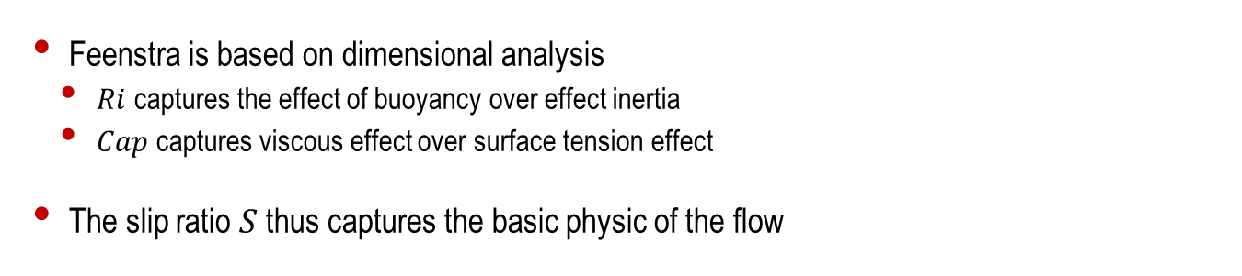
cell_voidFraction
Feenstra is based on dimensional analysis
$Ri$ captures the effect of buoyancy over effect inertia
$Cap$ captures viscous effect over surface tension effect
The slip ratio $S$ thus captures the basic physic of the flow

Slide 27
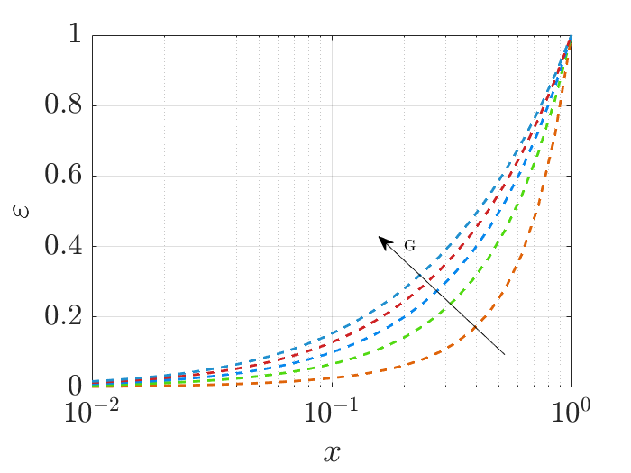
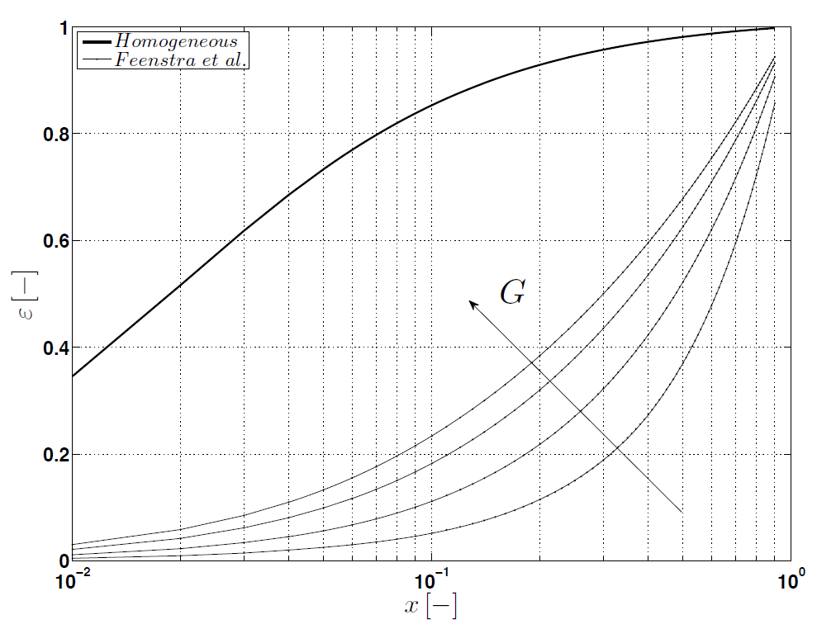

cell_voidFraction
$ε$ as function of $x$ at $T_{sat}=15C^{o}$for R134a
Feenstra correlation implemented in our code
Feenstra correlation in Agostini thesis
Notes:
We don’t know s and D Agostini used => not perfectly the same curves

Slide 28
SolveCell
Needs: $T_{w}^{in}, P_{wf}^{in}, T_{wf}^{in}T_{wf}^{out}$
Needs: 𝑇_𝑤^𝑖𝑛, 𝑃_𝑤𝑓^𝑖𝑛, 𝑇_𝑤𝑓^𝑖𝑛 𝑇_𝑤𝑓^𝑜𝑢𝑡
2: cell_vaporQuality
Needs: $T_{w}^{in}, T_{w}^{out}, T_{wf}^{in}, x_{wf}^{in}$
Needs: 𝑇_𝑤^𝑖𝑛, 𝑇_𝑤^𝑜𝑢𝑡, 𝑇_𝑤𝑓^𝑖𝑛, 𝑥_𝑤𝑓^𝑖𝑛
Computes $x_{wf}^{out}$
Computes 𝑥_𝑤𝑓^𝑜𝑢𝑡
3: cell_voidFraction
Needs: $x_{wf}^{out}, T_{wf}^{out}, ε_{wf}^{in}$
Needs: 𝑥_𝑤𝑓^𝑜𝑢𝑡, 𝑇_𝑤𝑓^𝑜𝑢𝑡, 𝜀_𝑤𝑓^𝑖𝑛
4: cell_pressureDrop
Needs: $T_{w}^{out}, ε_{wf}^{out}, x_{wf}^{out}, T_{wf}^{out}, P_{wf}^{in}, P_{w}^{in}, ε_{wf}^{in}$
Needs: 𝑇_𝑤^𝑜𝑢𝑡, 𝜀_𝑤𝑓^𝑜𝑢𝑡, 𝑥_𝑤𝑓^𝑜𝑢𝑡, 𝑇_𝑤𝑓^𝑜𝑢𝑡, 𝑃_𝑤𝑓^𝑖𝑛, 𝑃_𝑤^𝑖𝑛, 𝜀_𝑤𝑓^𝑖𝑛
5: $T_{wf}^{out}$update
5: 𝑇_𝑤𝑓^𝑜𝑢𝑡update
Update of $T_{wf}^{out}$ using new state ($P_{wf}^{out}$ and $x_{wf}^{out}$)
Update of 𝑇_𝑤𝑓^𝑜𝑢𝑡 using new state (𝑃_𝑤𝑓^𝑜𝑢𝑡 and 𝑥_𝑤𝑓^𝑜𝑢𝑡)
Computes $T_{w}^{out}$ using Newton algorithm and EnergyBalance.py
Computes 𝑇_𝑤^𝑜𝑢𝑡 using Newton algorithm and EnergyBalance.py
1: $T_{w}^{out}$computation
1: 𝑇_𝑤^𝑜𝑢𝑡computation
Computes $ε_{wf}^{out}$
Computes 𝜀_𝑤𝑓^𝑜𝑢𝑡
Computes $P_{wf}^{out}, P_{w}^{out}$
Computes 𝑃_𝑤𝑓^𝑜𝑢𝑡, 𝑃_𝑤^𝑜𝑢𝑡
Iterate until $\left|P_{wf_{NEW}}^{out}−P_{wf}^{out}\right|<tol$
Algorithm

Slide 29
cell_pressureDrop
WAS IST LOS !!! GAUTIER IS ASSIGNED
Algorithm

Slide 30
SolveCell
Needs: $T_{w}^{in}, P_{wf}^{in}, T_{wf}^{in}T_{wf}^{out}$
Needs: 𝑇_𝑤^𝑖𝑛, 𝑃_𝑤𝑓^𝑖𝑛, 𝑇_𝑤𝑓^𝑖𝑛 𝑇_𝑤𝑓^𝑜𝑢𝑡
2: cell_vaporQuality
Needs: $T_{w}^{in}, T_{w}^{out}, T_{wf}^{in}, x_{wf}^{in}$
Needs: 𝑇_𝑤^𝑖𝑛, 𝑇_𝑤^𝑜𝑢𝑡, 𝑇_𝑤𝑓^𝑖𝑛, 𝑥_𝑤𝑓^𝑖𝑛
Computes $x_{wf}^{out}$
Computes 𝑥_𝑤𝑓^𝑜𝑢𝑡
3: cell_voidFraction
Needs: $x_{wf}^{out}, T_{wf}^{out}, ε_{wf}^{in}$
Needs: 𝑥_𝑤𝑓^𝑜𝑢𝑡, 𝑇_𝑤𝑓^𝑜𝑢𝑡, 𝜀_𝑤𝑓^𝑖𝑛
4: cell_pressureDrop
Needs: $T_{w}^{out}, ε_{wf}^{out}, x_{wf}^{out}, T_{wf}^{out}, P_{wf}^{in}, P_{w}^{in}, ε_{wf}^{in}$
Needs: 𝑇_𝑤^𝑜𝑢𝑡, 𝜀_𝑤𝑓^𝑜𝑢𝑡, 𝑥_𝑤𝑓^𝑜𝑢𝑡, 𝑇_𝑤𝑓^𝑜𝑢𝑡, 𝑃_𝑤𝑓^𝑖𝑛, 𝑃_𝑤^𝑖𝑛, 𝜀_𝑤𝑓^𝑖𝑛
5: $T_{wf}^{out}$update
5: 𝑇_𝑤𝑓^𝑜𝑢𝑡update
Update of $T_{wf}^{out}$ using new state ($P_{wf}^{out}$ and $x_{wf}^{out}$)
Update of 𝑇_𝑤𝑓^𝑜𝑢𝑡 using new state (𝑃_𝑤𝑓^𝑜𝑢𝑡 and 𝑥_𝑤𝑓^𝑜𝑢𝑡)
Computes $T_{w}^{out}$using Newton algorithm and EnergyBalance.py
Computes 𝑇_𝑤^𝑜𝑢𝑡using Newton algorithm and EnergyBalance.py
1: $T_{w}^{out}$computation
1: 𝑇_𝑤^𝑜𝑢𝑡computation
Computes $ε_{wf}^{out}$
Computes 𝜀_𝑤𝑓^𝑜𝑢𝑡
Computes $P_{wf}^{out}, P_{w}^{out}$
Computes 𝑃_𝑤𝑓^𝑜𝑢𝑡, 𝑃_𝑤^𝑜𝑢𝑡
Iterate until $\left|P_{wf_{NEW}}^{out}−P_{wf}^{out}\right|<tol$
Algorithm

Slide 31
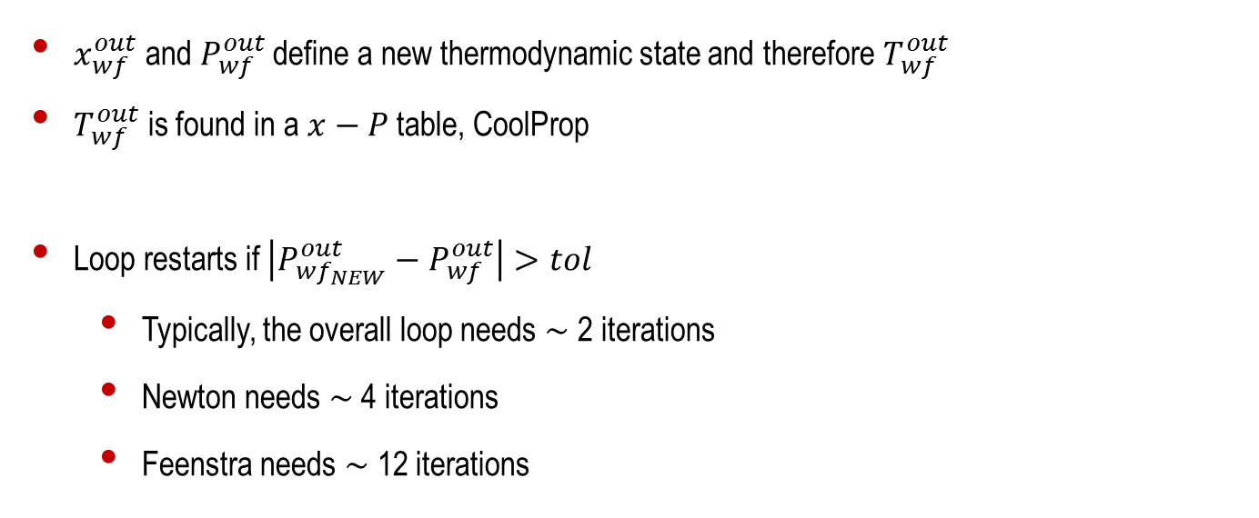
$T_{wf}^{out}$ update and Loop end
$x_{wf}^{out}$ and $P_{wf}^{out}$ define a new thermodynamic state and therefore $T_{wf}^{out}$
$T_{wf}^{out}$ is found in a $x−P$ table, CoolProp
Loop restarts if $\left|P_{wf_{NEW}}^{out}−P_{wf}^{out}\right|>tol$
Typically, the overall loop needs $∼$ 2 iterations
Newton needs $∼$ 4 iterations
Feenstra needs $∼$ 12 iterations
Algorithm

Slide 32
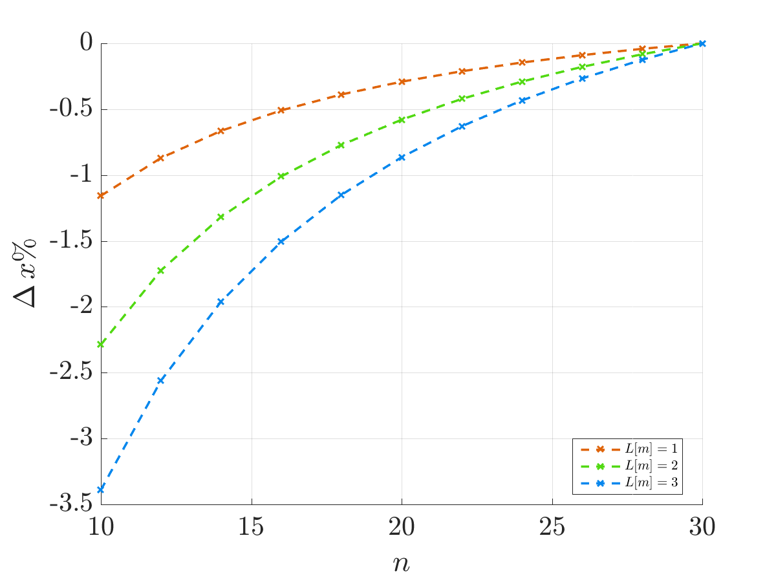
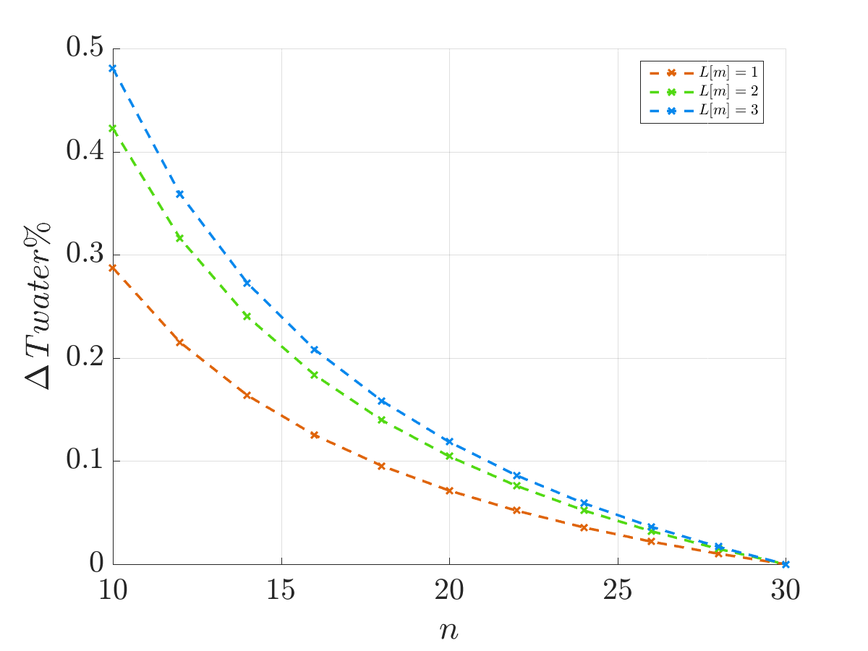
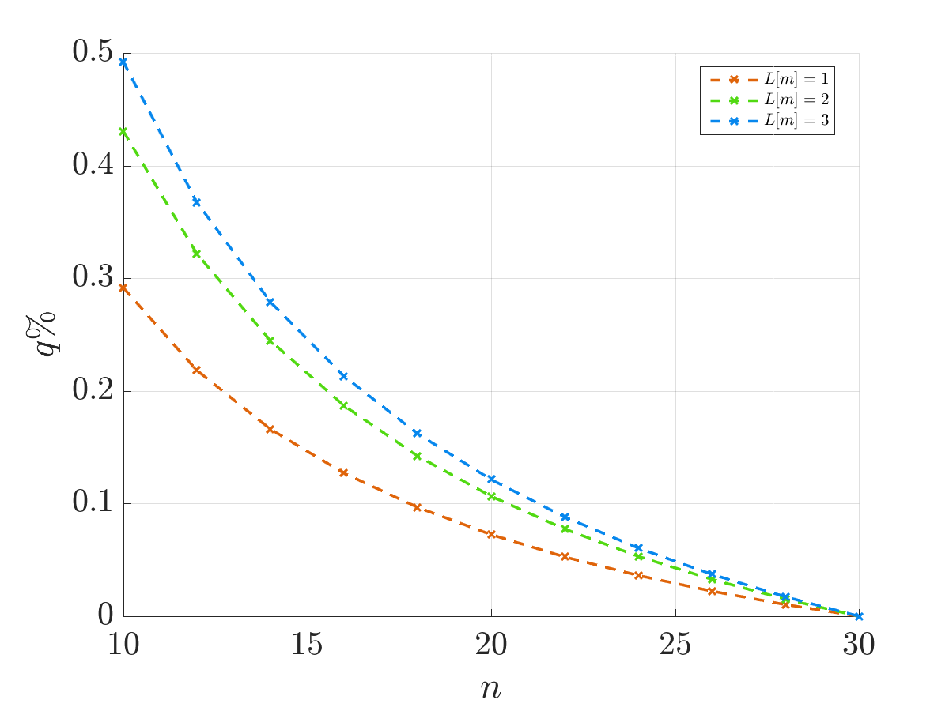
Space discretization convergence

Slide 33
Parametric tool
With this code, we can estimate the performances of a tube bundle boiler
Could be interesting to study parameter sensibility
Parametric analysis available
Returns plot of any result depending on any two input parameters

Slide 34
GUI presentation
EMILE IS ASSIGNED
Exploitation

Slide 35
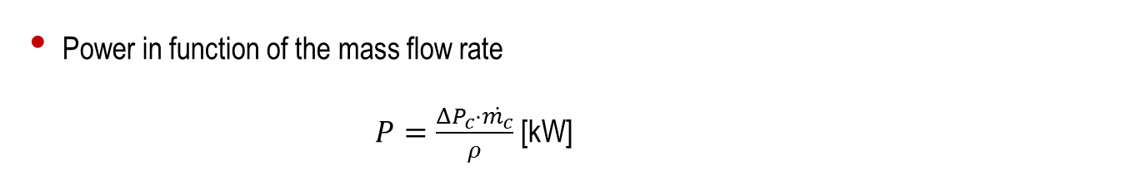
Trend curves
Power in function of the mass flow rate
$P=\frac{ΔP_{c}⋅\dot{m_{c}}}{ρ}$ [kW]
Trend Curves

Slide 36
Trend curves
Total heat transfer in function of rugosity
Trend Curves

Slide 37
Trend curves
Total heat transfer in function of the thermal conductivity of the material
Trend Curves
Notes:
We see that at low mass flow rates, the fluid is overheated and the evaporator is far from being efficient. The by increasing the mass flow rate we get limited by the thermal conductivity. As expected, the steel (with the worse thermal conductivity) stagnate at a certain level. The reason is that

Slide 38
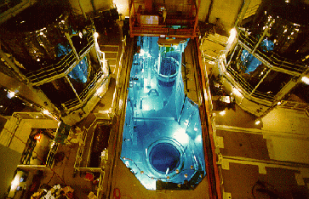
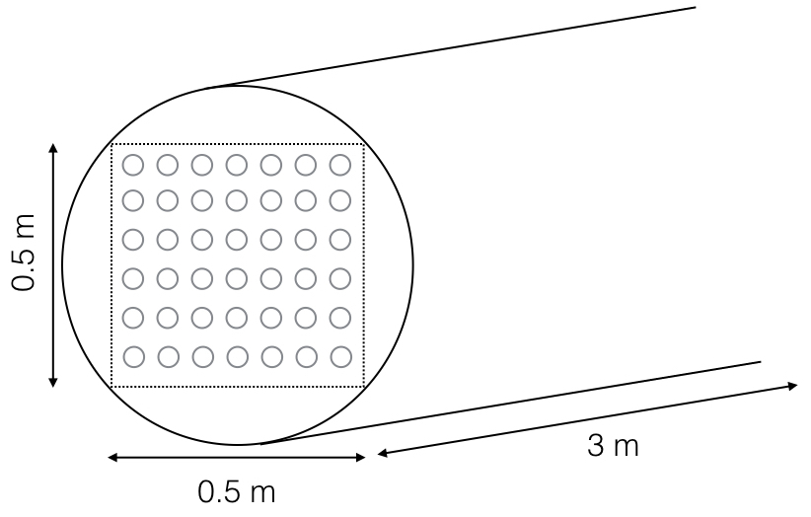
Case study
Cooling system of the water circuit of the spent fuel pool in a nuclear power plant
Inputs
Inlet water temperature: 25°C
Outlet water temperature: 12-15°C
Power: 600-1000[kW]
Geometrical constraints:
Heat exchanger size:
Wide: 0.5 m
Height: 0.5 m
Length: 3 m
Case study

Slide 39
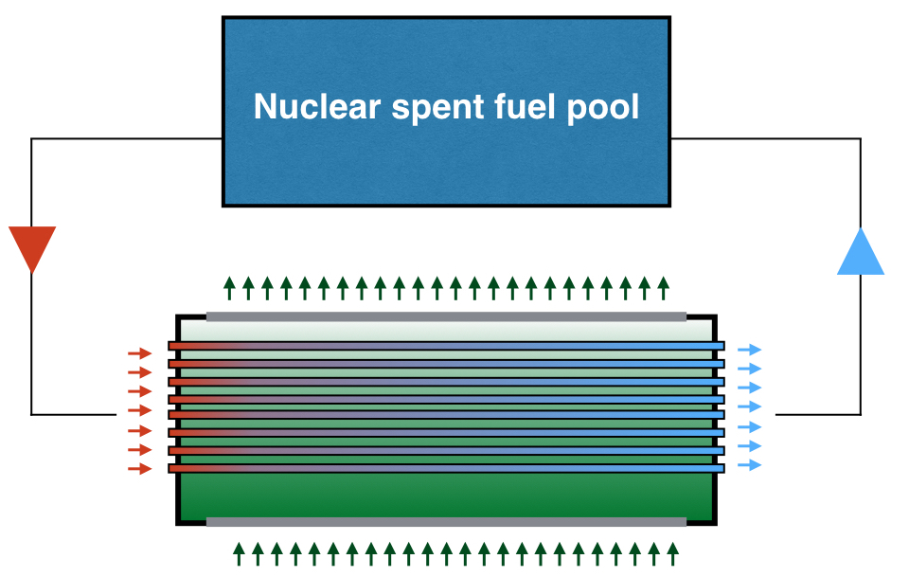




Case study
Gaz Refrigerant at ${T_{wf}}_{outlet}$
Water
$$Tw= {{12}^{o}C−15}^{o}C$$
$$Tw= {25}^{o}C$$
$$\dot{{ m}_{w}}=15 kg/s$$
Liquid Refrigerant at $T_{wf_{inlet}}$ with ${x_{wf}}_{inlet}$
Case Study

Slide 40



Initial Design (Standard)
Geometry :
- Length L = 3 m
- Surface 0,5 m x 0,5 m
- Diameter D = 3 cm
- Thickness t = 3 mm
- Pitch s = 4,5 cm
- Number of tubes N = 11x11 = 121
- Tube material : Copper
Flow inputs:
Water
$Tw_{inlet}= {25}^{o}C$
$\dot{{\dot{m}}_{w_{inlet}}}=15{kg}/s$
Operating condition:
Refrigerant : R134a
$Twf_{inlet}= 5^{o}C$
${{\dot{m}}_{wf}}_{inlet}=40{kg}/s$
Results:
Capacity Q =
$Tw_{outlet}= ?$
Trend Curves

Slide 41
Design 1 – Choice of the Working fluid
Case study

Slide 42
Design 2 – bundle arrangement
Case study

Slide 43
Design 3 – effect of tube type
Case study

Slide 44
Design 4 – effect of tube pitch
Case study

Slide 45
Design 5 – effect of mass flow rate
Case study

Slide 46
Potential improvements
Heat advection – diffusion
Optimization algorithm
Integration of superheating
Water flow direction
GUI
Conclusion

Slide 47
Ecole Polytechnique
Fédérale de Lausanne
EPFL
Présentation EPFL-Public | 2016

Slide 48
Photo en arrière plan
Chapitre

Slide 49
Titre
Texte Arial Narrow Bold
Texte Arial Narrow
Texte Arial Narrow Bold couleur
Rubrique
Sujet

Slide 50
Titre
Photo
Rubrique
Sujet

Slide 51
Elements graphiques
Texte Arial Narrow Bold
Texte Arial Narrow
Texte Arial Narrow Bold couleur
Texte Arial Narrow Bold
Rubrique
Sujet

