Slide 1
Breaking Down 12-Month SIP Continuation for First-Time Investors
Decomposing Retention into North Star, Primary, L1 Operational Metrics & The 5-Stage Lifecycle Journey
🌟 NORTH STAR METRIC
% First-Time Investors Active at M12
Formula: ≥1 successful debit in trailing 30 days at M12 ÷ Total First-Time Cohort.
Goal: Defends genuine compounding habit.
🎯 PRIMARY METRICS
• 12-Mo SIP Retention: 50% ➔ 56% (+6% absolute lift).
• Month 2–6 Cliff: Reduce drop-off from 45% to <30%.
• Inflow Retention: Preserve ~₹2,500/mo avg instalment.
⚙️ L1 / INPUT METRICS
• Mandate Success: Debits cleared without fee (>95%).
• Engagement: Reviewing monthly debrief (≥65%).
• Query Resolution: In-app doubt resolution (>85%).
• Flexibility: Skip/Pause chosen vs cancel (>50%).
Month 0: Setup | Month 1: 1st Debit | Months 2–6: Churn Cliff 🔥 | Months 7–11: Habit | Month 12+: Step-Up
UPI auto-pay setup; initial fund pick. | 1st automated debit processes. | Encounter 1st market dip (-5% to -10%). | Routine stabilizes; market recovers. | 1-year investing anniversary.
High optimism, low market literacy. | Verifies debit; flat return (+₹10). | Panic: Red returns (-₹520) & XIRR (-14%). | Observes recovery; ignores daily noise. | Habit cemented; ready for step-up.
Frictionless setup; set 3-yr horizon. | 1st milestone consistency badge. | Reframing: Dip = unit discount; 1-click skip. | Celebrate 6-mo investing streak. | Milestone badge; prompt 10% step-up.
[Placeholder: Link to Business Metric Decomposition Doc] | NextLeap PM Graduation Project • Groww Growth Track • Strictly Anonymized
Slide 1 of 10

Slide 2
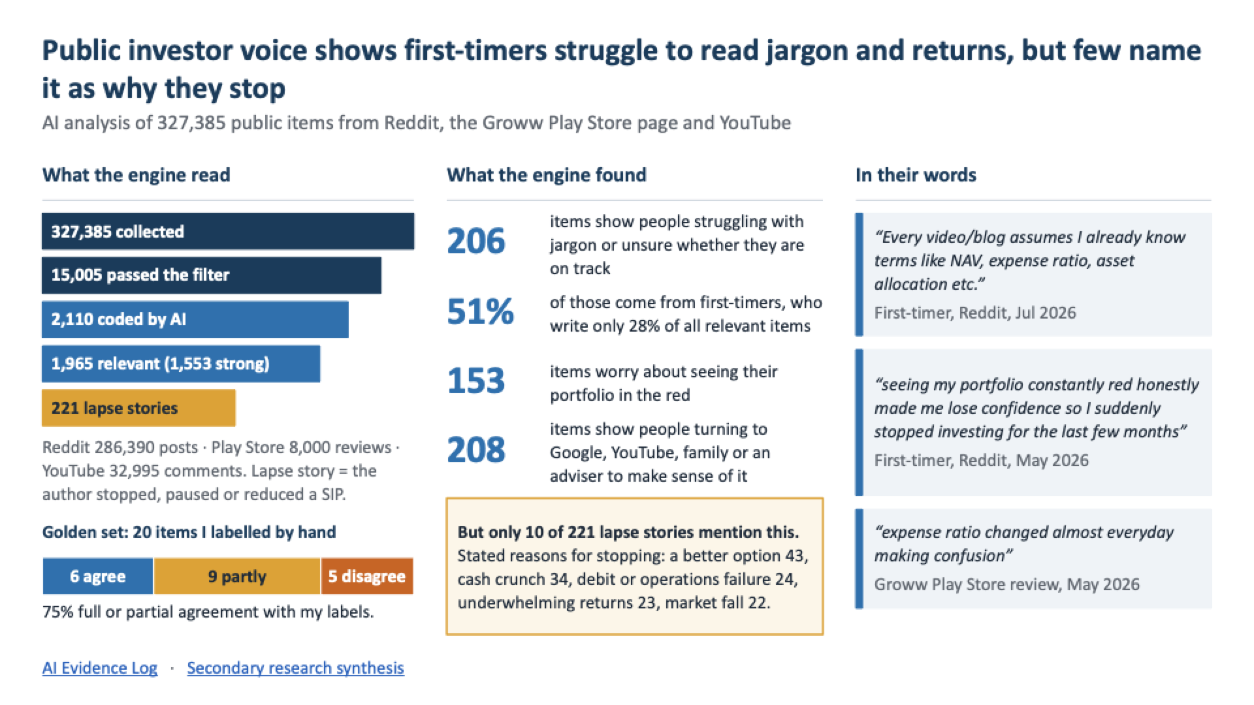

Slide 3
Primary User Research: Confusion and Support Voids Drive Cancellation Intent
5 In-Depth Qualitative 1-on-1 Interviews (30–45 Mins) with Retail SIP Investors across Groww & Competitors
UI Overload Designed for Veterans
Legacy trading layouts spook beginners with high data density and live price updates.
“Everything is tailor-made for veterans... Lot of numbers getting updated without clarity in layman language.”
— Pradhul (36, Salaried IT Professional, Groww user)
Dashboard Confusion Drives Churn Intent
Inability to track progress or understand metrics induces cognitive fatigue and exit intent.
“As a first-timer, identifying what to track was difficult. Made me consider stopping my SIP... too hectic.”
— Sushant (27, First-Time SIP Investor, Groww user)
The Support & Handholding Void
Zero in-app contextual reassurance forces users to abandon the platform for YouTube and Google search.
“No one gives advice, but there was no handholding... had to search Google and YouTube to understand.”
— Bijoy (38, Retail Investor, Groww & Zerodha user)
Mandate Timing Anxiety & Bank Penalties
1-day notice creates acute balance anxiety, risking ₹250–₹500 bank bounce fees and reactive churn.
“Groww intimates only 1 day before debit. If they gave 3–4 days advance notice, we could maintain funds in time.”
— Pradhul & Bijoy (Joint Finding on Mandate Timing)
[Placeholder: Link to Full Verbatim Interview Transcripts] | NextLeap PM Graduation Project • Groww Growth Track • Strictly Anonymized
Slide 3 of 10

Slide 4
Target Segment: Salaried First-Timers Entering the Month 2–6 "Conviction Cliff"
Zero Prior Financial Literacy Meets the First Flat or Negative Market Correction Cycle
👤 TARGET PERSONA: SUSHANT
• Demographics: 27 yrs old, Salaried Software Engineer, Bengaluru.
• Investment: ₹3,000/mo SIP in Flexi Cap Fund (Month 3 active).
• Goal & Intent: Long-term wealth compounding (5–10 years).
• Financial Literacy: Zero prior market experience; relies completely on Groww UI.
• Behavior: Checks portfolio 3–5x/month; easily spooked by red returns.
• Core Dilemma: Experiences acute guilt when seeing paper loss during dips.
⚡ THE CRITICAL DROP-OFF MOMENT (MONTH 3)
Trigger: Month 3 auto-debit clears ₹3,000. Market enters 4% dip.
What Groww Displays (Panic Trigger):
Total Invested: ₹9,000 | Current Value: ₹8,480
Total Returns: -₹520.00 (-5.8%) | XIRR: -14.2%
1. Paper Loss Panic: Interprets -₹520 loss as vanishing capital.
2. Jargon Alienation: Assumes -14.2% XIRR means losing 14% of principal.
3. YouTube Search: Leaves app; overwhelmed by finfluencer panic videos.
4. Permanent Churn: Cancels auto-pay mandate at first tight month.
[Placeholder: Link to User Journey & Friction Mapping] | NextLeap PM Graduation Project • Groww Growth Track • Strictly Anonymized
Slide 4 of 10

Slide 5
First-Time Investors Lapse Due to an Early Conviction Deficit and Red-Return Panic
The NextLeap 6-Box Framework: Deconstructing Root Causes, Target Cohort, and Strategic Value for Groww
1. THE PROBLEM First-time mutual fund investors on Groww pause or cancel SIPs within 12 months because the dashboard overwhelms them with jargon and raw metrics, offering zero guidance—leading to panic when markets dip or cash tightens. | 2. TARGET SEGMENT First-Time SIP Investors in Months 2–6: Salaried retail investors (age 22–30, SIP ₹1k–₹5k/mo) with long-term wealth goals but zero financial literacy, who encounter their first flat/negative return cycle during a market dip. | 3. HOW WE KNOW IT'S REAL Direct Primary & Secondary Validation: • Sushant (27): "Hard to know what to track. Made me consider stopping." • Pradhul (36): "Tailor-made for veterans." • Secondary: 64% negative reviews cite red return confusion.
4. VALUE FOR THE BUSINESS Plugs the 12-Month SIP Churn Cliff: Retaining users past Months 2–6 boosts 12-month retention (>75% survival post-M6). Retained investors step up SIP amounts, expanding compounding AUM and protecting acquisition CAC. | 5. VALUE FOR THE USERS Replaces Anxiety with Habit Conviction: Translates complex jargon into plain-English progress. Explains that dips buy cheaper units (Rupee-Cost Averaging), protecting users from panic-stopping wealth creation. | 6. WHY SOLVING MAKES SENSE Bridging the Product DNA Gap: Groww's UI originated from active stock trading. Applying trading UI to a 10-year SIP product misaligns first-timers. Contextualizing metrics turns Groww into a trusted wealth partner.
[Placeholder: Link to Problem Definition Working Doc] | NextLeap PM Graduation Project • Groww Growth Track • Strictly Anonymized
Slide 5 of 10

Slide 6
Prioritizing an In-Context AI Companion to Translate Data into Conviction
Evaluating Solution Archetypes via RICE Scoring (Reach, Impact, Confidence, Effort)
👑 SELECTED: GROWW PERSPECTIVE (AI Companion)
• Core Mechanism: Monthly Debrief + NAV Simulator + "Ask About My SIP" decryptor with SEBI eval-gates.
• Why It Wins: Dynamically personalizes each user's exact numbers (78.70 discounted units), which static text cannot do.
• Defends Habit: Pairs plain education with 1-click Skip/Pause flexibility.
❌ EVALUATED & REJECTED ALTERNATIVES
1. Groww Clarity View (Beginner Mode Toggle):
• Why Rejected: Simply hides metrics. Passive; fails to build financial conviction. Users still panic when value drops below invested.
2. Static Tooltips & In-App Articles (Academy 2.0):
• Why Rejected: High cognitive load. Users in panic do not read 800-word articles. Cannot compute personal unit savings.
Solution Concept | Reach (1–10) | Impact (1–3) | Confidence | Effort (1–5) | RICE Score | Rank
👑 Groww Perspective (In-Context AI Companion) | 8 | 3 | 0.90 | 3 | 7.20 | Rank 1 (Selected)
Groww Clarity View (Beginner Mode Toggle) | 7 | 2 | 0.80 | 3 | 3.73 | Rank 2
Static Tooltips & Nudges (Academy 2.0) | 7 | 1 | 0.70 | 2 | 2.45 | Rank 3
[Placeholder: Link to Full RICE Prioritization Model] | NextLeap PM Graduation Project • Groww Growth Track • Strictly Anonymized
Slide 6 of 10

Slide 7
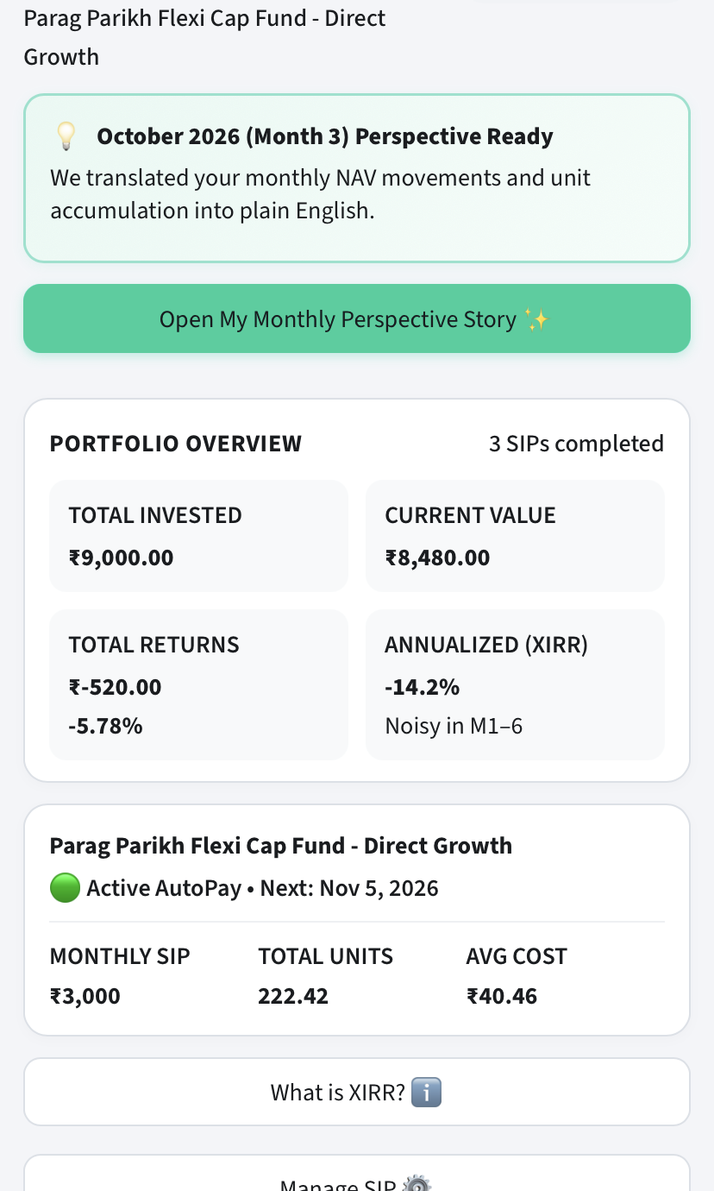
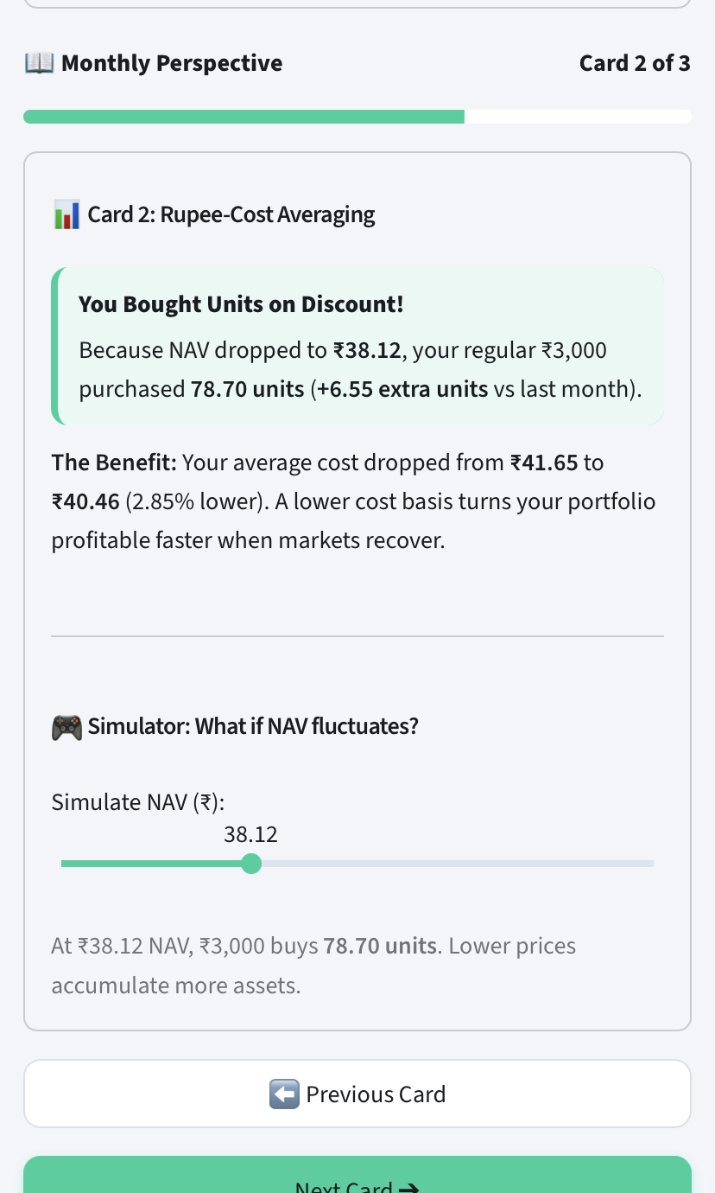
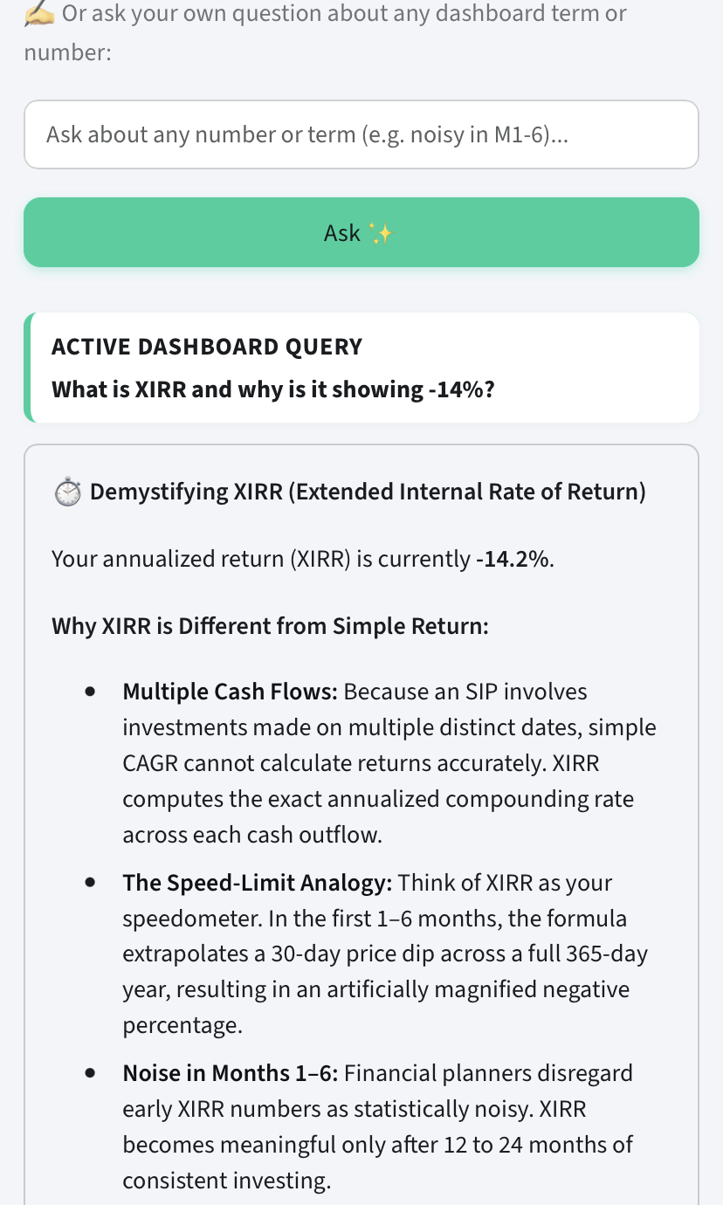
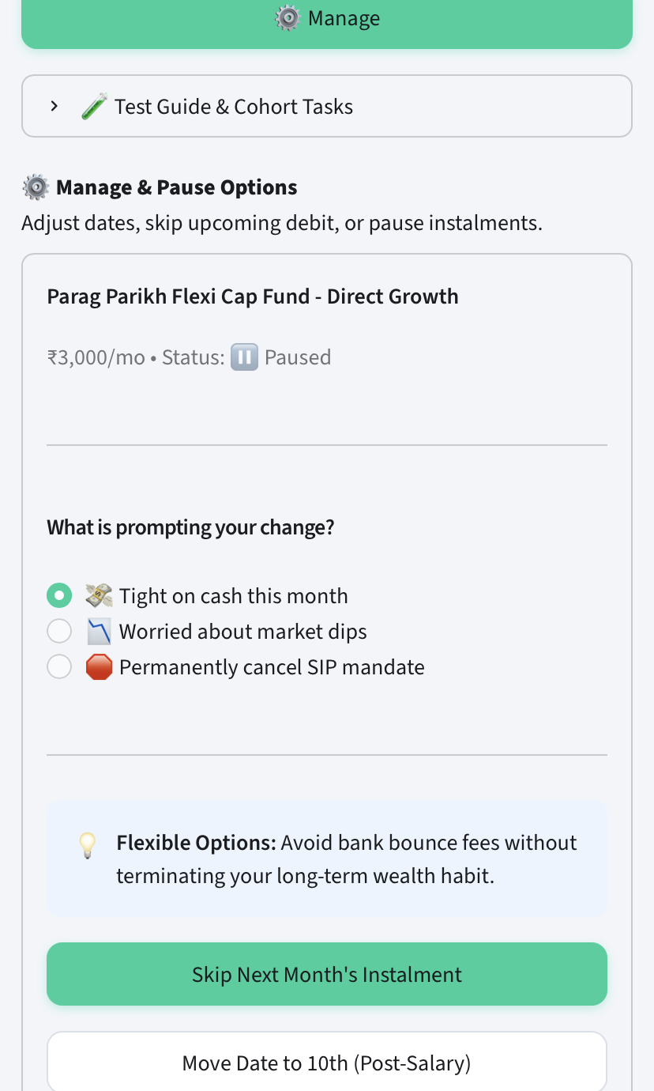
An Eval-Gated, SEBI-Compliant In-App Companion Built and Deployed
4-Pillar Architecture Translating Ledger Data into Plain-Language Conviction & Flexibility
1. Contextual Anchor
2. Cognitive Reframing
3. Plain-English Decryptor
4. Smart Exit Flexibility
Holdings reframes -₹520 loss via October Perspective card before panic sets in.
Proves mathematically that market dip bought 78.70 discounted units (+6.55 extra).
Speedometer metaphor for XIRR + Verified Ledger (100/100) SEBI compliance badge.
Non-punitive 1-click Skip 1 Month (zero fee) or Pause with zero dark patterns.
[Placeholder: Link to Live Interactive MVP & Evidence Log] | NextLeap PM Graduation Project • Groww Growth Track • Strictly Anonymized
Slide 7 of 10

Slide 8
Prototype Testing Validates Anxiety Reduction; Surfaces Demand for V2 Expansion
Task-Based Usability Protocol with Target First-Time SIP Investors Using Live Production MVP
✅ WHAT REAL USERS VALIDATED
• Uncluttered Mobile UI: “Data was not cluttered at all, very easy to focus on each button... self-explanatory.” Validates departure from trading clutter.
• NAV Simulator as Anxiety Diffuser: “Gave a very clear explanation... NAV Simulator slider will be very helpful for beginners to reduce anxiety.”
• Layman Jargon Decryption: “Very accurate and free of jargon, especially explaining XIRR and why it is noisy in Months 1 to 6... understood by any layman.”
• Habit Defense via Flexibility: “If I face a tight month I would definitely use this... can skip 1 month or manually select months to pause with immediate effect.”
📋 PRIORITIZED V2 ROADMAP (FROM USER TESTING)
[P0] Opportunistic Dip Top-Up • Med Effort
• Solves: In-story 1-click lump sum when NAV drops, turning market panic into compounding conviction.
[P0] 3-Day Advance Pre-Debit Alerts • Low Effort
• Solves: Replaces 1-day surprise with 3-day WhatsApp alert + 1-click Skip; eliminates ₹250–₹500 bounce fees.
[P1] Groww Wallet Auto-Fallback • Med Effort
• Solves: Automatically debits Groww wallet balance if bank account has insufficient funds to clear SIP.
[P1] Goal Tracking & Transparent Exits • High Effort
• Solves: Allows investors to map SIPs to life milestones and execute partial/full redemptions with zero dark patterns.
[Placeholder: Link to User Testing Transcripts & V2 PRD] | NextLeap PM Graduation Project • Groww Growth Track • Strictly Anonymized
Slide 8 of 10

Slide 9
Phased Rollout to High-Drop-Off Cohorts While Tracking 12-Month Mandate Health
4-Stage GTM Architecture & Guardrailed Metrics Hierarchy (Leading, Lagging, and Guardrail Indicators)
🚀 4-PHASE GTM STAGED ROLLOUT STRATEGY
• Phase 1: Validation & Legal Gate (Weeks 1–2):
Internal dogfooding & compliance review. 20-case Golden Set validation (100% adherence, zero SEBI advice breaches).
• Phase 2: Canary Beta Launch (Weeks 3–6):
Release to 10,000 first-time investors in Month 3. Monitor story completion rates, AI query topics, and support deflection.
• Phase 3: Staged A/B RCT Experiment (Weeks 7–12):
50/50 randomized trial during next market correction. Measure Net Negative-Market Retention Delta between treatment and control.
• Phase 4: Full Scale & Contextual Scale (Month 4+):
100% rollout across first-time investors. Contextual in-product entry points: monthly debriefs & 3-day pre-debit alerts.
📊 GUARDRAILED METRICS ARCHITECTURE
🌟 North Star Metric: 12-Month Active SIP Continuation Rate (% of first-timers with ≥1 successful debit in trailing 30 days at Month 12).
⏩ Leading Indicators: • Story Mode Completion Rate (≥65% target)
• In-App AI Query Resolution Rate (>85% target)
• Flexibility Adoption Rate (Skip/Pause vs cancel >50%)
📈 Lagging Indicators: • Month 2–6 Churn Cliff Survival Rate (>75% post-M6)
• Net Negative-Market Retention Delta (+5% to +8% over control)
• 12-Month Active SIP Retention Rate (50% ➔ 56% lift)
🛡️ Guard Rail Metrics: • SEBI Advice Breaches: Strictly 0% (zero stock/fund tips)
• Arithmetic Accuracy: 100% deterministic (Python ledger)
• Cancellation Flow Friction: <15s (zero dark patterns)
• App Page Load Latency: <200ms via overnight pre-computation
[Placeholder: Link to GTM Experimentation Protocol] | NextLeap PM Graduation Project • Groww Growth Track • Strictly Anonymized
Slide 9 of 10

Slide 10
Protecting ₹26.8 Cr Annualized Inflows While Mitigating Advice and Bounce Risks
Multi-Year Enterprise Financial Impact Sizing & Pre-Mortem Risk Mitigation Strategies
💰 BUSINESS IMPACT SIZING (FINANCIAL MODEL)
• Cohort Scale: Groww onboards ~500k first-time investors monthly (~6M/yr).
• Baseline Churn: Current 12-mo retention ~50% (steepest cliff in Months 2–6).
• Target Retention Lift: Conservative +6.0% absolute lift (50% ➔ 56%).
• Incremental Retained: 500k × 6% = 30k users/mo ➔ 360,000 active investors/yr.
• Direct Net AUM (Yr 1): 360k × ₹30k annual inflow = ₹1,080 Crores direct AUM preserved.
• Compounding AUM (Yr 3): >75% survival + 10% step-up = ₹4,500+ Crores AUM.
• Marketing CAC Savings: 360k users × ₹1,500 CAC = ₹54 Crores/yr saved in wasted CAC.
🛡️ PRE-MORTEM RISK & MITIGATION STRATEGIES
• 1. Regulatory & SEBI Advice Risk (Critical):
Hard-coded Advisory Interceptor blocks buy/sell/switch intents; deflects to certified advisors with mandatory disclaimer. Strictly 0% breaches (20/20 Golden Set).
• 2. Arithmetic & Ledger Hallucination Risk:
Zero runtime LLM math. All ledger metrics pre-computed deterministically in Python (portfolio_data.py). 100% deterministic agreement between ledger and UI.
• 3. Operational Churn & Mandate Penalty Risk:
3-day advance pre-debit notifications via WhatsApp with 1-click non-punitive Skip 1 Month or Date Move. Reduces bounce churn by ≥35%.
• 4. App Performance & Page Latency Risk:
Asynchronous overnight batch pre-computation post-market close stored in low-latency cache, ensuring <200ms instantaneous native UI render.
[Placeholder: Link to Risk & Compliance Register] | NextLeap PM Graduation Project • Groww Growth Track • Strictly Anonymized
Slide 10 of 10

