Slide 1

DATE: 12/03/2024
DATAFORGE
By,
Pranav Pradeep Nair
Emil George Mathew
Abhishek Bhosale
Henry Kangten

Slide 2
BACKGROUND

Slide 3

PROJECT GOAL:
Analyse the performance of Amtrak stations using various performance metrics like ridership, on-time performance and budgeting across different stations in various states.
END USERS:
Executive officers, decision makers, directors, operations team, data analysts.

Slide 4
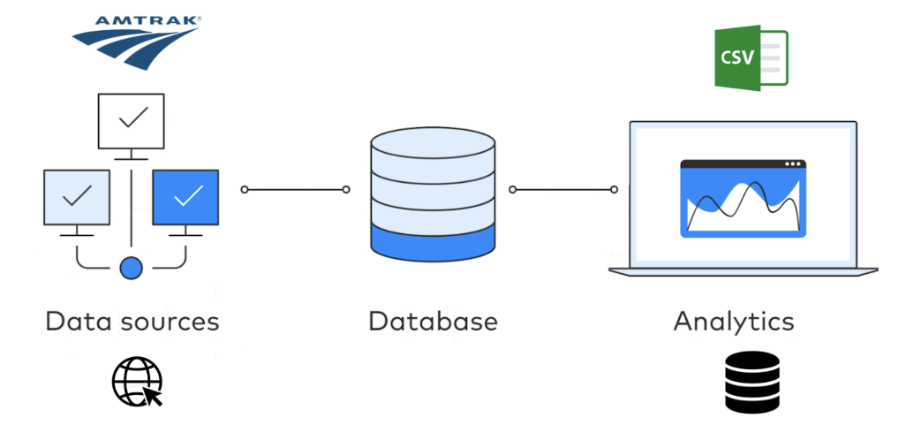
DATA SOURCES

Slide 5
INTRODUCTION

Slide 6
MISSION OBJECTIVE
The mission is to analyze Amtrak’s last 3 years data to provide insights and
recommendations on budgeting and costs using on-time performance, and ridership for
various stations across cities. To analyze performance, recommendations and story tell
using intuitive visualizations and data-driven decisions.
MISSION STATEMENTS
Identify key metrics such as on-time performance by route and station.
Analyze ridership trends across different stations and routes, focusing on high-traffic locations.
Determine procurement spending distribution by city and category to assess impact.
Track employment spends in various states and analyze key metrics.

Slide 7
CONCEPTUAL DATABASE DESIGN

Slide 8
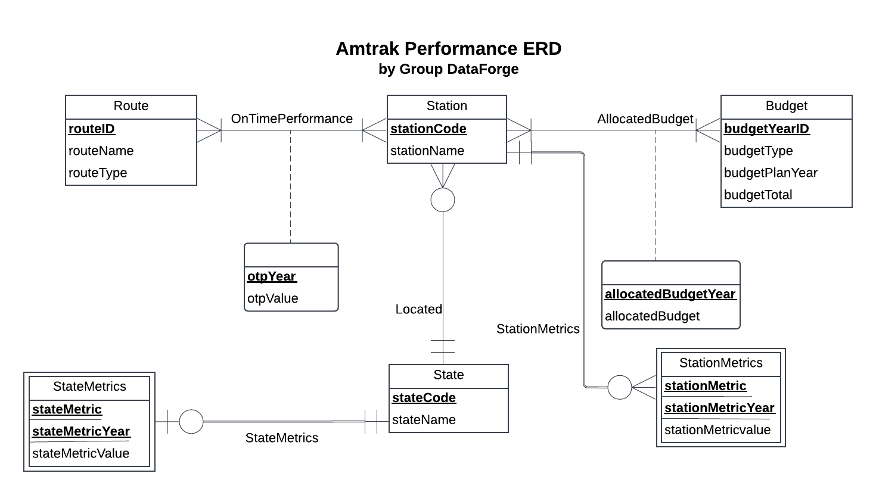
ER DIAGRAM

Slide 9
LOGICAL DATABASE DESIGN

Slide 10
RELATIONAL SCHEMA
State (stateCode, stateName)
Station (stationCode, stationName, stateCode)
StateMetrics (stateCode,stateMetric,stateMetricYear,stateMetricValue)
StationMetrics (stationCode,stationMetric,stationMetricYear,stationMetricValue)
Route (routeID, routeName, routeType)
OnTimePerformance (routeID, stationCode, otpYear, otpValue)
Budget (budgetYearID, budgetType, budgetPlanYear, budgetTotal)
AllocatedBudget (stationCode, budgetYearID, allocatedBudgetYear, allocatedBudget)

Slide 11
PHYSICAL DATABASE DESIGN

Slide 12
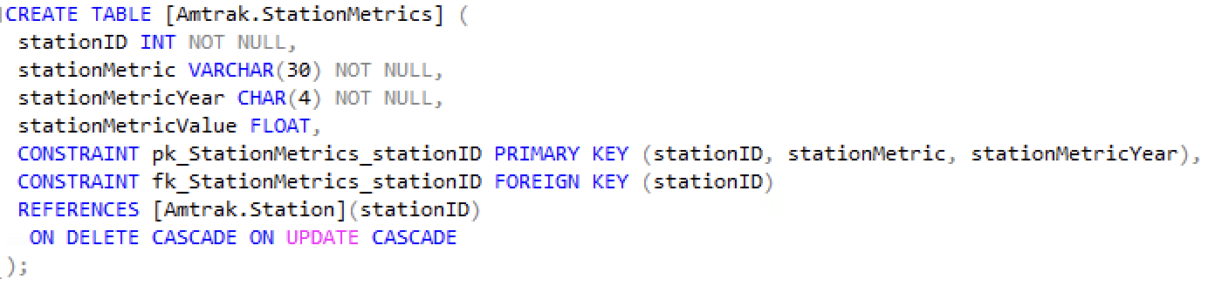
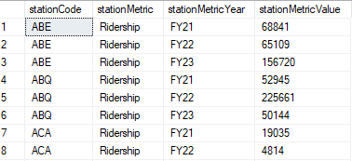
CREATE TABLE

Slide 13
BUSINESS TRANSACTIONS

Slide 14
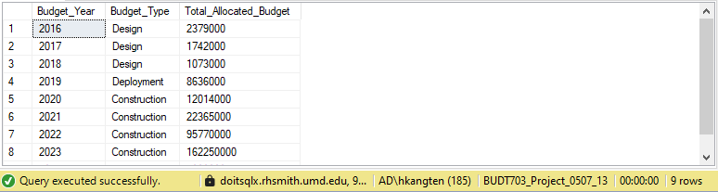
Which budget type received the highest allocated budget in each year?
WITH YearlyBudget AS
( SELECT b.budgetPlanYear AS Budget_Year,
b.budgetType AS Budget_Type,
SUM(ab.allocatedBudget) AS Total_Allocated_Budget
FROM [Amtrak.Budget] b JOIN [Amtrak.AllocatedBudget] ab
ON b.budgetYearID = ab.budgetYearID
GROUP BY b.budgetPlanYear, b.budgetType ),
HighestBudgetPerYear AS
( SELECT Budget_Year, Budget_Type, Total_Allocated_Budget,
RANK() OVER (PARTITION BY Budget_Year ORDER BY Total_Allocated_Budget DESC) AS BudgetRank
FROM YearlyBudget )
SELECT Budget_Year, Budget_Type,
Total_Allocated_Budget
FROM HighestBudgetPerYear
WHERE BudgetRank = 1
ORDER BY Budget_Year ASC;

Slide 15
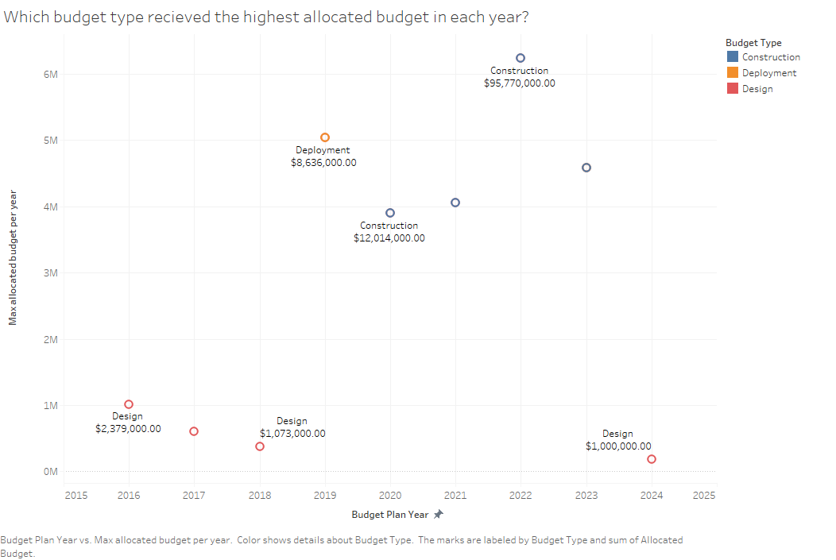
Which budget type received the highest allocated budget in each year?

Slide 16
Observations
Yearly Trends: Budget allocations vary yearly, with "Construction" peaking in years like 2022, while "Design" remains consistently lower.
Dominance of Construction: "Construction" dominated allocations in 2020 to 2023, reflecting a focus on infrastructure projects, with "Deployment" and "Design" playing supportive roles.
Shifting Priorities: Prioritization shifted over time, as seen in "Deployment" peaking in 2019 but declining in later years, indicating strategic or project-specific changes.
Suggestions
Review Allocation Rationale: Evaluate the justification for higher "Construction" allocations in specific years to ensure alignment with strategic goals and long-term benefits.
Balance Budget Distribution: Optimize the budget allocation between "Construction," "Deployment," and "Design" to improve efficiency and cost-effectiveness in future project phases.
Strategic Planning: Analyze historical allocation trends to stabilize future budgets, enhance resource planning, and reduce reliance on any single budget type.

Slide 17
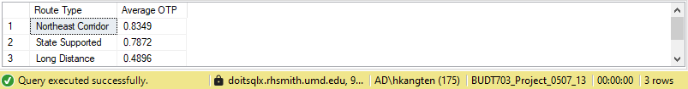
What are the average On-Time performance values for the 3 types of routes?
SELECT r.routeType AS 'Route Type', ROUND(AVG(o.otpValue),4) AS 'Average OTP'
FROM [Amtrak.Route] r
INNER JOIN [Amtrak.OnTimePerformance] o
ON r.routeId = o.routeId
GROUP BY r.routeType
ORDER BY ROUND(AVG(o.otpValue),2) DESC

Slide 18
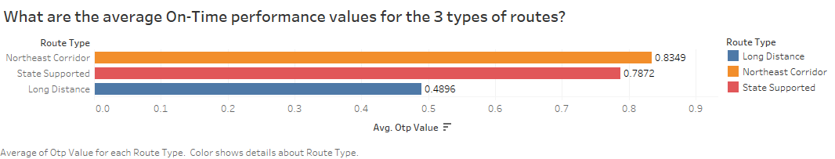
What is the average on time performance values for the 3 types of routes

Slide 19
Observations
High OTP for Northeast Corridor: Northeast Corridor leads with the highest OTP at 0.8349.
State-Supported OTP: State-supported routes perform well at 0.7872, slightly below the Northeast Corridor.
Low OTP for Long-Distance Routes: Long-distance routes lag significantly with an OTP of 0.4896.
Suggestions
Improve Long-Distance Routes: Invest in infrastructure and scheduling to reduce delays.
Replicate Northeast Corridor Success: Apply best practices from Northeast Corridor to other routes.
Enhance State Collaboration: Partner with states to further optimize state-supported route performance.

Slide 20
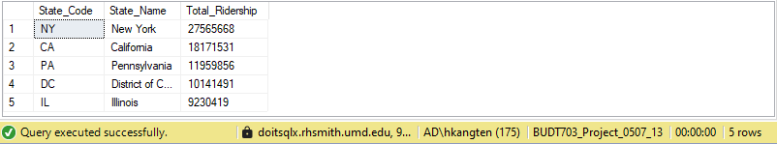
What are the top 5 states with the highest ridership?
SELECT TOP 5 t.stateCode AS State_Code, s.stateName AS State_Name, SUM(m.stationMetricValue) AS Total_Ridership
FROM [Amtrak.StationMetrics] m
JOIN [Amtrak.Station] t ON m.stationCode = t.stationCode
JOIN [Amtrak.State] s ON t.stateCode = s.stateCode
WHERE m.stationMetric = 'Ridership'
GROUP BY t.stateCode, s.stateName
ORDER BY Total_Ridership DESC

Slide 21
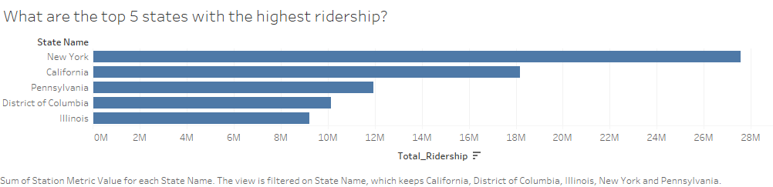
What are the top 5 states with the highest ridership?

Slide 22
Observations
New York leads with the highest ridership at 27.5M, followed by California at 18M.
Pennsylvania, D.C., and Illinois rank next with notable contributions.
High ridership reflects key urban transit hubs in these states.
Suggestions
Prioritize New York and California for maintaining service quality.
Promote strategies of the top 5 states to increase ridership in low ridership states.
Analyze drivers of high ridership in top states for broader application.

Slide 23
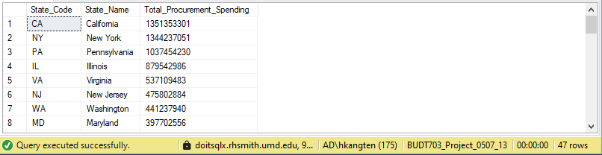
What is the total procurement spending for each state across all years?
SELECT m.stateCode AS State_Code, t.stateName AS State_Name, SUM(m.stateMetricValue) AS Total_Procurement_Spending
FROM [Amtrak.StateMetrics] m
JOIN [Amtrak.State] t ON m.stateCode = t.stateCode
WHERE m.stateMetric = 'Procurement'
GROUP BY m.stateCode, t.stateName
ORDER BY Total_Procurement_Spending DESC;

Slide 24
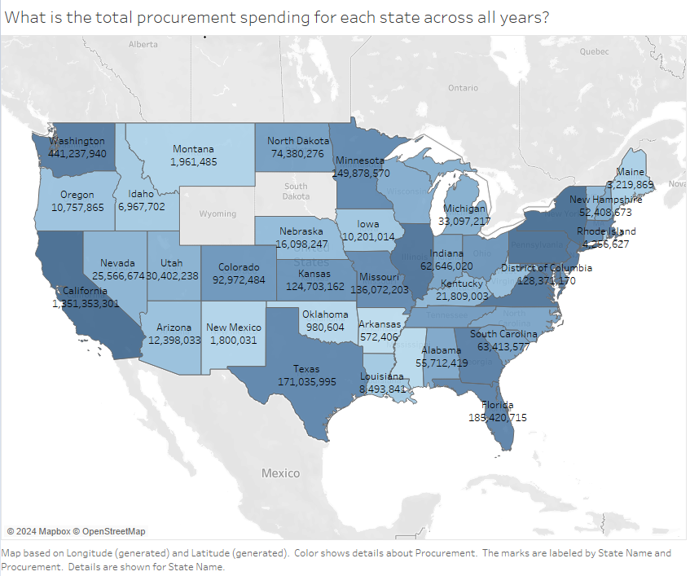
What is the total procurement spending for each state across all years?

Slide 25
Observations
California Leads in Procurement Spending: California has the highest total procurement spending at over $1.35 billion, far exceeding other states.
High Spending in Key States: New York ($1.34 billion) and Pennsylvania ($1.03 billion) also have significant procurement expenditures, reflecting their high operational demands.
Regional Disparities: There are noticeable differences in spending, with Western states like California dominating and many Central states having considerably lower spending.
Suggestions
Investigate High Procurement States: Analyze procurement trends in California, New York, and Pennsylvania to identify efficiencies or cost-saving opportunities.
Reallocate Resources Strategically: Consider redistributing funds to underfunded states if they show potential for growth or improvement in infrastructure.
Optimize Procurement Practices: Use data from high-performing states to streamline procurement strategies in lower-spending regions to enhance their effectiveness and output.

Slide 26
THANK YOU

