Slide 1
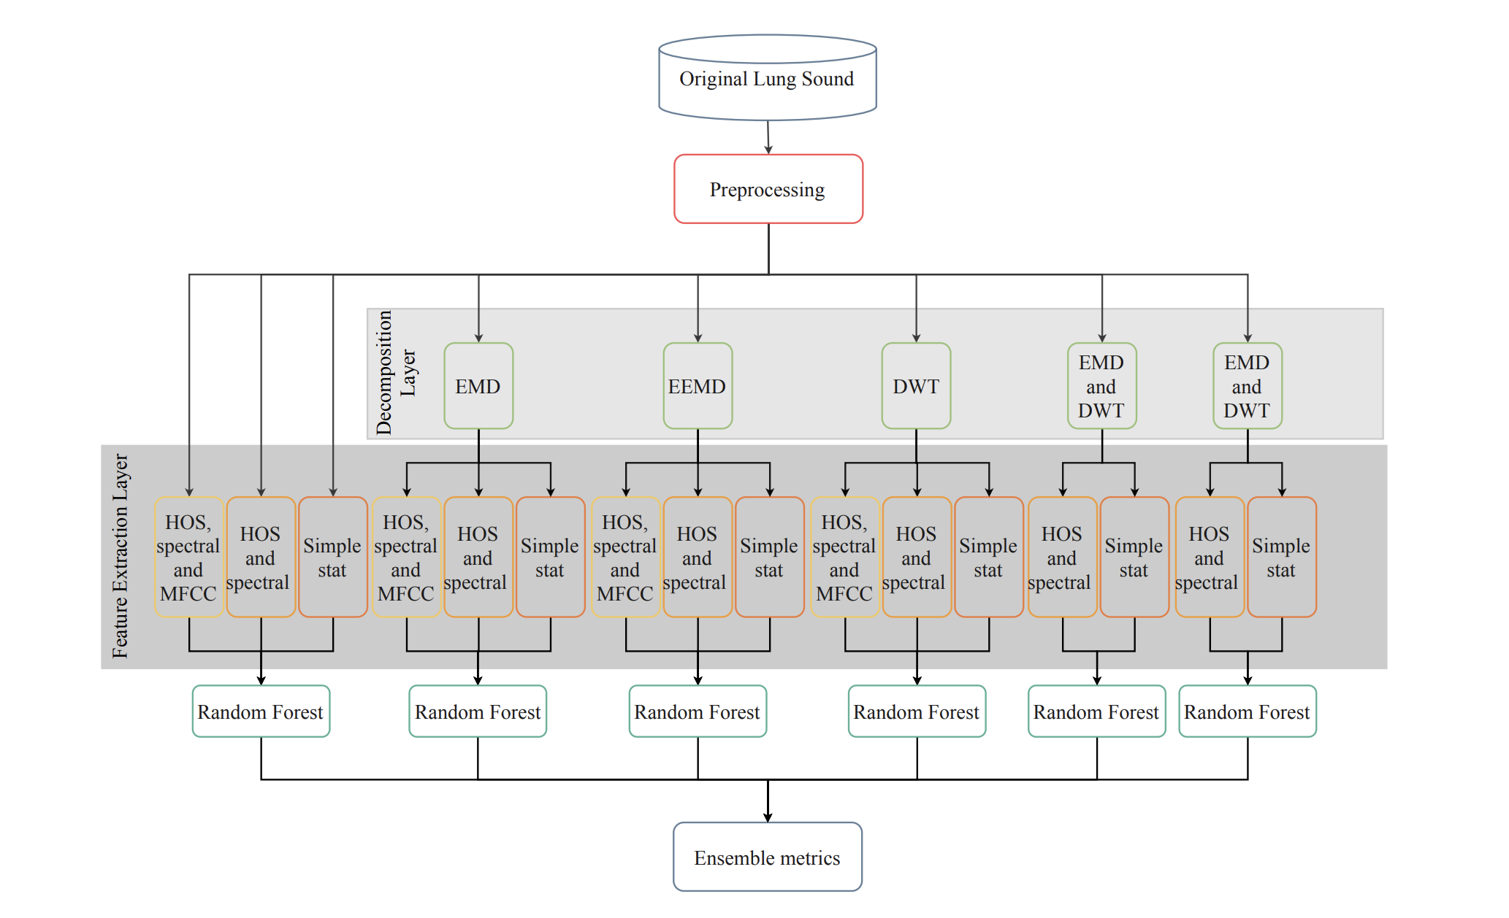
Drilling data
PCA
PCA
PCA
PCA
PCA
PCA

Slide 2
Decomposition and Feature Extraction on Oil Well Drilling Data
Adil Rasheed and Emil Johannesen Haugstvedt
Department of Engineering Cybernetics
NTNU

Slide 3
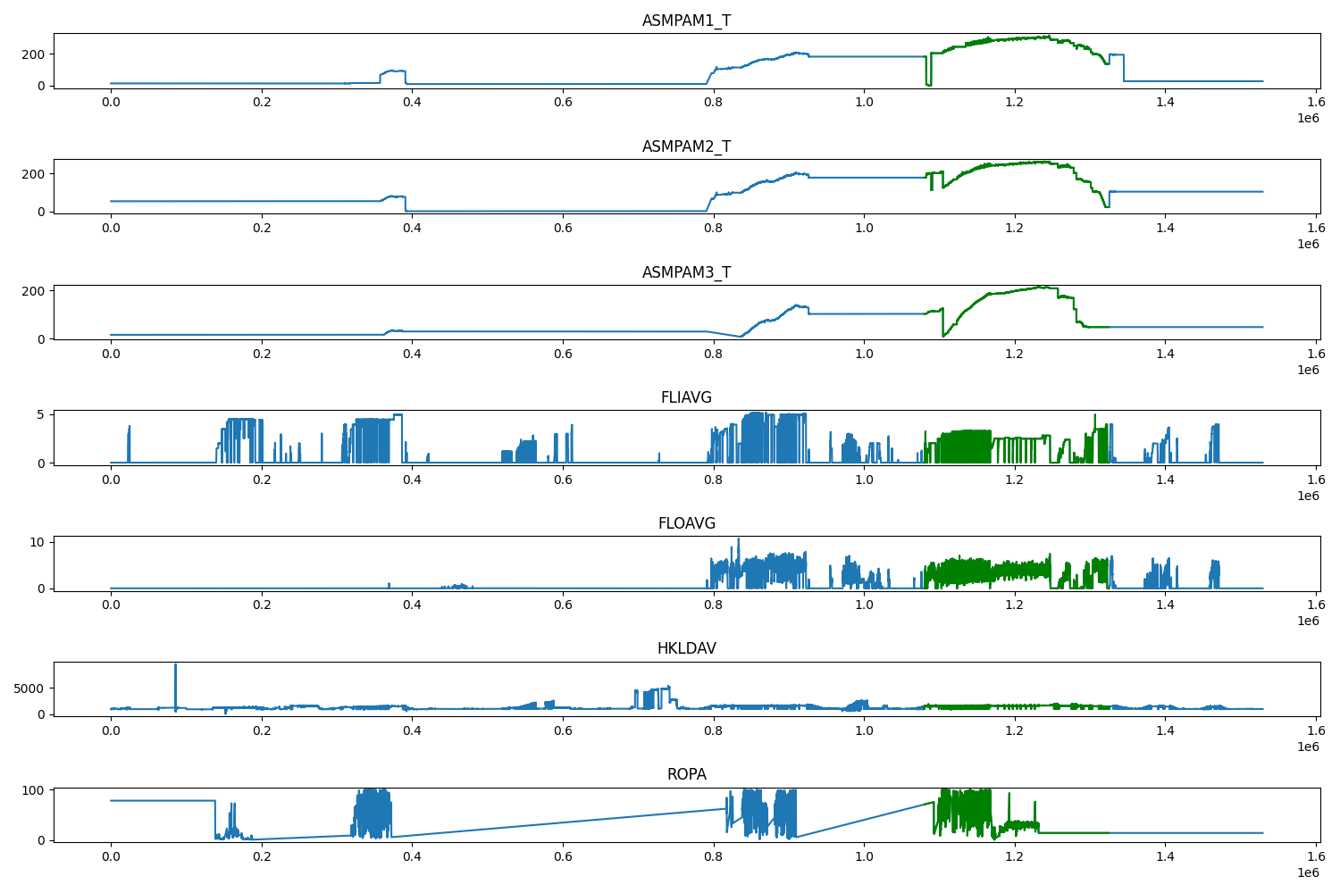
Data

Slide 4
