Slide 1

Demographic Dynamics
Scientific and Large Data Visualization
Emilia Sobolewska M.712854
1

Slide 2

Research Question
Is Europe growing or shrinking- and when did it start?
1. Which European countries are naturally shrinking today?
2
2. When did a country tip from growth to natural decline?
3
3. How steep is the demographic slope?
4
4. Is it fewer births or more deaths?
5. How does the country stack up against its neighbours?
6
7
2

Slide 3
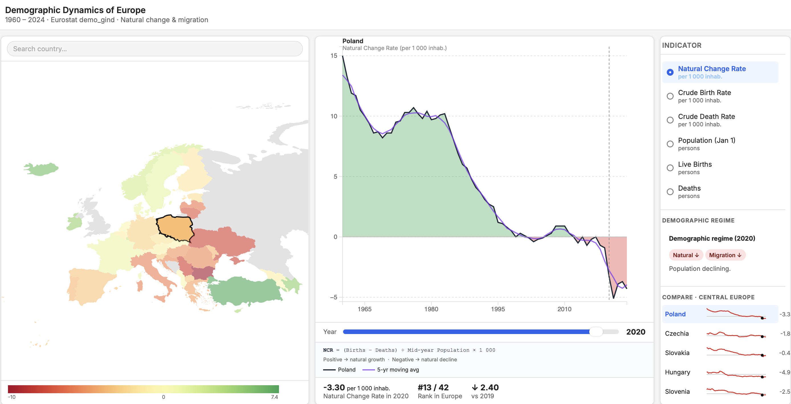
Poland – Natural Change Rate - 2020
3
Notes:
Let's look at Poland specifically. The chart shows the full 60-year journey." "In 1960, Poland had 15 more births per 1,000 people than deaths — a massive natural surplus. The chart is solid green above zero." "Then watch the slope. Through the 1980s and 90s, births fell. The country crossed zero around 2002. Now it's at -3.30 — natural decline." "The purple line is a 5-year moving average. It smooths out noise — COVID spikes, economic shocks — and shows the real underlying trend. And the trend has been downward for 40 years.

Slide 4
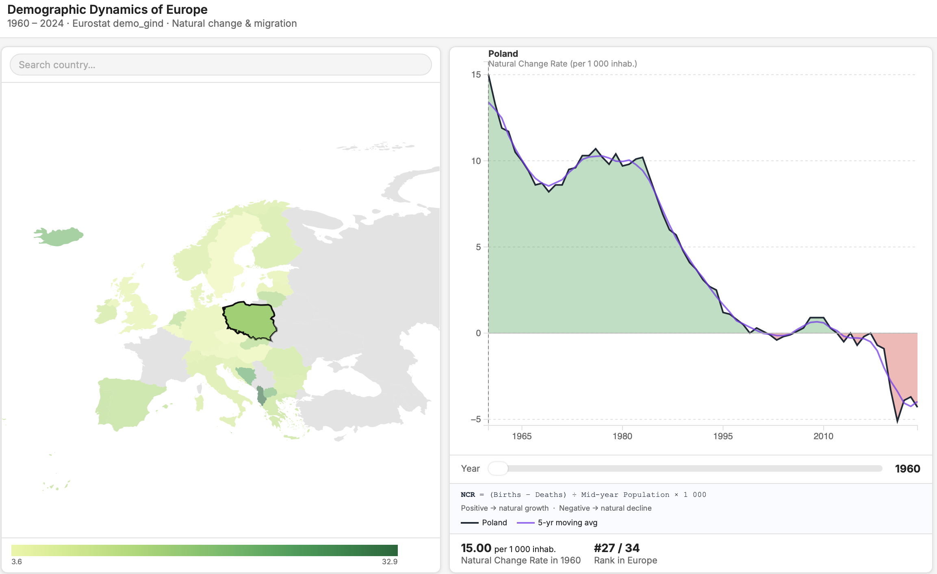
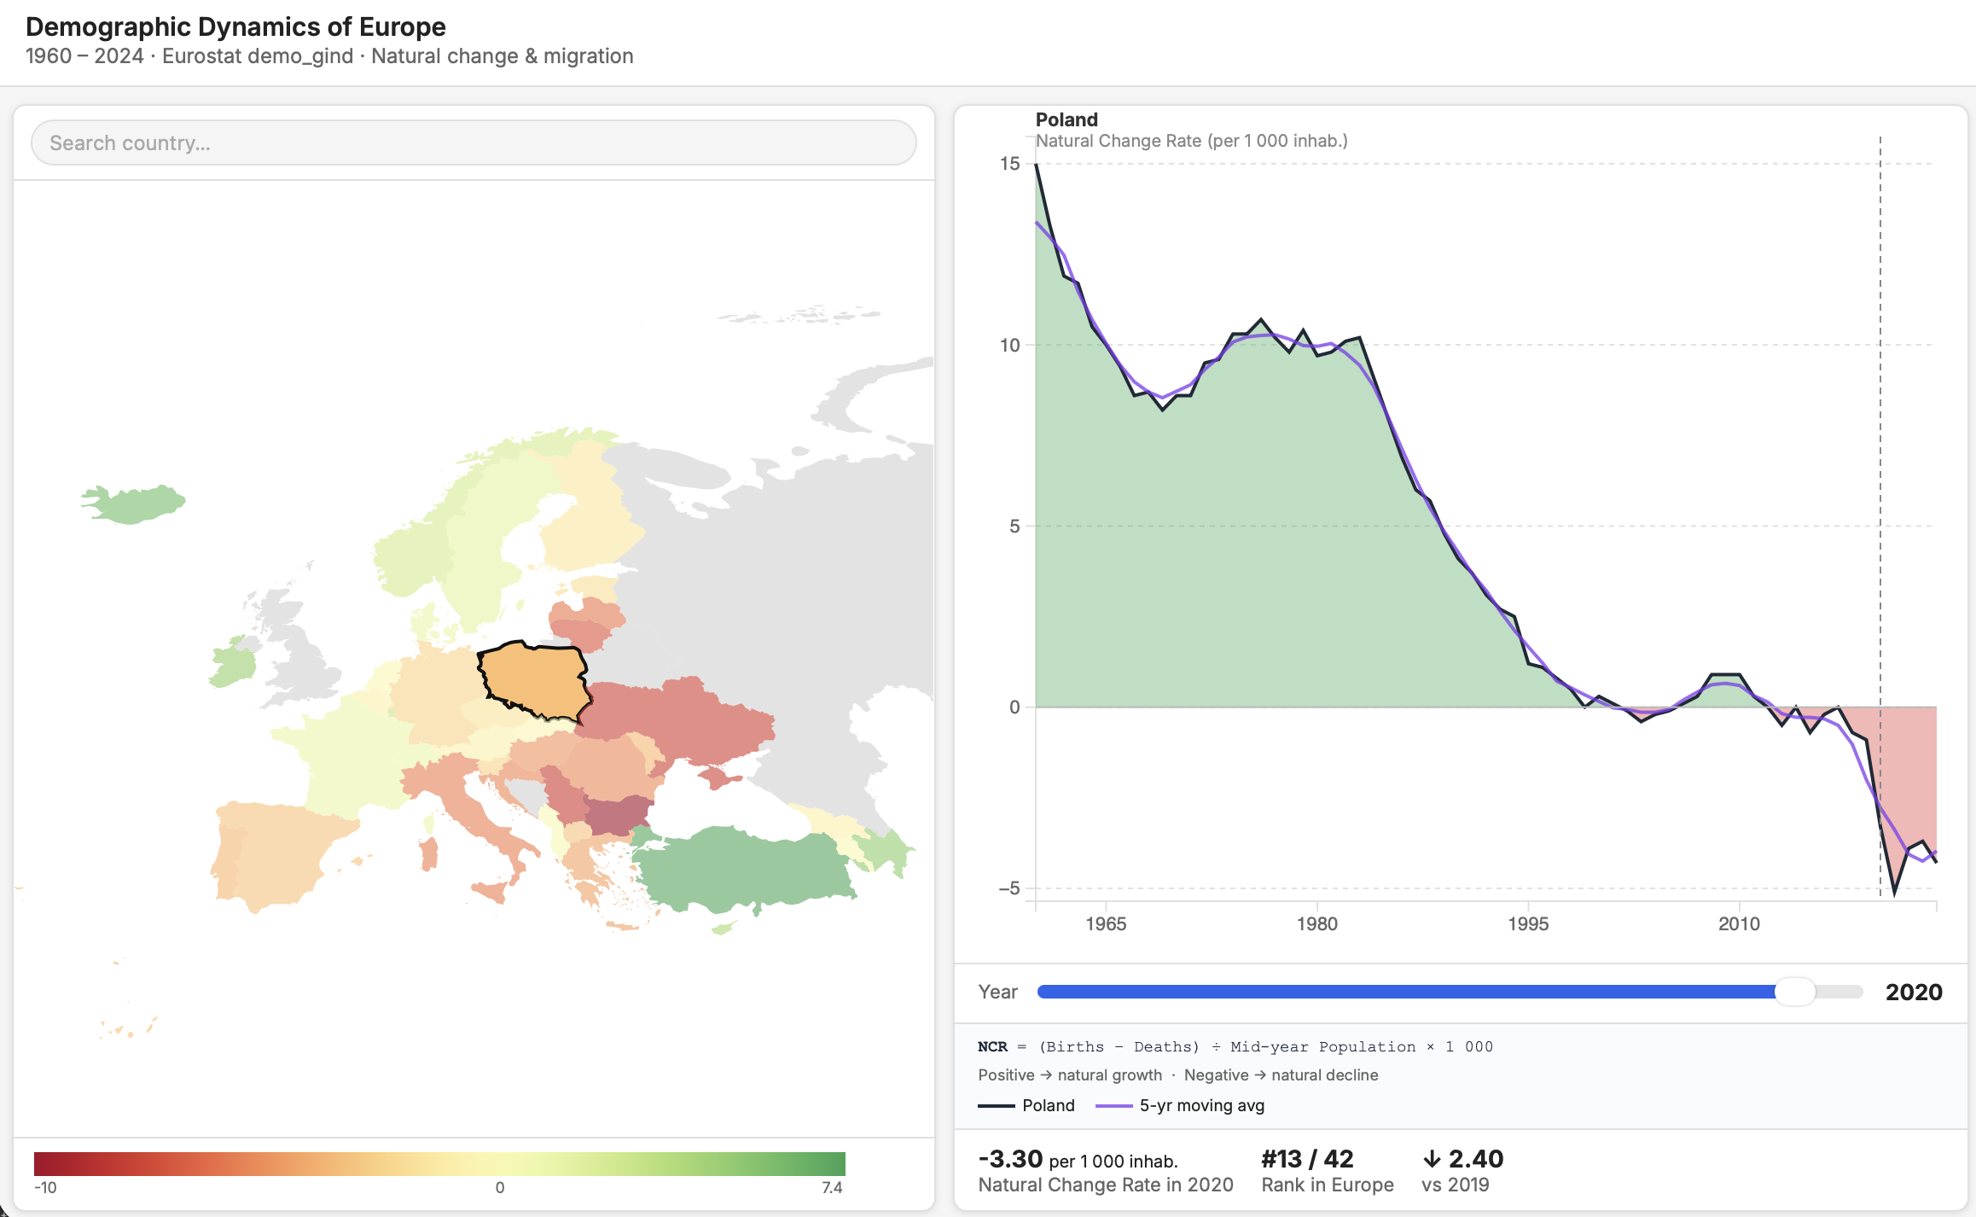
Poland – Natural Change Rate – 1960 vs 2020
4
Notes:
Let's rewind 60 years. Watch the map." "In 1960, natural growth was positive almost everywhere. Birth rates were high. The baby boom was real. Something changed — and this visualization lets us see exactly what, and where, and when.
Poland is not alone. Here are its neighbors — Czechia, Slovakia, Hungary, Slovenia. All of them show the same red downward sparklines. This is a Central European demographic story, not a uniquely Polish one." "You can click any country in this list to switch your selection instantly."

Slide 5
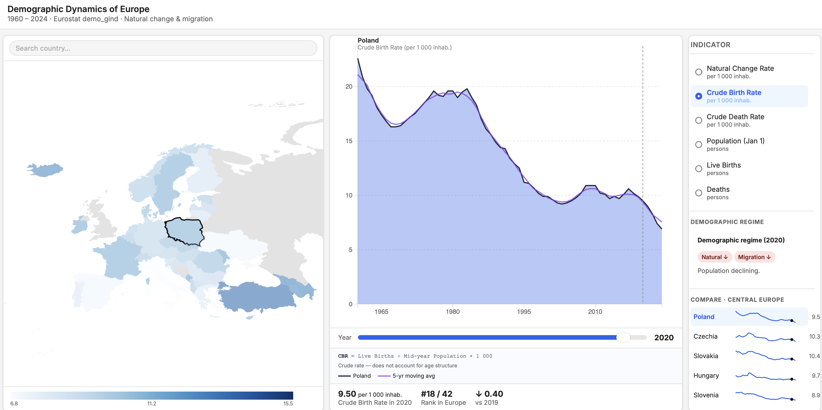
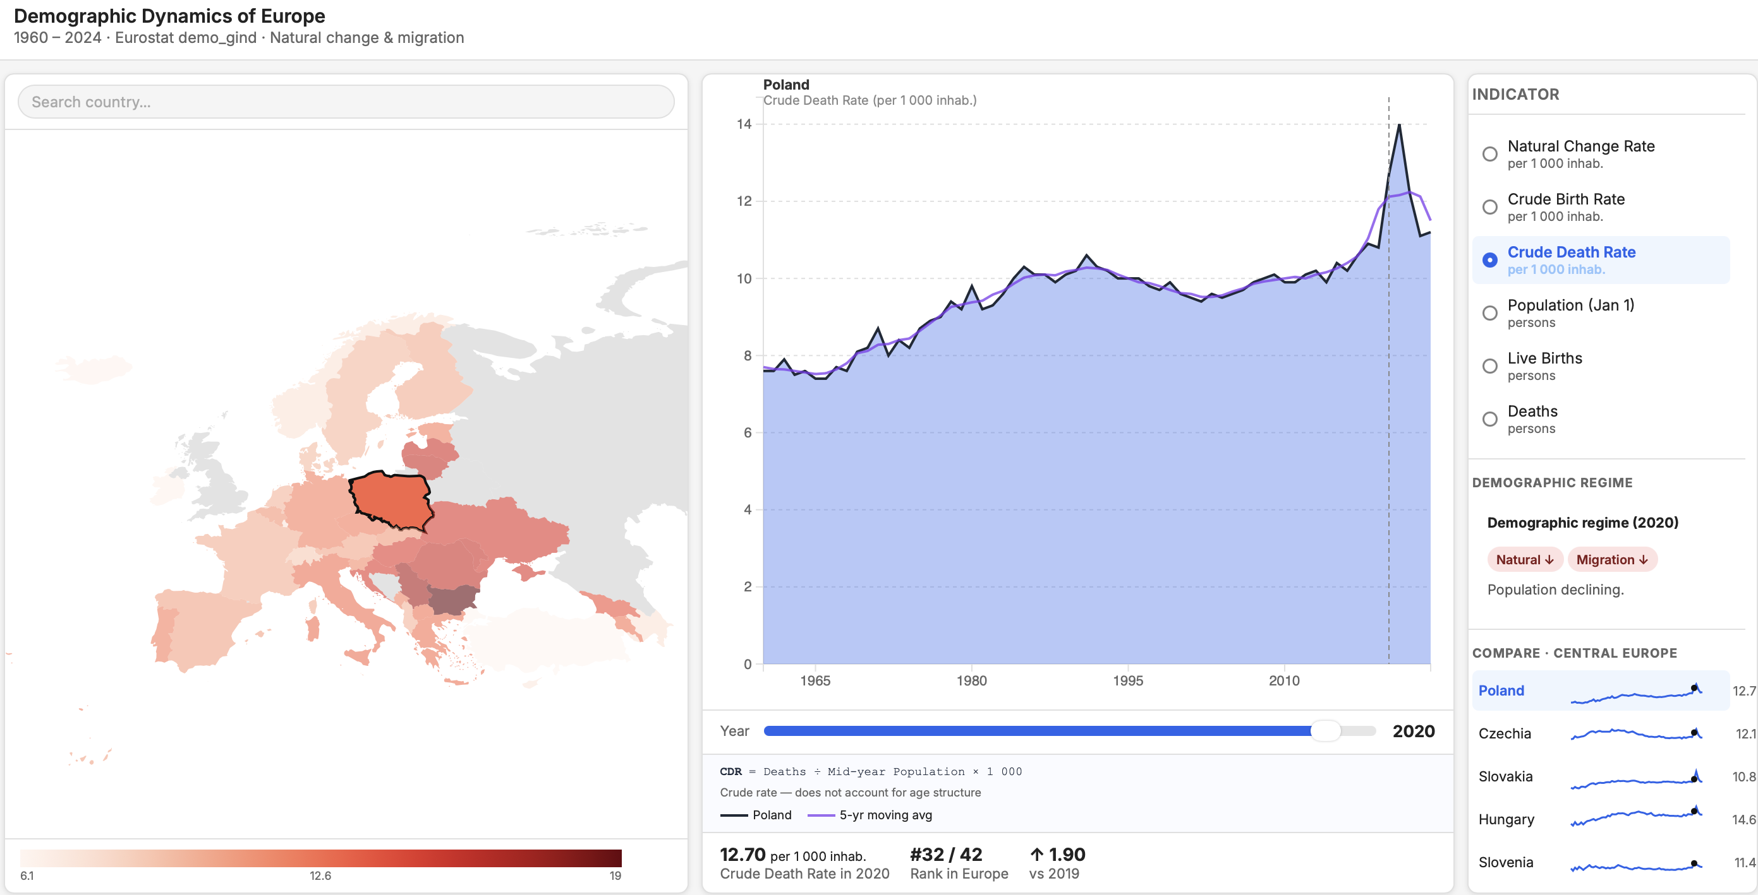
Why is NCR declining?
Crude Birth Rate · Poland · 2020
Crude Death Rate · Poland · 2020
Birth rate: ~25 per 1000 in 1960 → 9.5 in 2020
Death rate: ~8 in 1960 → 12.7 in 2020 (COVID spike) Conclusion: the decline is driven by collapsing births, not rising mortality.
5
Notes:
Why is natural growth declining? There are only two components: births and deaths." (switch to Crude Birth Rate) "Birth rate in Poland: from ~20 per 1,000 in 1960 to around 9 today. Cut in half." (switch to Crude Death Rate) "Death rate: relatively stable, around 10–11 per 1,000. Hasn't changed dramatically." "So the decline is driven almost entirely by collapsing birth rates, not rising mortality. That's the story.
This visualization was built to answer five specific questions about European demographics:"
WHERE is natural decline happening? → the choropleth map
WHEN did a country tip from growth to decline? → the zero-crossing in the area chart
HOW FAST is the trend? → the slope of the moving average
WHAT IS DRIVING IT — births or deaths? → switching indicators
HOW DOES MY COUNTRY COMPARE to its neighbors? → the sparkline panel

Slide 6
Design Decisions
COLORS
CHARTS
Red–Yellow–Green for Natural Change Rate
Choropleth map → WHERE
→ Symmetric: ±5 are equally far from balance
→ Spatial question answered quickly
→ Green = growth / Red = decline
→ Natural Earth: no size distortion
Blues for Birth Rate (sequential: more = darker)
Area chart → WHEN + HOW FAST
→ Green above / red below zero: crossing visible
Reds for Death Rate (sequential: more = darker)
5-yr moving average → TREND vs NOISE
→ Smooths COVID spikes, economic shocks
→ Standard in demography literature
6
Notes:
Earlier in the lifecycle = cheaper to fix. The three approaches are complementary, not competing.

Slide 7
Coordinated Multiple View
Map
Line Chart
Controls
Choropleth –geoNaturalErth1 TopoJSON GISCO 2024
Area chart
5- year moving average
Year slider 1960-2024
Country search
Indicator radio list
7

Slide 8
Eurostat data
Source
Eurostat (EU statistical office) · demo_gind table
Format
JSON-stat · fetched via Eurostat REST API
Coverage
42 European countries · 1960 – 2024
Indicators
Natural Change Rate · Crude Birth Rate · Crude Death Rate · Population · Live Births · Deaths
8

Slide 9
Thank you!
17

