Slide 1
Code: Rendering & Fitness
# renderer.py (excerpt)
def render(self, individual):
canvas = np.ones((self.height, self.width, 3),
np.uint8) * 255
for poly in individual.polygons:
pts = np.array([[poly[0], poly[1]],
[poly[2], poly[3]],
[poly[4], poly[5]]], np.int32)
color = (poly[8], poly[7], poly[6]) # RGB -> BGR
alpha = poly[9] / 255.0
temp = canvas.copy()
cv2.fillPoly(temp, [pts.reshape(-1, 1, 2)], color)
canvas = cv2.addWeighted(temp, alpha,
canvas, 1 - alpha, 0)
return canvas
def calculate_fitness(self, individual):
img = self.render(individual)
mse = np.mean((self.target_image - img) ** 2)
individual.fitness = 1.0 / (1.0 + mse)
Alpha
Each triangle is blended with its own transparency
1 / (1 + MSE)
Higher fitness = closer to the target image
Drawing order matters: later triangles cover earlier ones.
Notes:
The renderer turns the list of numbers (the genome) into an image. Every triangle is drawn on a copy of the canvas and blended back with its own alpha, so later triangles overlay earlier ones. Fitness is 1/(1+MSE) against the target image. This is the most expensive step of the whole program: it runs once per individual per generation. (This replaces the old 'Code - MSE' slide: evaluate() now lives in renderer.py.)

Slide 2
Code: Mutation & Crossover
# individual.py (excerpt)
def mutate(self, mutation_rate, strength):
child = self.copy()
idx = [i for i in range(len(child.polygons))
if random.random() < mutation_rate]
if not idx: # at least one
idx = [random.randrange(len(child.polygons))]
for i in idx:
poly = child.polygons[i]
kind = random.choice(
["move_point", "color", "alpha"])
# move one vertex +/- 10 px
# change one colour +/- 20
# change alpha +/- 15
return child
# individual.py (excerpt)
def crossover(self, other):
child = self.copy()
n = min(len(self.polygons),
len(other.polygons))
cut = random.randint(1, n - 1)
child.polygons = (
[list(p) for p in self.polygons[:cut]] +
[list(p) for p in other.polygons[cut:]])
return child
# A: [t1 t2 t3 t4 t5 t6]
# B: [u1 u2 u3 u4 u5 u6]
# cut after 3
# child: [t1 t2 t3 u4 u5 u6]
Small steps (±10 px, ±20 colour, ±15 alpha), 5 % of the triangles per child.
One-point crossover on polygon level, applied to 70 % of the children.
Notes:
Mutation: every triangle is mutated with probability 5 percent, at least one per child. A mutation moves one vertex, changes one colour channel or changes the alpha, always by a small step. Crossover is one-point on polygon level: the child takes the first triangles from parent A and the rest from parent B. Because the list order defines the overlay order, the cut stays at the same position in both parents.

Slide 3
Code: Selection & One Generation
# population.py (excerpt)
def _tournament_select(self, k):
return max(random.sample(self.individuals, k),
key=lambda ind: ind.fitness)
def evolve(self, mutation_rate, mutation_strength,
crossover_rate, tournament_size, elite_count=1):
new = [ind.copy()
for ind in self.individuals[:elite_count]]
while len(new) < self.size:
a = self._tournament_select(tournament_size)
if random.random() < crossover_rate:
b = self._tournament_select(tournament_size)
child = a.crossover(b)
else:
child = a.copy()
new.append(child.mutate(mutation_rate,
mutation_strength))
self.individuals = new
1
Elitism
Best individual survives unchanged
2
Tournament
3 random individuals, fittest wins
3
Crossover (70 %)
Mix two parents at a random cut
4
Mutation (5 %)
Small random change per triangle
Notes:
One generation of the GA: keep the best individual unchanged (elitism), then fill the rest of the population. For every child a tournament picks parent A (three random individuals, the fittest wins). With 70 percent probability a second tournament picks parent B and the two are crossed, otherwise A is just copied. Finally the child is mutated.

Slide 4
Code: The (1+1) Hillclimber
# hillclimber.py (excerpt)
def evolve(self, renderer, evaluations):
for _ in range(evaluations):
child = self.current.mutate(mutation_rate=0.0)
renderer.calculate_fitness(child)
if child.fitness >= self.current.fitness:
self.current = child
 | Hillclimber | Genetic Algorithm
Individuals | 1 | 30
Selection | keep if not worse | tournament (3)
Crossover | none | 70 % of children
Mutation | 1 triangle | 5 % of triangles
Evaluations / generation | 30 steps | 30 individuals
mutation_rate=0.0 means: exactly one triangle is changed. The child is kept only if it is not worse than the current image.
Same interface (evolve, evaluate_generation, get_best_individual): the app can swap both.
Notes:
The hillclimber is the baseline from Roger Alsing: one individual, no population, no crossover. Each step creates a mutated copy with exactly one changed triangle and keeps it only if it is not worse. It has the same interface as Population, so both can be swapped in the app.

Slide 5
Fair Comparison: Same Budget
30,000
50
120 px
3
fitness evaluations per run
triangles (growing from 15)
working width of the target
random seeds per setup
# evolution.py (excerpt)
for gen in range(1, max_generations + 1):
if use_ga:
pop.evolve(mutation_rate=0.05,
crossover_rate=0.7,
tournament_size=3, ...)
else:
# same budget as one GA generation
pop.evolve(renderer, population_size)
...
pop.evaluate_generation(renderer)
Why count evaluations?
Rendering and comparing the image is the expensive step. A GA generation costs 30 renders, a hillclimber step costs 1. So one hillclimber “generation” = 30 steps.
Notes:
Rendering and evaluating an image is by far the most expensive step, so the fair currency is the number of fitness evaluations, not the number of generations. A GA generation evaluates 30 individuals. For the hillclimber one 'generation' is defined as 30 mutation steps, so both get about 30,000 evaluations per run. Each setup was run with 3 seeds on a 120 px version of the Mona Lisa with up to 50 triangles.

Slide 6
Results: Convergence
2.3×
lower final error for the hillclimber
103
Hillclimber, final MSE
237
GA (pop 30), final MSE
Mean of 3 seeds
Notes:
Mean MSE over 3 seeds against the number of fitness evaluations, log scale. All curves start very high because the random triangles are far from the image. The hillclimber converges fastest and ends at about 103, the GA with population 30 at about 237, which is 2.3 times higher. The GA with population 100 only gets 300 generations out of the budget and is far behind.

Slide 7
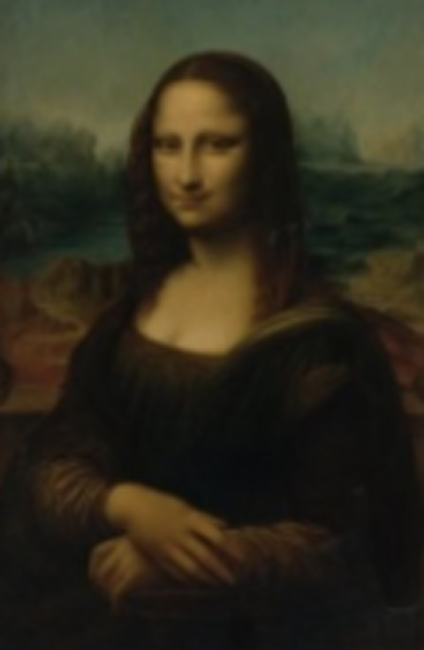
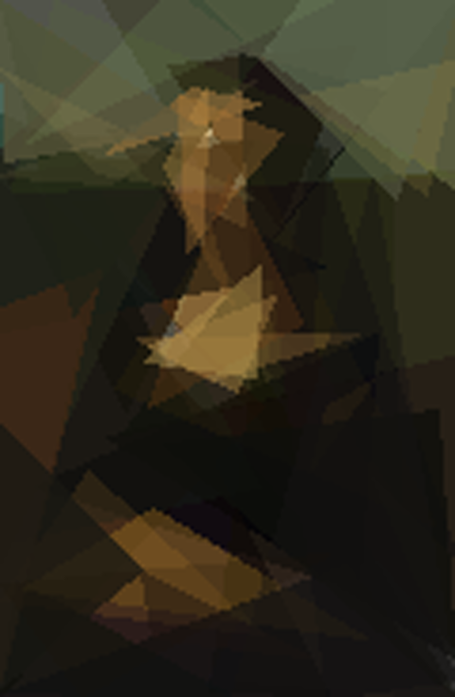
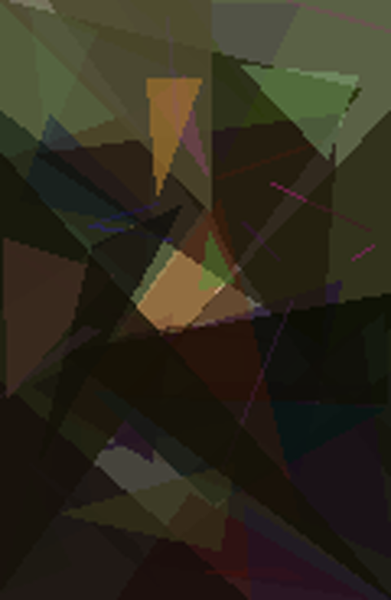
Results: Same Budget, Different Image
Target
Mona Lisa, 120 px
Hillclimber
MSE 103
Genetic Algorithm
MSE 224 (pop 30)
Notes:
Seed 0 of each setup after 30,000 evaluations with 50 triangles. The hillclimber already shows face, hair and shoulders; the GA is blurrier. The MSE values are single-seed values (hillclimber 103, GA 224).

Slide 8
What Hurts the GA?
1
Fewer individuals win
Pop 10 → 3,000 generations, pop 30 → 1,000, pop 100 → only 300
2
Lower mutation rate: worse
0.02 instead of 0.05 raised the error from 237 to 404
3
Pop 100 left out
Final MSE 2,547 (not shown): too few generations
Notes:
Same 30,000-evaluation budget for every bar. A smaller population is better: with population 10 the GA gets 3,000 generations instead of 1,000. Lowering the mutation rate from 0.05 to 0.02 made the GA worse, not better. The GA with population 100 ended at 2,547 (only 300 generations) and is left out of the chart so the other bars stay readable.

Slide 9
Takeaways
Why the hillclimber wins here
Full-size app runs (1 run each)
Smooth problem: many small improvements add up
Each mutation is tested on its own, a good change is never hidden by a bad one
Equal budget: the GA spends 30 renders per generation, the hillclimber makes 30 steps
Crossover gave no visible benefit on this task
0.00878
0.00721
Hillclimber fitness (MSE ≈ 113)
GA fitness (MSE ≈ 138)
300 triangles, population 100, 2000 generations, 120 px
Next: macro-mutations (re-roll a whole triangle) · adaptive mutation rate · hybrid GA with local search
Notes:
Why the hillclimber wins here: the fitness landscape is smooth, so many small improvements add up. Every mutation is tested on its own, so a good change is never hidden by a bad one in the same child. The GA spends most of its evaluations on children of average parents. The full-size runs from the app (300 triangles, population 100, 2000 generations, one run each) point in the same direction: fitness 0.00878 for the hillclimber against 0.00721 for the GA, i.e. an MSE of about 113 against 138. Outlook: macro-mutations, adaptive mutation rate, or a hybrid with local search.

