Slide 1
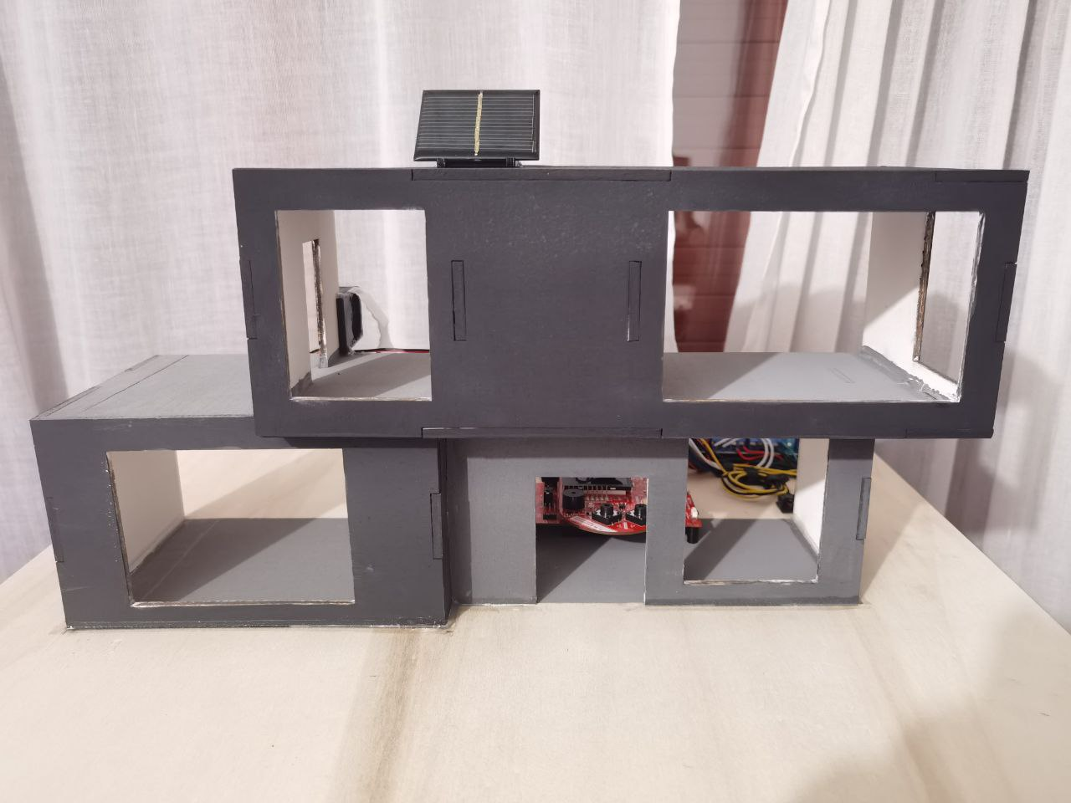
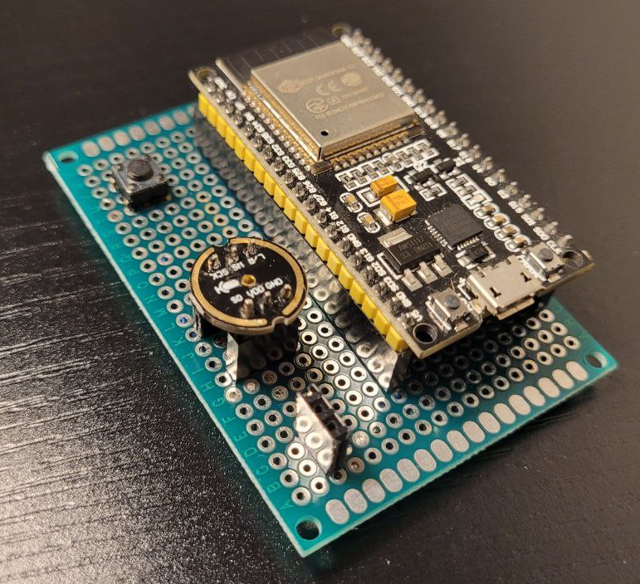
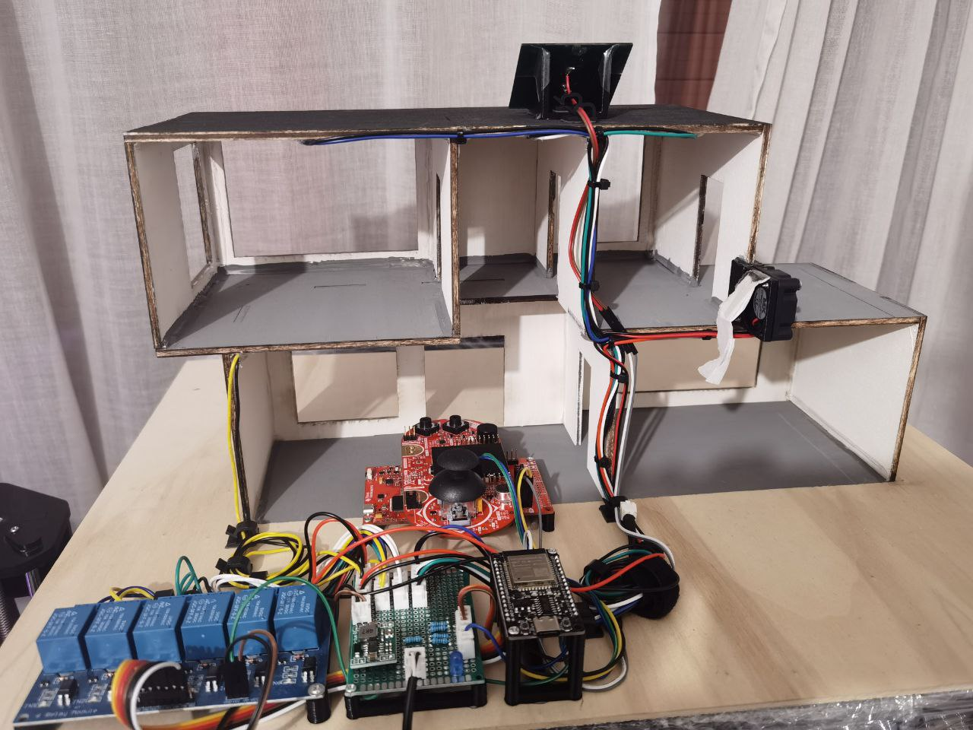
DOMOTIC
HOUSE
Embedded Software
for the Internet of Things 2023/2024
Emilian Manole, Leonardo Rigotti,
Riccardo Randon, Elia Avanzolini

Slide 2
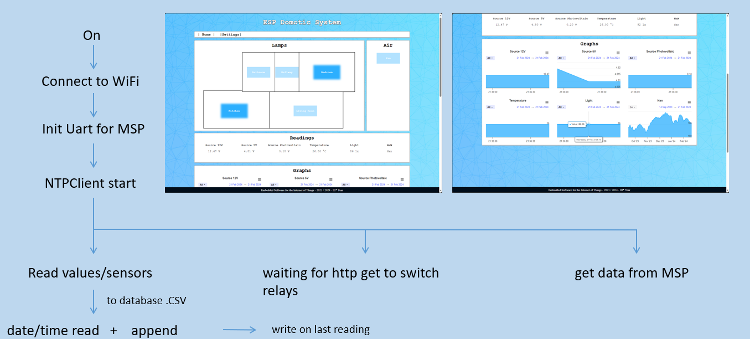
BASIC MODUS OPERANDI

Slide 3

MSP432 timer and interrupts
- Continous mode timer
- ACLK at 32kHz, divided by 14 so ~2.2kHz
- Overflows when hits 0xFFFF, around every 28s and sends an interrupt
- MCU is in LPM0 (ACLK and SMCLK active)
- ISR sends data via UART to other device
- return to LPM0:
- Interrupt_enableSleepOnIsrExit();
in main.c
- interrupt on EUSCIA2 (pin 3.2, 3.3)
- executes when something is received via the UART receiver
- stores the data in a global variable and clear flags

Slide 4
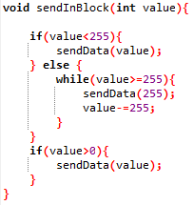
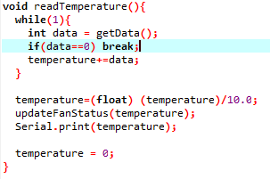
MSP432-ESP32 UART communication
- EUSCI UART configuration
- 24MHz (SMCLK source), 115200 baudrate, no parity bit, one stop bit, 8 bit long message
- Using eUSCI 2, i.e. pin 3.2 and 3.3
PROBLEM: only 1 byte via UART
SOLUTION: send data that is >= 255 (max value with a byte)
in smaller blocks ...
in esp_uart.cpp
in uart.c
… that get sum up on the ESP side
4

Slide 5

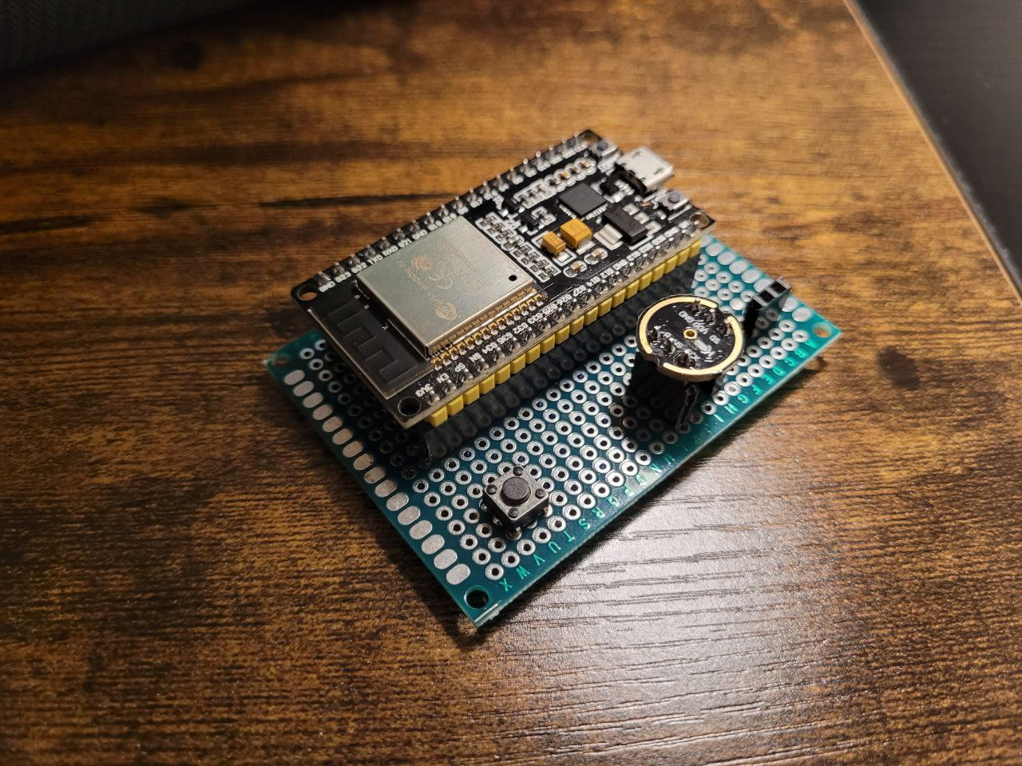
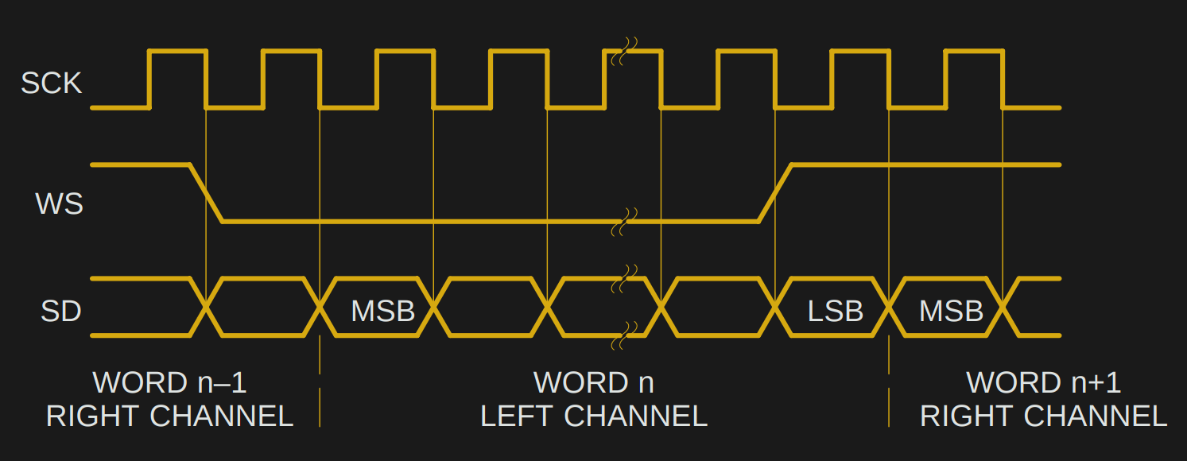
Voice Command
We utilized an ESP32 board to capture audio signals from an INMP441 microphone using the I2S protocol.
Due to the high data rate, we employ DMA to store the incoming data in memory.
Afterwards, we utilize flash memory
to store the file and produce the
necessary WAV audio file format as
per Google APIs.
5

Slide 6
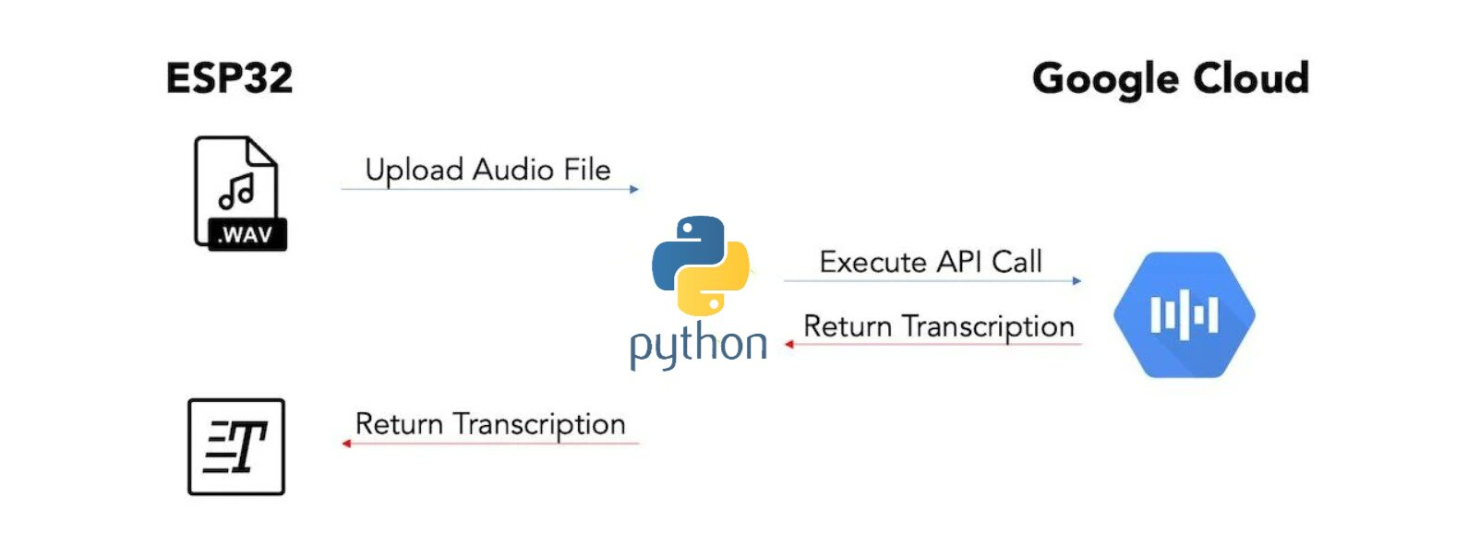
Speech to Text API
Once we obtain the WAV file, ESP32 sends it to the PC's Python server.
Here, with the assistance of the library provided by Google, we send a request to the Speech-to-Text APIs.
The response comes as a JSON file, which we extract the needed information from,
then send an integer containing home automation configurations back to ESP32.
6

