Slide 1

Football Spotlight
A football app
Notes:
1

Slide 2

Databases
Local database
existDB database
Notes:
1

Slide 3
Categories in my database
Users : Information about the users of the platform, including their full name and mode (e.g., admin/user).
Players: Comprehensive data about the football players, including their full name, date of birth, age, height, citizenship, position, foot and outfitter.
Managers: Details about the managers including their full name, date of birth, age, nationality, and role.
Football Clubs: Information about the football clubs, including their name, squad size, average age of players, and name of the stadium.
Contracts: Details about the contracts, including the joined date, contract expiry date, contract option.

Slide 4

APIs developed
1. SOAP
2. REST

Slide 5


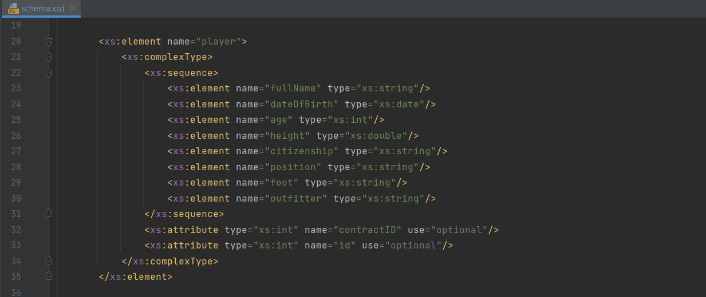
SOAP
For building SOAP webservices I created the model with the help of the schema

Slide 6
SOAP endpoints with eXist-db database
Example of endpoint:
Endpoint: /getManagers2
Description: Retrieves all managers from ExistDB.
Request: ExistDBManagersRequest
Response: Managers

Slide 7
SOAP endpoints with local XML database
Example of endpoints:
  getPlayers:
  Endpoint: /getPlayers
  Description: Retrieves all players.
  Request: PlayersRequest
  Response: Players
getPlayers (by full name):
Endpoint: /getPlayersByN
Description: Retrieves players by full name.
Request: PlayersByNRequest
Response: Players

Slide 8
SOAP endpoints with local XML database
getPlayers(): Retrieves all players.
getPlayers (with citizenship and foot parameters): Retrieves players by citizenship and foot.
getPlayers (by full name): Retrieves players by full name.
addPlayer:Adds a new player.
deletePlayer: Removes a player.
updateContract: Updates a player's contract.
updateManager: Updates a manager.
getManagers: Retrieves all managers.
getContractOption: Retrieves player's contract option.
Example of endpoints:

Slide 9
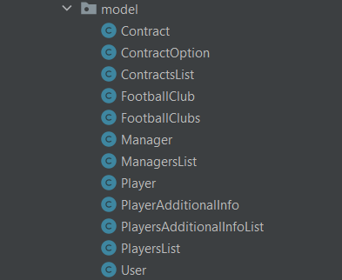
REST
For building REST webservices I created the model which contains different classes

Slide 10
REST CONTROLLERS
Controller1
Controller2
Controller3
Controller4

Slide 11
REST CONTROLLERS
Controller1 – endpoints based on local XML db.
Endpoints consume XML and produce XML
Examples:
/update/manager/{id}: PUT endpoint to update a manager's information by their ID.
/managers: GET endpoint to retrieve a list of managers from the database.
/contracts/add: POST endpoint to add a new contract to the database.
/players/{id}/contractOption: GET endpoint to retrieve contract options for a player based on their ID.
/players: GET endpoint to retrieve a list of all players from the database.
/players/citizenship/{citizenship}/foot/{foot}: GET endpoint to retrieve players based on citizenship and foot.
/players/{fullName}: GET endpoint to retrieve player information based on their full name.
/players/add: POST endpoint to add a new player to the database.
/players/{id}: DELETE endpoint to remove a player from the database by their ID.

Slide 12
REST CONTROLLERS
Controller2 – endpoints based on local XML db.
Endpoints consume XML and produce XML
Examples:
/exist/update/manager/{id}: PUT endpoint to update a manager's information by their ID.
/exist/managers: GET endpoint to retrieve a list of managers from the eXist-db database.
/exist/contracts/add: POST endpoint to add a new contract to the eXist-db database.
/exist/players/{id}/contractOption: GET endpoint to retrieve contract options for a player based on their ID.
/exist/players: GET endpoint to retrieve a list of all players from the eXist-db database.
/exist/players/citizenship/{citizenship}/foot/{foot}: GET endpoint to retrieve players based on citizenship and foot from the eXist-db database.
/exist/players/{fullName}: GET endpoint to retrieve player information based on their full name from the eXist-db database.
/exist/players/add: PUT endpoint to add a new player to the eXist-db database.
/exist/players/update: POST endpoint to update a player's information in the eXist-db database.
/exist/players/{id}: DELETE endpoint to remove a player from the eXist-db database by their ID.

Slide 13
REST CONTROLLERS
Controller3 – endpoints based on eXist-db.
Endpoints produce XHTML_XML
Examples:
/exist/xslt/players: GET endpoint to retrieve players using XSLT transformation without UI. Returns an XML representation of the players transformed using XSLT.
/exist/xslt/ui/players: GET endpoint to retrieve players using XSLT transformation with UI. Returns an XML representation of the players transformed using XSLT with UI components.

Slide 14
REST CONTROLLERS
Controller4 – endpoints based on eXist-db.
Endpoints consume JSON and produce JSON
Examples:
/exist/update/user/: POST endpoint to update a user's information. Accepts a JSON representation of the updated user.
/exist/update/manager/: PUT endpoint to update a manager's information. Accepts a JSON representation of the updated manager.
/json/exist/managers: GET endpoint to retrieve a list of managers in JSON format.
/json/exist/playersInfo: GET endpoint to retrieve additional information about players in JSON format.
/json/exist/delete/players/{id}: DELETE endpoint to delete a player by their ID in JSON format.
/json/exist/delete/managers/{id}: DELETE endpoint to delete a manager by their ID in JSON format.

Slide 15
REST CONTROLLERS
Controller4 – endpoints based on eXist-db.
Endpoints consume JSON and produce JSON
Examples:
/json/exist/footballClubs: GET endpoint to retrieve football clubs information in JSON format.
/json/exist/contracts/add: POST endpoint to add a new contract in JSON format.
/json/exist/footballClubs/add: POST endpoint to add a new football club in JSON format.
/json/exist/players/add: POST endpoint to add a new player in JSON format.
/json/exist/managers/add: POST endpoint to add a new manager in JSON format.
/json/exist/user/{id}: GET endpoint to retrieve a user by their ID in JSON format.

Slide 16

Apache Camel
Built some routes with Apache Camel

Slide 17
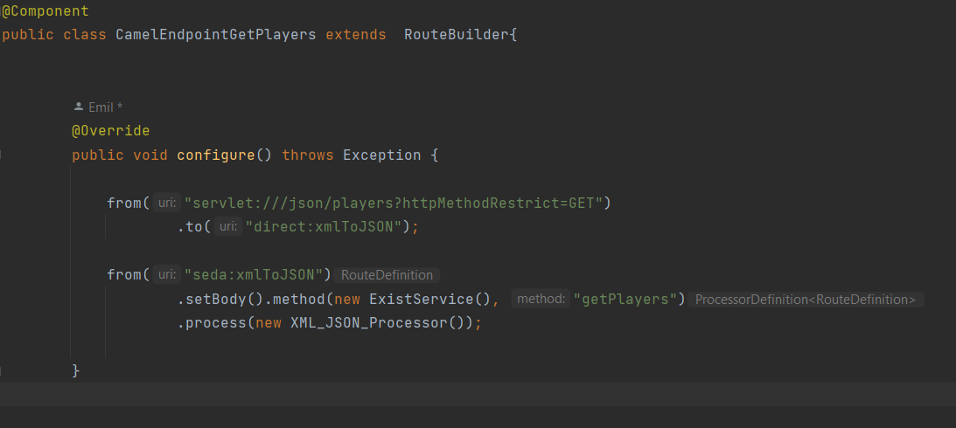
Apache Camel exemple #1
This Apache Camel route listens for HTTP GET requests to /json/players, converts XML player data to JSON format, and responds with the JSON representation. It uses the ExistService to fetch XML player data and the XML_JSON_Processor to perform the XML to JSON conversion.
Components used:
servlet: Listens for incoming HTTP requests.
seda: Provides a simple in-memory queue for asynchronous processing.

Slide 18
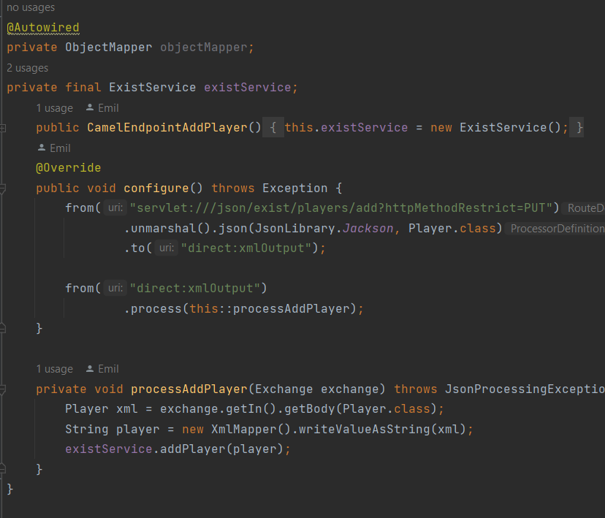
Apache Camel exemple #2
Apache Components:
servlet: Listens for incoming HTTP requests and handles PUT requests to /json/exist/players/add.
direct: Provides a point-to-point communication channel for routing messages within the Camel context. Used to direct messages to the xmlOutput endpoint.
unmarshal: Converts JSON data to Java objects using Jackson's JsonLibrary.Jackson.
process: Custom processor method used to handle and process the incoming message.
This Apache Camel route listens for HTTP PUT requests to /json/exists/players/add and adds a player to the eXist-db.

Slide 19
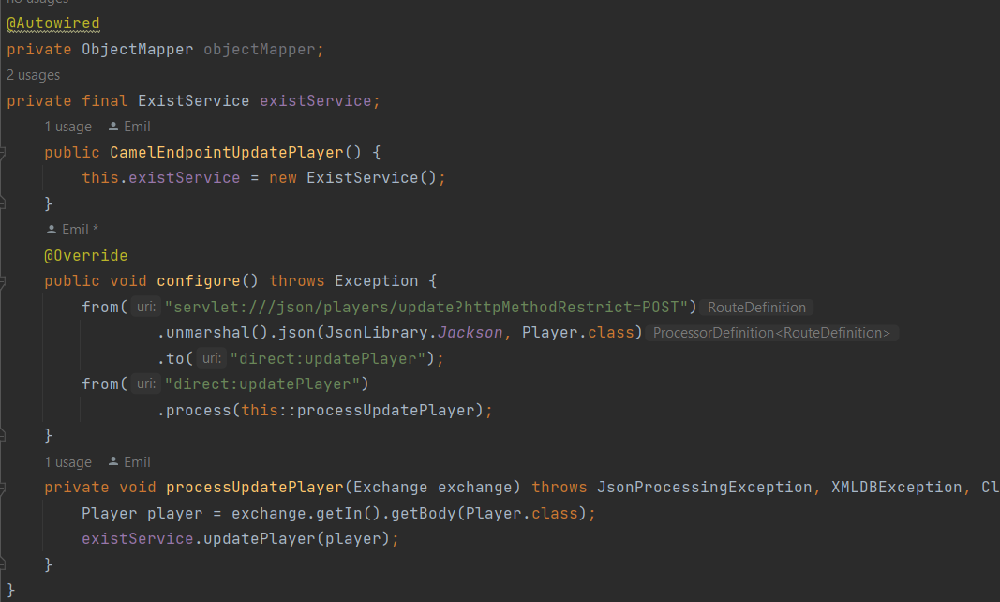
Apache Camel exemple #3
This Apache Camel route listens for POST requests to /json/players/update. Upon receiving a request, it unmarshals the JSON player data and processes it to update the player's information in the ExistDB database.
Components used:
servlet: Listens for incoming HTTP requests and handles PUT requests to /json/exist/players/add.
direct: Provides a point-to-point communication channel for routing messages within the Camel context. Used to direct messages to the updatePlayer endpoint.
unmarshal: Converts JSON data to Java objects using Jackson's JsonLibrary.Jackson

Slide 20
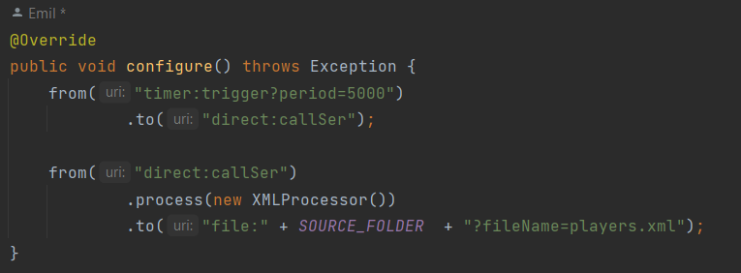
Apache Camel exemple #4
This Apache Camel route fetches data from exist db and creates the "players.xml" into a folder(SOURCE_FOLDER) every 5 seconds.
Apache Camel components:
timer: Generates trigger events at regular intervals (every 5000 milliseconds in this case).
direct: Provides a point-to-point communication channel for routing messages within the Camel context. Used to direct messages to the callSer endpoint.
file: Writes files to the filesystem. In this case, it writes the "players.xml" file to the destination folder specified by DESTINATION_FOLDER.

Slide 21
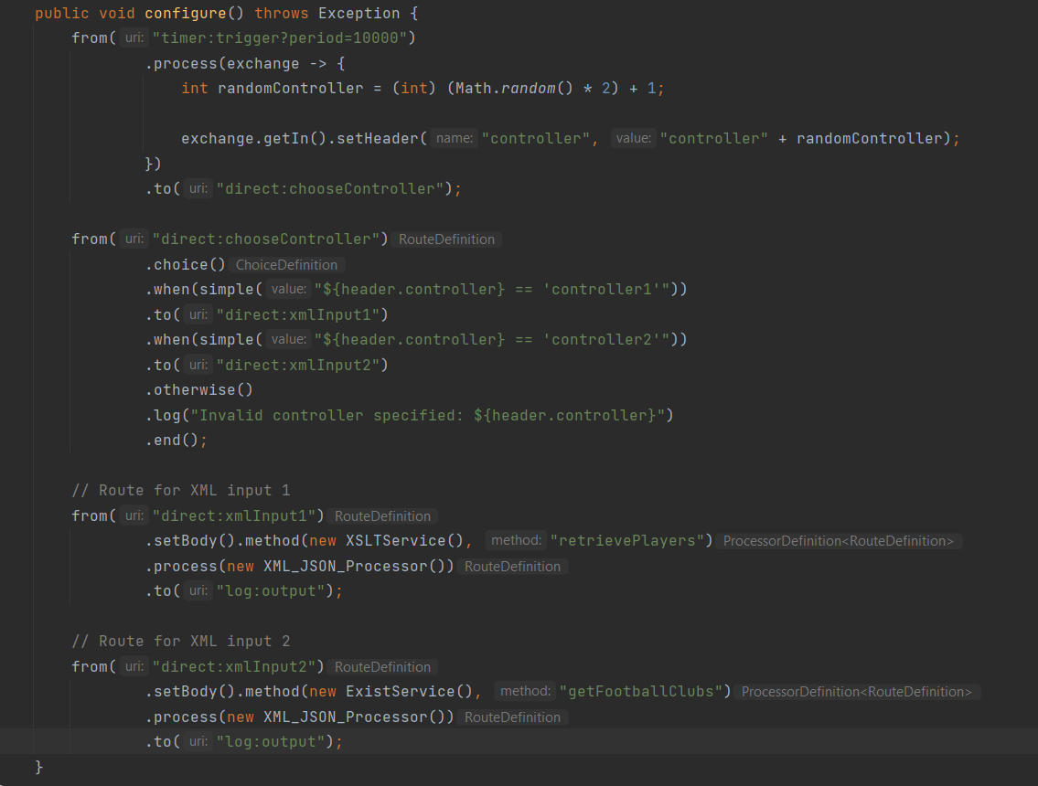
Apache Camel exemple #5

Slide 22
Apache Camel exemple #5
Components used:
timer: Generates trigger events at regular intervals (every 10,000 milliseconds).
process: Generates a random number (either 1 or 2) representing a controller and sets it as a header in the exchange.
direct: Provides a point-to-point communication channel for routing messages within the Camel context. Used to direct messages to the chooseController endpoint.
choice: Evaluates the value of the controller header and routes the message accordingly.
from("direct:xmlInput1"): Defines a route for XML input 1. Retrieves players' data using an XSLT transformation service (XSLTService). Processes the XML data to convert it to JSON format using a custom processor (XML_JSON_Processor). Logs the output.
from("direct:xmlInput2"): Defines a route for XML input 2. Retrieves football clubs' data using an ExistDB service (ExistService). Processes the XML data to convert it to JSON format using the same custom processor. Logs the output.
This Apache Camel route demonstrates a dynamic routing scenario where XML data is transformed to JSON format based on a random selection of controllers. Here's a breakdown:

Slide 23
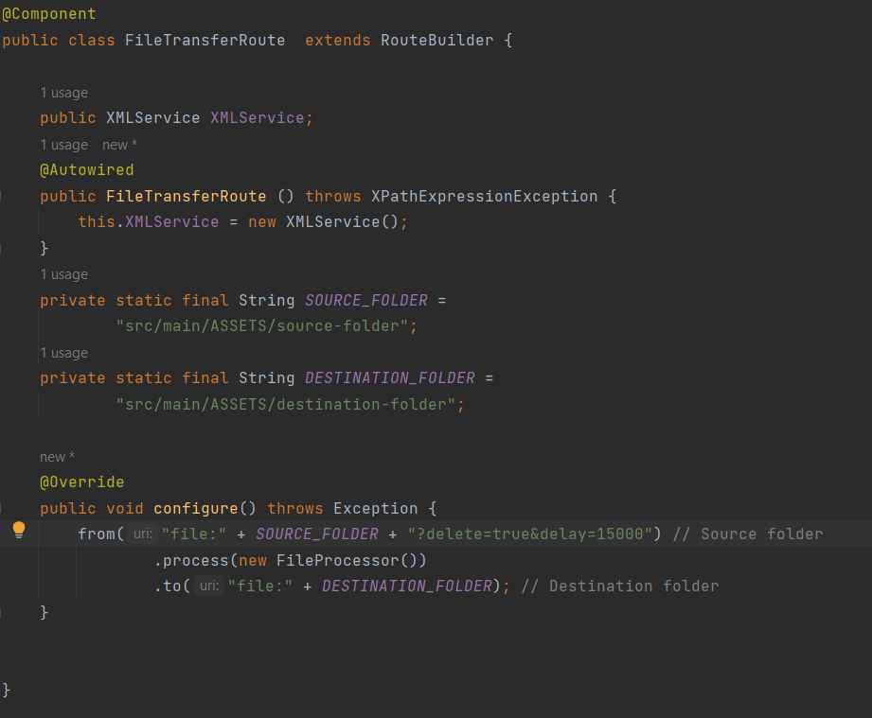
Apache Camel exemple #6
This Apache Camel example transfers files from a source folder to a destination folder with a delay of 15 seconds and deletes the files from the source folder after successful transfer.
Apache Camel components:
delete: deletes the files from the source folder after successful processing.
Delay: adds a delay before starting to move files.
file: allows Apache Camel to interact with files, enabling routes to read from or write to files on the file system.

Slide 24


Tested from client side the endpoints with Swagger and Postman

Slide 25
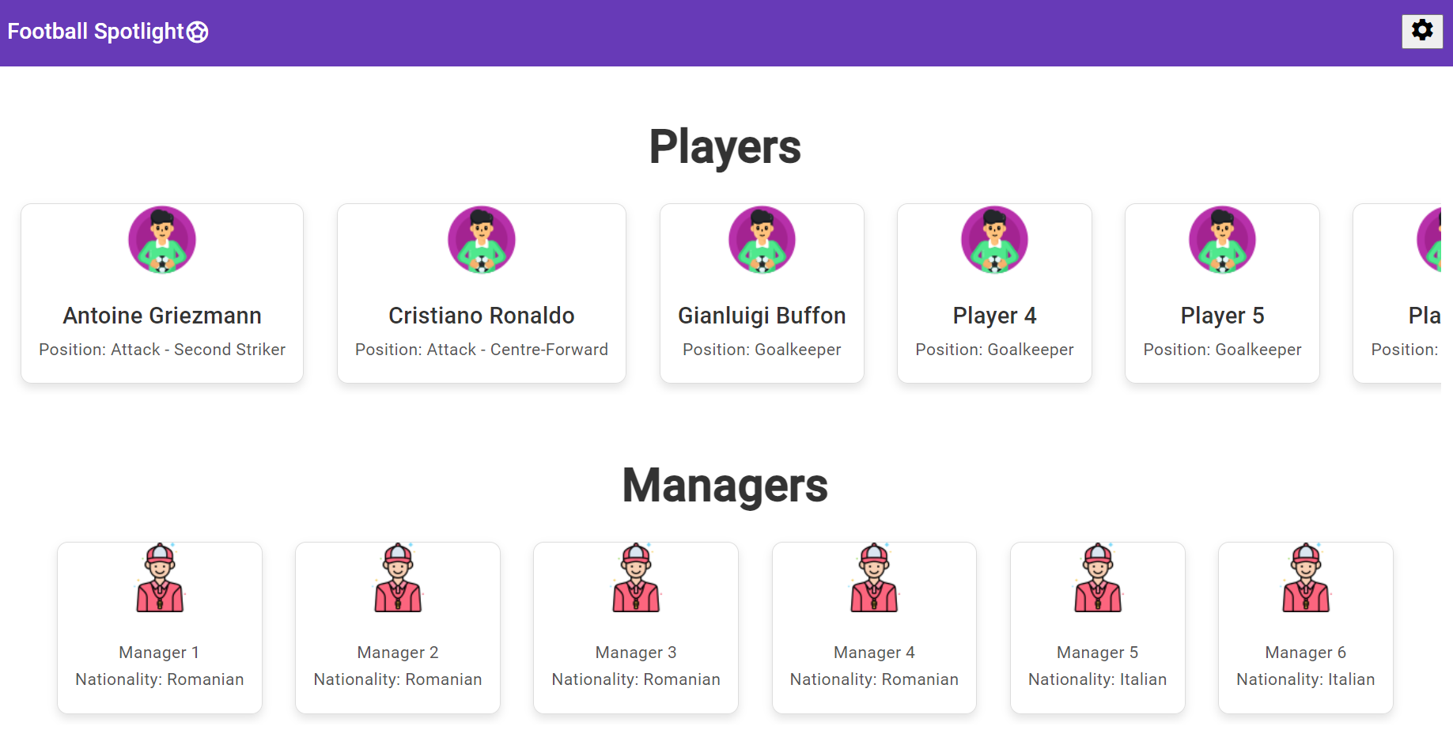
Built an UI based on Angular, that connects with the services
This Apache Camel route demonstrates a dynamic routing scenario where XML data is transformed to JSON format based on a random selection of controllers. Here's a breakdown:

