Slide 1
CS 130
Spring 2016

Slide 2

What is Connexity
Technology-driven marketing solutions company
Connect retailers to the customers they care about
Use our shopping insights to drive sales for our partners

Slide 3






What Happened To Shopzilla
Our foundation remains the same
We are powered by shopping

Slide 4



What Happened To Shopzilla
We have acquired some new brands

Slide 5
Project Idea

Slide 6
Publisher Challenge
Use the Shopzilla Catalog API to build your own shopping website
Expose shopping content
Develop back-end and front-end components of shopping site
Compete for most redirects and “revenue”

Slide 7
Publisher Challenge
The Challenges:
API integration
What data should your website use
Determining what additional information would be useful
Completing the flow – API -> Backend logic -> Front-end display

Slide 8
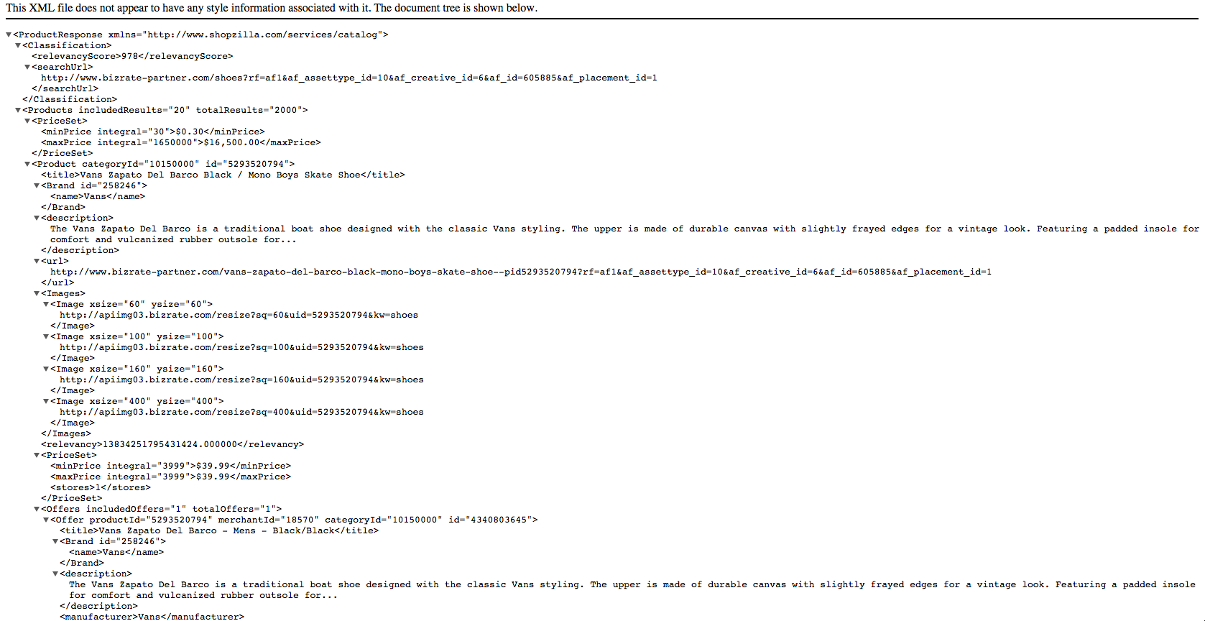
Publisher Challenge

Slide 9
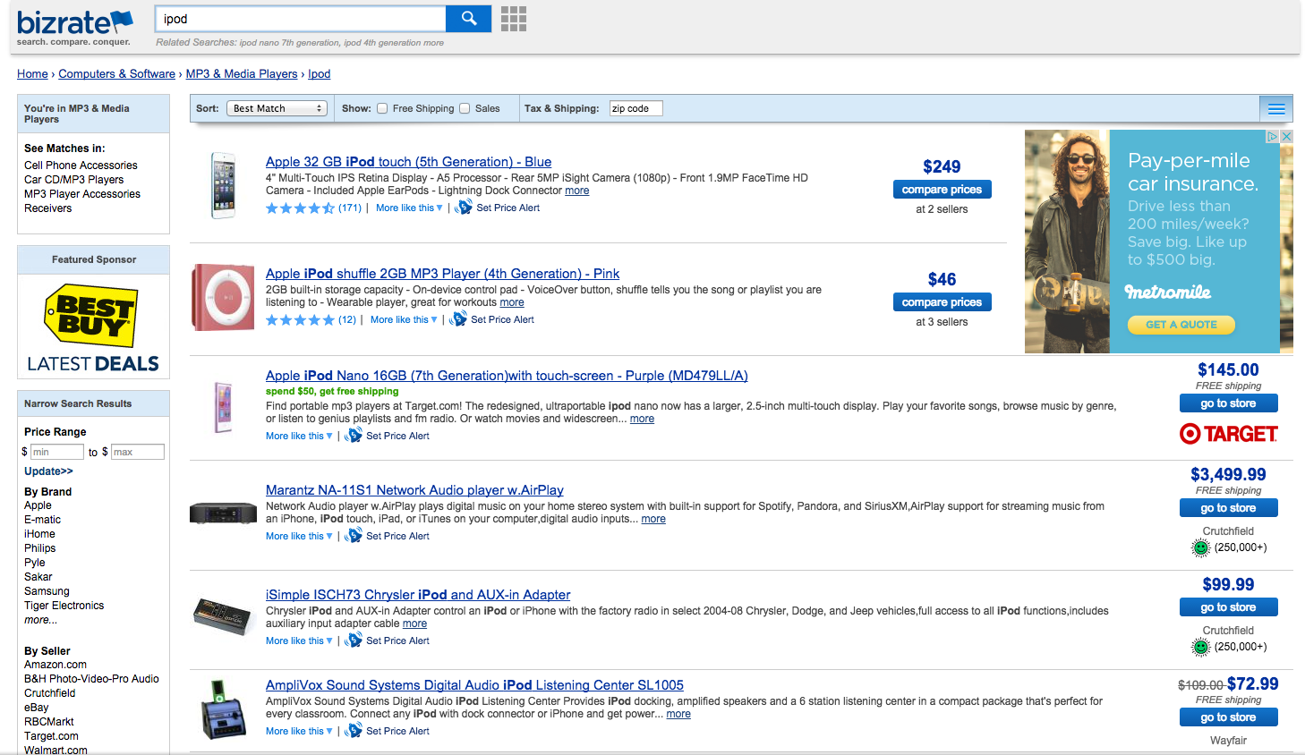
Publisher Challenge

Slide 10
Technologies
Enterprise level technologies
Java
Spring MVC
UI component
Interaction with API

Slide 11
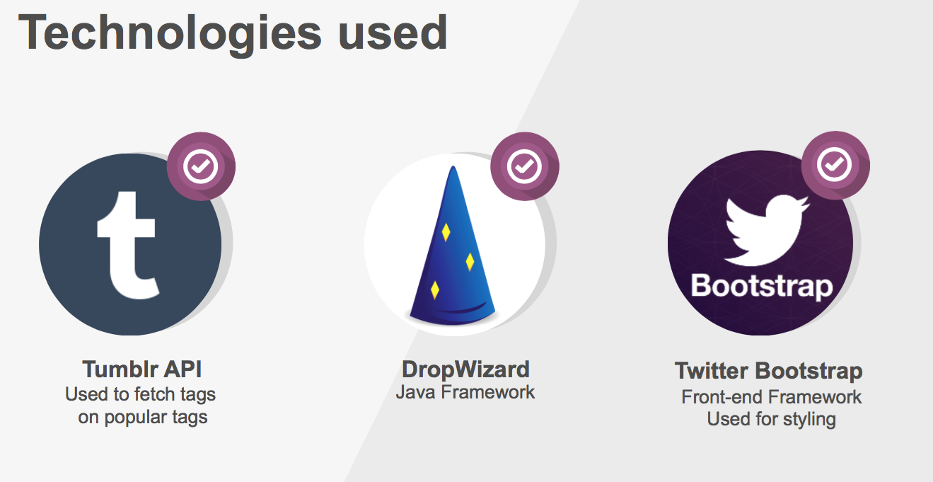
Previous Quarter Sample
￼

Slide 12
Logistics
Mentorship from former CS130 students
Direct experience with enterprise level engineering practices
Setup guidelines
On site development workshops
Git/Github
Various methods of communication between teams and Connexity

Slide 13

Questions?

