Slide 1
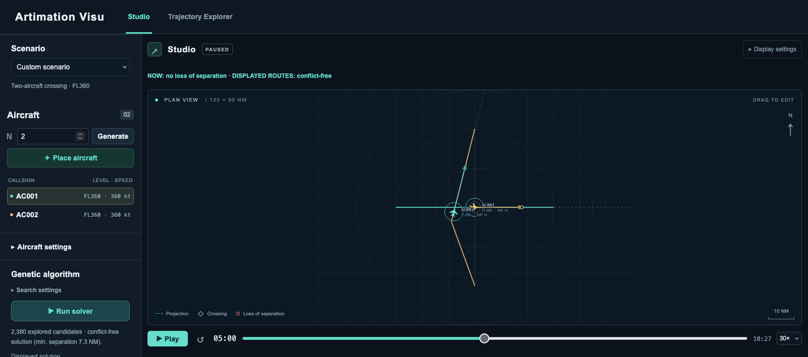
Artimation Visu
Two-aircraft crossing. Same altitude (FL360), minimum horizontal separation 7 NM.
1 / 10

Slide 2
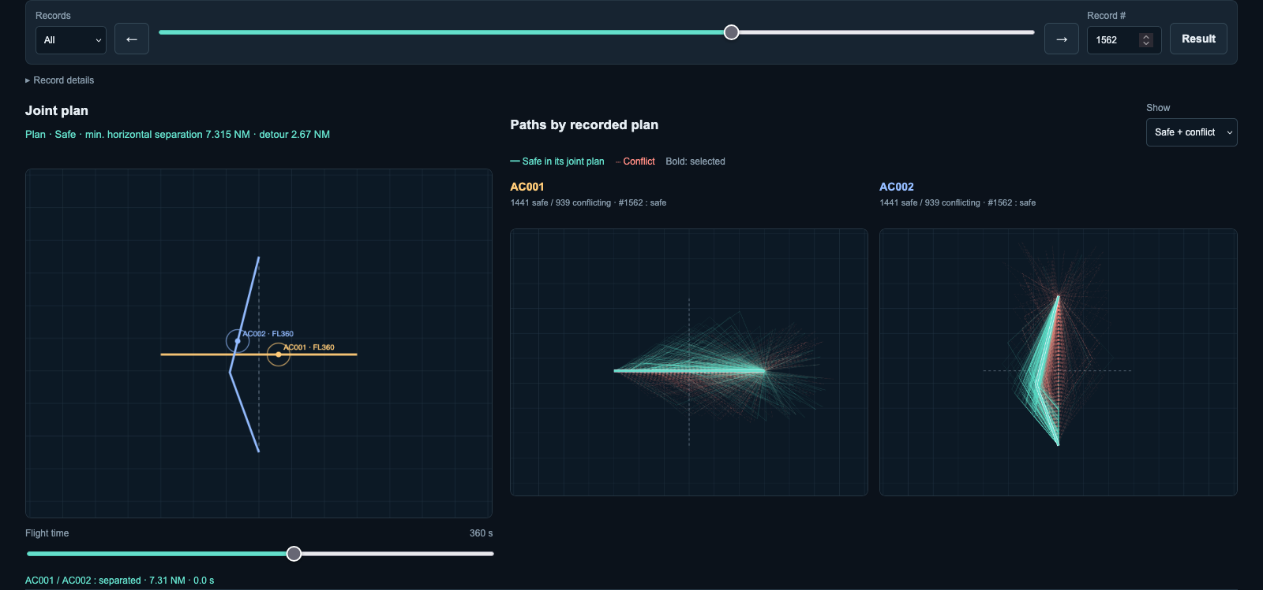
Trajectory Explorer
2 / 10

Slide 3
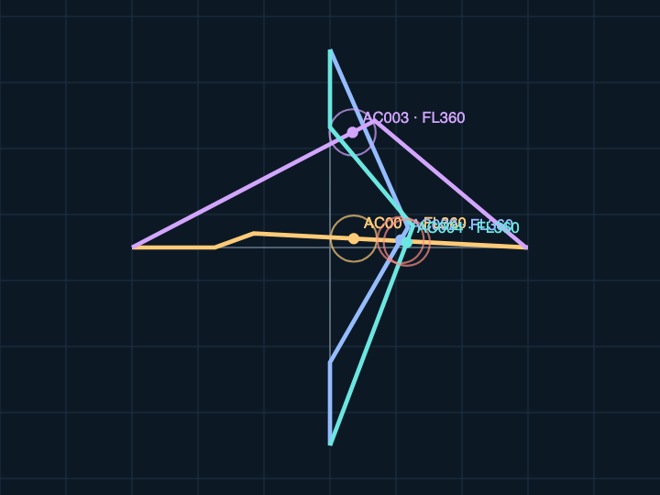
Four aircraft create six pairwise checks
Minimum horizontal separation (NM)
All aircraft are at the same altitude.
Pair | Distance | Status
001 / 002 | 4.901 | Conflict
001 / 003 | 15.754 | Separated
001 / 004 | 4.901 | Conflict
002 / 003 | 14.213 | Separated
002 / 004 | 1.007 | Conflict
003 / 004 | 7.101 | Separated
AC003 trajectory: safe
Joint candidate: unsafe
AC001, AC002 and AC004 conflict with each other.
Aircraft positions at t = 340 s
3 / 10

Slide 4
How we build the dataset
Save the proposals, their trajectories and their safety labels.
Run one search
One saved GA trajectory: AC002
scenario, algorithm, seed
Maneuver: [0, 260.68, 20, 0]
Left 20° at 0 s. Head toward the destination at 260.7 s.
Keep the search records
maneuvers or commands, pairwise safety
t (s) | x (NM) | y (NM) | z (ft)
0.00 | 60.00 | 75.00 | 36000
260.68 | 51.08 | 50.50 | 36000
600.00 | 59.35 | 17.59 | 36000
626.74 | 60.00 | 15.00 | 36000
Save timed trajectories
one aircraft, its label and timed points
Export JSON and CSV
complete JSON, safe and unsafe CSVs
One CSV row = one timed point. Controllers distinguish forecasts from executed flights.
4 / 10

Slide 5
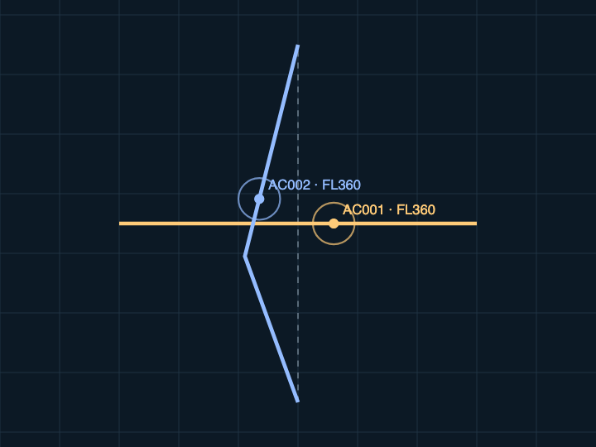
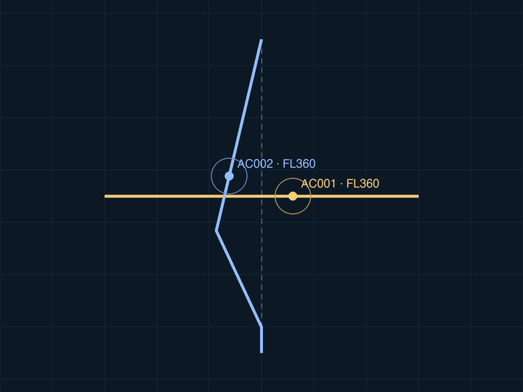
Two searches on the same scenario
AC001 stays on route. Only AC002 maneuvers.
Genetic algorithm
Simulated annealing
Combine maneuvers from existing solutions.
Change one aircraft, then accept or reject.
AC002: left 20° at 0 s. Direct at 261 s.
AC002: left 25° at 48 s. Direct at 252 s.
Minimum horizontal separation (NM): 7.315
Minimum horizontal separation (NM): 7.172
5 / 10

Slide 6
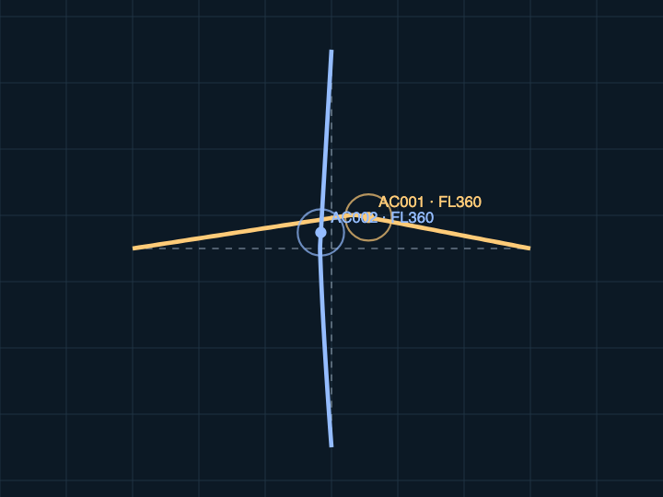
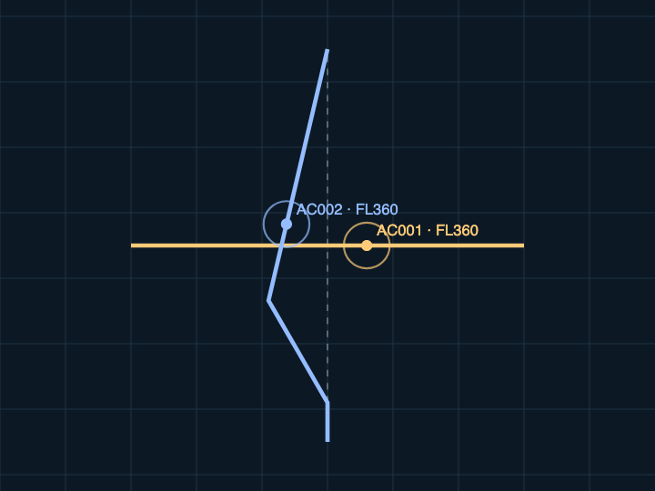
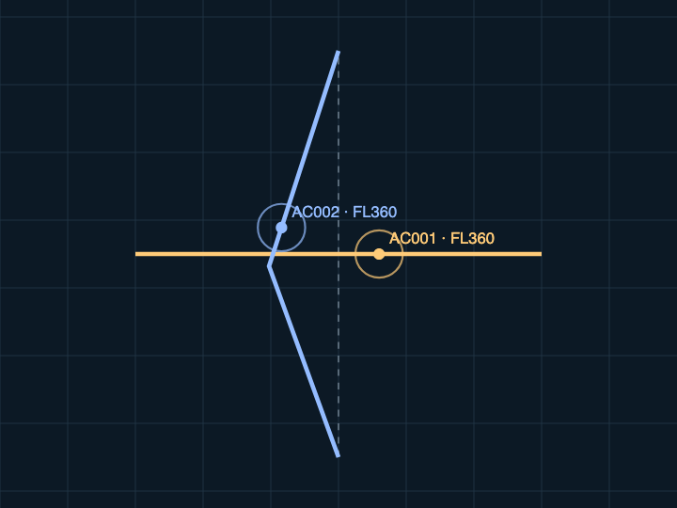
Three more methods on the same crossing
Positions at 360 s. ORCA changes speed. MPC and MILP keep AC001 on route.
ORCA
MPC
MILP
At 0 s: AC001 left 8.7°, 360 kt.
AC002 left 4.3°, 327 kt.
Update every 10 s.
AC002: left 30° at 60 s.
Direct at 240 s.
Replan every 20 s.
AC002: left 20° at 0 s.
Direct at 300 s.
49 options per aircraft.
Minimum horizontal separation (NM), over the full flight
7.000
7.576
7.367
6 / 10

Slide 7



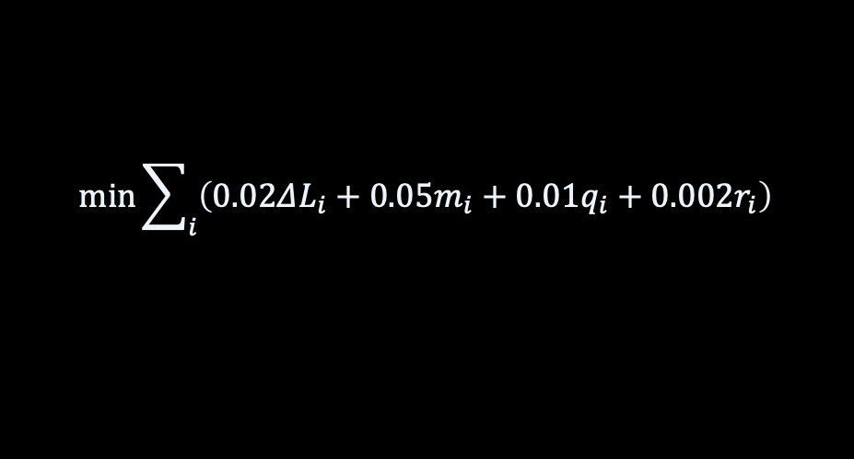


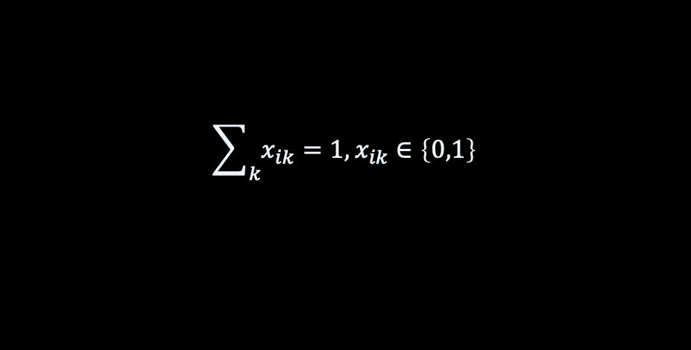



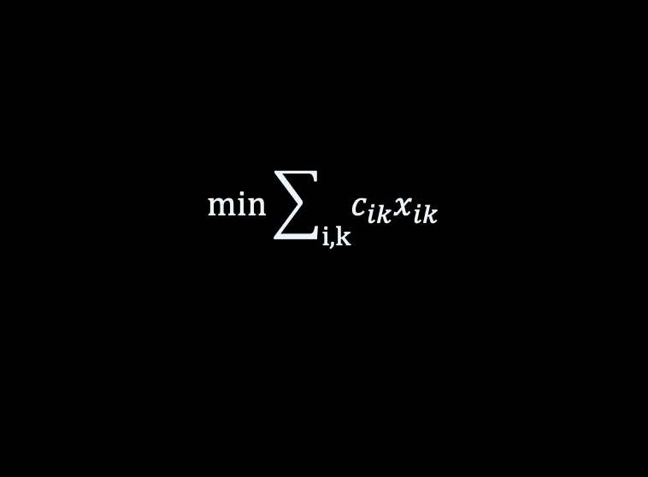
Objectives and safety checks
Same altitude (FL360). Default weights.
Shared trajectory evaluation
$$d_{min}=\min_{i<j,t}\left\|p_{i}\left(t\right)−p_{j}\left(t\right)\right\|$$
$$P=C+10\max\left(0,7−d_{min}\right)$$
All aircraft pairs, over their common flight time
$$+0.02ΔL+0.05M$$
$$d_{min}≥7 NM (safe)$$
C: conflict seconds ΔL: extra distance (NM)
M: number of maneuvering aircraft
$$F=\frac{0.5}{1+P}+0.5I\left(safe\right)$$
I(safe) = 1 when safe, otherwise 0
7 / 10

Slide 8
Objectives and safety checks
Same altitude (FL360). Default weights.
$$\max{F}$$
GA
$$E=1−F$$
Annealing
$$\operatorname{Pr}\left(accept\right)=\min\left(1,e^{−\frac{ΔE}{T}}\right)$$
8 / 10

Slide 9
Objectives and safety checks
Same altitude (FL360). Default weights.
Other method objectives
$$\min_{v}{\left\|v−v^{∗}\right\|}^{2}$$
ORCA
$$v∈ORCA,\left\|v\right\|≤0.1 NM/s$$
v*: desired velocity (heading and speed)
MPC
$$min\sum_{i}{\left(0.02ΔL_{i}+0.05m_{i}+0.01q_{i}+0.002r_{i}\right)}$$
Plan 400 s. Execute 20 s, then replan.
$$q_{i}=\frac{{\left\|v_{first}−v_{prev}\right\|}^{2}}{v_{nom}^{2}}$$
mᵢ: maneuver flag rᵢ: NM to goal at +400 s
9 / 10

Slide 10
Objectives and safety checks
Same altitude (FL360). Default weights.
Other method objectives
$$min\sum_{i,k}{c_{ik}x_{ik}}$$
MILP
$$c_{ik}=0.02ΔL_{ik}+0.05m_{ik}$$
$$\sum_{k}{x_{ik}}=1,x_{ik}∈\left\{0,1\right\}$$
$$x_{ik}+x_{jl}≤1$$
for conflicting options
10 / 10

