Slide 1
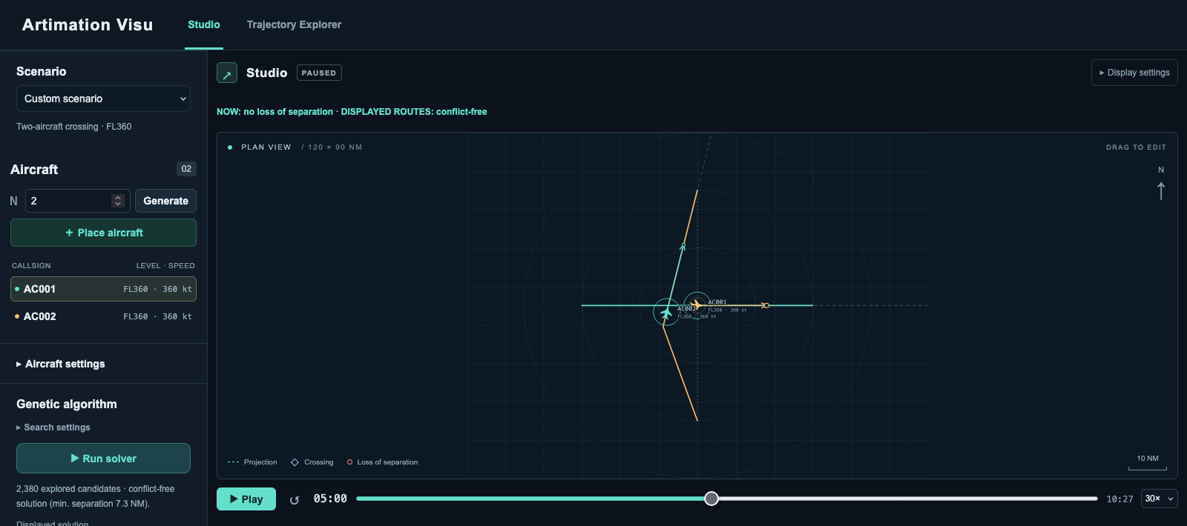
Artimation Visu
Two-aircraft crossing. Same altitude (FL360), minimum horizontal separation 7 NM.
1 / 7
Notes:
Current direct-served Artimation Visu Studio interface, captured at http://localhost:8501. The Studio contains the built-in two-aircraft crossing fixture, with no change to its physical model. Population 60, 40 generations, seed 0, altitude changes disabled. The actual GA result is candidate 1562: AC001 unchanged, AC002 [0,260.6800338421475,20,0]. Positions in the screenshot are at t=300 s. Minimum horizontal separation over the complete common flight interval is 7.314860078148733 NM. All aircraft remain at FL360. The new header and permanent Studio/Trajectory Explorer tabs are visible. Source: assets/studio-crossing2-ga-result-t300.png and assets/manifest.json.

Slide 2
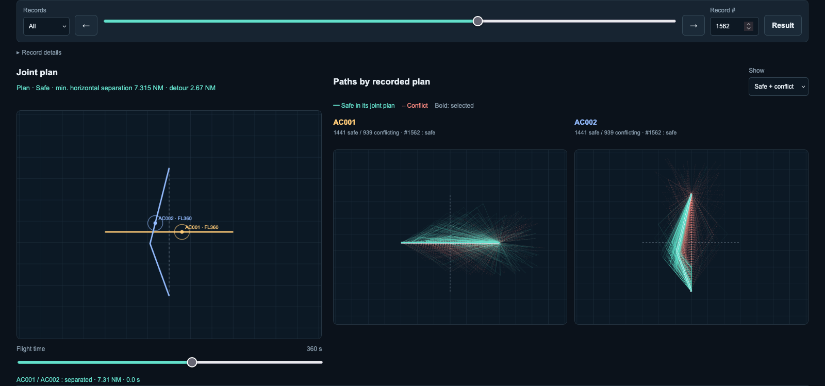
Trajectory Explorer
2 / 7
Notes:
Actual Artimation Visu Trajectory Explorer interface, cropped to the record browser and trajectory area. The screenshot retains all three full plots and the flight-time control. Two-aircraft GA run, population 60, 40 generations, seed 0, altitude changes disabled. Record 1562 is selected at t=360 s. All 2380 recorded joint plans remain available, including duplicates: 1441 safe and 939 conflicting. Green means separated from the other aircraft in the same joint plan. Green trajectories from separate plans cannot freely be combined. This screenshot shows the new interface and the original, numerically unchanged GA result. Source: assets/explorer-crossing2-ga-result-t360-full.png and assets/manifest.json.

Slide 3
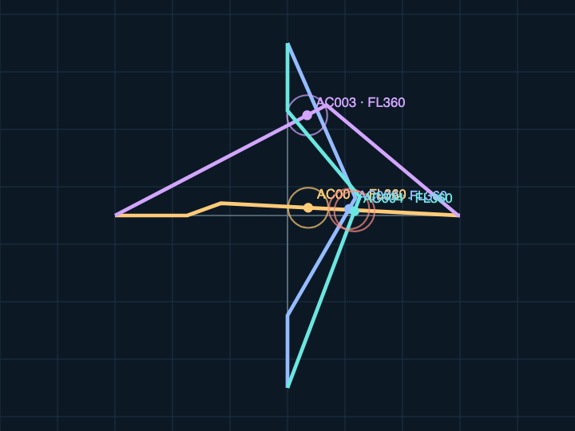
Four aircraft create six pairwise checks
Minimum horizontal separation (NM)
All aircraft are at the same altitude.
Pair | Distance | Status
001 / 002 | 4.901 | Conflict
001 / 003 | 15.754 | Separated
001 / 004 | 4.901 | Conflict
002 / 003 | 14.213 | Separated
002 / 004 | 1.007 | Conflict
003 / 004 | 7.101 | Separated
AC003 trajectory: safe
Joint candidate: unsafe
AC001, AC002 and AC004 conflict with each other.
Aircraft positions at t = 340 s
3 / 7
Notes:
The left image is candidate #73 from the four-aircraft genetic run, captured at t = 340 s, near the closest instantaneous conflict between AC002 and AC004. The table shows minima over the complete common flight intervals, not just the snapshot. Prefix all pair labels with AC when presenting. AC003 is separated from every other aircraft, yet three other pair combinations have conflict. Therefore joint_label is unsafe while AC003 trajectory_label is safe. Its trajectory is exported to the safe CSV, together with the unsafe joint label. The overall minimum is 1.007045 NM. Conflict_s equals 208.568435 seconds summed across pairs and can count simultaneous conflicts more than once.
Sources: convergence-4-ga-0-60x40-2d-7d325442.json, candidate 73. Real capture four_ga_mixed_73.png. All six pair distances copied from the JSON.
All aircraft in these displayed examples remain at FL360. The table therefore reports the minimum horizontal distance between simultaneous aircraft positions over their common flight interval, in nautical miles.
Fresh figures in this revision come from the current Artimation Visu interface. Capture parameters, scenario, selected record and exact numeric results are retained in assets/manifest.json. The displayed maneuvers and complete-flight minima are unchanged.

Slide 4
How we build the dataset
Save the proposals, their trajectories and their safety labels.
Run one search
One saved GA trajectory: AC002
scenario, algorithm, seed
Maneuver: [0, 260.68, 20, 0]
Left 20° at 0 s. Head toward the destination at 260.7 s.
Keep the search records
maneuvers or commands, pairwise safety
t (s) | x (NM) | y (NM) | z (ft)
0.00 | 60.00 | 75.00 | 36000
260.68 | 51.08 | 50.50 | 36000
600.00 | 59.35 | 17.59 | 36000
626.74 | 60.00 | 15.00 | 36000
Save timed trajectories
one aircraft, its label and timed points
Export JSON and CSV
complete JSON, safe and unsafe CSVs
One CSV row = one timed point. Controllers distinguish forecasts from executed flights.
4 / 7
Notes:
The four runs combine two scenarios (two and four aircraft) with two classical algorithms (GA and simulated annealing), all at seed 0 with altitude disabled. Each run records 2,380 joint candidates. Multiplying candidates by the number of aircraft gives 28,560 trajectory instances across the four runs, including duplicates. The dataset stores model metadata, source routes, configuration, full search trace, pairwise metrics, and exact timed points. Points define piecewise linear interpolation and are not uniformly sampled every second. The CSV grain is one timed point. A reliable point key is (run_id, candidate_id, aircraft_id, knot_index). joint_label and trajectory_label have different scopes. Annealing adds accepted, temperature, parent_candidate_id, energy and acceptance_probability. Accepted and safe are independent labels. In the example gene, t2 is the command time to head toward the destination, not arrival time. Actual source values retain full precision; the slide rounds only the display.
Sources: summary-seed-0.json and the four referenced run JSONs. Timed-point table: crossing-2-ga-0-60x40-2d-3b39c926.json, candidate 1562, AC002.
Concrete dataset example: the two-aircraft GA candidate #1562 keeps AC001 on its route. AC002 uses [0,260.6800338421475,20,0]. Reconstructing that maneuver yields the four timed points shown in the preserved table. JSON retains the full joint candidate and model/configuration. The CSVs repeat that context for each point and split trajectories by their local safety label. Rejected annealing proposals also remain in the exports. Source: crossing-2-ga-0-60x40-2d-3b39c926.json and exploration.js.
The extended dataset also stores ORCA and MPC timed paths and controls directly. Their genes are null because repeated commands cannot be represented by one four-component gene. Records distinguish baseline, counterfactual forecast and final executed flight. The displayed example remains the original GA candidate, whose gene and timed points are unchanged. MILP records its complete catalogue assignments; partial branch-and-bound nodes are not trajectory proposals. MPC records its chosen forecast per replanning instant rather than every internal MILP node. Source: src/artimation/web/exploration.js, orca.js, mpc.js and milp.js.

Slide 5
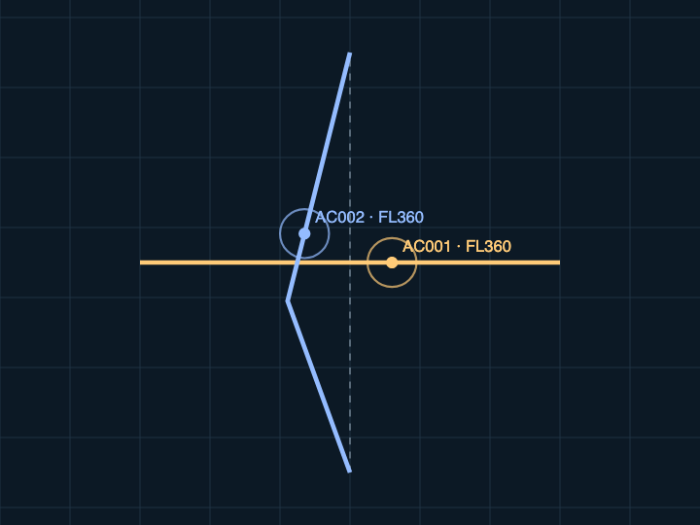
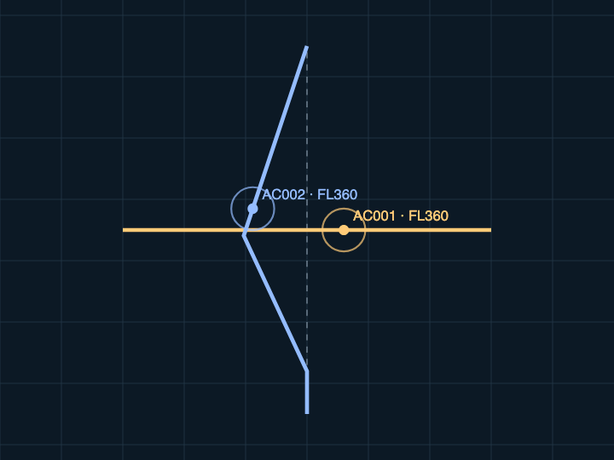
Two searches on the same scenario
AC001 stays on route. Only AC002 maneuvers.
Genetic algorithm
Simulated annealing
Combine maneuvers from existing solutions.
Change one aircraft, then accept or reject.
AC002: left 20° at 0 s. Direct at 261 s.
AC002: left 25° at 70 s. Direct at 314 s.
Minimum horizontal separation (NM): 7.315
Minimum horizontal separation (NM): 7.047
5 / 7
Notes:
GA details: use tournament selection of size 3. A per-child crossover occurs with probability 0.7, with whole aircraft genes selected from either parent. Each aircraft has mutation probability 0.4. The probability of a random immigrant at a new-candidate slot is 0.1. Two elites survive. The recorded budget is 60 + 40 × 58 = 2,380. Simulated annealing starts from the unchanged routes. Each proposal mutates one aircraft. Energy is E = 1 − fitness. Improvements and equal-energy proposals are accepted. A deterioration ΔE > 0 is accepted with exp(−ΔE/T). If rejected, the current candidate does not change. Temperature decreases geometrically from 0.15 to 0.00001. The trace keeps the initial state and all 2,379 proposals. The temperature is dimensionless. A proposal can be accepted and unsafe, or rejected and safe. The mutation neighborhood is asymmetric, so this is an optimization heuristic rather than a certified equilibrium sampler. Safety evaluation always ranks conflict-free candidates above conflicting ones, but annealing may temporarily accept a worse state. Equal proposal budgets do not imply equal unique evaluations or equal runtime. Neither algorithm guarantees a global optimum.
Sources: Local implementations: ga.js, annealing.js and model.js. Parameters and traces are recorded in the four run JSONs listed in summary-seed-0.json.
The two images show actual solutions at t = 360 s with the same framing. Left: GA candidate #1562, AC002 turns left 20 degrees at t=0 and heads directly toward its destination at t=260.680 s. Right: simulated annealing candidate #51, AC002 turns left 25 degrees at t=69.790 s and heads toward its destination at t=313.572 s. AC001 stays on its original route in both examples. The displayed minima evaluate complete trajectories, not only the snapshots. These are two concrete outputs, not a general performance comparison. Source runs: crossing-2-ga-0-60x40-2d-3b39c926.json and crossing-2-sa-0-2379-2d-0d2da4fb.json. Native demo canvas captures are recorded in minimalmanifest.json.
A parent simply means an existing joint candidate: one proposed maneuver for every aircraft. To choose one, our GA draws three candidates at random and keeps the highest fitness. Crossover can reuse AC001’s complete maneuver from one selected candidate and AC002’s complete maneuver from another, then evaluate the new combination.
Fresh figures in this revision come from the current Artimation Visu interface. Capture parameters, scenario, selected record and exact numeric results are retained in assets/manifest.json. The displayed maneuvers and complete-flight minima are unchanged.

Slide 6
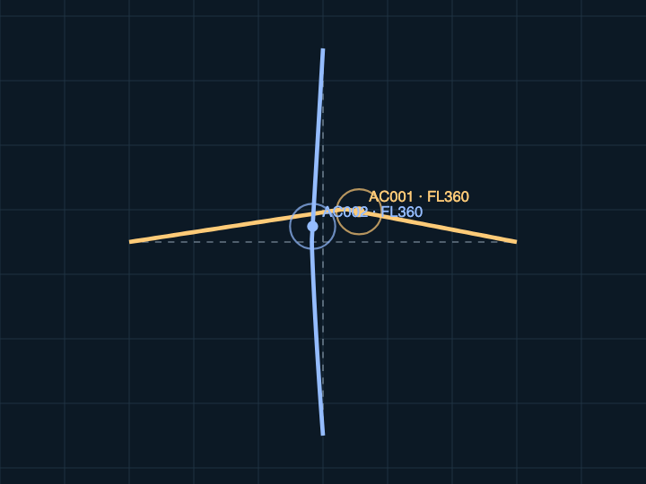
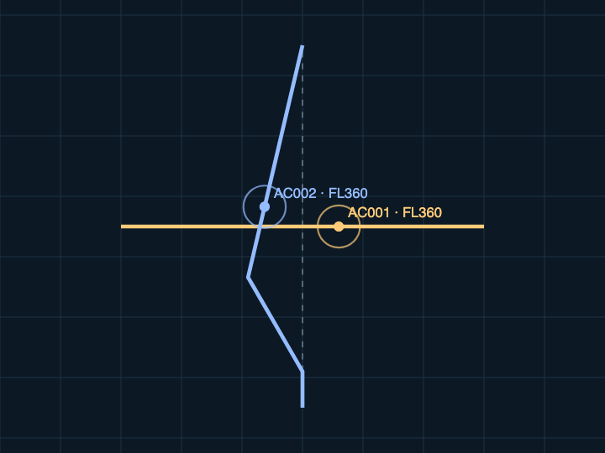
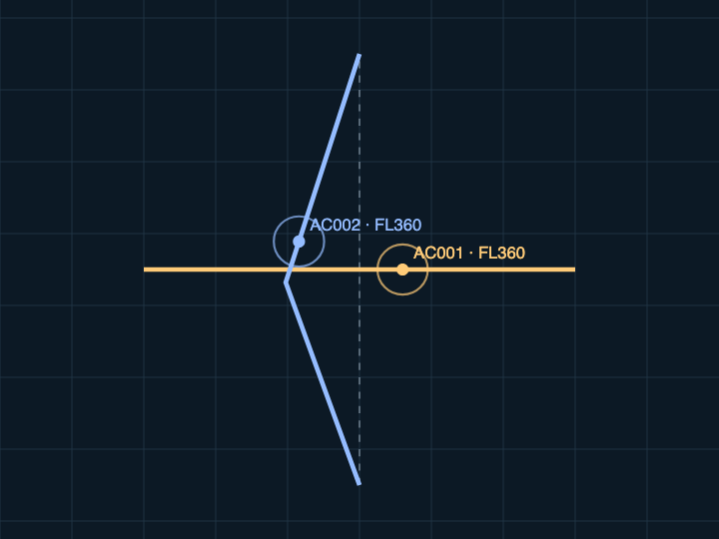
Three more methods on the same crossing
Positions at 360 s. ORCA changes speed. MPC and MILP keep AC001 on route.
ORCA
MPC
MILP
At 0 s: AC001 left 8.7°, 360 kt.
AC002 left 4.3°, 327 kt.
Update every 10 s.
AC002: left 30° at 60 s.
Direct at 240 s.
Replan every 20 s.
AC002: left 20° at 0 s.
Direct at 300 s.
49 options per aircraft.
Minimum horizontal separation (NM), over the full flight
7.000
7.576
7.367
6 / 7
Notes:
The three images are native canvases from the implemented demo, captured in headless Firefox at t=360 s. The viewport is identical for all three: x=10..110 NM, y=7.5..82.5 NM. All aircraft remain at FL360. Captures use the final executed result for ORCA and MPC, and the selected complete plan for MILP. Minima assess the entire flight, not only the snapshot. Source manifest: assets/manifest.json in the private build folder.
ORCA: standard reciprocal velocity constraints with a velocity disc. Preferred speed is 360 kt and speed may vary between zero and 360 kt. At t=0 AC001 turns from heading90 to81.2831986 degrees and keeps360kt. AC002 turns from0 to355.718566 degrees and uses326.720232kt. The method updates every10s with400s lookahead. Actual minimum separation7.000010NM, total added distance0.967010NM, arrivals610s and640s. Source: src/artimation/web/orca.js, default crossing-2 run. A small explicit safety margin0.00001NM protects the numerical boundary.
MPC: fixed360kt, constant altitude,400s prediction horizon and20s execution intervals. Each replanning step solves a finite catalogue selection MILP and retains the shifted previous plan as an option. AC001 stays on route. AC002 flies north until60s, turns left30degrees, and heads directly to its goal at240s. Actual minimum7.576436718NM, total added distance3.451826511NM, arrivals600s and634.518265s. The final executed record is33, distinct from its best historical forecast. Source: src/artimation/web/mpc.js, default crossing-2 run.
MILP:49 trajectories per aircraft, comprising unchanged plus start delays{0,60}s, holds{180,300,420}s, and angles{-40,-30,-20,-10,10,20,30,40}degrees. Continuous pairwise checks identify incompatible options. The exact specialized branch-and-bound solve proves the catalogue optimum for this run. AC001 is unchanged and AC002 uses[0,300,20,0]. Minimum7.367268238NM, added distance3.423144154NM. This is optimal for the finite catalogue, without a claim of unrestricted trajectory optimality. Source: src/artimation/web/milp.js.
These outputs illustrate different decisions. ORCA has different admissible speed controls from GA, SA, MPC and MILP. The displayed examples do not establish a general performance ranking, and the common fitness does not penalize delay.
Primary references: https://gamma.cs.unc.edu/ORCA/ ; https://web.stanford.edu/~boyd/papers/code_gen_rhc.html ; https://www.centropiaggio.unipi.it/publications/mixed-integer-programming-aircraft-conflict-resolution.html
Fresh figures in this revision come from the current Artimation Visu interface. Capture parameters, scenario, selected record and exact numeric results are retained in assets/manifest.json. The displayed maneuvers and complete-flight minima are unchanged.

Slide 7
Objectives and safety checks
Default weights. All aircraft at the same altitude (FL360).
Shared trajectory evaluation
Method objectives
dmin = min ||pᵢ(t) − pⱼ(t)||
GA | maximize F
Annealing | E = 1 − F Pr(accept) = min(1, exp(−ΔE/T))
ORCA | minᵥ ||v − v*||² v ∈ ORCA, ||v|| ≤ 0.1 NM/s v*: desired velocity
MPC | min Σᵢ (0.02 ΔLᵢ + 0.05 mᵢ + 0.01 qᵢ + 0.002 rᵢ) Plan 400 s. Apply 20 s, then replan.
MILP | min Σᵢₖ cᵢₖ xᵢₖ cᵢₖ = 0.02 ΔLᵢₖ + 0.05 mᵢₖ Σₖ xᵢₖ = 1, xᵢₖ ∈ {0,1} xᵢₖ + xⱼₗ ≤ 1 for conflicting pairs
Over all aircraft pairs and common flight times
Safe if dmin ≥ 7 NM
P = C + 10 max(0, 7 − dmin)
+ 0.02 ΔL + 0.05 M
C: conflict seconds
ΔL: added distance (NM)
M: number of maneuvering aircraft
F = 0.5/(1 + P) + 0.5 I(safe)
I(safe) = 1 when safe, otherwise 0
mᵢ: maneuver flag
qᵢ = ||vfirst − vprev||² / vnom²
rᵢ: NM to goal 400 s ahead
7 / 7
Notes:
These formulas describe the actual implemented two-dimensional, constant-altitude examples. Conflict seconds sum over aircraft pairs; dmin is the minimum horizontal distance over common flight intervals. Added distance is the sum of positive extra path lengths versus original routes. The maneuvering-aircraft count includes any aircraft with a changed trajectory. In the general altitude-enabled evaluator, add0.04 times altitude_change_ft/1000 to P. JavaScript clamps fitness at0.5±Number.EPSILON to preserve strict safe/unsafe ordering at floating-point saturation. Source: src/artimation/web/model.js.
The genetic algorithm maximizes common fitness F. Simulated annealing uses E=1−F, a geometric temperature schedule, and Metropolis acceptance probability min(1,exp(−(E_new−E_current)/T)). Improvements and ties are accepted. Source: ga.js and annealing.js.
ORCA minimizes Euclidean squared distance from preferred velocity inside its reciprocal halfplanes and a speed disc. Each halfplane passes through v_current+u/2 with an outward normal from the pairwise velocity obstacle. Preferred velocity points toward the destination, bounded by360kt=0.1NM/s. The candidate enumeration computes the convex optimum from the preferred point, boundary projections, line intersections and line/circle intersections. Infeasible halfplanes use an explicitly recorded minimax relaxation. ORCA optimizes this local velocity objective, not the global F score. Source: orca.js; https://gamma.cs.unc.edu/ORCA/.
MPC native objective at each replanning time is sum_i[0.02*added_distance_nm_i+0.05*maneuver_i+0.01*||v_first_i−v_previous_i||²/v_nominal_i²+0.002*distance_to_goal_at_horizon_nm_i]. Added distance covers the complete candidate continuation to the goal, m is the catalogue option maneuver flag, continuity is normalized velocity-vector change, and terminal distance is measured400s ahead. Pairwise separation constraints apply continuously through the prediction horizon. The first20s interval undergoes an independent exact check before execution. Replanning uses a finite catalogue and does not claim unrestricted nonlinear MPC optimality. The final executed flight receives the same full-interval evaluation as other methods. Source: mpc.js; https://web.stanford.edu/~boyd/papers/code_gen_rhc.html.
MILP binary x_ik selects trajectory k for aircraft i. One option per aircraft and no incompatible trajectory pair are hard linear constraints. c_ik=0.02*extra_distance_nm+0.05*maneuvered_aircraft. Compatibility is precomputed with continuous piecewise-linear separation, not time-grid samples. Exact branch-and-bound certifies optimality only after exhaustive bound/pruning completion for the finite catalogue. Node-limit termination never implies optimality. Source: milp.js; https://www.centropiaggio.unipi.it/publications/mixed-integer-programming-aircraft-conflict-resolution.html.
The common F, minimum separation, conflict duration and detour remain reporting measures for all methods. The native ORCA/MPC objectives differ. No common delay cost or operational aircraft dynamics model is claimed. Every aircraft in the illustrated examples stays at FL360.
This clearer layout groups the shared full-flight evaluation on the left and each method objective on the right. Equations are unchanged. I(safe) is the indicator for a conflict-free trajectory set. The implementation retains strict floating-point safety-ordering clamps. The 2D examples have no altitude-cost term. In the MPC notation, q_i is the previous slide version’s delta_i squared and r_i is the previous d_i. q_i is dimensionless; r_i and extra length are in NM. m_i is one when that candidate aircraft trajectory includes a maneuver. T is the annealing temperature and delta E is proposal energy minus current energy. For ORCA, v belongs to the reciprocal safe-velocity halfplanes and the speed disc, with a 360 kt maximum (0.1 NM/s). MILP binary x_ik selects option k for aircraft i, with exactly one option per aircraft and incompatible pairs excluded. All changes concern presentation only; the algorithms and reported numerical examples are unchanged.

