Slide 1
Starting a data project
Management, data and computation Émilien Schultz - emilien.schultz@ensae.fr

Slide 2
Technical skills for the Policy-in-action Project
You : carring out a collaborative data project
What’s your background ?
Me : helping on data & code
emilien.schultz@ensae.fr / office 4044

Slide 3
General ideas of this workshop
Discussing best practices for collaboration
Showase existing computational resources
Starting the structure of a project
Getting familiar with code versioning (Git/GitHub)
Discussing about coding practices

Slide 4
Planned schedule
Session 1 (26/09/2025): Data science project : Management, data and computation
Session 2 (23/10/2025) : Code management and best practices
Group support for projects (zoom / office)

Slide 5
Today
Values & tools for data science
Manipulate data
Basics of Command Line Interfaces / *nux
Hands on

Slide 6
Values & tools for data science

Slide 7
What is your previous data science experience ?
What aspect of data analysis do you like (if any) ?
What is the task you found the most difficult ?
What software do you use ?

Slide 8
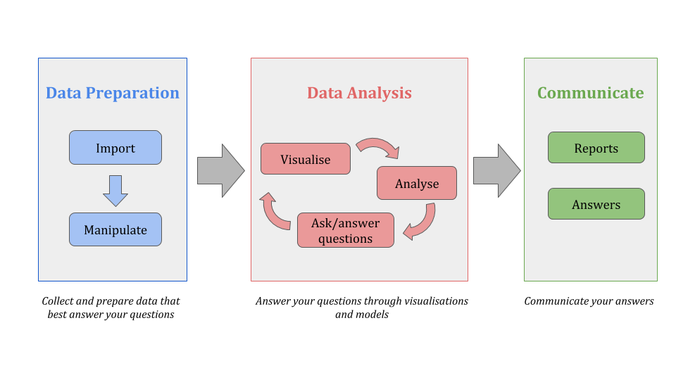
General workflow

Slide 9
Main values for public data analysis
Reproducibility
Openess
Explainability
(Maintainability)

Slide 10
What is reproducibility
A result or project is never not a one shoot
A result is reproducible when the same analysis steps performed on the same dataset consistently produces the same answer.

Slide 11
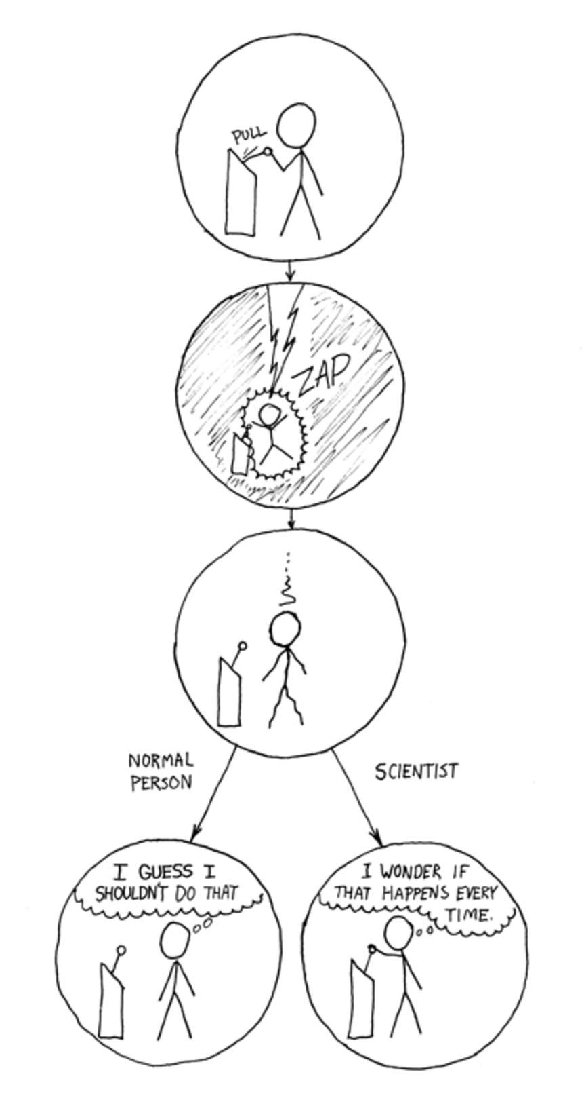

Slide 12
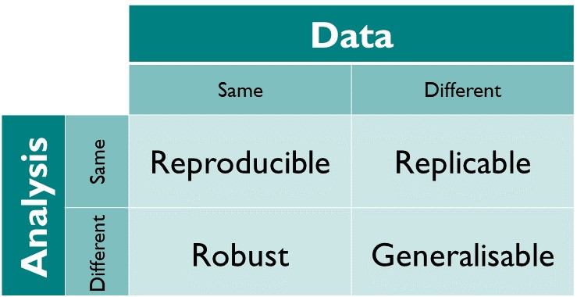
Different flavour of reproducibility

Slide 13
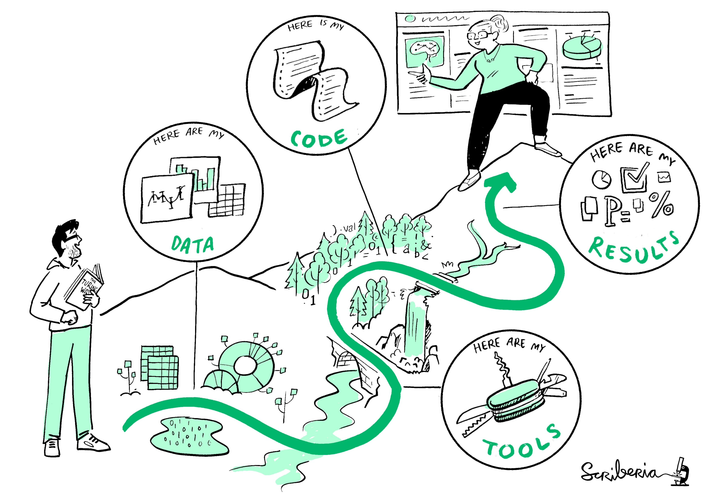
What it entails to be reproducible
Be able to walk the path again : connecting data, software and questions

Slide 14
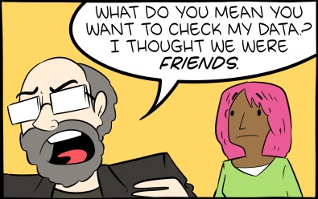
Openness
Both for data and code, create the possibility of reproducibility

Slide 15
Not always possible for data

Slide 16
Meaning of openness
Clear methodologies
Data accessibility
Reusable software

Slide 17
Explainability & Maintainability
The idea is to increase stability and the possibility to modify elements
Avoid dependencies of paid services and black boxes
Use technologies you understand
Use technologies used by others

Slide 18
The challenge of working together
data science project / software programming
Sharing storage
Communicating over various channels
Keeping track of various versions
…

Slide 19
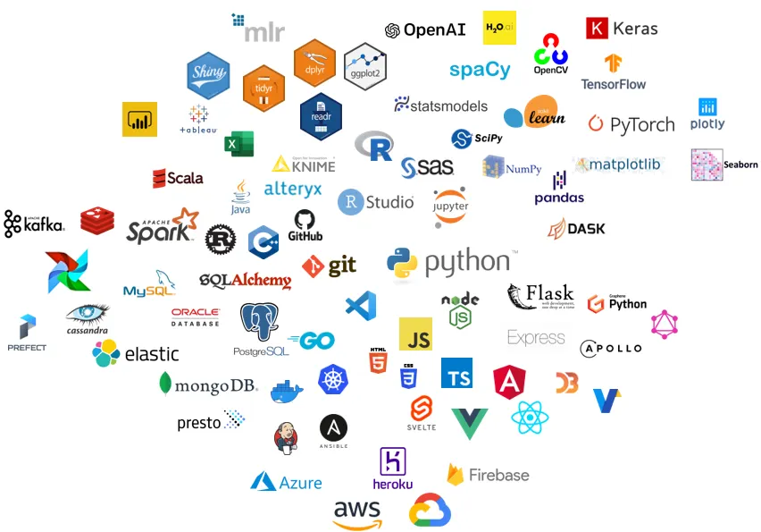
Tools : who’s who, and what do you use ?

Slide 20
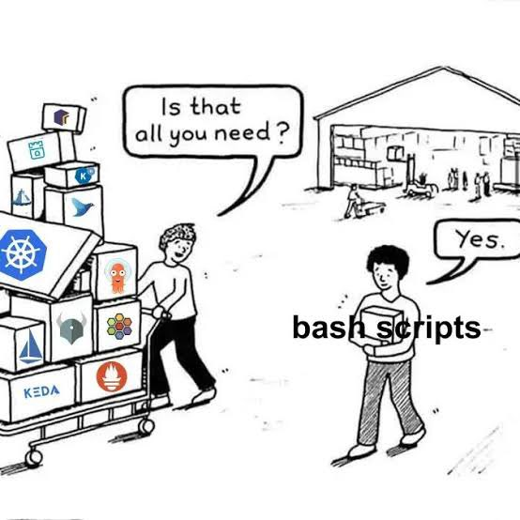
Software has consequences
Open/proprietary
Software/programming
Specialized/general purposes

Slide 21
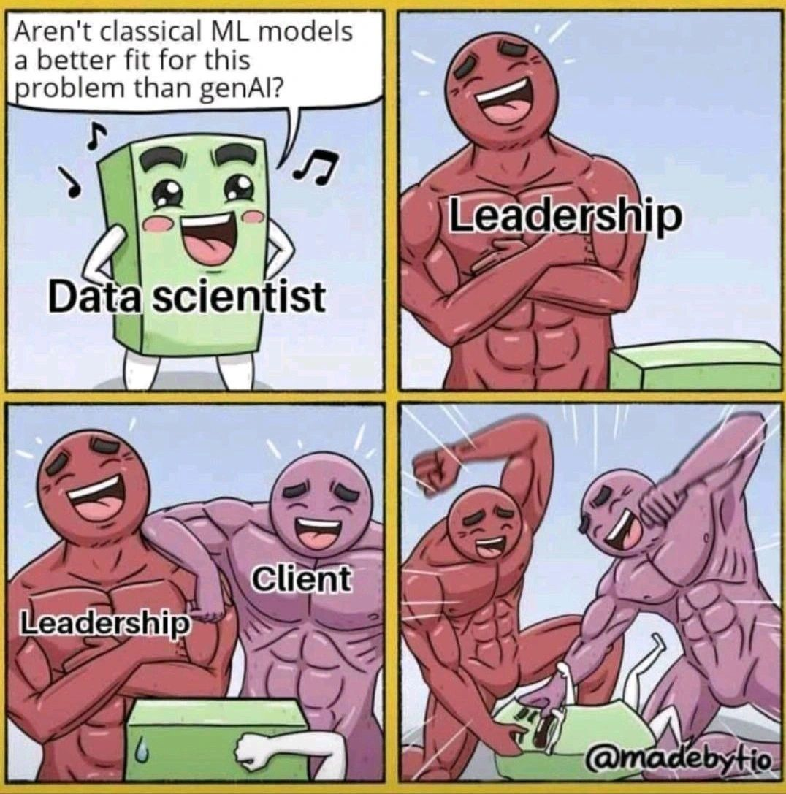
You can resist genAI (yes, it is hard)
Different uses, some more clever than other.

Slide 22
The role of programming in data science
Important for the flexibility of the workflow
Different languages
Different tools
Different workflow
What do you use for programming ?

Slide 23
Scripts, notebooks and packages
Notebooks allows litterate programming
Very useful for data exploration / prototyping
Convert to dashboard
Scripts are better for stability
A pathway from scripts to packages
What is your experience with notebooks ?

Slide 24
The unholy trinity
Computational service
Scripts/treatments
Data
What hardware do you need ?

Slide 25
Where could you run your code ?
Local computer
Limit of ressources / not collaborative / messy
Cloud services as Google Colab, Kaggle
Proprietary systems
Limit of ressources
Dedicated institution services (Onyxia, Jean Zay)
Condition of access
Availability
How to size ressources ?

Slide 26
Onyxia
GENES Data Lab, based on a plateforme developed by INSEE
Possibility to create temporary services
catalogs and services launched by the users (Kubernetes access)
a file browser (S3 access)
secret browser (Vault access)
Starting with Onyxia

Slide 27
Hands on
Connext to Onyxia : https://onyxia.lab.groupe-genes.fr
Create a Jupyter Lab project with 2 CPU and 20 Go of RAM
Run a script that get the course page (you can use genIA ^^)
If you need a project group on Onyxia, please send a mail

Slide 28
Manipulate data

Slide 29
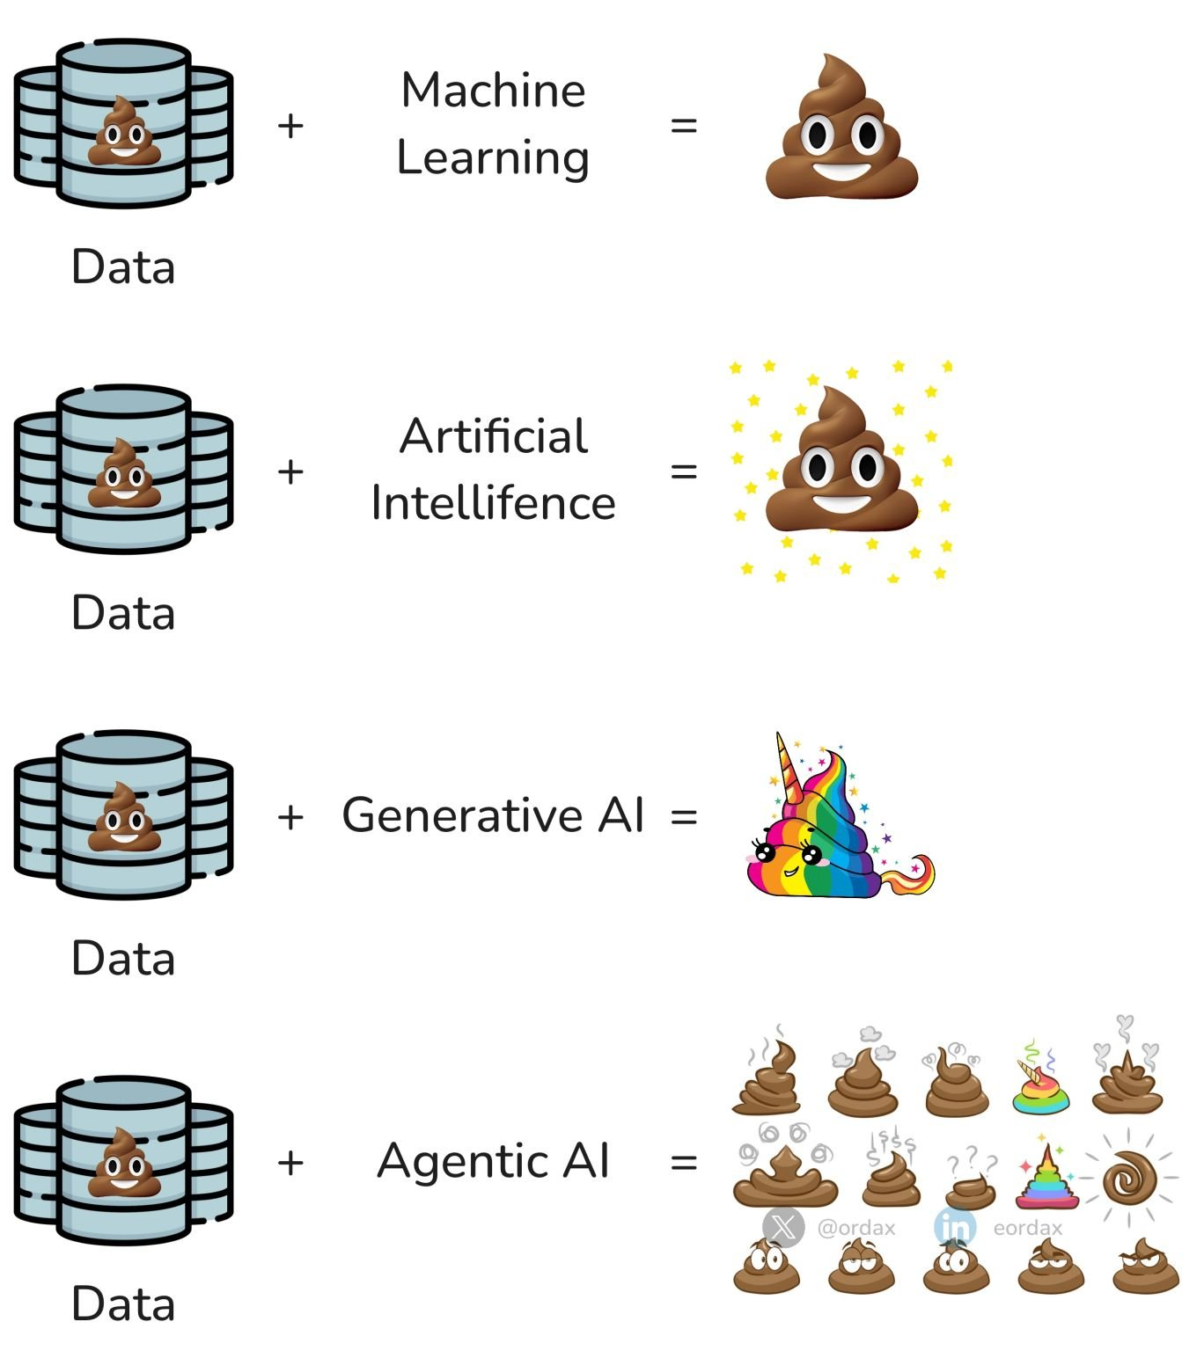
Data quality is central

Slide 30
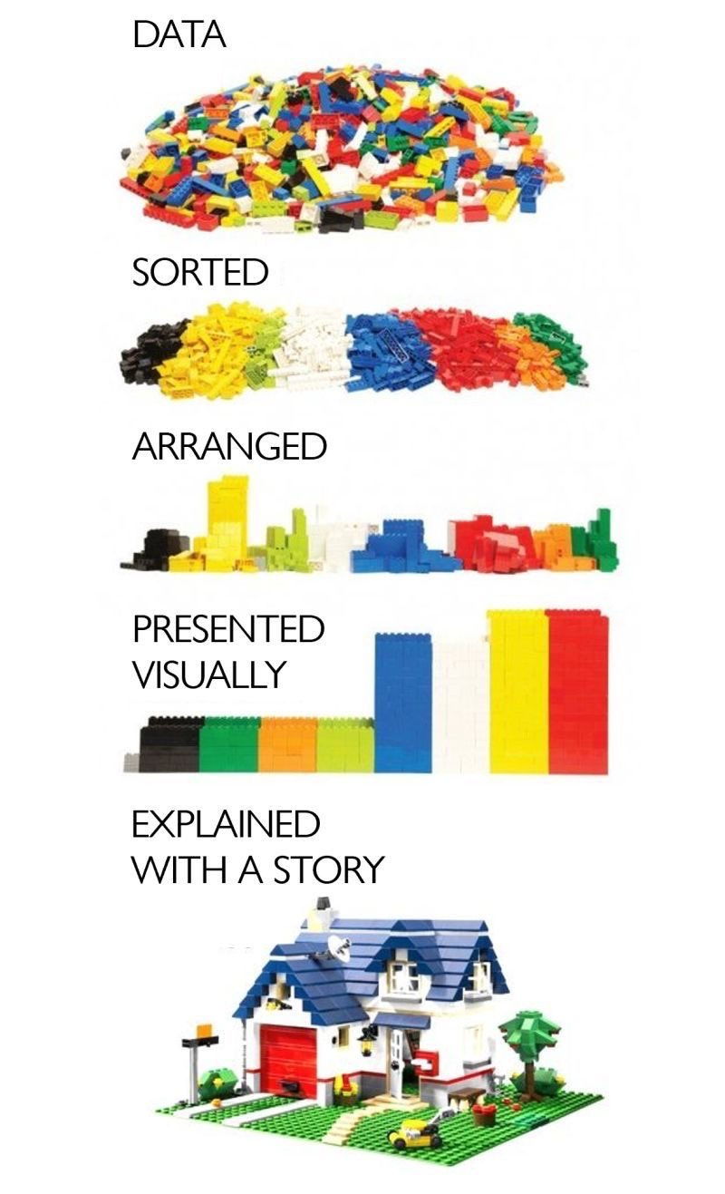
In theory

Slide 31
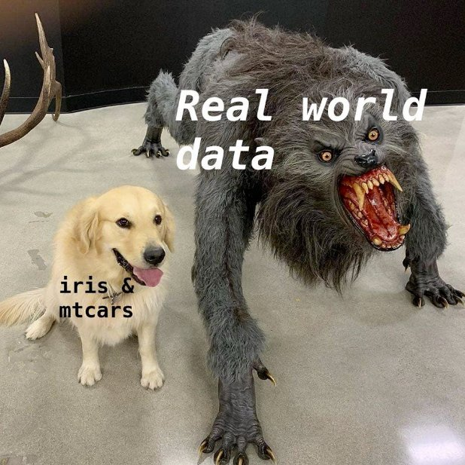
In reality

Slide 32
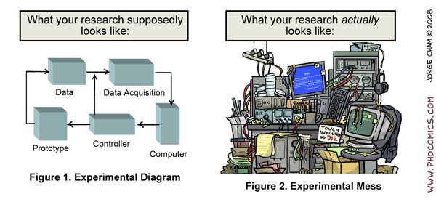
A practical middle ground

Slide 33
So many questions…
How to scrap online data ?
What are the best format to use ?
What is encoding ?
What can I do if my dataset is too large ?
What can I do if my scripts take too much time ?
What if my computer is too old ?
…

Slide 34
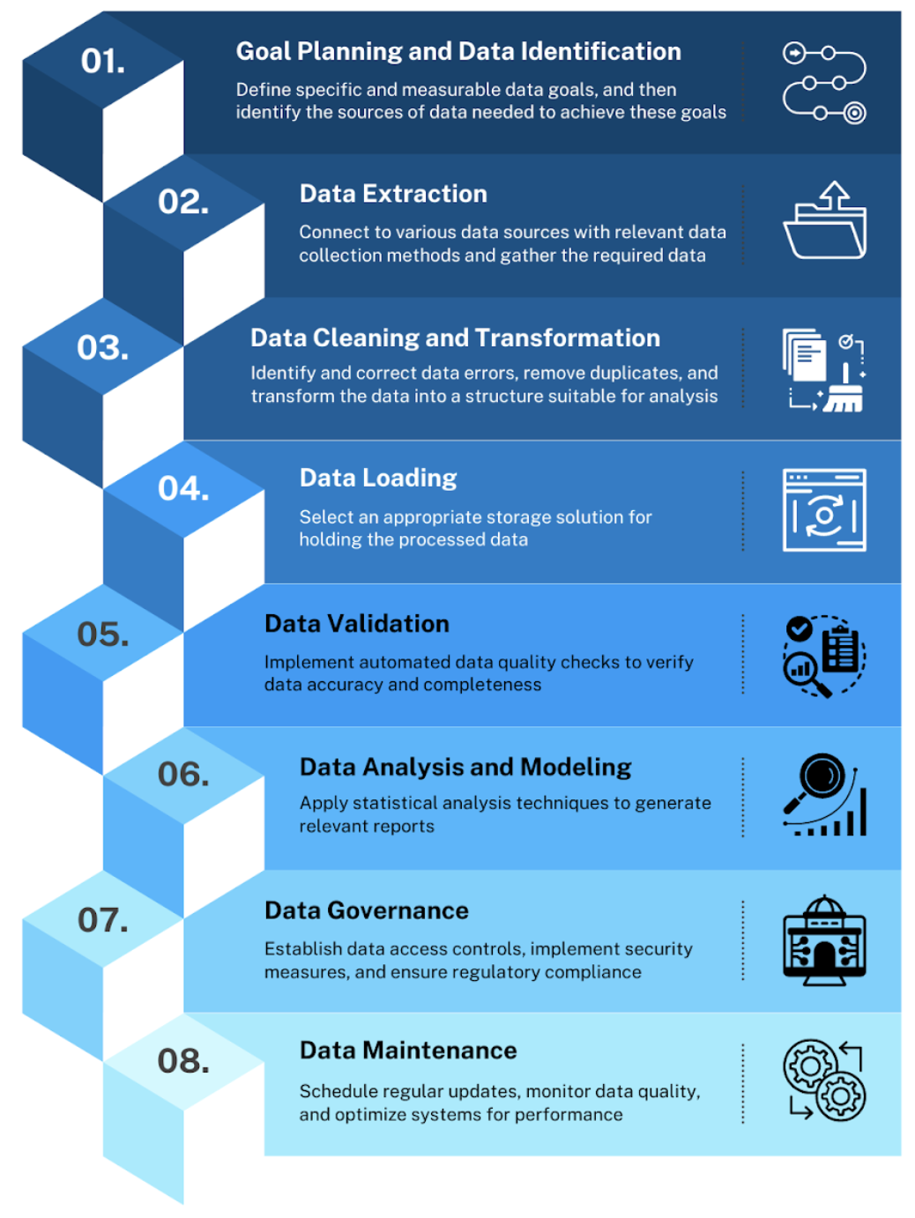
Different stages

Slide 35
What is FAIR data

Slide 36
Rule 0 : know your data
Have a look to your data
Duplicates
Empty data
Before starting complex treatments
Do simple treatments
Ask yourself if the question and the data match

Slide 37
Rule 1 : Structuring a Project
Separate code from data
Different logic
Different tools
Document / Comment your productions
Be explicit (variables, document file)
Yes, it is boring, but useful
Modularize : create distinct elements
One file per element
Function rather than repeating code

Slide 38
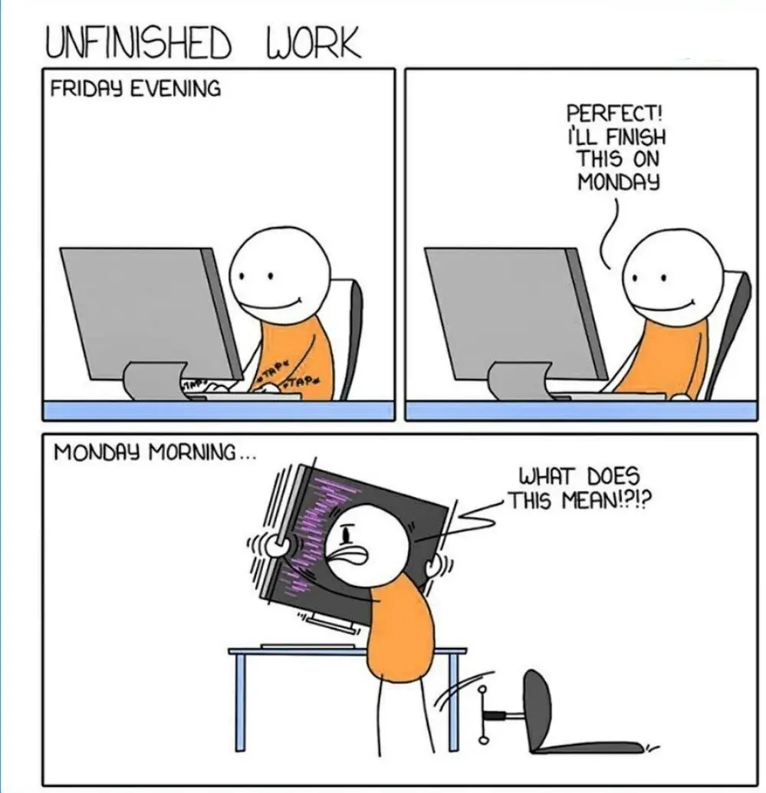
There will always be another monday

Slide 39
Rule 2 : a common file system
Organize your project
data in a data directory
scripts in a script directory
what else ?
Create a common place to store it

Slide 40
Example of a file system
project-name/ │ ├── README.md ├── data/ │ ├── raw/ # Unprocessed, original data │ ├── intermediate/ # Data after cleaning │ └── final/ # Cleaned, analysis-ready data ├── src/ │ ├── notebooks/ │ └── scripts/ ├── docs └── outputs/ ├── figures/ ├── tables/ └── reports/

Slide 41
Ideally, a DMP
Data management plan : Document that list the data and how you handle it
What types of data will I have?
What kind of file formats will my data be in?
Would a user of the data require special software to open/use the data?
What is the approximate volume of data to be generated?
What methods will I utilize to collect the data, including how they will be standardized for consistency and future re-use?
What is your naming and versioning strategy for storing the data that is collected?
…

Slide 42
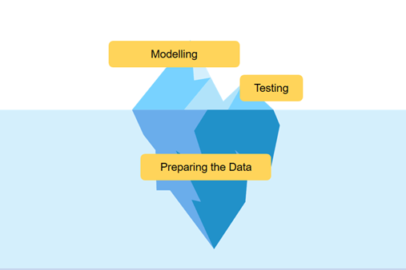
Rule 3 : accept to spend time on data preparations

Slide 43
Different types of data
Small (< 1 Go) : no pressure
Middle (< 10 Go) : some problem can arise
Large (~ 100 Go) : take some time to think
Could you think of examples for each category ?

Slide 44
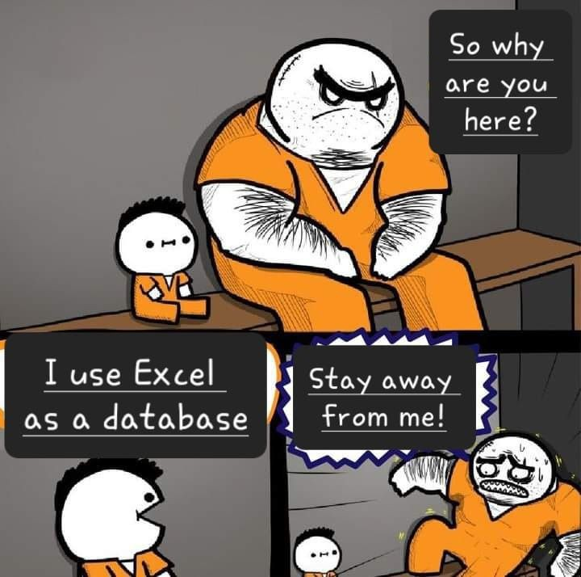
Use adequate tools

Slide 45
(in fact Excel-like tooks are fine for specific uses)

Slide 46
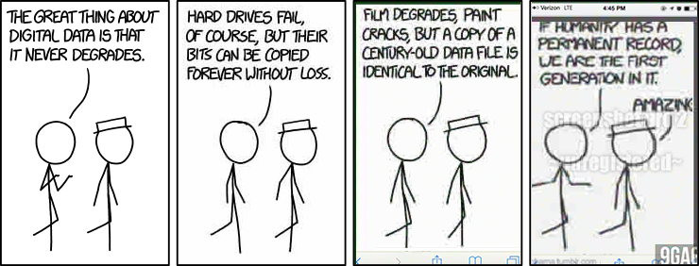
Let’s talk about data format
Format is both information & affordance

Slide 47
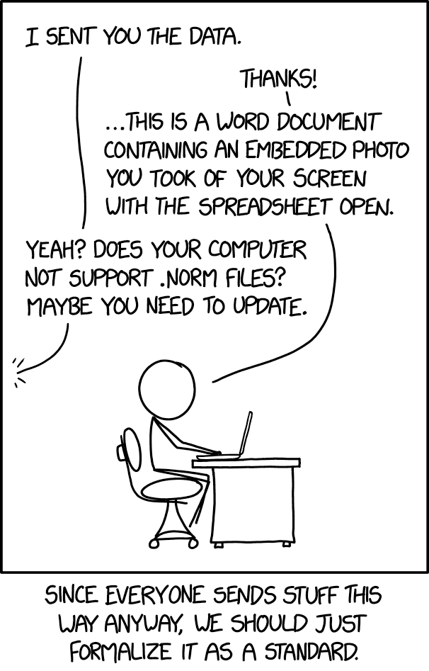
What are the best data format

Slide 48
My suggestion
There is no silver bullet, but : open format + think the way you need to access them
CSV : read by chunck, easy to check
Parquet : compressed + duck duck go
SQLITE : if relational
…

Slide 49
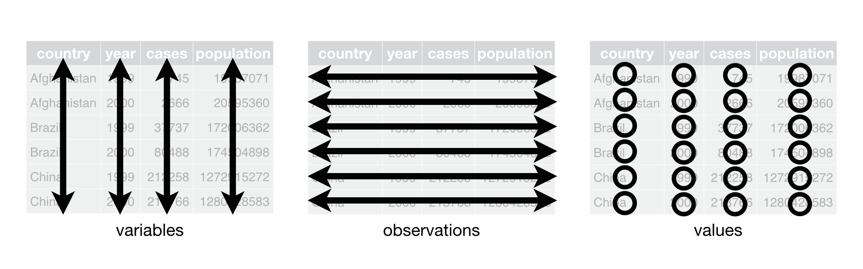
Data architecture : aim for tidy data
Separate raw data from transformed data
Move from unstructured to structured
Tidy data

Slide 50
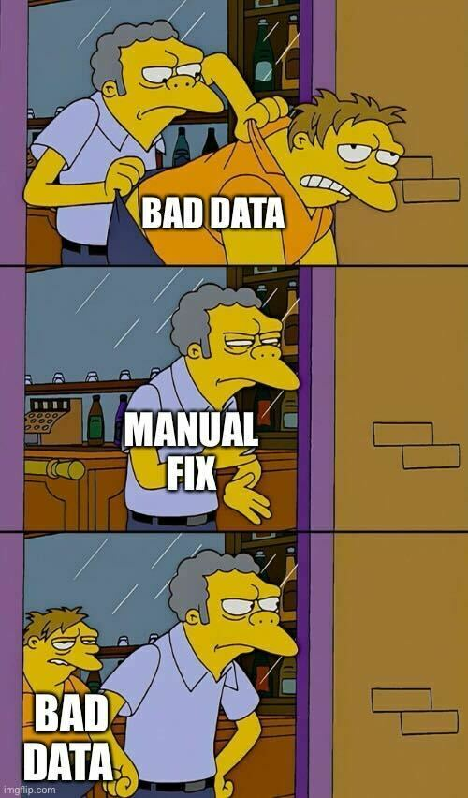
Avoid to correct your data manually
Build a workflow - write some scripts

Slide 51
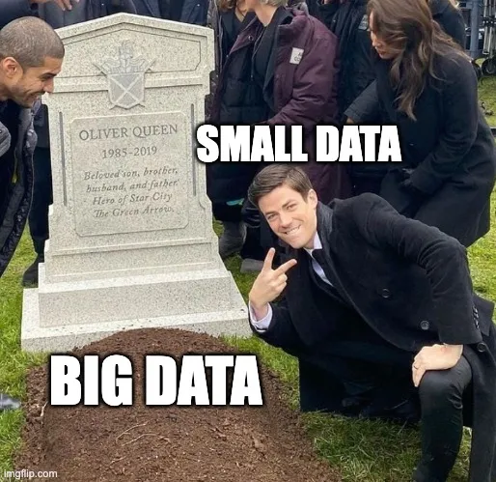
The case of Big Data
Favour small data if you can

Slide 52
Otherwise
Solution 1 : reduce your data
Work on subset
Sample
Batch
Solution 2 : parallelize
Dedicated data architecture
Parallelize (Dask)
Dedicated tools : Xan for csv

Slide 53
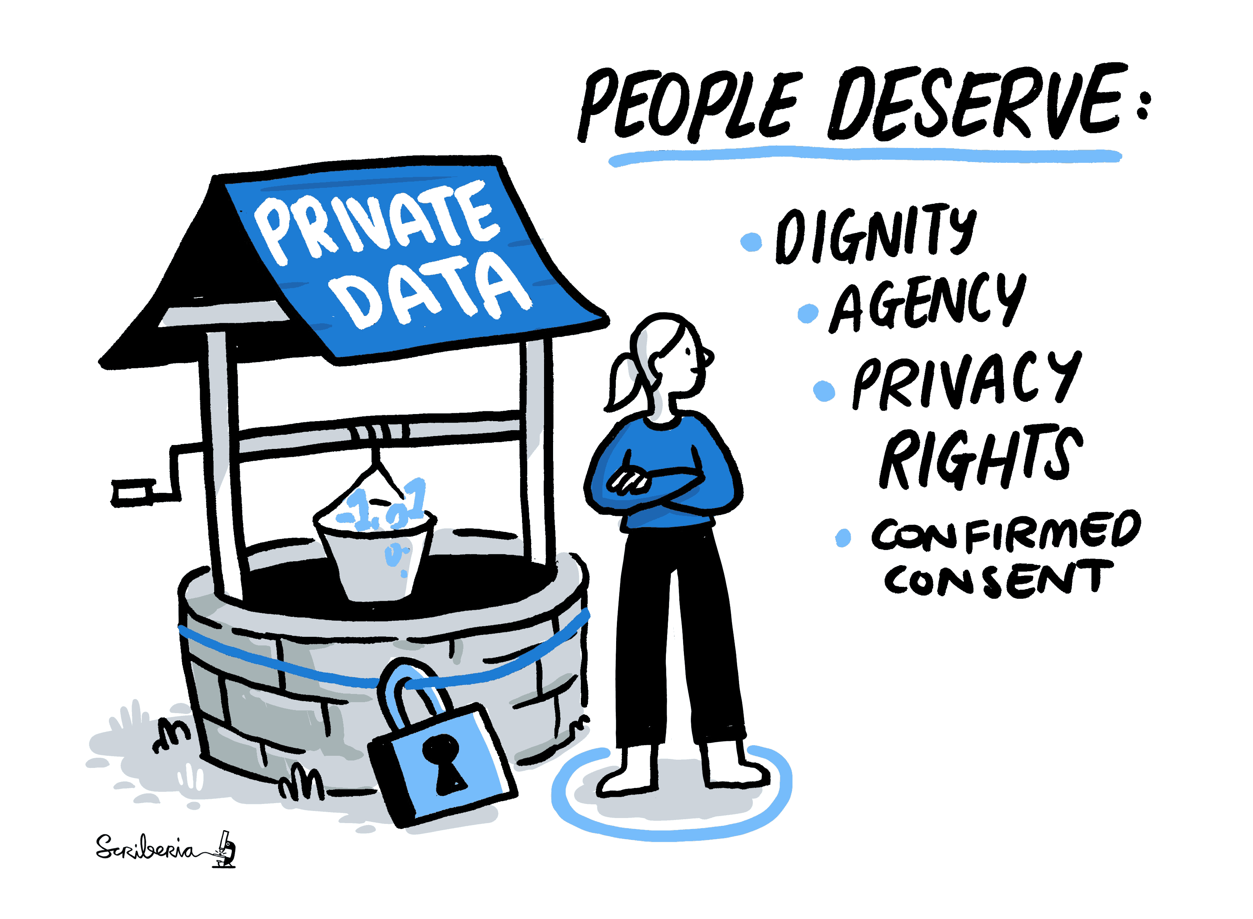
Be aware of data privacy

Slide 54
How to conciliate privacy with reproducibility
As open as possible, as closed as necessary
Anonymize / pseudonymize
Agregate
Use synthetic data

Slide 55
How to store the data
During the project
institutional solutions (S3 Onyxia)
cloud solutions
After the project
Zotero, Figshare

Slide 56
Hands on
Get the French association database https://www.data.gouv.fr/datasets/repertoire-national-des-associations/
Build a parquet file
Upload the database on the S3
Launch a service that can access the S3
Create a tidy data file with associations mentionning data

Slide 57
import pandas as pd df=pd.read_parquet('s3://eschultz-ensae/association.parquet', storage_options={ "client_kwargs": { "endpoint_url": S3_ENDPOINT_URL, }, 'key' :os.environ["AWS_ACCESS_KEY_ID"], 'secret' :os.environ["AWS_SECRET_ACCESS_KEY"], 'token' : os.environ["AWS_SESSION_TOKEN"] })

Slide 58
Introduction to CLI

Slide 59
The great divide
2 different traditions/philosophies
graphical user interface (GUI)
mouse + everything visible
massive software
command-line interface (CLI)
keyboard (text-based) + everything hidden
one command per tool
small, simple programs with clean interfaces can be combined to build larger systems

Slide 60
What is the command line interface ?
A command-line interface (CLI) is a means of interacting with a computer program by inputting lines of text called command-lines
A shell/terminal is a process that serves as a command processor
In the past, every computer
Now, mainly unix systems (linux, mac…)
And in programming
Different terminal (bash, zsh…)

Slide 61
Why do I have to care about CLI ?
Formalize all treatments to allow reproducibility
To be able to use different types of remote computer (high-performance computing)
To mix it with scripts (Python, R)
To use specific tools
Combine existing tools into powerful pipelines

Slide 62
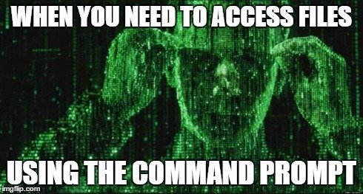

Slide 63
CLI is a general philosophy
Build-in commands (Unix/linux)
OS specific commands (Windows, Mac)
Specific tools command (once installed)
Using CLI mix general principles and some familiary with unix systems.
For instance always find help the same way

Slide 64
*nux systems in research
Linux (and Unix)
largely used in research
infrastructure of computing resources (Linux runs all the TOP500 supercomputer)
pervasive in a lot of tools
Beyond
Free and open (nobody owns it)
Diversity of versions

Slide 65
Some info on GNU-Linux
originated from Unix (1969); opened up by Linus Torvalds’ “Linux” kernel (1991)
different flavours : Debian (Ubuntu), Red Hat (CentOS), SUSE
Kernel / Desktop experience
centrality of command line
possibility to be close to the hardware / low level operations

Slide 66
Some examples
search all files with a .r extension
find ~/Documents -type f -name "*.r"
create a python virtual environment, install a package and run a script
conda create -n new_env python=3.8 pip install pandas python script.py
connect to a remote computer with ssh
ssh -Y eschultz@cca.in2p3.fr

Slide 67
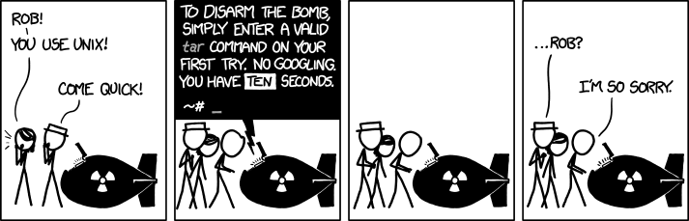
You don’t have to master all of it
You will use only specific command
You can search/chatgpt it
And you can make different attemps : it is a dialogue

Slide 68
Files, Directories, and Processes
A file is a collection of data held in non-volatile storage such as a hard disk. It has a location in the file system called a path. Paths will typically be a series of words (directory names) separated by forward slashes, /. (dot files are hidden) • A directory is a special type of file holding information about other files. It is the equivalent of a folder in Windows. Think of a directory as a container for other files or directories. • A process is an executing program that requires volatile storage such as RAM, as well as CPU resources. Processes may be short in duration, such as a process that prints a file to the screen, or they may run indefinitely

Slide 69
Manage a filesystem
file/directory (folder)
computer filesystem organiserd from a drive/root
/
C:\
The file system is a tree 🌲
Absolute path : from the root
It depends on the computer specific organization
Relative path : from current location
Each software is running from somewhere : its current location `.

Slide 70
The structure of a command

Slide 71
usally a command is a name
with options indicated with flag (-o VALUE) or full name (-option VALUE)
and different arguments (it can be quite long and confusing)
For instance
a man page man command or for tools an help : command --help

Slide 72
First commands for the filesystem
pwd : the current working directory
ls : list all the files in a folder
cd : change directory to a specific path
mkdir : create a folder (-p for nested)
rm : remove a file
touch : create an empty file
cp : copy a file
mv : move a file
Let’s have a quick look

Slide 73
Tips
Up/down arrows go up and down the list of previous commands
Use tab to facilitate completion
.. : parent folder
~ : home
history : display a list of the last N commands
Wildcard matching : *

Slide 74
More useful commands
echo : print text
cat : concatenate text then display
tail and head : display the beginning / end of a file
find
wc : word count
sort : sort
grep : contraction of ‘global/regular expression/print’

Slide 75
More (just to know they exist) !
top : see processes running
ps : see current processes
kill: kill a process
df: see disk space
du: disk usage
du -sh *: see disk usage of all files
vim or nano : edit text files
curl : download files

Slide 76
File permissions
Permissions are what the user can do with the file
ls -l : print “long format” information ; file mode is shown as read-write-execute (rwx) bits for user, group, others
chmod u+x file1 : change the file mode so that file1 can be executed like a command by the user
chmod 600 file2 : change the file mode so that file2 can be read

Slide 77
Successive commands : the pipe
output on files > (w) and >> (a)
pipe |
The number of lines :
ls -l | wc -l
Variables
$HOME, $PATH

Slide 78
Environment Variables
env : print names and values of all environment variables defined in the current shell
export VAR=val: set local variable VAR to the string “val” and export it to the environment
echo $VAR: print the value of variable VAR
which <command> :show the full path to the given command, as found by checking the directories in the PATH environment variable, in order

Slide 79
Install a tool
A lot of tools are software you need to install
Each OS has a package manager
Debian : apt-get
macOS : brew
Windows : choco
sudo apt-get update sudo apt-get install XXXX

Slide 80
Powerful tools exist
For instance, xan https://github.com/medialab/xan
xan is a command line tool that can be used to process CSV files directly from the shell. It has been written in Rust to be as performant as possible and can easily handle very large CSV files (Gigabytes). It is also able to leverage parallelism (through multithreading) to make some tasks complete as fast as your computer can allow. It can easily preview, filter, slice, aggregate, sort, join CSV files, and exposes a large collection of composable commands that can be chained together to perform a wide variety of typical tasks.

Slide 81
Hands on
Run a Jupyter lab server
Create the following filesystem
2024-11-06/ └── data ├── processed └── raw
move the dataset of association in it
count the number of line mentionning data

Slide 82
Ressources
The Turing Way. Guide for Reproducible Research
Video Linux for the researchers, Steve Lantz
The Unix Shell from Software Carpentry
Stoudt, S., Jernite, Y., Marshall, B., Marwick, B., Sharan, M., Whitaker, K., & Danchev, V. (2024). Ten simple rules for building and maintaining a responsible data science workflow. PLOS Computational Biology, 20(7), e1012232.
Wickham, H. (2014). Tidy data. Journal of statistical software, 59, 1-23.

