Slide 1
General Introduction
Introduction to git and Github for a fool-proof programming
March 24th 2022
Emilio Berti & Matthias Grenié

Slide 2
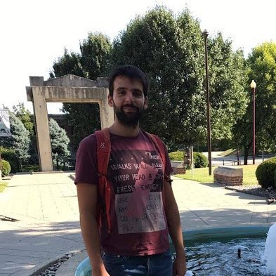
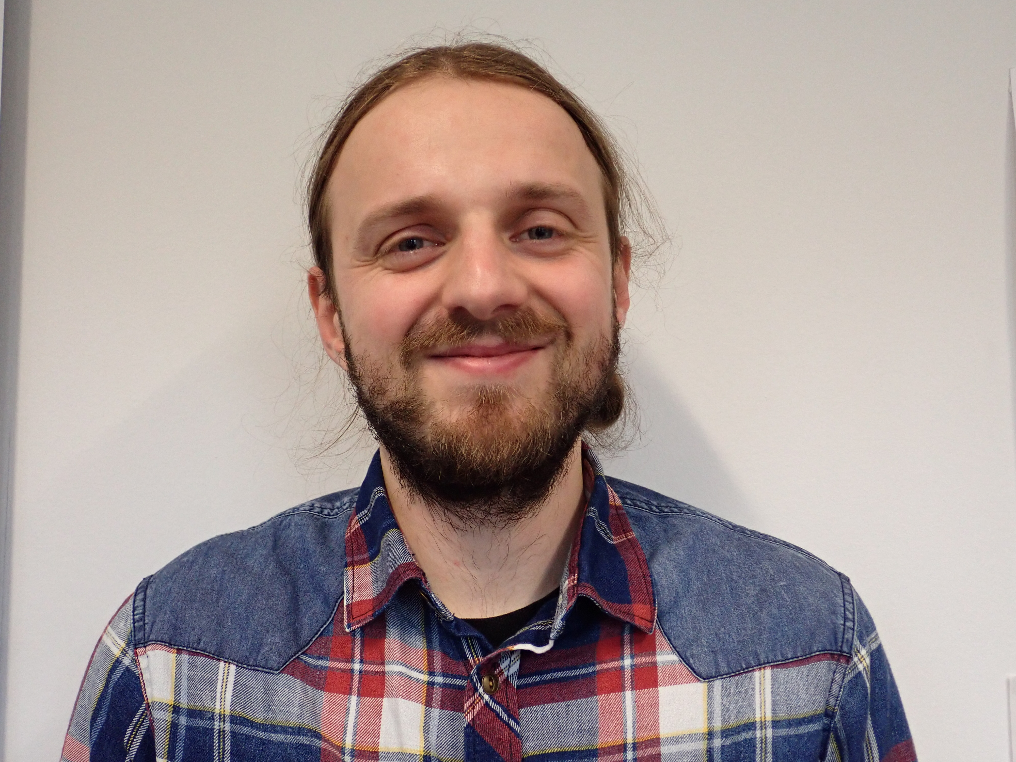
Your teachers
Matthias Grenié
Postdoctoral Researcher
sDiv group
Emilio Berti
Postdoctoral Researcher
Theory in Biodiversity Science (Ulrich Brose) group

Slide 3
Introduce yourself and your topic
Give your name
Give your group
One word for your research topic
(e.g. “dispersal”)
One fact that you’re proud of

Slide 4
Learning Goals
Being able to navigate through your computer in the Terminal
Setup a project with git and save its history
Synchronize the local project with GitHub and manage conflicts
Be able to use git from RStudio
Synchronize your code with the EVE High Performing Computer cluster
Explore code on GitHub with your history
Be able to generate a DOI from Zenedo with a GitHub repository

Slide 5
How we’re going to work
Two teachers alternating
Live-coding as much as possible (show how code works)
Do take notes if you want to
Everything (material & exercises) will be provided at the end of the workshop
Questions anytime
First time running this course, so be understanding :)

Slide 6
Schedule
PASTE SCHEDULE HERE

Slide 7
Questions?

