Slide 1
General Introduction
Introduction to git and Github for a fool-proof programming
March 24th 2022
Emilio Berti & Matthias Grenié

Slide 2
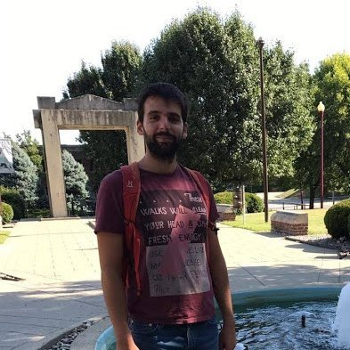
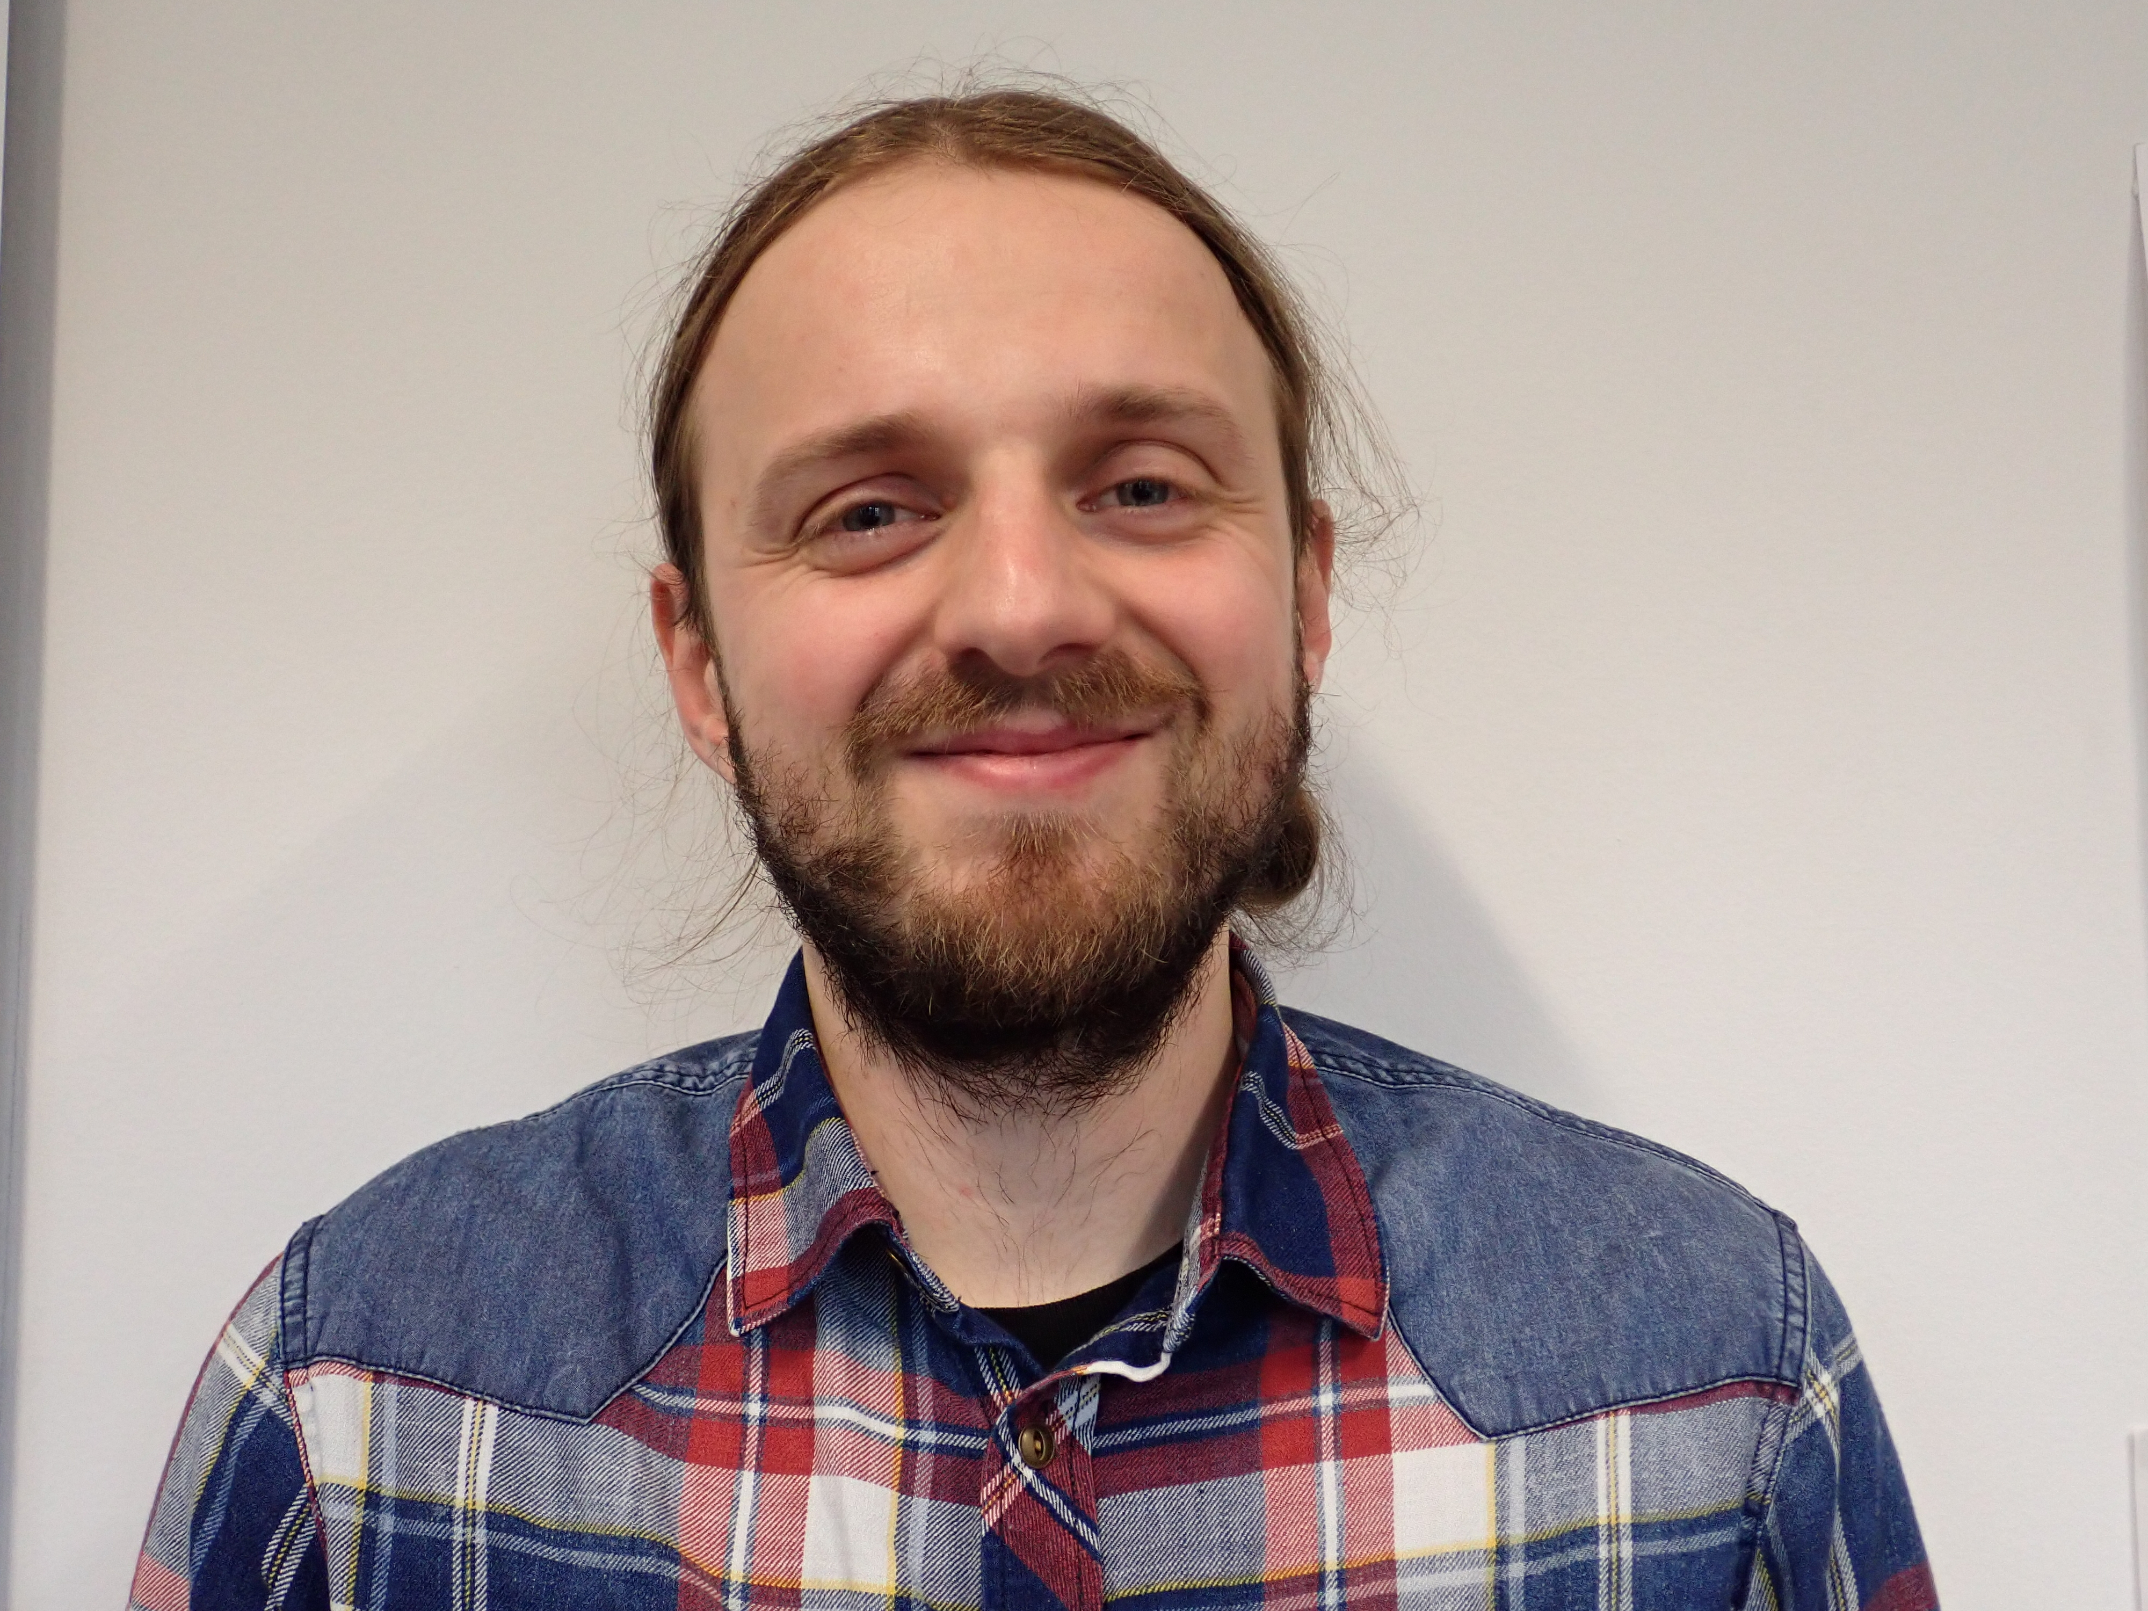
Your teachers
Matthias Grenié
Postdoctoral Researcher
sDiv group
Emilio Berti
Postdoctoral Researcher
Theory in Biodiversity Science (Ulrich Brose) group

Slide 3
Introduce yourself and your topic
Tell us your name
Tell us the name of your group
(e.g., Theory in Biodiversity, Biodiversity Conservation, etc.)
One word for your research topic
(e.g. “dispersal”)

Slide 4
Learning Goals
Being able to navigate through your computer in the Terminal
Setup a project with git and save its history
Synchronize the local project with GitHub and manage conflicts
Be able to use git from RStudio

Slide 5
How we’re going to work
Two teachers alternating
Live-coding as much as possible (show how code works)
Do take notes if you want to
Everything (material & exercises) will be provided at the end of the workshop
Questions anytime
First time running this course, so be understanding :)

Slide 6
Motivation to learn about git and GitHub
Exposure
You can use GitHub as a portfolio of your work
Become a contributor
You can track work your like and contribute to it if you want to!
Collaboration
It gets easier to work with multiple people on code
(vs. Email exchanges or Google Doc)

Slide 7
Schedule
09:30-09:45 – General Introduction
09:45-10:45 – First steps with git (Matthias)
10:45-11:00 – Coffee break
11:00-12:15 – Digging deeper and first steps with Github (Emilio)
12:15-13:15 – Lunch Break
13:15-14:20 – Collaboration & possible conflicts (Matthias)
14:20-14:35 – Coffee Break
14:35-15:15 – git on EVE, git with Rstudio, Zenodo & GitHub (both)
15:15-15:30 – Coffee Break
15:30-15:50 – Using GitHub to navigate code (Matthias)
15:50-17:00 – Extra Time

Slide 8
Setup
What operating system are you using?
(Mac, Linux, Windows)
Did you manage to install git?
(as suggested in the email)

Slide 9
Questions?

