Slide 1
Basics of git
Introduction to git and Github for a fool-proof programming
March 24th 2022
Emilio Berti & Matthias Grenié

Slide 2


Slide 3
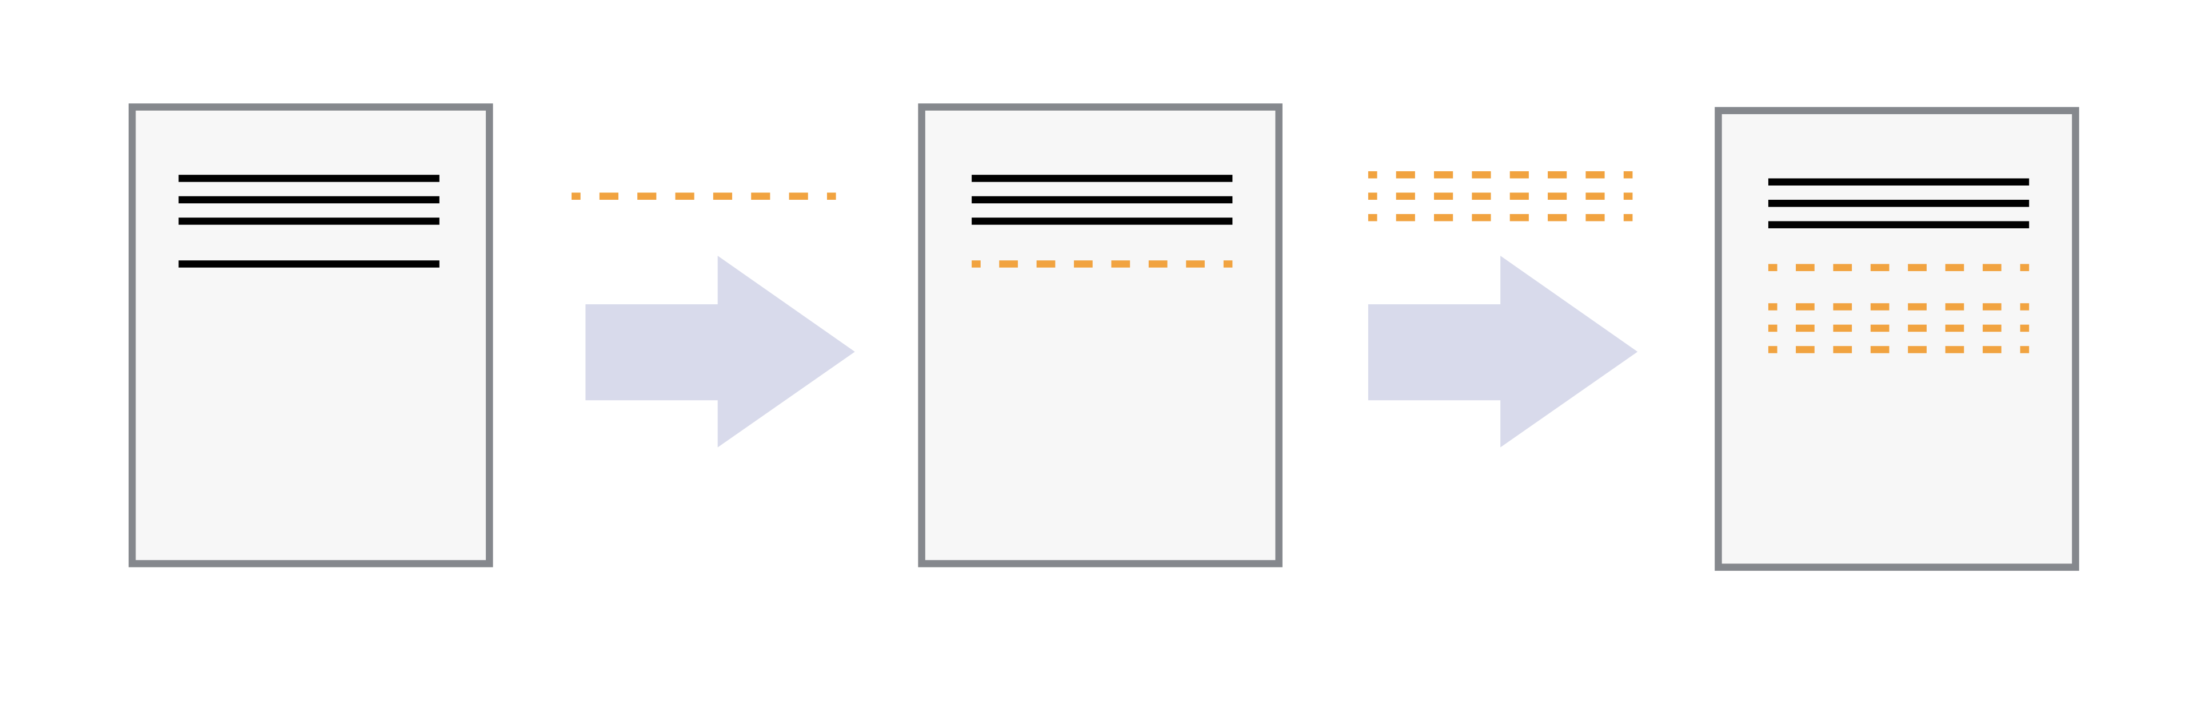
Version control systems start with a base version
of the document and then record changes

Slide 4
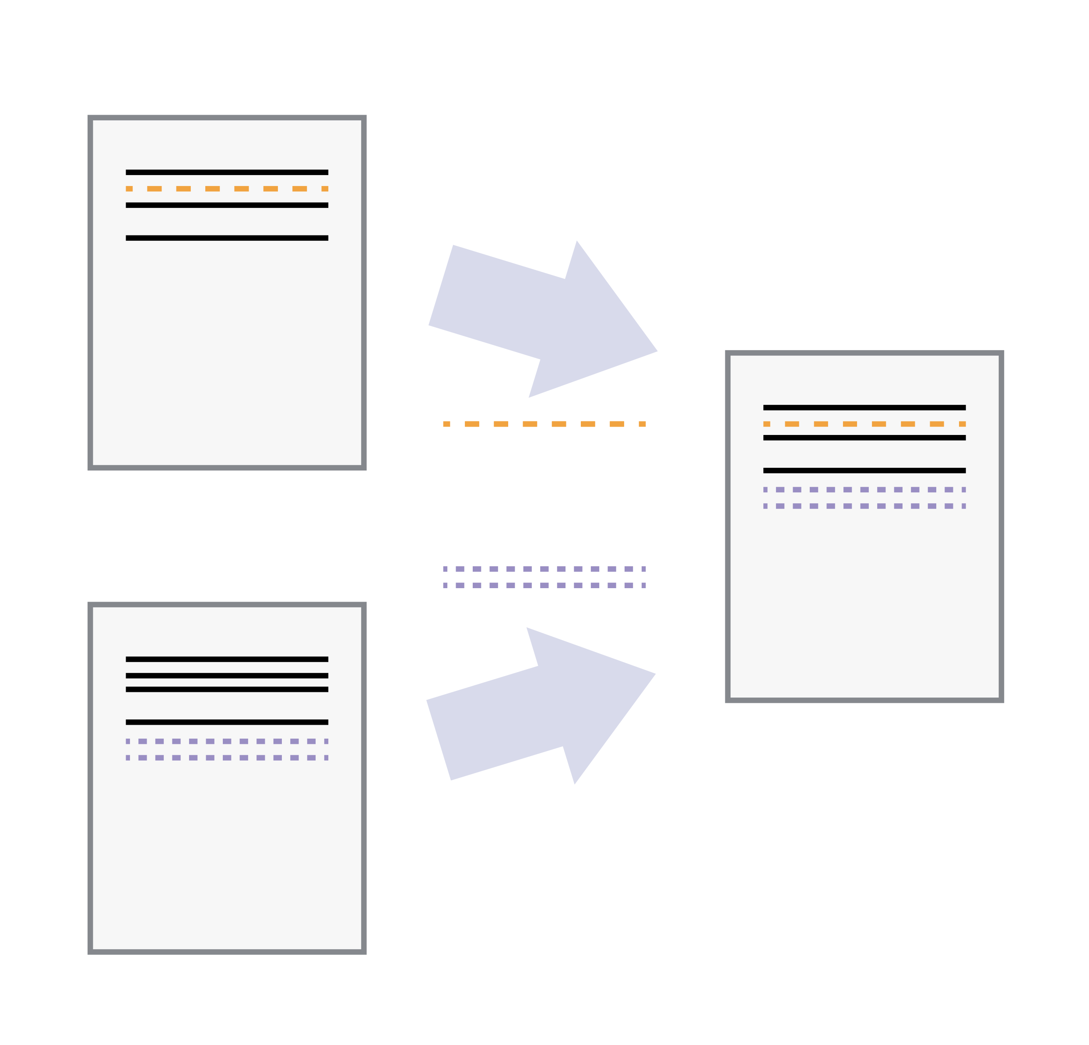
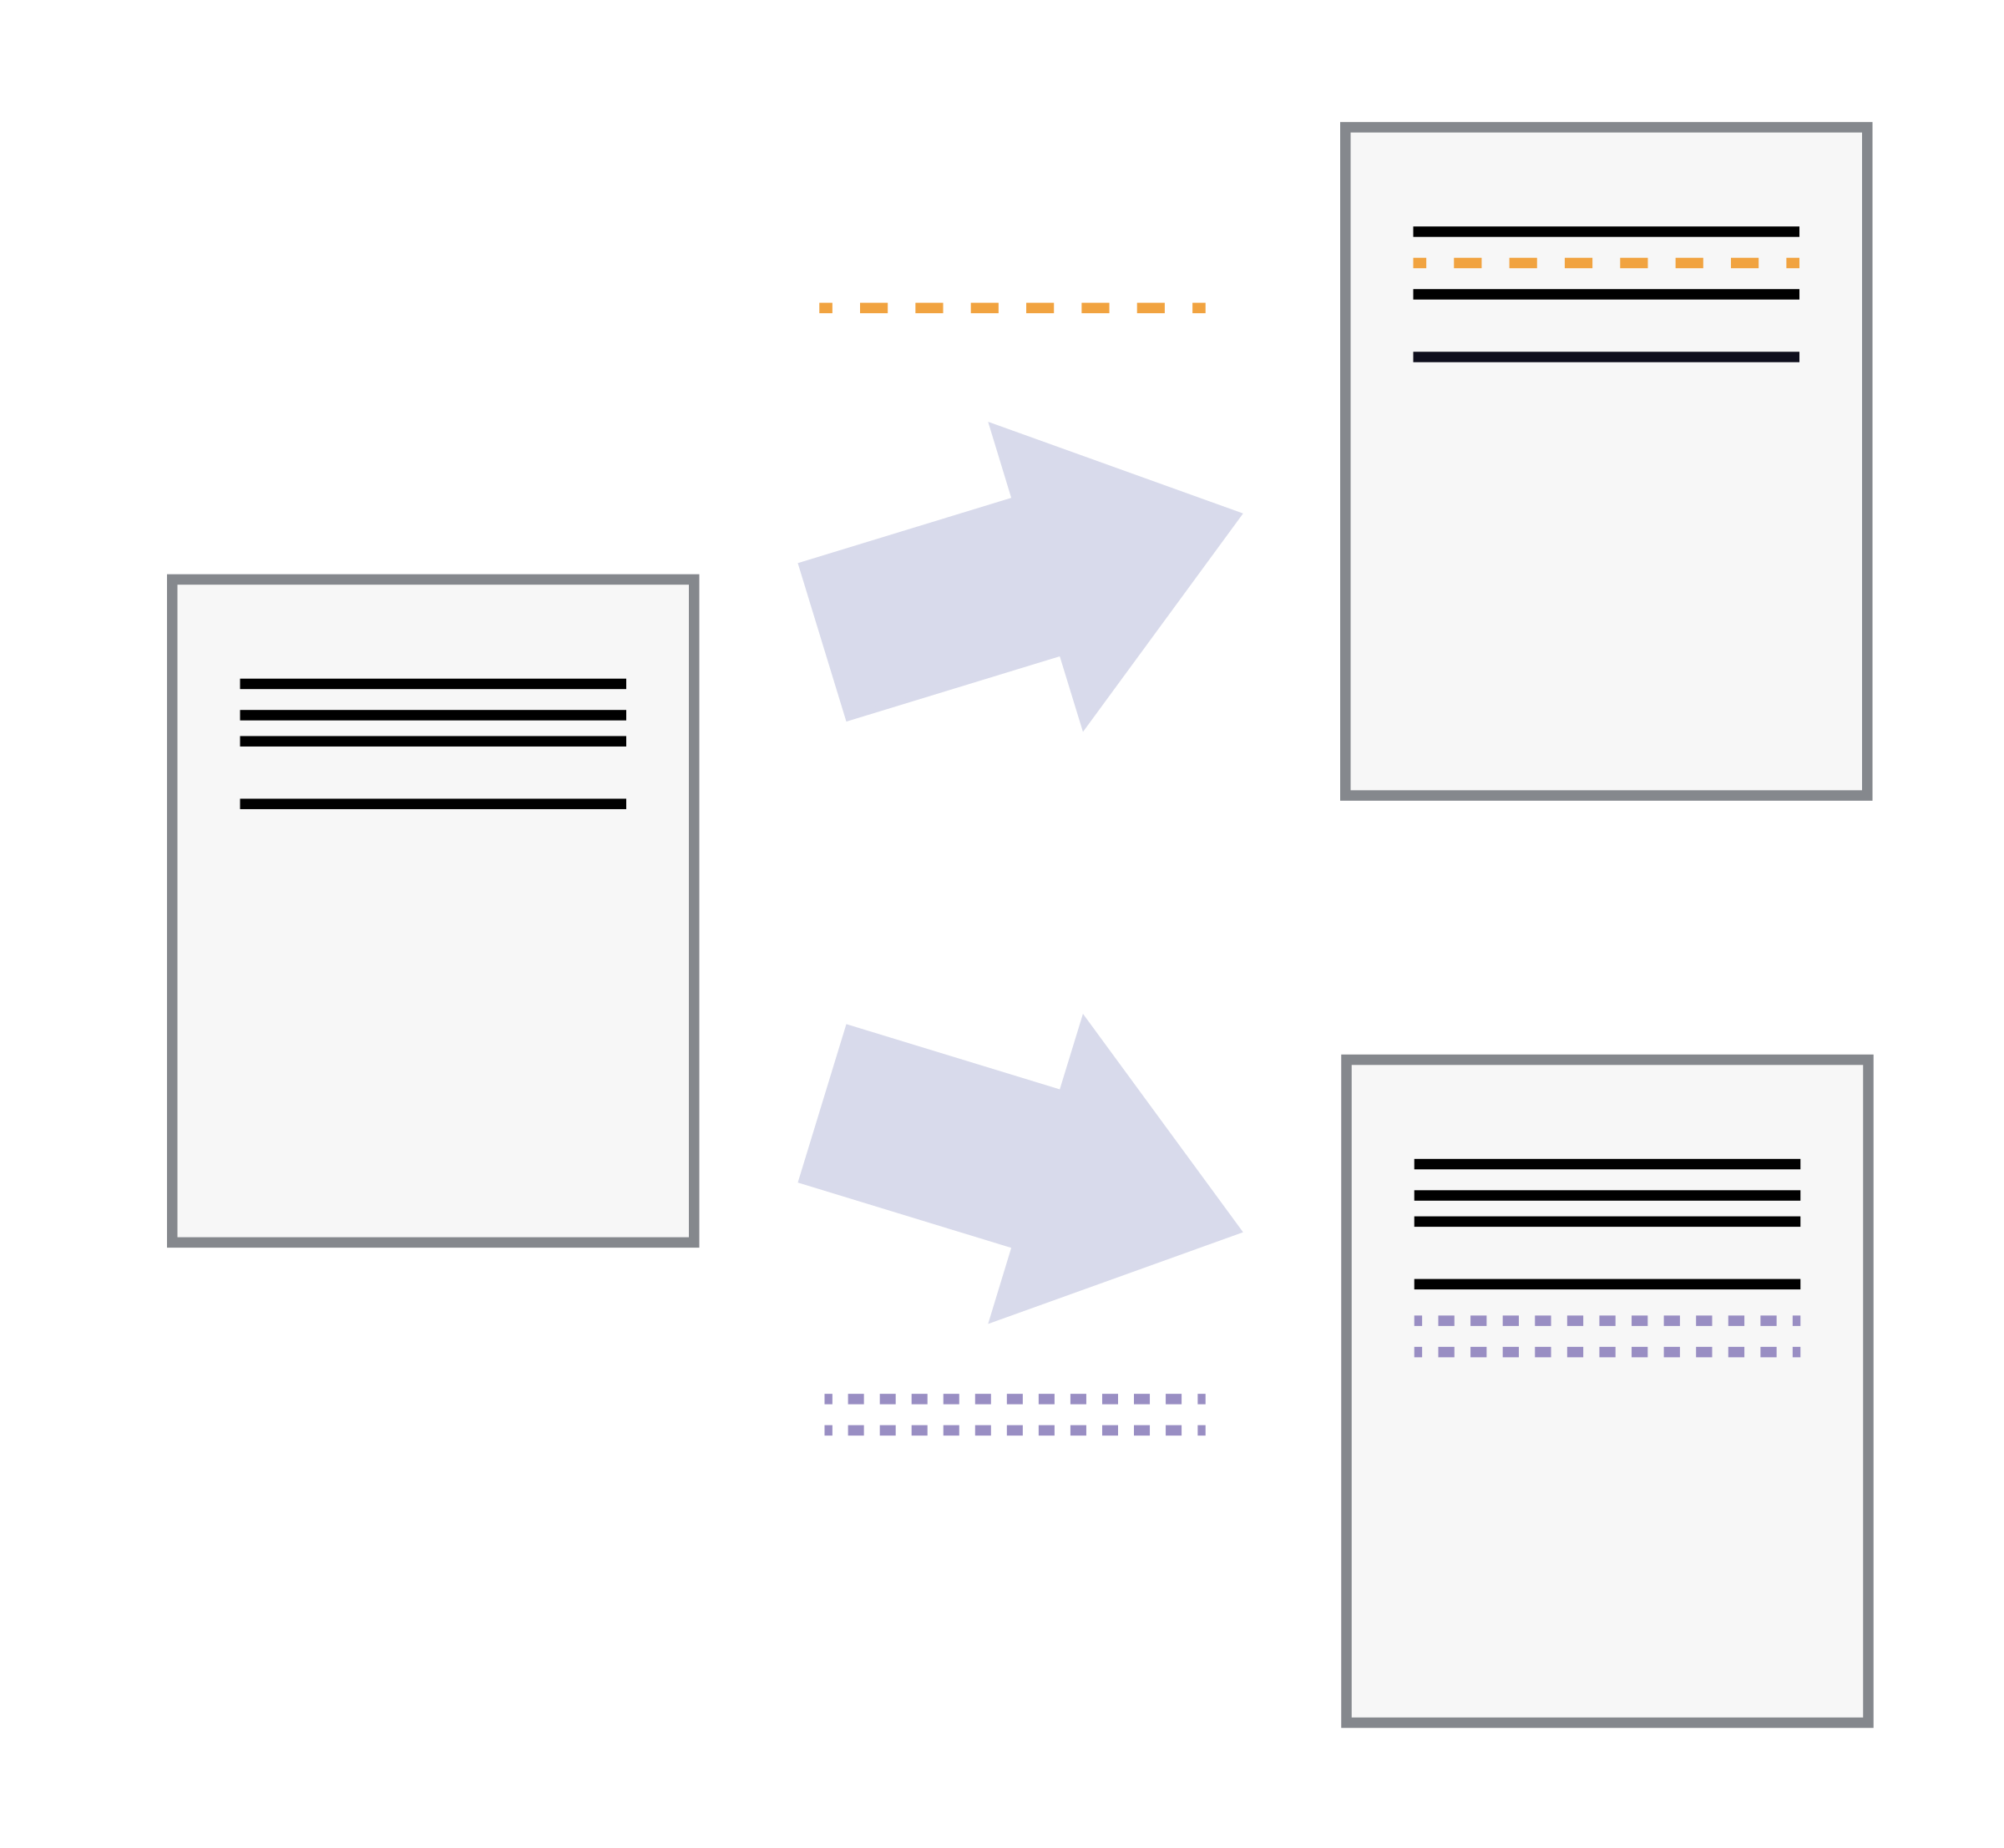
Version Control Systems
allow us to combine changes
if they affect independent parts
of the document
You can “replay”
independent sets of changes on the document

Slide 5
Vocabulary
Commit: a recorded change
Repository:
files of a project + entire history of commits associated to them

Slide 6
Questions?

