Slide 1



WEB ANALYTICS
VISUAL ANALYTICS PROJECT
Adriana López
William Rojas
Emilio Alvarado

Slide 2
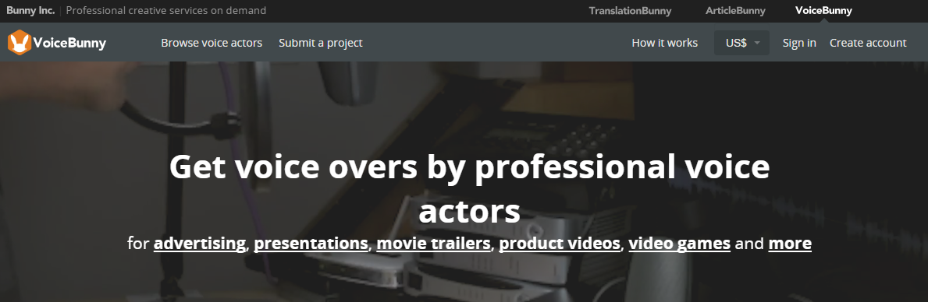
Our Customer
Voicebunny.com
Its goal is to connect customers who require high quality professional voices with the owners of these voices.

Slide 3
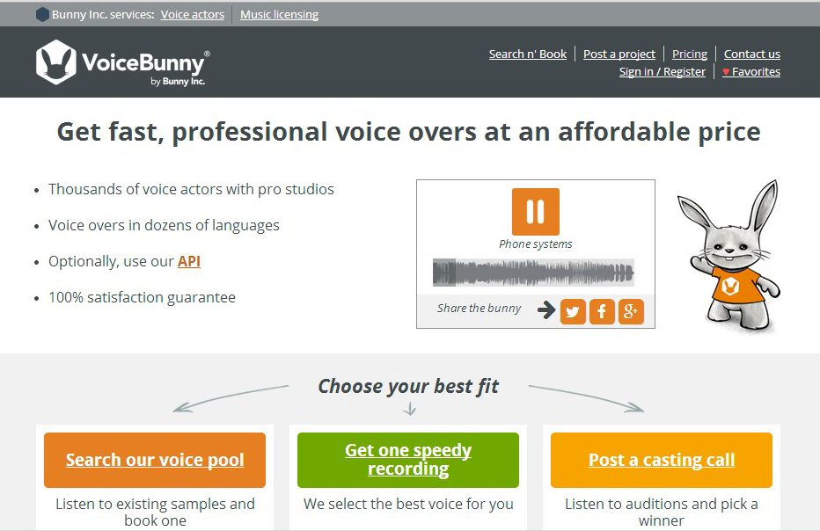
How does it work?
Notes:
Some of its services are: the search and hiring of speakers, the request for audition and selection of speakers, the postulation of short-term projects and the postulation of large-scale recording projects.

Slide 4
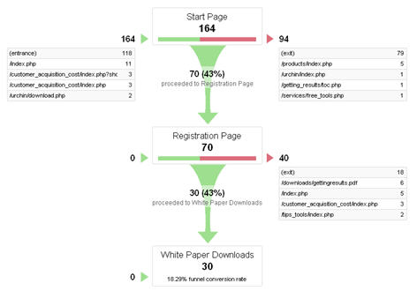
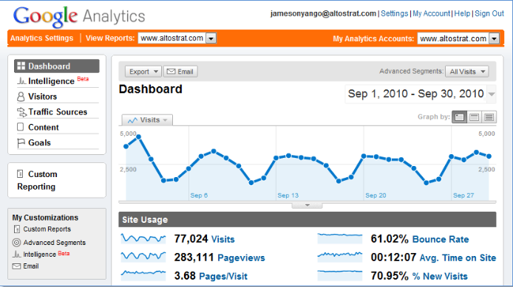
Limitations of current solutions
Previous parameterization
Inability to process after param. change
Use of sampling
Notes:
Web analytics services (Google Analytics)

Slide 5

The project
The main objective of the 'Web Analytics Visualization' project is to increase the client's analysis capabilities about its user's browsing behavior on the company's website.

Slide 6
Tasks
To present the distribution of the pages visited by the users in a given period of time.
To discover characteristics of interest – as the quantity of users with similar navigation behaviors per session or the different routes and sales funnels that were found.
To compare the behavior of browsing routes of site visitors without a previously established goal.

Slide 7
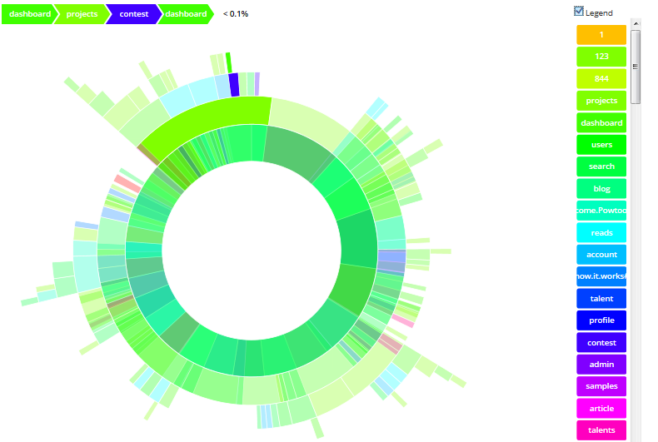
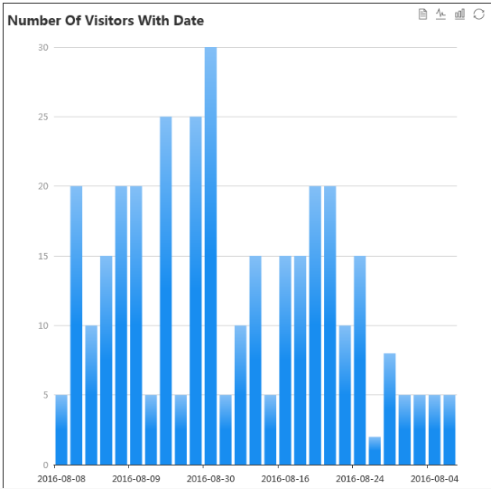
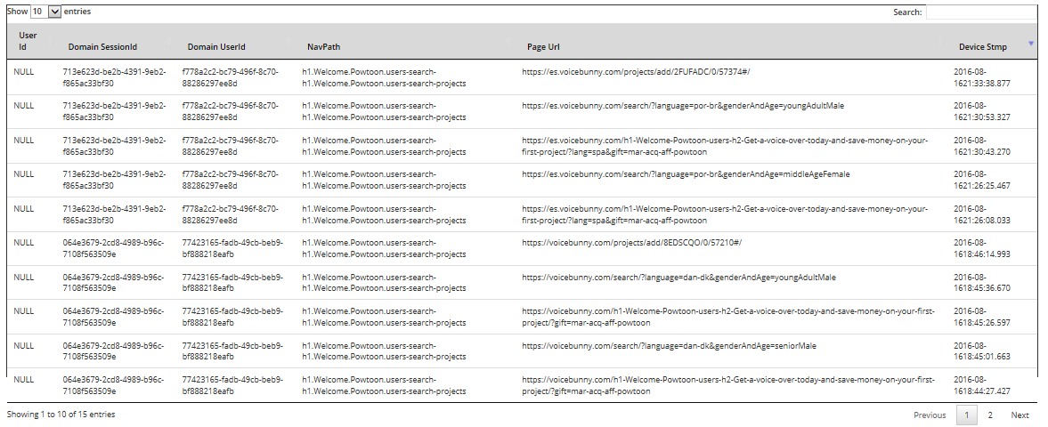
Solution
Sunburst (Overview)
Barchart (Zoom and Filter)
Table (Details on demad)

Slide 8
Thanks!

