Slide 1
Member get member
An interactive analysis of the member get member referral campaign

Slide 2

“Praying for a fair priced Nvidia GPU for Christmas” Emilio D’Souza
Technology consultant based in London
Enjoy building services that improve customer engagement and drive positive change 😊
Engineer at heart – love to explore/visualise problem domains and draw lots of diagrams ✏️
An evangelist of regular, bitesize project/product reassessment – to keep congruence with the big picture/business benefit and uplift team morale
Like to tinker with new technologies and build toy applications in my spare time – next mission is to secure major VC funding 🚀
Passionate gym-goer and boxing fan – and recently started a project to grow microgreens using hydroponics (the legal kind 😉)

Slide 3
Executive summary
Tasked with determining whether the “member get member” referral campaign was a success
Findings indicate several limitations with the campaign
Based on conservative, financial estimates - the cost does not appear to be recouped by the value brought from increased user growth
With additional financial information, and a better understanding of our customer groups, several, more insightful campaigns can be conducted

Slide 4
Approach
Set the scene
Context
Assumptions
Constraints
Explore/Discover
Data cleansing
Explore relationships between variables
Test our inference
Conclusion
Recommendations
Lessons learned
A new approach

Slide 5
Background
Assumptions
Food delivery business model profit margin assumed at 5% (conservative) – 15% (ambitious), averaged per customer, where we assume a value chain more akin to Dominoes/HelloFresh than with UberEats/GrubHub. ^{1, 2, 3, 4.}
The cost of the member get member referral code used by each referred member is not reflected within the average order value – allowing direct comparisons with remaining members.
Each user record can be assumed to be “independent”, i.e. a users ordering decisions over the length of the campaign are not significantly influenced by the ordering decisions
The sample size is reflective of the population and large enough to conduct statistically significant analysis
Constraints
Lack of clear definition on what is considered success to help guide focus of analysis.
Lack of relationship data between users and supporting financial information to supporting inference and validate results.

Slide 6

Analysis
An interactive Python (Jupyter) Notebook has been prepared.
A static version can be accessed here: https://nbviewer.jupyter.org/github/emiliod90/redkite_casestudy/blob/main/Redkite-casestudy.ipynb
The raw notebook and data can be cloned/downloaded from: https://github.com/emiliod90/redkite_casestudy

Slide 7
Insight conclusion
The objective was to determine whether the member get member referral campaign was a success.
Key insights:
Lack of engagement from the members who were referred.
Average order value is quite consistent across each group, however due to minimal engagement, the total value generated from referred members is considerable low.
We infer that referred members quickly disengage from the service after X months and significantly by 6 months.
If we assume that the referral costs must be absorbed, the total cost is
356 Members * £10 referral value = £3,560.
The total value generated solely from referred members is £12,642.
The ratio of costs / value is approx. 28%.
Assuming an ambitious profit margin (15%) leaves net balance of £1,896 - £3,560 = (-) £1,663.
Assuming a conservative profit margin (5%) leaves net balance of £632 - £3,560 = (-) 2,927.
If a balance between user growth and profitability was desired, then this is not being reflected in the data.

Slide 8
Approach Recommendations
Adding some structure and further clarity to the objectives of the campaign would help inform and guide a better round of analysis.
Key recommendations:
What is the vision
Understand our users
Interviews, workshops, surveys
Build User persona’s, empathy map, customer journeys and identify largest problems
Inform and plan for the the hypothesis tests / multivariate tests
Elicit what data could augment/enrich our analysis
Prove/Prototype
Run our tests at a scale which is both cost-effective and informative
Validate our hypotheses
Prepare to scale
Simulate, Design & Build (Agile vs Waterfall, Phased vs Big Bang)

Slide 9
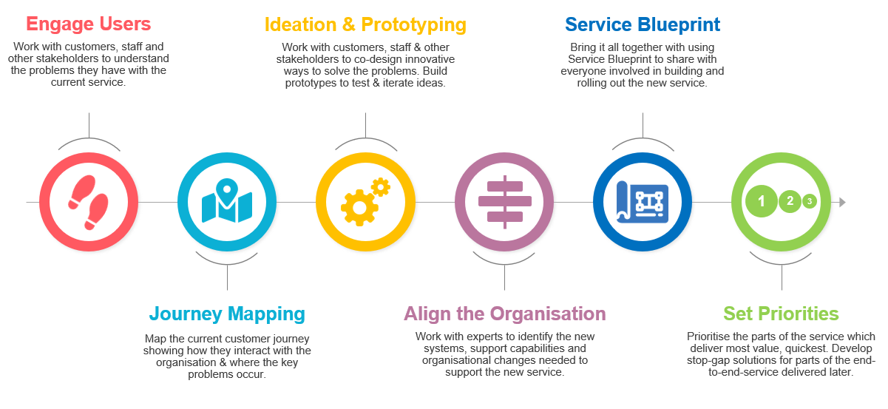
the User Experience (UX) 7 Step Ideation Process

Slide 10
Data Recommendations
The mapping of members who provided the referral and those that received it. This would enable an analyst to build a social network of members and would greatly aid in setting engagement scores against members. For example, which members like to send a lot of referrals that actually funnel into long-term engagement?
Costs. To provide a more clear picture around the total cost benefit analysis of a campaign, it would be necessary to understand the cost of acquisition for each member referred vs non-referred.
Member CSAT satisfaction scores. Can any satisfaction based data help us understand more about engagement drop-offs we are currently observing.
Condition on different categories time (monthly, and season), location, menu etc. Improve our demand forecasting, resource planning and product targeting.
Build member score, potentially derived from multiple factors, such as engagement length and/or value generated.
learn more about our members before we target promotions at larger scales. We can learn from the UX 7 step ideation/design process.

Slide 11
Questions / AOB
Thank you!

