Slide 1

BiG Mountain Resort
By Emilio Osmena IV

Slide 2
Problem Identification
The number of resorts in each state varied, and we found New York to have the most. The focus of our analysis is Montana and we don't want to skew the results based on other states.
Prices of tickets were separated by weekend/weekday in many locations.

Slide 3
Recommendation and Key Findings
The solution to mitigate that is to scale the data with population and number of results in the area.
We pulled USA state population data from Wikipedia and merged them with ski data to scale our data.

Slide 4
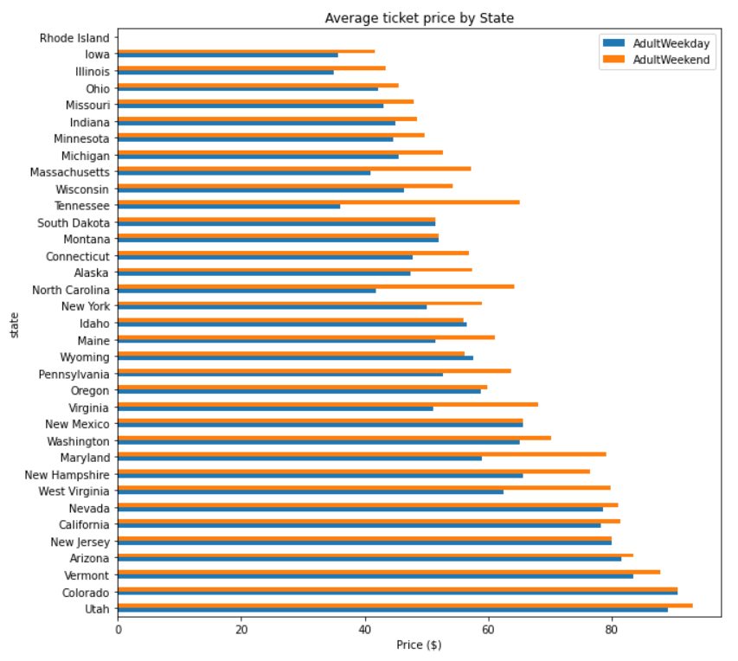
Ticket Prices
This is a visual representation of varying ticket prices in each state. The two colors represent Adult Weekday (Blue) and Adult Weekend prices(Orange).

Slide 5
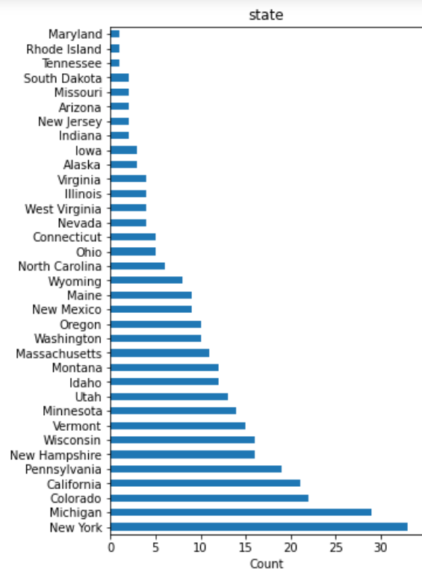
Resorts Per State
This is a visual representation of varying Resort counts in each state. Each state is listed, as well as the count of resorts below.

Slide 6
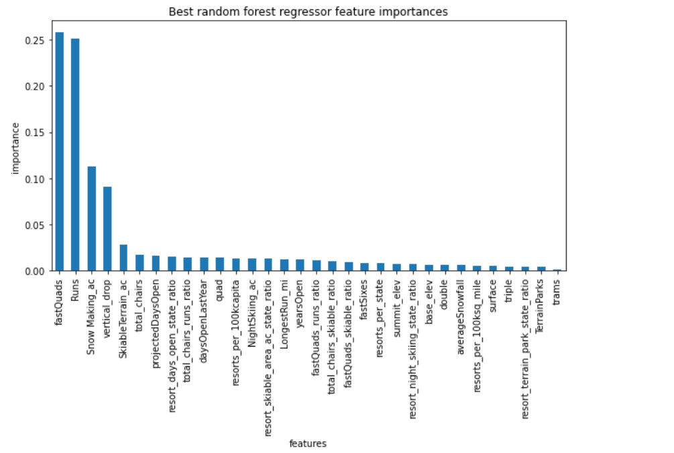
Important Features
This is a visual representation of features and their importance in determining ticket prices. Each feature is listed in descending order of importance.

Slide 7
Summary and Conclusion
We scaled our data to make sure its features accurately define by importance.
Based on projections we would recommend the second option of increasing vertical drop and an installation of an additional chair lift. This would raise ticket prices by $7.46 with a projected revenue of $13,061,848 over the next season.

Slide 8
Questions?

