Slide 1

Inflation during Presidential Transitions
Emilio Osmena IV
Non-technical

Slide 2
The Data
I found the data on www.kaggle.com which had the CPI(Consumer Price Index) or average cost of consumer goods
The data was from 1913-2022
Each year consisted of 12 months, Jan,Feb,Mar…etc.

Slide 3
United States Inflation Over the Years
CPI has exponentially risen from 9.8 in January 1913 to 289.1 today in 2022
The expansion of growth started around the 1980s and has not slowed down since

Slide 4
What are we focusing on?
Many talks today argue that presidents of political parties have a big influence on inflation in the United States
During these tough times, many arguments have become politically charged
Many arguments seem very divisive, but what can help with that is looking at data
The big question we are asking is have transitions from Republican Presidents to Democratic Presidents significantly changed inflation?

Slide 5
From President Bush to President Obama
For the Presidency of Bush, CPI started at 181 and ended with 210.(Total mean of about 195)(Change of 29 CPI)
For the Presidency of Obama, CPI started with Bush’s 201 and ending at 233.(Total mean of about 224)(Change of 32 CPI)

Slide 6
From President Trump to President Biden
For the Presidency of Trump, CPI started at 236 and ended with 256.(Total mean of about 247)(Change of 20 CPI)
For the Presidency of Biden so far, CPI started with Trump’s 256 and is currently at 289.(Total mean of about 270)(Change of 33 CPI)

Slide 7
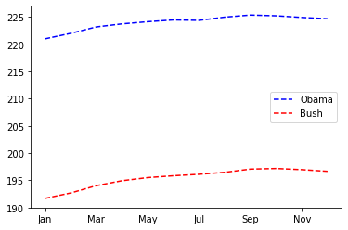
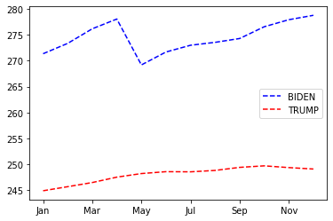
Graphical Representation of Avg CPI per Month

Slide 8
Conclusions
The transition of President Bush to President Obama has a very slight difference and there doesn’t seem to be a huge inflation change
The transition of President Trump to President Biden has a very noticeable difference and there seems to be a huge inflation change
The issue is that Biden’s term has just begun and may have outliers due to the length of his term so far.

Slide 9
Transitions from Republican Presidents to Democratic Presidents do not significantly changed inflation

