Slide 1


VM Setup
Emilio Paolini, PhD Student Andrea Sgambelluri, Assistant Professor
Luca Valcarenghi, Professor

Slide 2
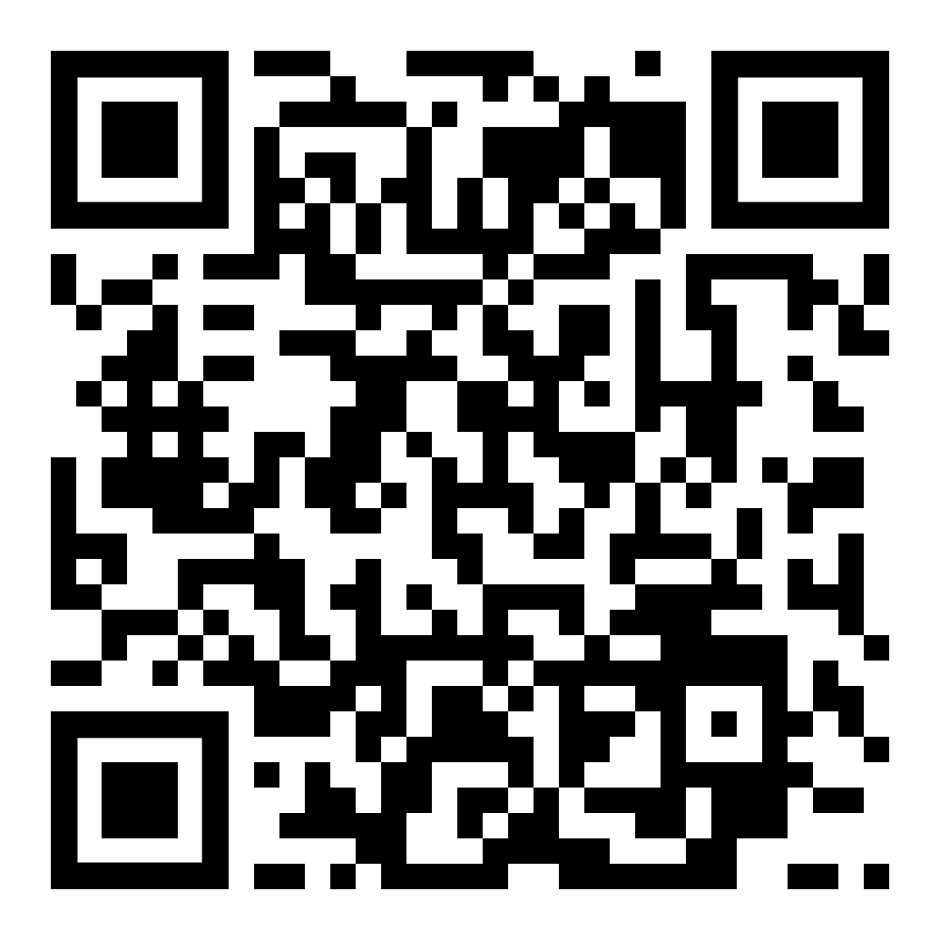
https://github.com/emiliopaolini/SEASONAL_2025
git clone https://github.com/emiliopaolini/SEASONAL_2025.git

Slide 3
You can use:
your own PC
A Virtual Machine (VM) provided by us, accessible through AnyDesk
AnyDesk:
https://anydesk.com/en/downloads/windows

Slide 4
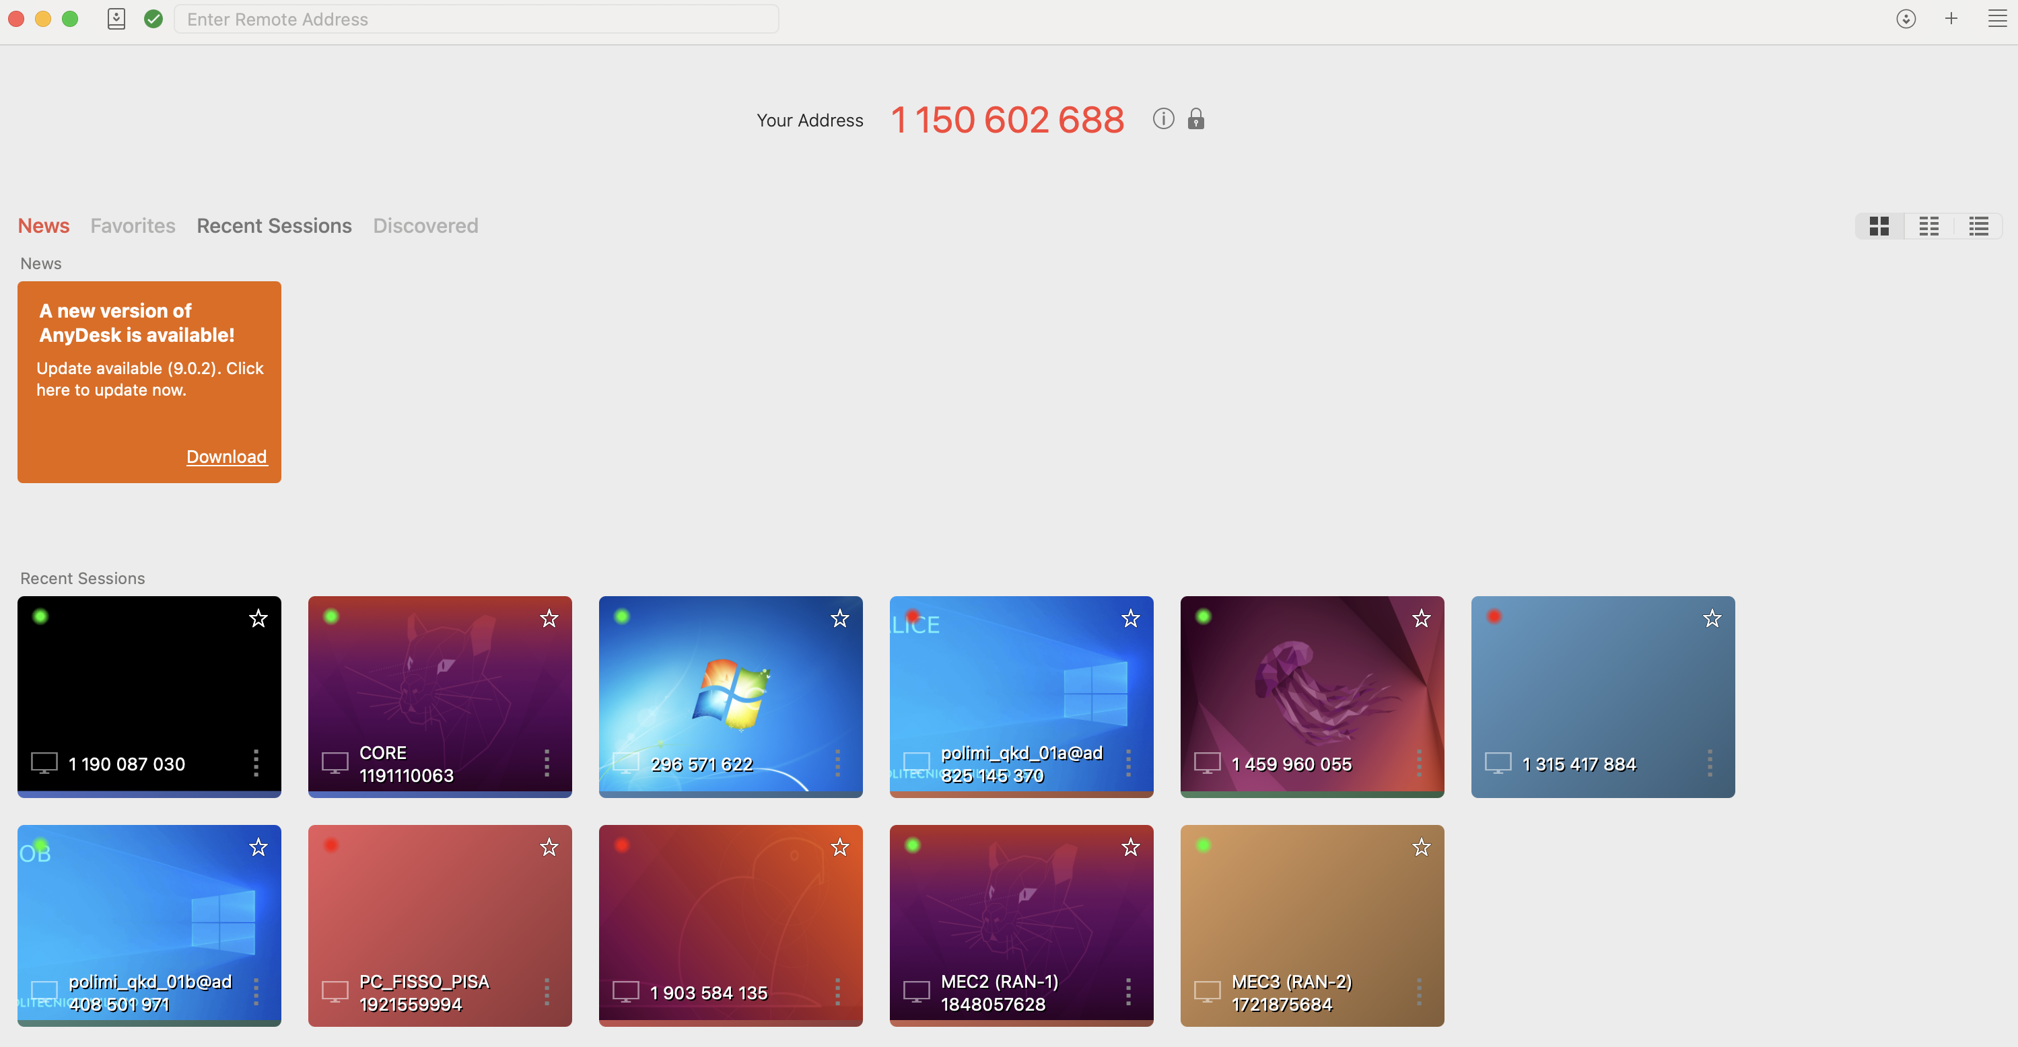
Insert here the remote address

Slide 5
Password AnyDesk: Artist2025
User VM: artist
Pass VM: artistuser

