Slide 1
Hack Race in Skoltech
chance to enter the Skoltech
February 13

Slide 2
About me
Boris Urman
Skoltech, MIPT
co-founder Sharxi

Slide 3
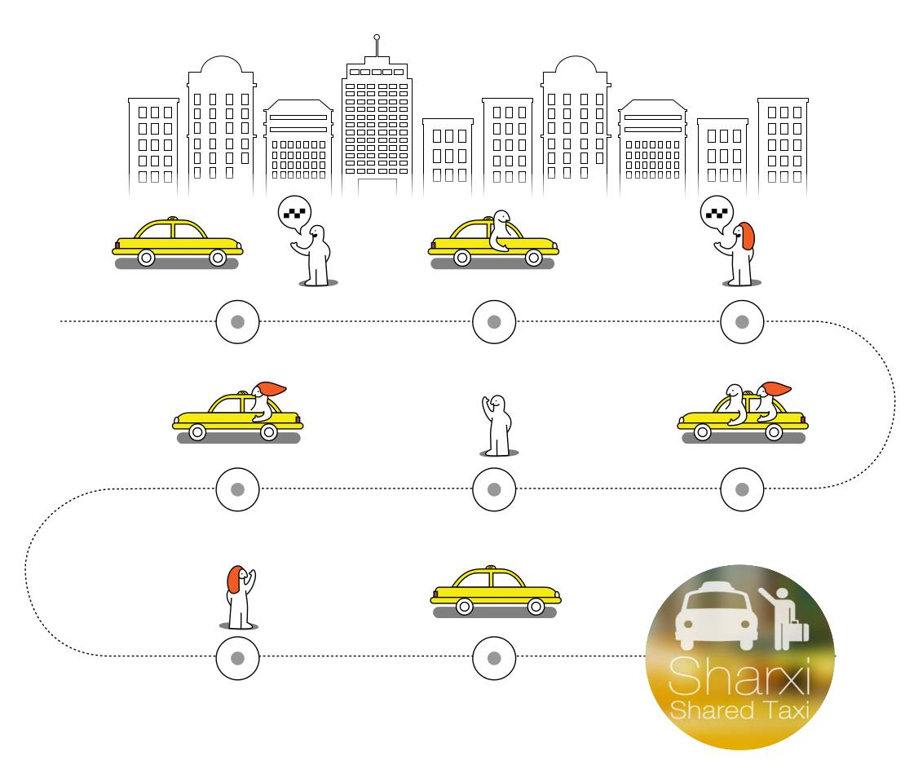
Sharxi

Slide 4
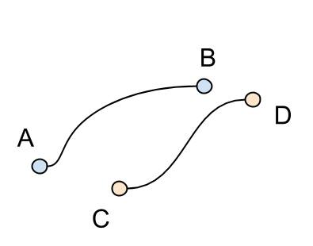
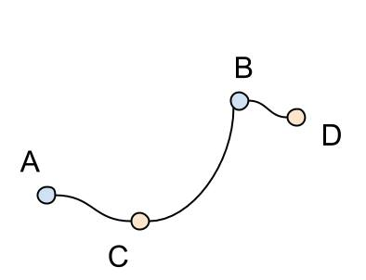
Problem

Slide 5
Problem
600
600
800
Time Saved = 600 + 600 – 800 = 400

Slide 6

Conditions
1
There can be up to 3 different orders in one car at each time point.
2
Each order is allowed to be delayed up to 15 minutes from its desired time.
3
Time to travel from Point K to Point L is given in (k,l) entry of time matrix.
4
You have infinite amount of cars. Think that if you need car in particular point in particular time you have it.

Slide 7
Input data
1
List of orders - order.csv
Example of order line:
orderID, pointA, pointB, time
2
Time matrix in seconds
times.npy, times.mat, times.csv
3
Sample of answer.txt and answer_explanation

Slide 8
Output format answer.txt
1
Each line is joint route
2
Example of line:
100 2643 0 1, 2 1, 2642 0
3
You can check your result - Run check.py

Slide 9
Example
Intput data:
1,2,45
3,4,15
5,6,20
7,8,60
Output data:
141,45
314,15
526,20
728,60
Не совсем понял формат выходного файла, но думаю ты все равно еще сделаешь более адекватный пример
Total time:
45+15+20+60=140
Total time:
140-10-5-25= 100

Slide 10

Each team is able to take one 2-minute consultation from Sharxi Team during Hacking Time

