Slide 1
Study Ontology Deep Dive
Adverse Event

Slide 2
Principles
Model Clinical Data in a way that makes sense to clinicians and other consumers of the data
Model only what is necessary to automate the creation of high quality standards conformant SDTM datasets
Reuse existing models and definitions where possible
e.g. W3C time ontology, SDTM Terminology, BRIDG, HL7, ISO
If necessary use “placeholder” classes until other standards have RDF/OWL representations

Slide 3
Adverse Events in Clinical Trials
AE’s are modeled in SDTM and BRIDG as Observations
This is incorrect
Adverse Events are Medical Conditions that are temporally associated with an Intervention.
Let’s look at some definitions. These are captured in the ontology.

Slide 4
Definitions of Clinical Concepts related to AEs
Observation: An Intervention whose intent is to measure the physical, physiological, or psychological state of a Person.
Intervention: A Study Activity that involves an interruption to the study subject's normal daily routine for the purpose of observing the subject's physical, psychological, or physiological state, and/or mitigating the effects of a medical condition.
Medical Condition: An Event that is a disease, injury, disorder, or transient physiologic state that interferes or may interfere with well-being. A medical condition persists in time.
Adverse Event: An adverse Medical Condition that emerges or worsens following a Medical Intervention, including the use of a drug. Note: there is no presumption of causality.

Slide 5
SDTM and BRIDG Models
Observation
Finding
Intervention
Adverse Event

Slide 6
Identifying an Adverse Event
An Observation must undergo an Assessment to determine if an Adverse Event is present
Intervention
Drug X 10mg qd
30 SEPT
Assessor
Assessment
input
Observation
e.g. BP 160/110
20 OCT
Output
Medical Condition
Hypertension
Adverse Event
Hypertension

Slide 7
Example #1 -- Blood Pressure
Observation - BP 160/100 R ARM Sitting
Adverse Event -- Hypertension ???
Other Observation – Morbidly Obese, Wrong Size BP Cuff Used, Repeat with large BP Cuff – 135/85
Assessment: NO AE

Slide 8
Example #2 -- Serum Sodium
Observation - Serum Na+ 125 mg/dL (normal 135-145)
Adverse Event -- Hyponatremia ???
Other Observation – Serum Protein Electropheresis – monoclonal gammopathy; serum osmolality elevated
Assessment: Falsely Decreased Serum Na+ due to Hyperosmolal state, No hyponatremia

Slide 9
Example #3 -- Serum Potassium
Observation - Serum K+ 5.7 mg/dL (normal 3.5 – 5.5)
Adverse Event -- Hyperkalemia ???
Other Observation – Hemolyzed blood sample on inspection. Repeat serum K+ 4.7k
Assessment: NO AE

Slide 10
The Reality: The Assessment of Abnormal Observations are not Formally Documented
There is no documented assessment information, if so it appears in non-standard location i.e. SUPPQUAL or custom domains
Unstated Policy that the abnormal observation is automatically an AE.
Particularly if it exceeds the upper limit of normal by a certain amount (e.g. 3xULN) This is actually the assessment criterion, which is not captured .
This adds burden to the analyst in having for perform independent assessment, which is time consuming and error prone

Slide 11
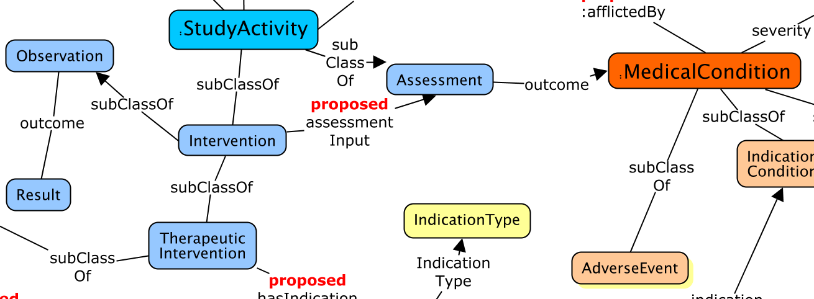
Study

Slide 12
RDF
:Subject_10-23-1435 :participatesIn :Activity_103.
:Activity_103
rdf:type :Observation, :GlucoseObservation;
:performedDate “2018-12-25T08:00:00 ;
:hasOutcome :Result_103 ;
:assessmentInput :Assessment_256 .
:Result_103 rdf:type :ObservationResult;
:hasValue “160” ;
:hasUnit “mg/dL” .
:Assesssment_256
rdf:type :Assessment ;
:hasOutcome :MedicalCondition_235456
MedicalCondition_235456
code:hasCode MEDDRA_xyz ;
rdf:type :AdverseEvent .
:MEDDRA_xyz skos:prefLabel “Hyperglycemia” .

Slide 13
Other Advantages
Safety Committees
Adjudication Committees
Their work is to provide independent assessments of observations. That information is captured in the proposed model.
Adjudication becomes a subClassOf Assessment
The committee becomes an instance of the Assessor Class

Slide 14
Other Advantage
Avoid mixing of observations and medical conditions.
Think of an observation as what one senses, (sees/hears/feels) with or without the help of a device, usually at a single point in time.
The Medical Condition is the cause of an abnormal observation. This is what gets treated, not the observation itself.

Slide 15
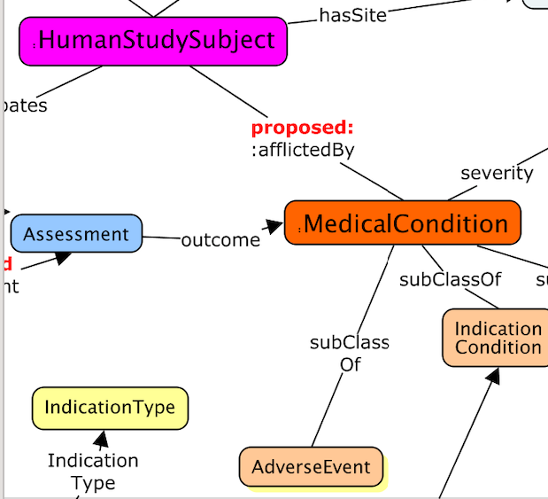
BUT, what about reality?
The mixing of observations and medical conditions will not go away overnight. How do we move forward?
Let’s take a look at a different portion of the ontology.
:HumanStudySubject :afflictedBy :MedicalCondition .
:AdverseEvent rdfs:subClassOf :MedicalCondition .

Slide 16
Support for current AE reporting practices
Subject is afflicted by an adverse event
The adverse event is linked to its properties:
Reported term (AETERM)
Beginning (AESTART)
End (AEEND)
Standard Terms (MedDRA Hierarchy)
Severity
Seriousness
Etc.

Slide 17
e.g. the first AE reported for the first sub
Raw term: application site erythema
MedDRA preferred term: Application Site Erythema
AESEV = Mild
(other parameters to be added in the coming weeks, to include)
AESER
AEOUT
AESTART
AEEND
others

Slide 18
RDF
Human Study Subject Triples:
cdiscpilot01:Person_01-701-1015
rdf:type study:EnrolledSubject ;
skos:prefLabel "Person 01-701-1015" ;
study:actualArm cd01p:Arm_Pbo ;
study:afflictedBy cdiscpilot01:AE01_AppSiteErythema ;

Slide 19
RDF
Adverse Event Triples: (Not complete)
cdiscpilot01:AE01_AppSiteErythema
rdf:type study:AdverseEvent ;
skos:prefLabel "APPLICATION SITE ERYTHEMA" ;
code:hasCode meddra:LLT01_AppSiteRedness ;
study:reportedTerm "APPLICATION SITE ERYTHEMA" ;
study:severity code:Severity_MILD ;
.

Slide 20
Conclusion
Standards for AE reporting today are hampered by lumping adverse event data with the observations that support the presence of an adverse event
Our ontology clearly splits the two
observations → undergo an assessment which → establishes the presence of an AE
But assessment information is often lacking in current reports, and when it’s present, there is no where to put it consistently. This approach changes that.
In the meantime, traditional reporting methods are also supported via subject → afflicted by → medical condition, which could be an AE if temporally associated with an intervention.

