Slide 1
C5g7 comsol valid

Slide 2
Global Definitions

Slide 3
Parameters
Parameters 1
Name | Expression | Value | Description
Chi_g1 | 5.87910000E-01 | 0.58791
Chi_g2 | 4.11760000E-01 | 0.41176
Chi_g3 | 3.39060000E-04 | 3.3906E−4
Chi_g4 | 1.17610000E-07 | 1.1761E−7
Chi_g5 | 0.0 | 0
Chi_g6 | 0.0 | 0

Slide 4
Parameters (continued)
Parameters 1
Name | Expression | Value | Description
Chi_g7 | 0.0 | 0
D_Mod_g1 | 2.09372344 | 2.0937
D_Mod_g2 | 0.80716113 | 0.80716
D_Mod_g3 | 0.56467506 | 0.56468
D_Mod_g4 | 0.57043439 | 0.57043
D_Mod_g5 | 0.46425255 | 0.46425

Slide 5
Parameters (continued)
Parameters 1
Name | Expression | Value | Description
D_Mod_g6 | 0.26572070 | 0.26572
D_Mod_g7 | 0.12576813 | 0.12577
Srem_Mod_g1 | 1.14728300E-01 | 0.11473
Srem_Mod_g2 | 1.30636000E-01 | 0.13064
Srem_Mod_g3 | 2.45054000E-01 | 0.24505
Srem_Mod_g4 | 4.93321600E-01 | 0.49332

Slide 6
Parameters (continued)
Parameters 1
Name | Expression | Value | Description
Srem_Mod_g5 | 5.78862000E-01 | 0.57886
Srem_Mod_g6 | 5.54537000E-01 | 0.55454
Srem_Mod_g7 | 1.69680000E-01 | 0.16968
NuSigF_Mod_g1 | 0.0 | 0
NuSigF_Mod_g2 | 0.0 | 0
NuSigF_Mod_g3 | 0.0 | 0

Slide 7
Parameters (continued)
Parameters 1
Name | Expression | Value | Description
NuSigF_Mod_g4 | 0.0 | 0
... | ... | ... | ...
NuSigF_GT_g5 | 0.0 | 0
NuSigF_GT_g6 | 0.0 | 0
NuSigF_GT_g7 | 0.0 | 0
Ss_GT_g1_to_g2 | 8.205011E-02 | 0.08205

Slide 8
Parameters (continued)
Parameters 1
Name | Expression | Value | Description
Ss_GT_g1_to_g3 | 4.695030E-04 | 4.695E−4
Ss_GT_g2_to_g3 | 8.521751E-02 | 0.085218
Ss_GT_g1_to_g4 | 2.429835E-06 | 2.4298E−6
Ss_GT_g2_to_g4 | 4.078803E-04 | 4.0788E−4
Ss_GT_g3_to_g4 | 1.483026E-01 | 0.1483
Ss_GT_g5_to_g4 | 5.175806E-05 | 5.1758E−5

Slide 9
Parameters (continued)
Parameters 1
Name | Expression | Value | Description
Ss_GT_g1_to_g5 | 3.440638E-08 | 3.4406E−8
Ss_GT_g2_to_g5 | 3.140497E-05 | 3.1405E−5
Ss_GT_g3_to_g5 | 1.119734E-02 | 0.011197
Ss_GT_g4_to_g5 | 2.739248E-01 | 0.27392
Ss_GT_g6_to_g5 | 1.466465E-03 | 0.0014665
Ss_GT_g2_to_g6 | 4.874424E-06 | 4.8744E−6

Slide 10
Parameters (continued)
Parameters 1
Name | Expression | Value | Description
Ss_GT_g3_to_g6 | 1.741829E-03 | 0.0017418
Ss_GT_g4_to_g6 | 4.189094E-02 | 0.041891
Ss_GT_g5_to_g6 | 3.358094E-01 | 0.33581
Ss_GT_g7_to_g6 | 8.474985E-02 | 0.08475
Ss_GT_g2_to_g7 | 6.853773E-07 | 6.8538E−7
Ss_GT_g3_to_g7 | 3.316186E-04 | 3.3162E−4

Slide 11
Parameters (continued)
Parameters 1
Name | Expression | Value | Description
Ss_GT_g4_to_g7 | 7.979038E-03 | 0.007979
Ss_GT_g5_to_g7 | 4.002267E-02 | 0.040023
Ss_GT_g6_to_g7 | 3.650485E-01 | 0.36505

Slide 12
Component 1

Slide 13
Definitions

Slide 14
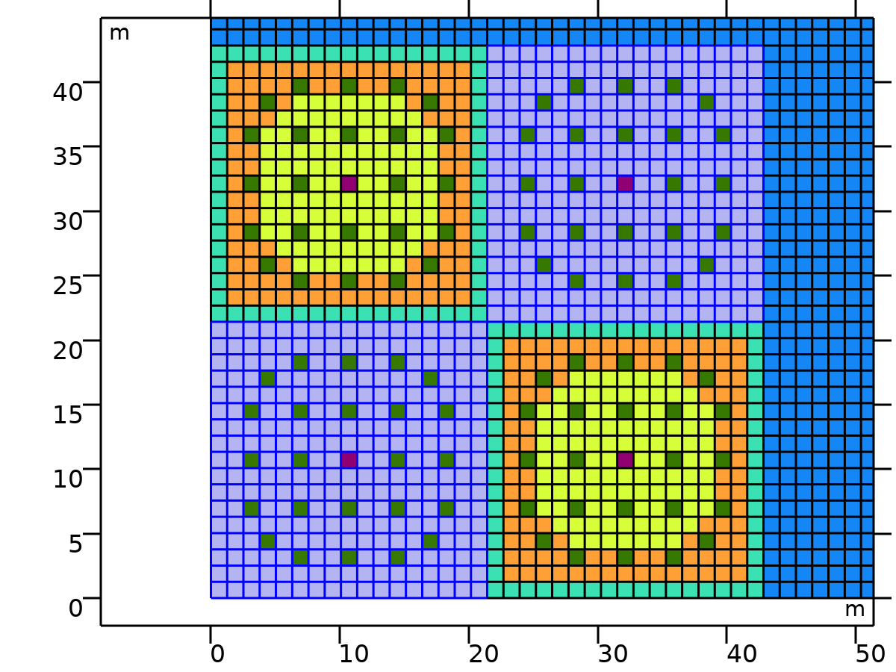
UO2
Selection type
Explicit
UO2

Slide 15
UO2 (continued)
Selection
Domains 1–17, 52–68, 103–107, 109–110, 112–113, 115–119, 154–156, 158–166, 168–170, 205–221, 256–257, 259–260, 262–263, 265–266, 268–269, 271–272, 307–323, 358–374, 409–410, 412–413, 415–416, 418–419, 421–422, 424–425, 460–476, 511–527, 562–563, 565–566, 568–569, 571–572, 574–575, 577–578, 613–629, 664–666, 668–676, 678–680, 715–719, 721–722, 724–725, 727–731, 766–782, 817–833, 885–901, 936–952, 987–991, 993–994, 996–997, 999–1003, 1038–1040, 1042–1050, 1052–1054, 1089–1105, 1140–1141, 1143–1144, 1146–1147, 1149–1150, 1152–1153, 1155–1156, 1191–1207, 1242–1258, 1293–1294, 1296–1297, 1299–1300, 1302–1303, 1305–1306, 1308–1309, 1344–1360, 1395–1411, 1446–1447, 1449–1450, 1452–1453, 1455–1456, 1458–1459, 1461–1462, 1497–1513, 1548–1550, 1552–1560, 1562–1564, 1599–1603, 1605–1606, 1608–1609, 1611–1615, 1650–1666, 1701–1717
UO2

Slide 16
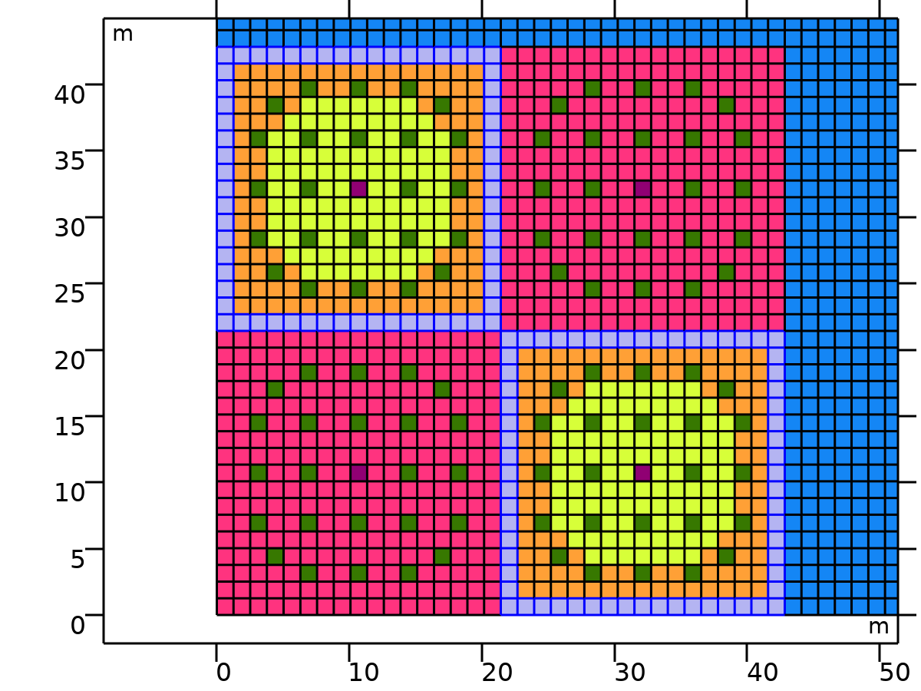
MOX %4.3
Selection type
Explicit
MOX %4.3

Slide 17
MOX %4.3 (continued)
Selection
Domains 18–34, 69, 85, 120, 136, 171, 187, 222, 238, 273, 289, 324, 340, 375, 391, 426, 442, 477, 493, 528, 544, 579, 595, 630, 646, 681, 697, 732, 748, 783, 799, 834–850, 868–884, 919, 935, 970, 986, 1021, 1037, 1072, 1088, 1123, 1139, 1174, 1190, 1225, 1241, 1276, 1292, 1327, 1343, 1378, 1394, 1429, 1445, 1480, 1496, 1531, 1547, 1582, 1598, 1633, 1649, 1684–1700
MOX %4.3

Slide 18
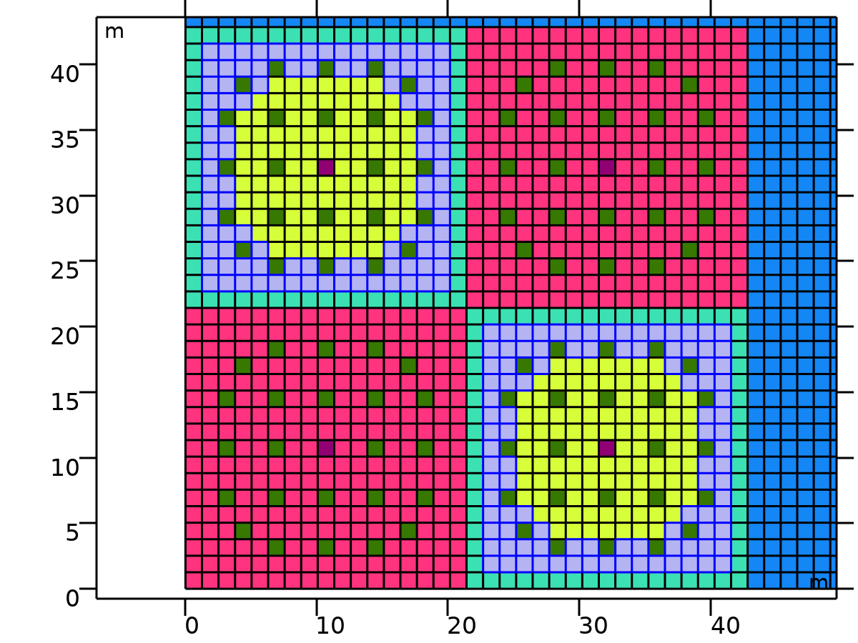
MOX %7.0
Selection type
Explicit
MOX %7.0

Slide 19
MOX %7.0 (continued)
Selection
Domains 70–84, 121–124, 126–127, 129–130, 132–135, 172–173, 175, 183, 185–186, 223–225, 235–237, 274, 288, 325–326, 338–339, 376–377, 389–390, 427, 441, 478–479, 491–492, 529–530, 542–543, 580, 594, 631–633, 643–645, 682–683, 685, 693, 695–696, 733–736, 738–739, 741–742, 744–747, 784–798, 920–934, 971–974, 976–977, 979–980, 982–985, 1022–1023, 1025, 1033, 1035–1036, 1073–1075, 1085–1087, 1124, 1138, 1175–1176, 1188–1189, 1226–1227, 1239–1240, 1277, 1291, 1328–1329, 1341–1342, 1379–1380, 1392–1393, 1430, 1444, 1481–1483, 1493–1495, 1532–1533, 1535, 1543, 1545–1546, 1583–1586, 1588–1589, 1591–1592, 1594–1597, 1634–1648
MOX %7.0

Slide 20
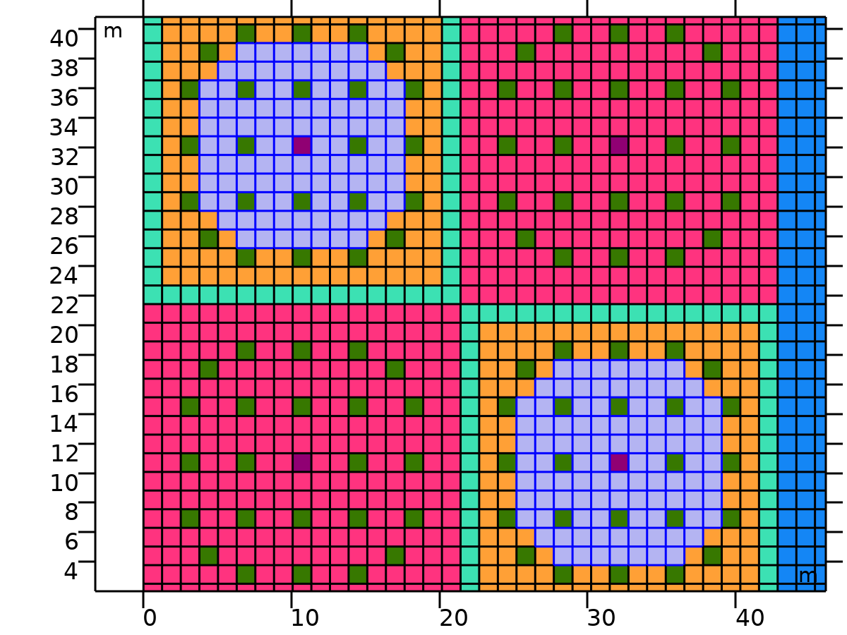
MOX %8.7
Selection type
Explicit
MOX %8.7

Slide 21
MOX %8.7 (continued)
Selection
Domains 176–182, 226–234, 276–277, 279–280, 282–283, 285–286, 327–337, 378–388, 429–430, 432–433, 435–436, 438–439, 480–490, 531–541, 582–583, 585–586, 588–589, 591–592, 634–642, 686–692, 1026–1032, 1076–1084, 1126–1127, 1129–1130, 1132–1133, 1135–1136, 1177–1187, 1228–1238, 1279–1280, 1282–1283, 1285–1286, 1288–1289, 1330–1340, 1381–1391, 1432–1433, 1435–1436, 1438–1439, 1441–1442, 1484–1492, 1536–1542
MOX %8.7

Slide 22
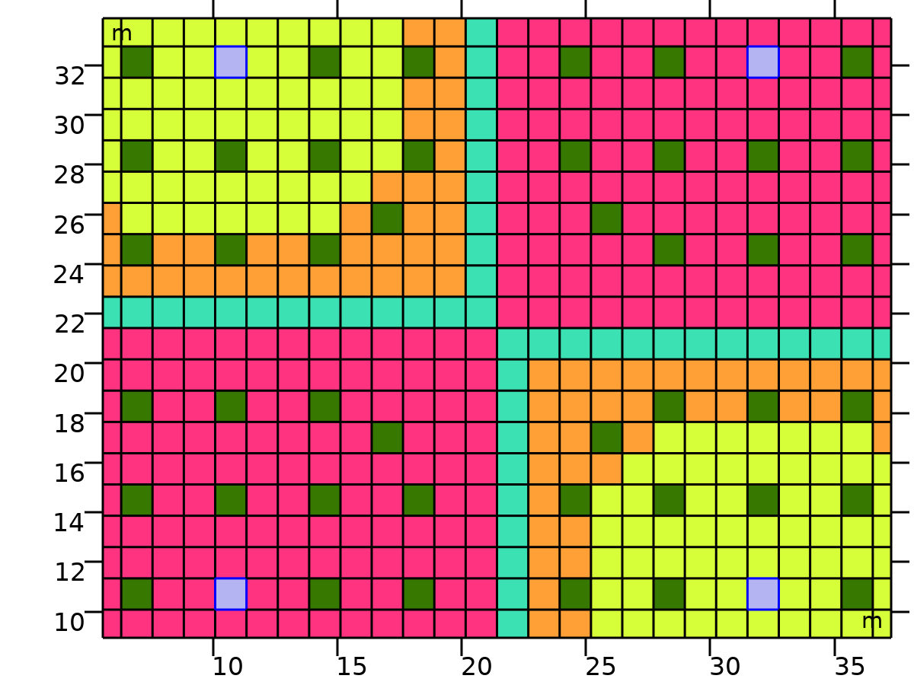
Fission Chamber
Selection type
Explicit
Selection
Domains 417, 434, 1284, 1301
Fission Chamber

Slide 23
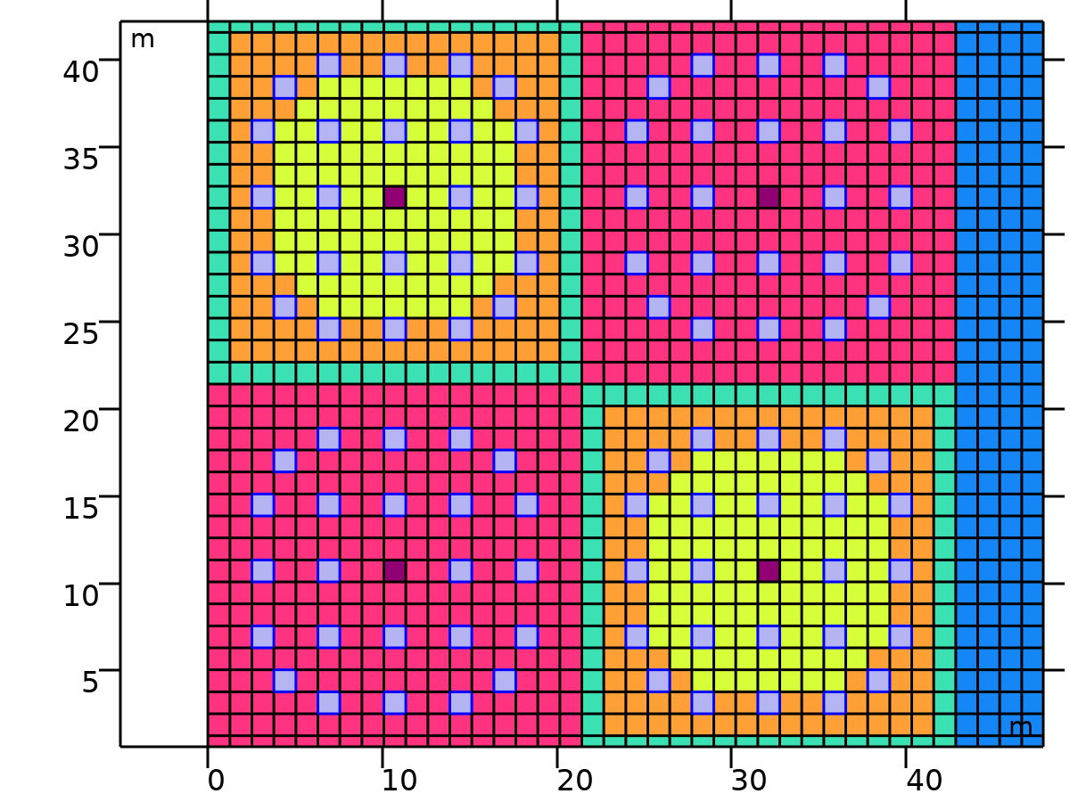
Guide Tube
Selection type
Explicit
Guide Tube

Slide 24
Guide Tube (continued)
Selection
Domains 108, 111, 114, 125, 128, 131, 157, 167, 174, 184, 258, 261, 264, 267, 270, 275, 278, 281, 284, 287, 411, 414, 420, 423, 428, 431, 437, 440, 564, 567, 570, 573, 576, 581, 584, 587, 590, 593, 667, 677, 684, 694, 720, 723, 726, 737, 740, 743, 975, 978, 981, 992, 995, 998, 1024, 1034, 1041, 1051, 1125, 1128, 1131, 1134, 1137, 1142, 1145, 1148, 1151, 1154, 1278, 1281, 1287, 1290, 1295, 1298, 1304, 1307, 1431, 1434, 1437, 1440, 1443, 1448, 1451, 1454, 1457, 1460, 1534, 1544, 1551, 1561, 1587, 1590, 1593, 1604, 1607, 1610
Guide Tube

Slide 25
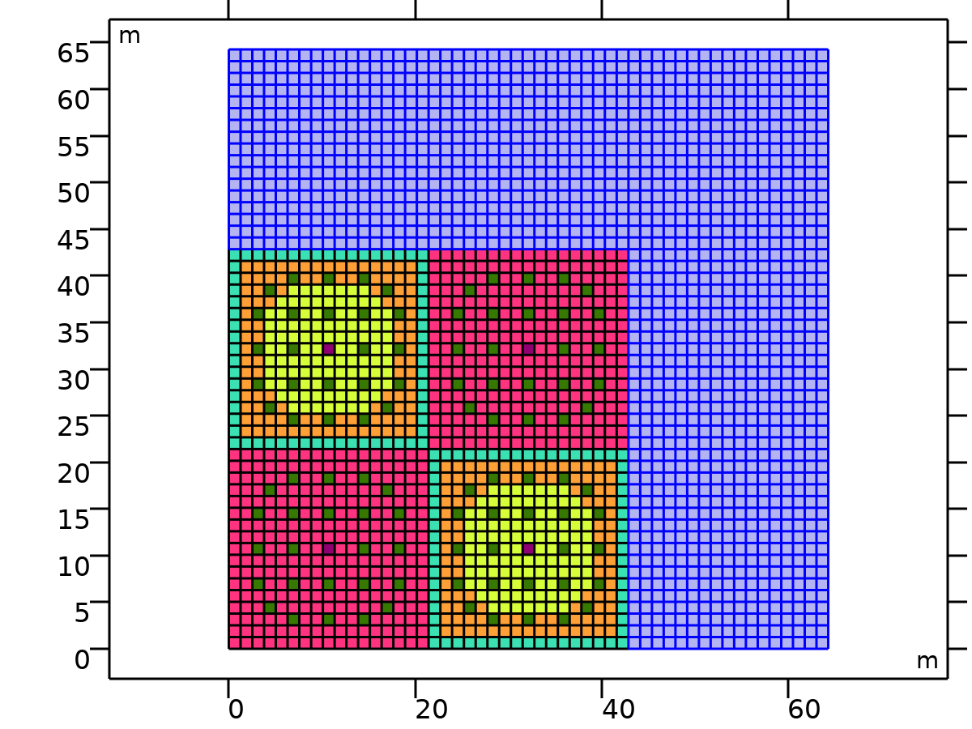
Moderator
Selection type
Explicit
Moderator

Slide 26
Moderator (continued)
Selection
Domains 35–51, 86–102, 137–153, 188–204, 239–255, 290–306, 341–357, 392–408, 443–459, 494–510, 545–561, 596–612, 647–663, 698–714, 749–765, 800–816, 851–867, 902–918, 953–969, 1004–1020, 1055–1071, 1106–1122, 1157–1173, 1208–1224, 1259–1275, 1310–1326, 1361–1377, 1412–1428, 1463–1479, 1514–1530, 1565–1581, 1616–1632, 1667–1683, 1718–2601
Moderator

Slide 27
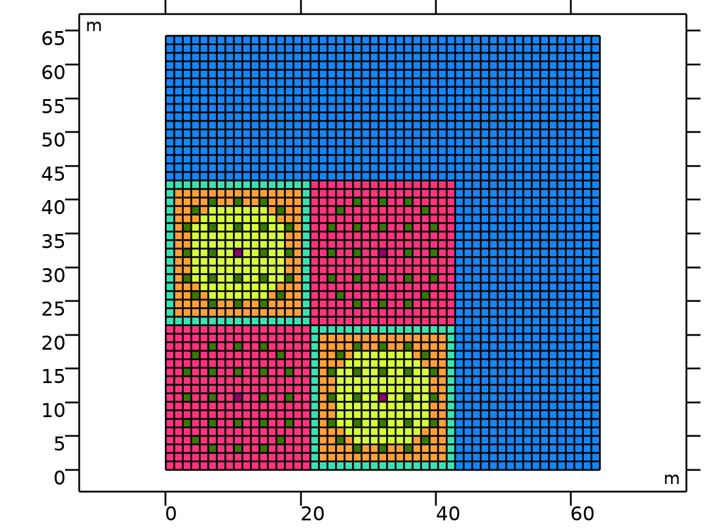
Geometry 1
Units
Length unit | m
Angular unit | deg
Geometry statistics
Description | Value
Space dimension | 2
Number of domains | 2601
Number of boundaries | 5304
Number of vertices | 2704
Geometry 1

Slide 28
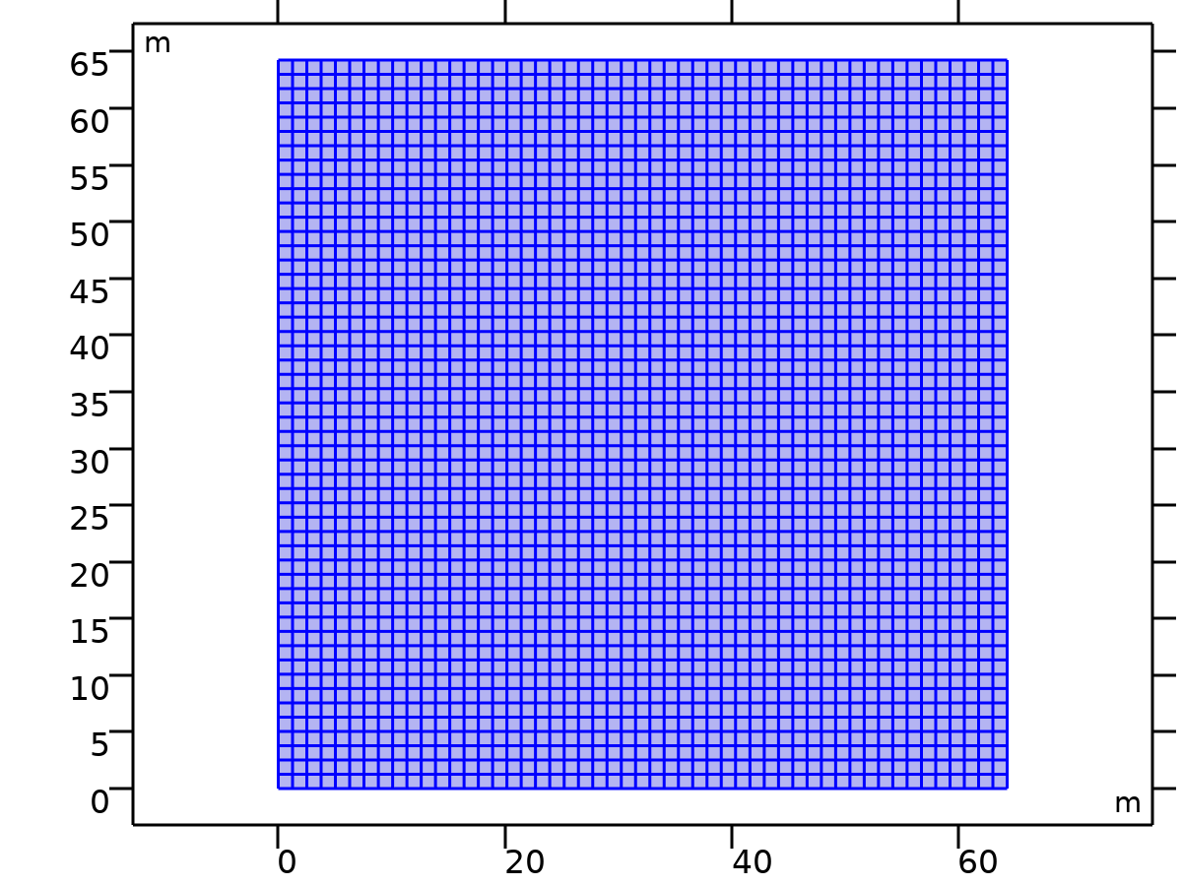
Coefficient Form PDE
Selection
Geometric entity level | Domain
Selection | Geometry geom1: Dimension 2: All domains
Coefficient Form PDE

Slide 29
Coefficient Form PDE (continued)
Interface Settings
Discretization
Settings
Description | Value
Shape function type | Lagrange
Element order | Quadratic
Frame | Spatial
Coefficient Form PDE

Slide 30
Coefficient Form PDE (continued)
Settings
Description | Value
Frequency | From solver
Coefficient Form PDE

Slide 31
Coefficient Form PDE (continued)
Units
Dependent variable quantity | Unit
Dimensionless | 1
Source term quantity | Unit
Custom unit | m^-2
Coefficient Form PDE

Slide 32
Coefficient Form PDE (continued)
Coefficient Form PDE 1
Selection
Geometric entity level | Domain
Selection | Geometry geom1: Dimension 2: All domains
Coefficient Form PDE 1

Slide 33


Coefficient Form PDE (continued)
Equations
Coefficient Form PDE 1

Slide 34
Coefficient Form PDE (continued)
Settings
Description | Value
Absorption coefficient | {{0, 0, 0, 0, 0, 0, 0}, {0, 0, 0, 0, 0, 0, 0}, {0, 0, 0, 0, 0, 0, 0}, {0, 0, 0, 0, 0, 0, 0}, {0, 0, 0, 0, 0, 0, 0}, {0, 0, 0, 0, 0, 0, 0}, {0, 0, 0, 0, 0, 0, 0}}
Coefficient Form PDE 1

Slide 35
Coefficient Form PDE (continued)
Settings
Description | Value
Diffusion coefficient | {{{{1, 0}, {0, 1}}, {{0, 0}, {0, 0}}, {{0, 0}, {0, 0}}, {{0, 0}, {0, 0}}, {{0, 0}, {0, 0}}, {{0, 0}, {0, 0}}, {{0, 0}, {0, 0}}}, {{{0, 0}, {0, 0}}, {{1, 0}, {0, 1}}, {{0, 0}, {0, 0}}, {{0, 0}, {0, 0}}, {{0, 0}, {0, 0}}, {{0, 0}, {0, 0}}, {{0, 0}, {0, 0}}}, {{{0, 0}, {0, 0}}, {{0, 0}, {0, 0}}, {{1, 0}, {0, 1}}, {{0, 0}, {0, 0}}, {{0, 0}, {0, 0}}, {{0, 0}, {0, 0}}, {{0, 0}, {0, 0}}}, {{{0, 0}, {0, 0}}, {{0, 0}, {0, 0}}, {{0, 0}, {0, 0}}, {{1, 0}, {0, 1}}, {{0, 0}, {0, 0}}, {{0, 0}, {0, 0}}, {{0, 0}, {0, 0}}}, {{{0, 0}, {0, 0}}, {{0, 0}, {0, 0}}, {{0, 0}, {0, 0}}, {{0, 0}, {0, 0}}, {{1, 0}, {0, 1}}, {{0, 0}, {0, 0}}, {{0, 0}, {0, 0}}}, {{{0, 0}, {0, 0}}, {{0, 0}, {0, 0}}, {{0, 0}, {0, 0}}, {{0, 0}, {0, 0}}, {{0, 0}, {0, 0}}, {{1, 0}, {0, 1}}, {{0, 0}, {0, 0}}}, {{{0, 0}, {0, 0}}, {{0, 0}, {0, 0}}, {{0, 0}, {0, 0}}, {{0, 0}, {0, 0}}, {{0, 0}, {0, 0}}, {{0, 0}, {0, 0}}, {{1, 0}, {0, 1}}}}
Coefficient Form PDE 1

Slide 36
Coefficient Form PDE (continued)
Settings
Description | Value
Convection coefficient | {{{0, 0}, {0, 0}, {0, 0}, {0, 0}, {0, 0}, {0, 0}, {0, 0}}, {{0, 0}, {0, 0}, {0, 0}, {0, 0}, {0, 0}, {0, 0}, {0, 0}}, {{0, 0}, {0, 0}, {0, 0}, {0, 0}, {0, 0}, {0, 0}, {0, 0}}, {{0, 0}, {0, 0}, {0, 0}, {0, 0}, {0, 0}, {0, 0}, {0, 0}}, {{0, 0}, {0, 0}, {0, 0}, {0, 0}, {0, 0}, {0, 0}, {0, 0}}, {{0, 0}, {0, 0}, {0, 0}, {0, 0}, {0, 0}, {0, 0}, {0, 0}}, {{0, 0}, {0, 0}, {0, 0}, {0, 0}, {0, 0}, {0, 0}, {0, 0}}}
Coefficient Form PDE 1

Slide 37
Coefficient Form PDE (continued)
Settings
Description | Value
Source term | {1, 1, 1, 1, 1, 1, 1}
Conservative flux source | {{0, 0}, {0, 0}, {0, 0}, {0, 0}, {0, 0}, {0, 0}, {0, 0}}
Coefficient Form PDE 1

Slide 38
Coefficient Form PDE (continued)
Settings
Description | Value
Conservative flux convection coefficient | {{{0, 0}, {0, 0}, {0, 0}, {0, 0}, {0, 0}, {0, 0}, {0, 0}}, {{0, 0}, {0, 0}, {0, 0}, {0, 0}, {0, 0}, {0, 0}, {0, 0}}, {{0, 0}, {0, 0}, {0, 0}, {0, 0}, {0, 0}, {0, 0}, {0, 0}}, {{0, 0}, {0, 0}, {0, 0}, {0, 0}, {0, 0}, {0, 0}, {0, 0}}, {{0, 0}, {0, 0}, {0, 0}, {0, 0}, {0, 0}, {0, 0}, {0, 0}}, {{0, 0}, {0, 0}, {0, 0}, {0, 0}, {0, 0}, {0, 0}, {0, 0}}, {{0, 0}, {0, 0}, {0, 0}, {0, 0}, {0, 0}, {0, 0}, {0, 0}}}
Coefficient Form PDE 1

Slide 39
Coefficient Form PDE (continued)
Settings
Description | Value
Mass coefficient | {{0, 0, 0, 0, 0, 0, 0}, {0, 0, 0, 0, 0, 0, 0}, {0, 0, 0, 0, 0, 0, 0}, {0, 0, 0, 0, 0, 0, 0}, {0, 0, 0, 0, 0, 0, 0}, {0, 0, 0, 0, 0, 0, 0}, {0, 0, 0, 0, 0, 0, 0}}
Coefficient Form PDE 1

Slide 40
Coefficient Form PDE (continued)
Settings
Description | Value
Damping or mass coefficient | {{1, 0, 0, 0, 0, 0, 0}, {0, 1, 0, 0, 0, 0, 0}, {0, 0, 1, 0, 0, 0, 0}, {0, 0, 0, 1, 0, 0, 0}, {0, 0, 0, 0, 1, 0, 0}, {0, 0, 0, 0, 0, 1, 0}, {0, 0, 0, 0, 0, 0, 1}}
Coefficient Form PDE 1

Slide 41

Coefficient Form PDE (continued)
Zero Flux 1
Selection
Geometric entity level | Boundary
Selection | Geometry geom1: Dimension 1: All boundaries
Zero Flux 1

Slide 42

Coefficient Form PDE (continued)
Equations
Zero Flux 1

Slide 43
Coefficient Form PDE (continued)
Initial Values 1
Selection
Geometric entity level | Domain
Selection | Geometry geom1: Dimension 2: All domains
Initial Values 1

Slide 44
Coefficient Form PDE (continued)
Settings
Description | Value
Initial time derivative of phi2 | 0
Initial time derivative of phi3 | 0
Initial time derivative of phi4 | 0
Initial time derivative of phi5 | 0
Initial Values 1

Slide 45
Coefficient Form PDE (continued)
Settings
Description | Value
Initial time derivative of phi1 | 0
Initial value for phi5 | 0
Initial value for phi6 | 0
Initial value for phi7 | 0
Initial value for phi1 | 0
Initial time derivative of phi6 | 0
Initial Values 1

Slide 46
Coefficient Form PDE (continued)
Settings
Description | Value
Initial value for phi2 | 0
Initial time derivative of phi7 | 0
Initial value for phi3 | 0
Initial value for phi4 | 0
Initial Values 1

Slide 47
Coefficient Form PDE (continued)
UO2_PDE
Selection
Geometric entity level | Domain
Name | UO2
UO2_PDE

Slide 48
Coefficient Form PDE (continued)
Selection
Selection | Named sel1: Geometry geom1: Dimension 2: Domains 1–17, 52–68, 103–107, 109–110, 112–113, 115–119, 154–156, 158–166, 168–170, 205–221, 256–257, 259–260, 262–263, 265–266, 268–269, 271–272, 307–323, 358–374, 409–410, 412–413, 415–416, 418–419, 421–422, 424–425, 460–476, 511–527, 562–563, 565–566, 568–569, 571–572, 574–575, 577–578, 613–629, 664–666, 668–676, 678–680, 715–719, 721–722, 724–725, 727–731, 766–782, 817–833, 885–901, 936–952, 987–991, 993–994, 996–997, 999–1003, 1038–1040, 1042–1050, 1052–1054, 1089–1105, 1140–1141, 1143–1144, 1146–1147, 1149–1150, 1152–1153, 1155–1156, 1191–1207, 1242–1258, 1293–1294, 1296–1297, 1299–1300, 1302–1303, 1305–1306, 1308–1309, 1344–1360, 1395–1411, 1446–1447, 1449–1450, 1452–1453, 1455–1456, 1458–1459, 1461–1462, 1497–1513, 1548–1550, 1552–1560, 1562–1564, 1599–1603, 1605–1606, 1608–1609, 1611–1615, 1650–1666, 1701–1717
UO2_PDE

Slide 49
Coefficient Form PDE (continued)
Equations
UO2_PDE

Slide 50
Coefficient Form PDE (continued)
Settings
Description | Value
Absorption coefficient | {{Srem_UO2_g1, -Ss_UO2_g1_to_g2, -Ss_UO2_g1_to_g3, -Ss_UO2_g1_to_g4, -Ss_UO2_g1_to_g5, 0, 0}, {0, Srem_UO2_g2, -Ss_UO2_g2_to_g3, -Ss_UO2_g2_to_g4, -Ss_UO2_g2_to_g5, -Ss_UO2_g2_to_g6, -Ss_UO2_g2_to_g7}, {0, 0, Srem_UO2_g3, -Ss_UO2_g3_to_g4, -Ss_UO2_g3_to_g5, -Ss_UO2_g3_to_g6, -Ss_UO2_g3_to_g7}, {0, 0, 0, Srem_UO2_g4, -Ss_UO2_g4_to_g5, -Ss_UO2_g4_to_g6, -Ss_UO2_g4_to_g7}, {0, 0, 0, -Ss_UO2_g5_to_g4, Srem_UO2_g5, -Ss_UO2_g5_to_g6, -Ss_UO2_g5_to_g7}, {0, 0, 0, 0, -Ss_UO2_g6_to_g5, Srem_UO2_g6, -Ss_UO2_g6_to_g7}, {0, 0, 0, 0, 0, -Ss_UO2_g7_to_g6, Srem_UO2_g7}}
UO2_PDE

Slide 51
Coefficient Form PDE (continued)
Settings
Description | Value
Diffusion coefficient | {{{{D_UO2_g1, 0}, {0, D_UO2_g1}}, {{0, 0}, {0, 0}}, {{0, 0}, {0, 0}}, {{0, 0}, {0, 0}}, {{0, 0}, {0, 0}}, {{0, 0}, {0, 0}}, {{0, 0}, {0, 0}}}, {{{0, 0}, {0, 0}}, {{D_UO2_g2, 0}, {0, D_UO2_g2}}, {{0, 0}, {0, 0}}, {{0, 0}, {0, 0}}, {{0, 0}, {0, 0}}, {{0, 0}, {0, 0}}, {{0, 0}, {0, 0}}}, {{{0, 0}, {0, 0}}, {{0, 0}, {0, 0}}, {{D_UO2_g3, 0}, {0, D_UO2_g3}}, {{0, 0}, {0, 0}}, {{0, 0}, {0, 0}}, {{0, 0}, {0, 0}}, {{0, 0}, {0, 0}}}, {{{0, 0}, {0, 0}}, {{0, 0}, {0, 0}}, {{0, 0}, {0, 0}}, {{D_UO2_g4, 0}, {0, D_UO2_g4}}, {{0, 0}, {0, 0}}, {{0, 0}, {0, 0}}, {{0, 0}, {0, 0}}}, {{{0, 0}, {0, 0}}, {{0, 0}, {0, 0}}, {{0, 0}, {0, 0}}, {{0, 0}, {0, 0}}, {{D_UO2_g5, 0}, {0, D_UO2_g5}}, {{0, 0}, {0, 0}}, {{0, 0}, {0, 0}}}, {{{0, 0}, {0, 0}}, {{0, 0}, {0, 0}}, {{0, 0}, {0, 0}}, {{0, 0}, {0, 0}}, {{0, 0}, {0, 0}}, {{D_UO2_g6, 0}, {0, D_UO2_g6}}, {{0, 0}, {0, 0}}}, {{{0, 0}, {0, 0}}, {{0, 0}, {0, 0}}, {{0, 0}, {0, 0}}, {{0, 0}, {0, 0}}, {{0, 0}, {0, 0}}, {{0, 0}, {0, 0}}, {{D_UO2_g7, 0}, {0, D_UO2_g7}}}}
UO2_PDE

Slide 52
Coefficient Form PDE (continued)
Settings
Description | Value
Convection coefficient | {{{0, 0}, {0, 0}, {0, 0}, {0, 0}, {0, 0}, {0, 0}, {0, 0}}, {{0, 0}, {0, 0}, {0, 0}, {0, 0}, {0, 0}, {0, 0}, {0, 0}}, {{0, 0}, {0, 0}, {0, 0}, {0, 0}, {0, 0}, {0, 0}, {0, 0}}, {{0, 0}, {0, 0}, {0, 0}, {0, 0}, {0, 0}, {0, 0}, {0, 0}}, {{0, 0}, {0, 0}, {0, 0}, {0, 0}, {0, 0}, {0, 0}, {0, 0}}, {{0, 0}, {0, 0}, {0, 0}, {0, 0}, {0, 0}, {0, 0}, {0, 0}}, {{0, 0}, {0, 0}, {0, 0}, {0, 0}, {0, 0}, {0, 0}, {0, 0}}}
UO2_PDE

Slide 53
Coefficient Form PDE (continued)
Settings
Description | Value
Source term | {0, 0, 0, 0, 0, 0, 0}
Conservative flux source | {{0, 0}, {0, 0}, {0, 0}, {0, 0}, {0, 0}, {0, 0}, {0, 0}}
UO2_PDE

Slide 54
Coefficient Form PDE (continued)
Settings
Description | Value
Conservative flux convection coefficient | {{{0, 0}, {0, 0}, {0, 0}, {0, 0}, {0, 0}, {0, 0}, {0, 0}}, {{0, 0}, {0, 0}, {0, 0}, {0, 0}, {0, 0}, {0, 0}, {0, 0}}, {{0, 0}, {0, 0}, {0, 0}, {0, 0}, {0, 0}, {0, 0}, {0, 0}}, {{0, 0}, {0, 0}, {0, 0}, {0, 0}, {0, 0}, {0, 0}, {0, 0}}, {{0, 0}, {0, 0}, {0, 0}, {0, 0}, {0, 0}, {0, 0}, {0, 0}}, {{0, 0}, {0, 0}, {0, 0}, {0, 0}, {0, 0}, {0, 0}, {0, 0}}, {{0, 0}, {0, 0}, {0, 0}, {0, 0}, {0, 0}, {0, 0}, {0, 0}}}
UO2_PDE

Slide 55
Coefficient Form PDE (continued)
Settings
Description | Value
Mass coefficient | {{0, 0, 00, 0, 0, 0, 0}, {0, 0, 0, 0, 0, 0, 0}, {0, 0, 0, 0, 0, 0, 0}, {0, 0, 0, 0, 0, 0, 0}, {0, 0, 0, 0, 0, 0, 0}, {0, 0, 0, 0, 0, 0, 0}, {0, 0, 0, 0, 0, 0, 0}}
UO2_PDE

Slide 56
Coefficient Form PDE (continued)
Settings
Description | Value
Damping or mass coefficient | {{Chi_g1*NuSigF_UO2_g1, Chi_g2*NuSigF_UO2_g1, Chi_g3*NuSigF_UO2_g1, Chi_g4*NuSigF_UO2_g1, 0, 0, 0}, {Chi_g1*NuSigF_UO2_g2, Chi_g2*NuSigF_UO2_g2, Chi_g3*NuSigF_UO2_g2, Chi_g4*NuSigF_UO2_g2, 0, 0, 0}, {Chi_g1*NuSigF_UO2_g3, Chi_g2*NuSigF_UO2_g3, Chi_g3*NuSigF_UO2_g3, Chi_g4*NuSigF_UO2_g3, 0, 0, 0}, {Chi_g1*NuSigF_UO2_g4, Chi_g2*NuSigF_UO2_g4, Chi_g3*NuSigF_UO2_g4, Chi_g4*NuSigF_UO2_g4, 0, 0, 0}, {Chi_g1*NuSigF_UO2_g5, Chi_g2*NuSigF_UO2_g5, Chi_g3*NuSigF_UO2_g5, Chi_g4*NuSigF_UO2_g5, 0, 0, 0}, {Chi_g1*NuSigF_UO2_g6, Chi_g2*NuSigF_UO2_g6, Chi_g3*NuSigF_UO2_g6, Chi_g4*NuSigF_UO2_g6, 0, 0, 0}, {Chi_g1*NuSigF_UO2_g7, Chi_g2*NuSigF_UO2_g7, Chi_g3*NuSigF_UO2_g7, Chi_g4*NuSigF_UO2_g7, 0, 0, 0}}
UO2_PDE

Slide 57
Coefficient Form PDE (continued)
MOX %4.3_PDE
Selection
Geometric entity level | Domain
Name | MOX %4.3
MOX %4.3_PDE

Slide 58
Coefficient Form PDE (continued)
Selection
Selection | Named sel2: Geometry geom1: Dimension 2: Domains 18–34, 69, 85, 120, 136, 171, 187, 222, 238, 273, 289, 324, 340, 375, 391, 426, 442, 477, 493, 528, 544, 579, 595, 630, 646, 681, 697, 732, 748, 783, 799, 834–850, 868–884, 919, 935, 970, 986, 1021, 1037, 1072, 1088, 1123, 1139, 1174, 1190, 1225, 1241, 1276, 1292, 1327, 1343, 1378, 1394, 1429, 1445, 1480, 1496, 1531, 1547, 1582, 1598, 1633, 1649, 1684–1700
MOX %4.3_PDE

Slide 59
Coefficient Form PDE (continued)
Equations
MOX %4.3_PDE

Slide 60
Coefficient Form PDE (continued)
Settings
Description | Value
Absorption coefficient | {{Srem_MOX43_g1, -Ss_MOX43_g1_to_g2, -Ss_MOX43_g1_to_g3, -Ss_MOX43_g1_to_g4, -Ss_MOX43_g1_to_g5, 0, 0}, {0, Srem_MOX43_g2, -Ss_MOX43_g2_to_g3, -Ss_MOX43_g2_to_g4, -Ss_MOX43_g2_to_g5, -Ss_MOX43_g2_to_g6, -Ss_MOX43_g2_to_g7}, {0, 0, Srem_MOX43_g3, -Ss_MOX43_g3_to_g4, -Ss_MOX43_g3_to_g5, -Ss_MOX43_g3_to_g6, -Ss_MOX43_g3_to_g7}, {0, 0, 0, Srem_MOX43_g4, -Ss_MOX43_g4_to_g5, -Ss_MOX43_g4_to_g6, -Ss_MOX43_g4_to_g7}, {0, 0, 0, -Ss_MOX43_g5_to_g4, Srem_MOX43_g5, -Ss_MOX43_g5_to_g6, -Ss_MOX43_g5_to_g7}, {0, 0, 0, 0, -Ss_MOX43_g6_to_g5, Srem_MOX43_g6, -Ss_MOX43_g6_to_g7}, {0, 0, 0, 0, 0, -Ss_MOX43_g7_to_g6, Srem_MOX43_g7}}
MOX %4.3_PDE

Slide 61
Coefficient Form PDE (continued)
Settings
Description | Value
Diffusion coefficient | {{{{D_MOX43_g1, 0}, {0, D_MOX43_g1}}, {{0, 0}, {0, 0}}, {{0, 0}, {0, 0}}, {{0, 0}, {0, 0}}, {{0, 0}, {0, 0}}, {{0, 0}, {0, 0}}, {{0, 0}, {0, 0}}}, {{{0, 0}, {0, 0}}, {{D_MOX43_g2, 0}, {0, D_MOX43_g2}}, {{0, 0}, {0, 0}}, {{0, 0}, {0, 0}}, {{0, 0}, {0, 0}}, {{0, 0}, {0, 0}}, {{0, 0}, {0, 0}}}, {{{0, 0}, {0, 0}}, {{0, 0}, {0, 0}}, {{D_MOX43_g3, 0}, {0, D_MOX43_g3}}, {{0, 0}, {0, 0}}, {{0, 0}, {0, 0}}, {{0, 0}, {0, 0}}, {{0, 0}, {0, 0}}}, {{{0, 0}, {0, 0}}, {{0, 0}, {0, 0}}, {{0, 0}, {0, 0}}, {{D_MOX43_g4, 0}, {0, D_MOX43_g4}}, {{0, 0}, {0, 0}}, {{0, 0}, {0, 0}}, {{0, 0}, {0, 0}}}, {{{0, 0}, {0, 0}}, {{0, 0}, {0, 0}}, {{0, 0}, {0, 0}}, {{0, 0}, {0, 0}}, {{D_MOX43_g5, 0}, {0, D_MOX43_g5}}, {{0, 0}, {0, 0}}, {{0, 0}, {0, 0}}}, {{{0, 0}, {0, 0}}, {{0, 0}, {0, 0}}, {{0, 0}, {0, 0}}, {{0, 0}, {0, 0}}, {{0, 0}, {0, 0}}, {{D_MOX43_g6, 0}, {0, D_MOX43_g6}}, {{0, 0}, {0, 0}}}, {{{0, 0}, {0, 0}}, {{0, 0}, {0, 0}}, {{0, 0}, {0, 0}}, {{0, 0}, {0, 0}}, {{0, 0}, {0, 0}}, {{0, 0}, {0, 0}}, {{D_MOX43_g7, 0}, {0, D_MOX43_g7}}}}
MOX %4.3_PDE

Slide 62
Coefficient Form PDE (continued)
Settings
Description | Value
Convection coefficient | {{{0, 0}, {0, 0}, {0, 0}, {0, 0}, {0, 0}, {0, 0}, {0, 0}}, {{0, 0}, {0, 0}, {0, 0}, {0, 0}, {0, 0}, {0, 0}, {0, 0}}, {{0, 0}, {0, 0}, {0, 0}, {0, 0}, {0, 0}, {0, 0}, {0, 0}}, {{0, 0}, {0, 0}, {0, 0}, {0, 0}, {0, 0}, {0, 0}, {0, 0}}, {{0, 0}, {0, 0}, {0, 0}, {0, 0}, {0, 0}, {0, 0}, {0, 0}}, {{0, 0}, {0, 0}, {0, 0}, {0, 0}, {0, 0}, {0, 0}, {0, 0}}, {{0, 0}, {0, 0}, {0, 0}, {0, 0}, {0, 0}, {0, 0}, {0, 0}}}
MOX %4.3_PDE

Slide 63
Coefficient Form PDE (continued)
Settings
Description | Value
Source term | {0, 0, 0, 0, 0, 0, 0}
Conservative flux source | {{0, 0}, {0, 0}, {0, 0}, {0, 0}, {0, 0}, {0, 0}, {0, 0}}
MOX %4.3_PDE

Slide 64
Coefficient Form PDE (continued)
Settings
Description | Value
Conservative flux convection coefficient | {{{0, 0}, {0, 0}, {0, 0}, {0, 0}, {0, 0}, {0, 0}, {0, 0}}, {{0, 0}, {0, 0}, {0, 0}, {0, 0}, {0, 0}, {0, 0}, {0, 0}}, {{0, 0}, {0, 0}, {0, 0}, {0, 0}, {0, 0}, {0, 0}, {0, 0}}, {{0, 0}, {0, 0}, {0, 0}, {0, 0}, {0, 0}, {0, 0}, {0, 0}}, {{0, 0}, {0, 0}, {0, 0}, {0, 0}, {0, 0}, {0, 0}, {0, 0}}, {{0, 0}, {0, 0}, {0, 0}, {0, 0}, {0, 0}, {0, 0}, {0, 0}}, {{0, 0}, {0, 0}, {0, 0}, {0, 0}, {0, 0}, {0, 0}, {0, 0}}}
MOX %4.3_PDE

Slide 65
Coefficient Form PDE (continued)
Settings
Description | Value
Mass coefficient | {{0, 0, 0, 0, 0, 0, 0}, {0, 0, 0, 0, 0, 0, 0}, {0, 0, 0, 0, 0, 0, 0}, {0, 0, 0, 0, 0, 0, 0}, {0, 0, 0, 0, 0, 0, 0}, {0, 0, 0, 0, 0, 0, 0}, {0, 0, 0, 0, 0, 0, 0}}
MOX %4.3_PDE

Slide 66
Coefficient Form PDE (continued)
Settings
Description | Value
Damping or mass coefficient | {{Chi_g1*NuSigF_MOX43_g1, Chi_g2*NuSigF_MOX43_g1, Chi_g3*NuSigF_MOX43_g1, Chi_g4*NuSigF_MOX43_g1, 0, 0, 0}, {Chi_g1*NuSigF_MOX43_g2, Chi_g2*NuSigF_MOX43_g2, Chi_g3*NuSigF_MOX43_g2, Chi_g4*NuSigF_MOX43_g2, 0, 0, 0}, {Chi_g1*NuSigF_MOX43_g3, Chi_g2*NuSigF_MOX43_g3, Chi_g3*NuSigF_MOX43_g3, Chi_g4*NuSigF_MOX43_g3, 0, 0, 0}, {Chi_g1*NuSigF_MOX43_g4, Chi_g2*NuSigF_MOX43_g4, Chi_g3*NuSigF_MOX43_g4, Chi_g4*NuSigF_MOX43_g4, 0, 0, 0}, {Chi_g1*NuSigF_MOX43_g5, Chi_g2*NuSigF_MOX43_g5, Chi_g3*NuSigF_MOX43_g5, Chi_g4*NuSigF_MOX43_g5, 0, 0, 0}, {Chi_g1*NuSigF_MOX43_g6, Chi_g2*NuSigF_MOX43_g6, Chi_g3*NuSigF_MOX43_g6, Chi_g4*NuSigF_MOX43_g6, 0, 0, 0}, {Chi_g1*NuSigF_MOX43_g7, Chi_g2*NuSigF_MOX43_g7, Chi_g3*NuSigF_MOX43_g7, Chi_g4*NuSigF_MOX43_g7, 0, 0, 0}}
MOX %4.3_PDE

Slide 67
Coefficient Form PDE (continued)
MOX %7.0_PDE
Selection
Geometric entity level | Domain
Name | MOX %7.0
MOX %7.0_PDE

Slide 68
Coefficient Form PDE (continued)
Selection
Selection | Named sel3: Geometry geom1: Dimension 2: Domains 70–84, 121–124, 126–127, 129–130, 132–135, 172–173, 175, 183, 185–186, 223–225, 235–237, 274, 288, 325–326, 338–339, 376–377, 389–390, 427, 441, 478–479, 491–492, 529–530, 542–543, 580, 594, 631–633, 643–645, 682–683, 685, 693, 695–696, 733–736, 738–739, 741–742, 744–747, 784–798, 920–934, 971–974, 976–977, 979–980, 982–985, 1022–1023, 1025, 1033, 1035–1036, 1073–1075, 1085–1087, 1124, 1138, 1175–1176, 1188–1189, 1226–1227, 1239–1240, 1277, 1291, 1328–1329, 1341–1342, 1379–1380, 1392–1393, 1430, 1444, 1481–1483, 1493–1495, 1532–1533, 1535, 1543, 1545–1546, 1583–1586, 1588–1589, 1591–1592, 1594–1597, 1634–1648
MOX %7.0_PDE

Slide 69
Coefficient Form PDE (continued)
Equations
MOX %7.0_PDE

Slide 70
Coefficient Form PDE (continued)
Settings
Description | Value
Absorption coefficient | {{Srem_MOX70_g1, -Ss_MOX70_g1_to_g2, -Ss_MOX70_g1_to_g3, -Ss_MOX70_g1_to_g4, -Ss_MOX70_g1_to_g5, 0, 0}, {0, Srem_MOX70_g2, -Ss_MOX70_g2_to_g3, -Ss_MOX70_g2_to_g4, -Ss_MOX70_g2_to_g5, -Ss_MOX70_g2_to_g6, -Ss_MOX70_g2_to_g7}, {0, 0, Srem_MOX70_g3, -Ss_MOX70_g3_to_g4, -Ss_MOX70_g3_to_g5, -Ss_MOX70_g3_to_g6, -Ss_MOX70_g3_to_g7}, {0, 0, 0, Srem_MOX70_g4, -Ss_MOX70_g4_to_g5, -Ss_MOX70_g4_to_g6, -Ss_MOX70_g4_to_g7}, {0, 0, 0, -Ss_MOX70_g5_to_g4, Srem_MOX70_g5, -Ss_MOX70_g5_to_g6, -Ss_MOX70_g5_to_g7}, {0, 0, 0, 0, -Ss_MOX70_g6_to_g5, Srem_MOX70_g6, -Ss_MOX70_g6_to_g7}, {0, 0, 0, 0, 0, -Ss_MOX70_g7_to_g6, Srem_MOX70_g7}}
MOX %7.0_PDE

Slide 71
Coefficient Form PDE (continued)
Settings
Description | Value
Diffusion coefficient | {{{{D_MOX70_g1, 0}, {0, D_MOX70_g1}}, {{0, 0}, {0, 0}}, {{0, 0}, {0, 0}}, {{0, 0}, {0, 0}}, {{0, 0}, {0, 0}}, {{0, 0}, {0, 0}}, {{0, 0}, {0, 0}}}, {{{0, 0}, {0, 0}}, {{D_MOX70_g2, 0}, {0, D_MOX70_g2}}, {{0, 0}, {0, 0}}, {{0, 0}, {0, 0}}, {{0, 0}, {0, 0}}, {{0, 0}, {0, 0}}, {{0, 0}, {0, 0}}}, {{{0, 0}, {0, 0}}, {{0, 0}, {0, 0}}, {{D_MOX70_g3, 0}, {0, D_MOX70_g3}}, {{0, 0}, {0, 0}}, {{0, 0}, {0, 0}}, {{0, 0}, {0, 0}}, {{0, 0}, {0, 0}}}, {{{0, 0}, {0, 0}}, {{0, 0}, {0, 0}}, {{0, 0}, {0, 0}}, {{D_MOX70_g4, 0}, {0, D_MOX70_g4}}, {{0, 0}, {0, 0}}, {{0, 0}, {0, 0}}, {{0, 0}, {0, 0}}}, {{{0, 0}, {0, 0}}, {{0, 0}, {0, 0}}, {{0, 0}, {0, 0}}, {{0, 0}, {0, 0}}, {{D_MOX70_g5, 0}, {0, D_MOX70_g5}}, {{0, 0}, {0, 0}}, {{0, 0}, {0, 0}}}, {{{0, 0}, {0, 0}}, {{0, 0}, {0, 0}}, {{0, 0}, {0, 0}}, {{0, 0}, {0, 0}}, {{0, 0}, {0, 0}}, {{D_MOX70_g6, 0}, {0, D_MOX70_g6}}, {{0, 0}, {0, 0}}}, {{{0, 0}, {0, 0}}, {{0, 0}, {0, 0}}, {{0, 0}, {0, 0}}, {{0, 0}, {0, 0}}, {{0, 0}, {0, 0}}, {{0, 0}, {0, 0}}, {{D_MOX70_g7, 0}, {0, D_MOX70_g7}}}}
MOX %7.0_PDE

Slide 72
Coefficient Form PDE (continued)
Settings
Description | Value
Convection coefficient | {{{0, 0}, {0, 0}, {0, 0}, {0, 0}, {0, 0}, {0, 0}, {0, 0}}, {{0, 0}, {0, 0}, {0, 0}, {0, 0}, {0, 0}, {0, 0}, {0, 0}}, {{0, 0}, {0, 0}, {0, 0}, {0, 0}, {0, 0}, {0, 0}, {0, 0}}, {{0, 0}, {0, 0}, {0, 0}, {0, 0}, {0, 0}, {0, 0}, {0, 0}}, {{0, 0}, {0, 0}, {0, 0}, {0, 0}, {0, 0}, {0, 0}, {0, 0}}, {{0, 0}, {0, 0}, {0, 0}, {0, 0}, {0, 0}, {0, 0}, {0, 0}}, {{0, 0}, {0, 0}, {0, 0}, {0, 0}, {0, 0}, {0, 0}, {0, 0}}}
MOX %7.0_PDE

Slide 73
Coefficient Form PDE (continued)
Settings
Description | Value
Source term | {0, 0, 0, 0, 0, 0, 0}
Conservative flux source | {{0, 0}, {0, 0}, {0, 0}, {0, 0}, {0, 0}, {0, 0}, {0, 0}}
MOX %7.0_PDE

Slide 74
Coefficient Form PDE (continued)
Settings
Description | Value
Conservative flux convection coefficient | {{{0, 0}, {0, 0}, {0, 0}, {0, 0}, {0, 0}, {0, 0}, {0, 0}}, {{0, 0}, {0, 0}, {0, 0}, {0, 0}, {0, 0}, {0, 0}, {0, 0}}, {{0, 0}, {0, 0}, {0, 0}, {0, 0}, {0, 0}, {0, 0}, {0, 0}}, {{0, 0}, {0, 0}, {0, 0}, {0, 0}, {0, 0}, {0, 0}, {0, 0}}, {{0, 0}, {0, 0}, {0, 0}, {0, 0}, {0, 0}, {0, 0}, {0, 0}}, {{0, 0}, {0, 0}, {0, 0}, {0, 0}, {0, 0}, {0, 0}, {0, 0}}, {{0, 0}, {0, 0}, {0, 0}, {0, 0}, {0, 0}, {0, 0}, {0, 0}}}
MOX %7.0_PDE

Slide 75
Coefficient Form PDE (continued)
Settings
Description | Value
Mass coefficient | {{0, 0, 0, 0, 0, 0, 0}, {0, 0, 0, 0, 0, 0, 0}, {0, 0, 0, 0, 0, 0, 0}, {0, 0, 0, 0, 0, 0, 0}, {0, 0, 0, 0, 0, 0, 0}, {0, 0, 0, 0, 0, 0, 0}, {0, 0, 0, 0, 0, 0, 0}}
MOX %7.0_PDE

Slide 76
Coefficient Form PDE (continued)
Settings
Description | Value
Damping or mass coefficient | {{Chi_g1*NuSigF_MOX70_g1, Chi_g2*NuSigF_MOX70_g1, Chi_g3*NuSigF_MOX70_g1, Chi_g4*NuSigF_MOX70_g1, 0, 0, 0}, {Chi_g1*NuSigF_MOX70_g2, Chi_g2*NuSigF_MOX70_g2, Chi_g3*NuSigF_MOX70_g2, Chi_g4*NuSigF_MOX70_g2, 0, 0, 0}, {Chi_g1*NuSigF_MOX70_g3, Chi_g2*NuSigF_MOX70_g3, Chi_g3*NuSigF_MOX70_g3, Chi_g4*NuSigF_MOX70_g3, 0, 0, 0}, {Chi_g1*NuSigF_MOX70_g4, Chi_g2*NuSigF_MOX70_g4, Chi_g3*NuSigF_MOX70_g4, Chi_g4*NuSigF_MOX70_g4, 0, 0, 0}, {Chi_g1*NuSigF_MOX70_g5, Chi_g2*NuSigF_MOX70_g5, Chi_g3*NuSigF_MOX70_g5, Chi_g4*NuSigF_MOX70_g5, 0, 0, 0}, {Chi_g1*NuSigF_MOX70_g6, Chi_g2*NuSigF_MOX70_g6, Chi_g3*NuSigF_MOX70_g6, Chi_g4*NuSigF_MOX70_g6, 0, 0, 0}, {Chi_g1*NuSigF_MOX70_g7, Chi_g2*NuSigF_MOX70_g7, Chi_g3*NuSigF_MOX70_g7, Chi_g4*NuSigF_MOX70_g7, 0, 0, 0}}
MOX %7.0_PDE

Slide 77
Coefficient Form PDE (continued)
MOX %8.7_PDE
Selection
Geometric entity level | Domain
Name | MOX %8.7
MOX %8.7_PDE

Slide 78
Coefficient Form PDE (continued)
Selection
Selection | Named sel4: Geometry geom1: Dimension 2: Domains 176–182, 226–234, 276–277, 279–280, 282–283, 285–286, 327–337, 378–388, 429–430, 432–433, 435–436, 438–439, 480–490, 531–541, 582–583, 585–586, 588–589, 591–592, 634–642, 686–692, 1026–1032, 1076–1084, 1126–1127, 1129–1130, 1132–1133, 1135–1136, 1177–1187, 1228–1238, 1279–1280, 1282–1283, 1285–1286, 1288–1289, 1330–1340, 1381–1391, 1432–1433, 1435–1436, 1438–1439, 1441–1442, 1484–1492, 1536–1542
MOX %8.7_PDE

Slide 79
Coefficient Form PDE (continued)
Equations
MOX %8.7_PDE

Slide 80
Coefficient Form PDE (continued)
Settings
Description | Value
Absorption coefficient | {{Srem_MOX87_g1, -Ss_MOX87_g1_to_g2, -Ss_MOX87_g1_to_g3, -Ss_MOX87_g1_to_g4, 0, 0, 0}, {0, Srem_MOX87_g2, -Ss_MOX87_g2_to_g3, -Ss_MOX87_g2_to_g4, -Ss_MOX87_g2_to_g5, -Ss_MOX87_g2_to_g6, -Ss_MOX87_g2_to_g7}, {0, 0, Srem_MOX87_g3, -Ss_MOX87_g3_to_g4, -Ss_MOX87_g3_to_g5, -Ss_MOX87_g3_to_g6, -Ss_MOX87_g3_to_g7}, {0, 0, 0, Srem_MOX87_g4, -Ss_MOX87_g4_to_g5, -Ss_MOX87_g4_to_g6, -Ss_MOX87_g4_to_g7}, {0, 0, 0, -Ss_MOX87_g5_to_g4, Srem_MOX87_g5, -Ss_MOX87_g5_to_g6, -Ss_MOX87_g5_to_g7}, {0, 0, 0, 0, -Ss_MOX87_g6_to_g5, Srem_MOX87_g6, -Ss_MOX87_g6_to_g7}, {0, 0, 0, 0, 0, -Ss_MOX87_g7_to_g6, Srem_MOX87_g7}}
MOX %8.7_PDE

Slide 81
Coefficient Form PDE (continued)
Settings
Description | Value
Diffusion coefficient | {{{{D_MOX87_g1, 0}, {0, D_MOX87_g1}}, {{0, 0}, {0, 0}}, {{0, 0}, {0, 0}}, {{0, 0}, {0, 0}}, {{0, 0}, {0, 0}}, {{0, 0}, {0, 0}}, {{0, 0}, {0, 0}}}, {{{0, 0}, {0, 0}}, {{D_MOX87_g2, 0}, {0, D_MOX87_g2}}, {{0, 0}, {0, 0}}, {{0, 0}, {0, 0}}, {{0, 0}, {0, 0}}, {{0, 0}, {0, 0}}, {{0, 0}, {0, 0}}}, {{{0, 0}, {0, 0}}, {{0, 0}, {0, 0}}, {{D_MOX87_g3, 0}, {0, D_MOX87_g3}}, {{0, 0}, {0, 0}}, {{0, 0}, {0, 0}}, {{0, 0}, {0, 0}}, {{0, 0}, {0, 0}}}, {{{0, 0}, {0, 0}}, {{0, 0}, {0, 0}}, {{0, 0}, {0, 0}}, {{D_MOX87_g4, 0}, {0, D_MOX87_g4}}, {{0, 0}, {0, 0}}, {{0, 0}, {0, 0}}, {{0, 0}, {0, 0}}}, {{{0, 0}, {0, 0}}, {{0, 0}, {0, 0}}, {{0, 0}, {0, 0}}, {{0, 0}, {0, 0}}, {{D_MOX87_g5, 0}, {0, D_MOX87_g5}}, {{0, 0}, {0, 0}}, {{0, 0}, {0, 0}}}, {{{0, 0}, {0, 0}}, {{0, 0}, {0, 0}}, {{0, 0}, {0, 0}}, {{0, 0}, {0, 0}}, {{0, 0}, {0, 0}}, {{D_MOX87_g6, 0}, {0, D_MOX87_g6}}, {{0, 0}, {0, 0}}}, {{{0, 0}, {0, 0}}, {{0, 0}, {0, 0}}, {{0, 0}, {0, 0}}, {{0, 0}, {0, 0}}, {{0, 0}, {0, 0}}, {{0, 0}, {0, 0}}, {{D_MOX87_g7, 0}, {0, D_MOX87_g7}}}}
MOX %8.7_PDE

Slide 82
Coefficient Form PDE (continued)
Settings
Description | Value
Convection coefficient | {{{0, 0}, {0, 0}, {0, 0}, {0, 0}, {0, 0}, {0, 0}, {0, 0}}, {{0, 0}, {0, 0}, {0, 0}, {0, 0}, {0, 0}, {0, 0}, {0, 0}}, {{0, 0}, {0, 0}, {0, 0}, {0, 0}, {0, 0}, {0, 0}, {0, 0}}, {{0, 0}, {0, 0}, {0, 0}, {0, 0}, {0, 0}, {0, 0}, {0, 0}}, {{0, 0}, {0, 0}, {0, 0}, {0, 0}, {0, 0}, {0, 0}, {0, 0}}, {{0, 0}, {0, 0}, {0, 0}, {0, 0}, {0, 0}, {0, 0}, {0, 0}}, {{0, 0}, {0, 0}, {0, 0}, {0, 0}, {0, 0}, {0, 0}, {0, 0}}}
MOX %8.7_PDE

Slide 83
Coefficient Form PDE (continued)
Settings
Description | Value
Source term | {0, 0, 0, 0, 0, 0, 0}
Conservative flux source | {{0, 0}, {0, 0}, {0, 0}, {0, 0}, {0, 0}, {0, 0}, {0, 0}}
MOX %8.7_PDE

Slide 84
Coefficient Form PDE (continued)
Settings
Description | Value
Conservative flux convection coefficient | {{{0, 0}, {0, 0}, {0, 0}, {0, 0}, {0, 0}, {0, 0}, {0, 0}}, {{0, 0}, {0, 0}, {0, 0}, {0, 0}, {0, 0}, {0, 0}, {0, 0}}, {{0, 0}, {0, 0}, {0, 0}, {0, 0}, {0, 0}, {0, 0}, {0, 0}}, {{0, 0}, {0, 0}, {0, 0}, {0, 0}, {0, 0}, {0, 0}, {0, 0}}, {{0, 0}, {0, 0}, {0, 0}, {0, 0}, {0, 0}, {0, 0}, {0, 0}}, {{0, 0}, {0, 0}, {0, 0}, {0, 0}, {0, 0}, {0, 0}, {0, 0}}, {{0, 0}, {0, 0}, {0, 0}, {0, 0}, {0, 0}, {0, 0}, {0, 0}}}
MOX %8.7_PDE

Slide 85
Coefficient Form PDE (continued)
Settings
Description | Value
Mass coefficient | {{0, 0, 0, 0, 0, 0, 0}, {0, 0, 0, 0, 0, 0, 0}, {0, 0, 0, 0, 0, 0, 0}, {0, 0, 0, 0, 0, 0, 0}, {0, 0, 0, 0, 0, 0, 0}, {0, 0, 0, 0, 0, 0, 0}, {0, 0, 0, 0, 0, 0, 0}}
MOX %8.7_PDE

Slide 86
Coefficient Form PDE (continued)
Settings
Description | Value
Damping or mass coefficient | {{Chi_g1*NuSigF_MOX87_g1, Chi_g2*NuSigF_MOX87_g1, Chi_g3*NuSigF_MOX87_g1, Chi_g4*NuSigF_MOX87_g1, 0, 0, 0}, {Chi_g1*NuSigF_MOX87_g2, Chi_g2*NuSigF_MOX87_g2, Chi_g3*NuSigF_MOX87_g2, Chi_g4*NuSigF_MOX87_g2, 0, 0, 0}, {Chi_g1*NuSigF_MOX87_g3, Chi_g2*NuSigF_MOX87_g3, Chi_g3*NuSigF_MOX87_g3, Chi_g4*NuSigF_MOX87_g3, 0, 0, 0}, {Chi_g1*NuSigF_MOX87_g4, Chi_g2*NuSigF_MOX87_g4, Chi_g3*NuSigF_MOX87_g4, Chi_g4*NuSigF_MOX87_g4, 0, 0, 0}, {Chi_g1*NuSigF_MOX87_g5, Chi_g2*NuSigF_MOX87_g5, Chi_g3*NuSigF_MOX87_g5, Chi_g4*NuSigF_MOX87_g5, 0, 0, 0}, {Chi_g1*NuSigF_MOX87_g6, Chi_g2*NuSigF_MOX87_g6, Chi_g3*NuSigF_MOX87_g6, Chi_g4*NuSigF_MOX87_g6, 0, 0, 0}, {Chi_g1*NuSigF_MOX87_g7, Chi_g2*NuSigF_MOX87_g7, Chi_g3*NuSigF_MOX87_g7, Chi_g4*NuSigF_MOX87_g7, 0, 0, 0}}
MOX %8.7_PDE

Slide 87
Coefficient Form PDE (continued)
Fission Chamber_PDE
Selection
Geometric entity level | Domain
Name | Fission Chamber
Selection | Named sel5: Geometry geom1: Dimension 2: Domains 417, 434, 1284, 1301
Fission Chamber_PDE

Slide 88
Coefficient Form PDE (continued)
Equations
Fission Chamber_PDE

Slide 89
Coefficient Form PDE (continued)
Settings
Description | Value
Absorption coefficient | {{Srem_FC_g1, -Ss_FC_g1_to_g2, -Ss_FC_g1_to_g3, -Ss_FC_g1_to_g4, -Ss_FC_g1_to_g5, 0, 0}, {0, Srem_FC_g2, -Ss_FC_g2_to_g3, -Ss_FC_g2_to_g4, -Ss_FC_g2_to_g5, -Ss_FC_g2_to_g6, -Ss_FC_g2_to_g7}, {0, 0, Srem_FC_g3, -Ss_FC_g3_to_g4, -Ss_FC_g3_to_g5, -Ss_FC_g3_to_g6, -Ss_FC_g3_to_g7}, {0, 0, 0, Srem_FC_g4, -Ss_FC_g4_to_g5, -Ss_FC_g4_to_g6, -Ss_FC_g4_to_g7}, {0, 0, 0, -Ss_FC_g5_to_g4, Srem_FC_g5, -Ss_FC_g5_to_g6, -Ss_FC_g5_to_g7}, {0, 0, 0, 0, -Ss_FC_g6_to_g5, Srem_FC_g6, -Ss_FC_g6_to_g7}, {0, 0, 0, 0, 0, -Ss_FC_g7_to_g6, Srem_FC_g7}}
Fission Chamber_PDE

Slide 90
Coefficient Form PDE (continued)
Settings
Description | Value
Diffusion coefficient | {{{{D_FC_g1, 0}, {0, D_FC_g1}}, {{0, 0}, {0, 0}}, {{0, 0}, {0, 0}}, {{0, 0}, {0, 0}}, {{0, 0}, {0, 0}}, {{0, 0}, {0, 0}}, {{0, 0}, {0, 0}}}, {{{0, 0}, {0, 0}}, {{D_FC_g2, 0}, {0, D_FC_g2}}, {{0, 0}, {0, 0}}, {{0, 0}, {0, 0}}, {{0, 0}, {0, 0}}, {{0, 0}, {0, 0}}, {{0, 0}, {0, 0}}}, {{{0, 0}, {0, 0}}, {{0, 0}, {0, 0}}, {{D_FC_g3, 0}, {0, D_FC_g3}}, {{0, 0}, {0, 0}}, {{0, 0}, {0, 0}}, {{0, 0}, {0, 0}}, {{0, 0}, {0, 0}}}, {{{0, 0}, {0, 0}}, {{0, 0}, {0, 0}}, {{0, 0}, {0, 0}}, {{D_FC_g4, 0}, {0, D_FC_g4}}, {{0, 0}, {0, 0}}, {{0, 0}, {0, 0}}, {{0, 0}, {0, 0}}}, {{{0, 0}, {0, 0}}, {{0, 0}, {0, 0}}, {{0, 0}, {0, 0}}, {{0, 0}, {0, 0}}, {{D_FC_g5, 0}, {0, D_FC_g5}}, {{0, 0}, {0, 0}}, {{0, 0}, {0, 0}}}, {{{0, 0}, {0, 0}}, {{0, 0}, {0, 0}}, {{0, 0}, {0, 0}}, {{0, 0}, {0, 0}}, {{0, 0}, {0, 0}}, {{D_FC_g6, 0}, {0, D_FC_g6}}, {{0, 0}, {0, 0}}}, {{{0, 0}, {0, 0}}, {{0, 0}, {0, 0}}, {{0, 0}, {0, 0}}, {{0, 0}, {0, 0}}, {{0, 0}, {0, 0}}, {{0, 0}, {0, 0}}, {{D_FC_g7, 0}, {0, D_FC_g7}}}}
Fission Chamber_PDE

Slide 91
Coefficient Form PDE (continued)
Settings
Description | Value
Convection coefficient | {{{0, 0}, {0, 0}, {0, 0}, {0, 0}, {0, 0}, {0, 0}, {0, 0}}, {{0, 0}, {0, 0}, {0, 0}, {0, 0}, {0, 0}, {0, 0}, {0, 0}}, {{0, 0}, {0, 0}, {0, 0}, {0, 0}, {0, 0}, {0, 0}, {0, 0}}, {{0, 0}, {0, 0}, {0, 0}, {0, 0}, {0, 0}, {0, 0}, {0, 0}}, {{0, 0}, {0, 0}, {0, 0}, {0, 0}, {0, 0}, {0, 0}, {0, 0}}, {{0, 0}, {0, 0}, {0, 0}, {0, 0}, {0, 0}, {0, 0}, {0, 0}}, {{0, 0}, {0, 0}, {0, 0}, {0, 0}, {0, 0}, {0, 0}, {0, 0}}}
Fission Chamber_PDE

Slide 92
Coefficient Form PDE (continued)
Settings
Description | Value
Source term | {0, 0, 0, 0, 0, 0, 0}
Conservative flux source | {{0, 0}, {0, 0}, {0, 0}, {0, 0}, {0, 0}, {0, 0}, {0, 0}}
Fission Chamber_PDE

Slide 93
Coefficient Form PDE (continued)
Settings
Description | Value
Conservative flux convection coefficient | {{{0, 0}, {0, 0}, {0, 0}, {0, 0}, {0, 0}, {0, 0}, {0, 0}}, {{0, 0}, {0, 0}, {0, 0}, {0, 0}, {0, 0}, {0, 0}, {0, 0}}, {{0, 0}, {0, 0}, {0, 0}, {0, 0}, {0, 0}, {0, 0}, {0, 0}}, {{0, 0}, {0, 0}, {0, 0}, {0, 0}, {0, 0}, {0, 0}, {0, 0}}, {{0, 0}, {0, 0}, {0, 0}, {0, 0}, {0, 0}, {0, 0}, {0, 0}}, {{0, 0}, {0, 0}, {0, 0}, {0, 0}, {0, 0}, {0, 0}, {0, 0}}, {{0, 0}, {0, 0}, {0, 0}, {0, 0}, {0, 0}, {0, 0}, {0, 0}}}
Fission Chamber_PDE

Slide 94
Coefficient Form PDE (continued)
Settings
Description | Value
Mass coefficient | {{0, 0, 0, 0, 0, 0, 0}, {0, 0, 0, 0, 0, 0, 0}, {0, 0, 0, 0, 0, 0, 0}, {0, 0, 0, 0, 0, 0, 0}, {0, 0, 0, 0, 0, 0, 0}, {0, 0, 0, 0, 0, 0, 0}, {0, 0, 0, 0, 0, 0, 0}}
Fission Chamber_PDE

Slide 95
Coefficient Form PDE (continued)
Settings
Description | Value
Damping or mass coefficient | {{Chi_g1*NuSigF_FC_g1, Chi_g2*NuSigF_FC_g1, Chi_g3*NuSigF_FC_g1, Chi_g4*NuSigF_FC_g1, 0, 0, 0}, {Chi_g1*NuSigF_FC_g2, Chi_g2*NuSigF_FC_g2, Chi_g3*NuSigF_FC_g2, Chi_g4*NuSigF_FC_g2, 0, 0, 0}, {Chi_g1*NuSigF_FC_g3, Chi_g2*NuSigF_FC_g3, Chi_g3*NuSigF_FC_g3, Chi_g4*NuSigF_FC_g3, 0, 0, 0}, {Chi_g1*NuSigF_FC_g4, Chi_g2*NuSigF_FC_g4, Chi_g3*NuSigF_FC_g4, Chi_g4*NuSigF_FC_g4, 0, 0, 0}, {Chi_g1*NuSigF_FC_g5, Chi_g2*NuSigF_FC_g5, Chi_g3*NuSigF_FC_g5, Chi_g4*NuSigF_FC_g5, 0, 0, 0}, {Chi_g1*NuSigF_FC_g6, Chi_g2*NuSigF_FC_g6, Chi_g3*NuSigF_FC_g6, Chi_g4*NuSigF_FC_g6, 0, 0, 0}, {Chi_g1*NuSigF_FC_g7, Chi_g2*NuSigF_FC_g7, Chi_g3*NuSigF_FC_g7, Chi_g4*NuSigF_FC_g7, 0, 0, 0}}
Fission Chamber_PDE

Slide 96
Coefficient Form PDE (continued)
Guide Tube_PDE
Selection
Geometric entity level | Domain
Name | Guide Tube
Guide Tube_PDE

Slide 97
Coefficient Form PDE (continued)
Selection
Selection | Named sel6: Geometry geom1: Dimension 2: Domains 108, 111, 114, 125, 128, 131, 157, 167, 174, 184, 258, 261, 264, 267, 270, 275, 278, 281, 284, 287, 411, 414, 420, 423, 428, 431, 437, 440, 564, 567, 570, 573, 576, 581, 584, 587, 590, 593, 667, 677, 684, 694, 720, 723, 726, 737, 740, 743, 975, 978, 981, 992, 995, 998, 1024, 1034, 1041, 1051, 1125, 1128, 1131, 1134, 1137, 1142, 1145, 1148, 1151, 1154, 1278, 1281, 1287, 1290, 1295, 1298, 1304, 1307, 1431, 1434, 1437, 1440, 1443, 1448, 1451, 1454, 1457, 1460, 1534, 1544, 1551, 1561, 1587, 1590, 1593, 1604, 1607, 1610
Guide Tube_PDE

Slide 98
Coefficient Form PDE (continued)
Equations
Guide Tube_PDE

Slide 99
Coefficient Form PDE (continued)
Settings
Description | Value
Absorption coefficient | {{Srem_GT_g1, -Ss_GT_g1_to_g2, -Ss_GT_g1_to_g3, -Ss_GT_g1_to_g4, -Ss_GT_g1_to_g5, 0, 0}, {0, Srem_GT_g2, -Ss_GT_g2_to_g3, -Ss_GT_g2_to_g4, -Ss_GT_g2_to_g5, -Ss_GT_g2_to_g6, -Ss_GT_g2_to_g7}, {0, 0, Srem_GT_g3, -Ss_GT_g3_to_g4, -Ss_GT_g3_to_g5, -Ss_GT_g3_to_g6, -Ss_GT_g3_to_g7}, {0, 0, 0, Srem_GT_g4, -Ss_GT_g4_to_g5, -Ss_GT_g4_to_g6, -Ss_GT_g4_to_g7}, {0, 0, 0, -Ss_GT_g5_to_g4, Srem_GT_g5, -Ss_GT_g5_to_g6, -Ss_GT_g5_to_g7}, {0, 0, 0, 0, -Ss_GT_g6_to_g5, Srem_GT_g6, -Ss_GT_g6_to_g7}, {0, 0, 0, 0, 0, -Ss_GT_g7_to_g6, Srem_GT_g7}}
Guide Tube_PDE

Slide 100
Coefficient Form PDE (continued)
Settings
Description | Value
Diffusion coefficient | {{{{D_GT_g1, 0}, {0, D_GT_g1}}, {{0, 0}, {0, 0}}, {{0, 0}, {0, 0}}, {{0, 0}, {0, 0}}, {{0, 0}, {0, 0}}, {{0, 0}, {0, 0}}, {{0, 0}, {0, 0}}}, {{{0, 0}, {0, 0}}, {{D_GT_g2, 0}, {0, D_GT_g2}}, {{0, 0}, {0, 0}}, {{0, 0}, {0, 0}}, {{0, 0}, {0, 0}}, {{0, 0}, {0, 0}}, {{0, 0}, {0, 0}}}, {{{0, 0}, {0, 0}}, {{0, 0}, {0, 0}}, {{D_GT_g3, 0}, {0, D_GT_g3}}, {{0, 0}, {0, 0}}, {{0, 0}, {0, 0}}, {{0, 0}, {0, 0}}, {{0, 0}, {0, 0}}}, {{{0, 0}, {0, 0}}, {{0, 0}, {0, 0}}, {{0, 0}, {0, 0}}, {{D_GT_g4, 0}, {0, D_GT_g4}}, {{0, 0}, {0, 0}}, {{0, 0}, {0, 0}}, {{0, 0}, {0, 0}}}, {{{0, 0}, {0, 0}}, {{0, 0}, {0, 0}}, {{0, 0}, {0, 0}}, {{0, 0}, {0, 0}}, {{D_GT_g5, 0}, {0, D_GT_g5}}, {{0, 0}, {0, 0}}, {{0, 0}, {0, 0}}}, {{{0, 0}, {0, 0}}, {{0, 0}, {0, 0}}, {{0, 0}, {0, 0}}, {{0, 0}, {0, 0}}, {{0, 0}, {0, 0}}, {{D_GT_g6, 0}, {0, D_GT_g6}}, {{0, 0}, {0, 0}}}, {{{0, 0}, {0, 0}}, {{0, 0}, {0, 0}}, {{0, 0}, {0, 0}}, {{0, 0}, {0, 0}}, {{0, 0}, {0, 0}}, {{0, 0}, {0, 0}}, {{D_GT_g7, 0}, {0, D_GT_g7}}}}
Guide Tube_PDE

Slide 101
Coefficient Form PDE (continued)
Settings
Description | Value
Convection coefficient | {{{0, 0}, {0, 0}, {0, 0}, {0, 0}, {0, 0}, {0, 0}, {0, 0}}, {{0, 0}, {0, 0}, {0, 0}, {0, 0}, {0, 0}, {0, 0}, {0, 0}}, {{0, 0}, {0, 0}, {0, 0}, {0, 0}, {0, 0}, {0, 0}, {0, 0}}, {{0, 0}, {0, 0}, {0, 0}, {0, 0}, {0, 0}, {0, 0}, {0, 0}}, {{0, 0}, {0, 0}, {0, 0}, {0, 0}, {0, 0}, {0, 0}, {0, 0}}, {{0, 0}, {0, 0}, {0, 0}, {0, 0}, {0, 0}, {0, 0}, {0, 0}}, {{0, 0}, {0, 0}, {0, 0}, {0, 0}, {0, 0}, {0, 0}, {0, 0}}}
Guide Tube_PDE

Slide 102
Coefficient Form PDE (continued)
Settings
Description | Value
Source term | {0, 0, 0, 0, 0, 0, 0}
Conservative flux source | {{0, 0}, {0, 0}, {0, 0}, {0, 0}, {0, 0}, {0, 0}, {0, 0}}
Guide Tube_PDE

Slide 103
Coefficient Form PDE (continued)
Settings
Description | Value
Conservative flux convection coefficient | {{{0, 0}, {0, 0}, {0, 0}, {0, 0}, {0, 0}, {0, 0}, {0, 0}}, {{0, 0}, {0, 0}, {0, 0}, {0, 0}, {0, 0}, {0, 0}, {0, 0}}, {{0, 0}, {0, 0}, {0, 0}, {0, 0}, {0, 0}, {0, 0}, {0, 0}}, {{0, 0}, {0, 0}, {0, 0}, {0, 0}, {0, 0}, {0, 0}, {0, 0}}, {{0, 0}, {0, 0}, {0, 0}, {0, 0}, {0, 0}, {0, 0}, {0, 0}}, {{0, 0}, {0, 0}, {0, 0}, {0, 0}, {0, 0}, {0, 0}, {0, 0}}, {{0, 0}, {0, 0}, {0, 0}, {0, 0}, {0, 0}, {0, 0}, {0, 0}}}
Guide Tube_PDE

Slide 104
Coefficient Form PDE (continued)
Settings
Description | Value
Mass coefficient | {{0, 0, 0, 0, 0, 0, 0}, {0, 0, 0, 0, 0, 0, 0}, {0, 0, 0, 0, 0, 0, 0}, {0, 0, 0, 0, 0, 0, 0}, {0, 0, 0, 0, 0, 0, 0}, {0, 0, 0, 0, 0, 0, 0}, {0, 0, 0, 0, 0, 0, 0}}
Guide Tube_PDE

Slide 105
Coefficient Form PDE (continued)
Settings
Description | Value
Damping or mass coefficient | {{0, 0, 0, 0, 0, 0, 0}, {0, 0, 0, 0, 0, 0, 0}, {0, 0, 0, 0, 0, 0, 0}, {0, 0, 0, 0, 0, 0, 0}, {0, 0, 0, 0, 0, 0, 0}, {0, 0, 0, 0, 0, 0, 0}, {0, 0, 0, 0, 0, 0, 0}}
Guide Tube_PDE

Slide 106
Coefficient Form PDE (continued)
Moderator_PDE
Selection
Geometric entity level | Domain
Name | Moderator
Moderator_PDE

Slide 107
Coefficient Form PDE (continued)
Selection
Selection | Named sel7: Geometry geom1: Dimension 2: Domains 35–51, 86–102, 137–153, 188–204, 239–255, 290–306, 341–357, 392–408, 443–459, 494–510, 545–561, 596–612, 647–663, 698–714, 749–765, 800–816, 851–867, 902–918, 953–969, 1004–1020, 1055–1071, 1106–1122, 1157–1173, 1208–1224, 1259–1275, 1310–1326, 1361–1377, 1412–1428, 1463–1479, 1514–1530, 1565–1581, 1616–1632, 1667–1683, 1718–2601
Moderator_PDE

Slide 108
Coefficient Form PDE (continued)
Equations
Moderator_PDE

Slide 109
Coefficient Form PDE (continued)
Settings
Description | Value
Absorption coefficient | {{Srem_Mod_g1, -Ss_Mod_g1_to_g2, -Ss_Mod_g1_to_g3, -Ss_Mod_g1_to_g4, -Ss_Mod_g1_to_g5, 0, 0}, {0, Srem_Mod_g2, -Ss_Mod_g2_to_g3, -Ss_Mod_g2_to_g4, -Ss_Mod_g2_to_g5, -Ss_Mod_g2_to_g6, -Ss_Mod_g2_to_g7}, {0, 0, Srem_Mod_g3, -Ss_Mod_g3_to_g4, -Ss_Mod_g3_to_g5, -Ss_Mod_g3_to_g6, -Ss_Mod_g3_to_g7}, {0, 0, 0, Srem_Mod_g4, -Ss_Mod_g4_to_g5, -Ss_Mod_g4_to_g6, -Ss_Mod_g4_to_g7}, {0, 0, 0, -Ss_Mod_g5_to_g4, Srem_Mod_g5, -Ss_Mod_g5_to_g6, -Ss_Mod_g5_to_g7}, {0, 0, 0, 0, -Ss_Mod_g6_to_g5, Srem_Mod_g6, -Ss_Mod_g6_to_g7}, {0, 0, 0, 0, 0, -Ss_Mod_g7_to_g6, Srem_Mod_g7}}
Moderator_PDE

Slide 110
Coefficient Form PDE (continued)
Settings
Description | Value
Diffusion coefficient | {{{{D_Mod_g1, 0}, {0, D_Mod_g1}}, {{0, 0}, {0, 0}}, {{0, 0}, {0, 0}}, {{0, 0}, {0, 0}}, {{0, 0}, {0, 0}}, {{0, 0}, {0, 0}}, {{0, 0}, {0, 0}}}, {{{0, 0}, {0, 0}}, {{D_Mod_g2, 0}, {0, D_Mod_g2}}, {{0, 0}, {0, 0}}, {{0, 0}, {0, 0}}, {{0, 0}, {0, 0}}, {{0, 0}, {0, 0}}, {{0, 0}, {0, 0}}}, {{{0, 0}, {0, 0}}, {{0, 0}, {0, 0}}, {{D_Mod_g3, 0}, {0, D_Mod_g3}}, {{0, 0}, {0, 0}}, {{0, 0}, {0, 0}}, {{0, 0}, {0, 0}}, {{0, 0}, {0, 0}}}, {{{0, 0}, {0, 0}}, {{0, 0}, {0, 0}}, {{0, 0}, {0, 0}}, {{D_Mod_g4, 0}, {0, D_Mod_g4}}, {{0, 0}, {0, 0}}, {{0, 0}, {0, 0}}, {{0, 0}, {0, 0}}}, {{{0, 0}, {0, 0}}, {{0, 0}, {0, 0}}, {{0, 0}, {0, 0}}, {{0, 0}, {0, 0}}, {{D_Mod_g5, 0}, {0, D_Mod_g5}}, {{0, 0}, {0, 0}}, {{0, 0}, {0, 0}}}, {{{0, 0}, {0, 0}}, {{0, 0}, {0, 0}}, {{0, 0}, {0, 0}}, {{0, 0}, {0, 0}}, {{0, 0}, {0, 0}}, {{D_Mod_g6, 0}, {0, D_Mod_g6}}, {{0, 0}, {0, 0}}}, {{{0, 0}, {0, 0}}, {{0, 0}, {0, 0}}, {{0, 0}, {0, 0}}, {{0, 0}, {0, 0}}, {{0, 0}, {0, 0}}, {{0, 0}, {0, 0}}, {{D_Mod_g7, 0}, {0, D_Mod_g7}}}}
Moderator_PDE

Slide 111
Coefficient Form PDE (continued)
Settings
Description | Value
Convection coefficient | {{{0, 0}, {0, 0}, {0, 0}, {0, 0}, {0, 0}, {0, 0}, {0, 0}}, {{0, 0}, {0, 0}, {0, 0}, {0, 0}, {0, 0}, {0, 0}, {0, 0}}, {{0, 0}, {0, 0}, {0, 0}, {0, 0}, {0, 0}, {0, 0}, {0, 0}}, {{0, 0}, {0, 0}, {0, 0}, {0, 0}, {0, 0}, {0, 0}, {0, 0}}, {{0, 0}, {0, 0}, {0, 0}, {0, 0}, {0, 0}, {0, 0}, {0, 0}}, {{0, 0}, {0, 0}, {0, 0}, {0, 0}, {0, 0}, {0, 0}, {0, 0}}, {{0, 0}, {0, 0}, {0, 0}, {0, 0}, {0, 0}, {0, 0}, {0, 0}}}
Moderator_PDE

Slide 112
Coefficient Form PDE (continued)
Settings
Description | Value
Source term | {0, 0, 0, 0, 0, 0, 0}
Conservative flux source | {{0, 0}, {0, 0}, {0, 0}, {0, 0}, {0, 0}, {0, 0}, {0, 0}}
Moderator_PDE

Slide 113
Coefficient Form PDE (continued)
Settings
Description | Value
Conservative flux convection coefficient | {{{0, 0}, {0, 0}, {0, 0}, {0, 0}, {0, 0}, {0, 0}, {0, 0}}, {{0, 0}, {0, 0}, {0, 0}, {0, 0}, {0, 0}, {0, 0}, {0, 0}}, {{0, 0}, {0, 0}, {0, 0}, {0, 0}, {0, 0}, {0, 0}, {0, 0}}, {{0, 0}, {0, 0}, {0, 0}, {0, 0}, {0, 0}, {0, 0}, {0, 0}}, {{0, 0}, {0, 0}, {0, 0}, {0, 0}, {0, 0}, {0, 0}, {0, 0}}, {{0, 0}, {0, 0}, {0, 0}, {0, 0}, {0, 0}, {0, 0}, {0, 0}}, {{0, 0}, {0, 0}, {0, 0}, {0, 0}, {0, 0}, {0, 0}, {0, 0}}}
Moderator_PDE

Slide 114
Coefficient Form PDE (continued)
Settings
Description | Value
Mass coefficient | {{0, 0, 0, 0, 0, 0, 0}, {0, 0, 0, 0, 0, 0, 0}, {0, 0, 0, 0, 0, 0, 0}, {0, 0, 0, 0, 0, 0, 0}, {0, 0, 0, 0, 0, 0, 0}, {0, 0, 0, 0, 0, 0, 0}, {0, 0, 0, 0, 0, 0, 0}}
Moderator_PDE

Slide 115
Coefficient Form PDE (continued)
Settings
Description | Value
Damping or mass coefficient | {{0, 0, 0, 0, 0, 0, 0}, {0, 0, 0, 0, 0, 0, 0}, {0, 0, 0, 0, 0, 0, 0}, {0, 0, 0, 0, 0, 0, 0}, {0, 0, 0, 0, 0, 0, 0}, {0, 0, 0, 0, 0, 0, 0}, {0, 0, 0, 0, 0, 0, 0}}
Moderator_PDE

Slide 116
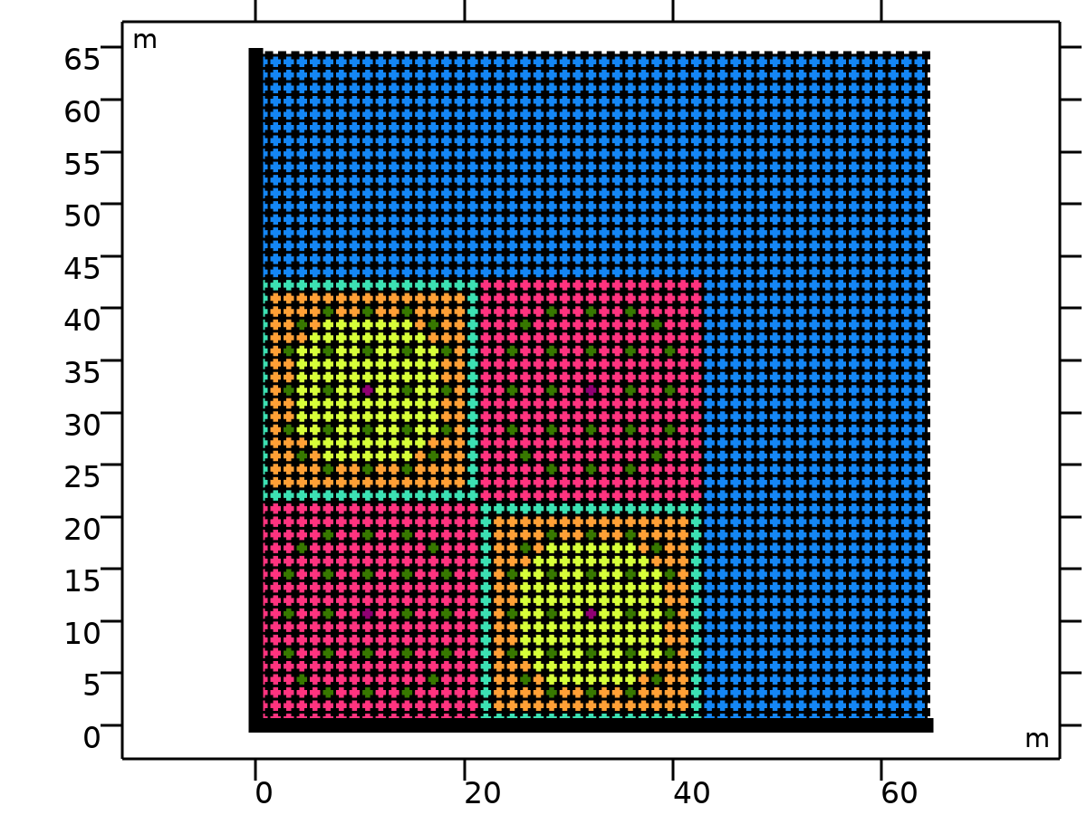
Coefficient Form PDE (continued)
Zero Flux 2
Selection
Geometric entity level | Boundary
Zero Flux 2

Slide 117
Coefficient Form PDE (continued)
Selection
Selection | Geometry geom1: Dimension 1: Boundaries 1–3, 5, 7, 9, 11, 13, 15, 17, 19, 21, 23, 25, 27, 29, 31, 33, 35, 37, 39, 41, 43, 45, 47, 49, 51, 53, 55, 57, 59, 61, 63, 65, 67, 69, 71, 73, 75, 77, 79, 81, 83, 85, 87, 89, 91, 93, 95, 97, 99, 101, 105, 208, 311, 414, 517, 620, 723, 826, 929, 1032, 1135, 1238, 1341, 1444, 1547, 1650, 1753, 1856, 1959, 2062, 2165, 2268, 2371, 2474, 2577, 2680, 2783, 2886, 2989, 3092, 3195, 3298, 3401, 3504, 3607, 3710, 3813, 3916, 4019, 4122, 4225, 4328, 4431, 4534, 4637, 4740, 4843, 4946, 5049, 5152
Zero Flux 2

Slide 118
Coefficient Form PDE (continued)
Equations
Zero Flux 2

Slide 119
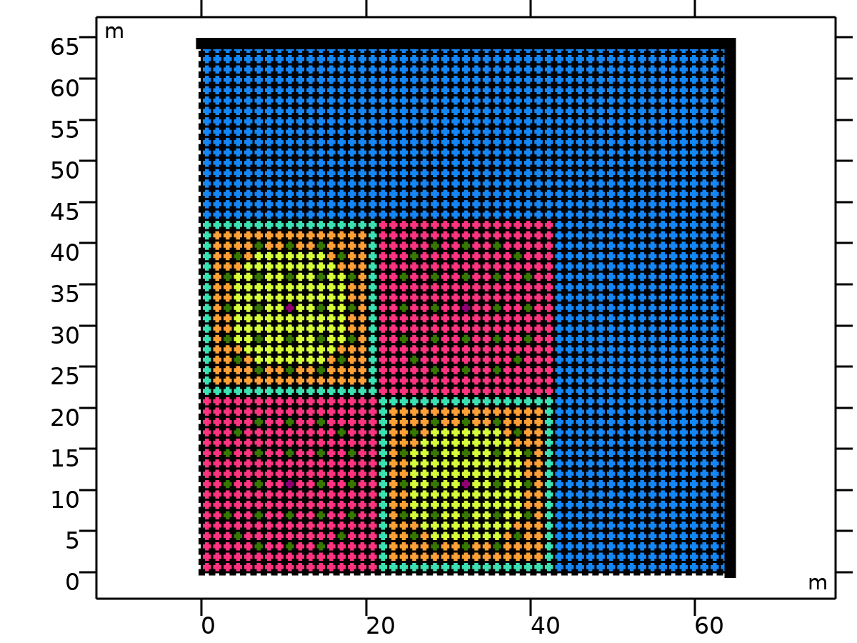
Coefficient Form PDE (continued)
Flux/Source 1
Selection
Geometric entity level | Boundary
Flux/Source 1

Slide 120
Coefficient Form PDE (continued)
Selection
Selection | Geometry geom1: Dimension 1: Boundaries 103, 206, 309, 412, 515, 618, 721, 824, 927, 1030, 1133, 1236, 1339, 1442, 1545, 1648, 1751, 1854, 1957, 2060, 2163, 2266, 2369, 2472, 2575, 2678, 2781, 2884, 2987, 3090, 3193, 3296, 3399, 3502, 3605, 3708, 3811, 3914, 4017, 4120, 4223, 4326, 4429, 4532, 4635, 4738, 4841, 4944, 5047, 5150, 5253–5304
Flux/Source 1

Slide 121

Coefficient Form PDE (continued)
Equations
Flux/Source 1

Slide 122
Coefficient Form PDE (continued)
Settings
Description | Value
Boundary absorption/impedance term | {{0, 0, 0, 0, 0, 0, 0}, {0, 0, 0, 0, 0, 0, 0}, {0, 0, 0, 0, 0, 0, 0}, {0, 0, 0, 0, 0, 0, 0}, {0, 0, 0, 0, 0, 0, 0}, {0, 0, 0, 0, 0, 0, 0}, {0, 0, 0, 0, 0, 0, 0}}
Flux/Source 1

Slide 123
Coefficient Form PDE (continued)
Settings
Description | Value
Boundary flux/source | {-0.5*phi1, -0.5*phi2, -0.5*phi3, -0.5*phi4, -0.5*phi5, -0.5*phi6, -0.5*phi7}
Flux/Source 1

Slide 124

Mesh 1
Mesh statistics
Description | Value
Status | Complete mesh
Mesh vertices | 5305
Triangles | 10404
Edge elements | 5304
Vertex elements | 2704
Number of elements | 10404
Minimum element quality | 0.75
Mesh 1

Slide 125
Mesh 1 (continued)
Mesh statistics
Description | Value
Average element quality | 0.75
Element area ratio | 1
Mesh area | 4129 m²
Mesh 1

Slide 126
Mesh 1 (continued)
Size (size)
Settings
Description | Value
Maximum element size | 4.31
Minimum element size | 0.0193
Curvature factor | 0.3
Maximum element growth rate | 1.3

Slide 127
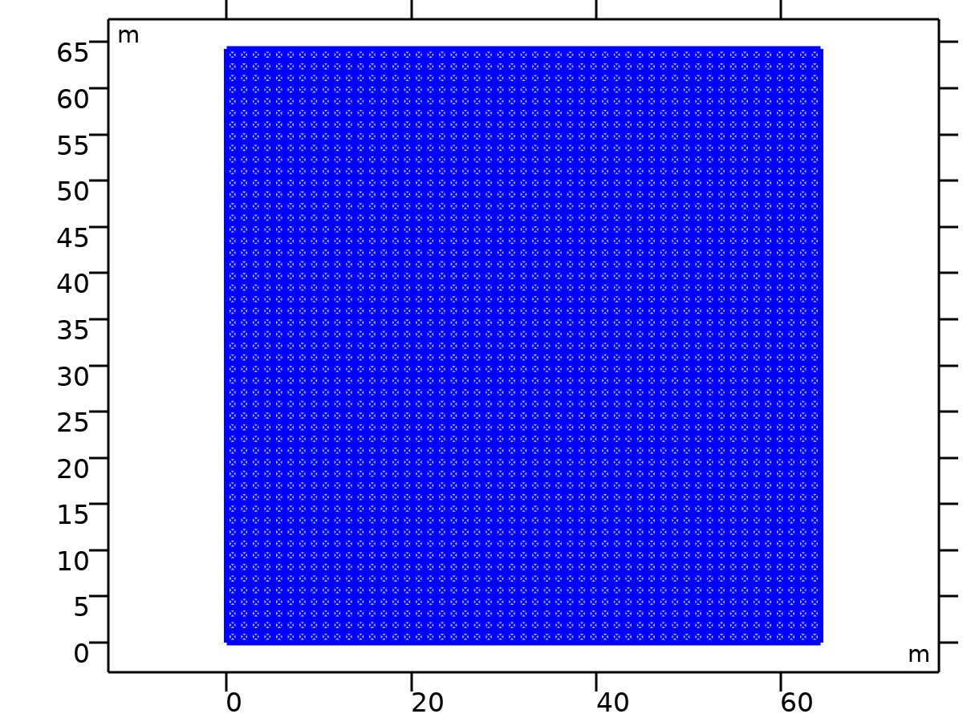
Mesh 1 (continued)
Free Triangular 1 (ftri1)
Selection
Geometric entity level | Domain
Selection | Remaining
Free Triangular 1

Slide 128
Mesh 1 (continued)
Settings
Description | Value
Number of iterations | 4
Maximum element depth to process | 4
Last build time | 4
Built with | COMSOL 6.0.0.318 (win64)|2026 - 06 - 28T14:53:05.253178700
Free Triangular 1

Slide 129
Results

Slide 130
Datasets

Slide 131
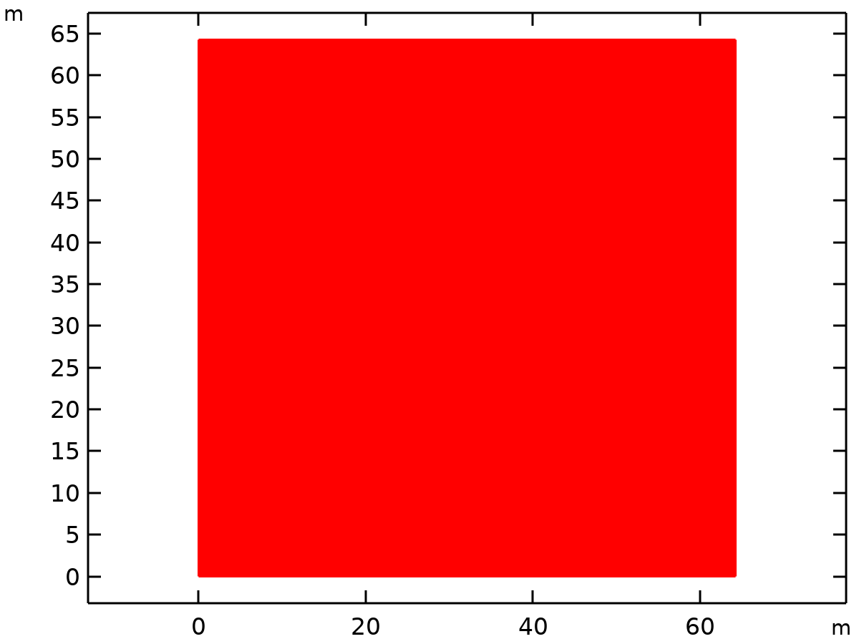
Study 1/Solution 1
Solution
Description | Value
Solution | Solution 1
Component | Component 1 (comp1)
Dataset: Study 1/Solution 1

Slide 132
Plot Groups

Slide 133
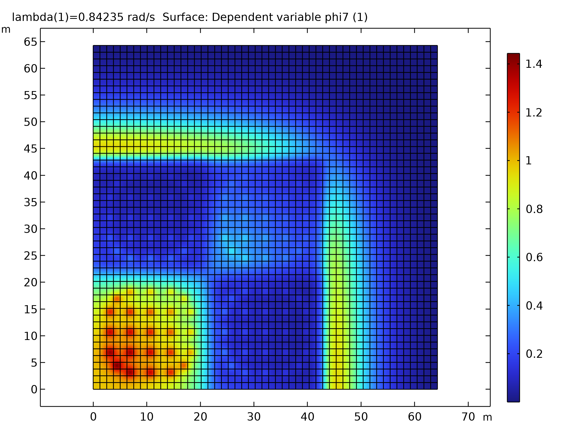
2D Plot Group 1
Surface: Dependent variable phi7 (1)

