Slide 1
RESOURCELOOP AI
AI-Powered Circular Resource Matching & Policy Intelligence
Miloni Mohanty
B.Tech CSE | ITER, Bhubaneswar

Slide 2
The problem: resources exist, but visibility doesn’t
01 — FRAGMENTED INVENTORY
02 — UNNECESSARY PROCUREMENT
03 — PREMATURE DISPOSAL
04 — NO DECISION LAYER
Assets are scattered across Excel/CSV, registers, storage rooms, logs, PDFs and images. No unified layer connects them.
Teams buy new equipment without seeing underutilised assets that could already meet the need.
Damaged or idle items are discarded before checking repair, reuse, or parts recovery.
Traditional inventory says what is owned. ResourceLoop says what can solve the request, where it is, and what happens next.
Real-world scale
Sources
UNEP — Global Resources Outlook 2024
ITU / UNITAR — Global E‑waste Monitor 2024
30.9B → 106.6B tonnes
62M tonnes e‑waste (2022)
Global annual material extraction rose from ~30.9 billion tonnes (1970) to 106.6 billion tonnes (2024). ~3.4× increase
62 million tonnes e‑waste were generated in 2022; 22.3% was formally collected and recycled. Projected: 82M tonnes by 2030.

Slide 3



The solution: one platform, two decisions
ResourceLoop AI connects discovery with end‑of‑life decisions — a single pane for “I need” and “I no longer need”.
SIDE A — “I NEED A RESOURCE”
SIDE B — “I NO LONGER NEED THIS”
1
2
1
2
RESOURCE MATCH
Example
CIRCULARITY ENGINE
Decisions
Natural‑language requirement → AI requirement extraction
Inventory search → Technical compatibility checks
Contextual ranking → Recommended existing resources
Request: “I need 10 computers with 16GB RAM and ≥512GB SSD” → Results: 4 (Dept A), 3 (Storage), 3 (Dept B)
Image / description / inventory record → AI assessment → Condition + repairability → Circularity decision
Reuse → Repair → Repurpose → Redistribute/Donate → Recycle → Dispose (only when appropriate)
ResourceLoop connects resource discovery with resource end‑of‑life decisions.
Human‑in‑the‑loop: AI recommends; authorised humans approve transfers, repairs and disposal decisions.

Slide 4


Resource match: more than keyword search
Five-step horizontal process: user request → structured parsing → inventory search → deterministic compatibility → explained match.
1
2
3
01 — USER REQUEST
02 — NLP / LLM PARSING
03 — RESOURCE SEARCH
“I need 10 computers with ≥16GB RAM, 512GB SSD, dedicated GPU.”
Structured output: Category=Computer; Quantity=10; RAM≥16GB; Storage≥512GB; GPU=Required
Search across org inventories, departments, storage and shared networks with canonicalised attributes.
4
5
04 — DETERMINISTIC COMPATIBILITY
05 — EXPLAINED MATCH
Verify CPU | RAM | Storage | GPU | Quantity | Condition | Availability using deterministic logic and hardware parsers — LLMs do NOT make the final compatibility call.
Deliver scored, traceable matches with per‑factor breakdown and human‑readable explanation.
Dell OptiPlex 7090 — Example
93% overall match
Technical compatibility — 100%
Condition — 80%
Availability — 100%
Underutilisation — 100%
Logistics — 70% (location penalty)
Remaining life — 100% (based on records, not image alone)
Note: LLM interprets the request; deterministic logic verifies technical constraints.

Slide 5


Circularity engine: what happens before disposal?
Repurpose/Recycle
Donate, recover, or dispose
Repairable?
Can damage be fixed?
Reusable?
Can be used as-is?
Record Image
Capture and analyze item
Computer vision — structured assessment
DAMAGED CHAIR — Example
Image → Vision AI → Structured output: object, category, material, condition, damage severity & location, repairability, structural integrity, safety concerns, visible observations, confidence.
Observed: Major structural break in back/seat; significant damage on right side.
Image-based scores are recommendations — always verify safety/structural integrity with a human when needed.
Condition — Severely damaged
Structural integrity — Compromised
Repairability — Low/Medium (depends on parts)
Potential action — Recycle OR major repair if replacement components available

Slide 6

How RAG Works: Policy Search & Knowledge Retrieval
Grounded Answers from Organizational Documents
Generate Grounded Answer
Retrieve Relevant Info
Find passages that match the user question.
Compose response using retrieved context only.
Upload & Chunk
Confirm & Prevent Hallucination
Ingest documents and split into searchable chunks.
Verify source availability before answering.
Example:
User: "Who approves the transfer of unused computers?"
Result: Answer + Sources from organizational policies
Key Benefit:
Users can search organizational policies in natural language instead of manually reading multiple documents.

Slide 7




Where AI actually fits
NLP / LLM
COMPUTER VISION
Input: natural request (e.g. “I need 10 laptops with 16GB RAM…”) → Output: structured requirements the matching engine can process.
Input: photo of unused/damaged resource → Output: object, material, condition, damage evidence and repairability signals. Human verification remains available.
RAG — ORGANISATION KNOWLEDGE
DECISION ENGINE
Documents (policies, manuals, transfer rules) → Chunking → Embeddings → Retrieval → LLM → Grounded answer + source. If no policy found, report absence; do not fabricate.
Combines hard constraints (compatibility, quantity, availability) and contextual factors (condition, utilisation, location, useful life) to produce an explained recommendation for human approval.
Data flows: Excel • CSV • Images • PDFs • User requests ↓ RESOURCE INTELLIGENCE ↓ NLP + VISION + RAG + MATCHING ↓ EXPLAINED RECOMMENDATION ↓ HUMAN APPROVAL

Slide 8

Prototype: from idea to working system
Circularity demo
Scenario: Damaged chair uploaded
Vision assessment: Severely damaged — structural integrity compromised.
Recommendation: Recycle OR major repair assessment. Human review required for safety decisions.
Resource Match demo
Scenario: AI Lab needs 10 computers
Parse requirements (NLP)
Search inventory (records & images)
Check compatibility (deterministic)
Score candidates
Explain why each matched
Current prototype
The prototype implements parsing, search, deterministic compatibility checks and basic vision assessment. Further integrations (full RAG policy automation, multi‑org transfer workflow) are planned; not all future architecture components are fully implemented.
Match #1 — Dell OptiPlex 7090
93% Match — 16GB RAM ✓ 512GB SSD ✓ GPU ✓ Available ✓ Underutilised ✓ Recommended for redistribution

Slide 9
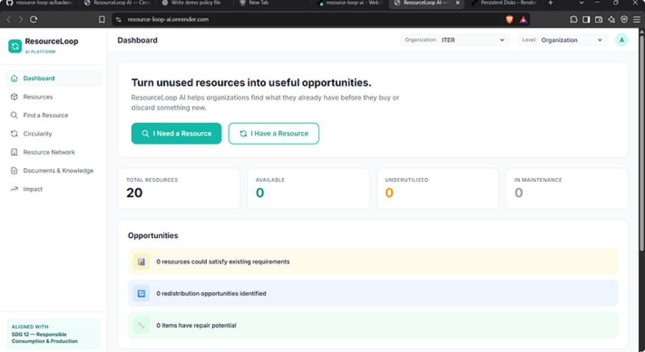
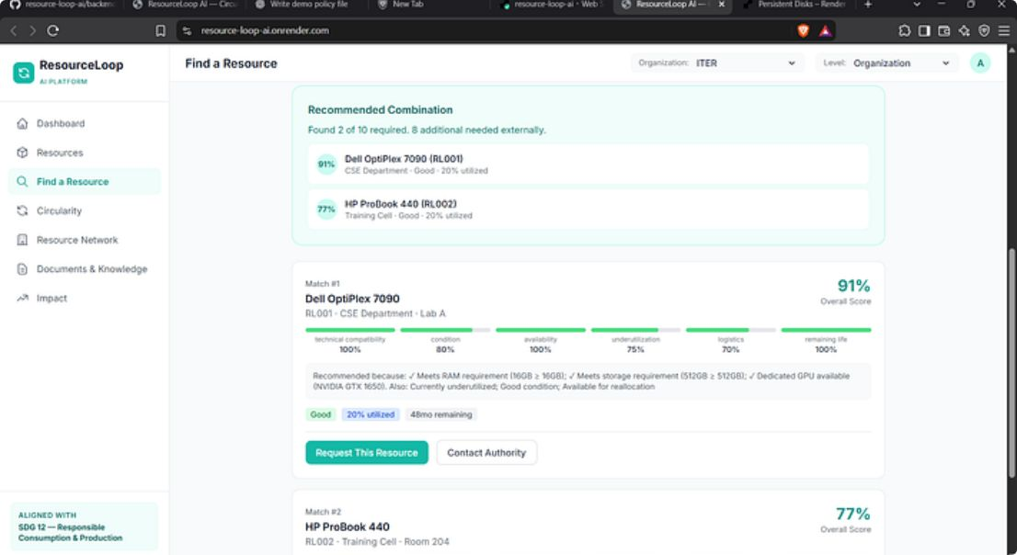
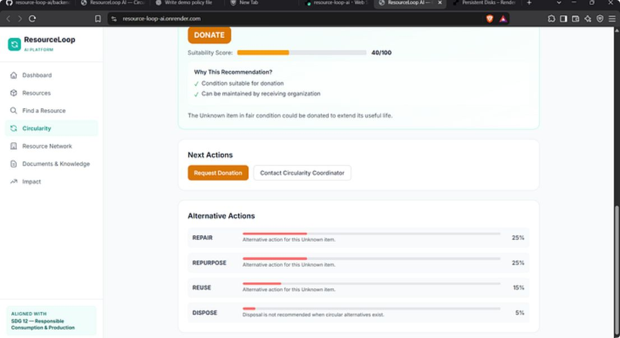
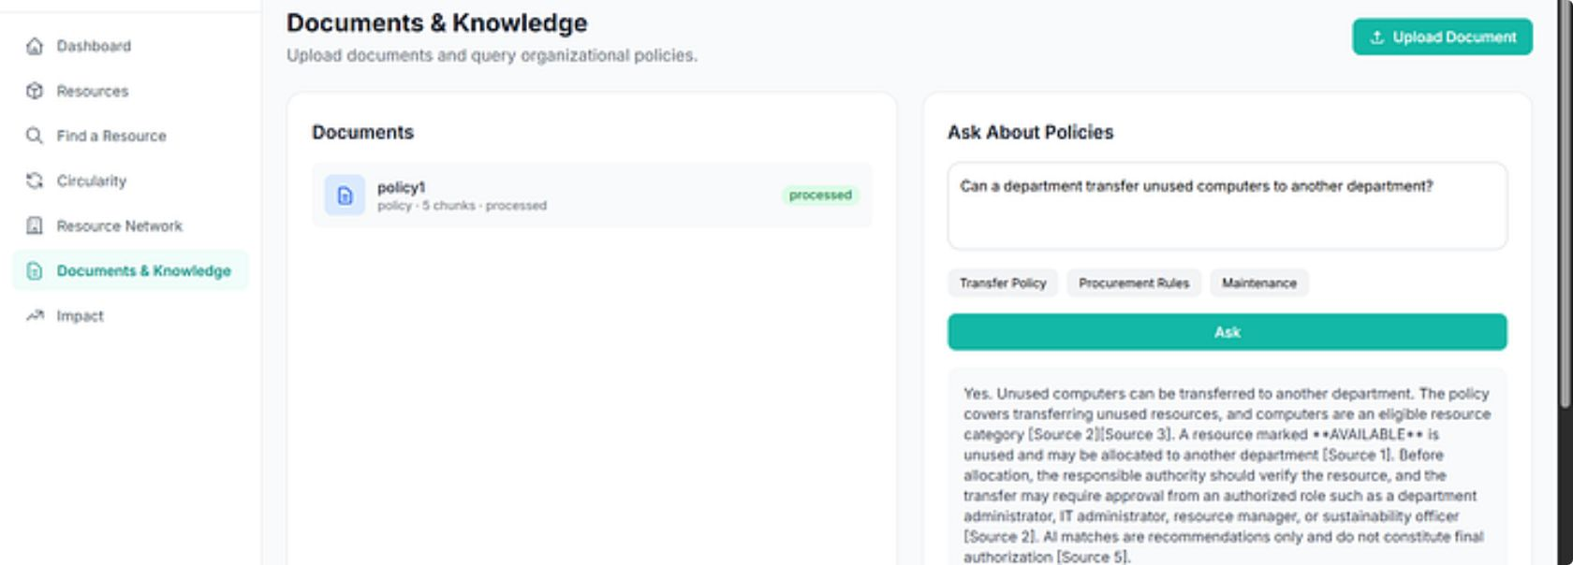
Working Prototype
① Dashboard Overview
② Resource Matching
③ Circularity Assessment
④ Policy Search & RAG
⑤ Impact Tracking

Slide 10






Impact, scalability & SDG alignment
Impact (potential)
Scale
SDG alignment
Economic
01
SDG 12 — Primary
Potential procurement avoided via reuse; improved asset utilisation; reduced purchasing costs (estimated / to be measured).
LEVEL 1 — Organisation
Responsible consumption & production: Reduce unnecessary procurement, extend asset lifetimes, improve resource recovery.
Campus / hospital / company — single canonical inventory and approval workflows.
02
SDG 9
Operational
LEVEL 2 — Local network
Industry, Innovation & Infrastructure: AI-enabled infrastructure and resource intelligence.
Faster discovery, centralised intelligence, explainable recommendations and structured transfer workflow.
Multiple organisations share availability with governed transfers and approvals.
SDG 11 & 17
Environmental
03
Supports sustainable cities, communities and partnerships for resource sharing.
Longer useful lives, less premature disposal, better redistribution and material recovery (potential impact; future measurement required).
LEVEL 3 — City / Regional
Cross‑organisation exchange, scheduling, transfer completion and trusted partners.
Future network capabilities: authority contact, transfer request, owner & receiver approval, scheduling, transfer completion.
Final statement
ResourceLoop does not simply track what an organisation owns. It adds an intelligence layer that asks what can be reused, where it is, whether it can solve another requirement, and what should happen to it next.
Find what already exists. Use it intelligently. Give everything a better next life.
Sources: UNEP — Global Resources Outlook 2024; ITU / UNITAR — Global E‑waste Monitor 2024

Slide 11
Thank You
Miloni Mohanty
B.Tech CSE | ITER, Bhubaneswar
ResourceLoop AI
AI-Powered Circular Resource Matching & Policy Intelligence
Find what already exists. Use it intelligently. Give everything a better next life.

