Slide 1

Predicting EV Infrastructure in Southern Ontario

Slide 2
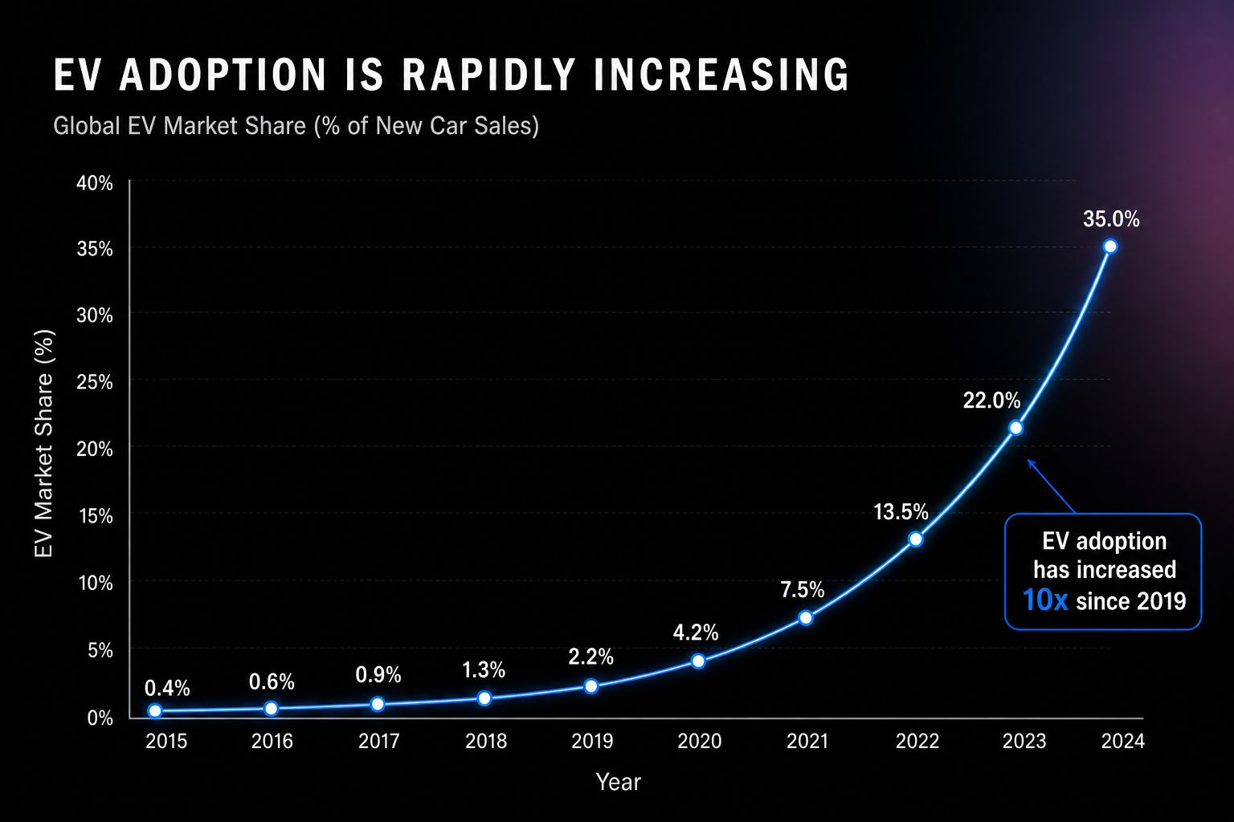
Introduction
EV adoption is rapidly increasing.
Infrastructure must scale accordingly.

Slide 3
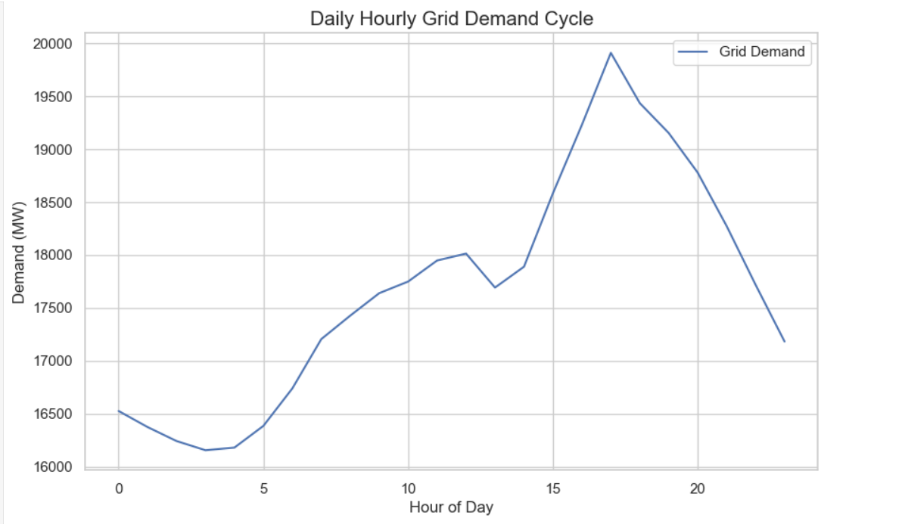
Problem Statement
Uneven charging distribution.
Need predictive planning.

Slide 4
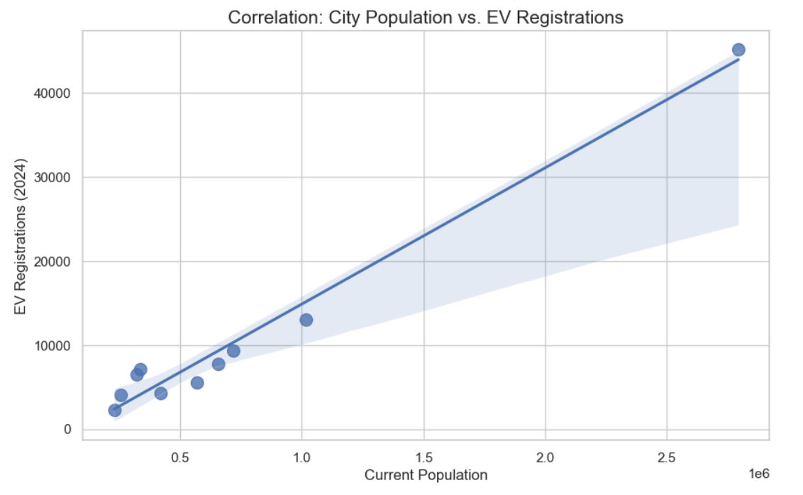
Objectives
Predict demand
Identify high-demand zones
Support planning decisions

Slide 5
Data Sources
IESO Hourly Demand - http://reports.ieso.ca/public/Demand/PUB_Demand_{year}.csv
Ontario EV Stations - https://developer.nrel.gov/api/alt-fuel-stations/v1.json
Ontario EV Trends & population - NRCan API for Alternative Fuel Stations
Ontario Weather Data-https://climate.weather.gc.ca/climate_data/bulk_data_e.html?format=csv&stationID=4932&Year=2026&Month=4&Day=1&timeframe=1&submit=Download+Data

Slide 6
Methodology
Data preprocessing
Feature selection
Model training

Slide 7
Models Used
Decision Tree Regression
Handles Non Linearity : Electricity demand doesn't move in a straight line; it has sharp spikes. Decision trees are excellent at capturing these complex, non-linear patterns
Predicts Continous values : Since I am forecasting Megawatts (a continuous number), a "Regressor" is the correct choice

Slide 8
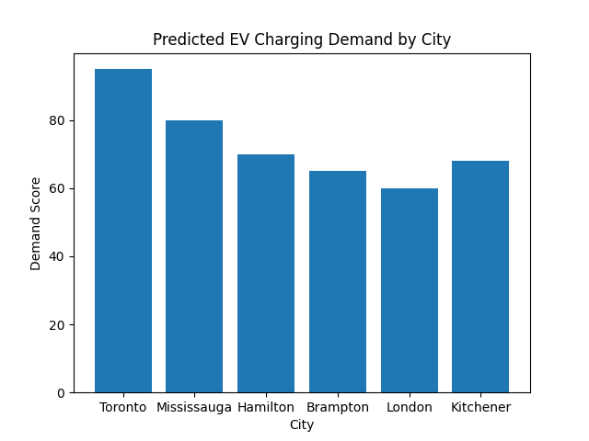
Demand by City

Slide 9
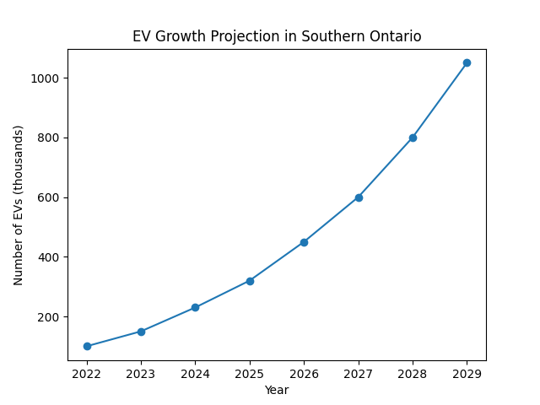
EV Growth Projection

Slide 10
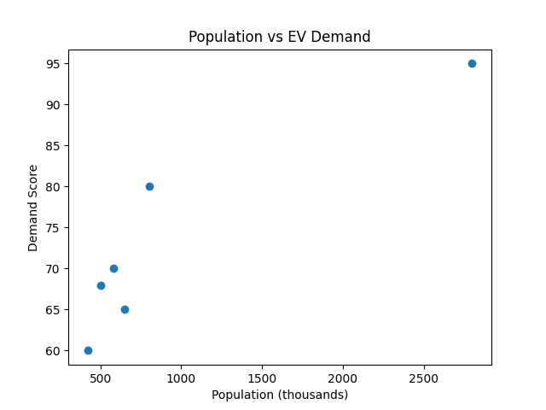
Population vs Demand

Slide 11
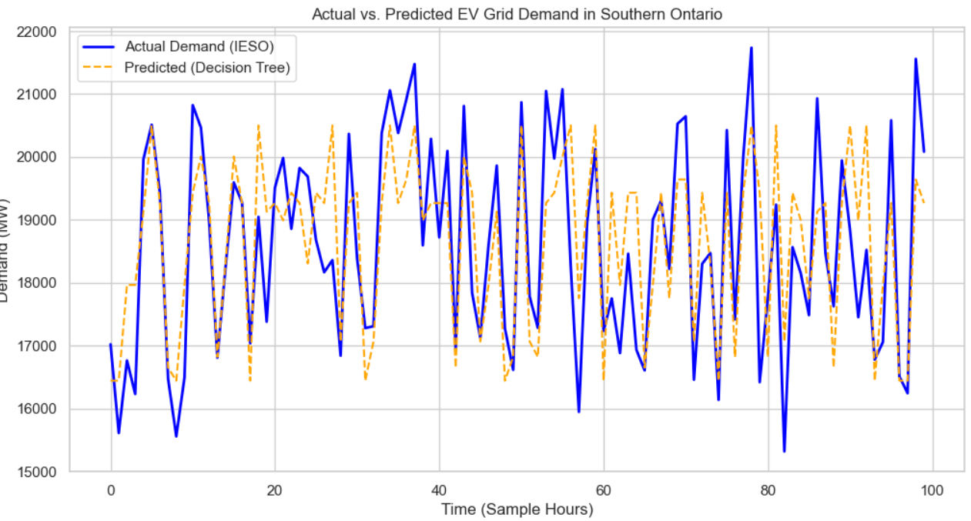
Results
Urban areas show highest demand.
Suburban areas growing rapidly.

Slide 12
Discussion
Infrastructure must expand strategically.
Planning required for future growth.

Slide 13
Challenges
Limited real-time data
Model assumptions

Slide 14
Future Work
Add real-time data
Improve model accuracy

Slide 15
Conclusion
ML helps predict EV infrastructure needs.
Supports sustainable planning.

Slide 16
References
Government data
Research papers
Ontario datasets

